Slide 1
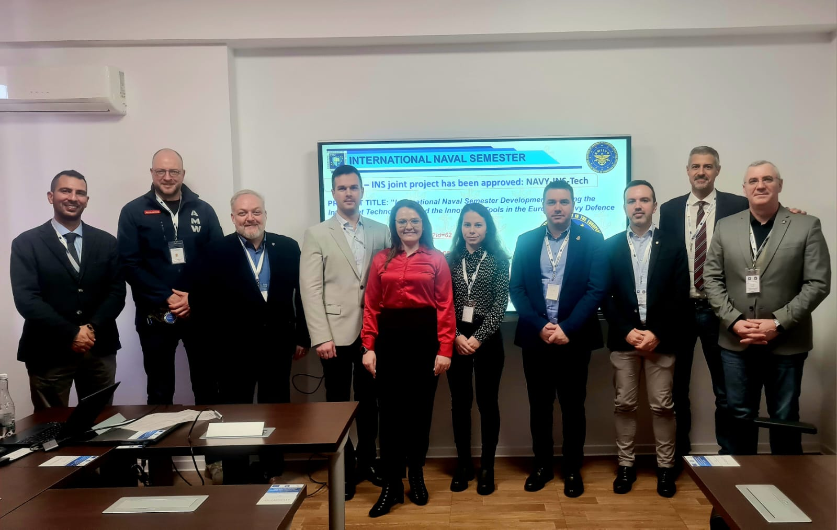
61st IG Meeting, Bucharest, Romania
LoD 11 – participant BOEI
12 participants
7 partners institutions
Romanian Naval Academy, Romania (2);
Polish Naval Academy, Poland (2);
“Nikola Vaptsarov” Naval Academy, Bulgaria (2);
Italian Naval Academy, Italy (2);
Hellenic Naval Academy, Greece (2);
Spanish Naval Academy, Spain (1);
National Defence Academy of Latvia, Latvia (1).
Colonel Catalin POPA
Associate Professor, PhD
Chairperson LoD 11

Slide 2

LoD 11 – discussions/topics/debates
The INS project presentation – activities and tasks settings;
The partners presented the upcoming modules for 2024;
The projects results under implementation were disseminated;
The joint Navy online platform had been updated (marplat.eu);
The implementation of NAVY-INS-Tech project has been monitored based on the progress report – partners conducted disscussions on further activities/tasks.

Slide 3
LoD 11 – INS joint project has been approved: NAVY-INS-Tech
PROJECT TITLE: ”International Naval Semester Development Applying the Intelligent Technologies and the Innovative Tools in the European Navy Defence System”
https://www.anmb.ro/navy-ins-tech
https://marplat.eu/course/view.php?id=62
Coordinator: Romanian Naval Academy,
Partners: Polish Naval Academy,
Bulgarian Naval Academy, Italian Naval Academy
Potential Beneficiaries: BOEIs, all services
Approved budget: 250.000 Euro
Period of implementation: 1st of November 2023 – 1st of September 2025

Slide 4
LoD 11 – Joint projects approved for INS
Major foreseen results:
1 joint harmonized curriculum;
8 STEM courses learning and teaching materials, using modern and intelligent technologies;
4 HASS courses learning and teaching materials, centered on EU culture and values;
1 e-campus will be implemented (www.marplat.eu) by all interested BOEI;
8 short term students exchanges to be organized: 4 STEM modules x 16 students = 64 students and 4 HASS modules x 8 students= 16 students, total of 80 students exchanged;
3 public events organized in each partner country, with at least 30 attendees/event;
1 International Naval Semester implemented/harmonized learning resources.

Slide 5


WP2/WP3 - Course resources will be harmonized in the project framework – responsible partners:
STEM education (SCIENCES, TECHNICAL, ENGINEERING)
Power Plants – coordinator: Italian Naval Academy (3 ECTS)
Naval Sensors – coordinator: Italian Naval Academy (3 ECTS)
Computer network – coordinator: Polish Naval Academy (2 ECTS)
Naval Cyber Threats – coordinator: Polish Naval Academy (2 ECTS)
Naval Electronics – coordinator: Bulgarian Naval Academy (3 ECTS)
Naval Communication – coordinator: Bulgarian Naval Academy (3 ECTS)
Oceanography – coordinator: Romanian Naval Academy (2 ECTS)
Naval Architecture – coordinator: Romanian Naval Academy (3 ECTS)
HASS education (HUMANITIES, SOCIAL SCIENCES and EU culture)
Military Leadership (physical training) – Polish Naval Academy (2 ECTS)
Maritime Security – Bulgarian Naval (2 ECTS)
CSDP – Romanian Naval Academy (2 ECTS)
Naval Leadership – Italian Naval Academy (2 ECTS)

Slide 6
LoD 11 – Joint projects approved for INS
Work packages brief description:
Work package n°1 – ”Project Management” (42 000 Euro);
Work package n°2 - „Development of a harmonized International Naval Semester curriculum, using the intelligent technologies and innovative tools in NHEI-Navy Military Higher Education Institutions, to enhance the STEM competences” (112 540 Euro);
Work package n°3 – ”Development of a European Security and Defence culture within the International Naval Semester framework, building the social competences in NHEI-Navy Higher Education Institutions” (58 620 Euro);
Work package n°4 – ”Building a teaching NHEI Network to enhance the implementation of the International Naval Semester using the STEM intelligent technologies and innovative tools in Navy Higher Education in harmonization with the HASS European values” (36 840 Euro).

Slide 7
LoD 11 – INS strategic project : NAVY-INS-Tech
Upcoming events:
TM1 – Kick off meeting – RNA, Constanta, Romania, February 2024 – 3 days, 2 pax/partner, 14th – 15th of February 2024;
E1 Public event: ”SQF-MILOF standards and STEM curriculum priorities in Navy Military Higher Education” – organized by RNA, in Romania – 1 day, 30 participants, 17th of May 2025;

Slide 8
LoD 11 – INS strategic project : NAVY-INS-Tech
COURSES TO BE ORGANIZED IN THE UPCOMING SEMESTER
C1S. STEM harmonized curriculum for digital skills and IT technology abilities – organized by PNA, in Poland - 2 modules to be delivered as BIP:”Computer Networks” (2 ECTS) and ”Maritime Cyber Threats”, online theory, residentially skills (labs, seminars) - 16 students to be instructed (4 students/partner) – 5 days, October 2024;
C2S. STEM harmonized curriculum for competencies in Hi Tech, Electronics and Telecommunications – organized by NVNA, in Bulgaria - 2 modules to be delivered as BIP: ”Naval Electronics” (3 ECTS) and ”Naval Communications” (3ECTS)- online theory, residentially skills (labs, seminars) - 16 students to be instructed (4 students/partner) – 5 days, 24.06-28.06.2024;
C3S. STEM competencies in Navy Engineering and Intelligent Weapon Systems – organized by INA, in Italy - 2 modules to be delivered as BIP: ”Power Plants” (3 ECTS) and ”Naval Sensors”(3 ECTS) - online theory, residentially skills (labs, seminars) - 16 students to be instructed (4 students/partner) – 5 days, 07.10-11.10.2024;
C4S. STEM competencies in Naval Sciences – organized by RNA, in Romania - 2 modules to be delivered as BIP: ”Oceanography” (2 ECTS) and ”Naval Architecture” (3 ECTS) - online theory, residentially skills (labs, seminars) - 16 students to be instructed (4 students/partner) – 5 days, 11.11-15.11.2024.

Slide 9
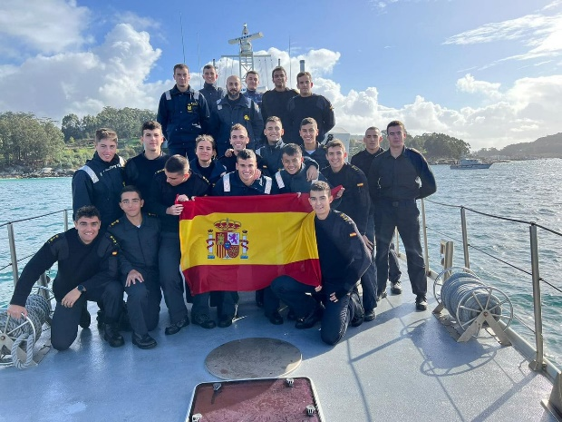
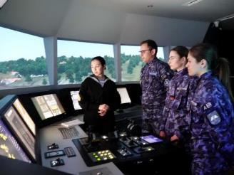
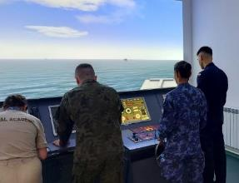
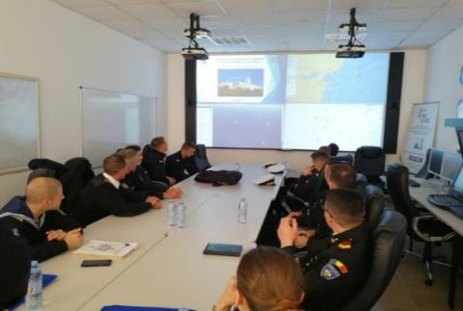
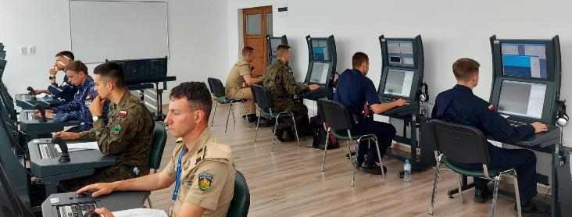
Training modules/events offer for spring semester 2024:
”Ship handling and Safety of Navigation” – NVNA (13th-17th of May);
”Navy Tactics Warefare on Simulator” – RNA (Romania, 22-26th of April 2024) - Blended Intensive Program;
”Maritime Security” common module – HNA (Piraeus, 1st-5th of April 2024);
”International Training Week” – SNA (Spain, 4th-9th March 2024);
”Seamanship Training Week” – RNA (Romania, 24th-28th of June 2024);
”Integrated Ship handling/Engine room training on simulator” – RNA (Romania, October 2024) - Blended Intensive Program;
”Seamanship Training Week” – NVNA (Varna, June-July 2024);
”Training at sea” – RNA (Romania, July-September 2024).

Slide 10
LoD 11 – Future projects for INS to be applied on 2024
LoD 11 – Joint project will be prepared as proposal under RNA guidance, by 5 of March 2024:
KA226 – ”European Navy Training Network for Improving the C-VET Curriculum toward a joint European Security and Defence Culture valuing the Work-based Learning Tools and Smart Training Technologies” – ”NAVY-Train”- (March 2024) – the project application has been drafted in its major outlines (WP, activities, LLT, events, budget) – the partners were asked to express their willingness to participate in this intiative!!! (if not received, the project will be postponed for 2025)
Major foreseen results: the curriculum for Navy training programs to be harmonized, 8 training modules to be harmonized, 6 programs to be jointly conducted.

Slide 11

LoD 11 – Joint projects under implementation
MARS-NET - Maritime Simulators and Training Facilities Network for Enhancing the Exchange of Good Practices and Digital Learning
PARTNERS : Romanian Naval Academy (coordinator) – Bulgarian Naval Academy & Polish Naval Academy - partners (2022-2024, 240.000 Euro) – results up-to-date:
- 10 course curriculum have been harmonized: Ship Handling and Manoeuvring, Cargo handling, Navigational Watchkeeping, Engine Room Watchkeeping, Radar Navigation, Maritime Search and Rescue, Coastal Navigation, Naval Machines and Equipment, Naval Communications, Celestial Navigation;
- 5 courses using the simulators digitalized, covered with video tutorials: Ship Handling and Manoeuvring, Navigational Watchkeeping, Radar Navigation, Engine Room Watchkeeping, Cargo handling (5 BIMs-blended intensive modules will be organized in the fall semester on the project portal www.marplat.eu = 5 BIMs x 50 students 250 students to be instructed);
- 3 courses for teachers using the simulating facilities had been conducted – 45 teachers had been instructed;
- 2 courses (short modules) for students had been conducted – 30 students had been instructed.

Slide 12

SEA MENTORS – SEAfarers Experiential Knowledge Based MENTORS PARTNERS : Romanian Naval Academy (coordinator) – Bulgarian Naval Academy & Polish Naval Academy - partners (2022-2024, 200.000 Euro) – results up-to-date:
- online joint platform for students counselling and mentoring for smoothing the Naval carrier path (www.seamentors.eu) containing: a joint carrier councelling center, a sharing point of cadetship experiences, mentors interviews, mentorship materials – the partners are recording now the video testimonial to be uploaded in the project ”library of experiences”;
- research/survey is conducted to disclose the role of mentoring programs for Navy graduates: a complex survey has been applied to the cadets, professionals and potential mentors;
- increase the awareness of seafaring cadets regarding the onboard experiences o military/civilian ships – 8 online and 4 residential meetings with professional mentors will be organized by the partners in the fall semester;
- In the project conclusion the partners will build a bridge between the cadets and the mentors to smooth the cadets’ insertion onboard military and civilian ships – build a mentoring network identifying the potential mentors in different areas.

Slide 13

QUESTIONS?
?
Thank you!

