Slide 1





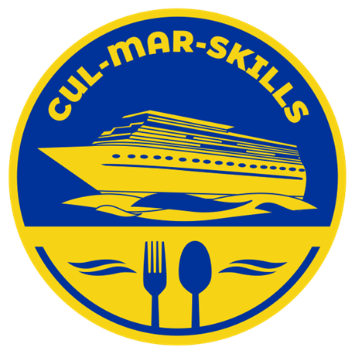

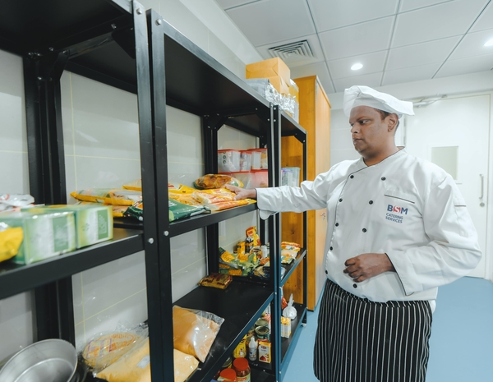


MARitime Soft Skills for Onboard Healthy Nutrition and CULinary Arts in Seagoing Services – CUL-MAR-Skills
KA220-VET - Cooperation partnerships in vocational education and training
2023-1-RO01-KA220-VET-000156711
SUPPLY CHAIN MANAGEMENT AND THE VICTUALLING SERVICES ONBOARD 1
SUMMER TRAINING SCHOOL FOR TEACHERS AND CADETS
Disclaimer: “Funded by the European Union. Views and opinions expressed are however those of the author(s) only and do not necessarily reflect those of the European Union or the ANPCDEFP. Neither the European Union nor the ANPCDEFP can be held responsible for them”

Slide 2


learning objectivesa explicitly state what a learner should be able to do once they have completed the course/lesson.
1. Understand the fundamentals of supply chain management (SCM) and its core components.
2 - Learn the concept of victualling services and their historical and modern importance.
3 - Analyze the unique challenges of managing supply chains in maritime environments.
4 - Apply SCM principles to design and optimize victualling services onboard.
5 - Discuss case studies to evaluate real-world applications and problem-solving techniques.
The most important part of a learning objective is that its success can be measured.

Slide 3
THE LEARNING ACTIVITIES THAT CAN BE USED IN A VICTUALLING COURSE:
Case studies on supply chain and inventory issues aboard ships
Role-playing exercises for procurement and budgeting scenarios
Simulations of victualling planning and emergency rationing
Hands-on practice with inventory management systems or software
Group discussions on international food regulations and cultural dietary needs
Workshops on menu planning and nutritional requirements at sea
Field visits to ship chandlers or supply depots
Presentations on cost-effective provisioning strategies
learning activities

Slide 4
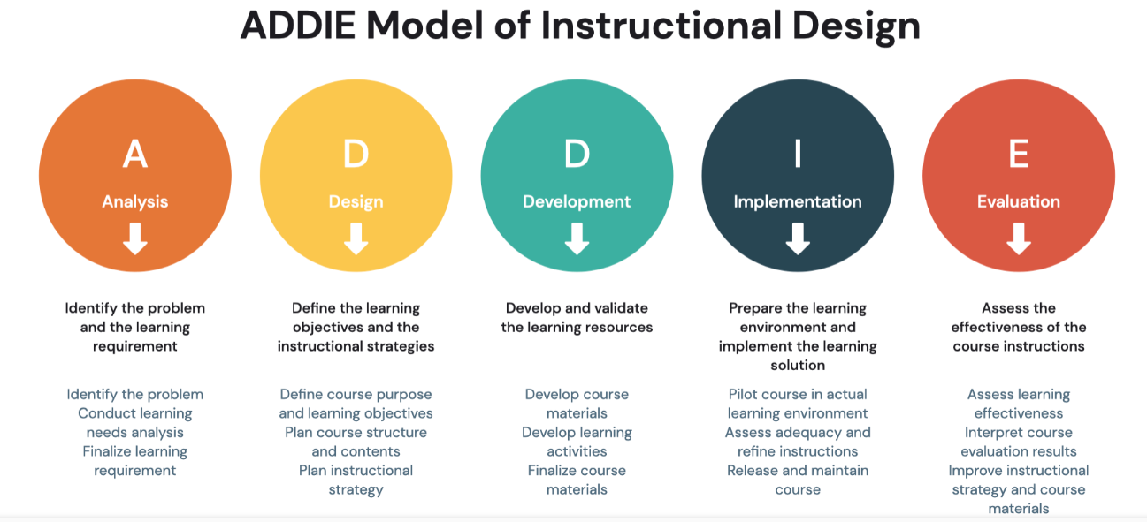
The ADDIE Model

Slide 5
UNDERSTANDING VICTUALLING
What is Victualling?
Victualling is an older or specialized term (still used in maritime, military, and hospitality industries) that refers to supplying food and provisions to people—like sailors, soldiers, or passengers.
Think of it as the provisioning of consumables, especially food and drink.
VICTUALLING ONBOARD

Slide 6
UNDERSTANDING VICTUALLING
Where Does Victualling Fit?
1. In Logistics
Yes—victualling is very much a part of logistics. It involves:
Procurement of food and supplies
Storage (especially for long voyages or military bases)
Transport (getting it from the supplier to the ship, base, or event)
Inventory management (making sure nothing runs out or spoils)
VICTUALLING ONBOARD

Slide 7
UNDERSTANDING VICTUALLING
Where Does Victualling Fit?
2. In Supply Chain Management
Also yes—victualling can be a component of SCM, particularly when:
There’s strategic planning of food sourcing (local vs international suppliers)
You need to coordinate with multiple vendors
Managing contracts, demand forecasting, or sustainability initiatives
You’re ensuring food compliance across countries or standards
VICTUALLING ONBOARD

Slide 8
UNDERSTANDING VICTUALLING
Function | Victualling Role | SCM? | Logistics?
Choosing food suppliers in Miami, Barcelona, and Singapore | ✅ | ✅ | ❌
Loading 10,000 eggs and 1,000 kg of salmon onto the ship | ✅ | ❌ | ✅
Tracking food usage to prevent waste | ✅ | ✅ | ✅
Ensuring food meets local customs laws | ✅ | ✅ | ❌
Delivering ingredients to 12 kitchens on board | ✅ | ❌ | ✅
VICTUALLING ONBOARD

Slide 9
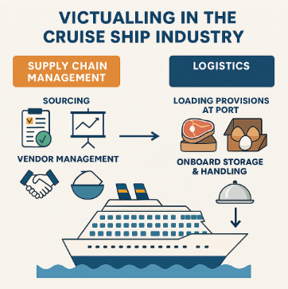
UNDERSTANDING VICTUALLING
VICTUALLING ONBOARD

Slide 10
MAIN CONSIDERATIONS IN VICTUALLING ONBOARD IN THE PAST
Victualling on board in the past was a delicate balance between ensuring enough food to sustain a crew for long periods, managing the quality and storage of provisions, and preventing disease and malnutrition. The challenges were numerous—limited preservation methods, limited space, and unpredictable conditions on the open sea made victualling a critical and often hazardous task. Despite these challenges, victualling systems were vital for the success of maritime expeditions, both military and commercial, and played a key role in the history of exploration, trade, and naval warfare.
VICTUALLING ONBOARD

Slide 11
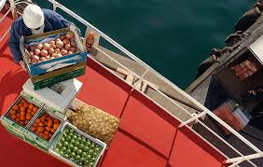
MAIN CONSIDERATIONS IN VICTUALLING ONBOARD TODAY
Victualling on board modern ships—whether naval, commercial, or cruise vessels—still involves careful planning and management, but the considerations have evolved significantly due to advances in technology, better supply chain management, and increased focus on crew welfare, safety, and nutrition.
VICTUALLING ONBOARD

Slide 12
MAIN CONSIDERATIONS IN VICTUALLING ONBOARD TODAY
1. Food Safety and Hygiene
• Modern Regulations and Standards: Today, food safety is paramount. Ships must comply with strict international regulations (such as those from the International Maritime Organization (IMO) and International Health Regulations), as well as national and regional food safety standards.
o This includes proper handling, storage, and preparation of food to prevent contamination, spoilage, and foodborne illnesses. There are protocols for regular inspections, sanitation, and hygiene.
o HACCP (Hazard Analysis and Critical Control Point) principles are often applied to ensure that potential hazards at each stage of food handling, from procurement to consumption, are identified and controlled.
VICTUALLING ONBOARD

Slide 13
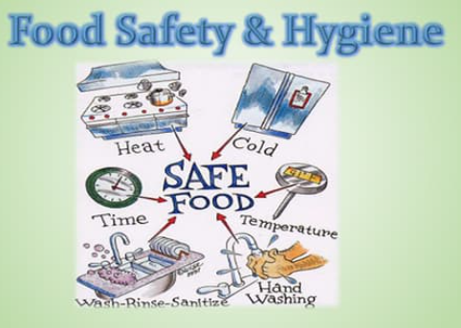
MAIN CONSIDERATIONS IN VICTUALLING ONBOARD TODAY
1. Food Safety and Hygiene
Consideration: Strict hygiene measures are taken in food storage and preparation areas, with a focus on preventing contamination. Food is regularly checked for quality and safety, and training in food handling is essential for crew members.
VICTUALLING ONBOARD

Slide 14
MAIN CONSIDERATIONS IN VICTUALLING ONBOARD TODAY
2. Nutritional Balance
• Health and Wellness: Modern victualling has a stronger focus on ensuring a balanced and nutritious diet for the crew. Unlike the past, where food was often monotonous and nutrient-poor, today’s diet focuses on providing adequate energy and a variety of essential nutrients.
o Ships often have nutritionists or dietitians who plan meals that include proteins, carbohydrates, fats, and essential vitamins and minerals.
o On longer voyages, careful attention is paid to vitamins (like vitamin C, to avoid scurvy), dietary preferences, and special needs (e.g., vegetarian, halal, kosher, gluten-free).
VICTUALLING ONBOARD

Slide 15
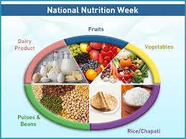
MAIN CONSIDERATIONS IN VICTUALLING ONBOARD TODAY
2. Nutritional Balance
• Consideration: The goal is to maintain crew health, energy levels, and morale. Balanced meals are designed not only to provide necessary calories but also to prevent deficiencies and promote overall well-being, helping to avoid issues like fatigue, poor concentration, or weakened immune systems.
VICTUALLING ONBOARD

Slide 16
MAIN CONSIDERATIONS IN VICTUALLING ONBOARD TODAY
3. Supply Chain Management
• Fresh and Frozen Provisions: With advancements in refrigeration and freezing technology, it is now possible to bring fresh produce and frozen food on board, which greatly improves the variety and quality of food available.
o Logistics: Effective supply chain management is crucial. Ships need to ensure that food and supplies are well-planned before departure and that they have the necessary facilities to store them properly. This may include chilled storage for perishables, dry storage for non-perishables, and water storage systems.
VICTUALLING ONBOARD

Slide 17
MAIN CONSIDERATIONS IN VICTUALLING ONBOARD TODAY
3. Supply Chain Management
• Resupply at Ports: While fresh food can be loaded before departure, ships on longer journeys rely on regular stops at ports for resupply. Modern logistics allows for efficient resupply of fresh items and other goods, which is coordinated through advanced supply chain systems.
Consideration: Planning for resupply, managing inventory, and anticipating the need for food during the journey is vital. Supply chains must be resilient to any disruptions, ensuring that the crew is never left without sufficient provisions.
VICTUALLING ONBOARD

Slide 18
MAIN CONSIDERATIONS IN VICTUALLING ONBOARD TODAY
4. Storage Space and Organization
• Efficient Use of Storage: Ships today have sophisticated storage systems, with designated areas for dry, refrigerated, and frozen foods. Efficient use of space is critical, especially for large vessels or those on long voyages, where the quantity of food required is significant.
o Modern ships are designed with better compartmentalization to prevent cross-contamination of different types of provisions (e.g., meats stored separately from fruits and vegetables).
VICTUALLING ONBOARD

Slide 19
MAIN CONSIDERATIONS IN VICTUALLING ONBOARD TODAY
4. Storage Space and Organization
Consideration: Space optimization is necessary to avoid spoilage and to ensure that provisions are easily accessible when needed. Proper labeling, inventory control, and rotation of stock (First-In-First-Out or FIFO) are standard practices.
VICTUALLING ONBOARD

Slide 20
MAIN CONSIDERATIONS IN VICTUALLING ONBOARD TODAY
5. Cultural and Dietary Needs
• Diverse Crews: Ships today often carry international crews, which means there is a variety of dietary needs and preferences that must be catered to. These may include dietary restrictions based on religion (e.g., halal, kosher), allergies (e.g., gluten-free, nut-free), or personal preferences (e.g., vegetarian, vegan).
VICTUALLING ONBOARD

Slide 21
MAIN CONSIDERATIONS IN VICTUALLING ONBOARD TODAY
5. Cultural and Dietary Needs
• Consideration: The food planning process has to account for these dietary requirements to ensure that all crew members are adequately fed and feel respected and valued. It’s important to offer a diverse menu and to accommodate special dietary needs without compromising nutritional value.
VICTUALLING ONBOARD

Slide 22
MAIN CONSIDERATIONS IN VICTUALLING ONBOARD TODAY
6. Waste Management and Sustainability
Environmental Impact: In modern times, there is a growing emphasis on sustainability and minimizing the environmental impact of food provisioning. This includes reducing food waste, sourcing food responsibly, and minimizing plastic and packaging waste.
  Ships are increasingly adopting waste management practices that involve recycling and composting food waste. Sustainable sourcing practices are also prioritized, such as choosing responsibly sourced fish or organic produce.
VICTUALLING ONBOARD

Slide 23
MAIN CONSIDERATIONS IN VICTUALLING ONBOARD TODAY
6. Waste Management and Sustainability
Consideration: Reducing food waste is a key issue, both for sustainability and for the efficient use of limited storage. Efforts are made to use food before it spoils, and excess food is repurposed when possible. Additionally, minimizing packaging waste helps reduce the environmental footprint of the ship’s operation.
VICTUALLING ONBOARD

Slide 24
MAIN CONSIDERATIONS IN VICTUALLING ONBOARD TODAY
7. Meal Variety and Crew Morale
• Psychological Well-Being: Meal variety continues to play a key role in maintaining crew morale, especially on long voyages. Modern victualling emphasizes not just nutritional value but also meal variety, flavor, and cultural preferences, which can keep morale high and reduce the sense of monotony.
o On cruise ships or in military operations, meals are often viewed as a social event, and chefs are given the opportunity to create a range of dishes, making the dining experience a highlight of the day for the crew.
VICTUALLING ONBOARD

Slide 25
MAIN CONSIDERATIONS IN VICTUALLING ONBOARD TODAY
7. Meal Variety and Crew Morale
• Consideration: Ensuring a variety of meals (with rotating menus) helps keep crew members engaged and prevents fatigue from eating the same food every day. Treating food as an important part of crew well-being and morale is a modern consideration that contributes to overall productivity and satisfaction.
VICTUALLING ONBOARD

Slide 26
MAIN CONSIDERATIONS IN VICTUALLING ONBOARD TODAY
8. Alcohol and Beverage Provisioning
• Controlled Use of Alcohol: Alcohol consumption on board ships, especially naval ships, has historically been a part of crew life, though modern policies have become stricter. While alcohol was once distributed as part of regular rations (e.g., rum for British sailors), today there are often regulations governing its provision.
o Alcohol is typically provided in controlled quantities for social occasions or as part of morale-building efforts. It is also common for ships to ensure that non-alcoholic beverages (like coffee, tea, juice, and soft drinks) are available at all times.
VICTUALLING ONBOARD

Slide 27
MAIN CONSIDERATIONS IN VICTUALLING ONBOARD TODAY
8. Alcohol and Beverage Provisioning
Consideration: Modern ships need to balance the historical tradition of providing alcohol with the responsibility of maintaining safety and ensuring that consumption doesn’t interfere with crew duties. Policies around alcohol depend on the type of ship, its mission, and the specific policies of the shipping company or military.
VICTUALLING ONBOARD

Slide 28
MAIN CONSIDERATIONS IN VICTUALLING ONBOARD TODAY
9. Crew Feedback and Satisfaction
Monitoring Satisfaction: On cruise ships, yachts, or commercial vessels with long-term crews, regular feedback on meal quality and variety is often collected to ensure satisfaction. This might involve surveys, crew meetings, or direct input from ship officers.
VICTUALLING ONBOARD

Slide 29
MAIN CONSIDERATIONS IN VICTUALLING ONBOARD TODAY
9. Crew Feedback and Satisfaction
Consideration: Keeping the crew satisfied with meals is important not only for morale but also for productivity and overall health. Being receptive to feedback allows for adjustments to the menu or meal times to suit the crew’s preferences and needs.
VICTUALLING ONBOARD

Slide 30
MAIN CONSIDERATIONS IN VICTUALLING ONBOARD TODAY
Conclusion:
While victualling on board today benefits from technological advancements, more stringent food safety regulations, and improved supply chains, the core goal remains the same as in the past: to keep the crew healthy, well-nourished, and motivated throughout the voyage. The key considerations now encompass a broader range of factors, including dietary needs, environmental sustainability, and the psychological well-being of the crew. Modern victualling systems are more sophisticated, but the underlying importance of effective provisioning remains a crucial aspect of maritime operations.
VICTUALLING ONBOARD

Slide 31
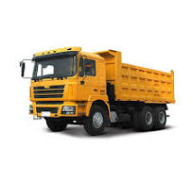
REAL LIFE EXAMPLES
When operating in the Mediterranean, and before every cruise, MSC Bellissima loads most of its provisions at its home port of Genoa, Italy, and receives an average of 15 full trucks of food and beverages per cruise (two of them carrying fresh fruit and vegetables).
VICTUALLING ONBOARD

Slide 32
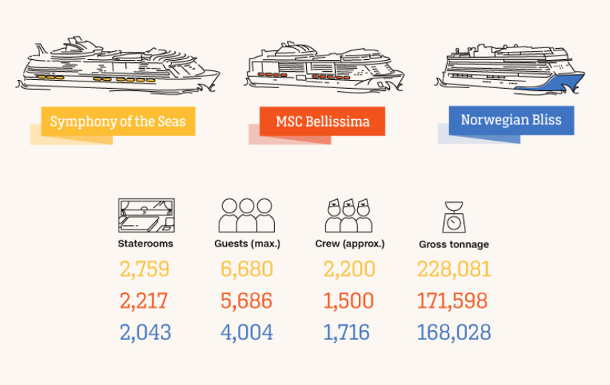
VICTUALLING ONBOARD

Slide 33
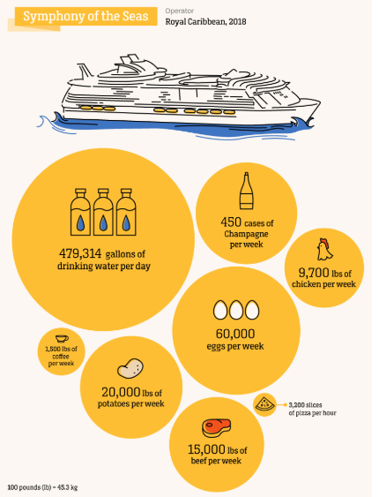
VICTUALLING ONBOARD

Slide 34
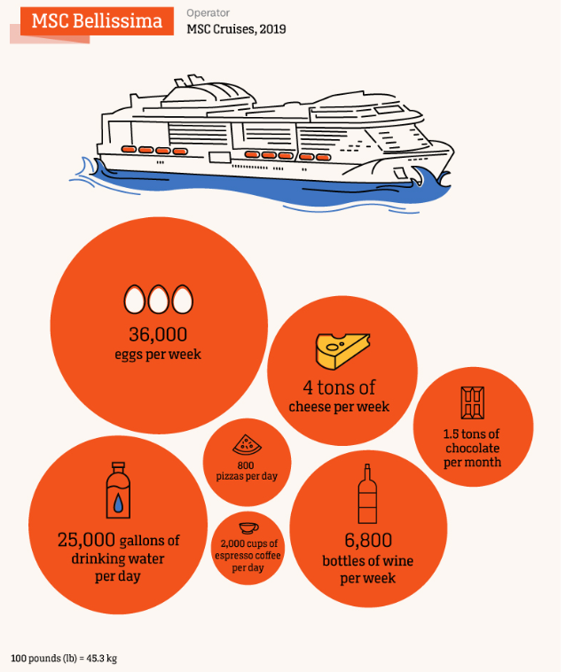
VICTUALLING ONBOARD

Slide 35
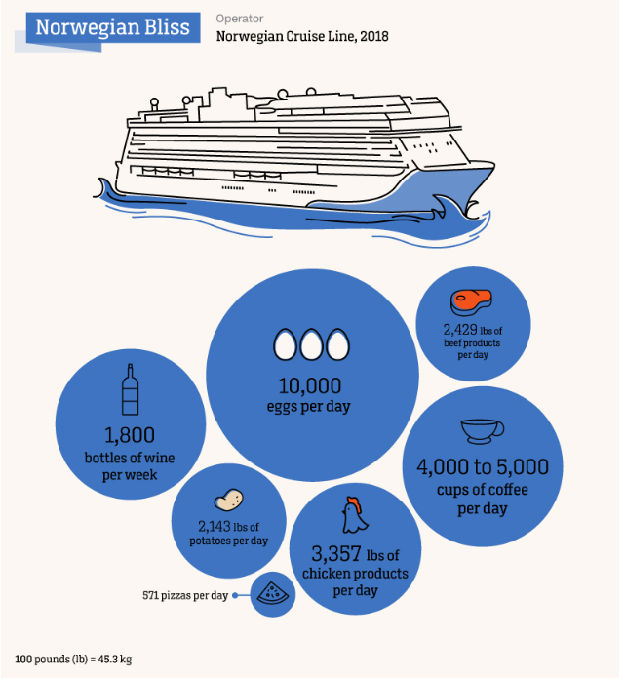
VICTUALLING ONBOARD

Slide 36
REAL LIFE BEST PRACTICES
Fresh produce is often sourced locally during the itinerary,
limited shelf life
storage temperature constraints
Loading activities
six and eight hours on the pier,
100 different stakeholders.
the management of related waste
a major concern when the fragile health of marine ecosystems is at stake.
VICTUALLING ONBOARD
Notes:
Fresh produce is often sourced locally during the itinerary, since it must be managed and delivered very carefully due to limited shelf life and storage temperature constraints,” says Lavarello.
“We also use tactics like buying different kind of ripeness for the same products in order to have ready-to-eat items that can be served at perfect ripeness for the guests throughout the cruise.”
Loading activities can take between six and eight hours on the pier, and easily involve more than 100 different stakeholders. On the ship’s side, the inventory compliance officer, the food and beverages director, the provision master and the chef and storekeepers all play a role in loading products and checking quality and quantity, so that they meet the cruise operator’s standards.
And just as important as getting all those provisions on board, there’s the management of related waste, a major concern when the fragile health of marine ecosystems is at stake.

Slide 37
REAL LIFE BEST PRACTICES
Globally, around one third of food produced for human consumption goes to waste. Buffet-style dining, being a key part of the cruise experience, the risk of excess is high.
The proper food quantities required, based on a number of factors including prior guest history and occupancy,”
“The provision master works in conjunction with the food and beverage director to ensure they are sourcing and receiving the appropriate supplies and quantities for each cruise.”
Carnival’s Costa Cruises has reduced food waste by 50% fleetwide by 2020, with the help of tech company and its system which weighs and records what kitchens throw away.
VICTUALLING ONBOARD
Notes:
All major cruise operators go to great lengths to highlight their waste mitigation efforts.
Globally, around one third of food produced for human consumption goes to waste. With lavish buffet-style dining currently being a key part of the cruise experience, the risk of excess is high.
“We are able to identify the proper food quantities required, based on a number of factors including prior guest history and occupancy,” says a source at Norwegian Cruise Line, some of whose ships, such as the 4,000-passenger Norwegian Bliss, are among the world’s largest.
“The provision master works in conjunction with the food and beverage director and our corporate team to ensure we are sourcing and receiving the appropriate supplies and quantities for each cruise.”
Carnival’s Costa Cruises has pledged to reduce food waste by 50% fleetwide by 2020, with the help of tech company Winnow and its system which weighs and records what kitchens throw away.

Slide 38
REAL LIFE BEST PRACTICES
Cruise ships recycle about 60% more waste per person than the average person recycles on shore.
A ship with 6,000 people on board can generate around 2,100 tons of waste water, 24 tons of wet waste (food waste and bio sludge from waste water treatment plants) and 14 tons of dry waste per day (solid burnable waste, plastic, glass, tins and cans).
All this waste altogether is enough to fill around 110 trucks.
VICTUALLING ONBOARD
Notes:
Waste management
In their annual environmental reports, cruise operators like to emphasize how much investment has gone into waste management and waste recycling and repurposing.
“There are significant improvements compared to the situation 15 years ago,” says Konstantin Tchetchine, general manager, business development, marine solutions/water and waste at Wärtsilä, a Finnish company that provides waste management technology for the shipping industry.
“For example, cruise ships recycle about 60% more waste per person than the average person recycles on shore. Still, the ship owners and ship operators are facing many challenges,” he adds.
A ship with 6,000 people on board can generate around 2,100 tons of waste water, 24 tons of wet waste (food waste and bio sludge from waste water treatment plants) and 14 tons of dry waste per day (solid burnable waste, plastic, glass, tins and cans). All this waste altogether is enough to fill around 110 trucks.

Slide 39
PROCESSING
Each of these three main types of waste categorized into multiple other waste categories, each requiring its own treatment.
Waste water comprises black water, from toilets, gray water from showers, galleys and laundry, as well as bilge waters, that have gone through the engine room and been exposed to oil and chemicals. Ships must have processes in place to treat each of these.
Wet waste is, in turn, de-watered and dried. This reduces its volume considerably and it is then stored in a silo. From there it can be conveyed into an incinerator for burning, or to a bagging station prior to discharge to land facilities after docking in port.
VICTUALLING ONBOARD
Notes:
Waste management
In their annual environmental reports, cruise operators like to emphasize how much investment has gone into waste management and waste recycling and repurposing.
“There are significant improvements compared to the situation 15 years ago,” says Konstantin Tchetchine, general manager, business development, marine solutions/water and waste at Wärtsilä, a Finnish company that provides waste management technology for the shipping industry.
“For example, cruise ships recycle about 60% more waste per person than the average person recycles on shore. Still, the ship owners and ship operators are facing many challenges,” he adds.
A ship with 6,000 people on board can generate around 2,100 tons of waste water, 24 tons of wet waste (food waste and bio sludge from waste water treatment plants) and 14 tons of dry waste per day (solid burnable waste, plastic, glass, tins and cans). All this waste altogether is enough to fill around 110 trucks.

Slide 40
PROCESSING
Dry waste is divided before treatment into burnable, non-burnable and recyclable items. Then, depending on the material (plastic, aluminum, glass and so on), it’s either shredded or compacted, again with the goal of reducing the space it takes up.
In summary, the whole waste treatment infrastructure required by a large cruise ship is nothing short of that of a small city.
https://edition.cnn.com/travel/article/cruise-ships-food-supplies/index.html
VICTUALLING ONBOARD
Notes:
Waste management
In their annual environmental reports, cruise operators like to emphasize how much investment has gone into waste management and waste recycling and repurposing.
“There are significant improvements compared to the situation 15 years ago,” says Konstantin Tchetchine, general manager, business development, marine solutions/water and waste at Wärtsilä, a Finnish company that provides waste management technology for the shipping industry.
“For example, cruise ships recycle about 60% more waste per person than the average person recycles on shore. Still, the ship owners and ship operators are facing many challenges,” he adds.
A ship with 6,000 people on board can generate around 2,100 tons of waste water, 24 tons of wet waste (food waste and bio sludge from waste water treatment plants) and 14 tons of dry waste per day (solid burnable waste, plastic, glass, tins and cans). All this waste altogether is enough to fill around 110 trucks.

Slide 41
REAL LIFE BEST PRACTICES
1. Maersk – Digital Inventory & Spare Part Management
Best Practice:
Maersk uses integrated inventory systems (often tied into ERP platforms like SAP) to manage spare parts for engine rooms and bridge equipment across its massive fleet.
Key Features:
Barcode tagging of every spare part.
RFID integration in storage areas.
Centralized monitoring by shore-based logistics teams.
Predictive restocking based on usage patterns and route forecasts.
Impact:
Drastically reduced downtime from equipment failure by ensuring “critical spares” were always onboard, and avoided overstocking via data-driven demand planning.
VICTUALLING ONBOARD

Slide 42
REAL LIFE BEST PRACTICES
2. Royal Caribbean – Provisions Inventory via FIFO & HACCP
Best Practice:
Royal Caribbean cruise ships manage thousands of food items with strict FIFO (First In, First Out) and HACCP protocols.
Key Features:
Digital tracking of food expiry dates and temperatures (automated sensors).
FIFO rotation enforced through physical layout and daily audits.
Food portions and consumption patterns are monitored to avoid waste.
Impact:
They reduced food waste by 20% on select ships and maintained full compliance with food safety standards across international jurisdictions.
VICTUALLING ONBOARD

Slide 43
REAL LIFE BEST PRACTICES
3. Shell Shipping – Critical Spares & Redundancy Planning
Best Practice:
Shell’s LNG and oil tankers carry a pre-determined list of “critical spares” using a risk-based matrix.
Key Features:
Items like oil filters, O-rings, hydraulic hoses, and electrical components are stocked redundantly.
Each vessel is aligned with a digital CMMS (Computerized Maintenance Management System) that flags items approaching depletion.
Onboard engineers input consumption rates directly into the system.
Impact:
Preventive maintenance combined with inventory integration resulted in fewer mechanical failures and improved uptime.
VICTUALLING ONBOARD

Slide 44
REAL LIFE BEST PRACTICES
4. Japanese Shipping Companies – Kanban-Style Resupply System
Best Practice:
Some Japanese fleets have implemented a Kanban-style inventory system where items are only replenished when “visual cues” signal depletion.
Key Features:
Color-coded bins with “minimum stock” markers.
Resupply requests are triggered only when minimum levels are hit.
Crew members trained to report usage with simple cards/tokens or app check-ins.
Impact:
Simple but effective system for managing non-critical consumables (like gloves, tapes, cleaning supplies) without requiring full digital infrastructure.
VICTUALLING ONBOARD

Slide 45
REAL LIFE BEST PRACTICES
5. Military & Naval Ships – Redundant Stores & Auditable Logs
Best Practice:
Naval vessels (e.g., US Navy) keep detailed, redundant stores of mission-critical items with strict audit trails.
Key Features:
Inventory is split into main and emergency stores.
Weekly or monthly audits are conducted with signatures and cross-checks.
Use of standardized inventory software (e.g., OMMS-NG or R-Supply).
Logistics personnel trained in inventory accountability and forecasting.
Impact:
Maximized mission readiness and ensured every item could be accounted for—even during extended deployments or combat readiness drills.
VICTUALLING ONBOARD

Slide 46
REAL LIFE BEST PRACTICES
Key Lessons from These Real-Life Practices:
Digital systems help, but simplicity works too—Kanban methods can be just as effective for small ships.
Critical spares should never be left to chance—engine failure at sea is costly and dangerous.
Food and perishables need proactive rotation and monitoring—especially on long voyages.
Integration with shoreside logistics enhances efficiency—especially for container fleets.
VICTUALLING ONBOARD

Slide 47
REAL LIFE BEST PRACTICES
https://www.google.com/search?sca_esv=7b7b3c18afc3e931&sxsrf=AHTn8zoKBZXpDiXReSCNWPoYHe9uNxuW9A:1744264673959&q=daily+food+consumption+in+a+cruiser&udm=7&fbs=ABzOT_AeWVZgM1ygG9loIv1sab0j2HB687sEni7_6XgT5zHBctPQQWJnv2cP3Dmrkn2lJOh5lu93jiZ-Ywq6SEsOdip7ujEjU9EMjufK6WMNjQ1OgFVlcAQT_EQ4ev5sXdL5_7UnQ_ji-5_JZ-N6pxXJq7BQ8Dg9hZvlfuz0sFQ6AUADuUanPpMipLj09lGmhTuJ_6c9_dZO&sa=X&ved=2ahUKEwjDkKSi5MyMAxULg_0HHfnCGFcQtKgLegQIEhAB&biw=1536&bih=730&dpr=1.25#fpstate=ive&vld=cid:ef4904ae,vid:R2vXbFp5C9o,st:0
VICTUALLING ONBOARD

Slide 48
REAL LIFE BEST PRACTICES
https://www.google.com/search?sca_esv=7b7b3c18afc3e931&sxsrf=AHTn8zqYYid0V7A2A5IofLYcs50ZZNjfAA:1744265060406&q=food+consumption+amounts+onboard+a+cruise+ship&udm=7&fbs=ABzOT_AeWVZgM1ygG9loIv1sab0j2HB687sEni7_6XgT5zHBctPQQWJnv2cP3Dmrkn2lJOgsbfHmVGgQVXlaZGFgFFx9HgKczC4sVbIvcQOY9-Xzx_tBkOlEzBrbJWv7PKHVl9IYM6nLQFfprTp2Srprm91xO7atDWzs0gyW8LFHV3fB87aPtLJ6bE0H13pIwTdFBEzj-ULp&sa=X&ved=2ahUKEwjmjsfa5cyMAxVg-AIHHQX-NqMQtKgLegQIEhAB&biw=1536&bih=730&dpr=1.25#fpstate=ive&vld=cid:566629eb,vid:U0Andj4_-aE,st:0
VICTUALLING ONBOARD

Slide 49
5. Evaluation
Formative Evaluation:
Quizzes after each module
Peer feedback in group tasks
Summative Evaluation:
Final graded simulation project
Written test on regulations and planning
Course Feedback:
Participant feedback forms
Trainer debrief
Post-course performance tracking (optional)
The ADDIE Model

Slide 50
Course References
Atkins, P. J. (2022). Navy victuallers and the rise of Cheshire cheese. International Journal of Maritime History, 34(1), 196-209.
Gu, B., Liu, J., & Chen, J. (2023). Scenario-based strategies evaluation for the maritime supply chain resilience. Transportation Research Part D: Transport and Environment, 124, 103948.
https://jollyparrot.co.uk/blog/what-is-victualling-and-what-are-the-considerations#:~:text=Victualling%20is%20the%20name%20given,healthy%20and%20successful%20time%20afloat.
Libero, E. C. (2021). Currency, Credit, and Trust: Naval Victualing at the Cape Colony, 1795–1815. In Edges of Transatlantic Commerce in the Long Eighteenth Century (pp. 167-187). Routledge.
Mouschoutzi, M., & Ponis, S. T. (2022). A comprehensive literature review on spare parts logistics management in the maritime industry. The Asian Journal of Shipping and Logistics, 38(2), 71-83.
ONBOARD HEALTHY NUTRITION

Slide 51
Course References
6. https://www.standard-club.com/fileadmin/uploads/standardclub/Documents/Import/publications/standard-safety/split-articles/2018/2767952-victualling-in-the-modern-maritime-industry.pdf
7. https://sites.rootsweb.com/~pbtyc/Kr&ai_1953/Ch_49_Victualling.html
ONBOARD HEALTHY NUTRITION

