Slide 1




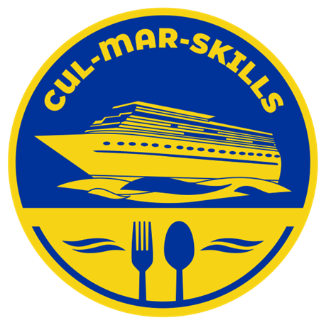

MARitime Soft Skills for Onboard Healthy Nutrition and CULinary Arts in Seagoing Services – CUL-MAR-Skills
KA220-VET - Cooperation partnerships in vocational education and training
2023-1-RO01-KA220-HED-000155888
Disclaimer: “Funded by the European Union. Views and opinions expressed are however those of the author(s) only and do not necessarily reflect those of the European Union or the ANPCDEFP. Neither the European Union nor the ANPCDEFP can be held responsible for them”

Slide 2
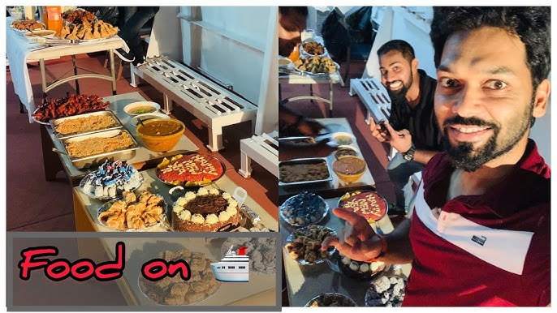
“ONBOARD HEALTHY NUTRITION” RESEARCH REPORT

Slide 3
“ONBOARD HEALTHY NUTRITION” RESEARCH REPORT

Slide 4
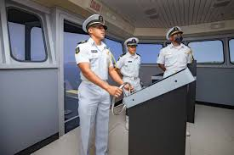
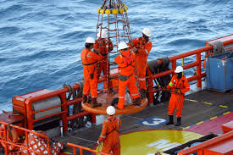
ANALYSIS OF THE SURVEY FOR STUDENTS AND SEAFARERS

Slide 5
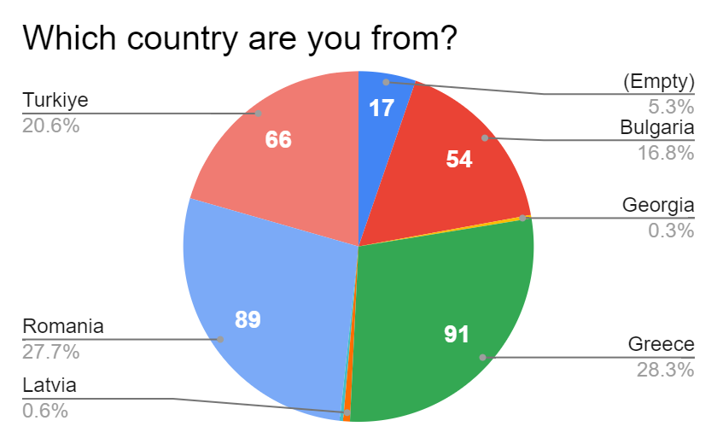
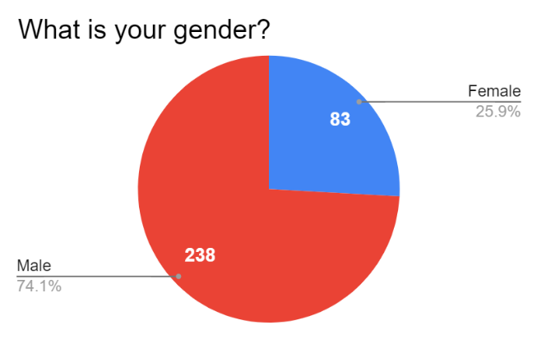
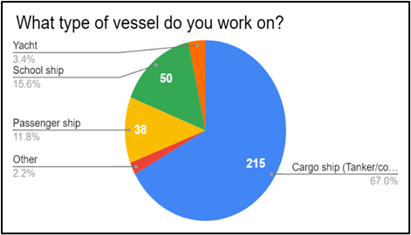
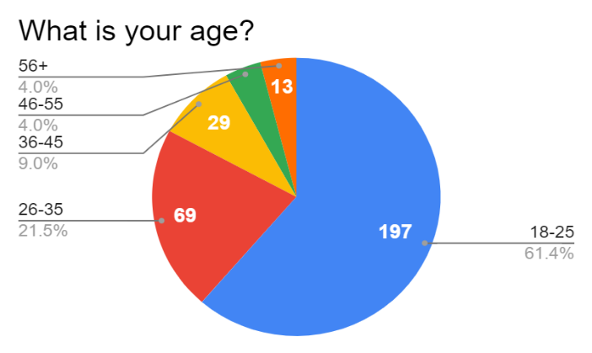
ANALYSIS OF THE SURVEY FOR STUDENTS AND SEAFARERS

Slide 6
ANALYSIS OF THE SURVEY FOR STUDENTS AND SEAFARERS
The analysis of the responses to this survey gave the following results:
Students and seafarers are quite conscious about consuming some foods, but more than half of the participants do not have healthy eating habits. It has been found that they do not have full knowledge about what they should eat to be strong, especially in the harsh circumstances onboard the ships and that they do not consume enough of the basic nutrients that are necessary for strong health. Some sailors and students are careful and conscious about this issue. However, almost half of the participants do not consume enough vegetables, fruit, eggs, offal, and legumes and do not drink enough water. Considering this information, it is concluded that students and seafarers need detailed information about proper nutrition, and they also need to refresh their existing knowledge on the issue.

Slide 7
ANALYSIS OF THE SURVEY FOR STUDENTS AND SEAFARERS
84.4% of the respondents accepted the motivating role of good food onboard.
A little bit more than half of them said they were satisfied with the current provision of healthy and nutritious food onboard, which also means almost half of them are not happy with the current food provision or have not had any idea concerning the food onboard.
Most respondents are aware of the sustainability concerns regarding food, bread, and water and they try not to waste them. However, responses to the question about environmental sustainability in the survey make it clear that participants need training to be more conscious of protecting the environment.

Slide 8
ANALYSIS OF THE SURVEY FOR STUDENTS AND SEAFARERS
Another important finding is that although most participants in the survey give importance to hygiene there are still some of them who are not so careful about this issue. On the other hand, respondents have doubts that the galley and food-related utensils are clean enough. Based on this result, it can be concluded that more attention should be paid to cleanliness and hygiene in the ship's galley and dining hall.
The proportion of seafarers and students who think that the galley is managed successfully is not very high.

Slide 9
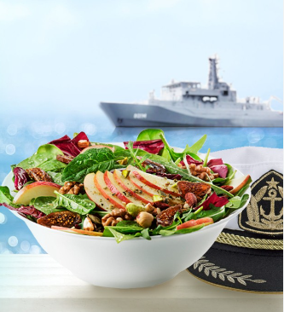
ANALYSIS OF THE SURVEY FOR STUDENTS AND SEAFARERS
Only half of the participants think that the galley is managed efficiently or very efficiently, 20% of the respondents think that it is managed inefficiently, while the rest of the participants do not have a positive or negative opinion. This result indicates that something needs to be done for the efficient management of galleys.

Slide 10
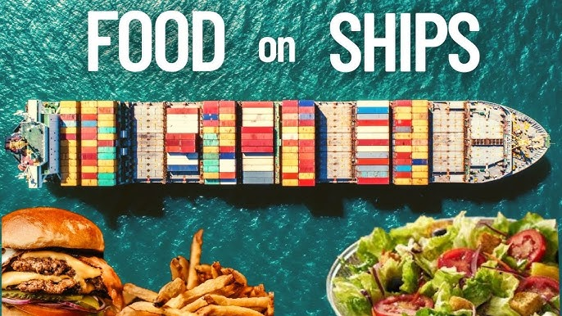
ANALYSIS OF THE SURVEY FOR GALLEY STAFF

Slide 11
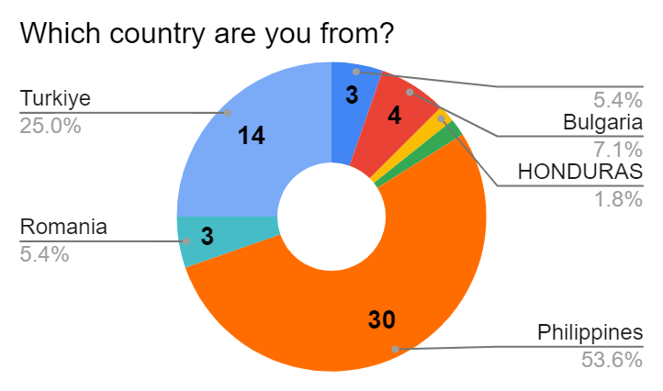
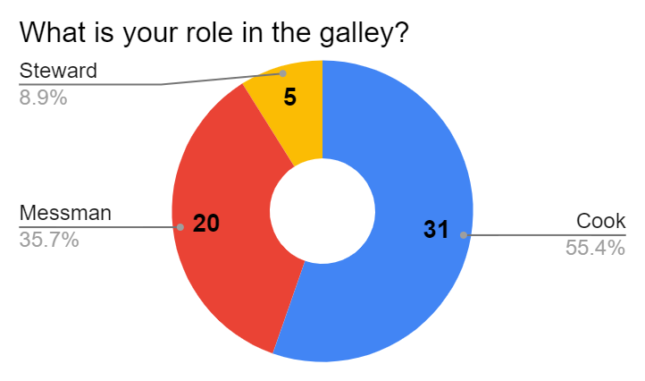
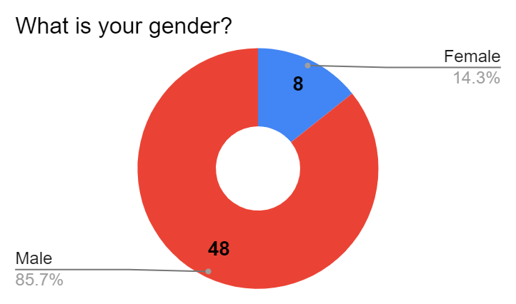
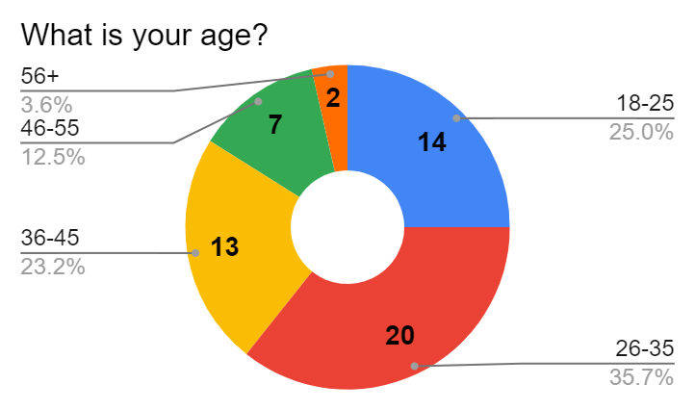
ANALYSIS OF THE SURVEY FOR GALLEY STAFF

Slide 12
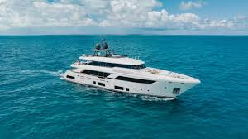
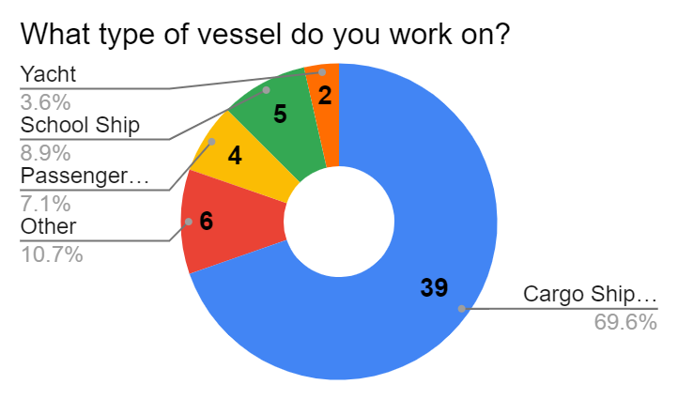


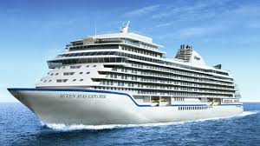
ANALYSIS OF THE SURVEY FOR GALLEY STAFF

Slide 13
ANALYSIS OF THE SURVEY FOR GALLEY STAFF
Most galley staff think they know what they should cook to keep the crew healthy. It means that they know the nutritional values and properties of foods and the food groups that seafarers need to work efficiently.
They also know the positive effects of good food on people, and why eating a nice meal is important for the motivation of the crew.
About ten percent of the respondents do not know much about menu planning. Although this is a low number, this is a very important issue, and it is crucial to provide both the existing galley staff and the new entrants with some kind of refreshing training and examples of good practices.

Slide 14
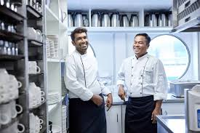
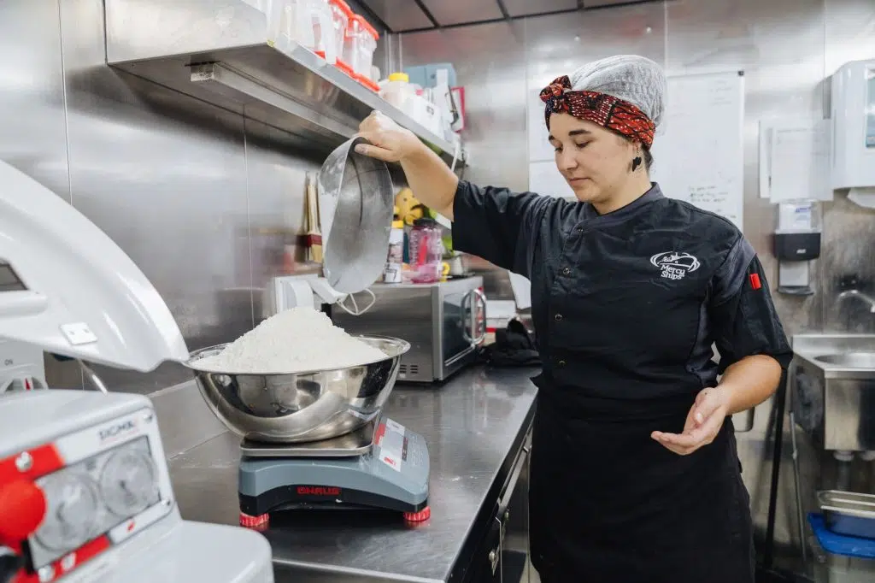
ANALYSIS OF THE SURVEY FOR GALLEY STAFF
Galley staff know how important it is to cook meals belonging to different nations; however, about one-fourth of the respondents need to know the international recipes.
It would be appropriate to inform galley staff about the basic foods that should be kept in the galley all the time, and what their nutritional values are.
The majority of the personnel are quite knowledgeable about sustainability. However, since this result cannot be generalized to all staff, it should be ensured that all galley staff are aware of this issue and for this, training on sustainability should be provided.

Slide 15
ANALYSIS OF THE SURVEY FOR GALLEY STAFF
Galley staff need to be well informed about this issue. It is necessary to follow the developments in the field of environmentally friendly practices in galleys or galleys to provide refreshment training for the staff. They should know what steps they can take both individually and together with the other members of the galley staff to provide sustainability in the galleys.
The galley staff obey the hygiene rules except for the failure to wear aprons, bonnets, and gloves. On the other hand, allowing unauthorized persons to enter the galley is a negative step that jeopardizes hygiene. For this reason, it is beneficial to reconsider the hygiene issue in general in all aspects and to increase the level of awareness of the personnel by providing training at specified intervals to refresh their knowledge and inform them about emerging threats that may cause problems.

Slide 16
ANALYSIS OF THE SURVEY FOR GALLEY STAFF
Training programs for culinary skills and food safety practices should be provided regularly to ensure that galley staff stay updated with best practices, regulations, and evolving culinary trends. The frequency of these training programs can depend on several factors, such as the nature of the ship's operations, crew turnover, and changes in food safety regulations.
The problems that the galley staff have regarding fresh ingredients and budget constraints are the ones that should be solved as soon as possible.
Galley staff should be provided with more storage space and more fresh products.

Slide 17

ANALYSIS OF THE SURVEY FOR EMPLOYERS

Slide 18
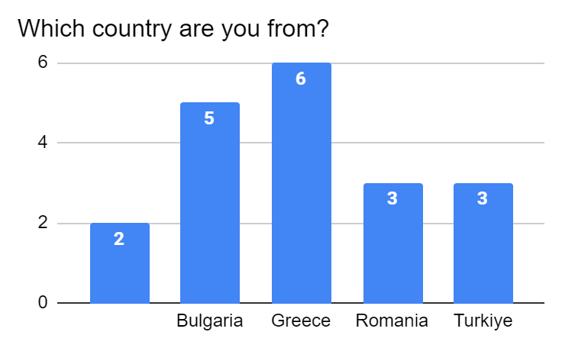
ANALYSIS OF THE SURVEY FOR EMPLOYERS
Although the number of participants is not high enough to generalize the survey results to the whole employers they can provide a significant insight into their attitudes toward the employers on the general situation

Slide 19
ANALYSIS OF THE SURVEY FOR EMPLOYERS
Employers in the maritime sector are sufficiently knowledgeable and interested in the diet and needs on board. They have sufficient knowledge about the reasons why seafarers should be well-nourished and the positive effects of good nutrition on health, motivation, and work efficiency. However, it would be better if they could consider the individual nutritional characteristics and problems of seafarers such as allergies.
Employers are conscious of the culturally important days or events for the seafarers, and they tend to prepare the menu to celebrate them. They are also aware of the importance of including different cultures on the menu.

Slide 20
ANALYSIS OF THE SURVEY FOR EMPLOYERS
Employers do not fully support the existence of women in the galley to a certain degree; however, they should pay attention to the fact that some of the personnel working in the galley should be women to provide diversity and bring the perspective of a different gender to the galley
Employers should value the innovative and entrepreneurial ideas of their galley staff and even encourage them to come up with such ideas.
They should learn about the importance of sustainability, recycling all waste materials in the galley, and portion control., some precautions should be taken to make employers more aware of the latest trends in recycling, sustainability, and circular economy, which in turn gives the same mindset to the staff.

Slide 21
ANALYSIS OF THE SURVEY FOR EMPLOYERS
Employers attach importance to keeping a strict pantry inventory and auditing it so that they can both identify missing items and those that need to be replenished and take action on food that is nearing or past its expiry date.
Training and upskilling opportunities are two important and demanded activities by employers. They want the galley staff to take such refreshing activities, however, there is not a consensus concerning the frequency of these trainings. Based on these results, it seems appropriate to provide this training at intervals of at least 6 months and/or when necessary.

Slide 22
ANALYSIS OF THE SURVEY FOR EMPLOYERS
The topics to be covered by the module “Onboard Healthy Nutrition” according to the survey results
SEAFARERS AND STUDENTS | GALLEY STAFF | EMPLOYERS
Proper Nutrition and Well-Being | Proper Nutrition and Well-Being | Proper Nutrition and Well-Being
Sustainability | Sustainability | Sustainability
Hygiene | Hygiene | Hygiene
Effects of Good Food | Victualling
General Impression | Training and Education | Training and Education
 | Challenges | Challenges
Detailed study; comprehensive training and education -------- Complementary and gap-filling training and education --------- Refreshing training and education ---------

Slide 23
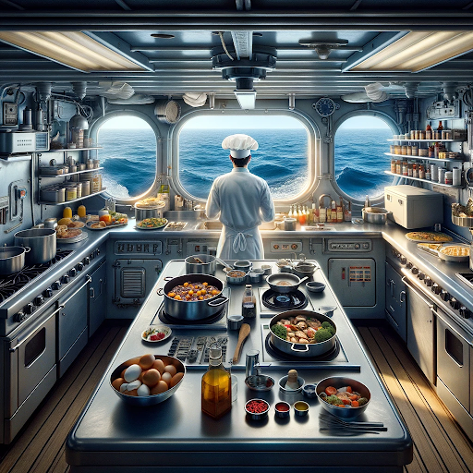
Thank you for your kind attention!

