Slide 1








MARitime Soft Skills for Onboard Healthy Nutrition and Culinary Arts in Seagoing Services – CUL-MAR-Skills
KA220-VET - Cooperation partnerships in vocational education and training
2023-1-RO01-KA220-VET-000156711
Seminar
SUSTAINABLE DEVELOPMENT AND ENTREPRENEURSHIP IN MARITIME SERVICES
13 May 2025
Disclaimer: “Funded by the European Union. Views and opinions expressed are however those of the author(s) only and do not necessarily reflect those of the European Union or the ANPCDEFP. Neither the European Union nor the ANPCDEFP can be held responsible for them”

Slide 2
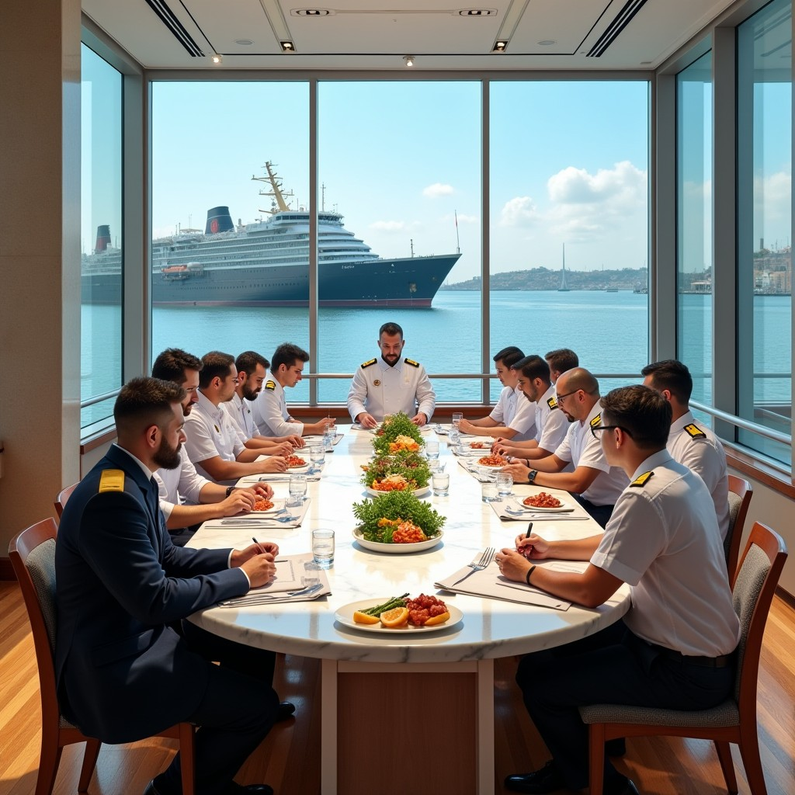
MARitime Soft Skills for Onboard Healthy Nutrition and CULinary Arts in Seagoing Services – CUL-MAR-Skills
KA220-VET - Cooperation partnerships in vocational education and training
2023-1-RO01-KA220-VET-000156711
Seminar
SUSTAINABLE DEVELOPMENT AND ENTREPRENEURSHIP IN MARITIME SERVICES
13 May 2025
Disclaimer: “Funded by the European Union. Views and opinions expressed are however those of the author(s) only and do not necessarily reflect those of the European Union or the ANPCDEFP. Neither the European Union nor the ANPCDEFP can be held responsible for them”

Slide 3
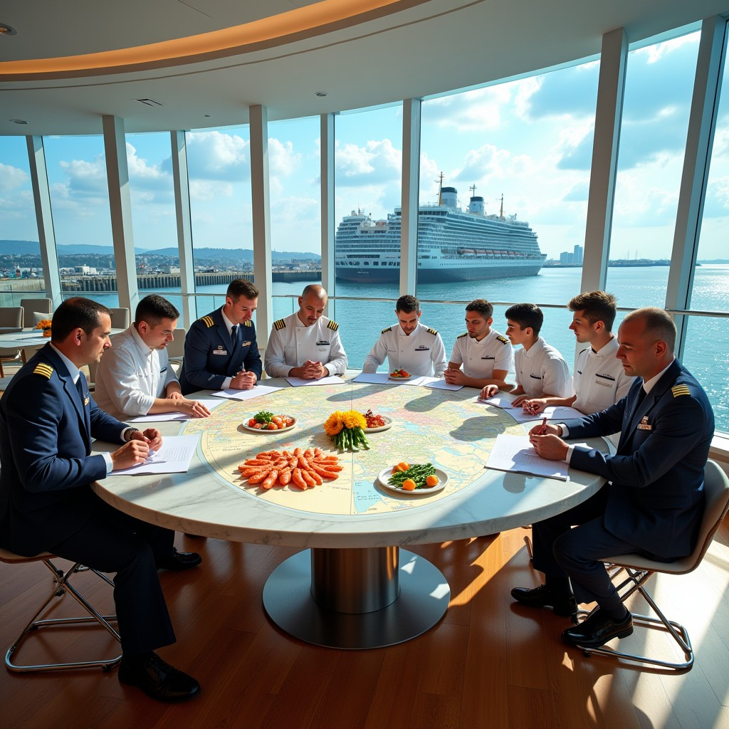
MARitime Soft Skills for Onboard Healthy Nutrition and CULinary Arts in Seagoing Services – CUL-MAR-Skills
KA220-VET - Cooperation partnerships in vocational education and training
2023-1-RO01-KA220-VET-000156711
Seminar
SUSTAINABLE DEVELOPMENT AND ENTREPRENEURSHIP IN MARITIME SERVICES
13 May 2025
Disclaimer: “Funded by the European Union. Views and opinions expressed are however those of the author(s) only and do not necessarily reflect those of the European Union or the ANPCDEFP. Neither the European Union nor the ANPCDEFP can be held responsible for them”

Slide 4
Introduction to the Seminar
Welcome to the International Conference seminar, themed "Sustainable Development and Entrepreneurship in Maritime Services", held on May 13, 2025.
This seminar is organized by Nikola Vaptsarov Naval Academy and brings together maritime professionals, researchers, and educators to explore how innovation, entrepreneurial thinking, and responsible governance can shape the future of maritime services.
NAVAL COMMUNICATIONS
SUSTAINABLE DEVELOPMENT AND ENTREPRENEURSHIP IN MARITIME SERVICES

Slide 5
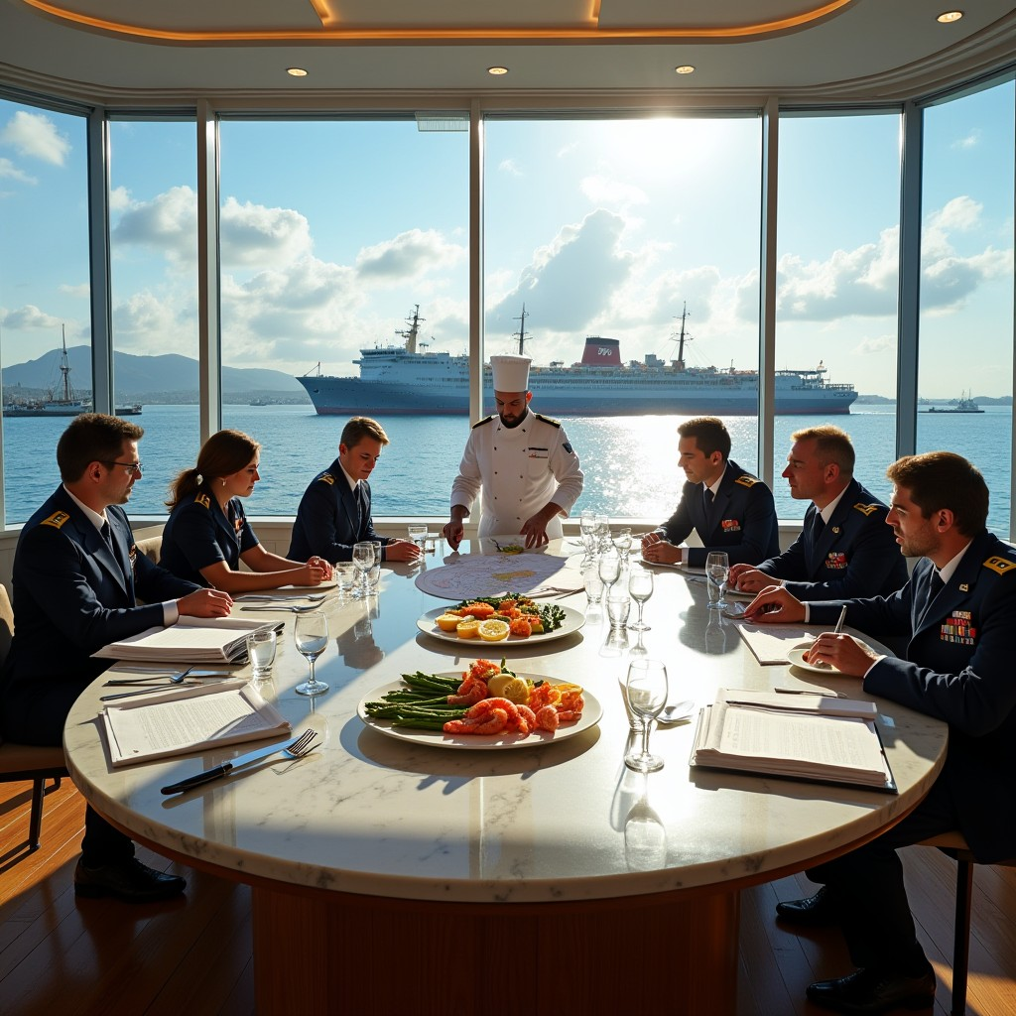
Introduction to the collection of abstracts
The collection presents the abstracts of the papers presented at the seminar "Sustainable Development and Entrepreneurship in Maritime Services" organised by the Nikola Vaptsarov Naval Academy.
The event focuses on issues related to re-evaluating the different approaches to managing maritime operations and logistics processes in the context of the challenges of sustainable development, digital transformation and the need for an entrepreneurial approach in the sector.
Sustainable Development and Entrepreneurship in Maritime Services
NAVAL COMMUNICATIONS

Slide 6

Introduction to the collection of abstracts
The maritime sector is currently experiencing a period of significant transformation driven by a variety of factors, including climate change, market volatility, technological advancements, and mounting international regulatory pressures. Consequently, it is imperative for individuals engaged in the maritime sector to adopt a novel mode of thinking and to develop contemporary skills. Moreover, there is an imperative for the implementation of integrated solutions that combine efficiency with sustainability over the long term.
NAVAL COMMUNICATIONS

Slide 7

Introduction to the collection of abstracts
The workshop's objective is to address this need by establishing an environment conducive to exchanging knowledge and practical experience. The event brings together academics, early-career researchers, practitioners, and business representatives to discuss best practices, working models, and opportunities for implementing innovations in the maritime environment.
Sustainable Development and Entrepreneurship in Maritime Services

Slide 8
Introduction to the collection of abstracts
The collection is comprised of ten abstracts in total, with each abstract making a unique contribution to the discussion on a sustainable future for the maritime sector. The studies presented herein range from case studies and empirical observations to conceptual developments based on international experience. It is hoped that the unifying theme of the aspiration to identify pragmatic solutions that address both contemporary imperatives and the distinct characteristics of the marine environment will be a source of inspiration for all.
The seminar organisers wish to extend their deepest gratitude to all participants, including speakers, authors and guests, for their active role and commitment. The materials compiled in this volume are of academic interest and reflect an imperative to disseminate knowledge and pursue new opportunities.
NAVAL COMMUNICATIONS
Sustainable Development and Entrepreneurship in Maritime Services

Slide 9
Seminar
IMPROVEMENT SOLUTIONS FOR HEALTHY NUTRITION IN SEAFARING ACTIVITIES
Abstract I. Entrepreneurial thinking in the maritime supply chain
Abstract II. The role of technology and digitalisation in warehouse innovation
Abstract III. Nurturing resourcefulness and initiative in logistics practice
Abstract IV. The maritime sector - challenges and opportunities for entrepreneurs
Abstract V. Sustainability in entrepreneurship - challenges and real solutions in the maritime sector
Abstract VI. Adapting the entrepreneurial perspective in the maritime sector
Abstract VII. Sustainable sourcing and use of seasonal products in maritime and logistics practice
Abstract VIII. Food waste reduction and efficient utilisation of residues
Abstract IX. Reducing plastic and packaging waste in the galley
Abstract X. Monitoring and measuring the environmental impact of the ship's galley. 18
Sustainable Development and Entrepreneurship in Maritime Services

Slide 10

Abstract I. Entrepreneurial thinking in the maritime supply chain
Sustainable Development and Entrepreneurship in Maritime Services

Slide 11

Abstract 1. Entrepreneurial thinking in the maritime supply chain
Background
The maritime logistics sector operates in an environment characterised by high uncertainty and constant volatility. This environment is influenced by external factors such as climate change and market instability, as well as internal organisational challenges. This complexity and unpredictability underline the need for an entrepreneurial mindset that combines analytical skills, creativity and a willingness to take calculated risks.
Sustainable Development and Entrepreneurship in Maritime Services

Slide 12

Abstract 1. Entrepreneurial thinking in the maritime supply chain
Objective
The aim of the study is to analyse how the development of an entrepreneurial mindset can contribute to more effective management and increased sustainability in maritime logistics. The study places particular emphasis on fostering a proactive approach to problem-solving, applying creative solutions in resource-constrained environments, and conscious risk-taking in professional practice.
Sustainable Development and Entrepreneurship in Maritime Services

Slide 13
Abstract 1. Entrepreneurial thinking in the maritime supply chain
Methodology
The study uses a practical approach, looking at real-life case studies of maritime logistics companies that have successfully used new and entrepreneurial working methods in their day-to-day operations. We had in-depth chats with experts and managers in the sector, who shared their personal experiences and observations on effective strategies to overcome challenges. The data collected was then subjected to qualitative analysis to identify behavioural and cognitive patterns that lead to improved efficiency and sustainability in the context of logistics processes.
Sustainable Development and Entrepreneurship in Maritime Services

Slide 14

Abstract 1. Entrepreneurial thinking in the maritime supply chain
Results
The results obtained from this study indicate that employees who possess an entrepreneurial mindset are better equipped to identify problems, propose effective solutions, and adapt their processes to the prevailing circumstances. Furthermore, creativity has been identified as a valuable tool for establishing effective and sustainable practices in constrained environments. The study also shows that taking risks, especially when you've got data analysis and team expertise to back you up, can lead to long-term improvements and new ideas in the sector.
Sustainable Development and Entrepreneurship in Maritime Services

Slide 15

Abstract 1. Entrepreneurial thinking in the maritime supply chain
Conclusion
The bottom line is that it's really important to encourage an entrepreneurial mindset in the workforce, as it helps people spot problems, develop effective solutions and adapt their processes to the situation. Furthermore, the study underscores the significance of creativity in establishing effective and sustainable practices within constrained environments. Finally, the study highlights the value of taking calculated risks, mainly when supported by data analysis and collective expertise, in driving sustainable improvements and innovation in the sector.
Sustainable Development and Entrepreneurship in Maritime Services

Slide 16

Abstract II. The role of technology and digitalisation in warehouse innovation
Sustainable Development and Entrepreneurship in Maritime Services

Slide 17

Abstract 1. The role of technology and digitalisation in warehouse innovation
Background
Recent developments in the field of technology have had a significant impact on warehouse logistics, leading to advancements in the processing of goods, the accuracy of inventory control, and the optimisation of space utilisation. Changes related to automation and digitalisation are becoming an integral part of the process but require a new way of thinking because they affect both the efficiency and security of warehouse operations.
Sustainable Development and Entrepreneurship in Maritime Services

Slide 18

Abstract 2. The role of technology and digitalisation in warehouse innovation
Objective
The objective of this study is to examine the impact of modern technology on the development of innovation in the field of warehousing. The study will examine three main aspects: the improvement of efficiency through automation, the possible risks associated with technological security, and the role of digital tools in generating new ideas and improvements.
Sustainable Development and Entrepreneurship in Maritime Services

Slide 19

Abstract 2. The role of technology and digitalisation in warehouse innovation
Methodology
The study utilises observations from real-life scenarios in logistics centres that have implemented automated warehouse management systems. A series of interviews were conducted with employees and managers at various levels, who shared their impressions of working with the new technologies and the problems they encountered in their practice. Furthermore, a range of innovative solutions that have emerged from the introduction of digital environments in warehousing are analysed.
Sustainable Development and Entrepreneurship in Maritime Services

Slide 20

Abstract 2. The role of technology and digitalisation in warehouse innovation
Results
The results demonstrate that technology has a beneficial effect on process management, reducing processing time and human errors. Many employees surveyed expressed that digital platforms facilitate the identification of optimisation opportunities. However, amidst these positive findings, it is crucial to acknowledge the limitations that emerge when inadequate training and ambiguous security protocols are in place. Such shortcomings can potentially engender tensions and risks, particularly in contexts involving traceability and access control software.
Sustainable Development and Entrepreneurship in Maritime Services

Slide 21

Abstract 2. The role of technology and digitalisation in warehouse innovation
Conclusion
The conclusion drawn from this analysis is that technology is contributing to many positive changes in warehouse logistics by encouraging innovation and improving efficiency. However, it is imperative that these changes are implemented with a focus on safety and active employee engagement. Only by ensuring that these principles are followed can the full benefits of digitisation be realised.
Sustainable Development and Entrepreneurship in Maritime Services

Slide 22
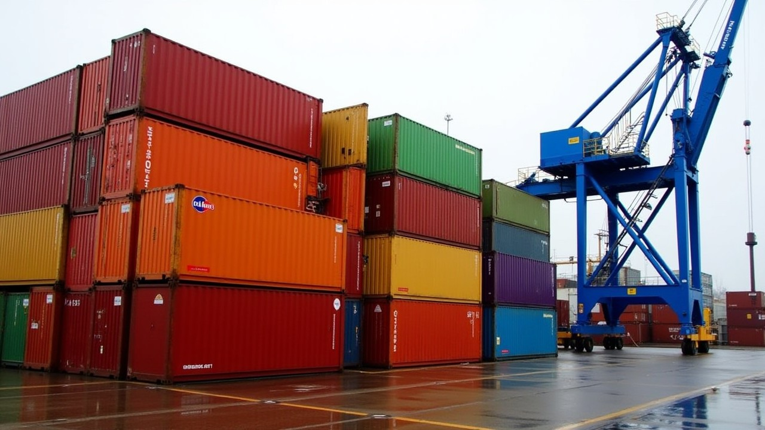
Abstract III. Nurturing resourcefulness and initiative in logistics practice
Sustainable Development and Entrepreneurship in Maritime Services

Slide 23

Abstract 3. Nurturing resourcefulness and initiative in logistics practice
Background
The contemporary business environment is characterised by dynamism, a quality especially evident in the logistics sector. In such a context, professionals are frequently required to make decisions in conditions of incomplete information, under time constraints, and in response to pressing demands. This necessitates that professionals possess not only a wealth of knowledge but also a can-do attitude, the ability to recognise opportunities, the capacity to take initiative, the aptitude to learn from mistakes, and the capacity to react flexibly when circumstances change. The development of resourcefulness and initiative has thus become a key resource for the sustainability of both individual professionals and organisations.
Sustainable Development and Entrepreneurship in Maritime Services

Slide 24

Abstract 3. Nurturing resourcefulness and initiative in logistics practice
Objective
The objective of this study is to investigate the mechanisms through which resourcefulness, entrepreneurial thinking and resilience attitudes are formed and developed in logistics professionals. The study focuses on the ability to recognise and exploit new opportunities, willingness to experiment, learning from mistakes, adaptation to changing environments, and the importance of teamwork and professional networks.
Sustainable Development and Entrepreneurship in Maritime Services

Slide 25

Abstract 3. Nurturing resourcefulness and initiative in logistics practice
Methodology
The study is based on a combined approach of interviews and observations in logistics companies, where decision-making processes and management responses in non-standard situations are observed. Examples of training programmes that encourage active participation and employee initiative are also included. Information on collaborative practices and internal and external networking to support and share experiences is also collected.
Sustainable Development and Entrepreneurship in Maritime Services

Slide 26

Abstract 3. Nurturing resourcefulness and initiative in logistics practice
Results
Properly The findings indicate that employees who possess the capacity to formulate and execute ideas and who demonstrate a willingness to accept failure are more adept at formulating alternative solutions and adapting more swiftly in critical situations. The ability to change direction without losing focus on the end goal is linked to building trust in the team. Furthermore, the analysis indicates that well-established networks of colleagues and external partners facilitate the exchange of ideas to address challenges.
Sustainable Development and Entrepreneurship in Maritime Services

Slide 27

Abstract 3. Nurturing resourcefulness and initiative in logistics practice
Conclusion
The development of resourcefulness and initiative is not solely dependent on individual effort but also on an organisational culture that embraces mistakes as integral components of the learning process. The ability to demonstrate resilience in the logistics sector is contingent upon a willingness to adapt, effective colleague support, and the capacity to leverage failures to address challenges. This enables implementing an approach to management based on flexibility, proactivity, and long-term sustainability.
Sustainable Development and Entrepreneurship in Maritime Services

Slide 28

IV. The maritime sector - challenges and opportunities for entrepreneurs
Sustainable Development and Entrepreneurship in Maritime Services

Slide 29

Abstract IV. The maritime sector - challenges and opportunities for entrepreneurs
Background
The contemporary business environment is characterised by dynamism, a quality especially evident in the logistics sector. In such a context, professionals are frequently required to make decisions in conditions of incomplete information, under time constraints, and in response to pressing demands. This necessitates that professionals possess not only a wealth of knowledge but also a can-do attitude, the ability to recognise opportunities, the capacity to take initiative, the aptitude to learn from mistakes, and the capacity to react flexibly when circumstances change. The development of resourcefulness and initiative has thus become a key resource for the sustainability of both individual professionals and organisations.
Sustainable Development and Entrepreneurship in Maritime Services

Slide 30

Abstract IV. The maritime sector - challenges and opportunities for entrepreneurs
Objective
The objective of this study is to investigate the mechanisms through which resourcefulness, entrepreneurial thinking and resilience attitudes are formed and developed in logistics professionals. The study focuses on the ability to recognise and exploit new opportunities, willingness to experiment, learning from mistakes, adaptation to changing environments, and the importance of teamwork and professional networks.
Sustainable Development and Entrepreneurship in Maritime Services

Slide 31

Abstract IV. The maritime sector - challenges and opportunities for entrepreneurs
Methodology
The study is based on a combined approach of interviews and observations in logistics companies, where decision-making processes and management responses in non-standard situations are observed. Examples of training programmes that encourage active participation and employee initiative are also included. Information on collaborative practices and internal and external networking to support and share experiences is also collected.
Sustainable Development and Entrepreneurship in Maritime Services

Slide 32

Abstract IV. The maritime sector - challenges and opportunities for entrepreneurs
Results
Properly The findings indicate that employees who possess the capacity to formulate and execute ideas and who demonstrate a willingness to accept failure are more adept at formulating alternative solutions and adapting more swiftly in critical situations. The ability to change direction without losing focus on the end goal is linked to building trust in the team. Furthermore, the analysis indicates that well-established networks of colleagues and external partners facilitate the exchange of ideas to address challenges.
Sustainable Development and Entrepreneurship in Maritime Services

Slide 33

Abstract IV. The maritime sector - challenges and opportunities for entrepreneurs
Conclusion
The development of resourcefulness and initiative is not solely dependent on individual effort but also on an organisational culture that embraces mistakes as integral components of the learning process. The ability to demonstrate resilience in the logistics sector is contingent upon a willingness to adapt, effective colleague support, and the capacity to leverage failures to address challenges. This enables implementing an approach to management based on flexibility, proactivity, and long-term sustainability.
Sustainable Development and Entrepreneurship in Maritime Services

Slide 34

Abstract V. Sustainability in entrepreneurship - challenges and real solutions in the maritime sector
Sustainable Development and Entrepreneurship in Maritime Services

Slide 35

Abstract V. Sustainability in entrepreneurship - challenges and real solutions in the maritime sector
Background
The issue of sustainability is becoming a more and more important part of business strategies, especially in areas that directly impact the environment, like the maritime sector. International regulations, public pressure and changing economic conditions are pushing for a change in mindset, moving away from short-term profit and towards long-term responsibility. However, even though it is clear that we need to be more sustainable, it is still tricky to put this into practice.
Sustainable Development and Entrepreneurship in Maritime Services

Slide 36

Abstract V. Sustainability in entrepreneurship - challenges and real solutions in the maritime sector
Objective
The objective of this study is twofold: firstly, to analyse the main difficulties entrepreneurs face when implementing sustainable solutions, and secondly, to present working examples from the maritime sector. The study aims to outline the strategies that lead to actual results and to provide guidance on how sustainability can become a competitive advantage.
Sustainable Development and Entrepreneurship in Maritime Services

Slide 37

Abstract V. Sustainability in entrepreneurship - challenges and real solutions in the maritime sector
Methodology
The study employed an empirical approach, conducting a survey of best practices in companies operating within the maritime transport, shipbuilding, port services and maritime logistics sectors. Many interviews were conducted with entrepreneurs and experts who shared real solutions, difficulties and best practices related to sustainability. In addition, relevant documents pertaining to corporate environmental and social responsibility strategies and reports have been analysed.
Sustainable Development and Entrepreneurship in Maritime Services

Slide 38

Abstract V. Sustainability in entrepreneurship - challenges and real solutions in the maritime sector
Results
The study found that sustainable practices are more likely to be successfully implemented in organisations with a strategic vision, a clear management commitment, and a willingness to invest in innovation. It is worth noting that there are examples of successful implementation, including projects that have reduced the carbon footprint through alternative fuels, optimised routes using digital tools, and effective onboard waste management. The analysis identified challenges frequently encountered by small and medium-sized enterprises, which include resource constraints, administrative burdens, and protracted returns on investment.
Sustainable Development and Entrepreneurship in Maritime Services

Slide 39

Abstract V. Sustainability in entrepreneurship - challenges and real solutions in the maritime
Conclusion
It seems that the successful integration of economic rationale and environmental responsibility could be pivotal in achieving sustainability in entrepreneurship. It seems that integrating sustainable practices into a comprehensive long-term strategy may have the potential to enhance reputation and foster a more resilient and adaptable business model.
Sustainable Development and Entrepreneurship in Maritime Services

Slide 40

Abstract VI. Adapting the entrepreneurial perspective in the maritime sector
Sustainable Development and Entrepreneurship in Maritime Services

Slide 41

Abstract VI. Adapting the entrepreneurial perspective in the maritime sector
Background
The following discussion will explore the notion of maritime entrepreneurship and the specific approach required to achieve it. It is important to note that this approach combines technical understanding, strategic thinking, and intuition about market opportunities. The process of transforming a creative concept into a functional and lucrative venture within the maritime sector necessitates not only innovation but also the capacity to adapt to the pragmatic constraints of the sector, including regulations, safety standards, international conventions, and logistical limitations. In this regard, role models who have proven successful in the maritime business can inspire and guide the new generation of entrepreneurs.
Sustainable Development and Entrepreneurship in Maritime Services

Slide 42

Abstract VI. Adapting the entrepreneurial perspective in the maritime sector
Objective
The objective of the research is twofold: firstly, to investigate how entrepreneurial thinking can be successfully adapted to the conditions of the maritime sector, and secondly, to determine the stages that a creative idea goes through until it becomes a sustainable business. The study focuses on the key role models set by leaders and innovators in the sector, whose actions and achievements motivate and inspire aspiring entrepreneurs.
Sustainable Development and Entrepreneurship in Maritime Services

Slide 43
Abstract VI. Adapting the entrepreneurial perspective in the maritime sector
Methodology
The analysis is based on interviews with entrepreneurs and innovators who have developed businesses in areas such as maritime transport, port logistics, maritime technology and services. Real case studies of company founders in the sector and specific cases of start-up ideas that have successfully gone through the development phases are studied. A comparative analysis is used to highlight commonalities in the approach, thinking and behaviour of successful entrepreneurs.
Sustainable Development and Entrepreneurship in Maritime Services

Slide 44

Abstract VI. Adapting the entrepreneurial perspective in the maritime sector
Results
The study results demonstrate that a comprehensive understanding of the marine environment, encompassing safety, sustainability, and technological reliability requirements, is the most significant factor in adapting an entrepreneurial perspective. A review of successful case studies indicates that the integration of creative ideas with professional expertise, networking opportunities, and guidance from experienced mentors can result in the establishment of prosperous and innovative businesses. Furthermore, role models, particularly in small and medium-sized enterprises, have been found to have a positive impact on the way young entrepreneurs implement their ventures.
Sustainable Development and Entrepreneurship in Maritime Services

Slide 45

Abstract VI. Adapting the entrepreneurial perspective in the maritime sector
Conclusion
The adaptation of entrepreneurial thinking to the maritime sector does not entail a compromise in creativity; rather, it entails the appropriate channelling of creativity towards sustainable and realistic solutions. By drawing upon real-life examples of success and drawing inspiration from the experience of seasoned professionals, new ideas can be successfully implemented in one of the most challenging yet promising economic sectors.
Sustainable Development and Entrepreneurship in Maritime Services

Slide 46

Abstract VII. Sustainable sourcing and use of seasonal products in maritime and logistics practice
Sustainable Development and Entrepreneurship in Maritime Services

Slide 47

Abstract VII. Sustainable sourcing and use of seasonal products in maritime and logistics practice
Background
In recent years, sustainable sourcing has gained increased relevance across a wide range of industries, particularly in shipping and food logistics. This transition can be attributed to two key factors: mounting environmental consciousness and the imperative to enhance economic efficiency. Consequently, novel criteria have emerged with regard to the selection of suppliers and raw materials. Recent studies have demonstrated that the utilisation of local and seasonal ingredients can lead to a substantial reduction in the carbon footprint whilst concurrently fostering regional economic resilience and ensuring access to fresh, high-quality food products.
Sustainable Development and Entrepreneurship in Maritime Services

Slide 48

Abstract VII. Sustainable sourcing and use of seasonal products in maritime and logistics practice
Objective
The present study has two principal objectives: The presentation of the core concepts and principles underlying sustainable sourcing practices and the exploration of the practical benefits that such practices can bring to the maritime sector. Furthermore, the study seeks to outline applicable strategies for identifying responsible suppliers – those who are transparent, ethically engaged, and environmentally conscious. The study places particular emphasis on the contribution of local and seasonal products to sustainable menu design and improved resource management aboard ships.
Sustainable Development and Entrepreneurship in Maritime Services

Slide 49
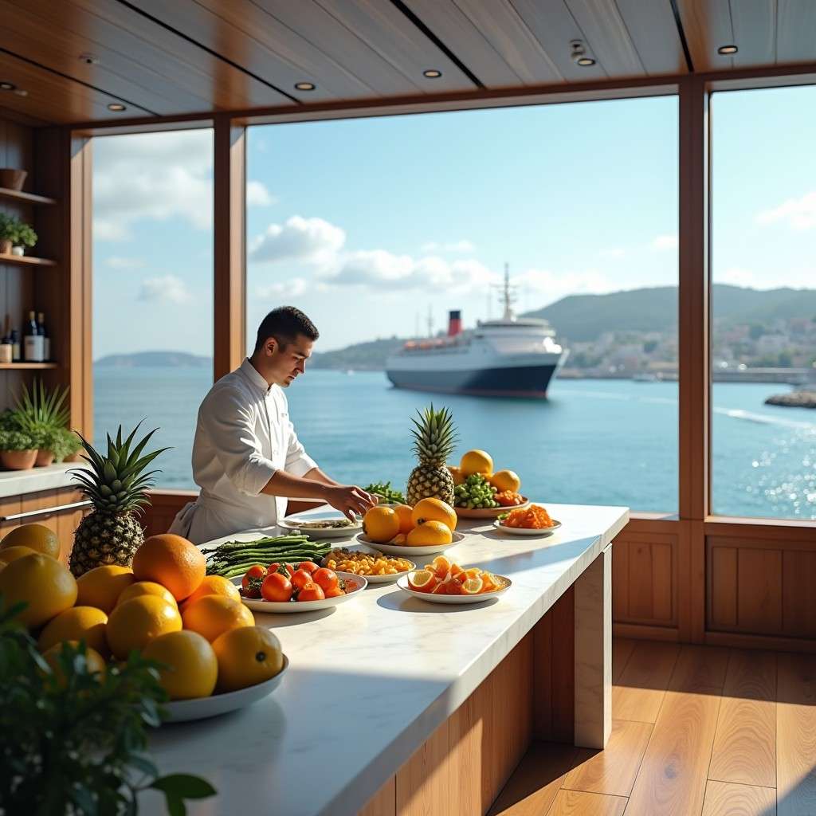
Abstract VII. Sustainable sourcing and use of seasonal products in maritime and logistics practice
Methodology
The research adopts an applied and practice-oriented methodology. Data collection involved conducting structured interviews with stakeholders from the maritime food supply chain, including chefs, procurement managers, and logistics coordinators. The study also includes case analyses of merchant and cruise ships that have successfully integrated sustainable sourcing strategies. The study places particular emphasis on the selection of suppliers, product traceability, and the integration of sustainability standards into procurement processes.
Sustainable Development and Entrepreneurship in Maritime Services

Slide 50

Abstract VII. Sustainable sourcing and use of seasonal products in maritime and logistics practice
Results
The analysis indicates that sustainable sourcing contributes to long-term cost reductions and enhances the quality of food offerings. Teams working with local suppliers report greater flexibility and better cooperation. The judicious use of seasonal produce has the potential to enhance the culinary experience and elevate crew satisfaction. The analysis indicates that sustainable sourcing is contingent on a combination of transparency, with optimal outcomes being achieved in long-term partnerships.
Sustainable Development and Entrepreneurship in Maritime Services

Slide 51

Abstract VII. Sustainable sourcing and use of seasonal products in maritime and logistics practice
Conclusion
The present study demonstrates that sustainable sourcing is not merely a passing fashion trend but rather a necessity in the face of limited resources and increased environmental responsibility. The utilisation of seasonal and local ingredients has the potential to yield both economic benefits and significant social impact. When employed with careful consideration and meticulous planning, this approach can result in more sustainable and efficient food chains within the seafood sector.
Sustainable Development and Entrepreneurship in Maritime Services

Slide 52

Abstract VIII. Food waste reduction and efficient utilisation of residues
Sustainable Development and Entrepreneurship in Maritime Services

Slide 53

Abstract VIII. Food waste reduction and efficient utilisation of residues
Background
The problem of food waste is a global problem with consequences for both the environment and the efficiency of supply systems. This is especially true in confined spaces like ships or logistics bases. The root causes of food wastage are frequently attributed to inadequate planning, insufficient portion control and inefficient storage methods. However, the adoption of suitable strategies and minor adjustments to workflow processes can lead to substantial reductions in food waste, along with the creative and economical utilisation of leftovers.
Sustainable Development and Entrepreneurship in Maritime Services

Slide 54

Abstract VIII. Food waste reduction and efficient utilisation of residues
Objective
The objective of this study is to investigate workable strategies to minimise food waste in a resource-limited environment, such as the marine environment. The study places particular emphasis on the creative utilisation of leftovers in menu planning, as well as on portion control and food storage practices.
Sustainable Development and Entrepreneurship in Maritime Services

Slide 55

Abstract VIII. Food waste reduction and efficient utilisation of residues
Methodology
The research is anchored in a multifaceted approach, encompassing observational studies and interviews with shipboard cooks, procurement personnel, and food managers. It also involves a thorough analysis of internal food resource management procedures. Best practices are collected from commercial and cruise ships where significant waste reduction has been achieved through the implementation of clear rules for innovative residue reuse methods.
Sustainable Development and Entrepreneurship in Maritime Services

Slide 56

Abstract VIII. Food waste reduction and efficient utilisation of residues
Results
The findings demonstrate that the most successful teams implement flexible menu planning, taking into account availability and seasonality. Leftovers are often repurposed in soups, side dishes, or snacks without compromising quality or safety. The use of portion control, facilitated by the implementation of pre-measurement and clear standards, has also been identified as a key factor in the reduction of excess food. The utilisation of proper storage and product utilisation prior to expiration have been identified as pivotal factors.
Sustainable Development and Entrepreneurship in Maritime Services

Slide 57
Abstract VIII. Food waste reduction and efficient utilisation of residues
Conclusion
The reduction of food waste is not only an issue of environmental concern but also a matter of professional responsibility and efficient resource management. In the marine sector, where access to new supplies is limited, the recovery of each portion is of significance. Achieving sustainable results in this sector is contingent on implementing effective organisational practices, comprehensive team training, and innovative culinary approaches, all of which contribute to reducing costs and enhancing the quality of meals served on board.
Sustainable Development and Entrepreneurship in Maritime Services

Slide 58
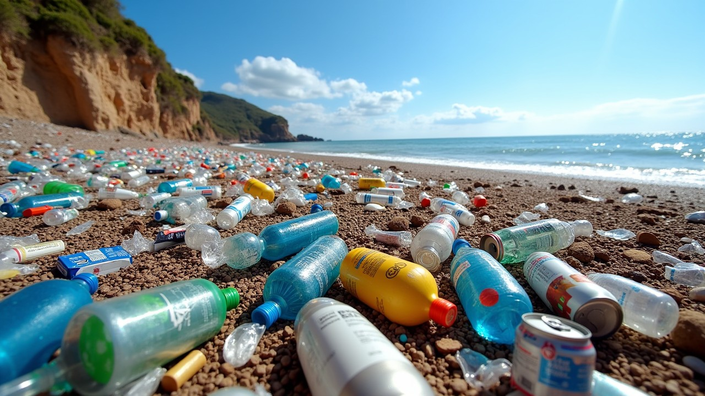
Abstract IX. Reducing plastic and packaging waste in the galley
Sustainable Development and Entrepreneurship in Maritime Services

Slide 59
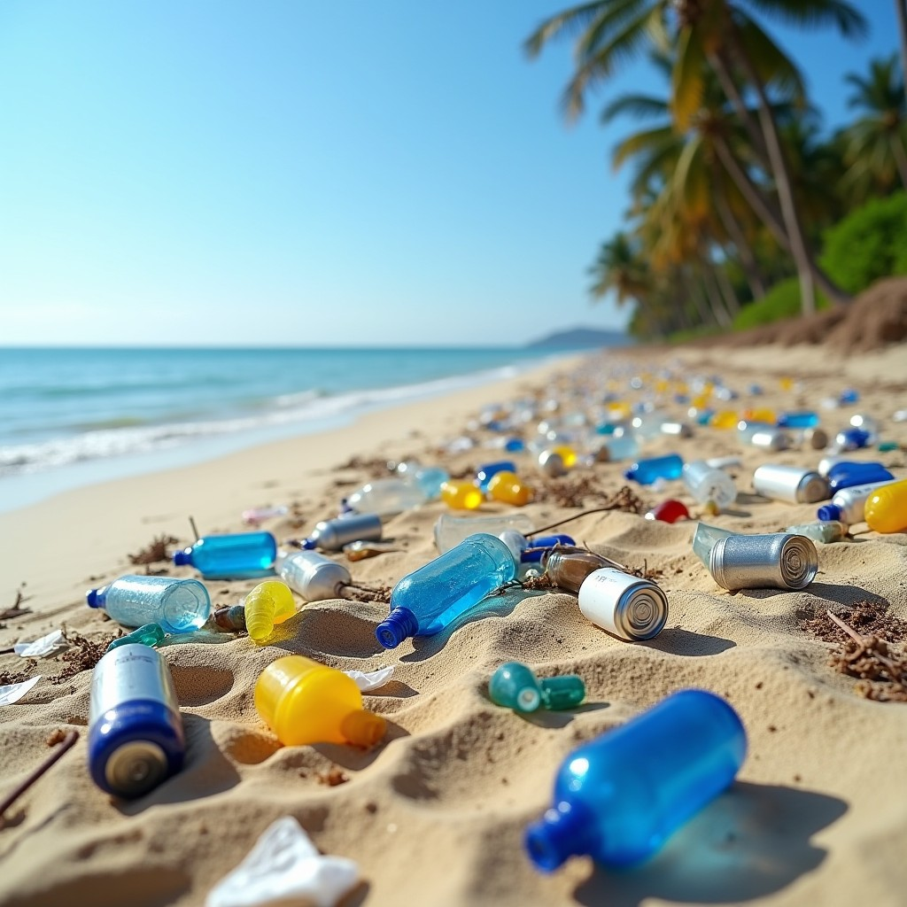
Abstract IX. Reducing plastic and packaging waste in the galley
Background
One of the most significant environmental issues in the marine sector pertains to the utilisation of single-use plastics and the accumulation of packaging waste. In the galley aboard ships, where considerations of convenience and safety frequently determine the selection of materials, single-use plastics remain a prevalent choice. Nevertheless, there are genuine opportunities to introduce sustainable alternatives and to educate crew members on how to implement effective waste reduction practices.
Sustainable Development and Entrepreneurship in Maritime Services

Slide 60
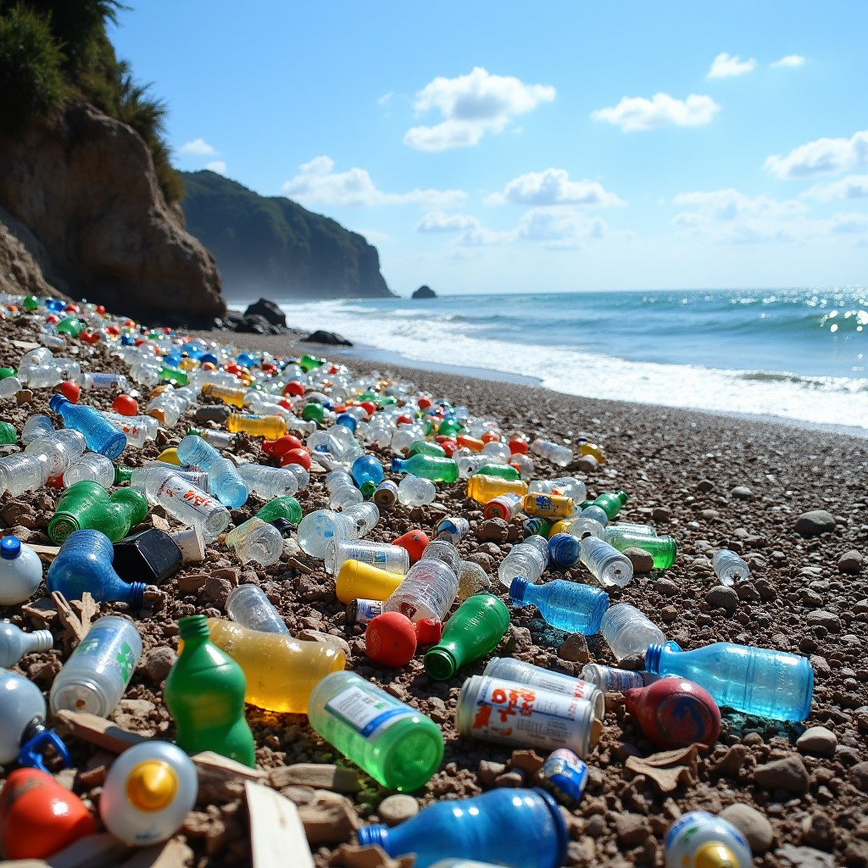
Abstract IX. Reducing plastic and packaging waste in the galley
Objective
The objective of this study is to investigate the feasibility of reducing the use of plastics and packaging in the ship's galley. The study will focus on the transition to reusable products, the utilisation of environmentally friendly packaging, and the role of crew training in fostering sustainable habits.
Sustainable Development and Entrepreneurship in Maritime Services

Slide 61
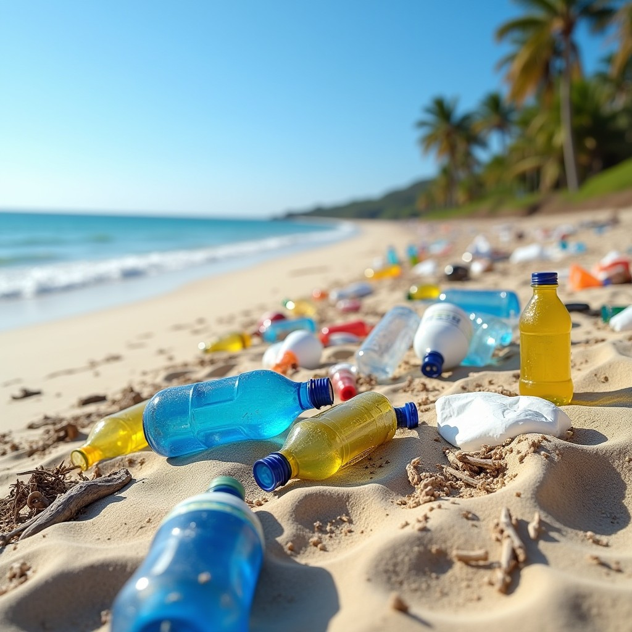
Abstract IX. Reducing plastic and packaging waste in the galley
Methodology
The present study is based on a comprehensive review of extant practices on board ships, complemented by in-depth interviews with cooks, procurement officers, and environmental officers. Furthermore, the study will analyse measures introduced by companies that have significantly reduced waste by introducing sustainable containers, containers and packaging. The effectiveness of training sessions related to sustainable kitchenware and packaging management is also evaluated.
Sustainable Development and Entrepreneurship in Maritime Services

Slide 62
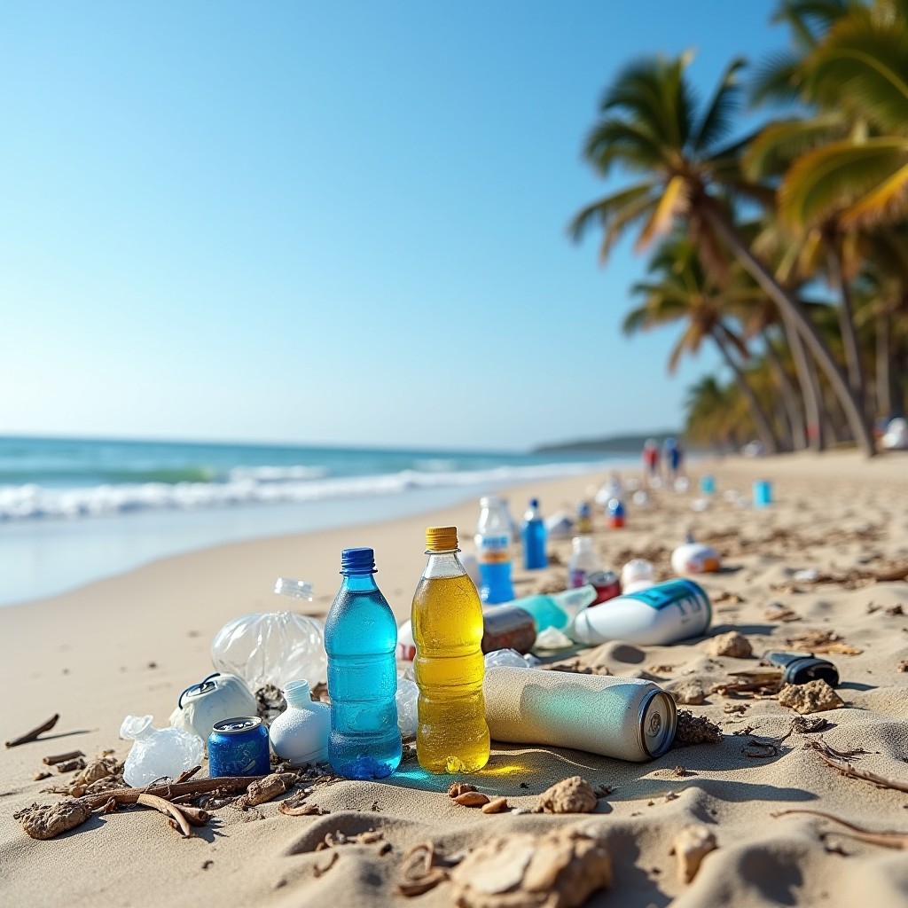
Abstract IX. Reducing plastic and packaging waste in the galley
Results
The findings demonstrate that eliminating single-use plastics is feasible, particularly when integrated with systematic supply planning and pre-planning. The analysis indicates that reusable products, including cans, bottles, and cutlery, are economically viable long-term. It is evident that personnel who have undergone specific training on the subject demonstrate a heightened level of commitment and initiative in reducing waste. The integration of novel practices with visual prompts and practical guidelines on the job has been identified as a particularly efficacious strategy.
Sustainable Development and Entrepreneurship in Maritime Services

Slide 63
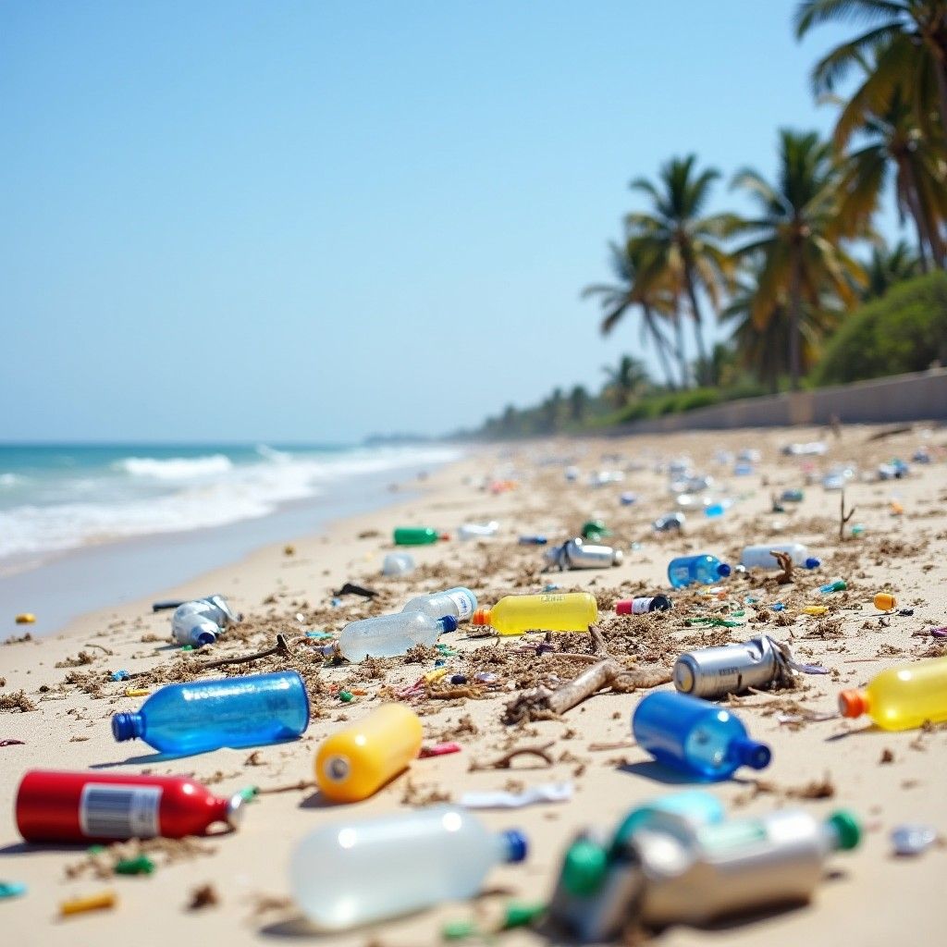
Abstract IX. Reducing plastic and packaging waste in the galley
Conclusion
The conclusion drawn from this analysis indicates that the reduction of plastic waste in the onboard kitchen environment is an attainable objective, provided that a comprehensive strategy is employed, that the organisation is optimised, and that the entire team demonstrates a collective commitment. The use of reusable alternatives and eco-friendly packaging not only mitigates the environmental impact of vessels but also fosters a culture of responsibility and sustainable behaviour among crew members.
Sustainable Development and Entrepreneurship in Maritime Services

Slide 64
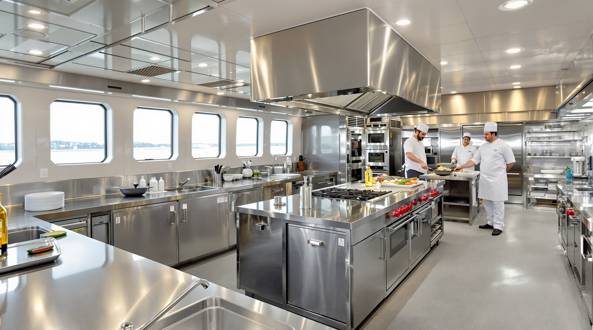
Abstract X. Monitoring and measuring the environmental impact of the ship's galley
Sustainable Development and Entrepreneurship in Maritime Services

Slide 65
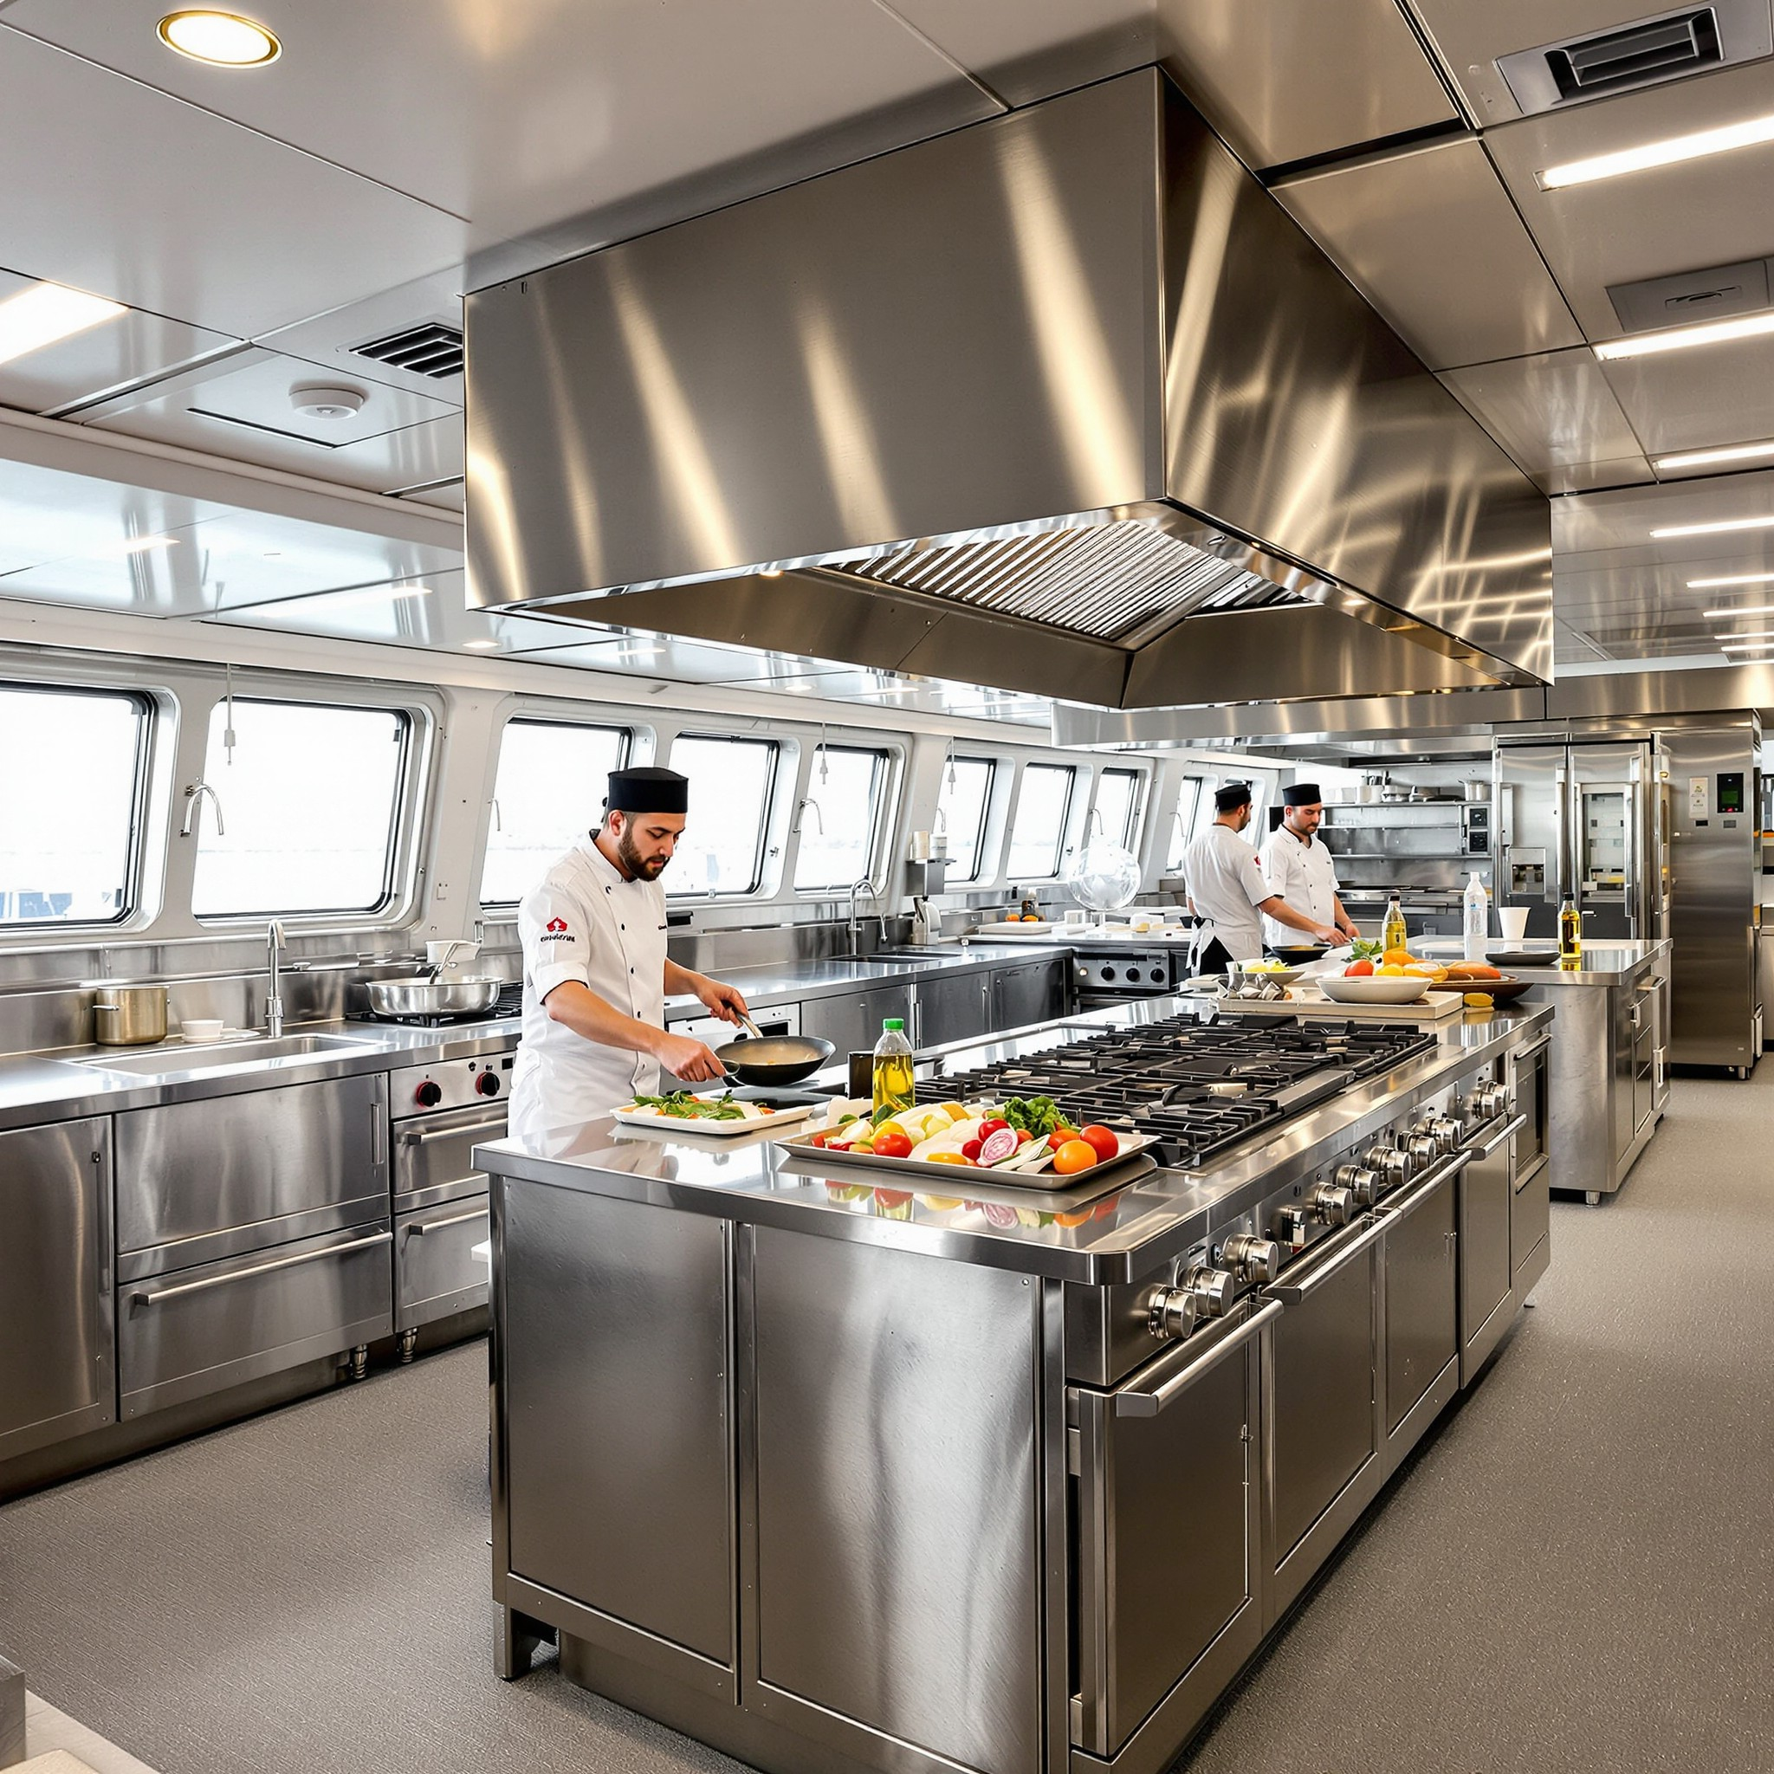
Abstract X. Monitoring and measuring the environmental impact of the ship's galley
Background
In the contemporary context, with an increasing focus on sustainability and marine conservation, the management of resources in the ship's galley is becoming an integral component of environmental responsibility on board. In order to ensure the efficacy of sustainability measures, it is essential that they are subject to systematic monitoring and quantification. The measurement of energy consumption, water consumption and waste generation provides a foundation for informed decision-making and the establishment of realistic targets for improvement.
Sustainable Development and Entrepreneurship in Maritime Services

Slide 66
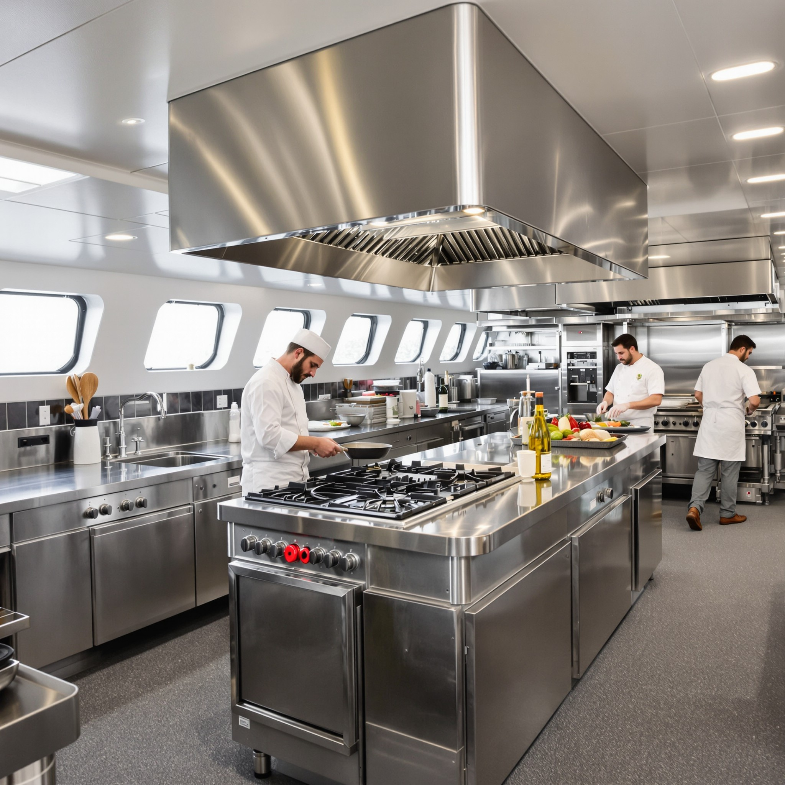
Abstract X. Monitoring and measuring the environmental impact of the ship's galley
Objective
The objectives of this study are twofold: firstly, to present effective tools and techniques for monitoring the environmental impact of the galley, and secondly, to demonstrate how continuous monitoring and data analysis could help sustainable resource management. The primary focus is on tracking key environmental indicators and formulating targets for continuous enhancement.
Sustainable Development and Entrepreneurship in Maritime Services

Slide 67
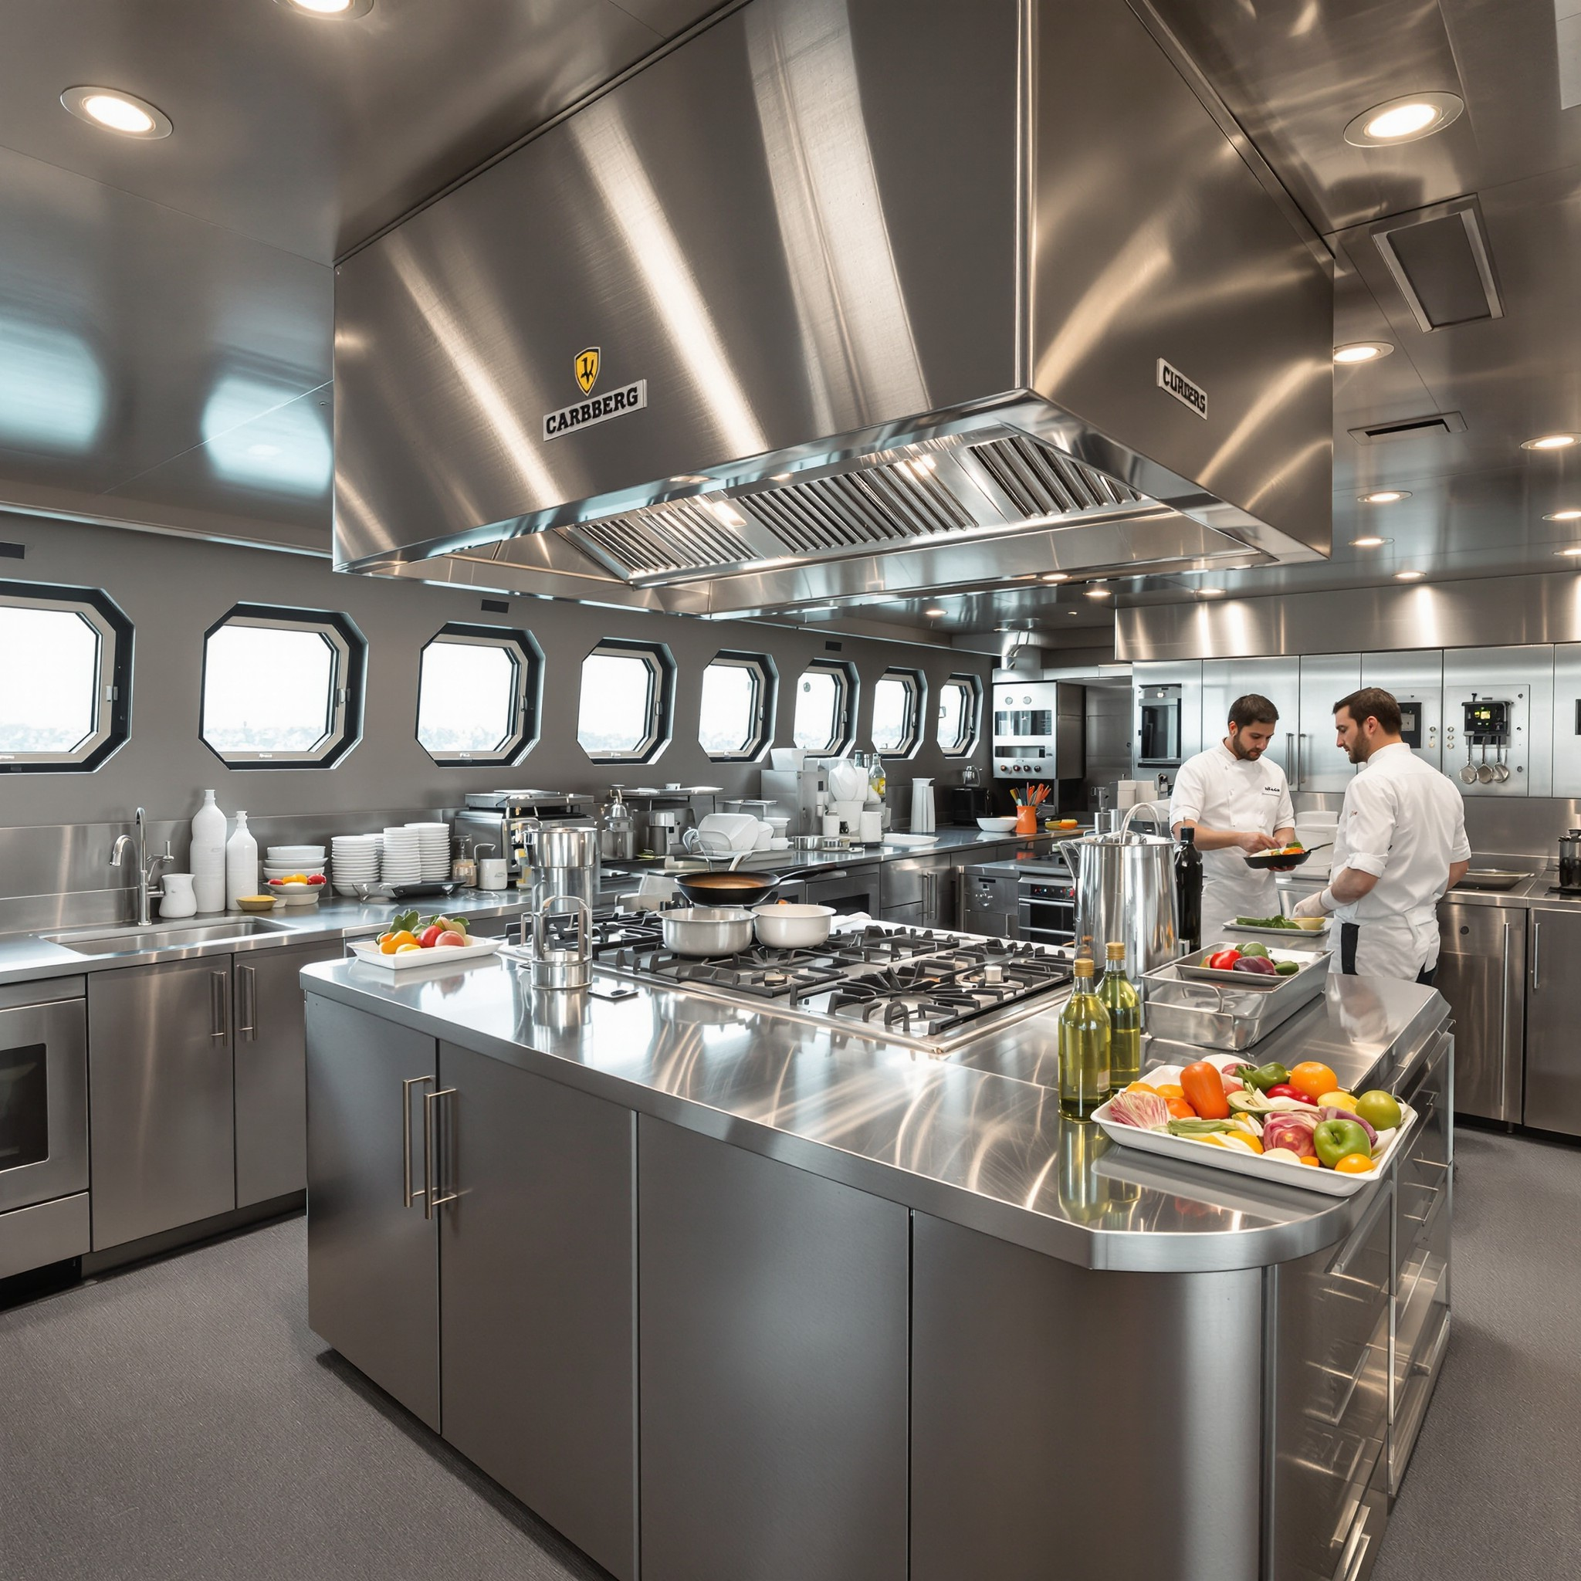
Abstract X. Monitoring and measuring the environmental impact of the ship's galley
Methodology
In the framework of the study, the internal monitoring systems of ships of different types were analysed. In-depth interviews were conducted with personnel, including chefs, maintenance engineers and environmental managers, to ascertain the reporting and control practices in place. In addition, digital tools for measuring water and energy costs were investigated, as well as methods for estimating waste.
Sustainable Development and Entrepreneurship in Maritime Services

Slide 68
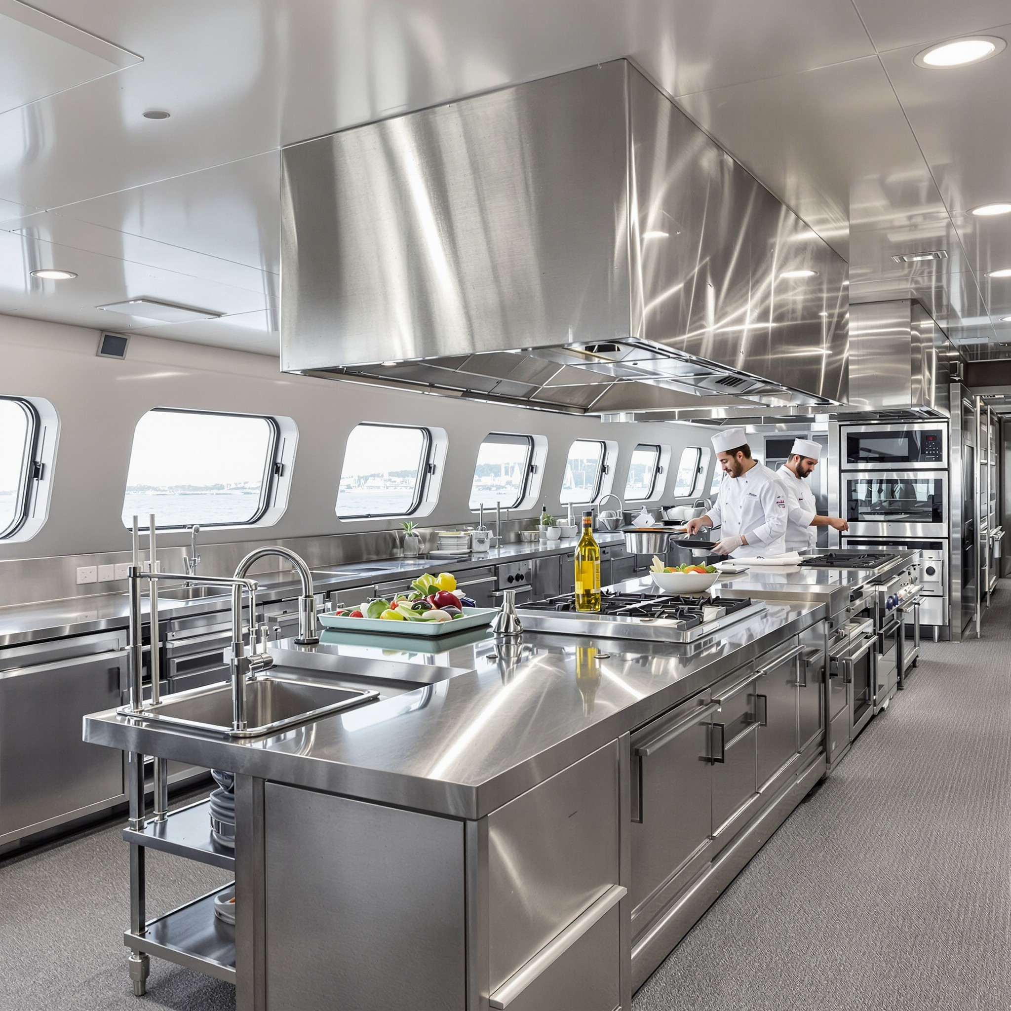
Abstract X. Monitoring and measuring the environmental impact of the ship's galley.
Results
The utilisation of digital platforms and automated resource accounting systems has been found to facilitate the control process. The application of daily and weekly reports has been demonstrated to facilitate the timely detection of deviations and the planning of timely corrective actions. The establishment of specific, attainable goals has been demonstrated to engender heightened engagement among crew members and more effective outcomes. It is evident that practices integrating monitoring with training and visual feedback for staff members have yielded optimal outcomes.
Sustainable Development and Entrepreneurship in Maritime Services

Slide 69
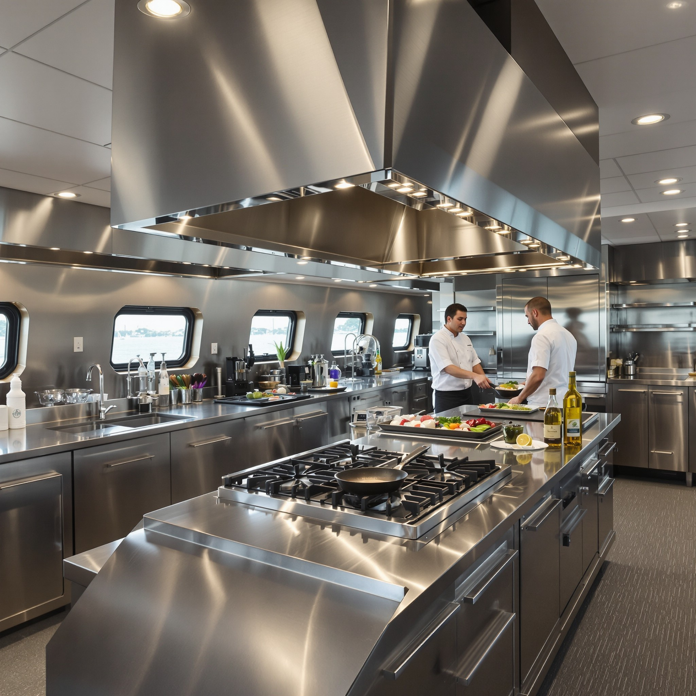
Abstract X. Monitoring and measuring the environmental impact of the ship's galley
Conclusion
In summary, monitoring and measuring the environmental impact of a ship's galley is not just a technical exercise but an integral part of an overall culture of sustainability. It has been shown that when carefully organised and understood by the crew, these processes lead to more conscientious behaviour and optimisation of resources.
Sustainable Development and Entrepreneurship in Maritime Services

Slide 70
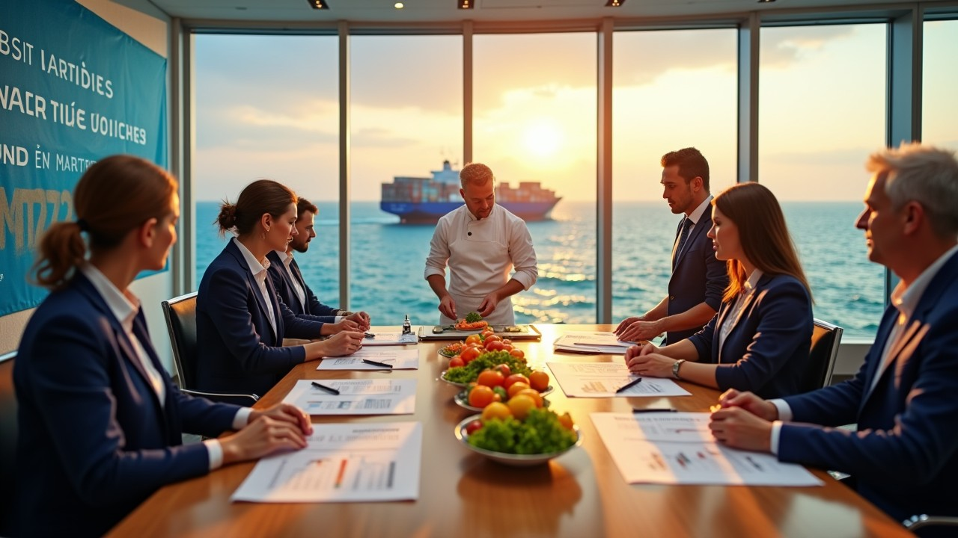
SUSTAINABLE DEVELOPMENT AND
ENTREPRENEURSHIP IN MARITIME SERVICES
Sustainable Development and Entrepreneurship in Maritime Services

