Slide 1
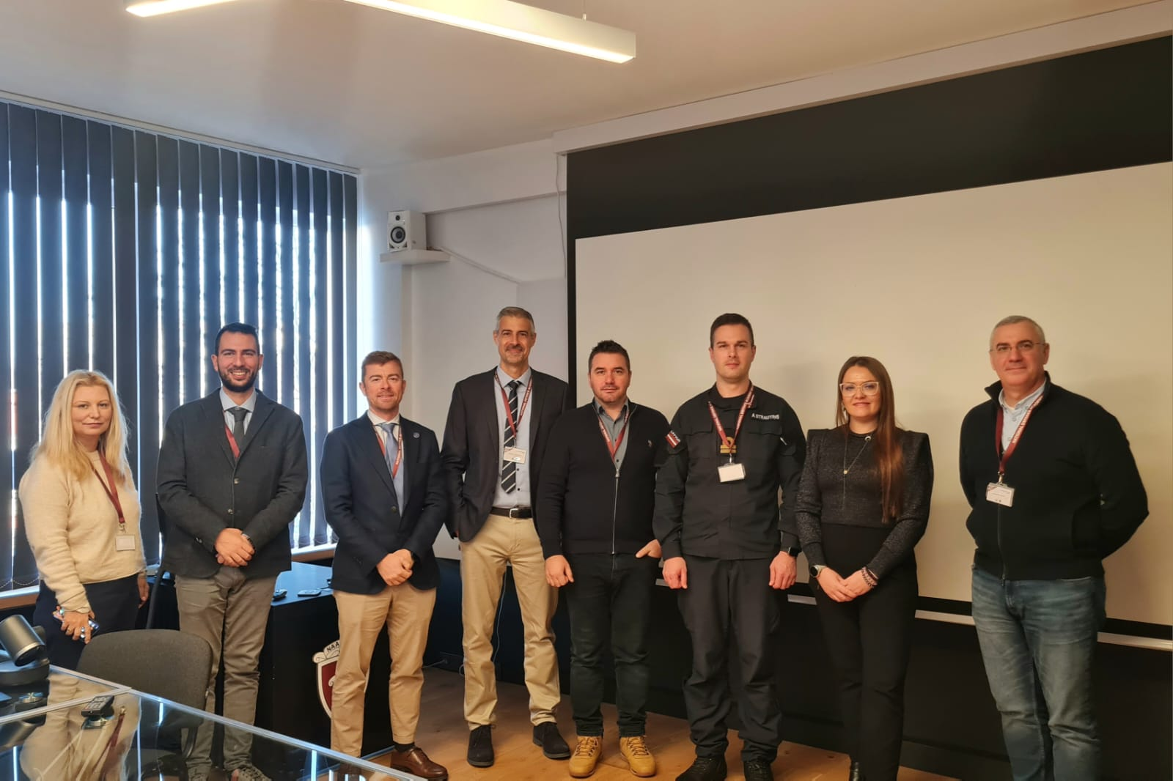
60th IG Meeting, Riga, Latvia
LoD 11 – participant BOEI
10 participants
7 partners institutions
Romanian Naval Academy, Romania (2);
Polish Naval Academy, Poland (1);
“Nikola Vaptsarov” Naval Academy, Bulgaria (1);
Hellenic Naval Academy, Greece (2);
Italian Naval Academy, Italy (2);
Spanish Naval Academy, Spain (1);
National Defence Academy of Latvia, Latvia (1).
Colonel Catalin POPA
Associate Professor, PhD
Chairperson LoD 11

Slide 2
LoD 11 – discussions/topics/debates
The INS project presentation – activities and tasks settings;
The partners presented the upcoming modules for 2023/2024;
The projects results under implementation were disseminated;
The joint Navy online platform had been updated (marplat.eu);
The project NAVY-INS-Tech has officially started and the partners have conducted disscussions on further activities/tasks assignment.

Slide 3
LoD 11 – INS strategic project : NAVY-INS-Tech
PROJECT TITLE: ”International Naval Semester Development Applying the Intelligent Technologies and the Innovative Tools in the European Navy Defence System”
Coordinator: Romanian Naval Academy,
Partners: Polish Naval Academy,
Bulgarian Naval Academy, Italian Naval Academy
Potential Beneficiaries: BOEIs, all services
Approved budget: 250.000 Euro
Period of implementation: 1st of November 2023 – 1st of September 2025

Slide 4
LoD 11 – INS strategic project : NAVY-INS-Tech
Major foreseen results:
1 joint harmonized curriculum;
8 STEM courses learning and teaching materials, using modern and intelligent technologies;
4 HASS courses learning and teaching materials, centered on EU culture and values;
1 e-campus will be implemented (www.marplat.eu) by all interested BOEI;
8 short term students exchanges to be organized: 4 STEM modules x 16 students = 64 students and 4 HASS modules x 8 students= 16 students, total of 80 students exchanged;
3 public events organized in each partner country, with at least 30 attendees/event;
1 International Naval Semester implemented/harmonized learning resources.

Slide 5


WP2/WP3 - Course resources will be harmonized in the project framework – responsible partners:
STEM education (SCIENCES, TECHNICAL, ENGINEERING)
Power Plants – coordinator: Italian Naval Academy (3 ECTS)
Naval Sensors – coordinator: Italian Naval Academy (3 ECTS)
Computer network – coordinator: Polish Naval Academy (2 ECTS)
Naval Cyber Threats – coordinator: Polish Naval Academy (2 ECTS)
Naval Electronics – coordinator: Bulgarian Naval Academy (3 ECTS)
Naval Communication – coordinator: Bulgarian Naval Academy (3 ECTS)
Oceanography – coordinator: Romanian Naval Academy (2 ECTS)
Naval Architecture – coordinator: Romanian Naval Academy (3 ECTS)
HASS education (HUMANITIES, SOCIAL SCIENCES and EU culture)
Naval Leadership – Italian Naval Academy (2 ECTS)
Maritime Security – Bulgarian Naval (2 ECTS)
CSDP – Romanian Naval Academy (2 ECTS)
Military Leadership (physical training) – Polish Naval Academy (2 ECTS)

Slide 6
LoD 11 – INS strategic project : NAVY-INS-Tech
Upcoming events:
TM1 – Kick off meeting – RNA, Constanta, Romania, February 2024 – 3 days, 2 pax/partner, 13th – 15th of February 2024;
E1 Public event: ”SQF-MILOF standards and STEM curriculum priorities in Navy Military Higher Education” – organized by RNA, in Romania – 1 day, 30 participants, 17th of May 2024;

Slide 7
LoD 11 – INS strategic project : NAVY-INS-Tech
COURSES TO BE ORGANIZED IN THE UPCOMING SEMESTER
C1S. STEM harmonized curriculum for digital skills and IT technology abilities – organized by PNA, in Poland - 2 modules to be delivered as BIP:”Computer Networks” (2 ECTS) and ”Maritime Cyber Threats”, online theory, residentially skills (labs, seminars) - 16 students to be instructed (4 students/partner) – 5 days, 15.04-19.04.2024;
C2S. STEM harmonized curriculum for competencies in Hi Tech, Electronics and Telecommunications – organized by NVNA, in Bulgaria - 2 modules to be delivered as BIP: ”Naval Electronics” (3 ECTS) and ”Naval Communications” (3ECTS)- online theory, residentially skills (labs, seminars) - 16 students to be instructed (4 students/partner) – 5 days, 10.06-14.06.2024;
C3S. STEM competencies in Navy Engineering and Intelligent Weapon Systems – organized by INA, in Italy - 2 modules to be delivered as BIP: ”Power Plants” (3 ECTS) and ”Naval Sensors”(3 ECTS) - online theory, residentially skills (labs, seminars) - 16 students to be instructed (4 students/partner) – 5 days, 07.10-11.10.2024;
C4S. STEM competencies in Naval Sciences – organized by RNA, in Romania - 2 modules to be delivered as BIP: ”Oceanography” (2 ECTS) and ”Naval Architecture” (3 ECTS) - online theory, residentially skills (labs, seminars) - 16 students to be instructed (4 students/partner) – 5 days, 11.11-15.11.2024.

Slide 8
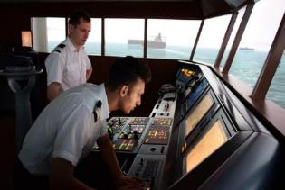
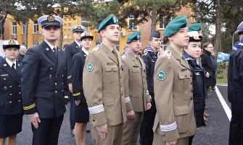
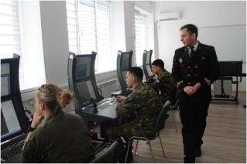
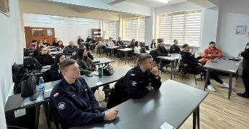
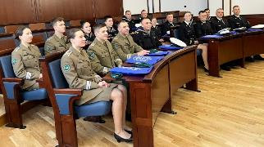
EMILYO Exchanges offer for fall semester 2023-2024:
Romanian Naval Academy – International Naval Semester/extensive Erasmus+ exchanges offer – Spring Semester (08.02.2024-01.06.2024)
Polish Naval Academy – International Naval Semester/extensive Erasmus+ exchanges offer – Spring Semester (08.02.2024-01.06.2024)
Bulgarian Naval Academy – International Naval Semester/extensive
Erasmus+ exchanges offer – Spring Semester (08.02.2024-01.06.2024)

Slide 9
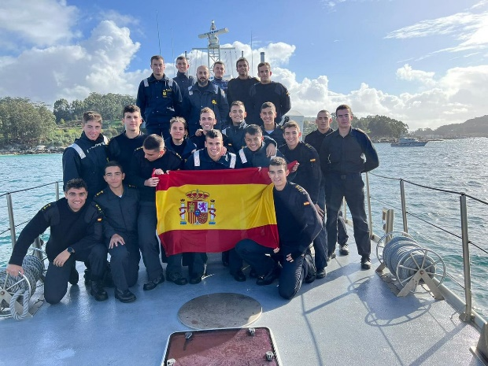
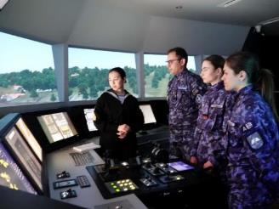
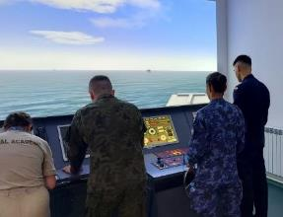
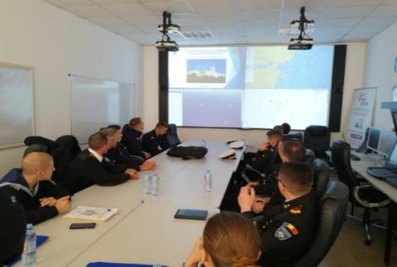
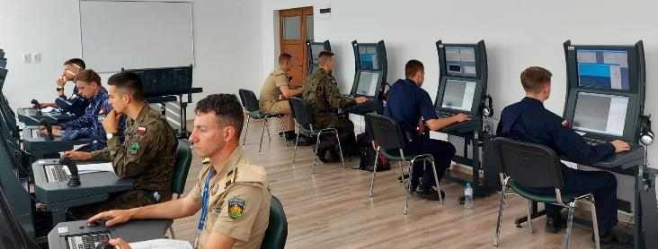
Training modules/events offer for spring semester 2023-2024:
”CSDP module” – SNA (Spain, 18-21 of December 2023);
”Integrated Ship handling/Engine room training on simulator” – RNA (Romania, March-April 2024) - Blended Intensive Program;
”Ship handling and Safety of Navigation” – NVNA (22nd-26th of April);
”Navy Tactics Warefare on Simulator” – RNA (Romania, March-April 2024) - Blended Intensive Program;
”International Training Week” – SNA (Spain, 4th-9th March 2024);
”Seamanship Training Week” – RNA (Romania, July 2024);
”Seamanship Training Week” – NVNA (Bulgaria, June-July 2024);
”Training at sea” – RNA (Romania, July-September 2024).

Slide 10

LoD 11 – Joint projects under implementation
MARS-NET - Maritime Simulators and Training Facilities Network for Enhancing the Exchange of Good Practices and Digital Learning
PARTNERS : Romanian Naval Academy (coordinator) – Bulgarian Naval Academy & Polish Naval Academy - partners (2022-2024, 240.000 Euro) – results up-to-date:
- 10 professional course curriculum have been harmonized: Ship Handling and Manoeuvring, Cargo handling, Navigational Watchkeeping, Engine Room Watchkeeping, Radar Navigation, Maritime Search and Rescue, Coastal Navigation, Naval Machines and Equipment, Naval Communications, Celestial Navigation;
- 5 professional courses using the simulators have been developed, covered with video tutorials: Ship Handling and Manoeuvring, Navigational Watchkeeping, Radar Navigation, Engine Room Watchkeeping, Cargo handling (5 BIMs-blended intensive modules will be organized in the fall semester on the project portal www.marplat.eu = 5 BIMs x 50 students 250 students to be instructed);
- 3 courses for teachers using the simulating facilities had been conducted – 45 teachers had been instructed;
- 2 courses (short modules) for students have been conducted – 30 students had been instructed.

Slide 11

SEA MENTORS – SEAfarers Experiential Knowledge Based MENTORS PARTNERS : Romanian Naval Academy (coordinator) – Bulgarian Naval Academy & Polish Naval Academy - partners (2022-2024, 200.000 Euro) – results up-to-date:
- online joint platform for students counselling and mentoring for smoothing the Naval carrier path (www.seamentors.eu) containing: a joint carrier councelling center, a sharing point of cadetship experiences, mentors interviews, mentorship materials – the partners are recording now the video testimonial to be uploaded in the project ”library of experiences”;
- research/survey is conducted to disclose the role of mentoring programs for Navy graduates: a complex survey has been applied to the cadets, professionals and potential mentors;
- increase the awareness of seafaring cadets regarding the onboard experiences o military/civilian ships – 8 online and 4 residential meetings with professional mentors will be organized by the partners in the fall semester;
- In the project conclusion the partners will build a bridge between the cadets and the mentors to smooth the cadets’ insertion onboard military and civilian ships – build a mentoring network identifying the potential mentors in different areas.

Slide 12

QUESTIONS?
?
Thank you!

