Slide 1


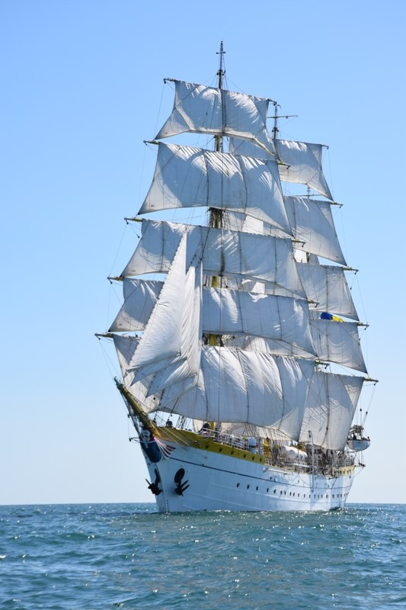


European Initiative
for the exchange of young officers inspired by Erasmus
LoD 11 Session International Naval Semester
57th IG Meeting, Sofia, Bulgaria
The Initiative
Erasmus
Militaire
Military
Erasmus
Colonel Catalin POPA
Associate Professor, PhD
Chairperson LoD 11
EMILYO

Slide 2
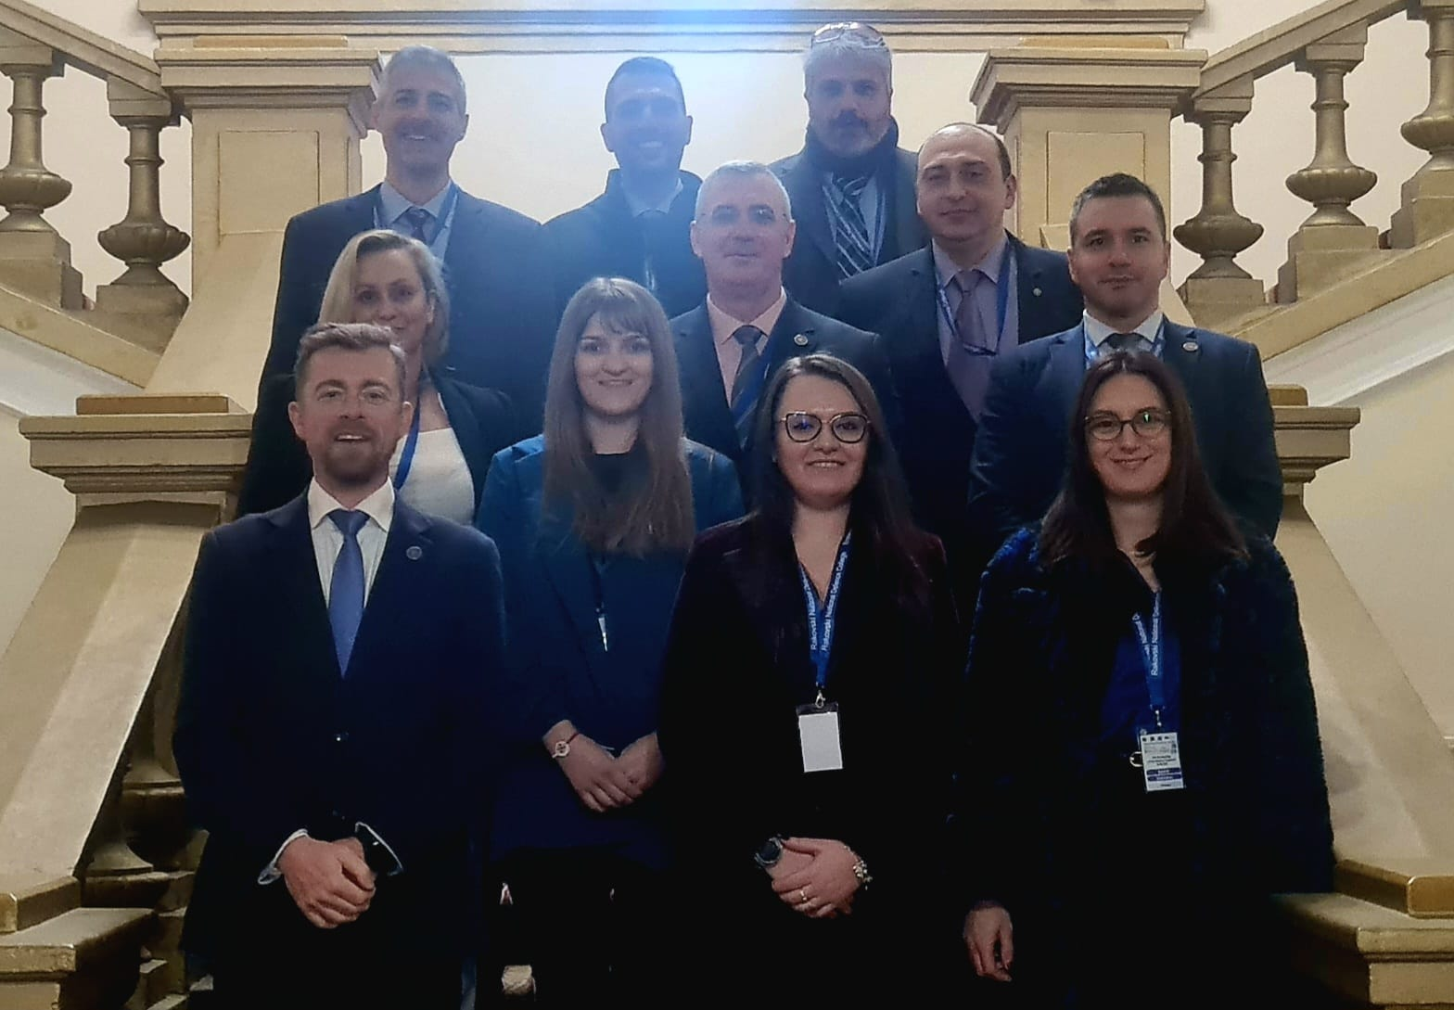
INTERNATIONAL NAVAL SEMESTER
LoD 11 – participant BOEI: 11 participants, 6 partner institutions
Polish Naval Academy “Heroes of Westerplatte”, Poland;
Romanian Naval Academy “Mircea cel Batran”, Romania;
“Nikola Vaptsarov” Naval Academy, Bulgaria;
Hellenic Naval Academy, Greece;
Italian Naval Academy, Italy;
Spanish Naval Academy, Spain.

Slide 3
INTERNATIONAL NAVAL SEMESTER
LoD 11 – discussions on agreed agenda topics:
The joint syllabuses have been approved (12 courses);
The joint educational platform had been set up (marplat.eu);
The planned joint activities for 2023 have been disseminated among the partners for the spring semester;
The projects under implementation have been disseminated;
The project initiative for INS has been presented by the potential applicant, Romanian Naval Academy.

Slide 4
INTERNATIONAL NAVAL SEMESTER – Joint modules/events
Training modules/events offer for spring semester 2022-2023:
Training modules - updates
Navy Warfare Tactics Module – RNA (Romania, 8-12 of May 2023)
Navy Warfare Tactics Module – NVNA (Bulgaria, 24-28 of April 2023)
Navigation/ Engine Room Simulation Module – RNA (Romania, 23-27 of October 2023) – it will be organized as Blended Intensive Program
Ship Handling Module – NVNA (Bulgaria, July 2023)
Seamanship Training Stages – RNA (Romania 26 of June - 02 of July 2023)
Maritime Security – HNA (Greece, 27-31 of March 2023)
Onboard Navy Cadetship Practice – RNA (Romania, onboard Mircea Tall Ship, 03-30 of July 2023)
International Training Week – SNA (Spain, 6-12 of March and November 2023)

Slide 5

INTERNATIONAL NAVAL SEMESTER – Course package
Course assignment/syllabuses approval:
Naval Leadership – Polish Naval Academy (Hellenic Naval Academy)
Power Plants – Italian Naval Academy (Romanian Naval Academy)
Computer network – Polish Naval Academy (Romanian Naval Academy)
Naval Electronics – Hellenic Naval Academy (Italian Naval Academy)
Naval Sensors – INA Italian Naval Academy (Hellenic Naval Academy)
Maritime Security – Bulgarian Naval Academy (Polish Naval Academy)
Naval Cyber Threats – Bulgarian Naval Academy (Italian Naval Academy)
Oceanography – Romanian Naval Academy
Naval Architecture – Romanian Naval Academy
Naval Communication – Hellenic Naval Academy/ Romanian Naval Academy
CSDP – Hellenic Naval Academy – common module
Military Leadership (physical training) – common module
Deadlines (updated!):
22nd of March 2023 – project submission for INS
September 2023 – course content development (depending on INS result);
November 2023 – submit the final modules offer for each partner (depending on INS result).

Slide 6
INTERNATIONAL NAVAL SEMESTER – Strategic projects
LoD 11 – Joint projects for INS to be applied by 23rd of March
1. LoD 11 – Joint projects are to be prepared (RNA guidance):
KA203 Common Curriculum Harmonization for Navy Education – curriculum framework development (March 2023) – RNA, NVNA, PNA, INA – the project application has been revised and approved (WP, activities, LLT, events, budget).
KA203 - Integrated Training Programs Network for EU Naval Academies (March 2024) – RNA, NVNA, PNA, INA – the project application has been revised and approved (WP, activities, LLT, events, budget).

Slide 7

INTERNATIONAL NAVAL SEMESTER – Strategic projects
LoD 11 – Navy joint projects under implementation:
1. MARS-NET - Maritime Simulators and Training Facilities Network for Enhancing the Exchange of Good Practices and Digital Learning – Romanian Naval Academy as coordinator – Bulgarian Naval Academy and Polish Naval Academy as partners (2022-2024) – results up-to-date:
- 10 course curriculum have been harmonized: Ship Handling and Manoeuvring, Cargo handling, Navigational Watchkeeping, Engine Room Watchkeeping, Radar Navigation, Maritime Search and Rescue, Coastal Navigation, Naval Machines and Equipment, Naval Communications, Celestial Navigation;
- 5 courses using the simulators are harmonized: Ship Handling and Manoeuvring, Navigational Watchkeeping, Radar Navigation, Engine Room Watchkeeping, Cargo handling;
- 3 courses for teachers using the simulating facilities had been conducted – 45 teachers had been instructed;
- 2 courses (short modules) for students had been conducted – 40 students had been instructed.

Slide 8

INTERNATIONAL NAVAL SEMESTER – Strategic projects
LoD 11 – Joint projects under implementation:
2. SEA MENTORS – SEAfarers Experiential Knowledge Based MENTORS – Romanian Naval Academy as coordinator – Bulgarian Naval Academy and Polish Naval Academy partners (2022-2024) – results up-to-date:
- building an online joint platform for students counselling and mentoring in carrier path (www.seamentors.com) containing: the carrier joint councelling center, the sharing point of cadetship experiences, mentors interviews, mentorship materials;
- increase the awareness of seafaring cadets regarding the onboard experiences o military/civilian ships – online and residential meetings with professional mentors will be organized by the partners;
- conduct the connection between the cadets and the mentors to smooth the cadets’ insertion onboard military and civilian ships – build a mentoring network identifying the potential mentors in different areas;

Slide 9
INTERNATIONAL NAVAL SEMESTER
Roadmap updates – way to go:
By 23rd of March 2023 – INS projects proposal preparation and submission (under the Romanian Naval Academy coordination)
By December 2023 – drafting the course content and approving the modules organization in the academic plan for 2023-2024/partners, depending on the INS project submission status.

Slide 10

INTERNATIONAL NAVAL SEMESTER
QUESTIONS?
Thank you!

