Slide 1


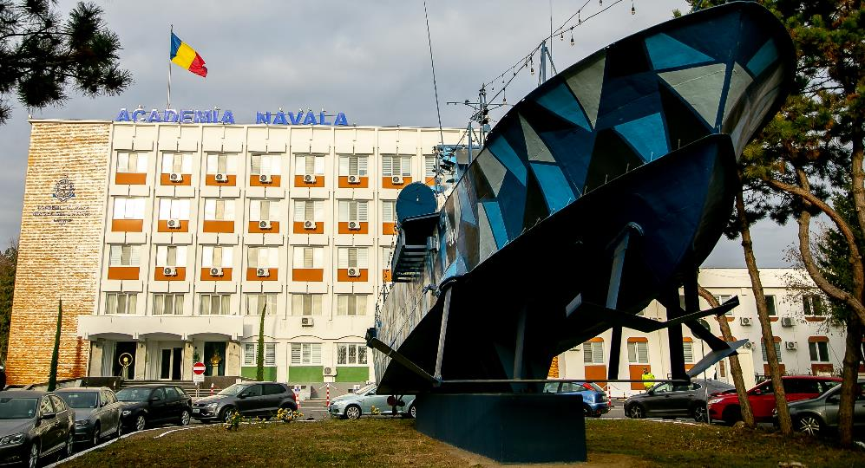

ROMANIAN NAVAL ACADEMY
International Naval Semester 2023-2024
12 weeks (02.10-24.12.2023)

Slide 2


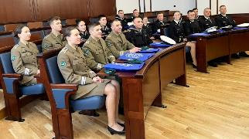
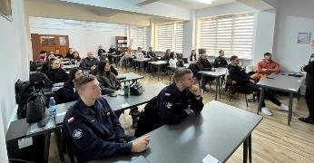
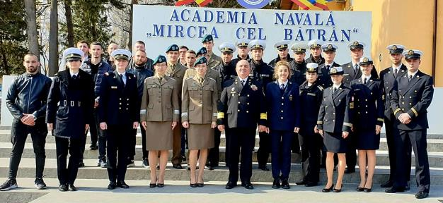
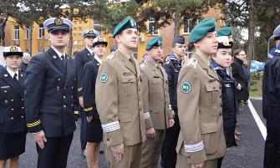
ROMANIAN NAVAL ACADEMY
International Naval Semester 2023-2024
4 Study Programs in Navy Engineering
1
Navigation and Naval Equipment
2
Electromechanics/Electric Engineering
3
Navy Logistics/General Logistics
4
INS common modules – only spring semester
https://www.anmb.ro/eng/files/erasmus/incoming_students.html

Slide 3
ROMANIAN NAVAL ACADEMY
International Naval Semester 2023-2024
Why our offer would suit your students?
1
Flexible Erasmus curriculum covering both engineering and fundamental sciences - more than 80 English taught courses
2
Subjects from Naval sciences to the Mechanical/Electrical Engineering, but also addressed to support services curriculum as LOGISTICS!
3
Our facilities have been newly updated covering the latest technologies in engineering with modern laboratory equipment/simulators!
4
The life conditions are up to the latest standards!
5
Romania is a beautiful country and the students will be able to travel!

Slide 4
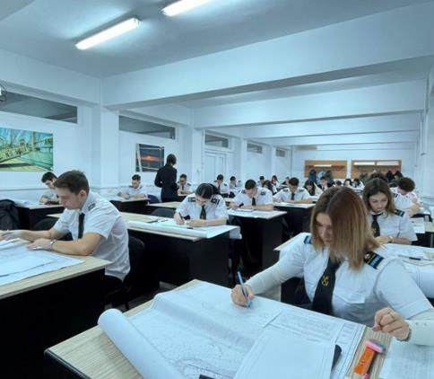
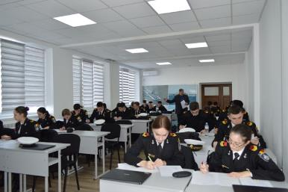
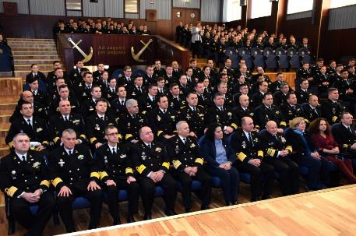
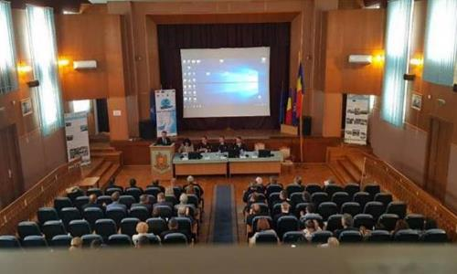


ROMANIAN NAVAL ACADEMY
International Naval Semester 2023-2024
10 auditoriums / more than 70 classrooms and study rooms.

Slide 5
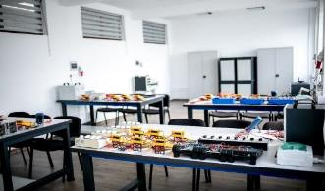
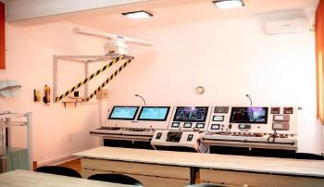
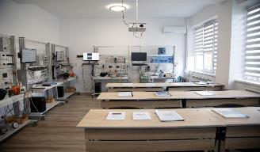
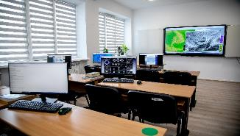

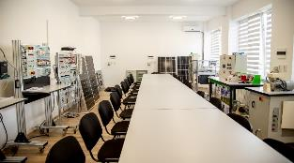
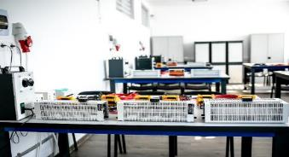
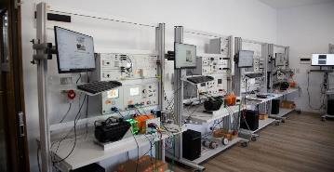
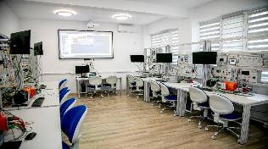
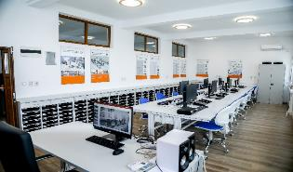
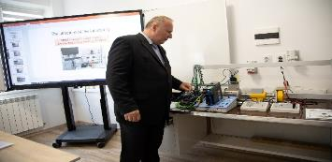

ROMANIAN NAVAL ACADEMY
International Naval Semester 2023-2024
8 Simulators and 41 laboratories with modern updated equipments and facilities (i.e. Proteus ASTT Tactical Simulator, Cargo Handling & Mechanical Engineering Simulators, GMDSS, Hidro-Meteo, Planetarium, Hi Voltage, Reefer Simulator, PISCES, Logistics Laboratory)

Slide 6
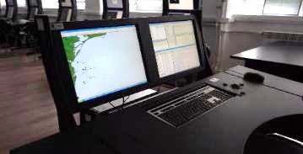
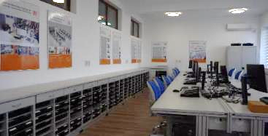
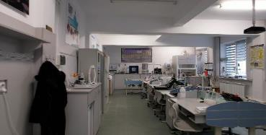

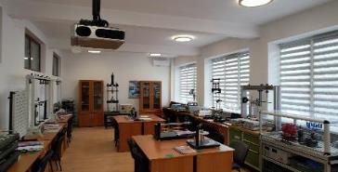
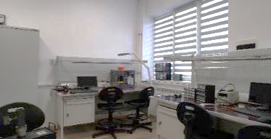

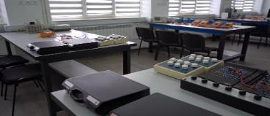
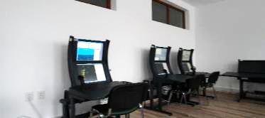
ROMANIAN NAVAL ACADEMY
International Naval Semester 2023-2024
Cobined updated research infrastructure

Slide 7
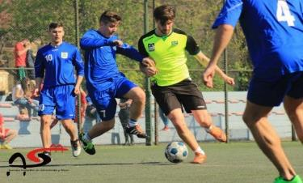
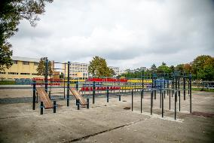
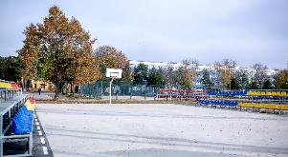
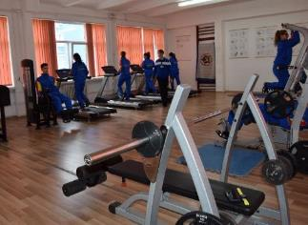
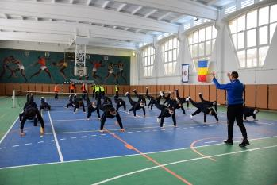
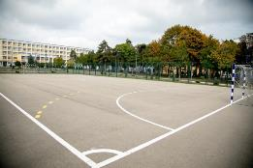
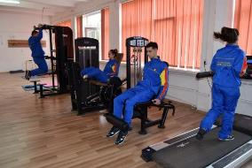
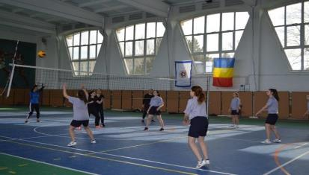
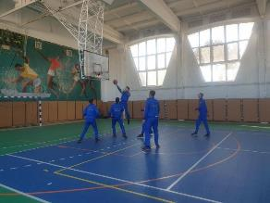
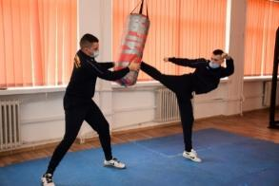
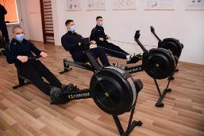
ROMANIAN NAVAL ACADEMY
International Naval Semester 2023-2024
Modern sports facilities (athletics stadium, 5 multifunctional indoor facilities, 18 outdoor sports fields, 4 firing ranges, etc.)

Slide 8
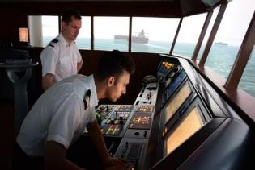

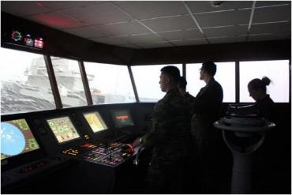
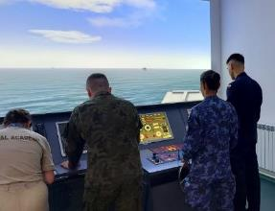

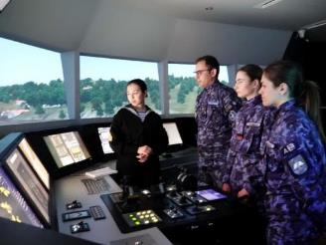
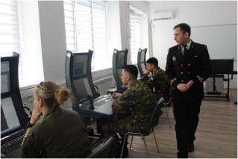
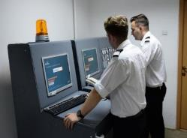
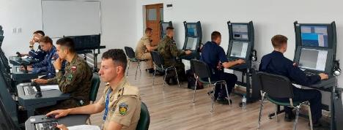
ROMANIAN NAVAL ACADEMY
International Naval Semester 2023-2024
Integrated Simulator NTPRO 5000 & TECHSIM 5000 (Bridge & Engine Rooms Simulator) PROTEUS ASTT Tactical Simulator

Slide 9
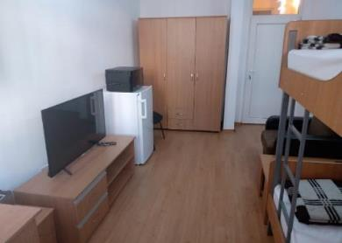
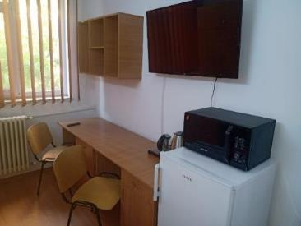
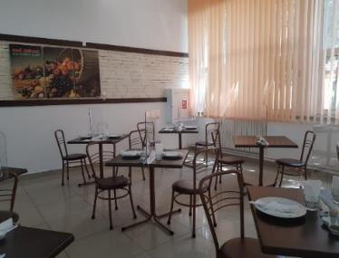
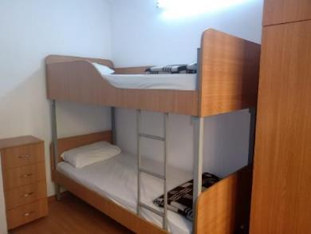
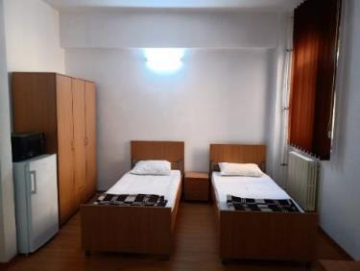
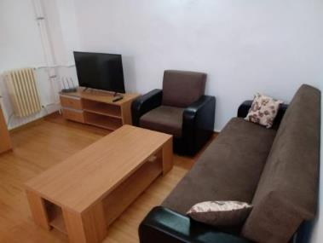
ROMANIAN NAVAL ACADEMY
International Naval Semester 2023-2024
ACADEMIC SUPPORT AND STUDENTS’ SERVICE

Slide 10


ROMANIAN NAVAL ACADEMY
International Naval Semester 2023-2024
TRAINING MODULES

Slide 11







ROMANIAN NAVAL ACADEMY
International Naval Semester 2023-2024
SEAMANSHIP TRAINING MODULE
24th June – 30th of June 2023
basic training...adressed to all services!!!

Slide 12

ROMANIAN NAVAL ACADEMY
International Naval Semester 2023-2024
NS ”MIRCEA” TRAINING PROGRAM AT SEA
3rd July-31st of July 2023
Port of calling | ARRIVAL / BERTHING / DEPARTURE
Constanţa (Romania) | ETD: 03.07.2023/11:00
Piraeus (Greece) | ETA: 07.07.2023/09:00 Berthing: 4 days ETD: 11.07.2023/10:00
Taranto (Italy) | ETA: 15.07.2023/09:00 Berthing: 4 days ETD: 19.07.2023/10:00
Izmir (Türkiye) | ETA: 24.07.2023/09:00 Berthing: 3 days ETD: 27.07.2023/10:00
Constanţa (Romania) | ETA: 31.07.2023/11:00
Voyage period: 03.07.2023 - 31.07.2023
Total voyage duration: 28 days
→ at sea: 17 days; berthing: 11 days;
Total distance: 2190 Mm

Slide 13













Training onboard Mircea Tall Ship
MIRCEA Tall Ship

Slide 14







ROMANIAN NAVAL ACADEMY
International Naval Semester 2023-2024
WONDERFUL PLACES TO VISIT IN ROMANIA
Over 190 Castles
Over 420 Monasteries
Transfagarasan
Best Road in the World
Danube Delta
Happy Cemetery

Slide 15


ROMANIAN NAVAL ACADEMY
International Naval Semester 2023-2024
WE ARE LOOKING FORWARD TO WELCOME YOUR STUDENTS
Contact details
www.anmb.ro/eng
Address: Fulgerului Street, no. 1, 900218
Constanta, Romania
Tel: 0241-653000 / 225
E-mail: international@anmb.ro

