Slide 1
INTRODUCTION
TO
ENGINEE ROOM SIMULATOR
(ERS)

Slide 2
AIM
SIMULATION OF OPERATIONS AND MAINTAINENANCE OF THE SHIP SYSTEMS AND MACHINES ECONOMICALLY, CONTINUOSLY, EFFICIENTLY, SAFELY, SECURELY AND ENVIRONMENT FRIENDLY
UNDER THE LIGTH OF KNOWLEDGE AND EXPERIENCE

Slide 3
OBJECTIVES
Be familiar with the use of instruments and parameters,
Develop proper pre-planning and the use of start up check list,
Develope awareness of correct watch keeping procedures,
Understand the interdependency of various Machinery,
Obtain experience in identifying operational problems,
Improve decision-making ability for efficient plant operation.
Make effective contribution to machinery installation.
Make analyzes and definitions to make correct decisions.

Slide 4
ASSESMENT CRITERIA
Knowing ship systems and machines
Familiarization on command and control elements
Understanding data signalization
Understanding system and machine relations
Familiarity in chain-events algorithm
Effective monitoring of operating values
Behaviour in emergencies

Slide 5
ASSESMENT
COMMON SKILLS
Self-management and improvement
Using the human, machine, automation relationship
Establishing team-work
Managing tasks and solving problems
Using references for details
Implementing the procedures
Generating creative ideas and designs

Slide 6
REFERENCES
STCW-Chapter VIII section A-VIII2, part 3-Watchkeeping at sea
Marine Engine Watchkeeping-STCW-IMO
IMO-Model Course-7.04-Officer in Charge of an Engineering Watch
STCW-Seafarers’ Training, Certification and Watchkeeping
TechSim_5000_ENG_Instructor_Manual(8.6)
TRANSAS-ERS 5000 Simultor.

Slide 7
INTRODUCTION TO SIMULATOR TRAINING
SIMULATOR TRANSAS ERS5000
Detached engine control room simulator in CLASSROOM Layout A 2-Screen-PCs were provided for each Training-Station/Desk which represents Engine Control Room automation system.

Slide 8
SIMULATOR SCENARIO
STARTING CONDITIONS
The ship
Type : Prduct Tanker
Max. continous power : 8 600 kW at 127 RPM
Length : 183 meters
Breadth : 32.2 meters
Dead Weight : 50 000 t
Max Speed : 15.7 knots
The main propulsion power engine
Type : MAN B&W model 6S50 MC-C: 2-stroke, single acting, direct reversible, cross-head type marine diesel engine with constant pressure turbo-Charging.
Number of cylinders : 6
Cylinder bore : 500 mm
Length of stroke : 2 000 mm
Nominal MCR : 8 600 kW at 127 RPM

Slide 9
SIMULATOR SCENARIO
STARTING CONDITIONS
Second Engineer is on Engine Room Watch (12:00-16:00)
Ship is on cruise speed.
Shaft-Generator is in progress
All systems are in Full-Sea condition
No system alarm exists

Slide 10
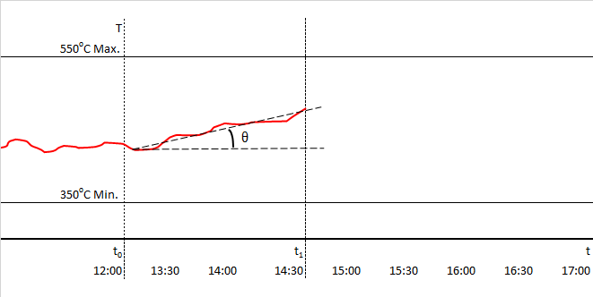
SCENARIO – Stage 1
Second Engineer takes over the engine room watch at t₀ and observes on the real time graphics on the automation screen that the main diesel engine exhaust temperature is operating between 450-500ºC with an increasing slope θ, which is in the safe operating limits.

Slide 11
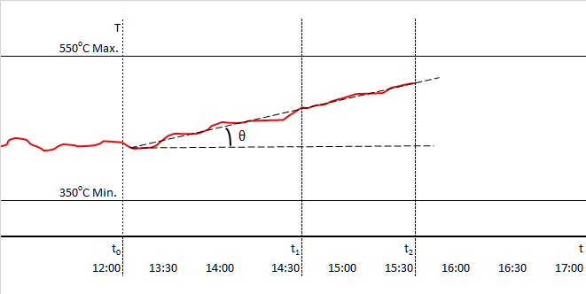
SCENARIO – Stage 2
The OOW continues to monitor, making sure that the exhaust gas temperature continues to rise during t₁ and t₂ .

Slide 12
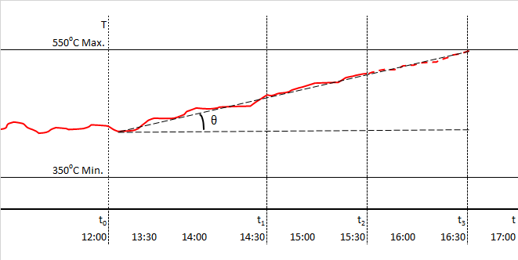
SCENARIO – Stage 3
OOW extends the seaman eye line until it cross the maximum temperature level at t₃ and understands that it takes 60 minutes and aware that the controller will automatically reduce the main engine speed.

Slide 13
SCENARIO – Stage 4
The OOW informs the Chief Engineer of the situation while trying to define the reasons that may effect on exhaust gas temperature increase.
OOW knows that it is caused by the oxidation of the injected fuel in the cylinder, and the deterioration in the fuel-air mixture ratio for any reason causes lean or rich combustion, which in turn causes an increase in the exhaust gas temperature. Therefore, OOW decides to examine the combustion process data of all cylinders to determine whether the fault is on the air or fuel side.

Slide 14
SCENARIO – Stage 5
The OOW informs the Chief Engineer of the situation while trying to define the reasons that may effect on exhaust gas temperature increase.
OOW knows that it is caused by the oxidation of the injected fuel in the cylinder, and the deterioration in the fuel-air mixture ratio for any reason causes lean or rich combustion, which in turn causes an increase in the exhaust gas temperature. Therefore, OOW decides to examine the combustion process data of all cylinders to determine whether the fault is on the air or fuel side.
The OOW checks the high temperature (HT) side of the jacket water cooling system and sees that the temperature is within normal limits.
NOTE: It was assumed in this scenario that, the jacket water temperature was set and operating correctly.

Slide 15
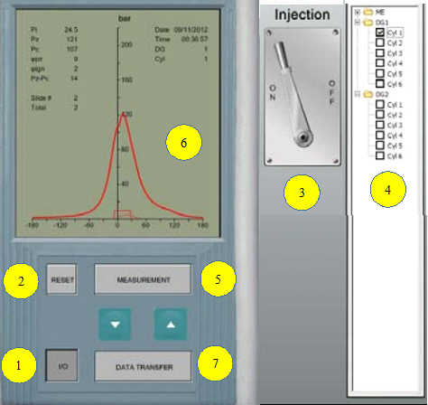
SCENARIO – Stage 6
OOW records the cylinder combustion data (Table.1) and transfers it to the interpretation graphs by using the cylinder analysis panel to interpret the exhaust gas temperature increase that will result from rich or lean combustion caused by the deterioration in the air-fuel mixture ratio.

Slide 16
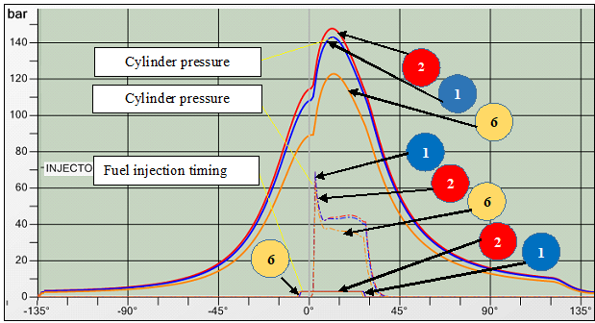
SCENARIO – Stage 7
OOW selects comparison screen from the menu in order to determine the differences on pressure, injection and torque curves, determined from the data measured and transferred, effected from rich or lean combustion caused by the deterioration in the air-fuel mixture ratio.

Slide 17
SCENARIO – Stage 8
OOW sees on the graphics that no-2 cylinder pressure is higher than no-1 cylinder, while no-6 cylinder is much lower. He/she also sees on the graphics that no-2 cylinder torque and injection timing is almost same with no-1 cylinder while no-6 cylinder torque is less and fuel injection timing is Early.

Slide 18
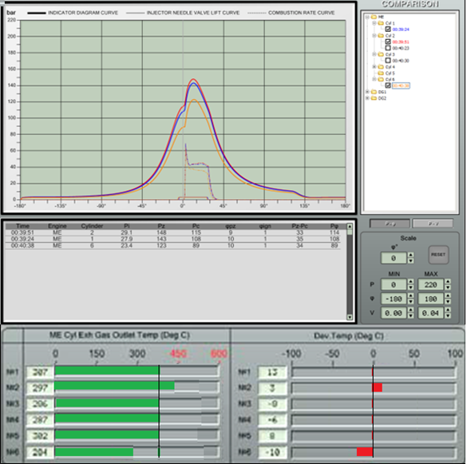
SCENARIO – Stage 9
The OOW compares the deviation in cylinders exhaust gas temperatures. He/she decides that there is no problem on the intake air side as no abnormality is observed in the values of the other cylinders except the 2nd and 6th cylinders. So, OOW makes the decision that the exhaust gas temperature increase was directly related with the rich combustion in cylinder-2 while lean combustion in cylinder-6 compared to the average combustion rate of the diesel.

Slide 19
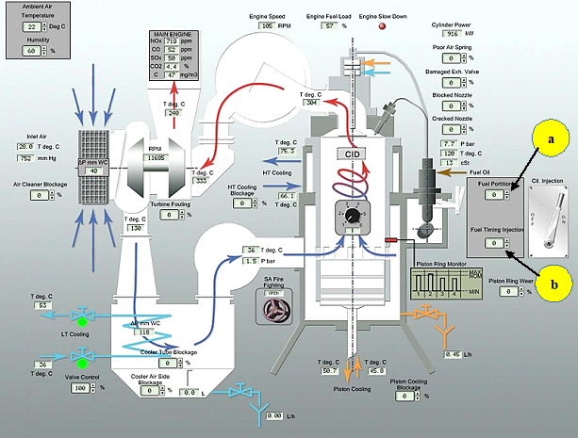
SCENARIO – Stage 10
OOW calls the engine performance screen to correct the amount of fuel injected into cylinder-2 and the amount and duration of fuel injected into cylinder-6. Using the command and control elements on the engine performance panel, OOW adjusts the 2nd and 6th cylinders fuel quantity (m) and injection duration (t) until matching the engine average values.

Slide 20
SCENARIO – Stage 11
OOW is aware of that, there is maximum one hour to apply the adjustments for cylinders 2 and 6 by using the command elements “a” and “b” shown on the engine performance panel

Slide 21
SCENARIO – Stage 12
However, adjustment capability of the command element “a” is limited with ± 10% while the command element “b” is limited with ± 5%. If it is not possible to make adjustments due to limited capability of command elements, then OOW must be fast enough to make decision for further corrective actions

Slide 22
SCENARIO – Stage 13
For instance; if amount of fuel, injected in cylinder-2, cannot be decreased by using command element “a”, it means that injector nozzles are leaking which needs replacement of the tip. On the other hand, if the fuel injection duration is not further adjusted due to 5% limitation in command element “b”, it means that timing electronic card or solenoid valve need to be rectified and the injector needs to be cleaned due to clogging.

Slide 23
SCENARIO – Stage 14
In this case, OOW is responsible for performing the necessary repair and/or maintenance. In order to stop or at least slow down the main engine, he informs the chief engineer of the situation without delay. Necessary maintenance/repair is done according to the decision of the ship management.

