Slide 1
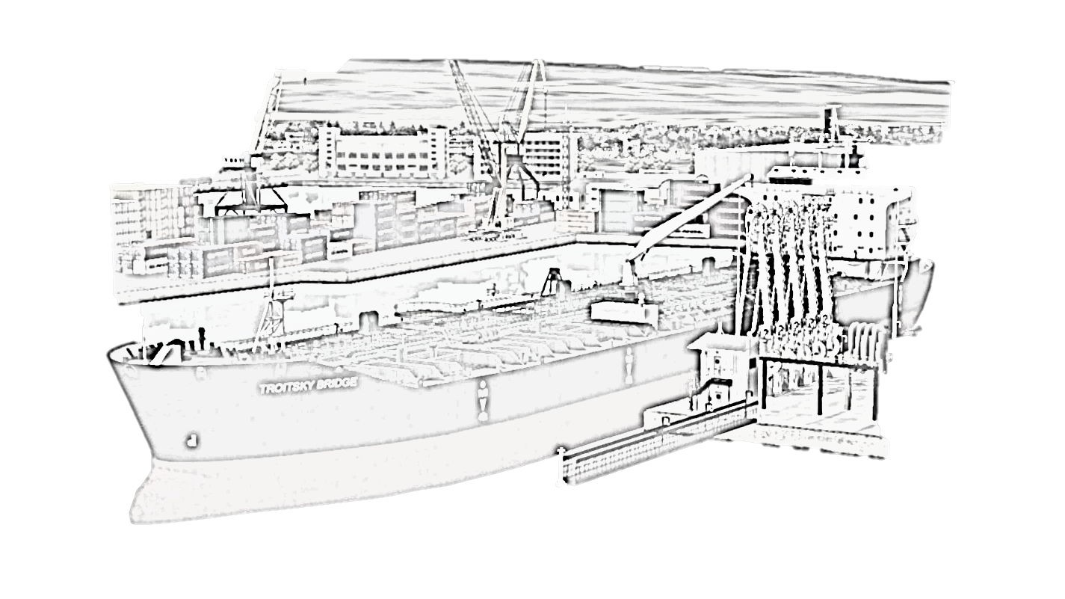
PREPARING TO LOAD SINGLE CARGO
2023

Slide 2
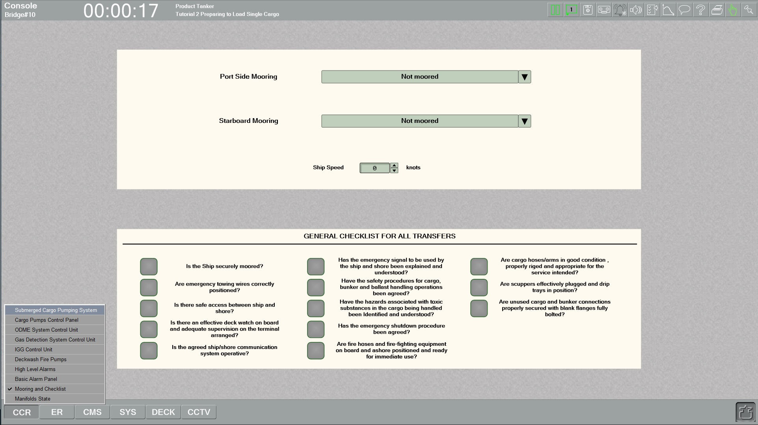
We are preparing to load cargo of Kerosene. All cargo tanks and slop tanks are inerted. Please go to the "CCR - Mooring and Checklist" and make sure the ship is moored port side, in position and ready to receive terminal personnel.

Slide 3
Specify mooring position „port side“ to the terminal pier.

Slide 4
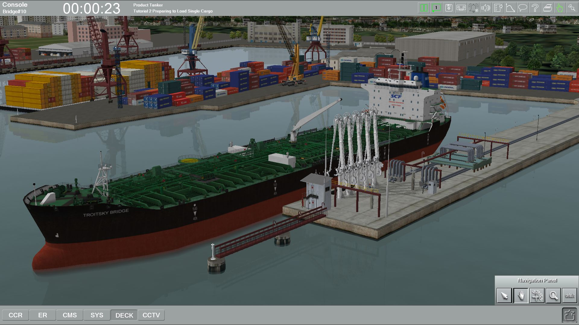
Make sure the ship is moored port side, in position and ready to receive terminal personnel.

Slide 5
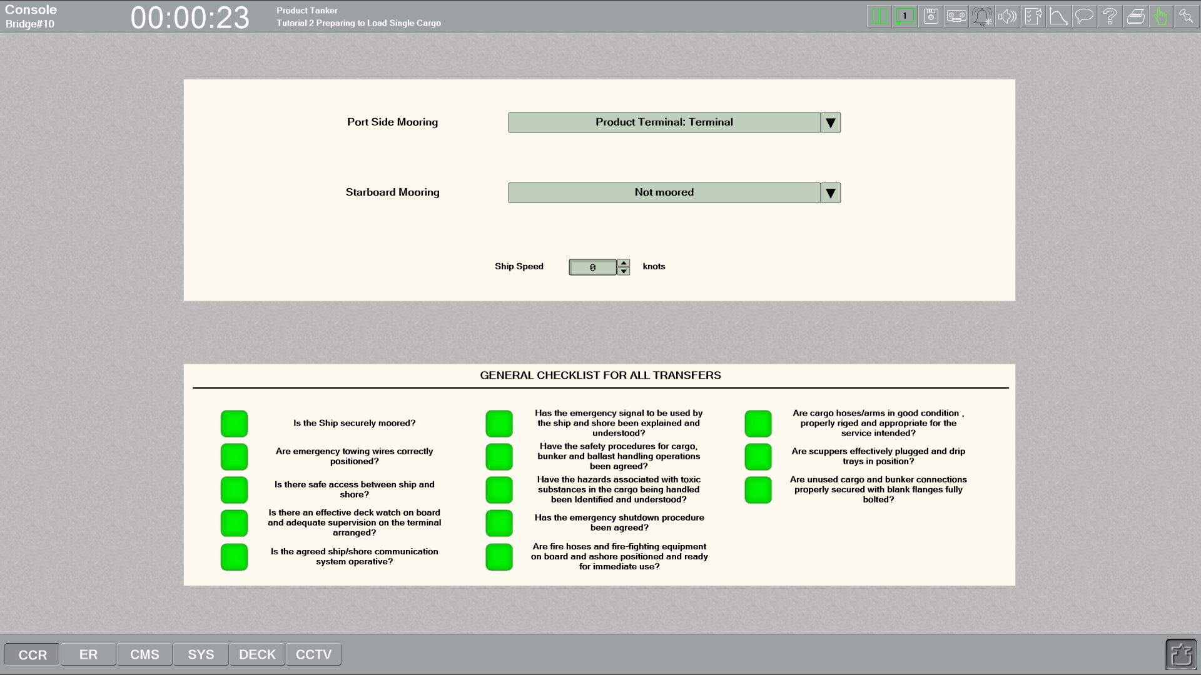
Fill in the Pre-Transfer Checklist with the Terminal Staff

Slide 6
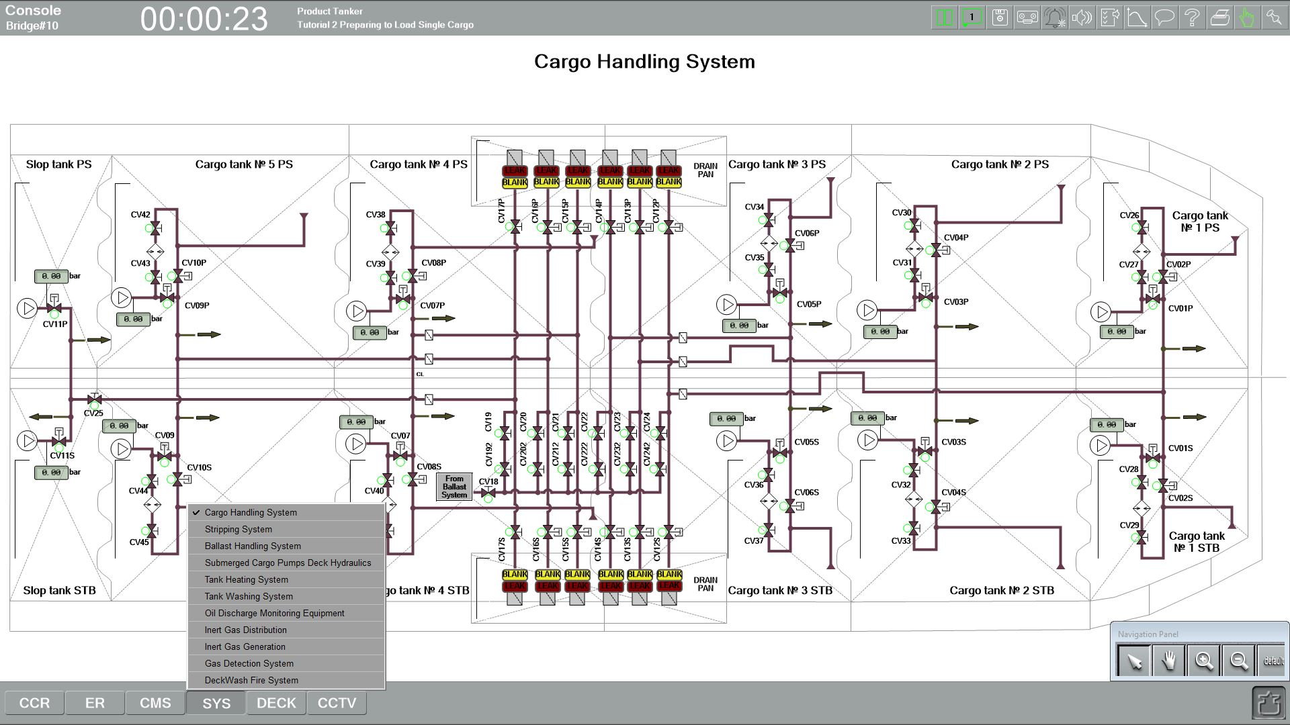
The Terminal has indicated that the checklist is complete.
On "SYS - Cargo Handling System" page and remove the blanks from manifolds #3 and #4 portside.

Slide 7
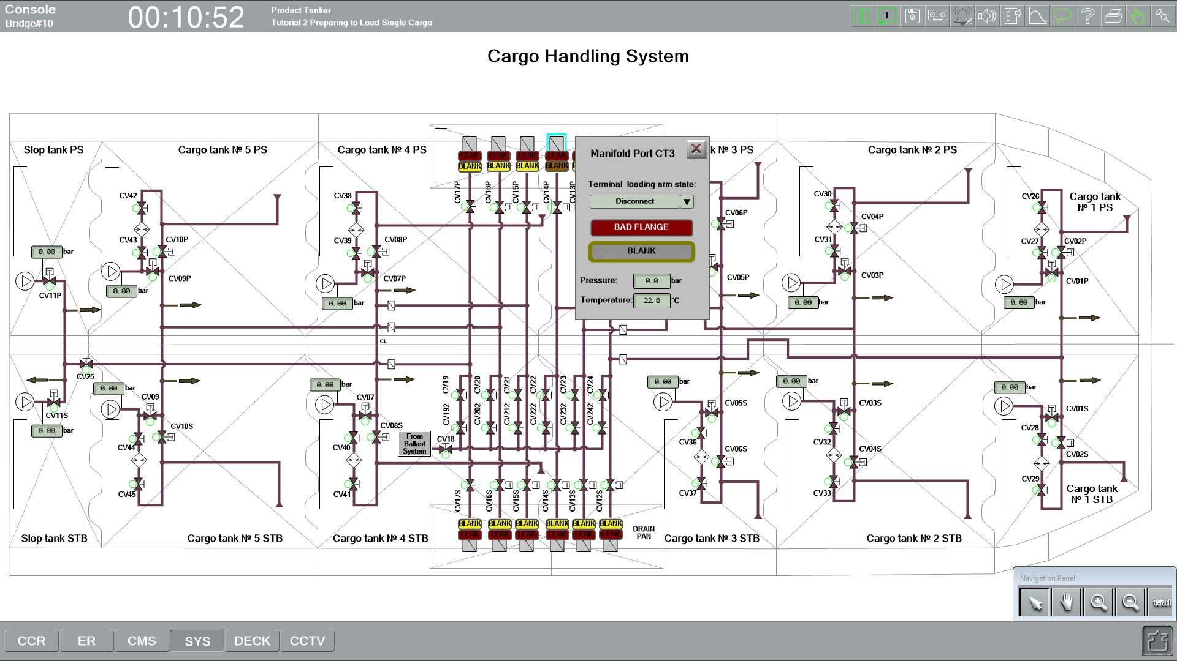
1
2
3
Click at the manifold CT3 to bring up the popup window, and in that window press yellow button "BLANK" and it will turn grey.

Slide 8
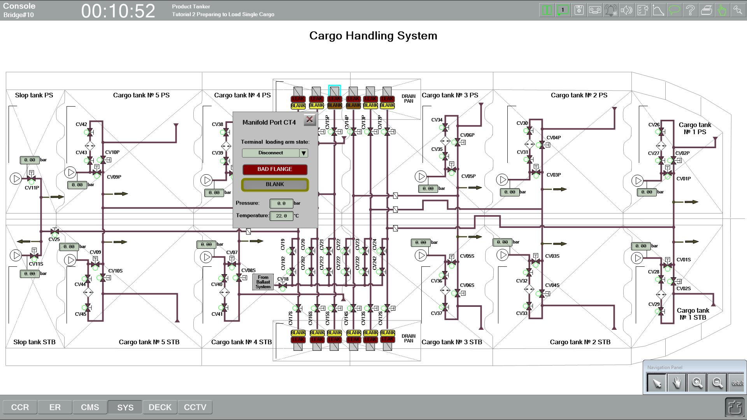
Click at the manifold CT4 and repeat

Slide 9
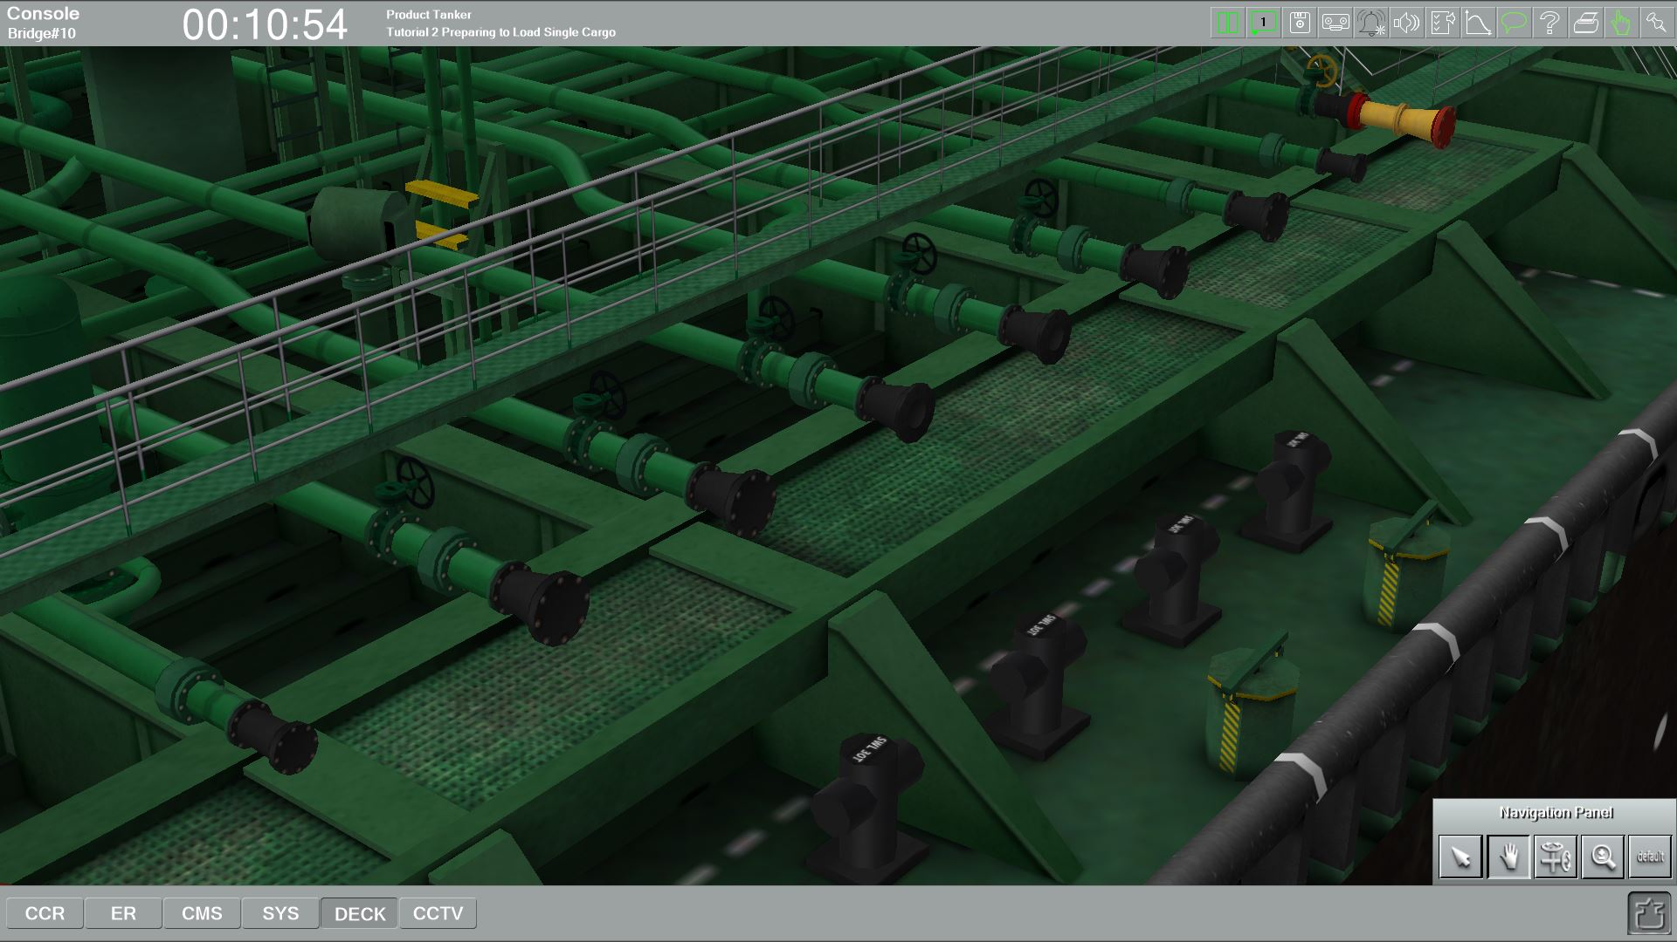
Check the condition of manifolds #3 and #4 portside – are the blanks off

Slide 10
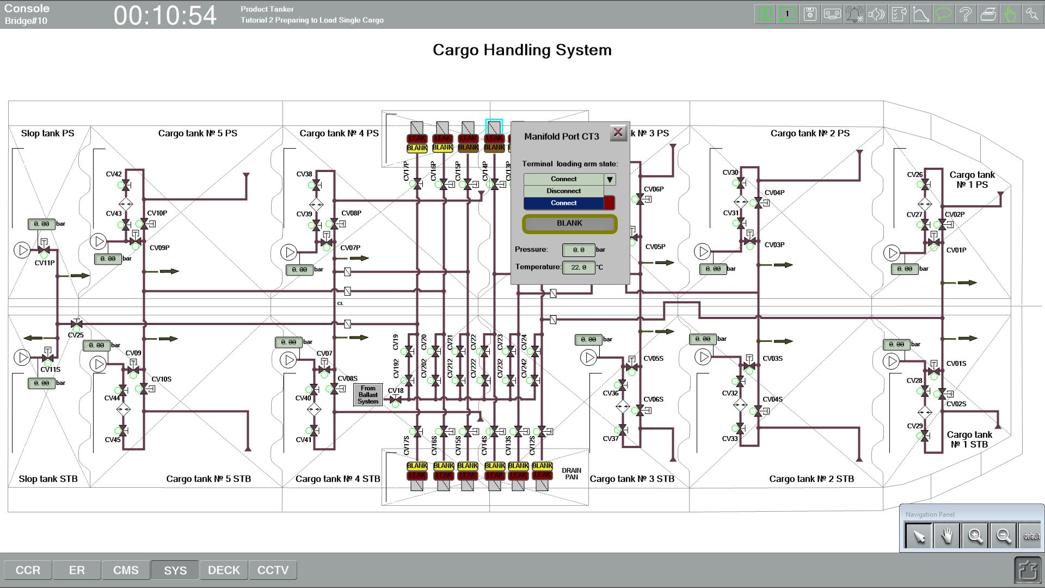
On "SYS - Cargo Handling System" page select manifolds CT3, CT4 and change status to „Connect“.

Slide 11
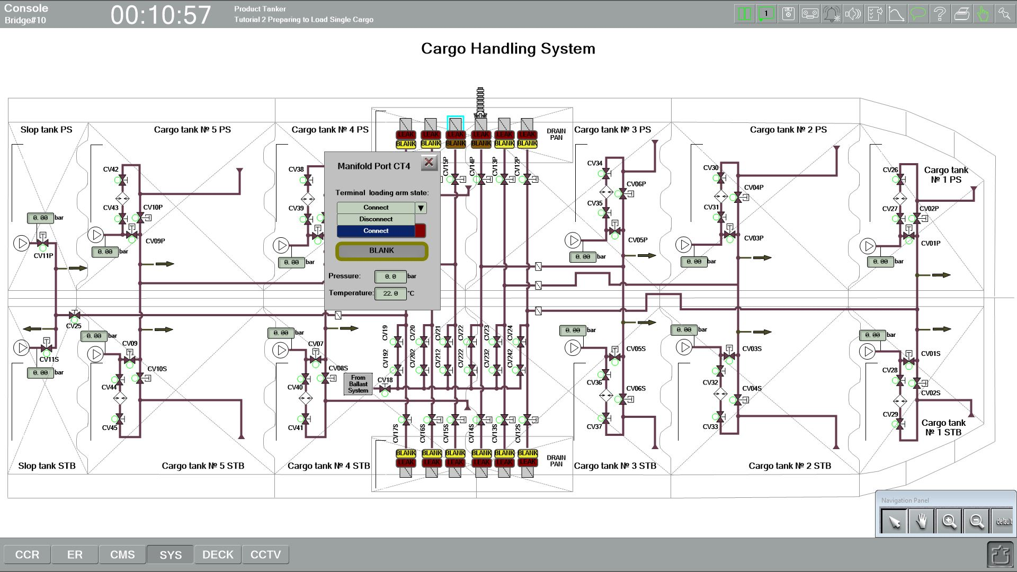

Slide 12
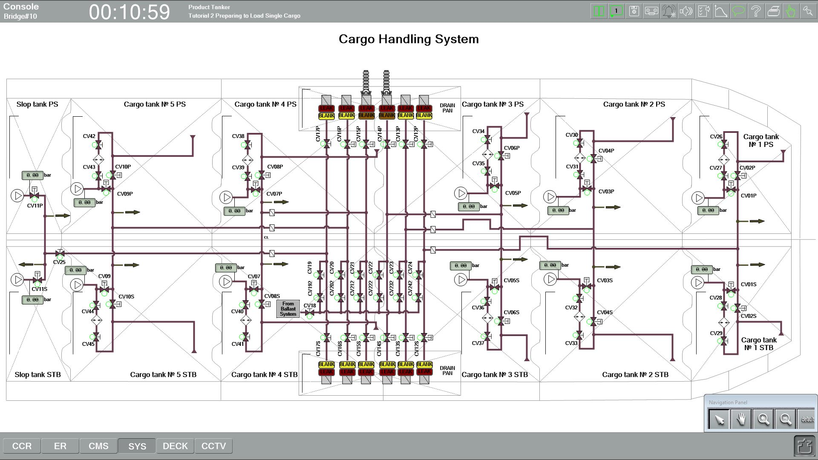

Slide 13
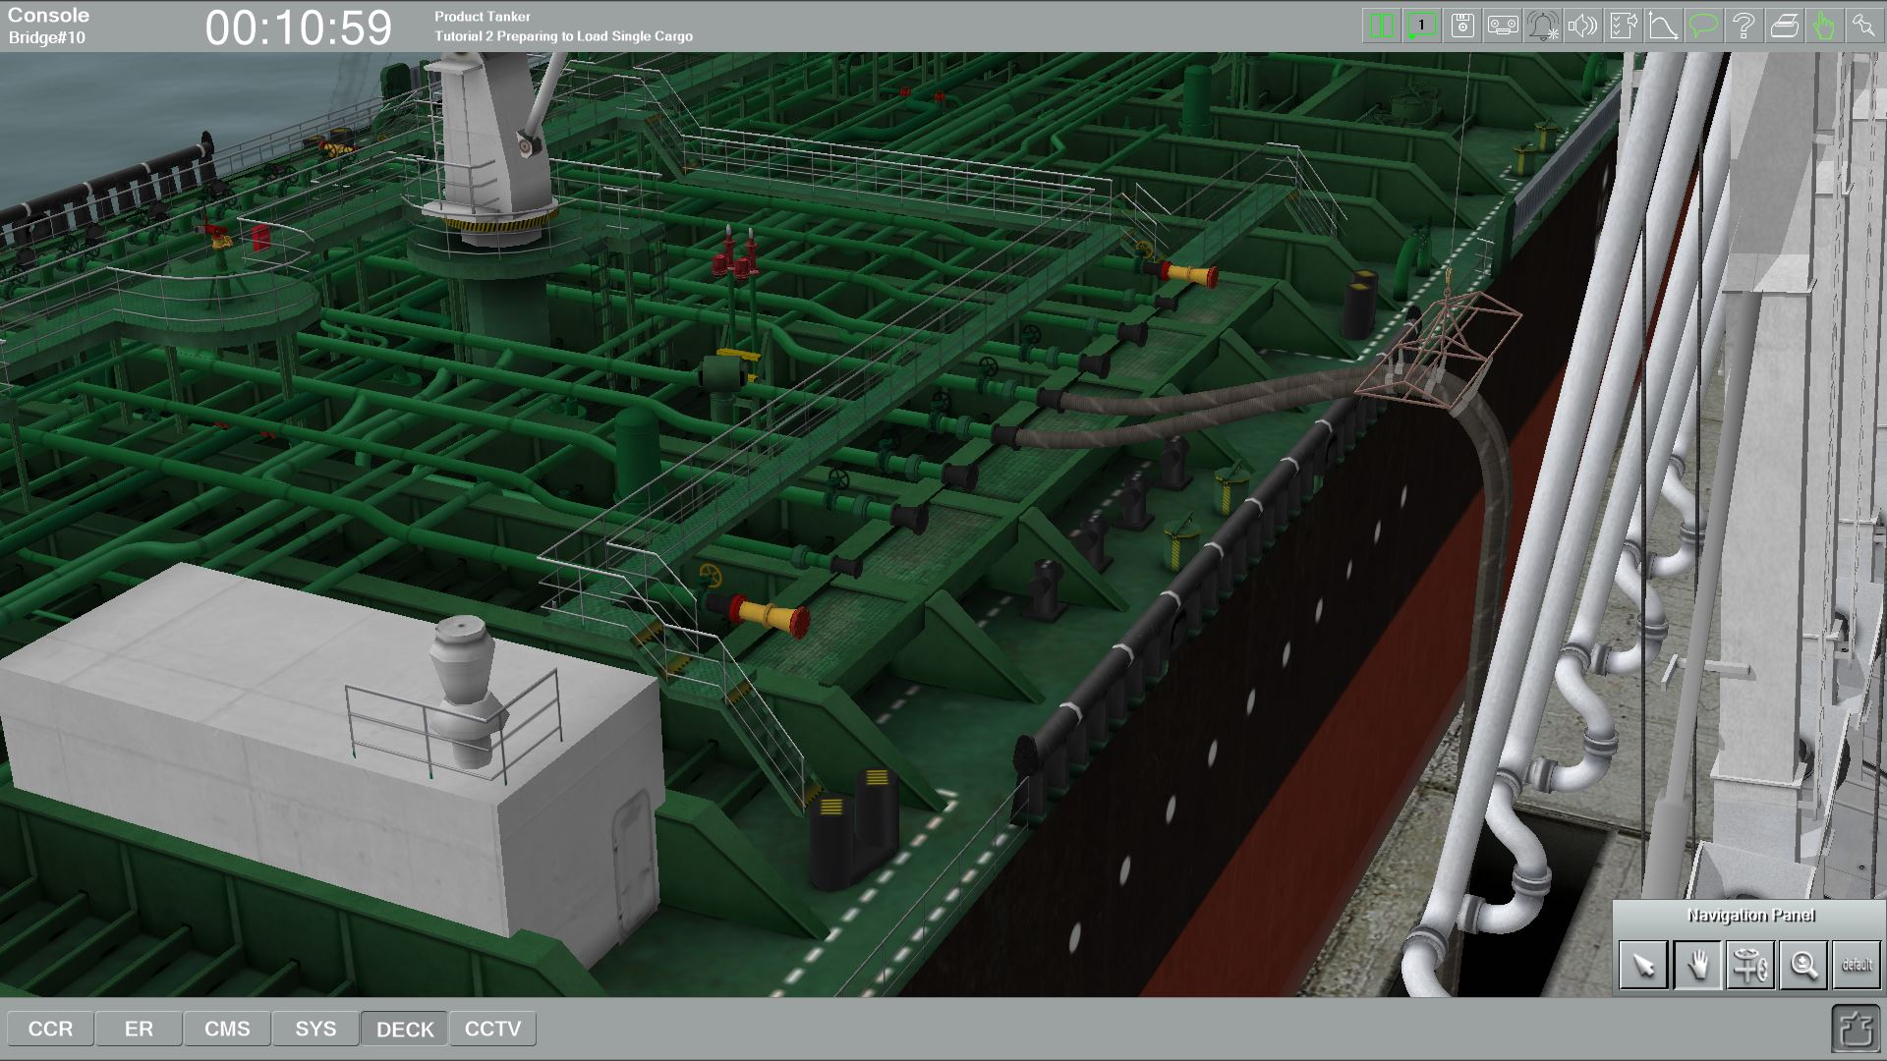

Slide 14
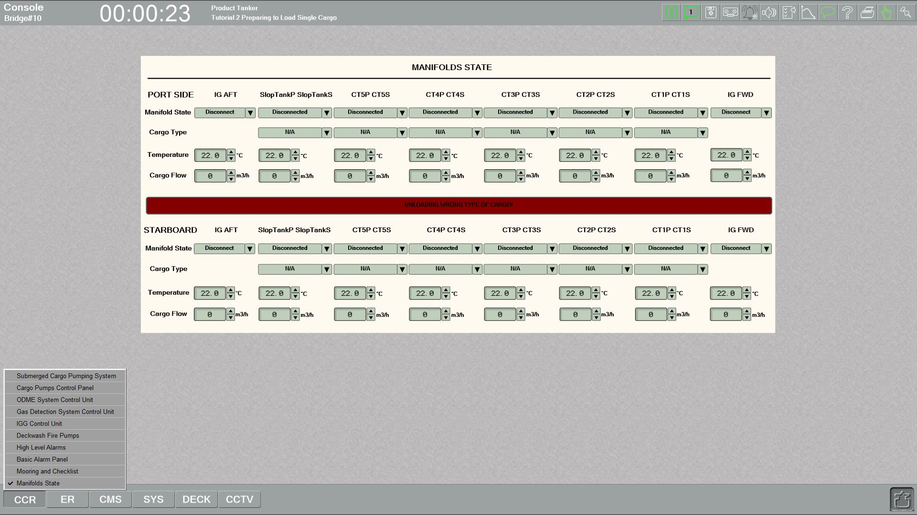
Back to "CCR - Manifolds state" and ask the terminal to prepare loading arms for loading.
(for manifolds "CT3P CT3S" and "CT4P CT4S" select Manifold State "Loading")

Slide 15
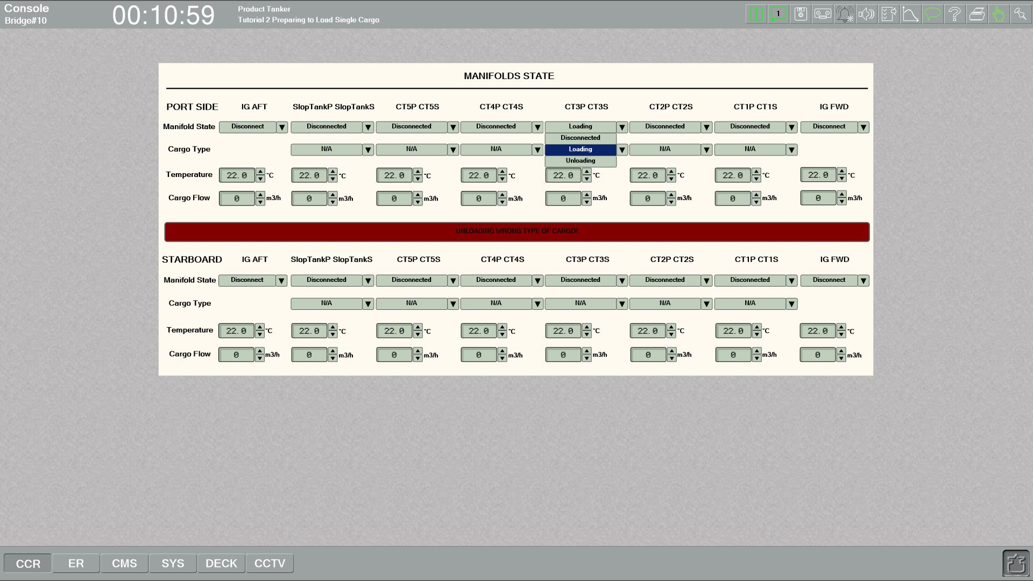

Slide 16
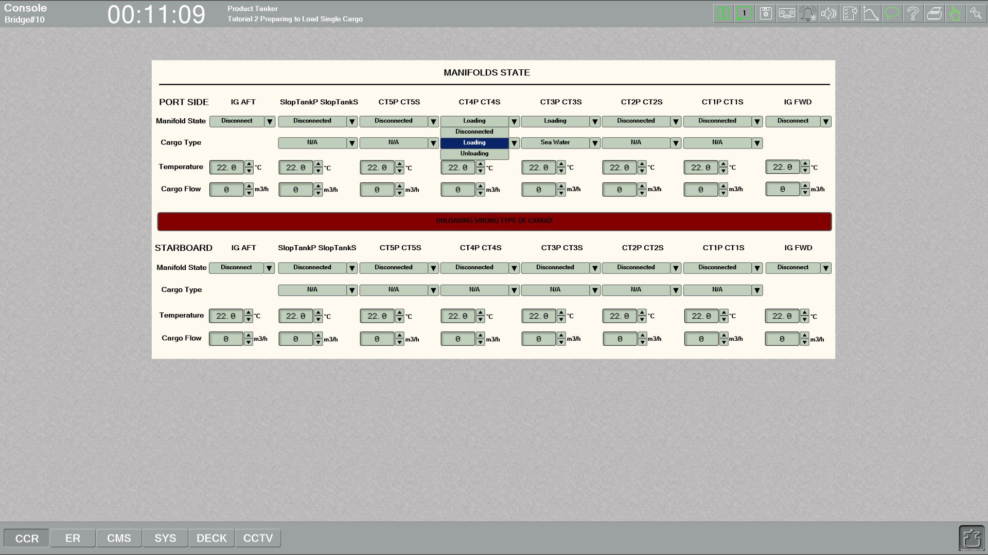

Slide 17
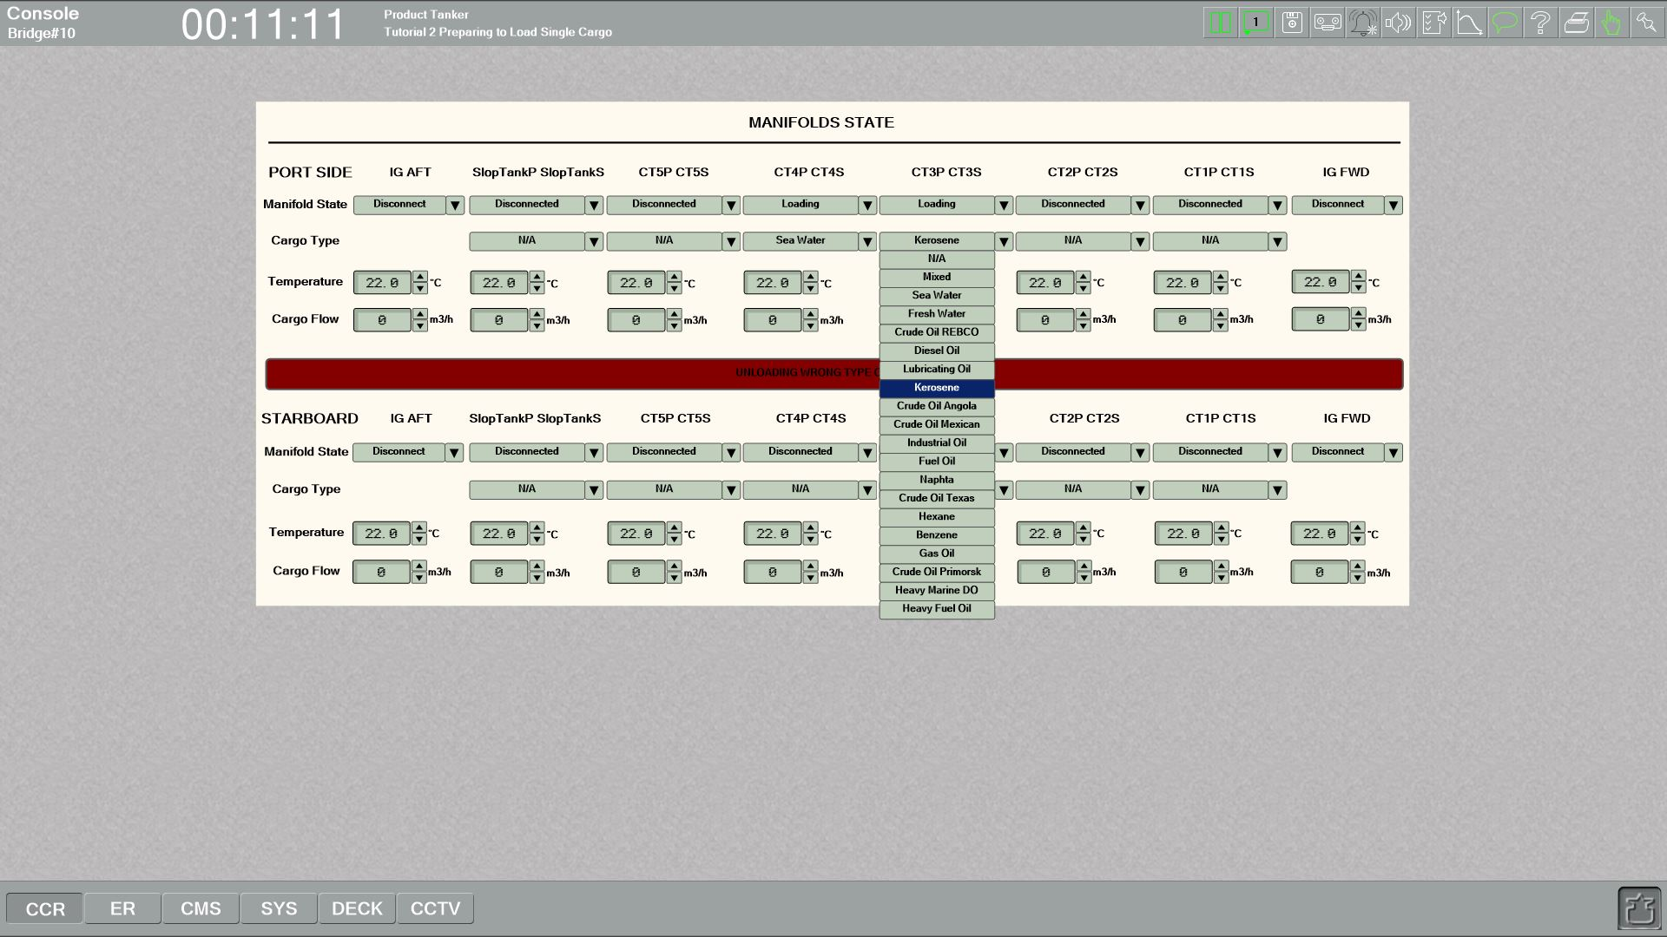
For CT3P CT3S manifold select Manifold State "Loading", then select Cargo Type "Kerosene" and then set Cargo Flow to 200 m3/h.

Slide 18
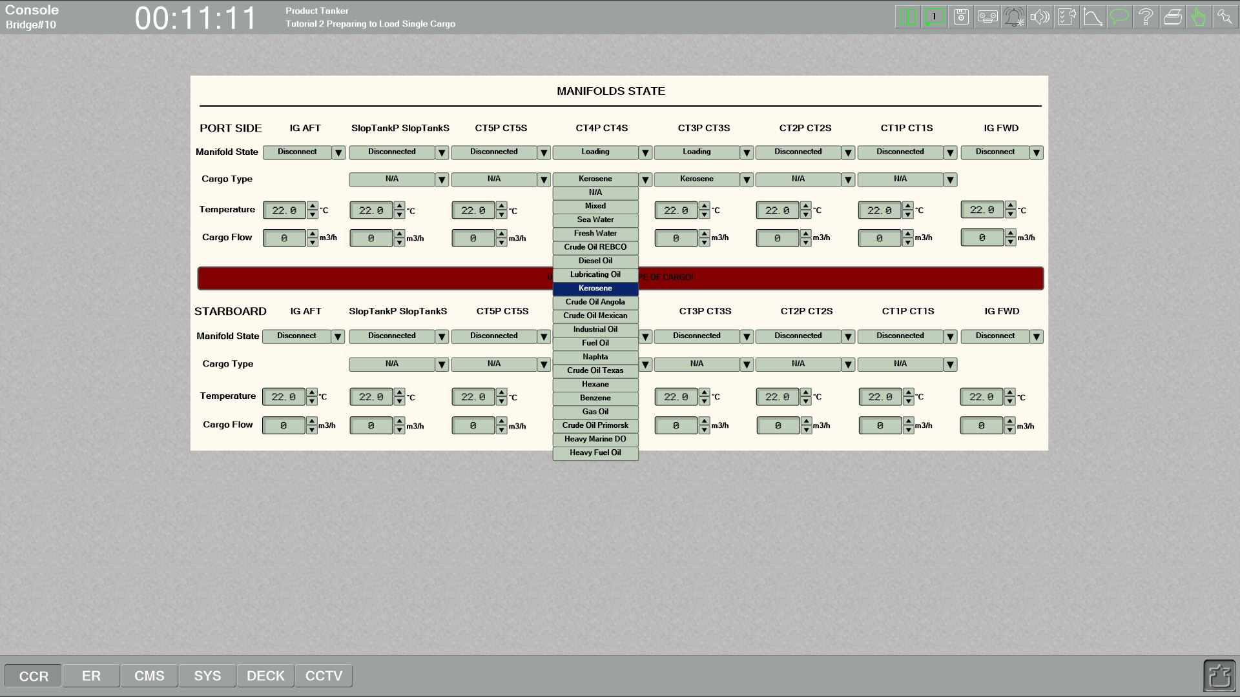
For CT4P CT4S manifold select Manifold State "Loading", then select Cargo Type "Kerosene" and then set Cargo Flow to 200 m3/h.

Slide 19
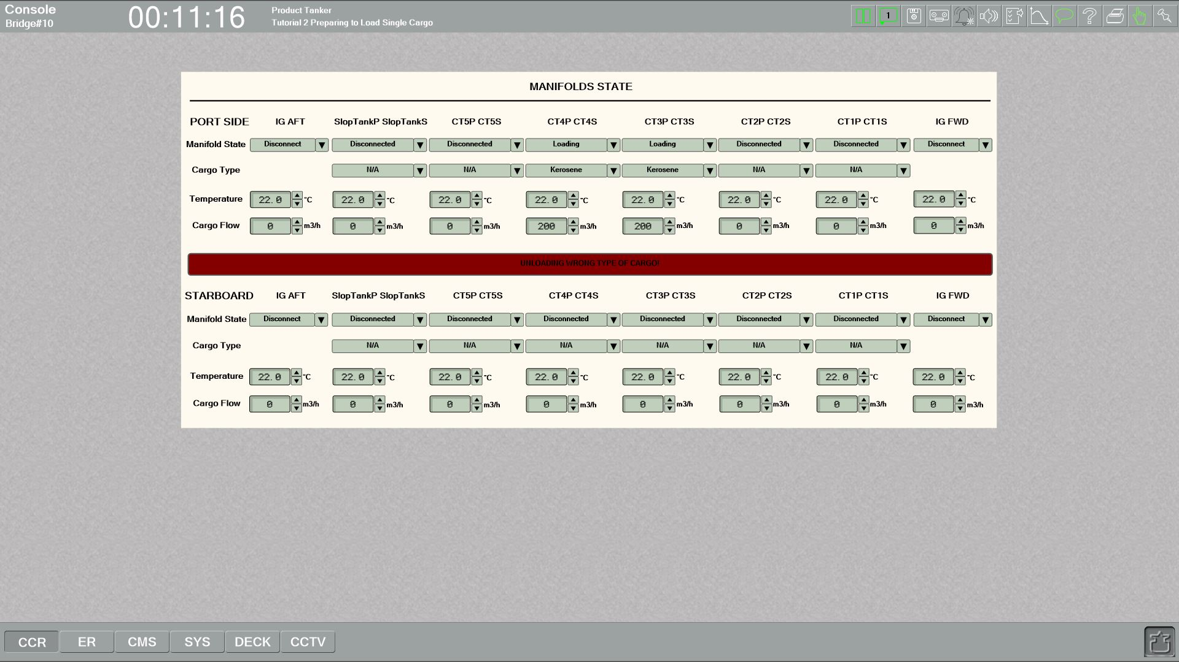

Slide 20
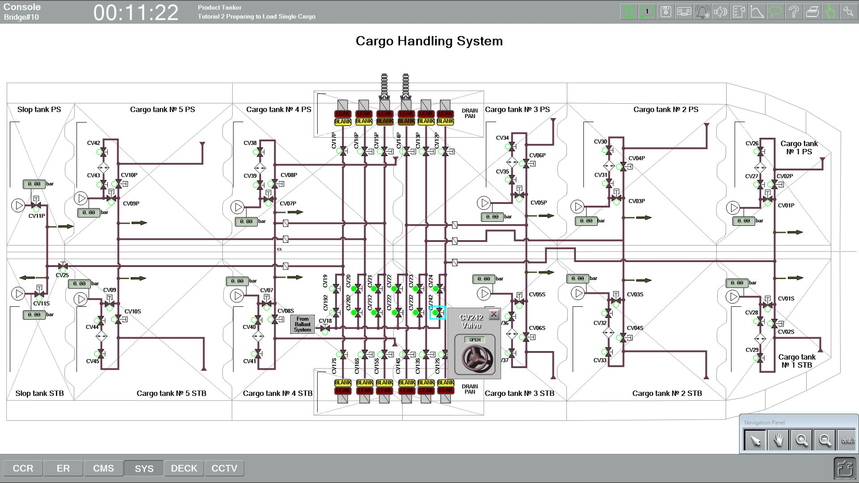
To prepare cargo system for loading single cargo, proceed to "SYS - Cargo Handling System" and open all crossover valves between cargo lines:
CV20, CV21, CV22, CV23, CV24 and CV202, CV212, CV222, CV232, CV242

Slide 21
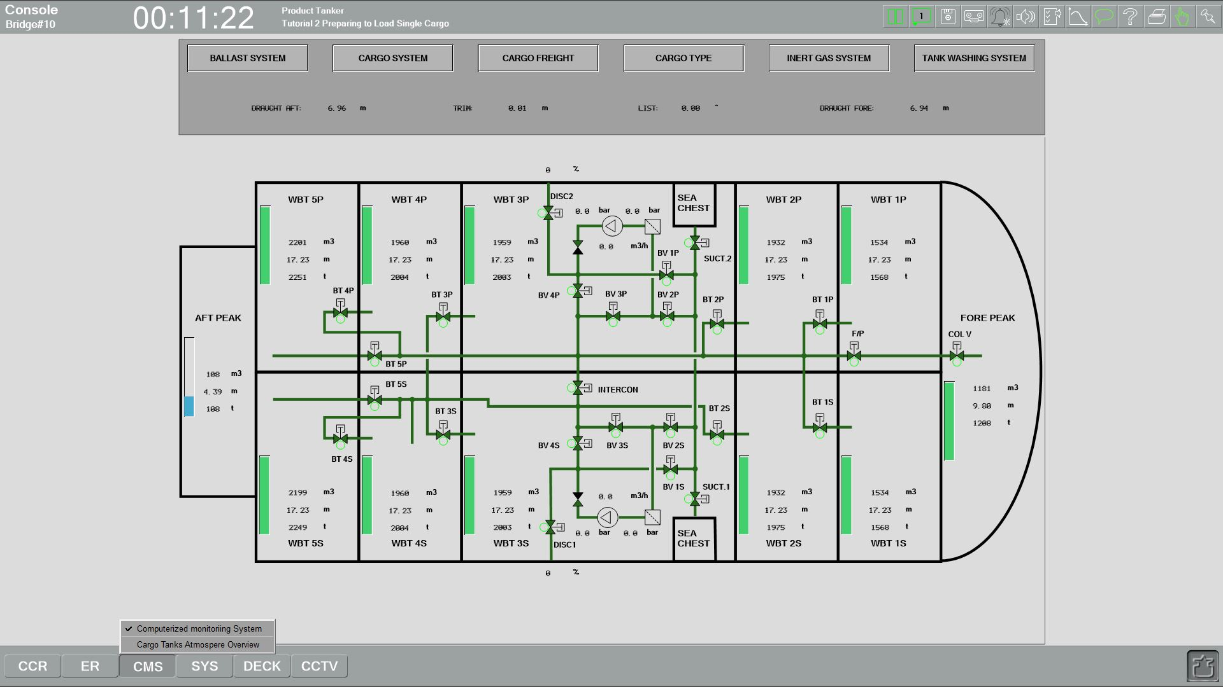
For open valves on drop line of cargo tanks # 3 P/S, you need to open valves on dropline in cargo tanks # 3 P/S. We are going to start loading into these tanks. Go back to the "CMS - Computerized Monitoring System - Cargo System" and open valves CV06P and CV06S.

Slide 22
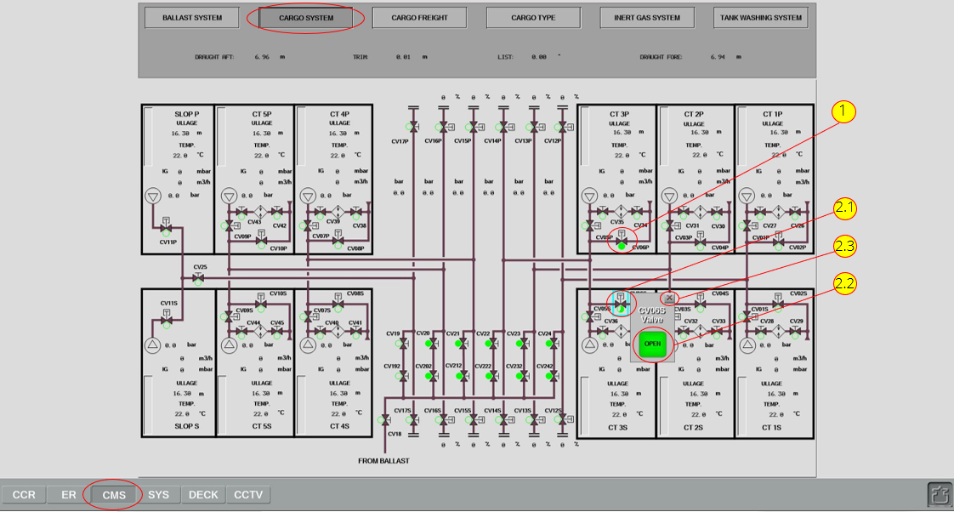
Open valves CV06P and CV06S. System is prepared. You need to inform shore terminal staff that we are ready for loading

Slide 23
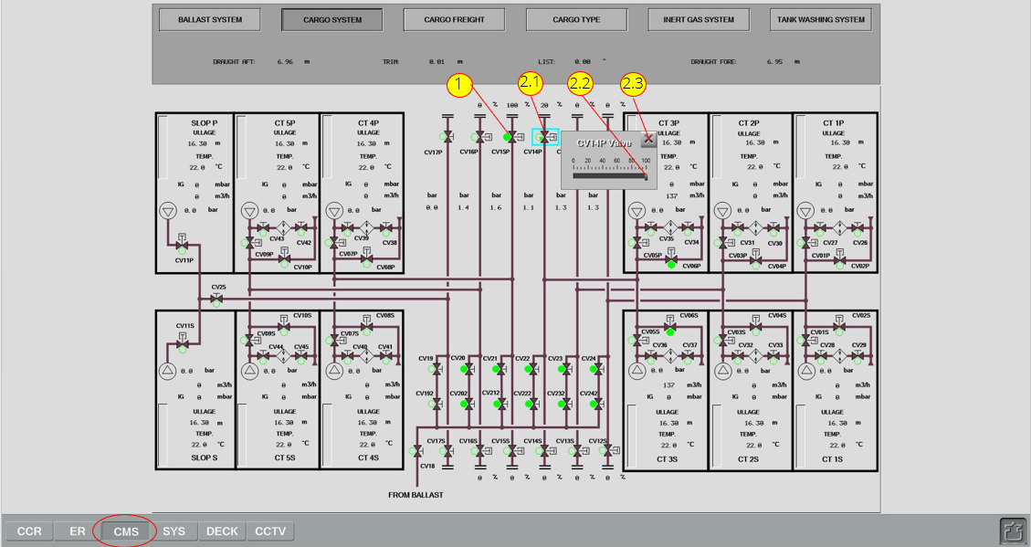
Terminal representative confirmed that they are also ready for loading and we can open manifold valves.
Go to "CMS - Computerized Monitoring System - Cargo System" and open manifold valves CV15P and CV14P

Slide 24
Loading to cargo tank #3 has being started.

Slide 25
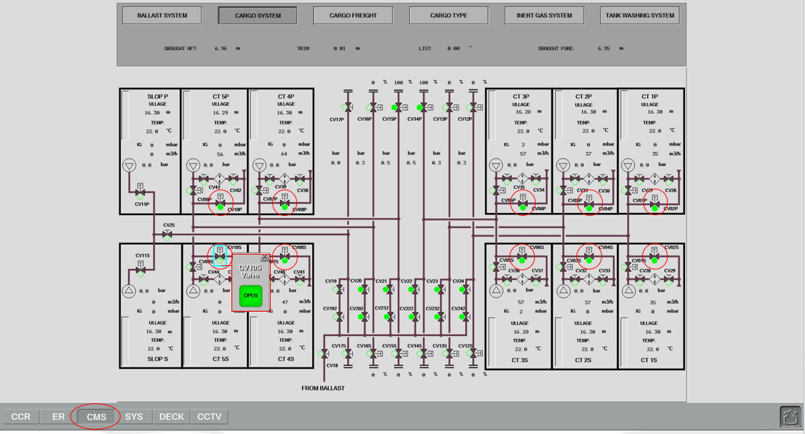
Open valves on drop lines for all other cargo tanks, except Slop Tanks.
Go to "CMS - Computerized Monitoring System - Cargo System" and open valves CV10P, CV08P, CV04P, CV02P, CV02S, CV04S, CV08S, CV10S)

Slide 26
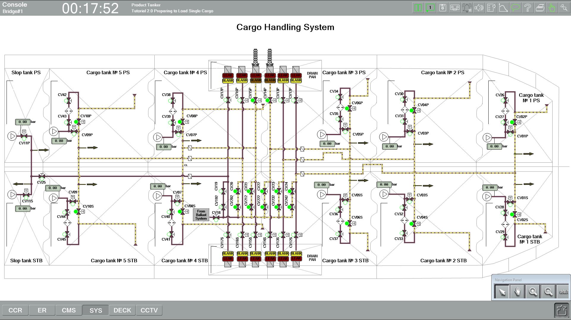
Cargo is going into the all tanks. Check the level of ullage in tanks!

Slide 27
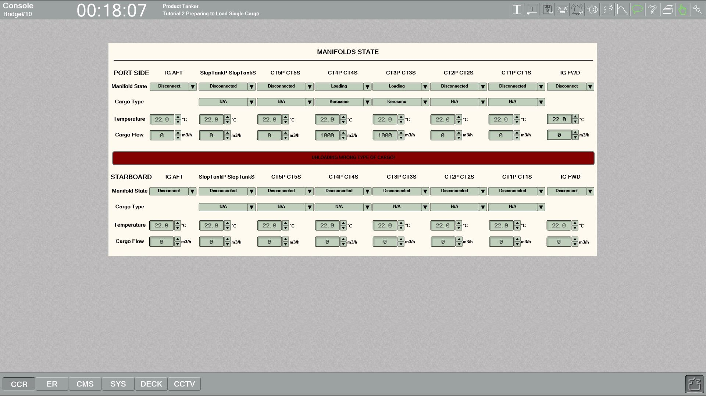
We need to do is to increase loading rate of loading to the maximum.
Go back to "CCR - Manifolds state" and set Cargo Flow to 1000 m3/h for the manifolds #3 and #4.

Slide 28
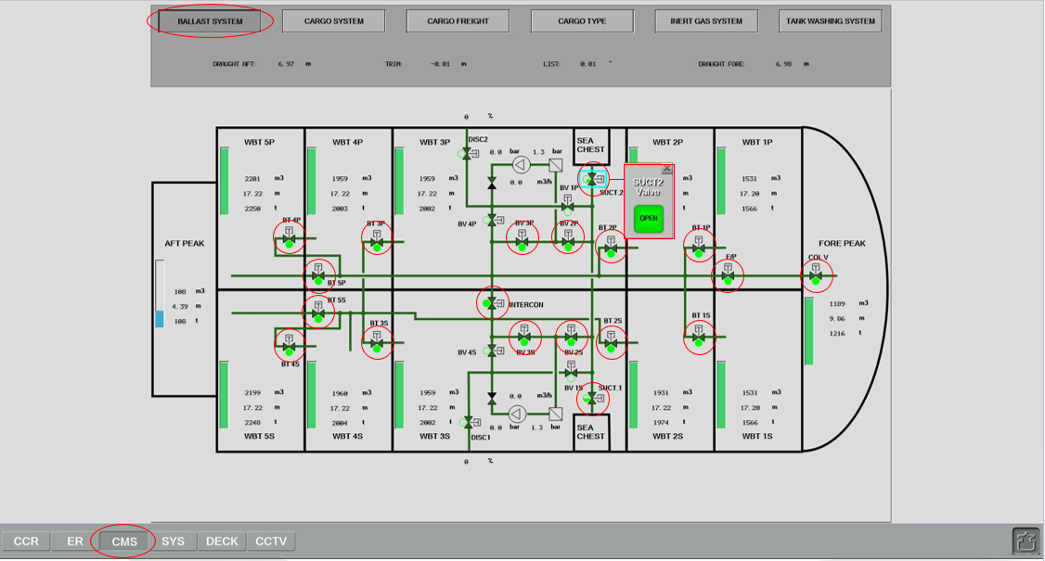
We need to start discharging the ballast water by gravity. Go to "CMS - Ballast System" and open the following valves:
COL V, F/P, BT1P, BT1S, BT2P, BT2S, BT3P, BT3S, BT4P, BT4S, BT5P, BT5S, INTERCON, BV3P, BV3S, BV2P, BV2S, SUCT1 and SUCT2.

Slide 29
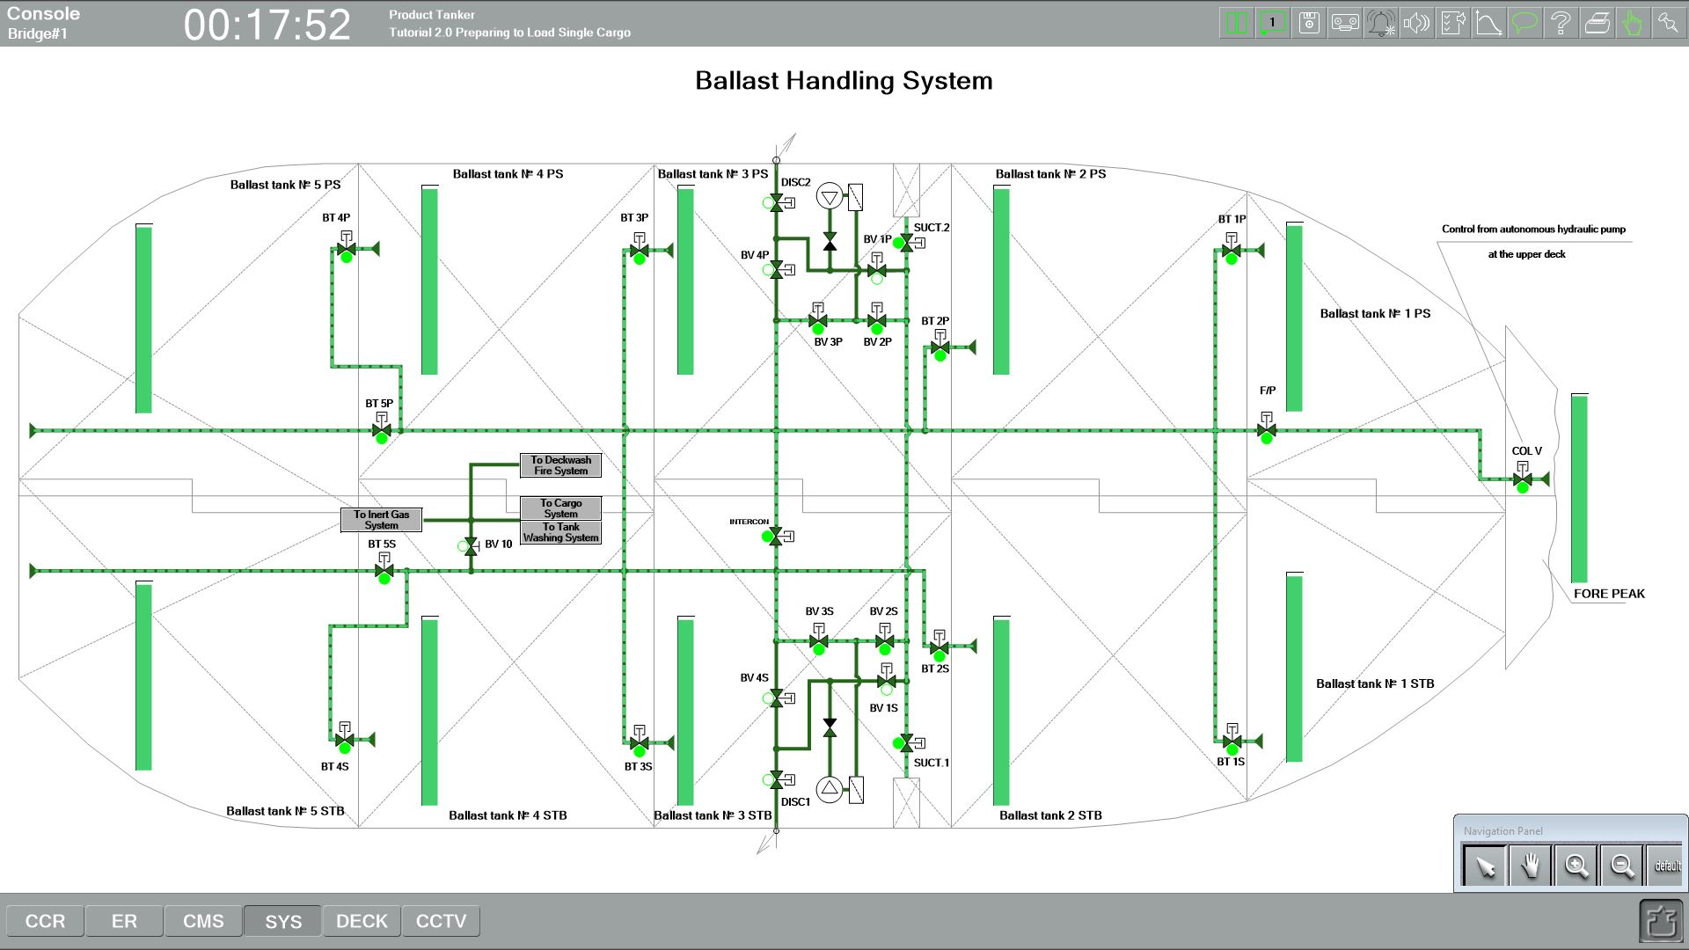
Check the conditions - ballast is discharging by gravity!

Slide 30
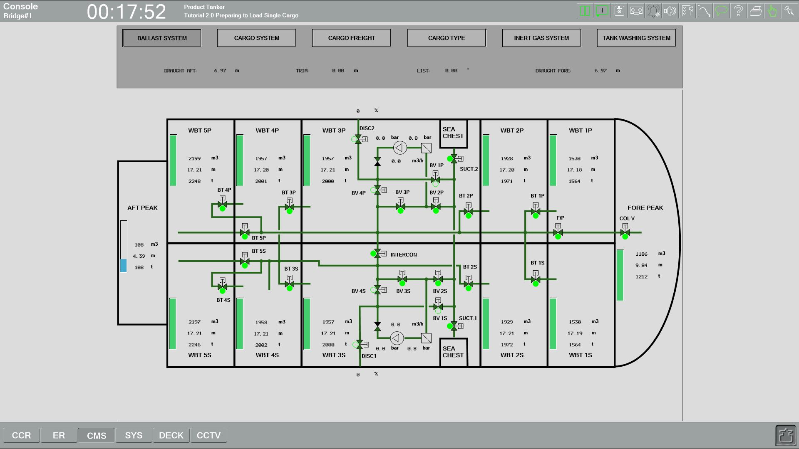
Check the conditions - ballast is discharging by gravity!

Slide 31
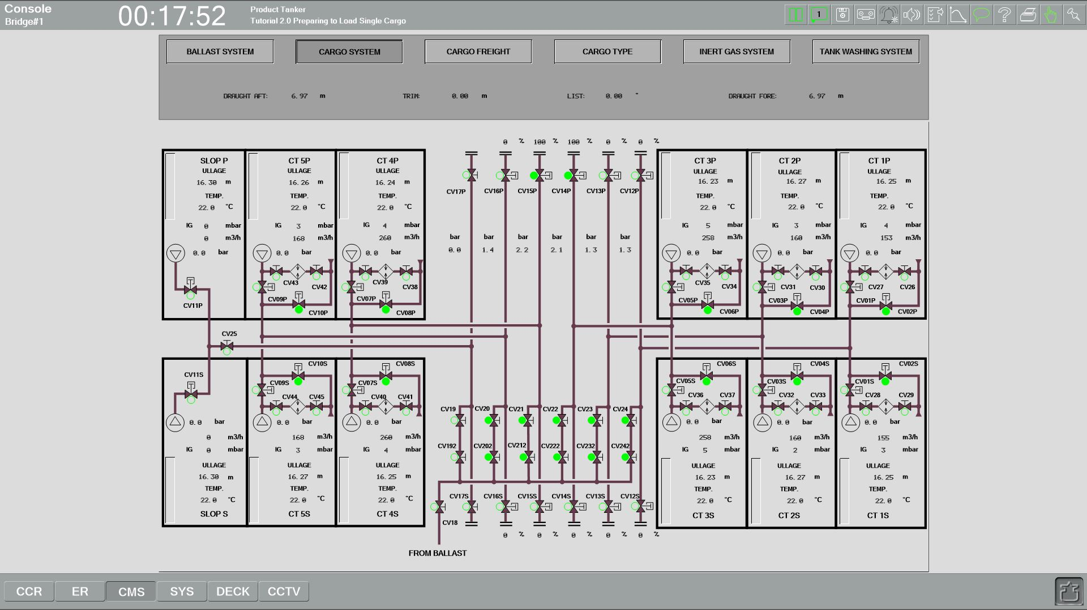

Slide 32
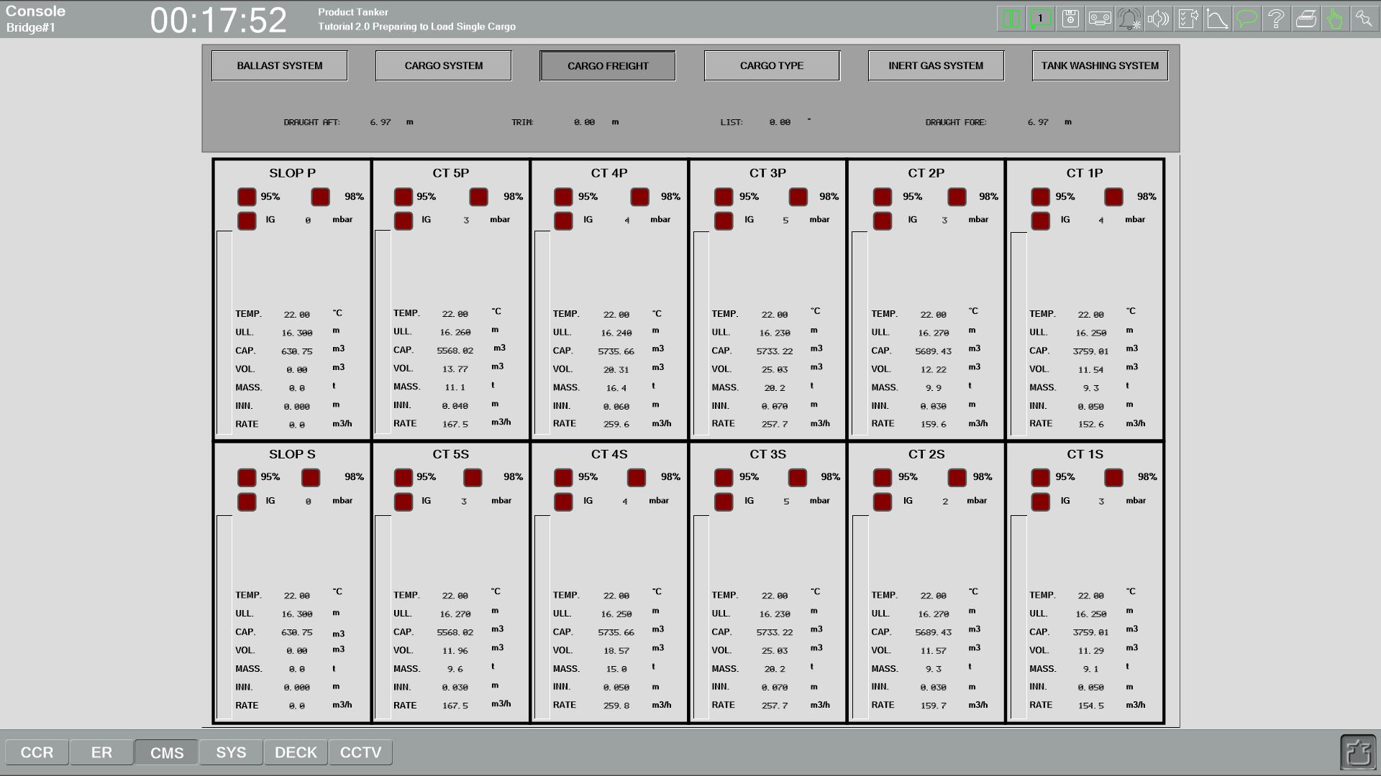
Check the conditions - Cargo is loading into all cargo tanks. Ullages in tanks are reducing.

Slide 33
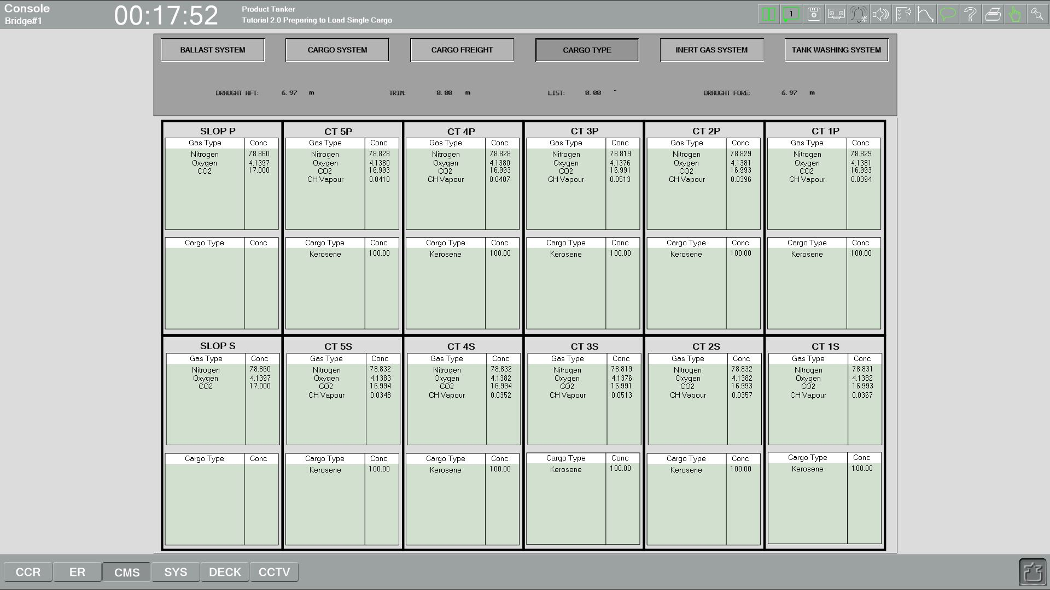
Check the conditions – single cargo “Kerosene” is loading into all cargo tanks. We can observe the level of vapour, the concentration of nitrogen, oxygen, and CO2

