Slide 1
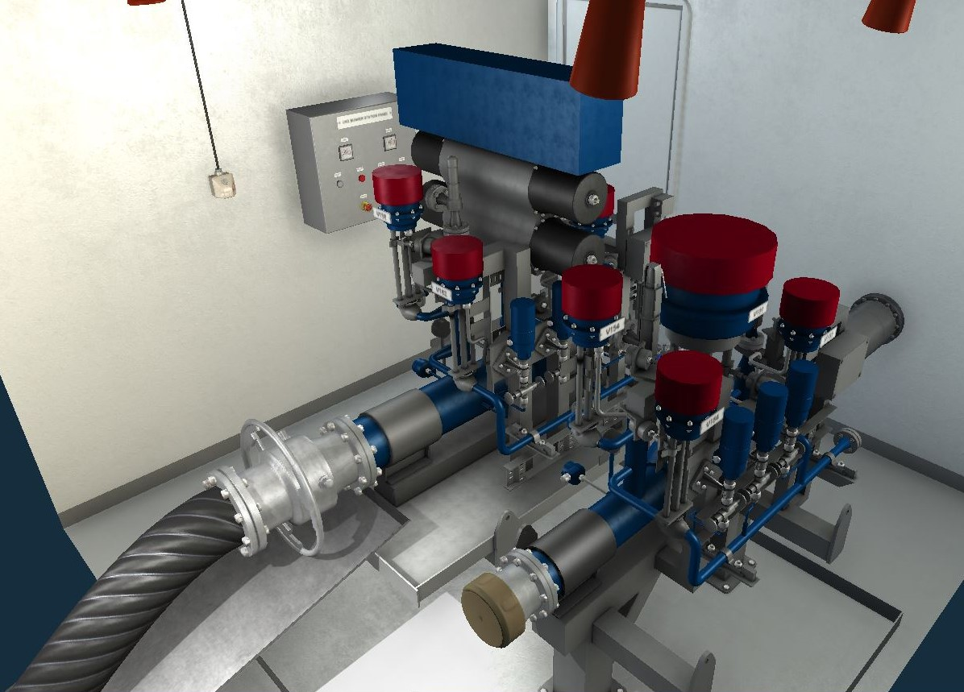
Loading LNG from the terminal to the ship’s tank
PREPARED BY
lect. MARIJUS JACEVICIUS
LITHUANIAN MARITIME ACADEMY
2023, Klaipeda

Slide 2
Initial condition:
LNG tank is 5% filled with liquid cargo at following conditions: -130 [°C], 6 [bar], bunkering station moored to terminal.
Task:
- connect loading hose to manifold
- inert the hose
- start loading LNG from terminal to tank

Slide 3
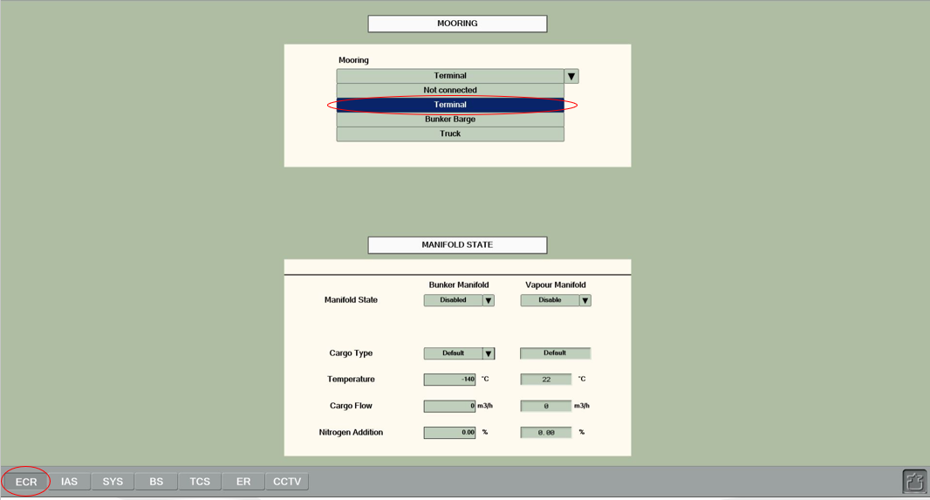
Bunkering station is moored to the terminal

Slide 4
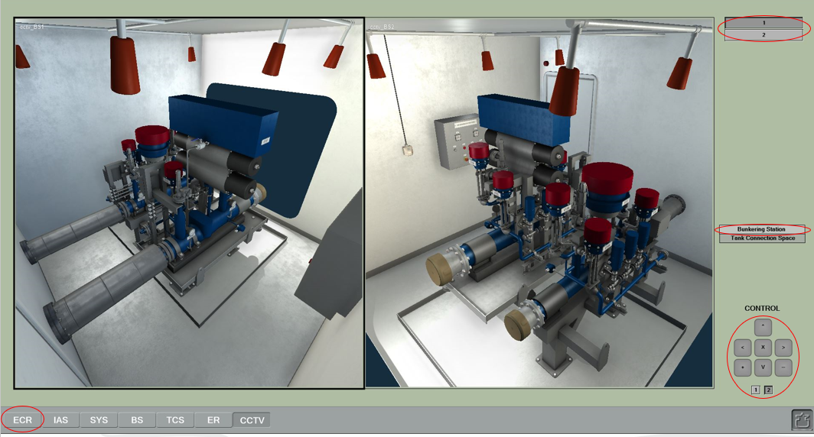

Slide 5
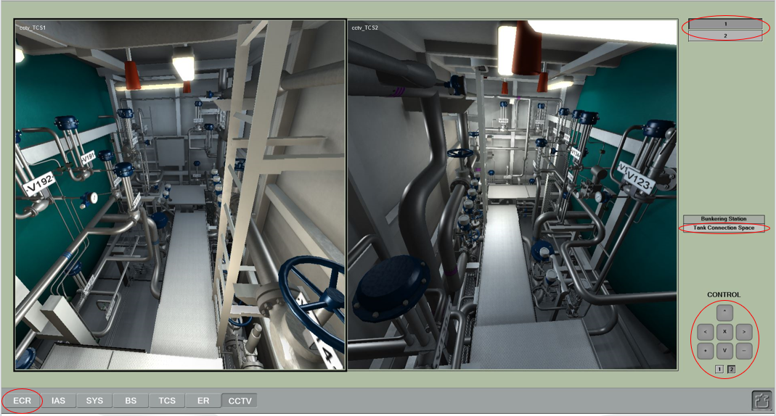

Slide 6
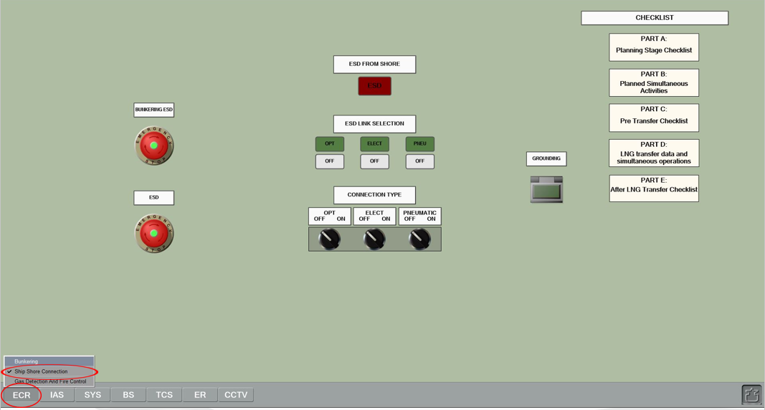
01. Connect the earthing cable and check the ship-to-shore link.

Slide 7
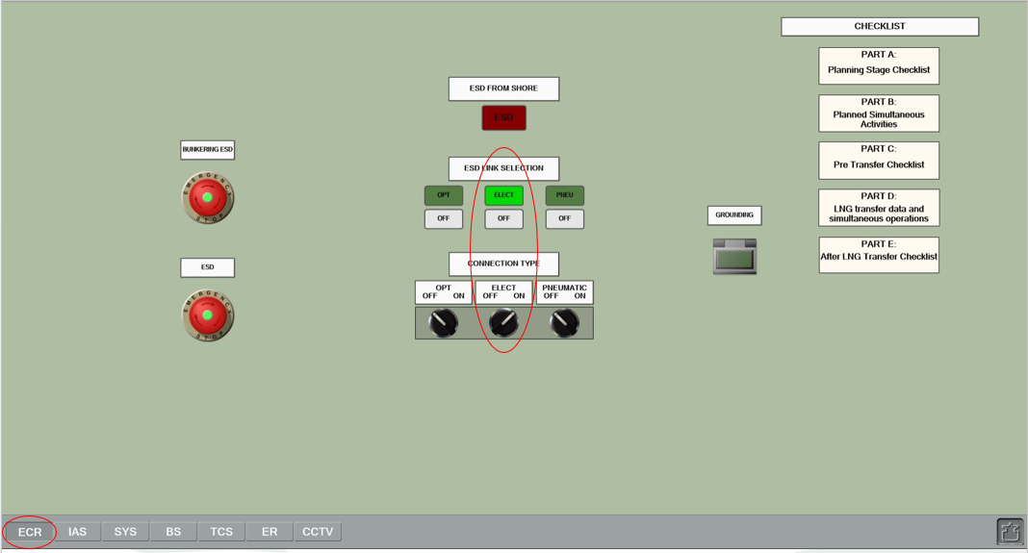
- Go to the ECR > Ship Shore Connection page. Change the ELECT switch state to ON to turn on the electrical ship-to-shore connection.

Slide 8
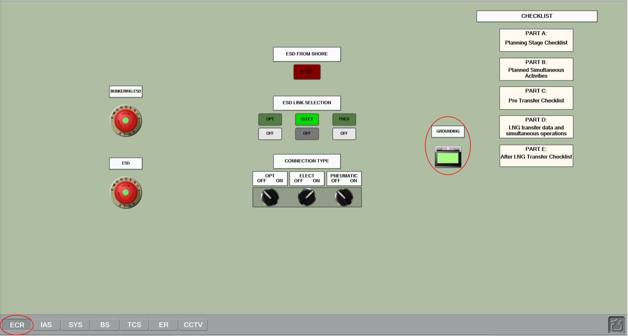
Click the Grounding button to remove the protecting coating.
Click the button for the second time to connect the earthing cable.
The lamp inside the button should light up.

Slide 9
Connect loading hose to the ship‘s manifold

Slide 10
02 Remove the protection blank flange from the bunkering manifold.
- Select the bunkering manifold. Click the BLANK button to remove the blank flange

Slide 11
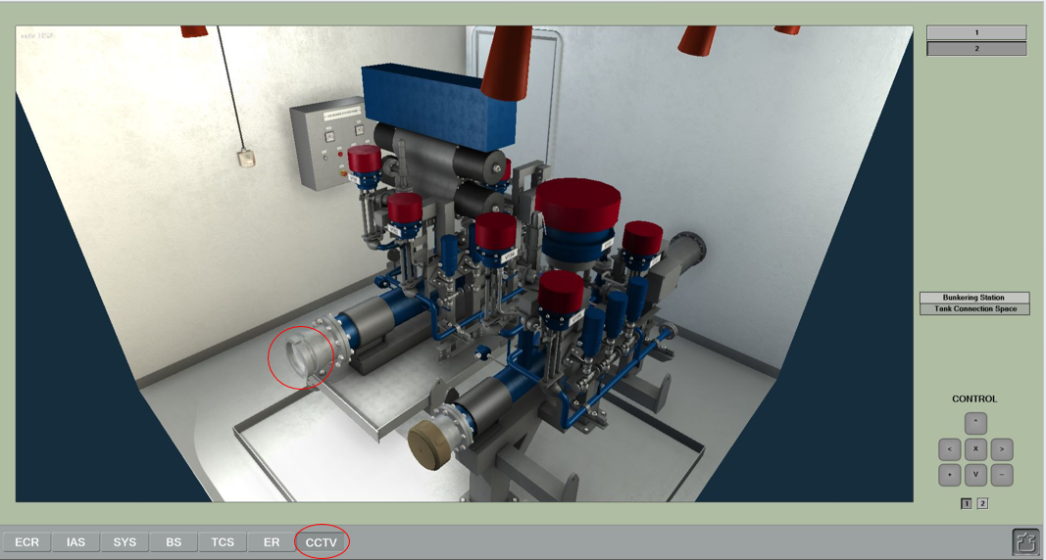
Check or the protection blank flange from the bunkering manifold is removed.

Slide 12
Connect loading hose to the ship‘s manifold.
Select Connect for the Loading Equipment State in the combobox

Slide 13
Loading hose is connected to the ship‘s manifold.

Slide 14
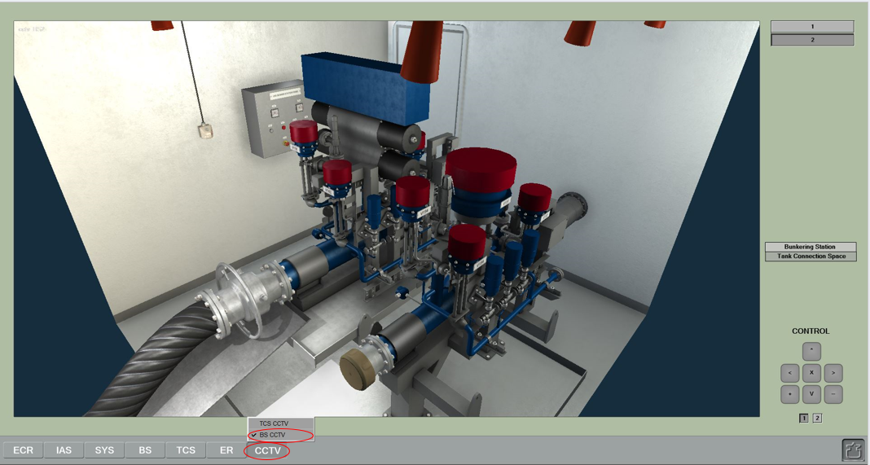

Slide 15
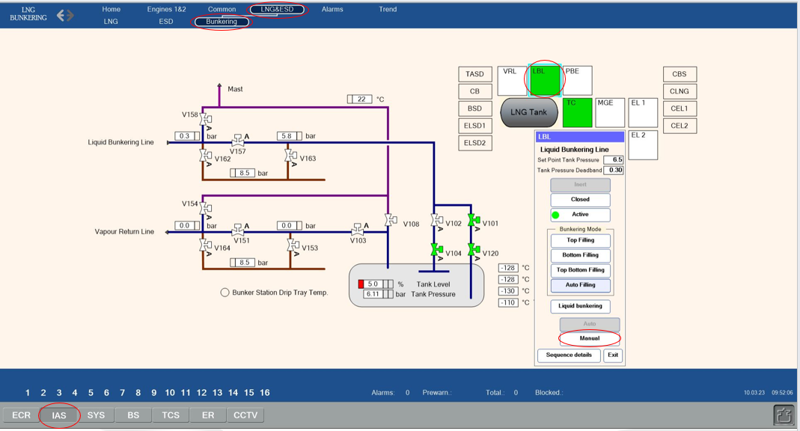
Inert the hose
04 Switch the bunkering line control to the manual mode.
- Go to the IAS > LNG&ESD > Bunkering page to switch the bunkering line control to the manual mode. Select the LBL control box and press the Manual button.

Slide 16
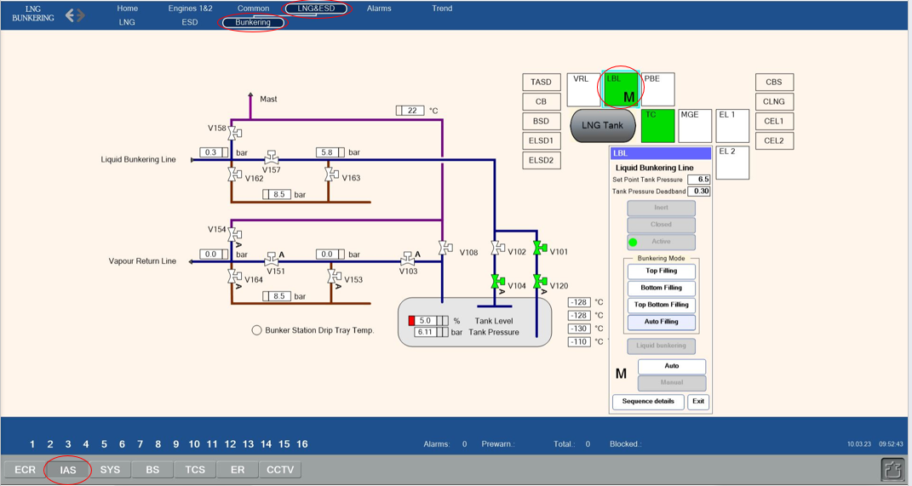
LBL control status is changed to M (Manual)

Slide 17
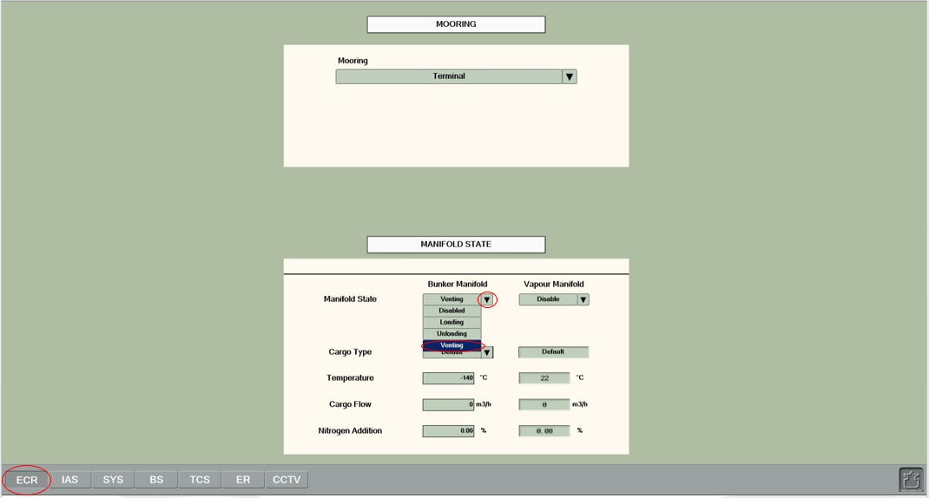
Inert the hose
05 Prepare bunker manifold for inerting.
- Go to the ECR > Bunkering page.
- Select Venting for the Bunker Manifold State in the combobox.

Slide 18
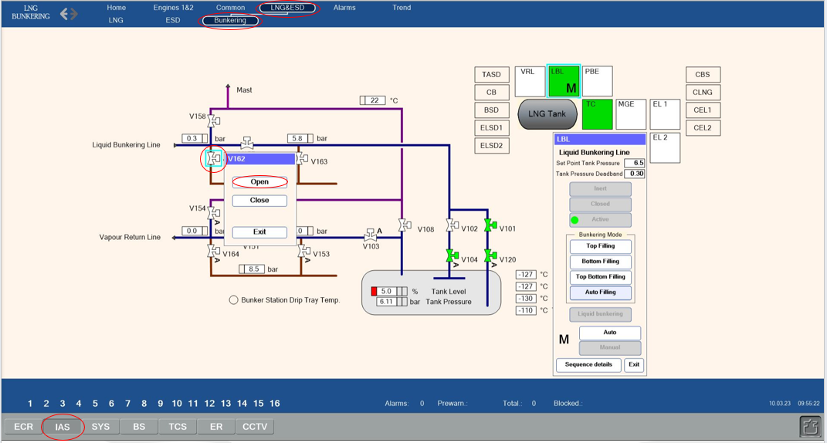
Inert the hose
06 Supply nitrogen to the pipeline and the hose.
- Go to the ECR > Bunkering page.
- Select valve V162 and click the Open button.

Slide 19
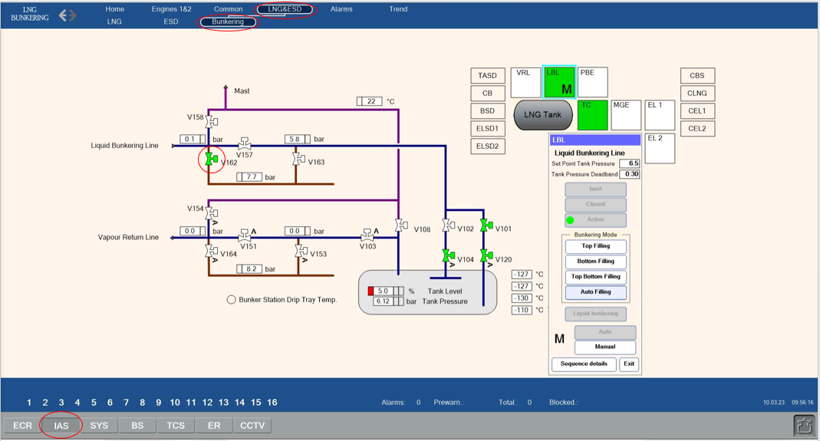
Valve V162 is opened.

Slide 20
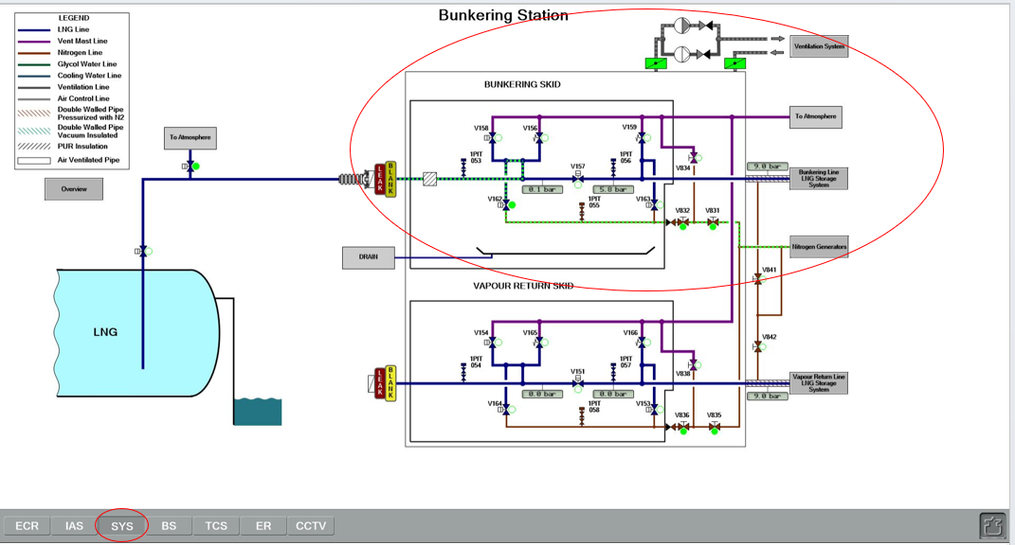
07 Let the inert gas flow through the hose and the piping until the inerting is considered complete.
Stop the inerting process after reasonable amount of time by disabling the bunkering manifold ventilation mode.
- The required inerting time depends on the total pipe volume and the available nitrogen flow.
- Check flow from the SYS > Bunkering Station page (hints should be turned on)

Slide 21
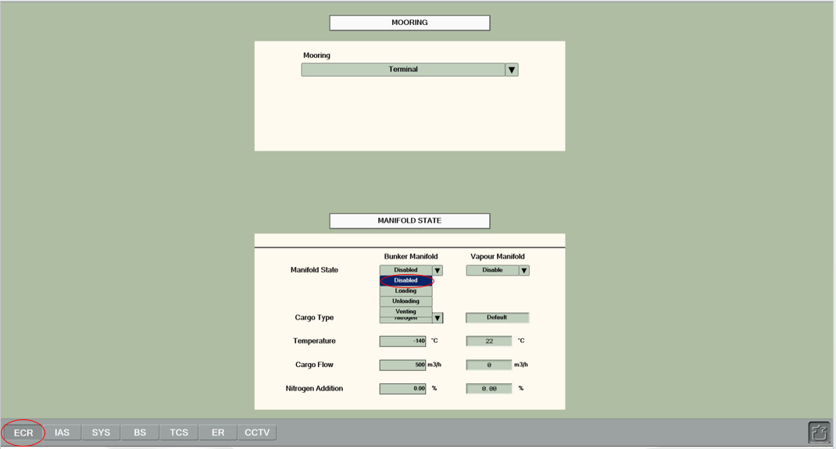
Select the Disabled Manifold state for the Bunker Manifold.

Slide 22
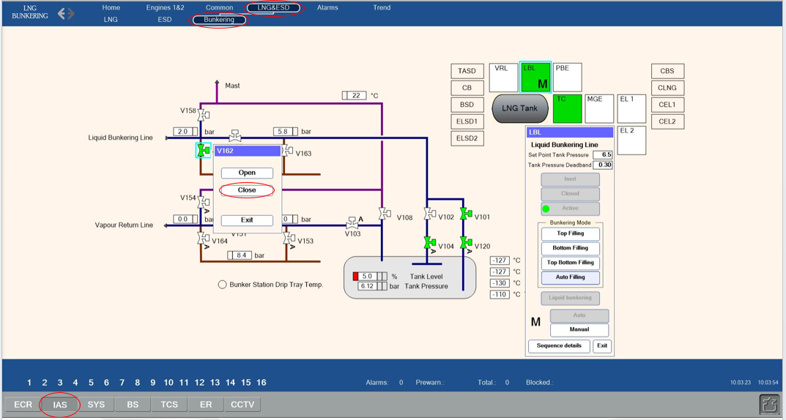
Commence loading of LNG from terminal to ship‘s tank. 08 Pressurize the hose and check connections for leakage.
- Ensure the pressure in the hose is not less than 2 bars.
- Close valve V162. Go to the IAS > LNG&ESD > Bunkering page.
- Select valve V162 and click the Close button.

Slide 23
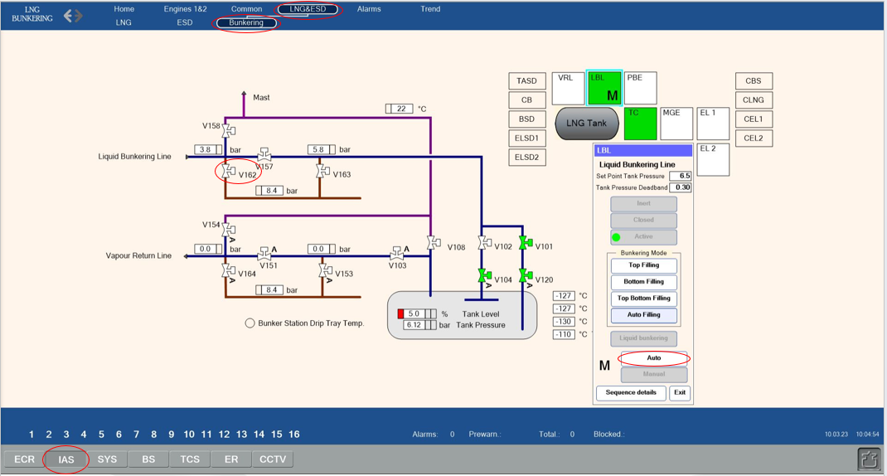
Commence loading of LNG from terminal to ship‘s tank.
Valve V162 is closed. If no leakage is observed, return the system to the automatic mode.
- Check pressure reading from the PIT053 sensor and confirm the pressure is constant.
- Select the LBL control box and press the Auto button.

Slide 24
Commence loading of LNG from terminal to ship‘s tank.
- Check pressure reading from the PIT053 sensor and confirm the pressure is constant.

Slide 25
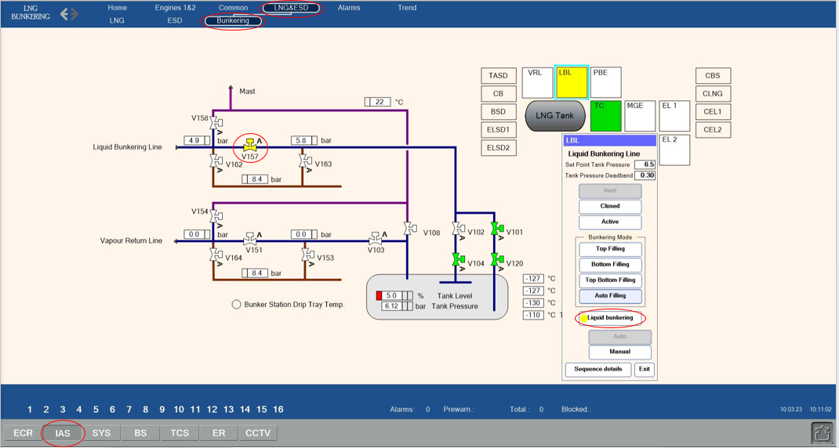
Commence loading of LNG from terminal to ship‘s tank
10 Switch on the automation for the bunkering.
- Select the LBL control box and press the Liquid bunkering button.
Bunkering valve V157 will open automatically

Slide 26
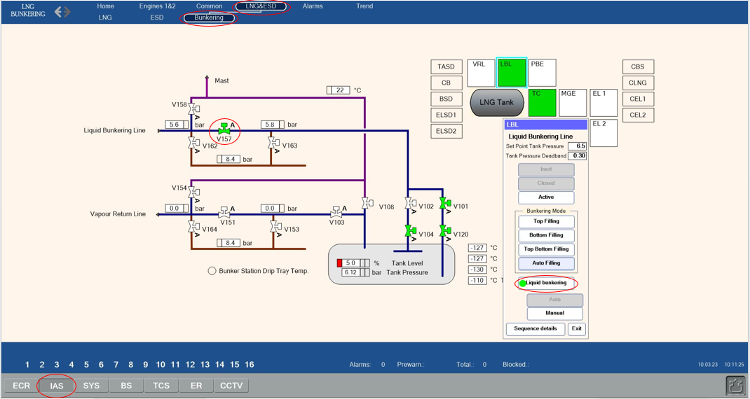

Slide 27
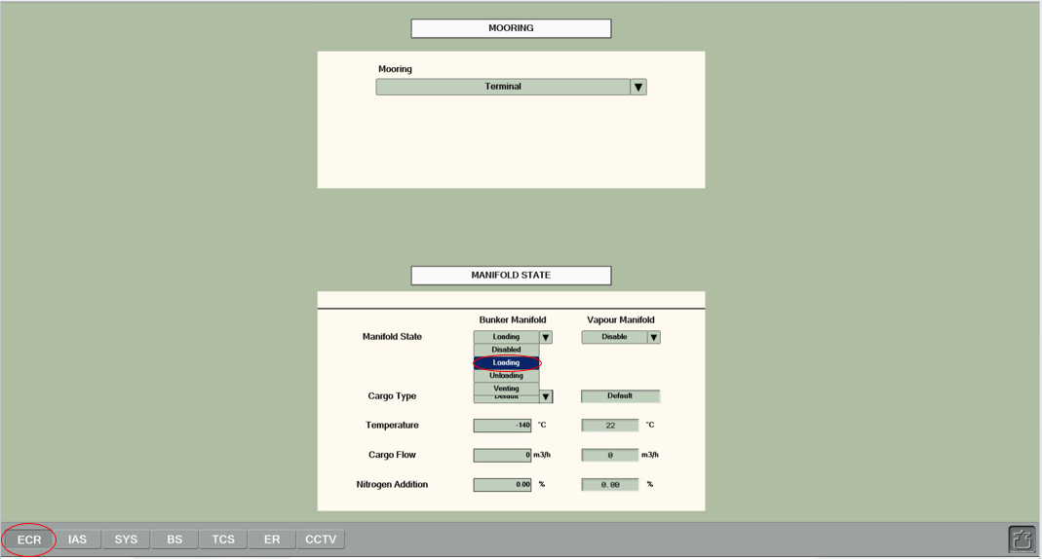
11 Start bunkering with a low flow of LNG.
- Go to the ECR > Bunkering page.
- Select Loading Manifold state for the Bunker Manifold to start bunkering process.

Slide 28
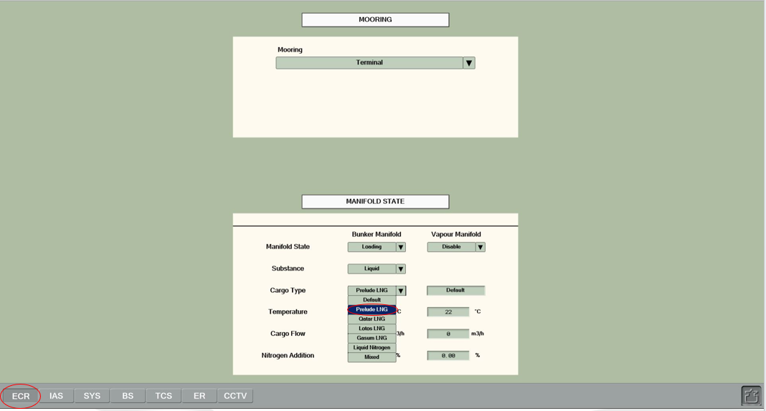
Choose Prelude LNG for the Cargo Type.

Slide 29
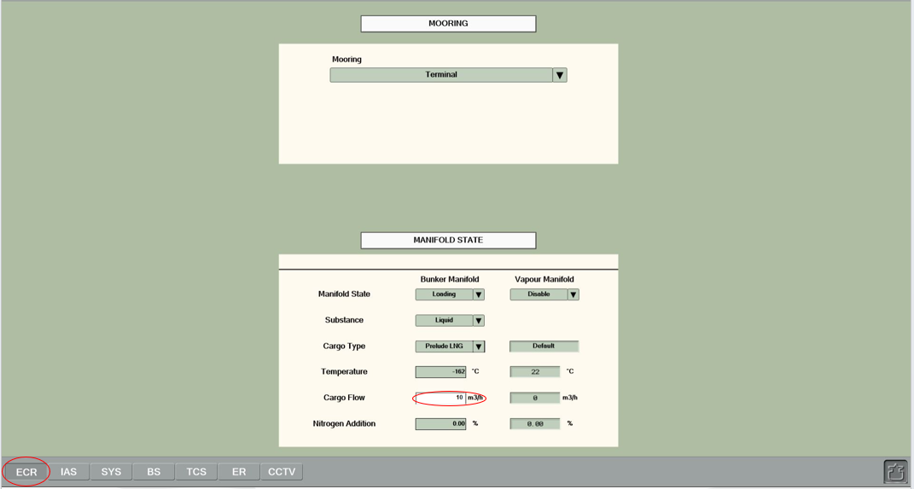
Enter a small value (5-15 m³/h) for the desired LNG flow in the Cargo Flow box.

Slide 30
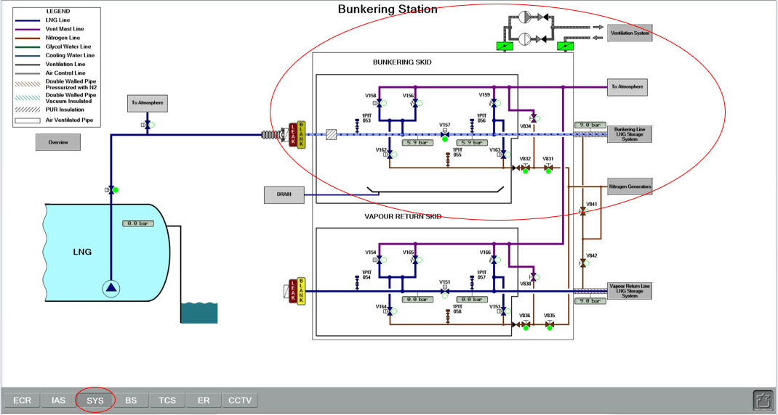
Commence loading of LNG from terminal to ship‘s tank
13 Monitor the bunkering process until the tank level reaches 10%

Slide 31
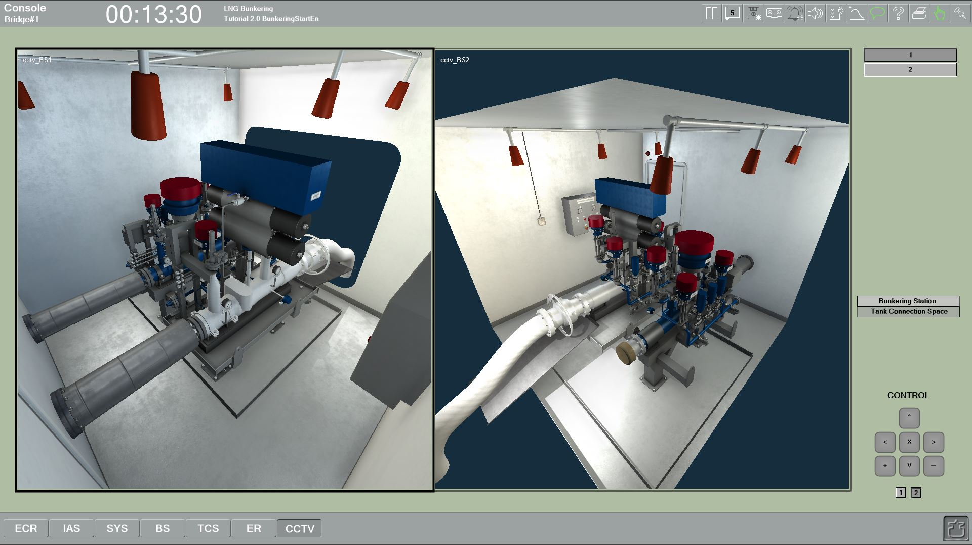

Slide 32
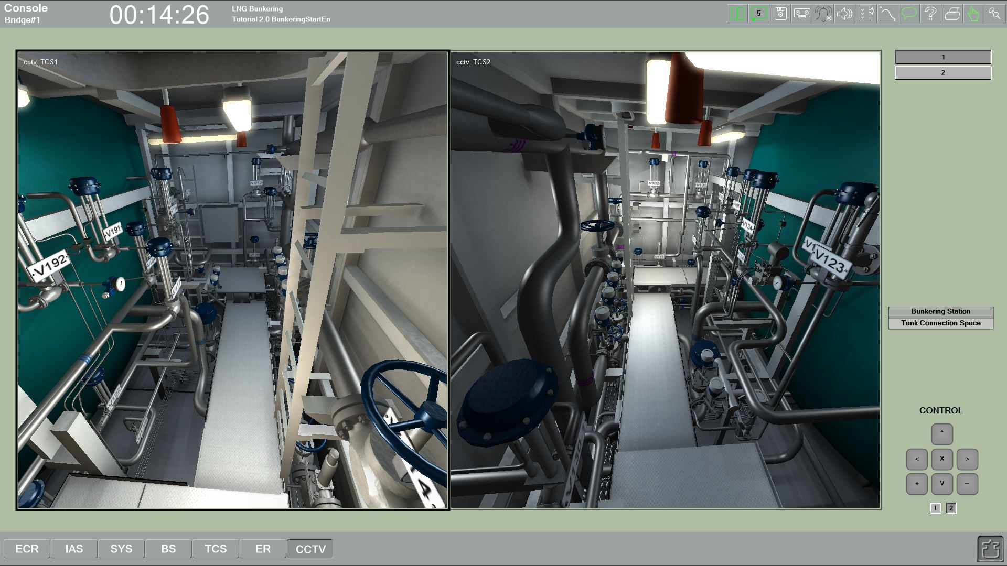

Slide 33
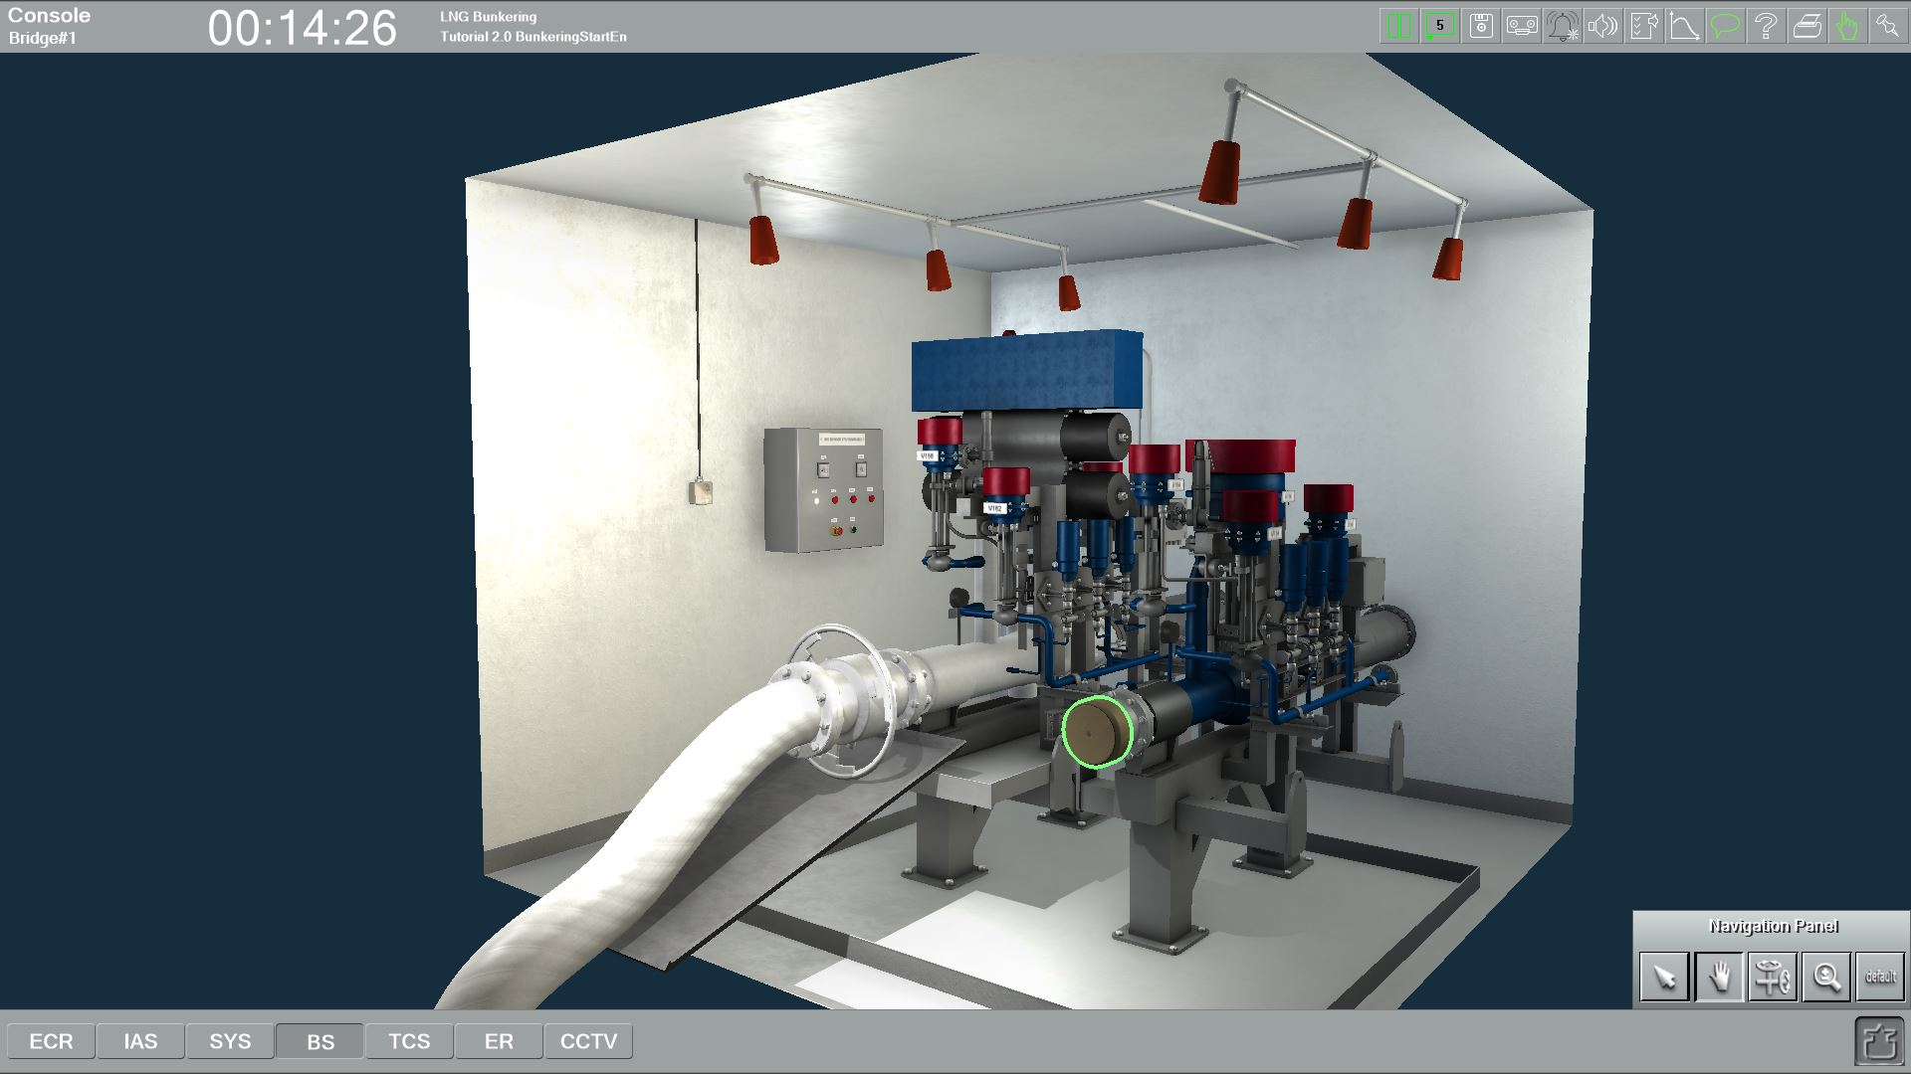

Slide 34
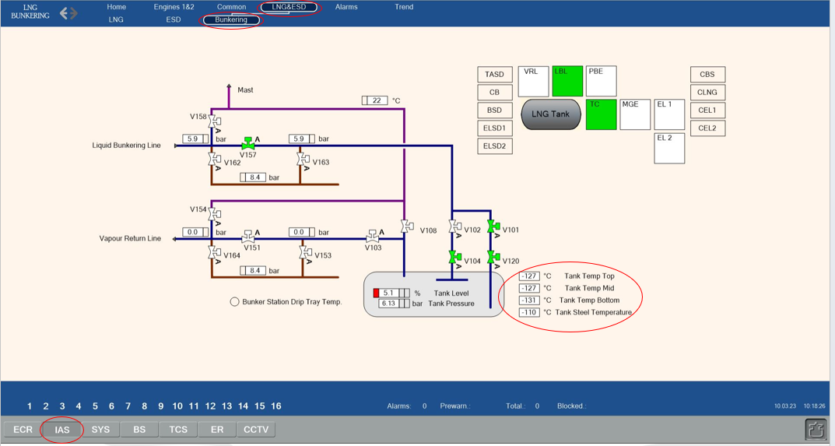
Wait for a reasonable amount of time until the bunkering pipelines cool down.
After the pipes have cooled down, the cargo flow setting can be increased to its maximum value.

Slide 35
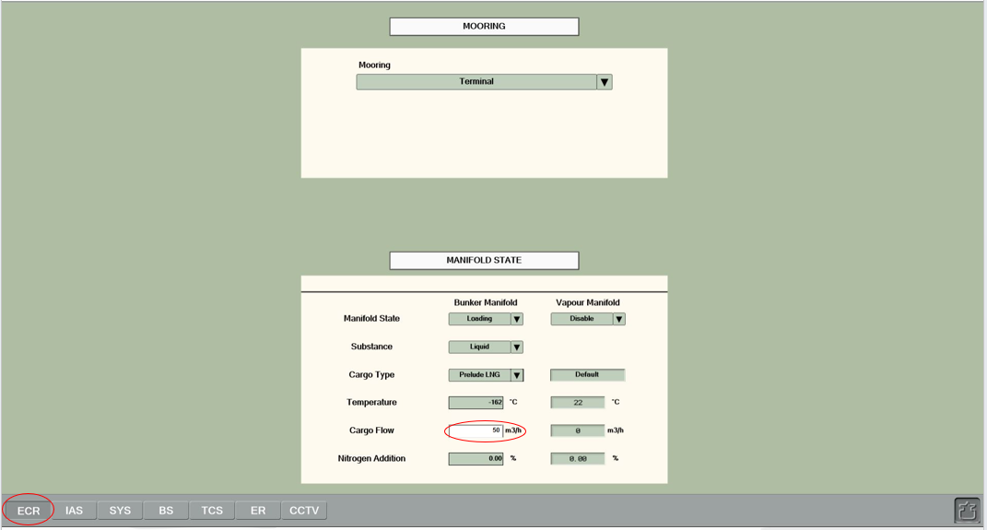
Enter 50 m³/h flow value in the Cargo Flow box.
NOTE: Now cargo flows into the tank (with 5-time acceleration)

Slide 36
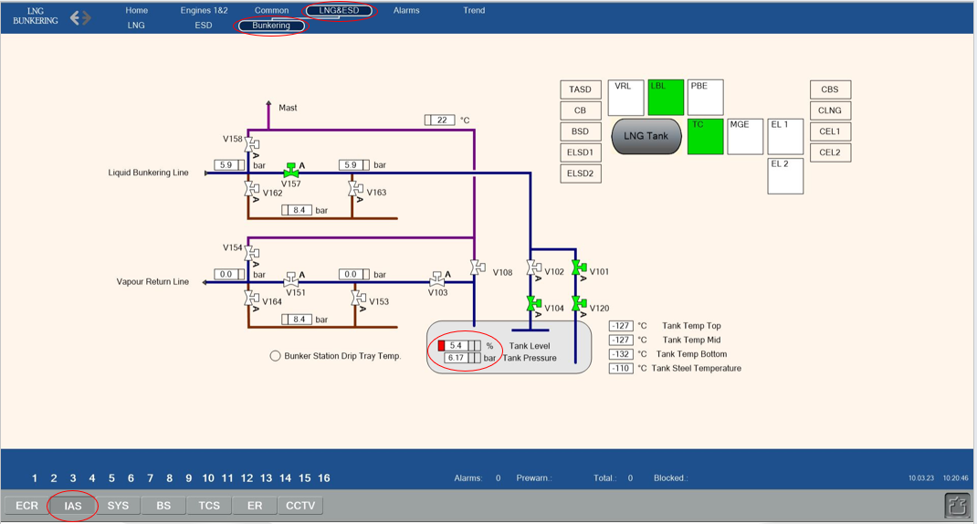
- Monitor the bunkering process until the tank level reaches 10%.
- Monitor the tank level and pressure readings from the IAS > LNG&ESD > Bunkering page.

Slide 37
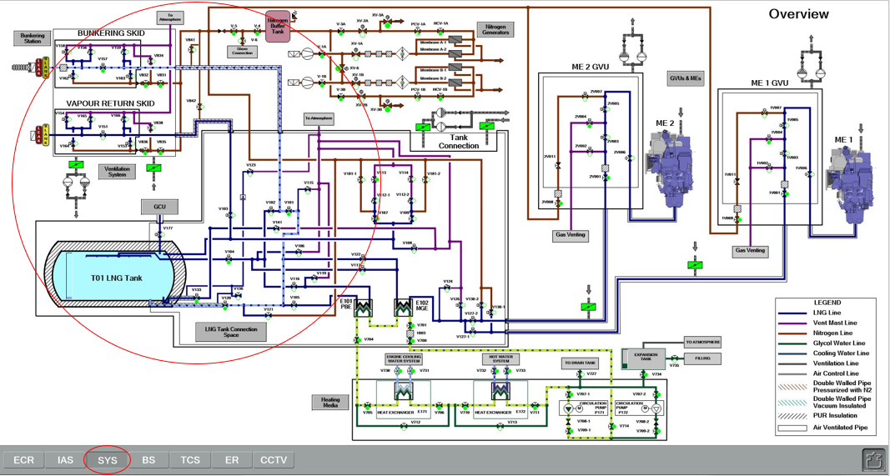
- Check the liquid flow from the SYS > Overview page (hints should be turned on)

Slide 38
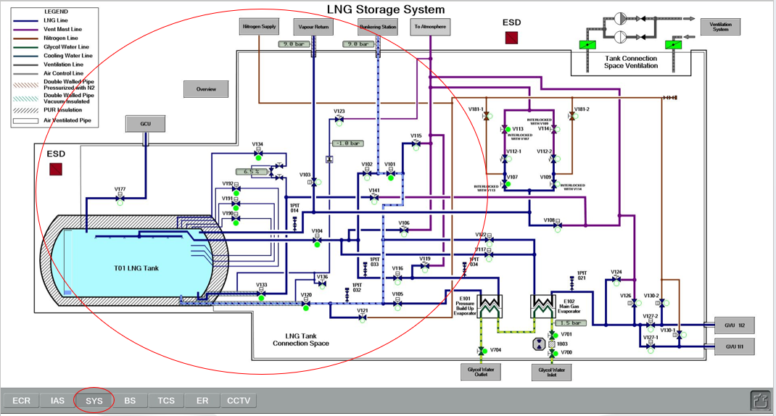
Bunkering start is successfully performed.

