Slide 1
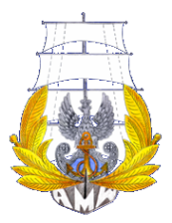
SEMINAR
SHIP BOILERS

Slide 2
Types of auxiliary boiler and heat medium boiler
Although auxiliary steam boilers are classified in several types, there are two types of auxiliary steam boiler from the aspect of structure, which are smoke tube type and water tube type. In the smoke tube type, combustion gas goes through in the smoke tube heating boiler water and boiler water goes through inside the water tube mounted in an exhaust gas passage in the water tube type boiler.
Heat medium boiler is not so popular so far however it is recently used especially on board domestic ships in cases where higher temperature than the steam is necessary and steam is not used for accommodation. In case of steam, higher temperature causes higher pressure and it can be avoided by using the heat medium boiler. In addition, if they use electric power for their accommodation, it is not necessary for them to use steam

Slide 3
Feed water system and its control system
Feed water system is a system to supply boiler water to a boiler and includes feed water pump, feed water heater (not included in some cases) and level control system.
Feed water pump
This pump compresses feed water until higher pressure than pressure of the boiler in order
to supply feed water to the boiler. Amount of water supply to the boiler usually varies according to steam consumption. For this reason, a circulating line is installed on the delivery side of the pump to avoid overheat of the pump casing when feed water control valve close. Most of the feed water pumps are electric motor driven pump and its type is centrifugal pump.

Slide 4
Feed water system and its control system
Feed water system is a system to supply boiler water to a boiler and includes feed water pump, feed water heater (not included in some cases) and level control system.
The line is quite simple however various ideas are incorporated in the system.
4.1 Feed water pump
This pump compresses feed water until higher pressure than pressure of the boiler in order
to supply feed water to the boiler. In case of smaller size of auxiliary boiler less than 3 ton/h of evaporation, the pump is started/stopped intermittently by level signal (ON-OFF Control). Other than that, most of feed water pump used for auxiliary boiler continuously run as long as the boiler is in service. However, amount of water supply to the boiler usually varies according to steam consumption. For this reason, a circulating line is installed on the delivery side of the pump to avoid overheat of the pump casing when feed water control valve close. Most of the feed water pumps are electric motor driven pump and its type is centrifugal pump.
4.2 Level control system
Level control system includes feed water control valve and its associated devices, level controller, level detecting equipment. This system is operated by various methodologies according to functions of boilers and other conditions.
(a) Feed water control valve and its associate devices
Most of feed water control valve is an air pneumatic diaphragm valve and a positioner is fitted to the control valve according to the valve capacity/size. The control valve is operated by a control signal (controller output: air, electric current/volt).
In case of controller output signal cannot control directly the valve, the positioner is used to ensure stable operation of the valve by converting/amplifying controller output. An air regulator and filter are also used to supply clean compressed air to the control valve and the positioner.

Slide 5
Level control system
Level control system includes feed water control valve and its associated devices, level controller, level detecting equipment. This system is operated by various methodologies according to functions of boilers and other conditions.
(a) Feed water control valve and its associate devices
Most of feed water control valve is an air pneumatic diaphragm valve and a positioner is fitted to the control valve according to the valve capacity/size. The control valve is operated by a control signal (controller output: air, electric current/volt).
In case of controller output signal cannot control directly the valve, the positioner is used to ensure stable operation of the valve by converting/amplifying controller output. An air regulator and filter are also used to supply clean compressed air to the control valve and the positioner.

Slide 6
(b) Level controller:
“PID” (Proportional, Integral and Derivative) controller is used for most of level controllers as a control methodology and its operation is performed by a pneumatic system or electronic system. “PI” control is usually used for controlling the water level of auxiliary boilers and “D” control is seldom used for level control. In some cases, PLC (Programmable Logic Controller) is used as an electronic system control however the control principle of PLC is same as PID.
PI control is a control action that integral action is added to the proportional action and proportional action is an output signal proportional to a deviation value.
The deviation value is a difference between the setting value and detected present value. Integral action is an output signal proportional to time integration of deviation value.

Slide 7
(c) Level detection equipment
Level detection of boiler water is performed by level condenser and differential pressure transmitter. The level condenser maintains constant water head in the condenser and difference pressure between the constant water level and actual boiler water level is represented by the movement of torque arm in the differential pressure transmitter. The transmitter outputs an air/electric signal according to the movement of the torque arm. The output is transmitted to the controller.
The principle of converting signal (movement of torque arm) is a nozzle flapper for a pneumatic converter and electromagnetic induction for an electric converter.

Slide 9
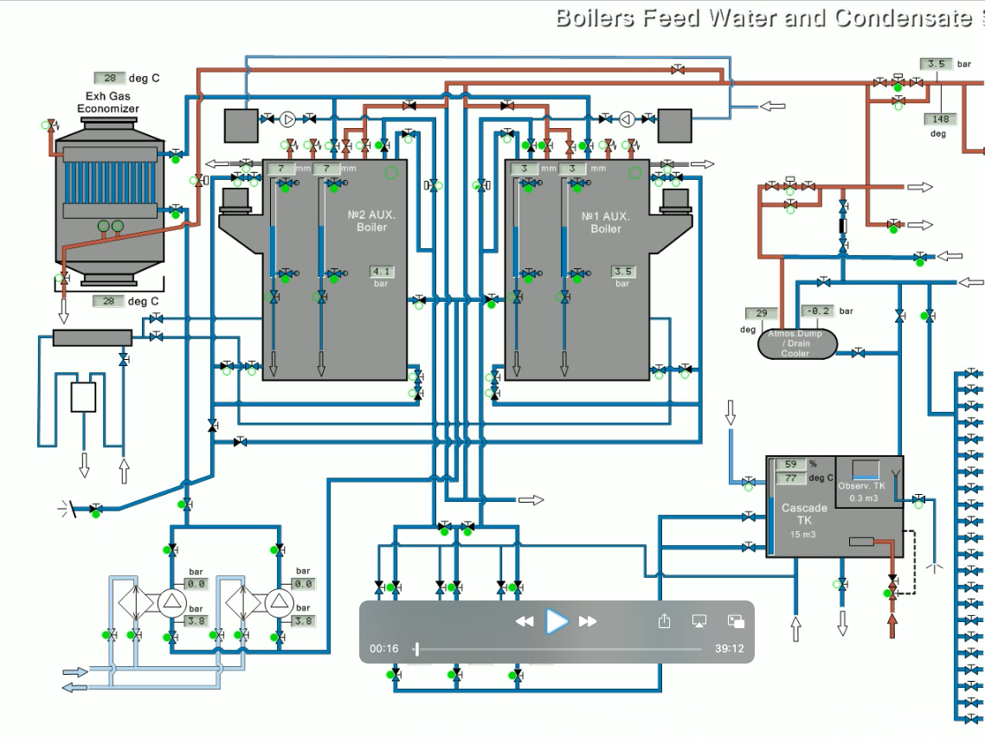

Slide 10
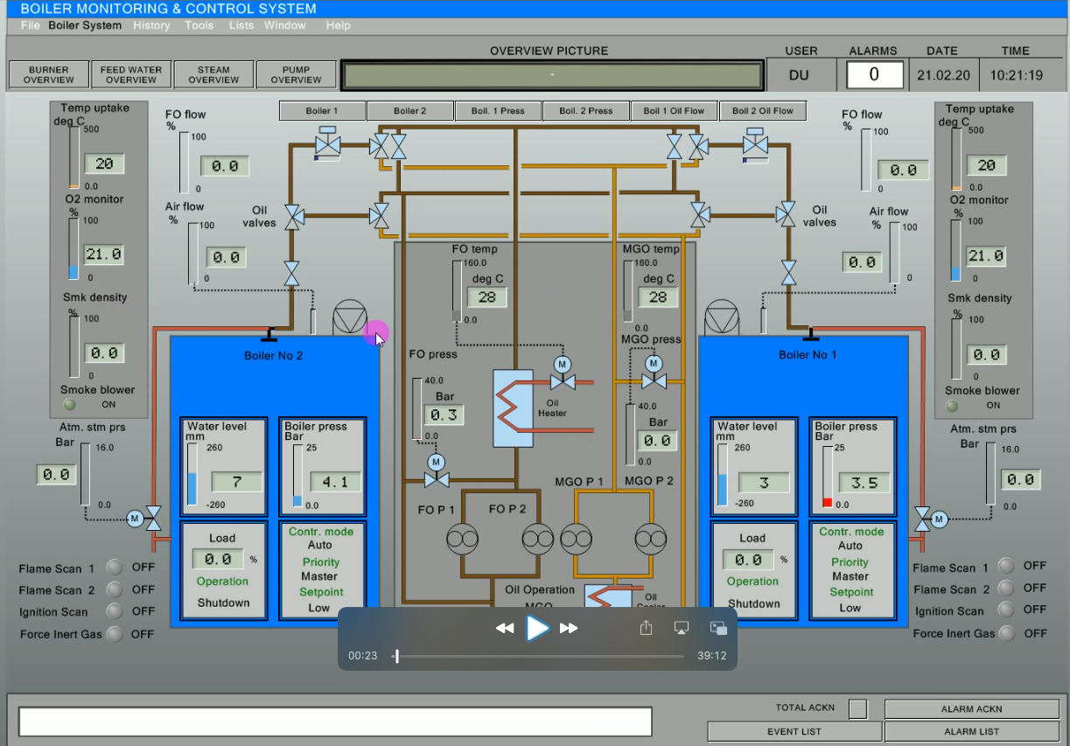

Slide 11
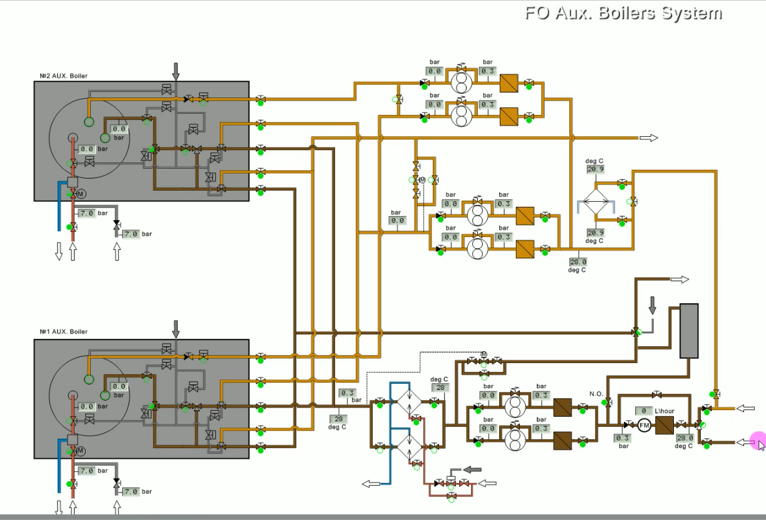

Slide 12
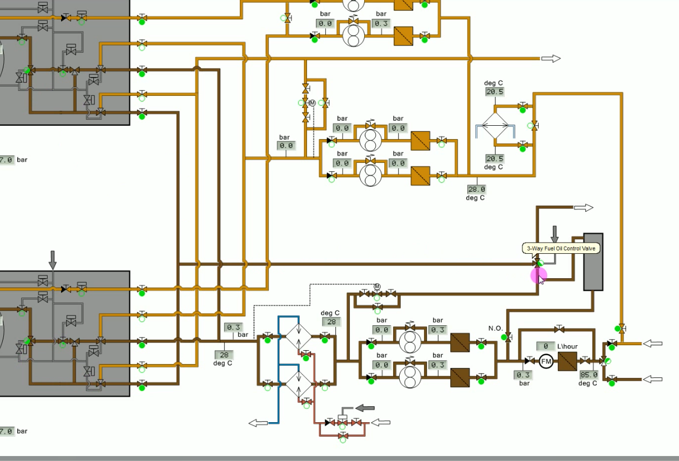

Slide 13
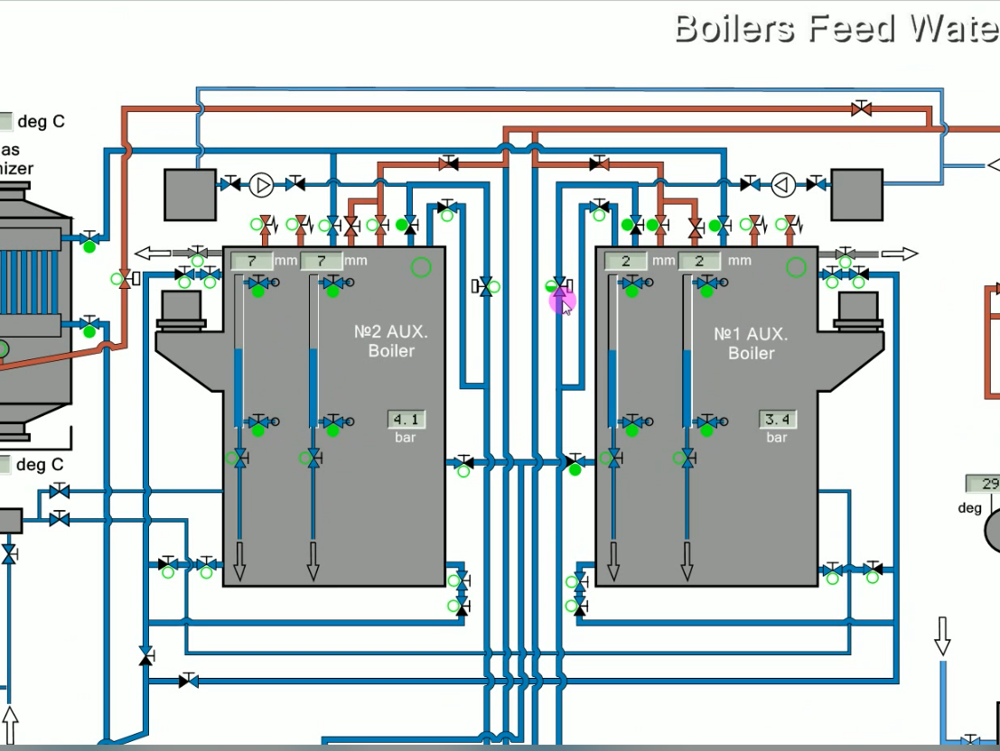

Slide 14
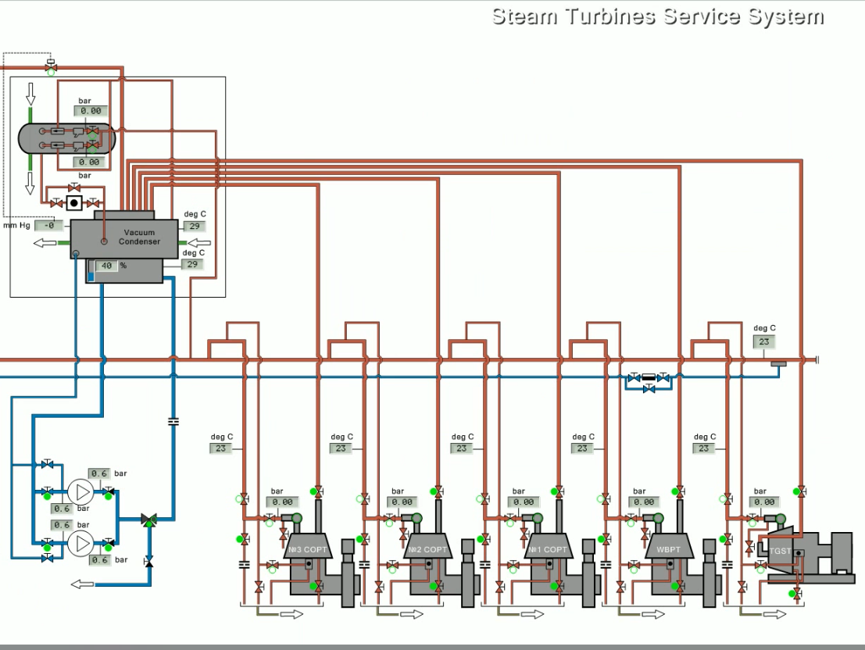

Slide 15
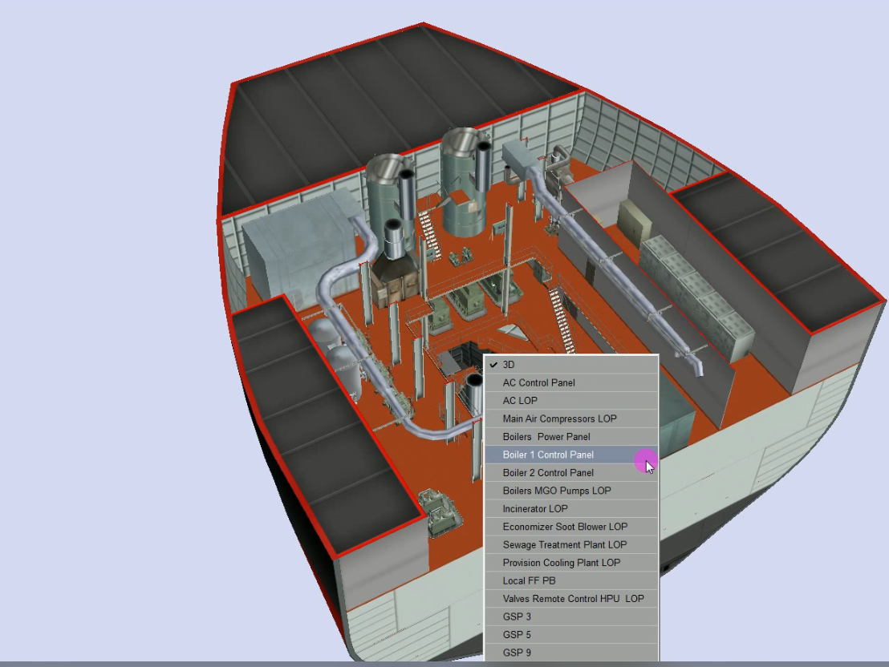

Slide 16
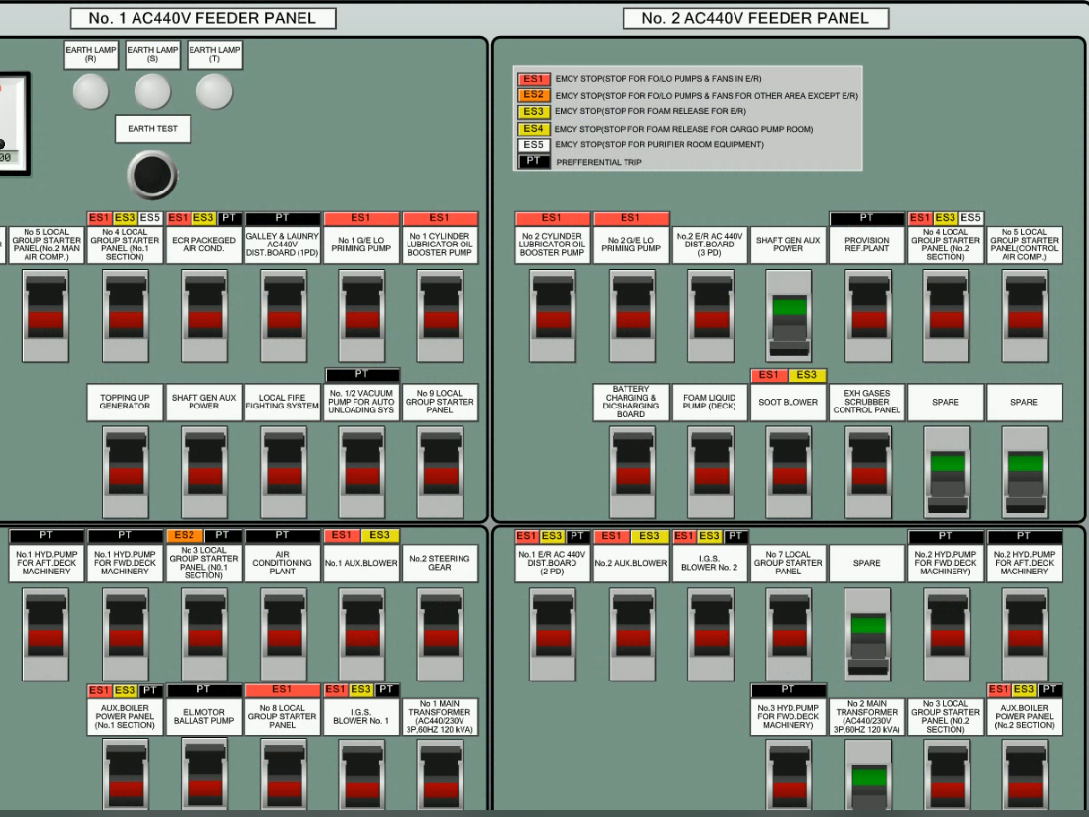

Slide 17
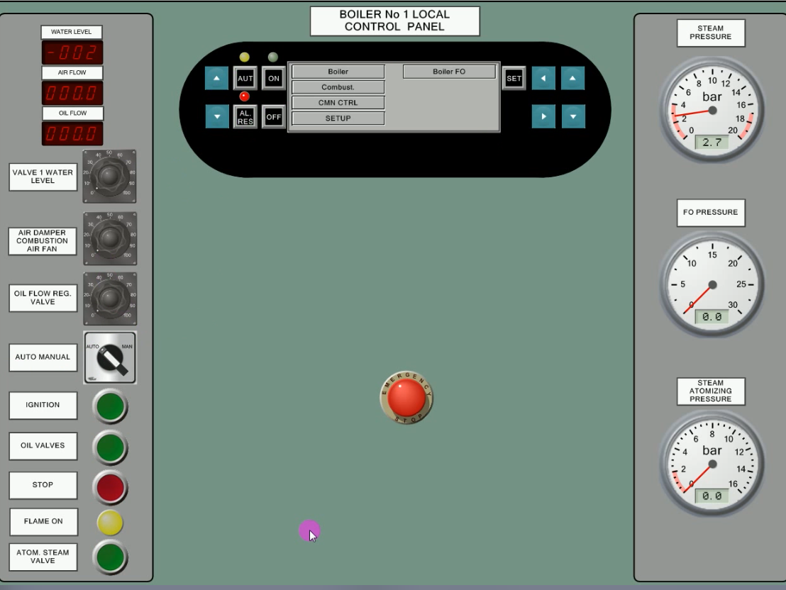

Slide 18
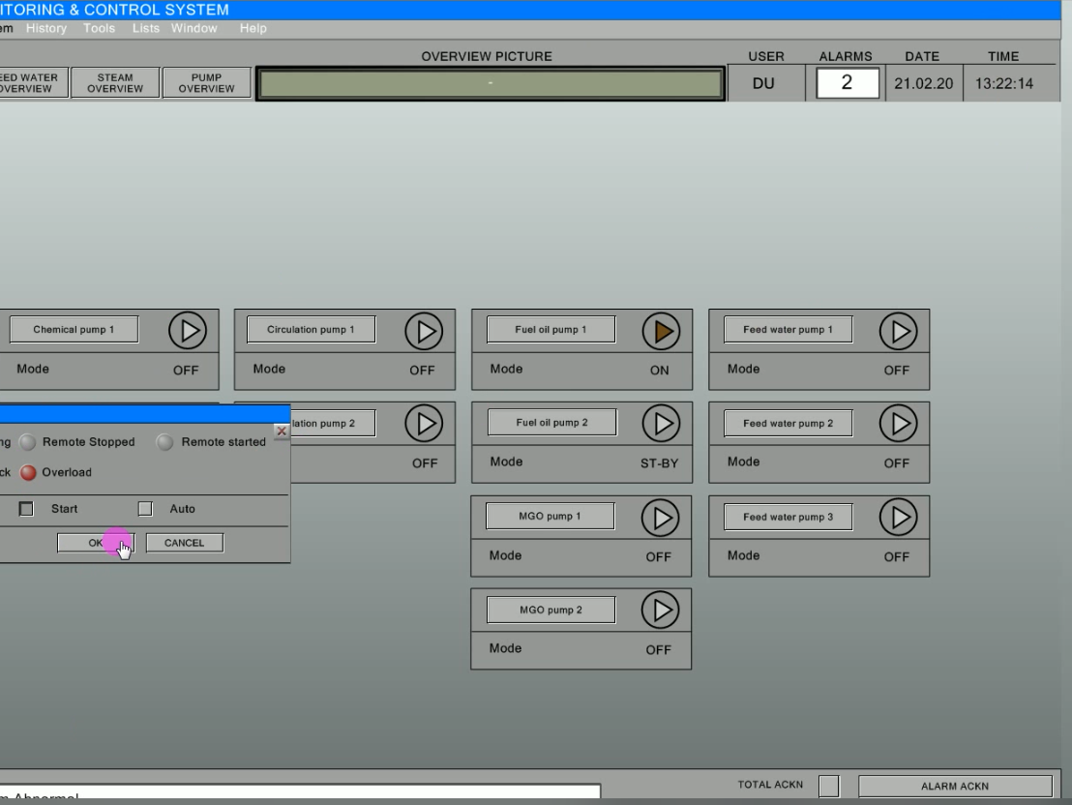

Slide 19
