Slide 1
SHIP GENERATORS
MARS-NET PROJECT

Slide 2
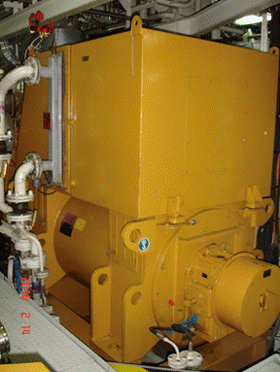
The electrical power demand on board ship will vary according to the ship type and its day-to-day operational needs (at sea or in port).
To meet the power demand, two or more main generators are used, which are backed up by an emergency generator and an emergency battery service.

Slide 3
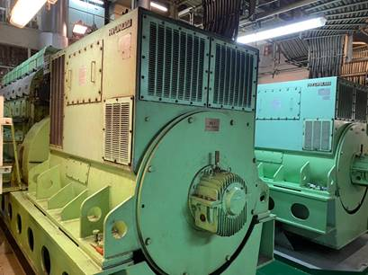
CONSTRUCTION OF GENERATORS

Slide 4
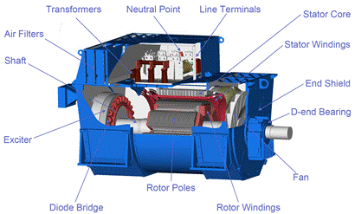
AC GENERATORS

Slide 5
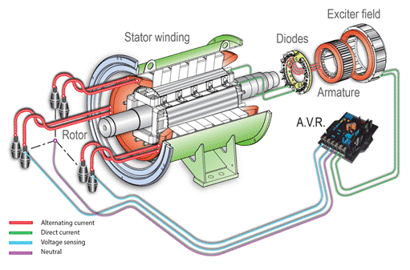
INTERNAL CONNECTIPNS

Slide 6
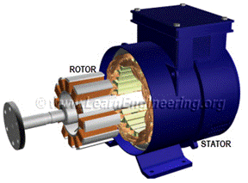
MAIN COMPONENTS

Slide 7
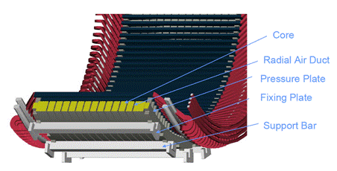
STATOR WINDING

Slide 8
ROTOR WINDING

Slide 9
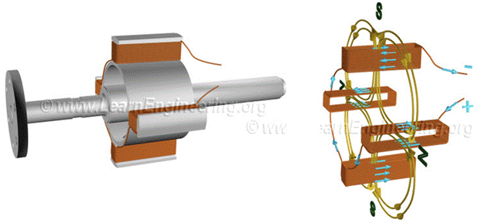
4 pole salient pole rotor and magnetic field produced around it when excited by a DC power supply

Slide 10
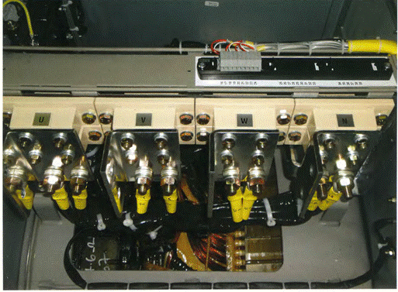
GENERATOR TERMINAL BOX

Slide 11
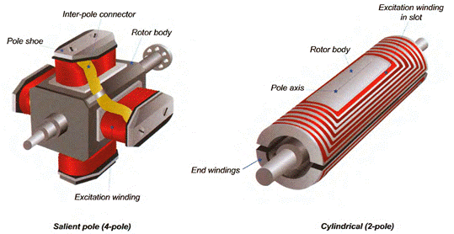
GENERATOR ROTORS SALIENT AND CYLINDRICAL CONSTRUCTION

Slide 12
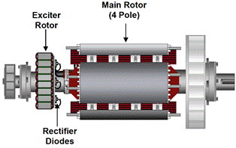
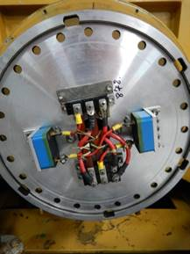
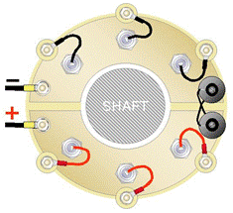
ROTOR DIODE PLATE
EXCITATION SYSTEM

Slide 13
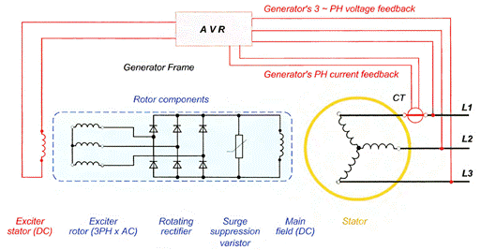
EXCITATION SYSTEM

Slide 14
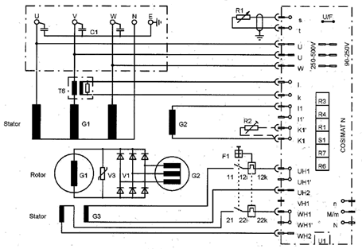
BRUSHLESS EXCITATION SYSTEM

Slide 15
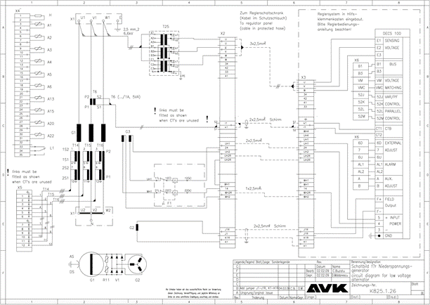
AVK GENERATOR CIRCUIT DIAGRAM

Slide 16
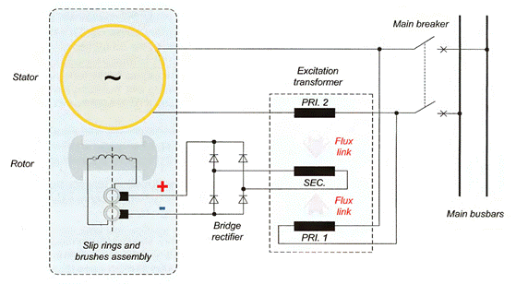
SINGLE-PHASE COMPOUND EXCITATION CIRCUIT

Slide 17
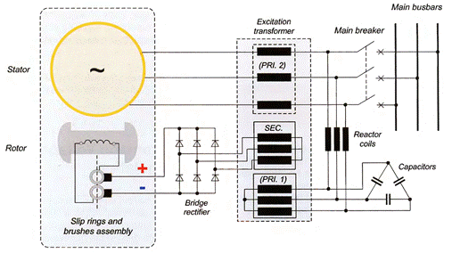
THREE-PHASE COMPOUND EXCITATION CIRCUIT

Slide 18
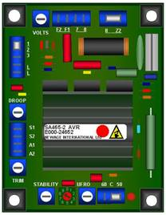
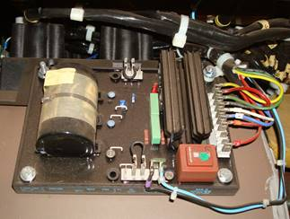
AUTOMATIC VOLTAGE REGULATOR (AVR) (ANALOGUE TYPE)

Slide 19
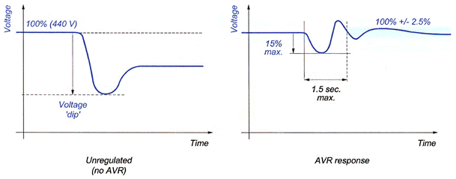
GENERATOR AVR VOLTAGE RESPONSE

Slide 20
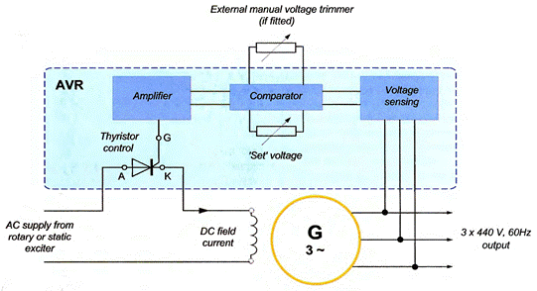
AVR BLOCK DIAGRAM

Slide 21
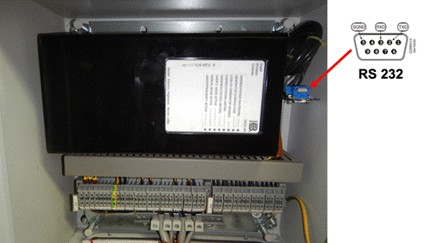
DIGITAL EXCITATION CONTROL SYSTEM (DECS)

Slide 22
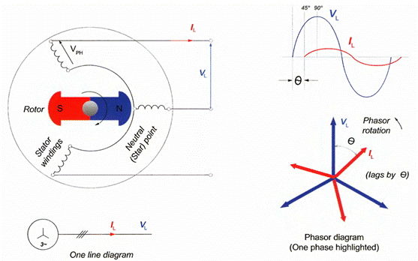
PRINCIPLE OF GENERATOR OPERATION

Slide 23
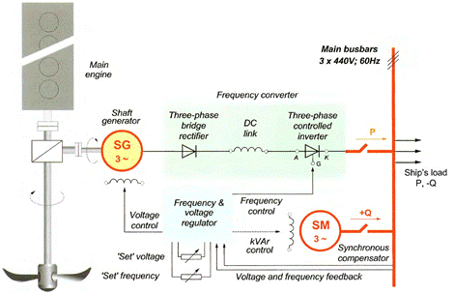
SHAFT-DRIVEN GENERATOR CONTROL

Slide 24
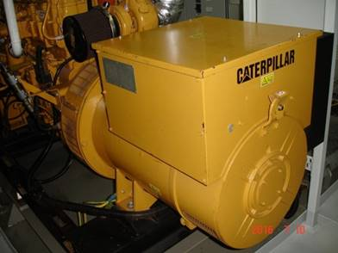
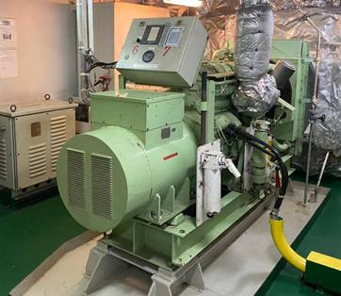
EMERGENCY GENERATOR

