Slide 1
STRUCTURE OF AIR COMPRESSOR
WORKING PRINCIPLES
AND
MAINTENANCE

Slide 2
Function and working principles of air compressor
Compressed air is used for starting diesel engines, controlling machinery and general use and their pressures are 2.5〜3.0 MPa for starting diesel engines and 0.8〜1.0 MPa for control and 0.4 MPa for general uses. These compressed airs are generated by reciprocating air compressors and the operation principle is same as a reciprocating pump however unlike the pump, two stages or multi stages compression system is usually applied for air compressors to avoid high temperature of compressed air and consequent damages.
In case of one stage compression, the temperature of the compressed air would be approximately 450℃ at 2.5〜3.0 MPa by compressing air of 20℃ at atmospheric pressure and it causes various damages. This can be avoided by adopting multi compression with intercoolers.

Slide 3
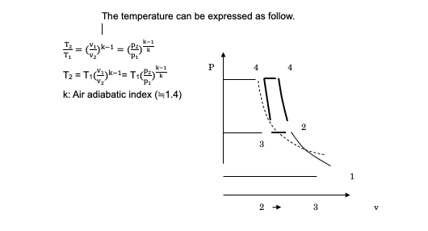

Slide 4
The advantages of multi compression system are as follow
・The temperature of compressed air can be kept within ordinary temperature.
・Power for driving compressor can be saved.
・Volumetric efficiency can be increased.
・Rapid deterioration of lubricating oil can be avoided.

Slide 5
1.1 Main air compressor/Starting air compressor (2.5〜3.0 MPa)
This air compressor generates staring air for diesel engines sending it to main air reservoirs and usually they have two sets of the main air compressor and main air reservoir considering their importance. There are some regulations when deciding their specific capacities such as compression speed, maximum pressure and others.
1.2 Control air compressor (0.8〜1.0 MPa)
This air compressor generates control air sending it to control air reservoir and used for automatic control of machinery such as main engine, generators, boilers automatic operations and others. In many cases, control air compressor has special structural features to avoid oil contamination of the compressed air. Actual pressures to be used as control air would be lower than the pressure generated by the compressor. Namely, control air must be supplied to the systems depending on the demands of characteristics of the machinery by reducing the pressure.

Slide 6
1.3 Ship’s service air compressor (0.8〜1.0 MPa)
This compressor generates compressed air sending it to miscellaneous air reservoir and the compressed air is used for general use such as cleaning, pressurizing tanks and others. If they have no service air compressor, the air deducing its pressure from the main air reservoir would be used for this purpose instead.
1.4. Emergency air compressor (2.5〜3.0 MPa)
When they have no compressed air due to overhauling of compressors and air reservoirs, and other reasons, emergency air compressor is used to generate primary compressed air to start generator. They operates emergency air compressor by hand sending compressed air to emergency air reservoir.

Slide 7
Structure of air compressor and operation mechanism
There are two types of structures which are one cylinder type and multi cylinder type. The one cylinder type has one piton combining two different diameters of pistons and the larger diameter piston generates the first stage compressed air and the smaller diameter piton generates the second stage compressed sir. This type compressor always gives an equal compression force to its crank shaft. Two or multi cylinder type compressor has pistons depending on the number of stages. The air compressors are usually operated automatically by pressure switches mounted to air reservoirs including automatic drain discharge mechanism.

Slide 8
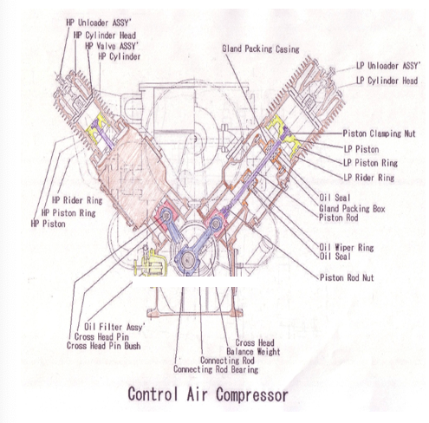

Slide 9
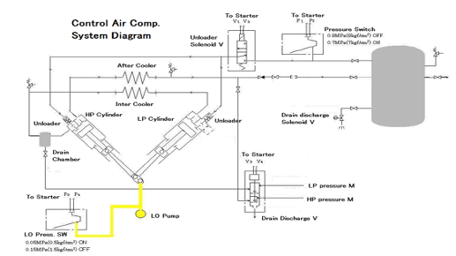

Slide 10
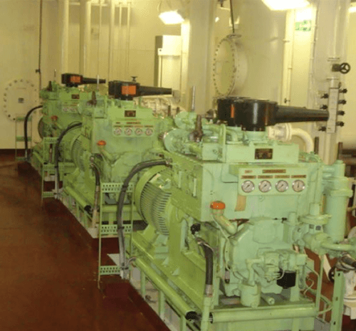
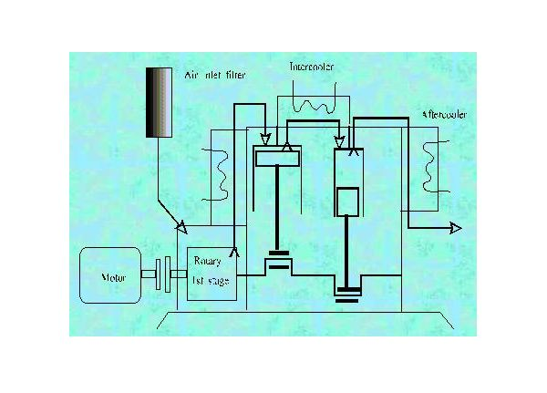
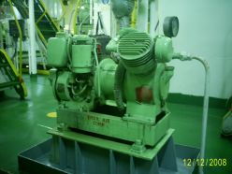

Slide 11
