Slide 1
ELECTRICAL DISTRIBUTION
SYSTEMS

Slide 2
AIM
SIMULATION OF OPERATIONS AND MAINTAINENANCE OF THE ELECTRICAL DISTRIBUTION SYSTEMS ECONOMICALLY, CONTINUOSLY, EFFICIENTLY, SAFELY, SECURELY AND ENVIRONMENT FRIENDLY
UNDER THE LIGTH OF KNOWLEDGE AND EXPERIENCE

Slide 3
OBJECTIVES
Be familiar with the use of electrical distribution systems and parameters,
Develop proper pre-planning and the use of start up check list,
Develope awareness of correct watch keeping procedures,
Understand the interdependency of various Machinery,
Obtain experience in identifying operational problems,
Improve decision-making ability for efficient plant operation.
Make effective contribution to machinery installation.
Make analyzes and definitions to make correct decisions.

Slide 4
ASSESMENT CRITERIA
Knowing ship electrical distribution systems systems
Familiarization on command and control elements
Understanding data signalization
Understanding system and machine relations
Familiarity in chain-events algorithm
Effective monitoring of operating values
Behaviour in emergencies

Slide 5
ASSESMENT
COMMON SKILLS
Self-management and improvement
Using the human, machine, automation relationship
Establishing team-work
Managing tasks and solving problems
Using references for details
Implementing the procedures
Generating creative ideas and designs

Slide 6
ELECTRICAL DISTRIBUTION SYSTEMS
The control of the machine is in this panel, if I take it to the bridge then I can't control my machine from here, then look at the bridge flashing. You've seen it from here, the bridge control console should be here... we can start and stop the machine directly from here. Look, when I moved, it immediately alarmed... It said wrong way alarm. See, the alarm started flashing. I can see this alarm from the main alarm panel.
You can also see the inert gas monitor from here. Besides this, you can see the main switch board, the main electrical distribution system of our entire ship.
All of these are defined in the electrical section.
Just below you see the electrical panels. Diesel panels are in the engine room panel

Slide 7
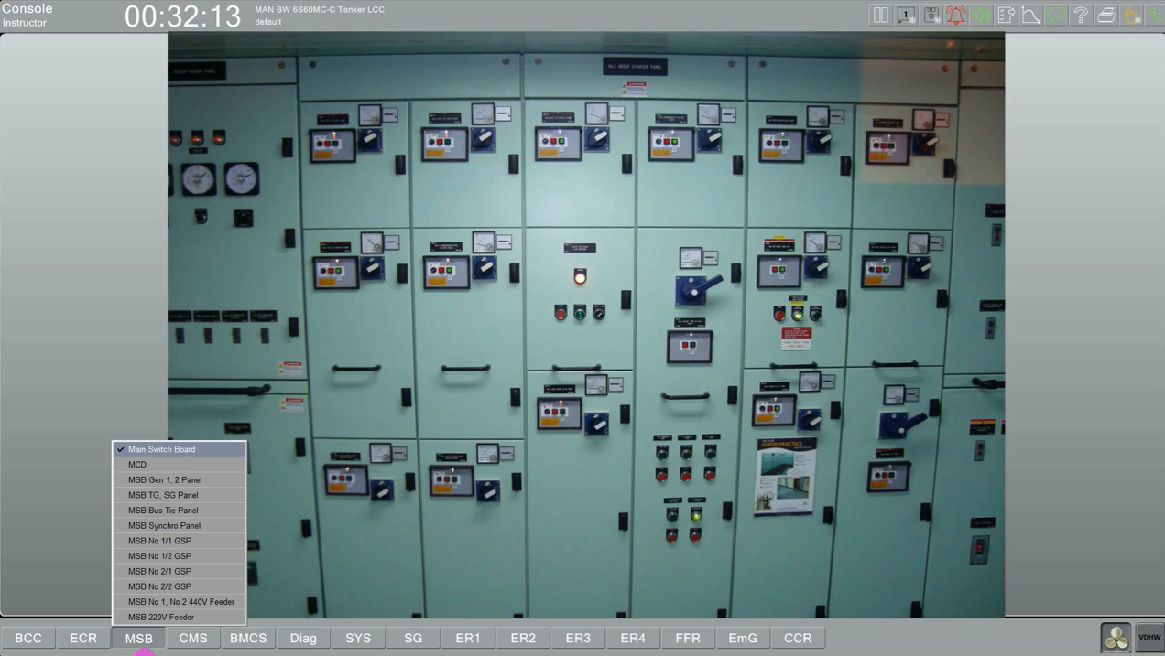

Slide 8
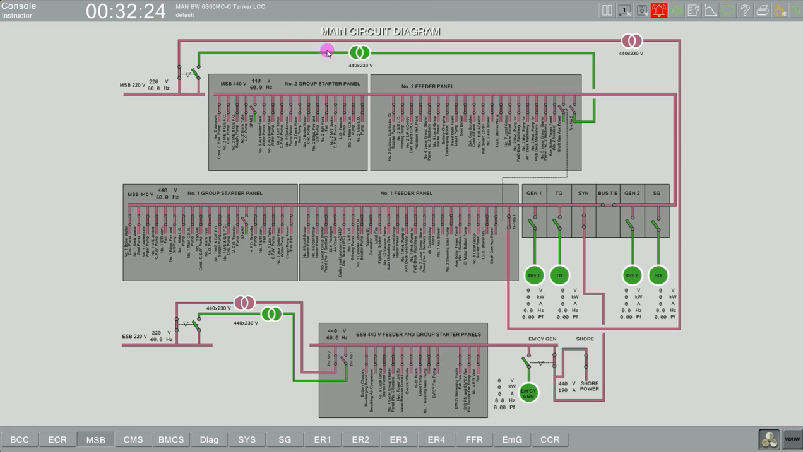

Slide 9
These here are the electrical panels... look, just below the main switch board it says turbo generator shaft generator. There is a turbo generator, a shaft generator and two diesel generators on board...These panels are almost the same as the others... there is a slight difference here. I will show you that when I explain the shaft generator... Moving on. There's a bus tie panel. I'm closing the bus tie. Underneath it, it says synchro panel. Since there is alternating current, I need to synchronize two generators to connect them to each other. I will do these operations through this panel. I will always explain these in the electrical section.

Slide 10
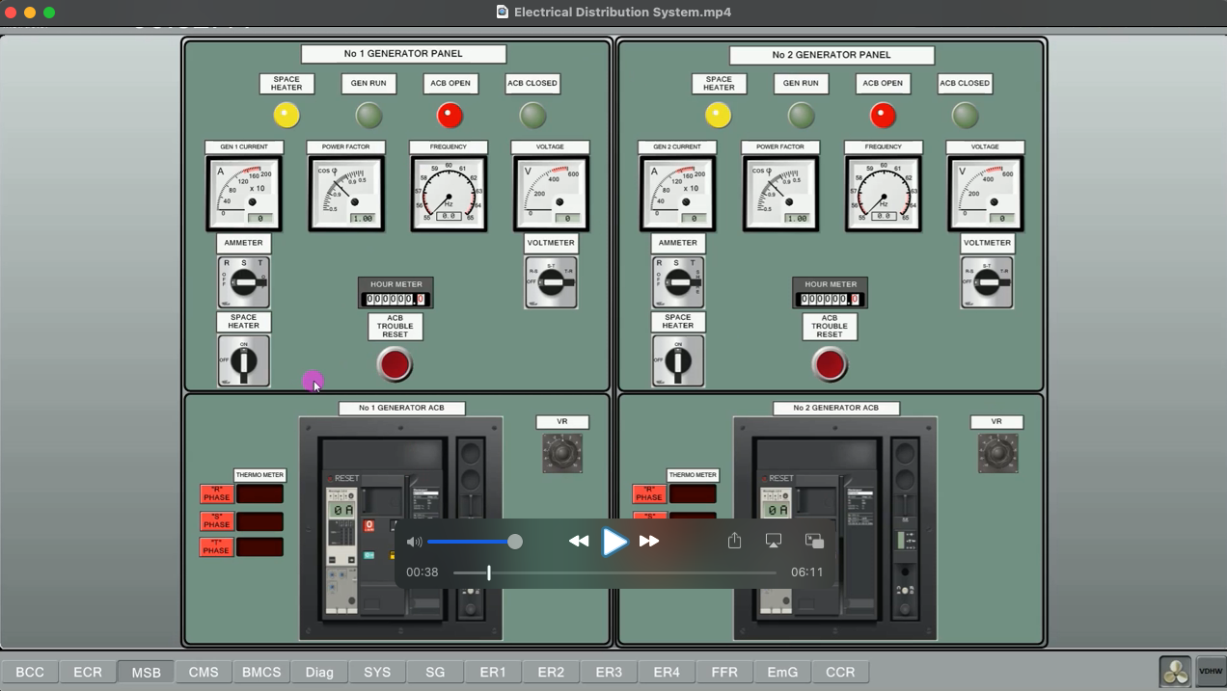

Slide 11
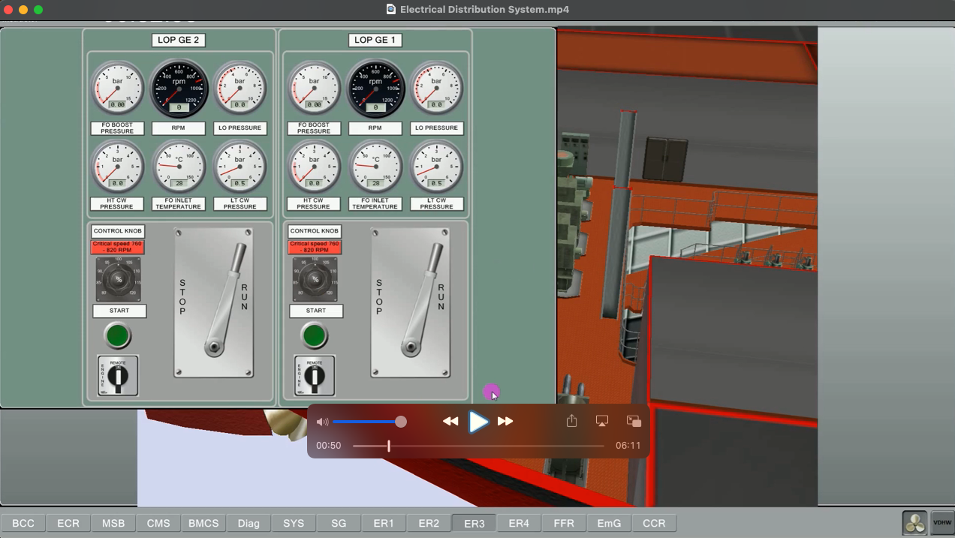

Slide 12
I have group starter panels. I have 1,2,3,4, you can see them here. I have a 440 distribution panel and a 220 distribution panel underneath it. So we can follow the entire electrical system on board under the main switch board panel. Next to it, it says control monitoring system. Yes... this system is a panel prepared for the automatic use of the ship. You can see there are sub-menus of it here. The menus under the CMS control monitoring system page... for example seawater cooling system. Let's come here. Here we can run the pumps. For example, my main seawater pumps are here... let's see if it will work... I press it... it didn't work. Why not? AA. It's controlled by the MSB. It's on the main switch board.

Slide 13
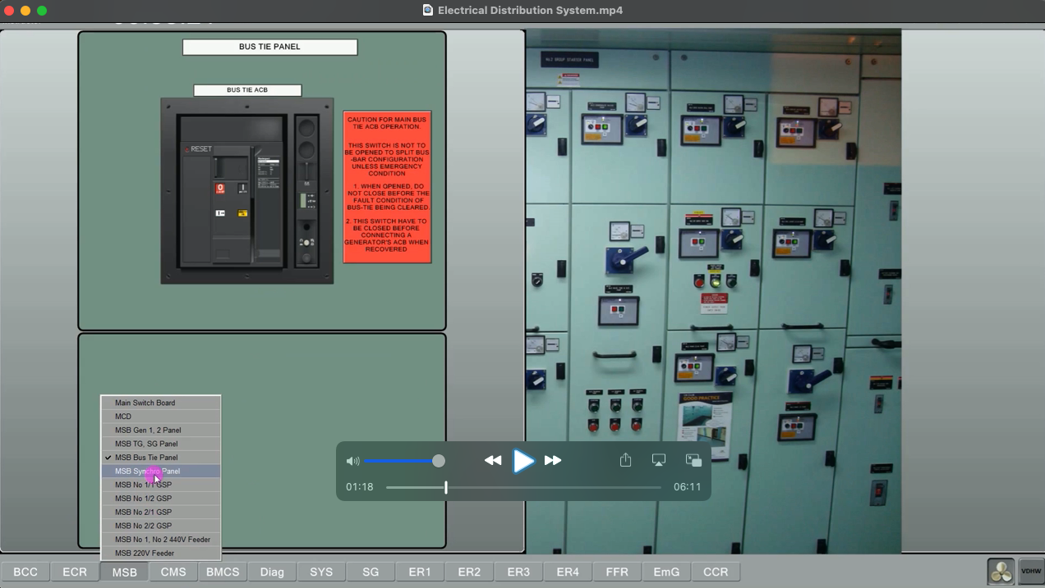

Slide 14
I have to go to the main switch board and find the board. The board should be over there. Main Switch Board is here. If I get it into the CMS... Control Monitoring system... then I can run it. What number is it? Number 1. I can control it from here. This is Number 1. Look, it says CMS, see here? Look, I pressed it….. now my pump is working, see, it's green inside. This one doesn't work, it's empty... see, it identifies it here. If it's like this, it means there's no power in this panel. If it's yellow like you see here, it means it's in local control.

Slide 15
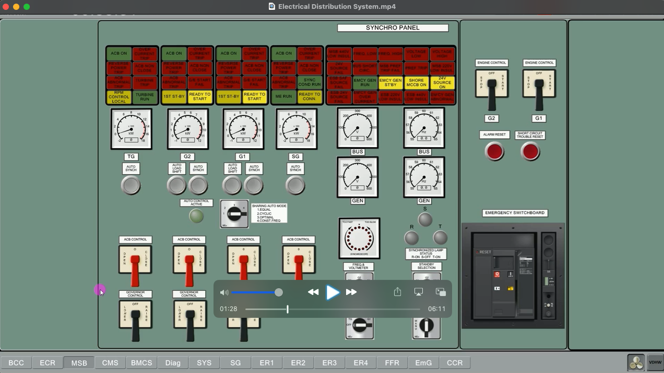

Slide 16
For the seawater pump, if you remember what I did. I did it like this…...these were the sea water pumps... I pressed it from here...I turned it on...see? Number two sea water pump is already running...let me take it to local. Now let me come and look from here. What will happen? See it turned yellow... it says... it's local...go start it from there... you can't control this pump from here anymore... if it's full... as you can see here... it's working. It's running from the local... then I'll go and start it from the local... I say start it from the local... it worked... Let's come here and look... Yellow... local... full... running. Here we have all the subsets of CMS… This is seawater. This is low temperature system...this is high temperature...This is auxiliary boiler… boiler has submenus

Slide 17
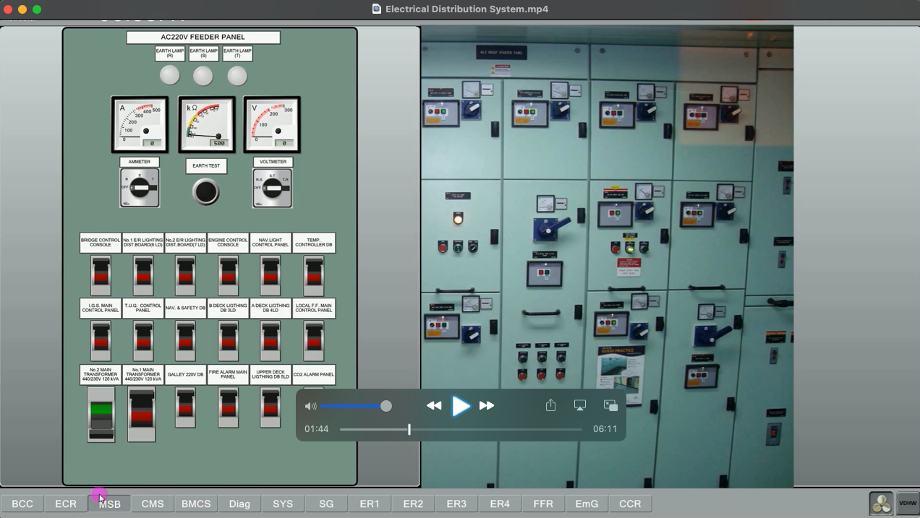

Slide 18
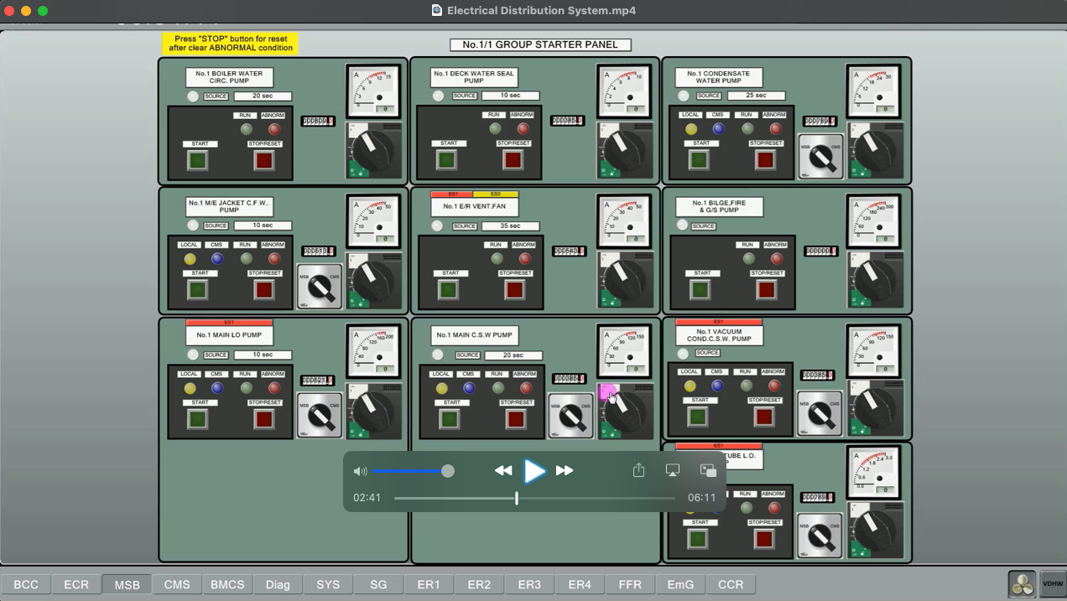

Slide 19
REFERENCES
STCW-Chapter VIII section A-VIII2, part 3-Watchkeeping at sea
Marine Engine Watchkeeping-STCW-IMO
IMO-Model Course-7.04-Officer in Charge of an Engineering Watch
STCW-Seafarers’ Training, Certification and Watchkeeping
TechSim_5000_ENG_Instructor_Manual(8.6)
TRANSAS-ERS 5000 Simultor.

