Slide 1
OPERATION
OF
CONTROL SYSTEMS

Slide 2
AIM
SIMULATION OF OPERATIONS AND MAINTAINENANCE OF THE SHIP CONTROL SYSTEMS ECONOMICALLY, CONTINUOSLY, EFFICIENTLY, SAFELY, SECURELY AND ENVIRONMENT FRIENDLY
UNDER THE LIGTH OF KNOWLEDGE AND EXPERIENCE

Slide 3
OBJECTIVES
Be familiar with the use of control systems and parameters,
Develop proper pre-planning and the use of start up check list,
Develope awareness of correct watch keeping procedures,
Understand the interdependency of various Machinery,
Obtain experience in identifying operational problems,
Improve decision-making ability for efficient plant operation.
Make effective contribution to machinery installation.
Make analyzes and definitions to make correct decisions.

Slide 4
ASSESMENT CRITERIA
Knowing ship control systems
Familiarization on command and control elements
Understanding data signalization
Understanding system and machine relations
Familiarity in chain-events algorithm
Effective monitoring of operating values
Behaviour in emergencies

Slide 5
ASSESMENT
COMMON SKILLS
Self-management and improvement
Using the human, machine, automation relationship
Establishing team-work
Managing tasks and solving problems
Using references for details
Implementing the procedures
Generating creative ideas and designs

Slide 6
OPERATION OF CONTROL SYSTEMS
There is a menu that shows whether my boilers are activated or not. Of course, I will not activate the boilers from here, I will activate them from another …..
Next to it I have my rudder adjustment panel. I have soft blowers. In order to control the whole system automatically, of course, there must be a power in this panel. This is the main power... that is, the power panel of my control circuits. My control circuits, and I'll tell you more about them later. are fed from 24-volt DC batteries and 220-volt AC circuits. Look, 24 volts DC is fed from the panel...220 volts is fed from the normal power panel, 220 volts is fed from the emergency panel... If any of them goes out of circuit, this system automatically renews itself, brings the one that is in circuit to itself and activates it and feeds the system. If this was manual, then I could manually select one of the emergency circuits or the main circuit, that is, the 220s.

Slide 7
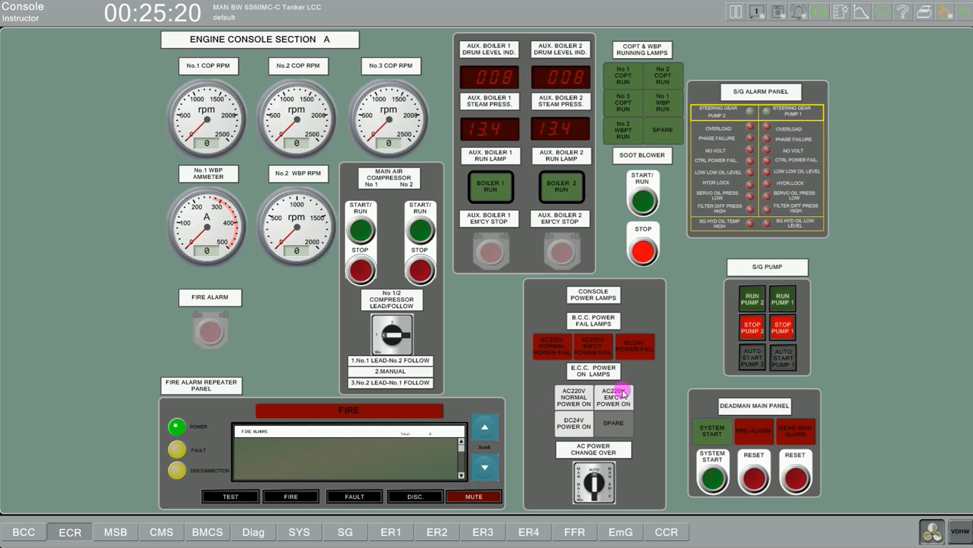

Slide 9
We always put it on automatic. We use it from automatic. There is a dead man panel next to it. What is this dead man panel? This dead man panel is this. This ship is a ship with an unmanned engine room, so there is no need for anyone to enter the engine room while we are on the road during normal operation. So we close the engine room and control everything from the normal control room. If we need to go down to the engine room in any way then we set this dead man alarm and it has a certain time... let's say we have 10 minutes. If we don't get out of the engine room within 10 minutes, the system alarms. It alarms from the bridge. Oh, they say that someone has entered the engine room and hasn't left for 10 minutes... I wonder if something has happened to him... Then they check... If our work in the engine room exceeds the time we have defined, then the person has to come to cancel this alarm. Look. I'm coming to the engine room, the dead man says reset, see? He has to come and reset the alarm from here. Therefore, he has to define another 10 minutes for himself. You will see this dead man reset on all machine room panels, see, it says dead man reset panel. Let's come here. It says deadman reset panel. See? In ER3, look, we have a dead man start panel... from here we'll put the dead man in or out…

Slide 10
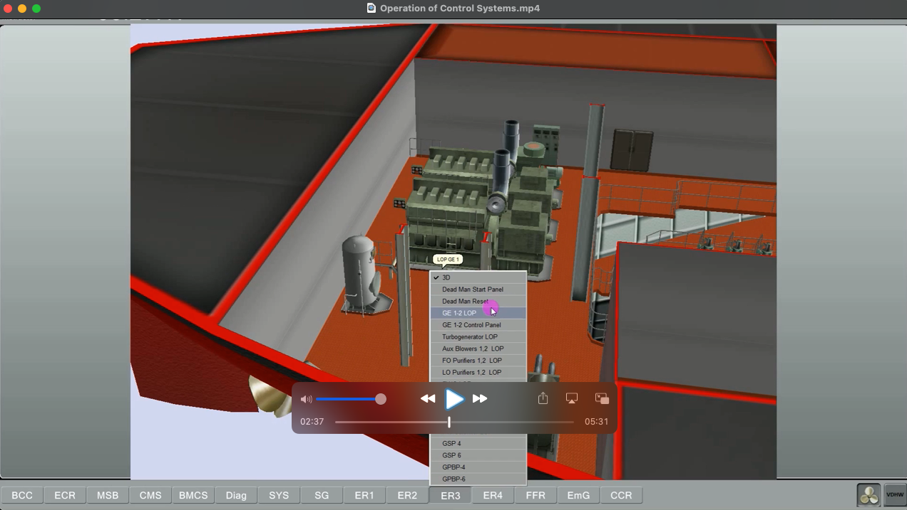

Slide 11
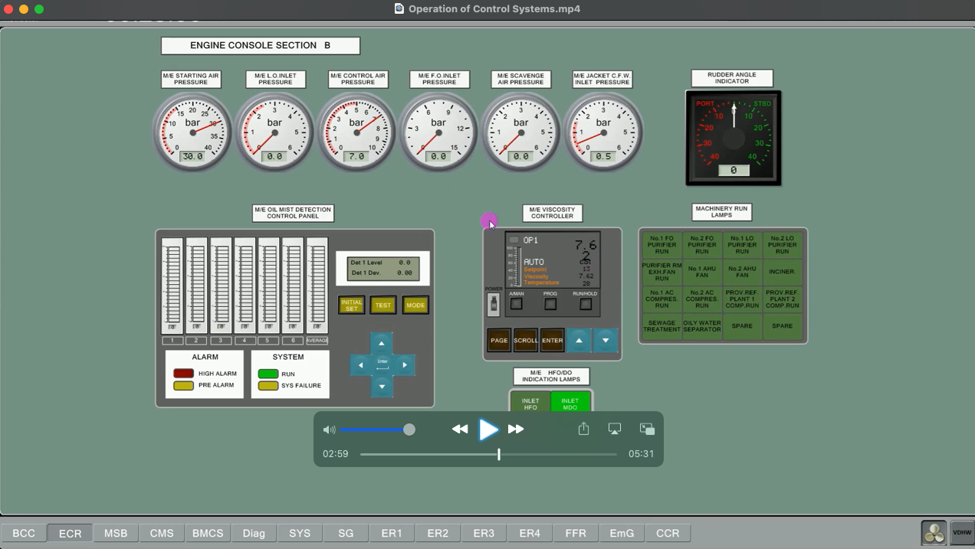

Slide 12
We have our viscus meter, our detector... and we have instruments where we see the main machine pressure and temperature values. Here we will see the systems that are in circuit, active, working. No1, if the purifier is on, this lamp should be on. And just below that, we'll see where your fuel system is. Is it running on fuel oil, is it running on diesel oil? We'll go just below.
Here we will check the main machine. Look, you see the speed of the machine... You see the turbo charger speed... How many... we see the loading amount... so let's say we see the index amounts of the fuel pumps. how much it is... Here we see the power produced by the main engine. We see the revolutions that our main engine makes. And from here, the control system... when we turn on our whole machine, these lights will light up in sequence and we will see that our machine is activated.

Slide 13
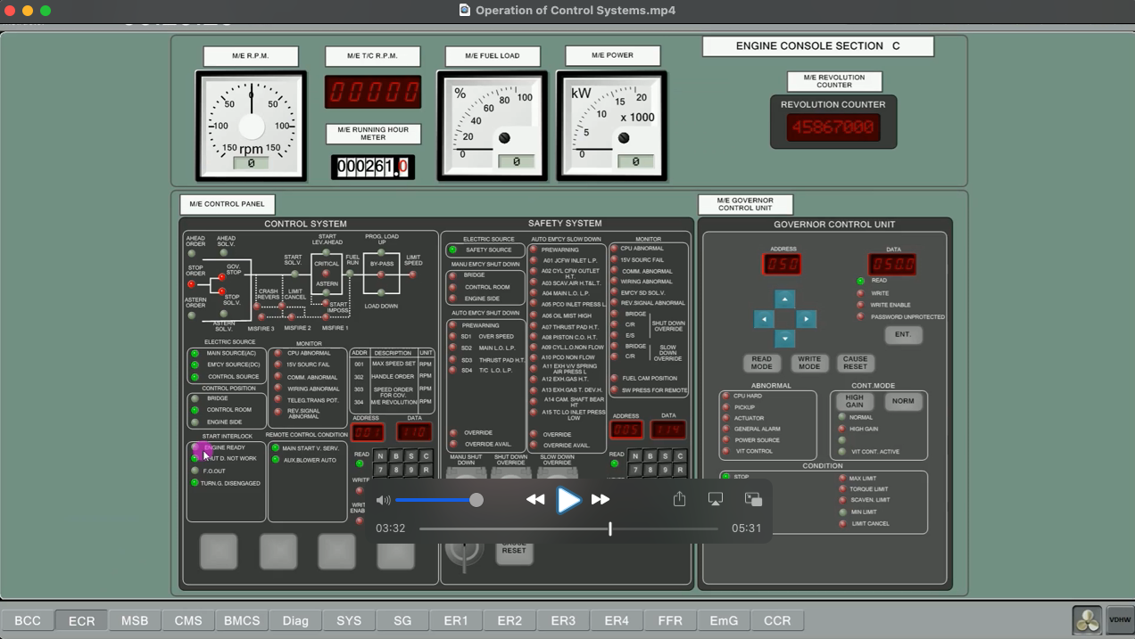

Slide 14
Our safety system is here, if any light comes on, we can follow what it gives here. Next to it, we have governor control. We can change this as we want from the main machine governor settings.
When I go down to the bottom, this is the main machine control panel. I can start and stop the main engine from here. This is a machine telegraph. This is where I respond to commands from the bridge, and this is where I can start and stop my machine.
When I move the lever on this button, look, it goes step by step. There are arrows here. If you type bar on them, we can see that it goes one by one. There is also the replicator control panel here. I will start and stop our replicators from here. I can also do it locally. So I can control them from inside the engine room or through this panel. I have a switch here. It says bridge engine control.

Slide 15
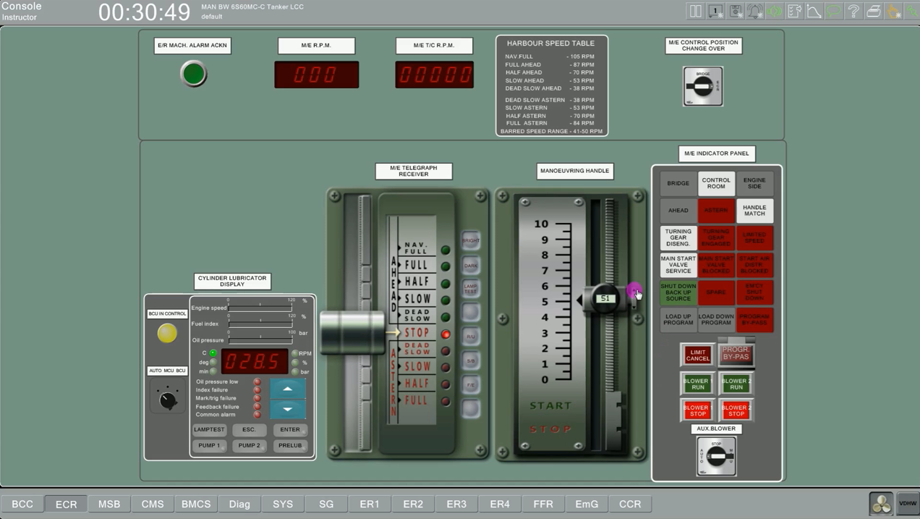

Slide 17
REFERENCES
STCW-Chapter VIII section A-VIII2, part 3-Watchkeeping at sea
Marine Engine Watchkeeping-STCW-IMO
IMO-Model Course-7.04-Officer in Charge of an Engineering Watch
STCW-Seafarers’ Training, Certification and Watchkeeping
TechSim_5000_ENG_Instructor_Manual(8.6)
TRANSAS-ERS 5000 Simultor.

