Slide 1
ENGINEE & BRIDGE
CONTROL CONSOLES

Slide 2
AIM
SIMULATION OF OPERATIONS AND MAINTAINENANCE OF THE SHIP SYSTEMS AND MACHINES ECONOMICALLY, CONTINUOSLY, EFFICIENTLY, SAFELY, SECURELY AND ENVIRONMENT FRIENDLY
UNDER THE LIGTH OF KNOWLEDGE AND EXPERIENCE

Slide 3
OBJECTIVES
Be familiar with the use of console instruments and parameters,
Develop proper pre-planning and the use of start up check list,
Develope awareness of correct watch keeping procedures,
Understand the interdependency of various Machinery,
Obtain experience in identifying operational problems,
Improve decision-making ability for efficient plant operation.
Make effective contribution to machinery installation.
Make analyzes and definitions to make correct decisions.

Slide 4
ASSESMENT CRITERIA
Knowing ship engine and bridge control consoles
Familiarization on command and control elements
Understanding data signalization
Understanding system and machine relations
Familiarity in chain-events algorithm
Effective monitoring of operating values
Behaviour in emergencies

Slide 5
ASSESMENT
COMMON SKILLS
Self-management and improvement
Using the human, machine, automation relationship
Establishing team-work
Managing tasks and solving problems
Using references for details
Implementing the procedures
Generating creative ideas and designs

Slide 6
ENGINE AND BRIDGE CONTROL CONSOLE
This will be the menu we will use in machine lessons after learning the system. I am closing it for now. There is a balloon outside of it. Keep it always open. I told you a little while ago in 3D, if this is closed, when you stand on any system, I open it, let me open a page from SYS.
Look, I'm coming at it because I turned it off...Because I turned it off, it doesn't tell me what it is, and if I turn it on, it will tell me what it is.

Slide 7
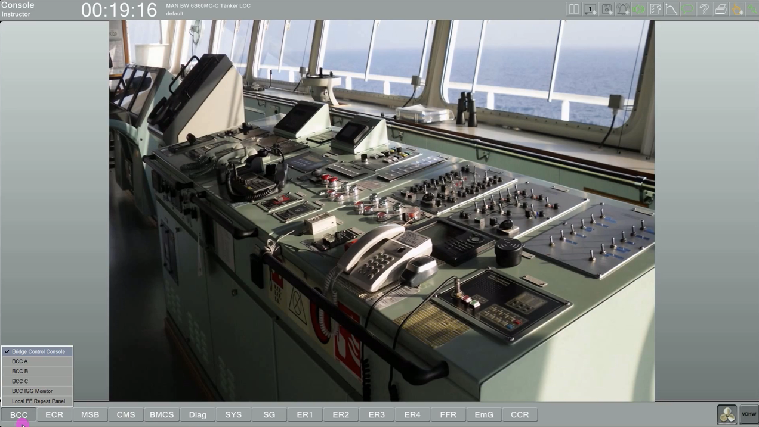

Slide 8
We will do all our operations on the pages we see below. There are 15 pages here. Let me say it very briefly. BCC is called bridge control consol. You can see the menus on the bridge that we can use under this page. There are these under the BCC page. BCC A has the rudder. BBC B has the main engine control. BCC C has the fire alarm panel. And underneath there are inert cards. And under that is the local fire control repeater panel. The first page is the bridge control console.
The second page is the engine control console. It has already given a picture of the engine control at the front. And if we go below it, if we open the engine control console A panel, as you can see, the panel came first. What's on this panel? It says engine control section A. Here he showed the circuits of the cargo pumps.

Slide 9
Now look, press that balloon at the top right of your screen, it should be green. And when you are in this state, when you are standing on any system…
And you were going to tell me what this is. What's he saying now? Number one was the number one main seawater pump…
If you double click on it, I double clicked. We open the local panel of this pump. See what it says above? Push button Panel one…

Slide 10
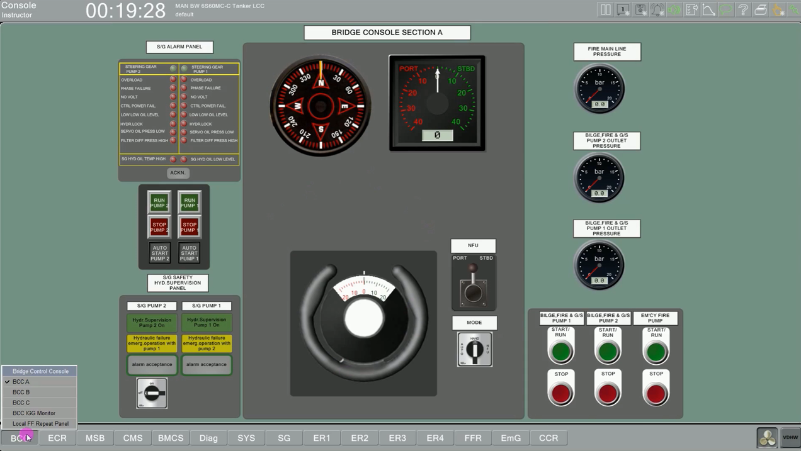

Slide 11
I can start and stop two compressors from here. But there is a switch here.. pay attention. It's number one. There are two of them and three of them. What's 1? It defines it right underneath. It says 1. Number 1 compressor leak, no 2 follow. If I put it on 2, it's manual.
If I put it on 3, then 1 and 2 have switched places. No. 2 compressor lead and the other one follow. What does lead and follow mean? It means fall. When I put the compressors on automatic, if the air pressure drops, of course they will not both be activated at the same time, right? Then I say that I need 30 kilos of compressed air for the compressors. If it goes down 4 kilos from 30 kilos, that is, if it comes to 26, I say compressor number 1 should work.

Slide 12
I say that this compressor is working but it can't deliver the air. My consumption is higher. So maybe I'm maneuvering too much. Then I say that if the bar drops another 2 bars, the follow one will be activated. That's it... If I set the values to 24 bars at 26 follows as lead, I come here and say 1 no lead, 2 follow. Or 2 lead, 1 follow. Or I say manual, I take it, I come to 2, from here I say start, I start the compressor. I say stop, I stop it. If I do it like this, that is, I have automatized it. Now my compressor will not work as you can see, why? Because I set it to automatic. The compressor will be activated automatically.

Slide 13
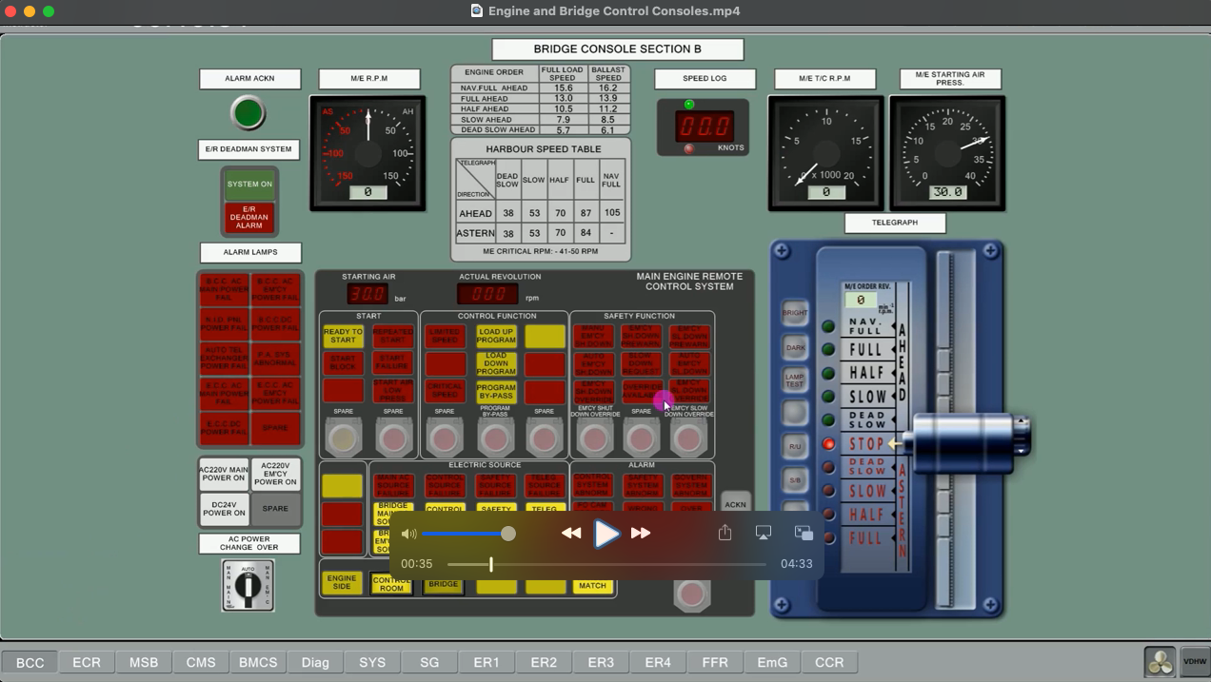

Slide 15
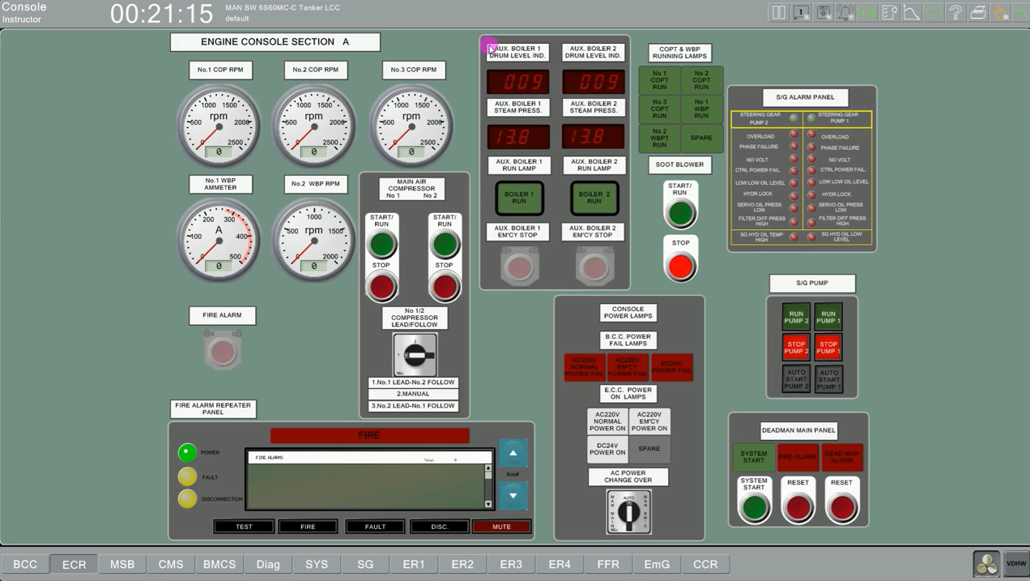

Slide 16
REFERENCES
STCW-Chapter VIII section A-VIII2, part 3-Watchkeeping at sea
Marine Engine Watchkeeping-STCW-IMO
IMO-Model Course-7.04-Officer in Charge of an Engineering Watch
STCW-Seafarers’ Training, Certification and Watchkeeping
TechSim_5000_ENG_Instructor_Manual(8.6)
TRANSAS-ERS 5000 Simultor.

