Slide 1
OPERATION
OF
GENERATORS

Slide 2
AIM
SIMULATION OF OPERATIONS AND MAINTAINENANCE OF THE SHIP GENERATORS ECONOMICALLY, CONTINUOSLY, EFFICIENTLY, SAFELY, SECURELY AND ENVIRONMENT FRIENDLY
UNDER THE LIGTH OF KNOWLEDGE AND EXPERIENCE

Slide 3
OBJECTIVES
Be familiar with the use of generators and parameters,
Develop proper pre-planning and the use of start up check list,
Develope awareness of correct watch keeping procedures,
Understand the interdependency of various Machinery,
Obtain experience in identifying operational problems,
Improve decision-making ability for efficient plant operation.
Make effective contribution to machinery installation.
Make analyzes and definitions to make correct decisions.

Slide 4
ASSESMENT CRITERIA
Knowing ship generators
Familiarization on command and control elements
Understanding data signalization
Understanding system and machine relations
Familiarity in chain-events algorithm
Effective monitoring of operating values
Behaviour in emergencies

Slide 5
ASSESMENT
COMMON SKILLS
Self-management and improvement
Using the human, machine, automation relationship
Establishing team-work
Managing tasks and solving problems
Using references for details
Implementing the procedures
Generating creative ideas and designs

Slide 6
ERS OPERATION OF GENERATORS
So from the three D menus, we can do these operations by traveling inside the ship. Or he did it inside the ship. We can do all these operations from the pages below, and we can do the same from the layout in the menu.
Now let me show you this. Where are we? Let me turn the generator like this. This was the local panel of our generator. It's here. Or if I don't go into 3D, I can do it directly from the menus.
I'm pressing it. Look, generator 1 2 local operation panel. I can open it from here... We usually don't use 3D for now. We will do all our operations through these menus. As I said, there was only one difference between the two screens. The 3D menu is loaded only on the right screen.

Slide 7
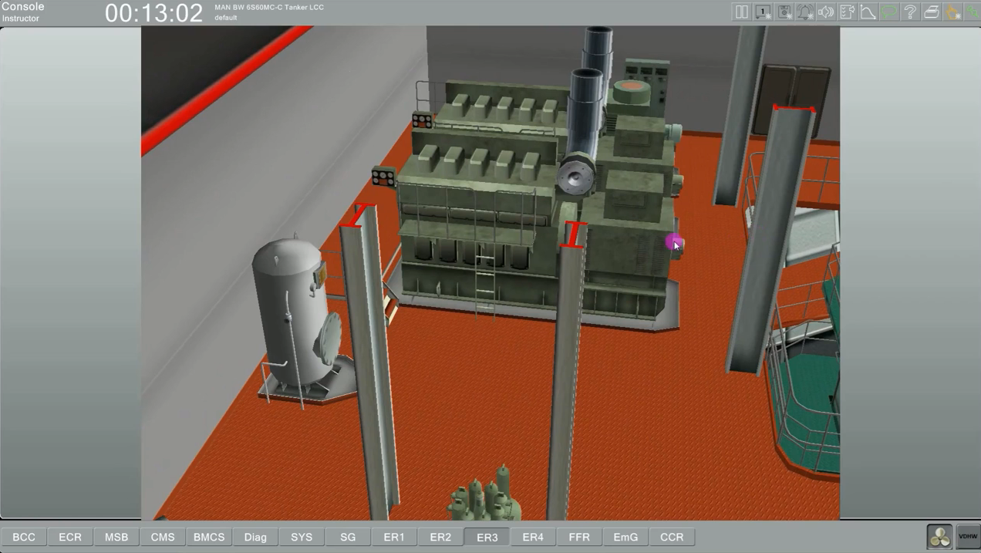

Slide 8
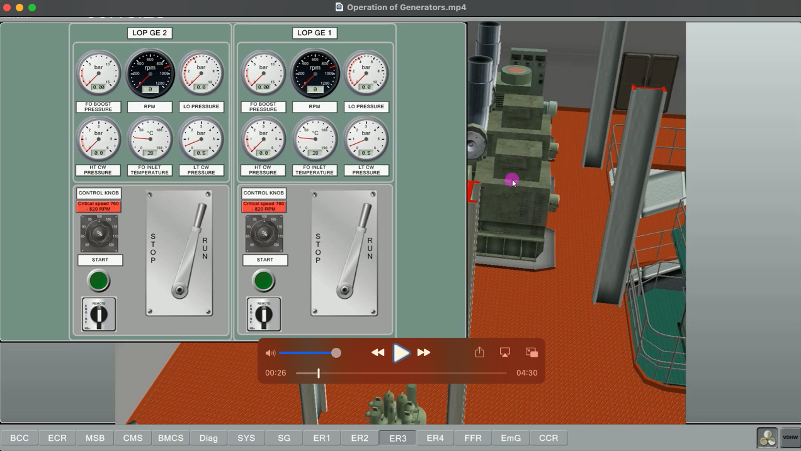

Slide 9
We can prepare different scenarios for different vessels in different systems and we can put them here and run them for you. If you come to the right side, the buttons with a star on them will not work. They are inactive. There is an alarm button which is important for you. If there is any alarm in the system, the lamp will start to flash and warn you. There is a speaker button next to it. Here you can listen to the sound of the system. You can listen to the model sound, that is, the sound of the machines or the alarm. these can be turned on and off.

Slide 10
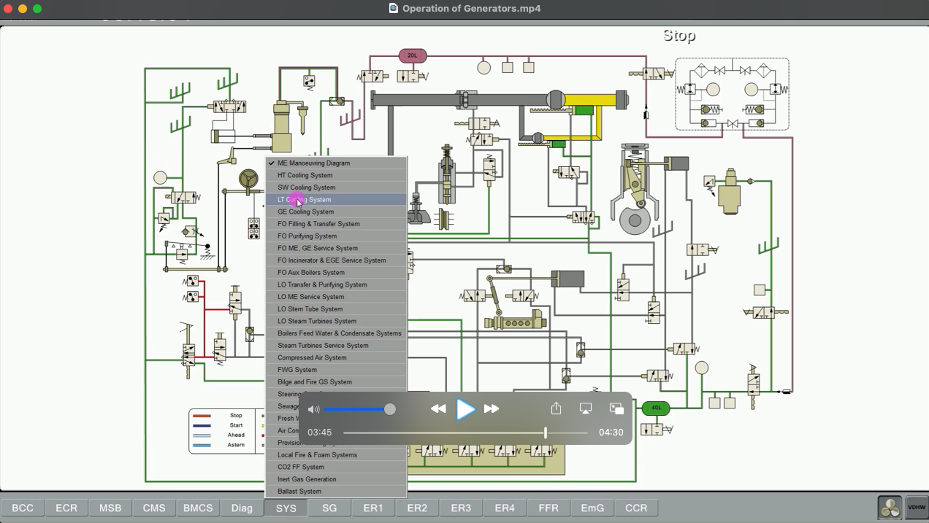

Slide 13
REFERENCES
STCW-Chapter VIII section A-VIII2, part 3-Watchkeeping at sea
Marine Engine Watchkeeping-STCW-IMO
IMO-Model Course-7.04-Officer in Charge of an Engineering Watch
STCW-Seafarers’ Training, Certification and Watchkeeping
TechSim_5000_ENG_Instructor_Manual(8.6)
TRANSAS-ERS 5000 Simultor.

