Slide 1
INTRODUCTION
TO
ENGINEE ROOM SIMULATOR
(ERS)

Slide 2
AIM
SIMULATION OF OPERATIONS AND MAINTAINENANCE OF THE SHIP SYSTEMS AND MACHINES ECONOMICALLY, CONTINUOSLY, EFFICIENTLY, SAFELY, SECURELY AND ENVIRONMENT FRIENDLY
UNDER THE LIGTH OF KNOWLEDGE AND EXPERIENCE

Slide 3
OBJECTIVES
Be familiar with the use of instruments and parameters,
Develop proper pre-planning and the use of start up check list,
Develope awareness of correct watch keeping procedures,
Understand the interdependency of various Machinery,
Obtain experience in identifying operational problems,
Improve decision-making ability for efficient plant operation.
Make effective contribution to machinery installation.
Make analyzes and definitions to make correct decisions.

Slide 4
ASSESMENT CRITERIA
Knowing ship systems and machines
Familiarization on command and control elements
Understanding data signalization
Understanding system and machine relations
Familiarity in chain-events algorithm
Effective monitoring of operating values
Behaviour in emergencies

Slide 5
ASSESMENT
COMMON SKILLS
Self-management and improvement
Using the human, machine, automation relationship
Establishing team-work
Managing tasks and solving problems
Using references for details
Implementing the procedures
Generating creative ideas and designs

Slide 6
Our engine room simulator is an ERS 5000 model simulator of Transas company. ERS stands for Engine Room Simulator.
You see two screens in front of you. If you check the menu of this screen, you will see that both of them are identical. In other words, you can use each of your two screens independently as you wish. They both do the same job. You can open any document on one page and do whatever you want on the other page.

Slide 7
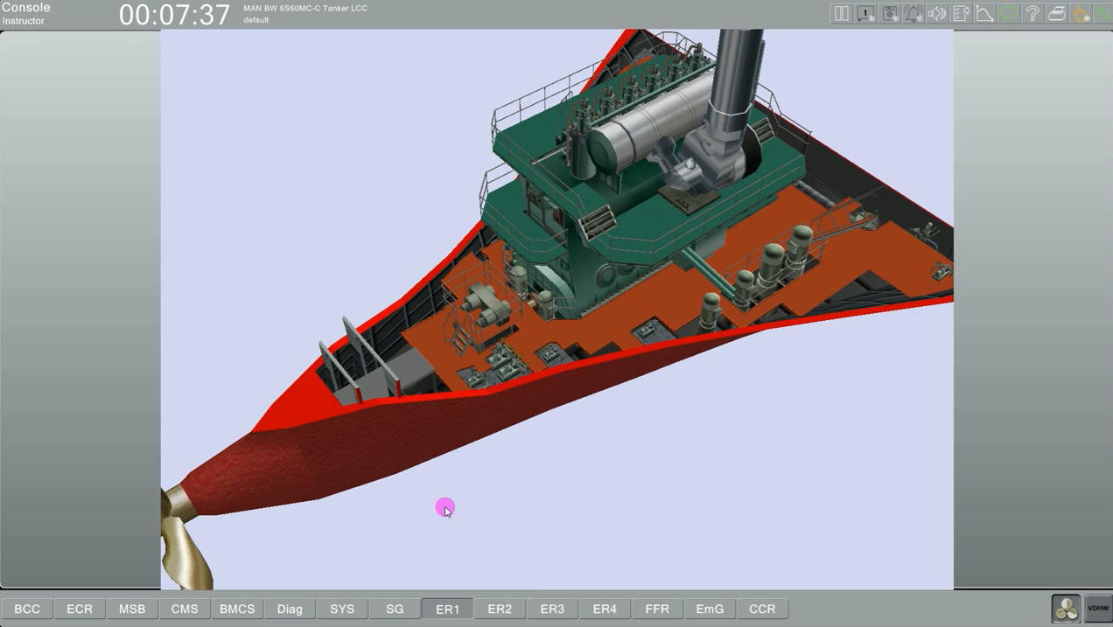

Slide 8
There is a slight difference between these two pages. And that is this: Now let's come to ER1 from the following pages. Look, at the top you see a menu called 3D. This page, i.e. 3D menus, is also on ER2. It is also in ER3. There are also in ER4. These are the menus that allow us to navigate around the engine room.
I am currently in the 3D menu of ER1. If you left click on this menu, as you can see, you can move it as you want. If you right click, you can rotate it. As you can see, let me turn it like this. Let me left click. Let me take it with me. As you can see...If you push your mallet.... If you push forward, the screen will get bigger. If you pull it towards you, the screen will shrink.

Slide 9
Now look, press that balloon at the top right of your screen, it should be green. And when you are in this state, when you are standing on any system…
And you were going to tell me what this is. What's he saying now? Number one was the number one main seawater pump…
If you double click on it, I double clicked. We open the local panel of this pump. See what it says above? Push button Panel one…

Slide 10
To protect itself, the safety reset and now this pump can no longer run from here. It can only work if I install this. You see below there is a selective remover.
It says remote and local. If I take it to remote, I still can't start and stop it from here. If I make it local, I can start and stop it from here.
Now I've got the local. Let's see if it works. I press it. I let it go and it worked. I've got a pump going now. I can stop it from here. I pressed it. And it stopped. Look, pay attention.
I pressed it for a long time. I mean, for example, when you guys play video games, you do this. You say click, click, click. Look, it didn't work. I say click, click, click. It doesn't work. See? I hold it down. I release it.

Slide 11
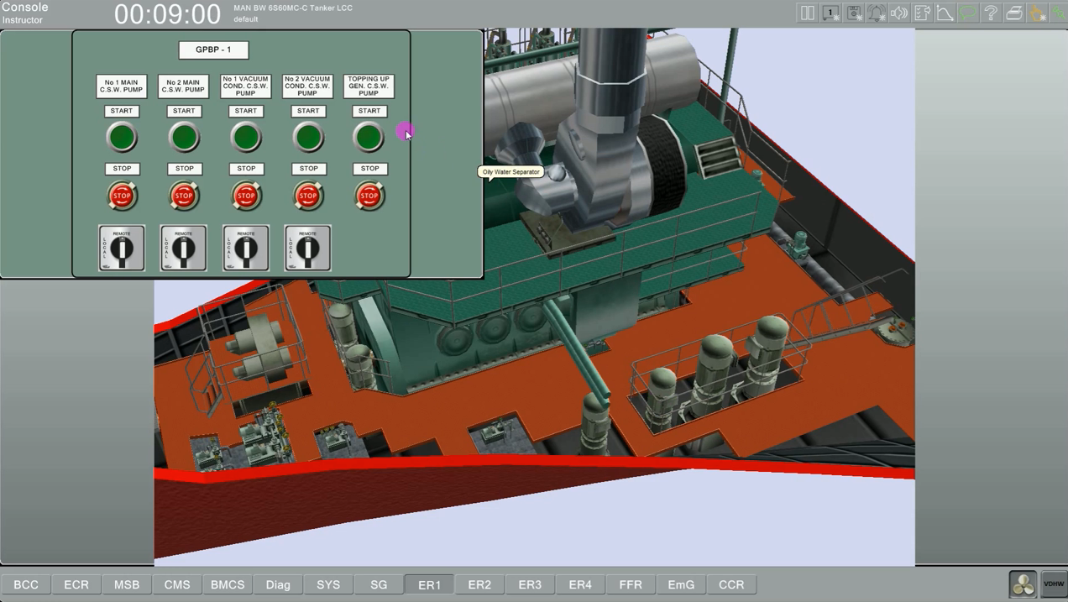

Slide 12
If I take it to remote, it shouldn't work from here anymore. Look, it's not working. He's in control of it because I transferred it to another station. That's number one. That was number two. These were vacuum condenser pumps.
And this is the condenser pumps, and this is the panels of the pumps of the generator. So, as I said, if we want to use the ship by traveling inside the ship in the operations you will do from the right screen, then it would be better to open each ER1, ER2 or ER3 or e ER3. Yes. It can come from ER 3 and use it by traveling inside the ship. Look, I have three generators. Number one, number two and the turbo generator. Let's turn it over. Look, I've got the local panels here.

Slide 13
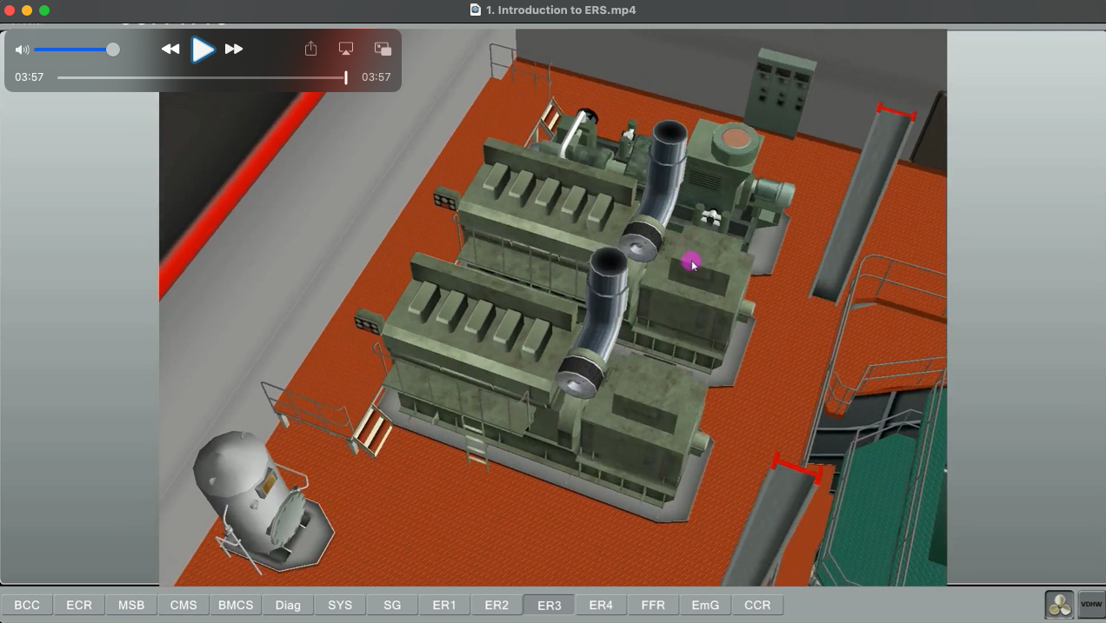

Slide 14
Now let me show you one more process here. In terms of using the mouse. I'm turning it over, see, here's my main machine. I'm enlarging it. I've enlarged it. Let me put it in front of me a little bit. Let me open it up a little bit more. Yeah…. Make it bigger like this.
Look at my cylinders. Look at my indicator valves. Look, you see. If I press the center wheel, you'll see the valve open. I press it again; you'll see the valve close.

Slide 15
REFERENCES
STCW-Chapter VIII section A-VIII2, part 3-Watchkeeping at sea
Marine Engine Watchkeeping-STCW-IMO
IMO-Model Course-7.04-Officer in Charge of an Engineering Watch
STCW-Seafarers’ Training, Certification and Watchkeeping
TechSim_5000_ENG_Instructor_Manual(8.6)
TRANSAS-ERS 5000 Simultor.

