Slide 1





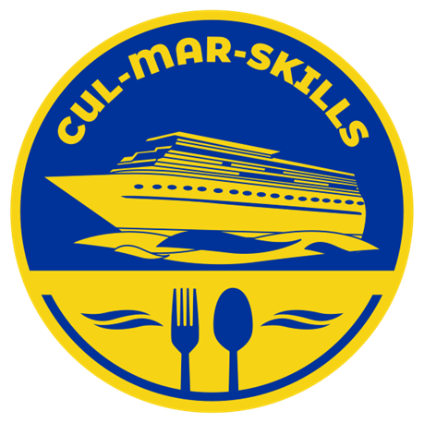


MARitime Soft Skills for Onboard Healthy Nutrition and CULinary Arts in Seagoing Services – CUL-MAR-Skills
KA220-VET - Cooperation partnerships in vocational education and training
2023-1-RO01-KA220-VET-000156711
Green Transition in Blue Galleys
Module 4:
SUSTAINABLE SOURCING AND PROCUREMENT
Disclaimer: “Funded by the European Union. Views and opinions expressed are however those of the author(s) only and do not necessarily reflect those of the European Union or the ANPCDEFP. Neither the European Union nor the ANPCDEFP can be held responsible for them”

Slide 2
Learning Objectives
WEEK 1 –Sustainable Sourcing and Procurement
Learning Outcomes
Upon completing this module, you will be able to:
Understand the overall structure of the module, from introduction to local sourcing, sustainable seafood, responsible procurement, regulations, business case and assessment.
Explain the role of sustainable sourcing and procurement within sustainable maritime operations.
Link everyday purchasing decisions to environmental impacts, social effects along the supply chain and economic performance.
Describe what “locally sourced products” mean on board and discuss their advantages and limitations (freshness, cost, logistics, community support).
Identify key principles of sustainable seafood and food choices, including stock status, fishing/farming methods and certification schemes.
Apply responsible procurement practices on board (specifications, supplier selection, reduced packaging, waste minimization, storage limits) and understand the main regulations, standards and company policies involved.
Sustainable Sourcing and Procurement

Slide 3
Contents of the course
Introduction
1. Locally sourced products
2. Sustainable seafood and food choices
3. Responsible procurement practices
4. Regulations, standards, and company policies for sustainable procurement
5. The business case for sustainable sourcing and procurement
6. Multimedia and online resources
7. Scenario-based simulation: building a sustainable onboard supply plan
8. Critical thinking activity: proactive vs reactive procurement decisions
9. Conclusion and key takeaways
10. Course references
.
Sustainable Sourcing and Procurement

Slide 4
Introduction
Welcome to Module 4: Sustainable Sourcing and Procurement
The module links sustainability directly to how orders are planned, placed and managed on board. Choosing locally sourced products where appropriate can reduce certain emissions and support port communities, selecting sustainable seafood helps protect marine ecosystems, and applying responsible procurement practices prevents waste, reduces costs and avoids non-compliance. In this way, sustainability becomes a practical, action-oriented framework for everyday decisions in the galley and ship’s stores.
Sustainable Sourcing and Procurement

Slide 5

Introduction
A key focus of the week is understanding “locally sourced products” as foods, beverages and other supplies produced, processed and distributed within a relatively short distance of where they are consumed. In maritime operations, this usually means purchasing from suppliers near ports of call rather than relying only on long global supply chains. Throughout the week, learners explore how such choices can provide fresher food, strengthen links with coastal communities, improve transparency in the supply chain and, together with menu planning, supplier relations, labelling and storage, shape the overall sustainability profile of the vessel.
Sustainable Sourcing and Procurement

Slide 6
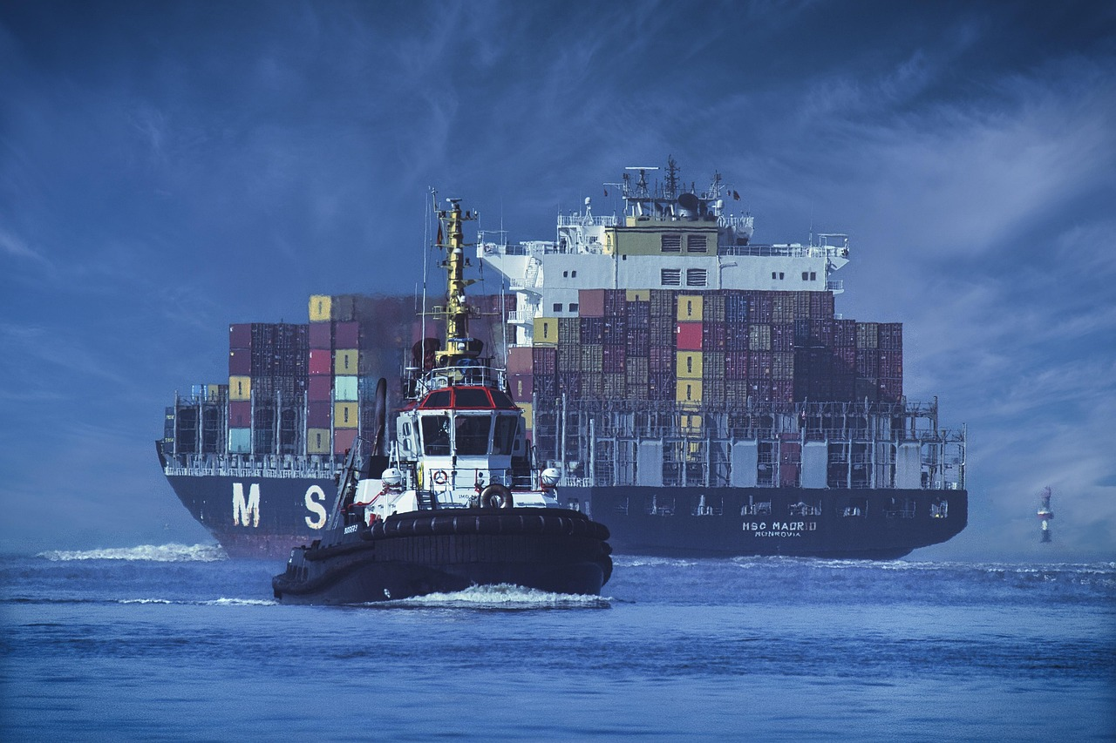
1. Locally sourced products
Sustainable Sourcing and Procurement

Slide 7

1. Locally sourced products: Basic Concept
The first main topic explains that locally sourced products are foods, beverages and other supplies produced, processed and distributed within a relatively short distance of where they will be consumed. In maritime operations, this typically means buying from suppliers located near the ports of call instead of relying solely on long global supply chains. For shipboard teams, such choices can contribute to fresher food, stronger links with coastal communities and more transparent supply chains.
Sustainable Sourcing and Procurement

Slide 8
1. Locally Sourced Products: Link to Sustainable Food Systems
Locally sourced products are presented as part of broader sustainable food systems, which aim to provide food security and nutrition without undermining environmental and social foundations. Short food supply chains with fewer intermediaries can increase transparency, build trust and keep more value within local economies. When a ship uses local suppliers for vegetables, bread, dairy or fish, it effectively connects onboard catering to these shorter, potentially more resilient chains.
Sustainable Sourcing and Procurement

Slide 9

1. Environmental Dimension of Local Sourcing
The text makes clear that transport, and thus food miles, is only one part of a product’s environmental footprint. Many emissions and resource impacts arise from farming or production methods, including energy use, fertilizer application and livestock management. Therefore, a local product grown in heated greenhouses can sometimes have a higher carbon footprint than a similar product imported from a region where it grows naturally, showing that “local” must be assessed together with production practices.
INTRODUCTION TO SUSTAINABILITY IN THE MARITIME INDUSTRY

Slide 10

1. Local vs Sustainable: A Nuanced View
Because of these complexities, the module insists that “local” cannot be treated as a simple synonym for “sustainable.” Local food systems may bring important social and economic advantages, but they do not automatically guarantee lower emissions or better environmental performance. Local sourcing becomes most effective as a sustainability tool when combined with criteria such as seasonality, environmentally sound production and attention to resource status, especially for fish and seafood.
Sustainable Sourcing and Procurement

Slide 11
1. Social and Economic Benefits of Local Sourcing
From a social and economic point of view, locally sourced products help support small producers, protect local jobs and sustain regional food cultures. Money spent on local food tends to circulate within nearby communities, contributing to their resilience and identity. For shipping companies, working with reliable local suppliers can improve traceability and respond to increasing expectations from customers and regulators about knowing where food and other supplies come from.
Sustainable Sourcing and Procurement

Slide 12

1. Practical Guidelines for Local and Seasonal Products
The module offers practical guidance for promoting local sourcing in port, such as prioritizing seasonal produce, coordinating with chandlers and shore-based teams to identify regional specialties, and avoiding demands for out-of-season items that require energy-intensive production or long-distance transport. Port-specific menu planning, which adapts dishes to what is locally abundant, is presented as a way to improve freshness, reduce storage needs and make meals more interesting for multicultural crews.
Sustainable Sourcing and Procurement

Slide 13

1. Local Sourcing, High-Impact Groups and Safety
Local sourcing efforts are encouraged for product groups that dominate menus and storage, like fresh vegetables, bakery goods and dairy. These should be combined with lower-impact menu choices, recognizing that what is bought can be more important than how far it travelled. At the same time, the module stresses the need to check the safety and sustainability of local products through documentation, hygiene certificates, traceability information and evidence of legal, well-managed fisheries.
Sustainable Sourcing and Procurement

Slide 14
1. Local Sourcing, Reliability and Cost
The section concludes that in some ports local supply may be limited, more expensive or inconsistent, so an inflexible “local only” approach is unrealistic. A balanced strategy might combine core staples from established global suppliers with selected local products that clearly meet safety, sustainability and value criteria. The key is to treat local sourcing as a targeted, evidence-based contribution to sustainable procurement rather than as an automatic solution.
Sustainable Sourcing and Procurement

Slide 15

2. Sustainable Seafood and Food Choices: Importance
The module then focuses on sustainable seafood and food choices, noting that seafood plays a central role in maritime life as both a cultural symbol and a source of high-quality protein. At the same time, global fisheries and some forms of aquaculture face serious pressures, making it essential to consider how fish and other marine products are sourced. For shipboard provisioning, seafood choices become both environmental and ethical decisions, not only culinary ones.
Sustainable Sourcing and Procurement

Slide 16

2. Defining Sustainable Seafood
Sustainable seafood is defined as seafood that is sourced, produced and consumed in ways that do not deplete stocks or damage marine ecosystems and that respect social and economic dimensions. This implies healthy fish populations, fishing and farming practices that minimize habitat damage and bycatch, respect for labor standards and a viable livelihood for communities. Sustainability therefore combines environmental, social and economic considerations rather than focusing on a single factor.
Sustainable Sourcing and Procurement

Slide 17
2. Environmental Performance and Species Choice
The text underlines that different seafood products have different environmental footprints, shaped by stock status, fishing gear, farming systems and fuel use. Lower-trophic species such as small pelagic fish and farmed bivalves like mussels and oysters often have relatively favourable profiles, while large predatory fish from overexploited stocks can be problematic. For onboard menu planning, it is recommended to favour species with lower impacts and good nutritional value and to avoid overfished or high-risk options.
Sustainable Sourcing and Procurement

Slide 18

2. Health, Nutrition and Crew Wellbeing
From a nutritional perspective, seafood provides complete protein, essential micronutrients and beneficial fats that can support cardiovascular and cognitive health when eaten in appropriate quantities. The module notes that preparation methods influence health outcomes, encouraging grilling, baking, steaming and stewing rather than excessive deep-frying and heavy sauces. Sustainable seafood choices are therefore presented as beneficial both for marine ecosystems and for crew wellbeing.
Sustainable Sourcing and Procurement

Slide 19
2. Practical Guidelines for Sustainable Seafood
Learners are encouraged to ensure that basic information about each seafood product is available and recorded, including species, catch or farming area and production method. This information allows comparisons against company policies and external guidance. The module promotes choosing products from well-managed fisheries or responsible aquaculture, where possible supported by recognised certification schemes, and diversifying species to avoid overdependence on any single stock or system.
Sustainable Sourcing and Procurement

Slide 20

2. Integrating Seafood into a Sustainable Menu
Sustainable seafood is placed within the context of an overall menu that balances animal and plant-based proteins. Combining responsibly sourced fish with increased use of legumes and other plant proteins can reduce environmental pressure while keeping meals attractive and nutritious. Portion control, waste monitoring and menu rotation are described as practical tools to make sure seafood contributes to sustainability rather than adding to waste and risk.
Sustainable Sourcing and Procurement

Slide 21
2. Role of Cadets and Crew in Seafood Choices
The section emphasizes that cadets and crew members can contribute to sustainable seafood choices by understanding basic criteria, checking labels and documentation, and raising questions when information is incomplete. They can consider environmental and health aspects alongside price and availability and support company policies that favor responsible fisheries and aquaculture. In this way, decision-making about fish and seafood becomes a shared responsibility across ranks.
Sustainable Sourcing and Procurement

Slide 22

3. Responsible Procurement Practices: Concept
Responsible procurement is introduced as a shift from simply buying the cheapest or most familiar products to deliberately purchasing in ways that support environmental protection, social responsibility and economic resilience. It recognizes that every item on board has a life cycle that includes production, transport, storage, use and disposal, and that procurement decisions strongly influence how efficient, safe and sustainable that life cycle will be in practice.
Sustainable Sourcing and Procurement

Slide 23
3. From Price-Driven to Value-Driven Procurement
The module contrasts price-driven purchasing, which focuses only on upfront cost, with value-driven procurement, which considers total cost of ownership, environmental performance and ethical dimensions. For example, a more expensive concentrated cleaning product in a refill system may be preferable to a cheaper alternative in many small single-use bottles, because it reduces packaging waste, storage needs, health risks and long-term disposal costs.
Sustainable Sourcing and Procurement

Slide 24
3. Procurement Cycle: Overview of Stages
Responsible procurement is presented as a continuous cycle with several stages: needs identification and planning, specification of sustainable requirements, supplier selection and evaluation, ordering and delivery, storage and handling, and ongoing use, monitoring and feedback. Each stage offers opportunities to reduce waste, improve safety and align purchases with company sustainability strategies. Treating procurement as a cycle rather than a one-off action supports continuous improvement.
Sustainable Sourcing and Procurement

Slide 25
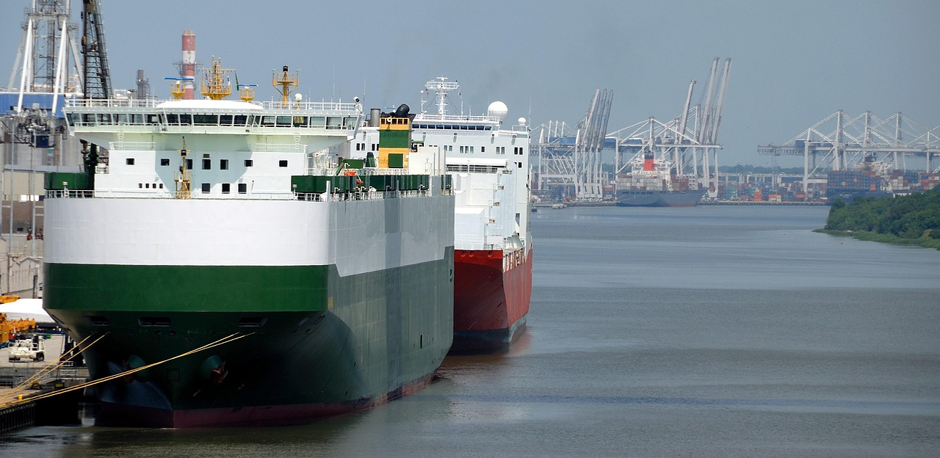
3. Procurement Cycle: Planning, Suppliers and Orders
In the planning phase, crews assess what is truly needed based on voyage length, crew size, route and existing stocks, and align menus with nutritional and cultural needs while controlling variety and complexity. Sustainable requirements are built into product specifications, such as preferences for local and seasonal produce, certified seafood, reduced or recyclable packaging and energy-efficient equipment. Suppliers are then chosen and evaluated not only on price but also on their ability to meet these quality, safety and sustainability expectations, and orders are placed in quantities that match actual consumption patterns..
Sustainable Sourcing and Procurement

Slide 26
3. Procurement Cycle: Delivery, Storage and Feedback
When goods arrive, deliveries are checked against orders, expiry dates and agreed criteria, and stock rotation principles like “first in, first out” are applied to minimize spoilage. During the voyage, consumption and waste are monitored so that over-ordered or consistently unused items can be identified. Feedback is communicated to shore-based teams and suppliers, allowing them to adjust future orders and propose more suitable or sustainable alternatives, turning procurement into a learning process.
Sustainable Sourcing and Procurement

Slide 27
3. Procurement, Compliance and Risk Management
The module underlines that procurement choices are closely connected to compliance with environmental, safety and food regulations. Products with excessive or non-recyclable packaging complicate garbage management under MARPOL; low-quality or unsafe food items can undermine compliance with the Maritime Labour Convention; and certain chemicals may affect occupational health and environmental performance. By integrating regulatory requirements into purchasing decisions from the beginning, vessels can reduce the risk of fines, detentions and reputational damage.
Sustainable Sourcing and Procurement

Slide 28

3. Role of Students and Cadets in Procurement
Even without signing contracts or managing budgets, students and cadets have a meaningful role in responsible procurement. They can contribute by reading and respecting labels and storage instructions, assisting with accurate inventory records, handling and storing goods correctly to avoid waste and offering feedback on the practicality and performance of products and packaging. These contributions help transform the galley and stores into strategic spaces that support sustainability, compliance and operational efficiency.
Sustainable Sourcing and Procurement

Slide 29

4. Regulations, Standards and Company Policies
The module explains that sustainable sourcing and procurement operate within a framework of international conventions, regional and national regulations, technical standards and company policies. Instruments such as MARPOL, SOLAS, the ISM Code and the Maritime Labor Convention shape what is acceptable or required on board, while food safety and environmental management standards influence how suppliers operate. Company-level procurement policies and supplier codes translate these external requirements into concrete rules for purchasing and supplier relationships.
Sustainable Sourcing and Procurement

Slide 30
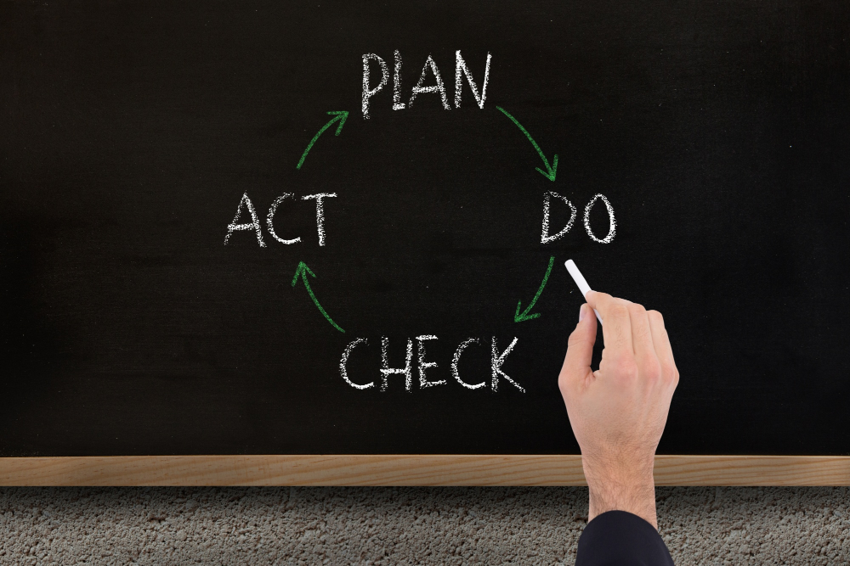
4. From Reactive Compliance to Proactive Culture
Rather than seeing regulations and policies as obstacles, the module encourages a proactive attitude that uses them as tools to improve planning and decision-making. Proactive procurement anticipates regulatory needs, integrates sustainability criteria into specifications and collaborates with suppliers on solutions that work both economically and environmentally. This approach reduces last-minute “firefighting,” emergency orders and compliance risks and supports a more stable and resilient operational culture.
Sustainable Sourcing and Procurement

Slide 31
5. The Business Case for Sustainable Procurement
The business case section argues that sustainable sourcing and procurement are not only ethically desirable but also financially and strategically advantageous. By reducing waste, preventing over-ordering, optimizing inventories and choosing durable, efficient products, companies can lower operating costs. At the same time, purchasing decisions that support compliance and transparency reduce regulatory risks and open doors to markets, clients and investors that prioritise environmental and social performance.
Sustainable Sourcing and Procurement

Slide 32

5. Market Advantage, Reputation and Human Capital
Sustainable procurement helps shipping companies meet the expectations of charterers, cargo owners, passengers and public authorities, many of whom now demand evidence of responsible supply chains. Strong policies and practices can enhance reputation, improve access to ESG-sensitive finance and differentiate companies in competitive markets. The text also notes that many young professionals prefer employers who take sustainability seriously, making responsible procurement part of an attractive, future-oriented organizational identity.
Sustainable Sourcing and Procurement

Slide 33

6. Multimedia and Online Resources in the Module
To support learning, the module incorporates selected multimedia and online resources, such as short videos on sustainable shipping, educational materials on sustainable fishing and seafood labelling, and e-learning modules on sustainable food systems and green skills for seafarers. These resources are used as triggers for discussion, reflection and project work, helping students connect abstract concepts with real-world examples and voices from industry, science and policy.
Sustainable Sourcing and Procurement

Slide 34

7. Scenario-Based Simulation: 10-Day Voyage
One core learning activity invites participants to develop a sustainable onboard supply plan for a 10-day voyage with a specific crew size and storage constraints. Learners must respect company targets, such as a minimum share of locally sourced produce, a proportion of responsibly sourced seafood and reductions in single-use plastic and food waste. They assess needs, apply sustainability criteria, design a supply plan table, explain waste minimization measures and link their decisions to compliance and company policy.
Sustainable Sourcing and Procurement

Slide 35

8. Critical Thinking Activity: Proactive vs Reactive
Another activity uses contrasting scenarios to explore reactive and proactive procurement behaviors. In one case, last-minute rushed orders lead to poor product quality, excessive packaging and high waste, while in another, careful planning, data use and clear specifications support sustainability and efficiency. Students analyze the impacts of each approach on cost, compliance, waste and crew workload, then redesign scenarios to demonstrate how small changes in behavior can significantly improve outcomes.
Sustainable Sourcing and Procurement

Slide 36
9. Conclusion and Key Takeaways
The concluding section summarizes that sustainable sourcing and procurement are central components of sustainable maritime operations rather than optional extras. Locally sourced products and sustainable seafood can support environmental goals and crew health when selected carefully, and responsible procurement connects what is purchased with how it is stored, used and disposed of. International regulations, standards and company policies provide a framework for action, while a strong business case shows that sustainable procurement reduces costs and risks and strengthens competitiveness. The module closes by emphasizing that proactive, data-informed decisions and the active involvement of students and cadets can help create safer, cleaner and more resilient maritime operations.
Sustainable Sourcing and Procurement

Slide 37
10. References
Bianchi, M., Hallström, E., Parker, R. W. R., Mifflin, K., Tyedmers, P., & Ziegler, F. (2022). Assessing seafood nutritional diversity together with climate impacts informs more comprehensive dietary advice. Communications Earth & Environment, 3(1), 188. https://doi.org/10.1038/s43247-022-00516-4
Coley, D. A., Howard, M., & Winter, M. (2009). Local food, food miles and carbon emissions: A comparison of farm shop and mass distribution approaches. Food Policy, 34(2), 150–155. https://doi.org/10.1016/j.foodpol.2008.11.001
Edwards-Jones, G. (2010). Does eating local food reduce the environmental impact of food production and enhance consumer health? Proceedings of the Nutrition Society, 69(4), 582–591. https://doi.org/10.1017/S0029665110002004
European Parliamentary Research Service. (2020). World Maritime Day 2020: “Sustainable shipping for a sustainable planet”. European Parliament. https://epthinktank.eu/2020/09/23/world-maritime-day-2020-sustainable-shipping-for-a-sustainable-planet/
Food and Agriculture Organization of the United Nations. (1995). Code of conduct for responsible fisheries. FAO. https://www.fao.org/iuu-fishing/international-framework/code-of-conduct-for-responsible-fisheries/en/
Food and Agriculture Organization of the United Nations. (2022). The state of world fisheries and aquaculture 2022: Towards blue transformation. FAO. https://www.fao.org/publications/sofia-2022
International Maritime Organization. (2020). World Maritime Theme 2020: Sustainable shipping for a sustainable planet. IMO. https://www.imo.org/en/About/Events/Pages/World-Maritime-Theme-2020.aspx
Marine Conservation Society. (n.d.). Good Fish Guide. Retrieved November 19, 2025, from https://www.mcsuk.org/goodfishguide/
Marine Stewardship Council. (n.d.). What is sustainable seafood? Retrieved November 19, 2025, from https://www.msc.org/what-you-can-do/eat-sustainable-seafood/what-is-sustainable-seafood
Sustainable Sourcing and Procurement

Slide 38
10. References
Mozaffarian, D., & Rimm, E. B. (2006). Fish intake, contaminants, and human health: Evaluating the risks and the benefits. JAMA, 296(15), 1885–1899. https://doi.org/10.1001/jama.296.15.1885
Poore, J., & Nemecek, T. (2018). Reducing food’s environmental impacts through producers and consumers. Science, 360(6392), 987–992. https://doi.org/10.1126/science.aaq0216
Ritchie, H., Rosado, P., & Roser, M. (2022). Environmental impacts of food production. Our World in Data. https://ourworldindata.org/environmental-impacts-of-food
SkillSea Consortium. (n.d.). SkillSea – Futureproof skills for the maritime transport sector. Retrieved November 19, 2025, from https://www.skillsea.eu/
Stein, A. J., & Santini, F. (2022). The sustainability of “local” food: A review for policy-makers. Review of Agricultural, Food and Environmental Studies, 103(1), 77–89. https://doi.org/10.1007/s41130-021-00148-w
Sustainable Fisheries – University of Washington. (n.d.). The environmental impact of food & seafood. University of Washington. Retrieved November 19, 2025, from https://sustainablefisheries-uw.org/seafood-101/cost-of-food/
Willett, W., Rockström, J., Loken, B., Springmann, M., Lang, T., Vermeulen, S., … Murray, C. J. L. (2019). Food in the Anthropocene: The EAT–Lancet Commission on healthy diets from sustainable food systems. The Lancet, 393(10170), 447–492. https://doi.org/10.1016/S0140-6736(18)31788-4
Sustainable Sourcing and Procurement

Slide 39
Quiz
1. In this module, sustainable sourcing and procurement are presented primarily as:
A. A purely environmental topic with little impact on operations
B. A minor administrative function of the galley
C. A core element of sustainable maritime operations and strategy
D. A temporary trend driven only by public opinion
2. In a maritime context, “locally sourced products” are best described as:
A. Products supplied only by global wholesale chains
B. Products produced, processed and distributed close to the ports where ships call
C. Products transported exclusively by sea freight
D. Products that are always cheaper than imported alternatives
3. Which statement about “local” food and sustainability most closely reflects the module?
A. Local food is always more sustainable than imported food
B. Local food has no influence on environmental impacts
C. Local food can have high impacts if produced in energy-intensive systems
D. Local food is only about supporting tourism
4. Which of the following is not listed as a potential social or economic benefit of local sourcing?
A. Strengthening local economies and jobs
B. Supporting community traditions and food cultures
C. Increasing resilience of food systems
D. Guaranteeing that all products are environmentally sustainable
5. Sustainable seafood is defined in the module as seafood that:
A. Comes from the cheapest available supplier
B. Is consumed only on special occasions
C. Is sourced, produced and consumed without depleting stocks or damaging ecosystems, while respecting social and economic aspects
D. Is always wild-caught rather than farmed
Sustainable Sourcing and Procurement

Slide 40
Quiz
6. Which combination of factors is highlighted as especially important when assessing seafood sustainability?
A. Colour of the fish, cooking method, and price
B. Stock status, fishing/farming method, and management of the fishery
C. Packaging design, brand name, and advertising
D. Portion size, crew preferences, and menu layout
7. Which seafood choices are mentioned as often having relatively favourable environmental profiles?
A. Large predatory fish from poorly managed stocks
B. Small pelagic fish and farmed bivalves
C. Any farmed fish, regardless of system
D. Only canned tuna products
8. Responsible procurement is described as a shift from:
A. Buying only luxury products to buying only basic items
B. Buying whatever is available to strictly following suppliers’ preferences
C. Simply buying the cheapest and most available items to purchasing in a way that supports environmental, social and economic goals
D. Centralised purchasing to completely unregulated on-board purchasing
9. Which of the following is not part of the responsible procurement cycle described in the module?
A. Needs identification and planning
B. Specification of sustainable requirements
C. Supplier selection and evaluation
D. Ignoring feedback from ships to keep procedures simple
10. How do MARPOL Annex IV and Annex V influence procurement, according to the module?
A. By banning all plastic products on board
B. By encouraging the purchase of products that generate less waste and are easier to segregate and store
C. By requiring that all food is frozen
D. By regulating only engine spare parts and lubricants
Sustainable Sourcing and Procurement

Slide 41
Quiz
11. The Maritime Labor Convention (MLC, 2006) affects procurement because it:
A. Focuses exclusively on navigation equipment
B. Requires wholesome food, water and catering arrangements of appropriate quality and quantity for seafarers
C. Deals only with ship construction standards
D. Regulates fuel prices in international ports
12. Which of the following is highlighted as a key business benefit of sustainable sourcing and procurement?
A. Guaranteed reduction of crew numbers
B. Higher waste and more complex logistics
C. Reduced waste, optimized inventories and lower regulatory risk
D. Complete independence from regulations
13. Which behavior best illustrates a proactive procurement approach as described in the module?
A. Placing hurried, unspecific orders one day before arrival in port
B. Waiting for items to run out before checking stock levels
C. Forecasting needs, adjusting menus and specifying sustainability and packaging requirements in advance
D. Ordering the same products every voyage without review
14. In the scenario-based simulation for a 10-day voyage, one of the company’s sustainability targets is to:
A. Eliminate all seafood from the menu
B. Achieve 100% local sourcing for all products
C. Reduce food waste in the galley by 20% through better planning, portion control and storage
D. Remove all disposable packaging from the vessel immediately
Sustainable Sourcing and Procurement

