Slide 1

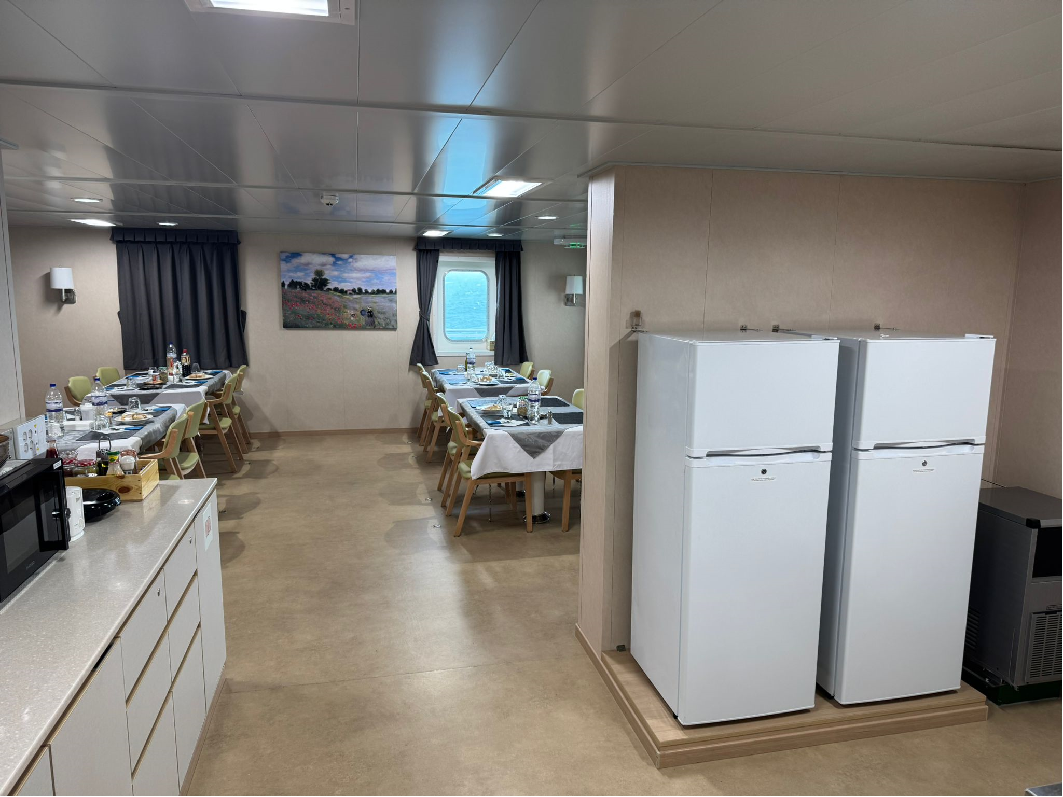
MARitime Soft Skills for Onboard Healthy Nutrition and CULinary Arts in Seagoing Services – CUL-MAR-Skills
KA220-VET - Cooperation partnerships in vocational education and training
2023-1-RO01-KA220-VET-000156711
Module 5
Implementing and
Promoting Sustainability:
Developing action plans.
Communicating sustainability initiatives.
Fostering a culture of sustainability
Disclaimer: “Funded by the European Union. Views and opinions expressed are however those of the author(s) only and do not necessarily reflect those of the European Union or the ANPCDEFP. Neither the European Union nor the ANPCDEFP can be held responsible for them”

Slide 2
Learning Objectives
WEEK 1 – Learning Outcomes
Upon completing this module, you will be able to:
Analyze the corporate communication ecosystem, stakeholder landscape, and specific challenges within the maritime transport sector.
Design effective internal communication strategies that foster organizational alignment, employee satisfaction, and productivity.
Evaluate the role of print, digital and social media platforms in branding, community management, and measuring communication impact.
Understand relationships with diverse internal and external stakeholder groups.
Be able to clearly, concisely, and convincingly present complex plans and analyses to an audience, and to effectively participate in feedback discussions.
Understand Collaborative Problem-Solving: Enhanced ability to work with fellow marines in discussions and potentially in group projects to analyze problems and develop communication solutions.
Implementing and
Promoting Sustainability

Slide 3
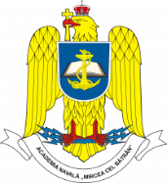





Introduction
For cadets and young mariners, sustainability is not an abstract concept. It directly affects their daily lives at sea — from the meals prepared in the galley to the management of waste, the use of energy, and the health of the oceans that sustain maritime livelihoods. Promoting personal health and sustainability onboard means making deliberate choices that minimize environmental impact while enhancing wellbeing and operational efficiency.
How can these policies be achieved? Action Plans are essential in order for any employee to understand the value of a new policy that affects one’s everyday life in his/ her working environment. Understanding Communication techniques and the principles of cultural change management complement are necessary for any policy to be successful and enduring.

Slide 4
Chapter 1. Developing Action Plans
Developing personal health, wellbeing and sustainability action plans onboard vessels is a structured approach
These plans serve as strategic frameworks that translate high-level sustainability goals into specific, measurable, and achievable steps. Thus integrating environmental responsibility into daily maritime operations.

Slide 5
Developing Action Plans
In the maritime context, such plans address the complex interactions between energy use, food systems, water management, and waste disposal in a confined and self-contained environment.
A personal health, wellbeing or sustainability action plan helps align the ship’s operations with both international environmental and maritime labour standards as well as company policies.
It ensures that all departments—from the galley to the engine room—work toward shared objectives that improve efficiency. Ιt becomes part of standard operational thinking, integrated into procurement, storage, preparation, and disposal routines.
Α well-crafted action plan fosters accountability and long-term improvement across the crew.

Slide 6
Understanding Maritime Personal health and Sustainability Challenges
Personal health and Sustainability at sea faces distinctive challenges shaped by isolation, lack of physical and outdoor exercise, limited storage capacity, and strict safety and hygiene standards. Unlike shore-based operations, seagoing vessels cannot easily access fresh supplies or dispose of waste responsibly once underway.
Energy Demand
Energy demand for lighting, galley operations, and refrigeration is continuous, and resource scarcity magnifies inefficiencies.
Food Waste
Food waste, single-use packaging, and overreliance on imported ingredients contribute to both cost and environmental burden.
Crew Nutrition
Crew nutrition also plays a role in sustainability: overstocking or poor menu planning can lead to waste and increased emissions.

Slide 7
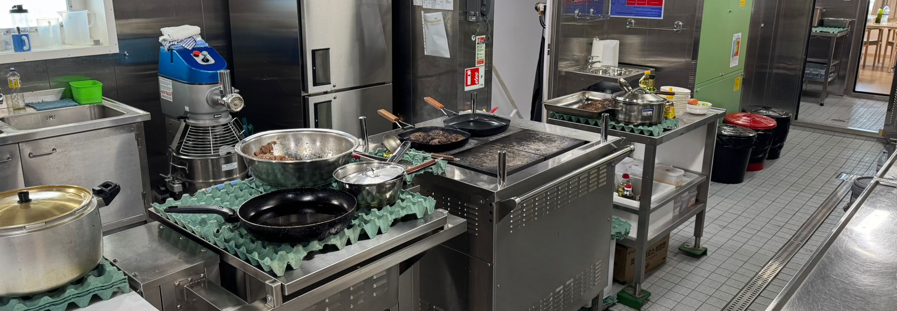
Understanding Maritime Personal health and Sustainability Challenges
Understanding these challenges requires a systems-thinking approach, where galley staff, engineers, and officers collaborate to map how different operational areas impact resource use.
Recognizing these interdependencies allows the creation of targeted strategies—such as optimizing meal planning, energy-efficient cooking, and waste segregation—that make sustainability not just an environmental concern but a core operational principle.
Kitchen
onboard a ship

Slide 8
Why Planning Matters
Planning is the cornerstone of sustainable maritime operations. Without deliberate planning, personal health, wellbeing and sustainability remains abstract ideals rather than a measurable objective. The demanding environment of a seagoing vessel requires precise scheduling and coordination, which can only be achieved through systematic planning.
A written action plan transforms broad sustainability goals—such as “reduce waste” or “improve nutritional quality”— into clear directives that specify who does what, when, and how progress will be measured.
Moreover, structured planning enhances communication between departments and ensures that personal health, wellbeing and sustainability objectives are embedded within standard operating procedures.
By planning ahead, crews can anticipate potential constraints, such as limited storage or supply chain disruptions, and develop contingency measures. In this way, sustainability becomes proactive, strategic, and resilient.

Slide 9
Key Components of an Action Plan
A robust action plan contains several key components that ensure clarity, feasibility, and accountability.
It begins with a clear objective that defines the intended outcome, such as reducing food waste or minimizing energy use.
Second, it assigns responsibilities to specific individuals or departments.
Third, it includes a timeline, with realistic milestones that track progress over time.
Fourth, resource allocation outlines the materials, training, and budget required for successful implementation.
Finally, monitoring and feedback mechanisms provide the means to measure results and refine the plan.
In maritime settings, this structured approach is essential for coordination among multinational crews.

Slide 10
Assessing the Current Situation
Every effective plan begins with an accurate assessment of the current situation.
Before setting targets, vessels must establish a baseline of existing practices and performance indicators. This involves collecting data on food waste quantities, water consumption, energy use, and the origin of ingredients. Observing workflows in the galley, storage, and waste-handling areas provides insights into inefficiencies or gaps. Audits and checklists can help identify where resources are being underused or wasted.
The assessment should also include crew awareness and attitudes toward personal health, wellbeing and sustainability , as cultural/ behavioral factors often influence operational outcomes.
Once this baseline is documented, improvement areas can be prioritized and realistic goals defined.
A data-driven understanding of the vessel’s current performance ensures that subsequent action plans are targeted, achievable, and tailored to the ship’s specific operating conditions.

Slide 11
Setting SMART Goals
Setting SMART goals—Specific, Measurable, Achievable, Relevant, and Time-bound—is the backbone of every successful sustainability plan.
In the maritime context, a vague ambition such as “reduce waste” becomes a concrete target like “reduce organic galley waste by 20 percent within six months.” The specific element defines exactly what will change; measurable ensures that progress can be tracked through data collection;
SMART goals also help prevent “initiative fatigue,” keeping crew motivation high by providing attainable milestones. They allow management to monitor progress objectively and adjust resources as necessary.
Over time, this disciplined approach builds a culture where personal health and sustainability outcomes are as closely managed as safety or maintenance standards.

Slide 12
Prioritizing Actions
An action plan can only succeed when actions are prioritized according to impact, feasibility, and cost.
Not all initiatives yield the same benefits, and ships operate within strict time and resource constraints.
Prioritization involves ranking actions—such as reducing plastic use, improving meal planning, or installing energy-efficient lighting—based on expected environmental returns and operational practicality.
Quick wins, like replacing single-use items, can build early momentum and demonstrate visible progress, while more complex projects, such as retrofitting galley equipment, require longer-term scheduling.
Using a simple matrix to evaluate impact versus effort helps decision-makers allocate resources efficiently.
Prioritization also supports communication: crew members clearly understand which actions take precedence and why.

Slide 13
Resource Planning
Resource planning ensures that sustainability objectives are realistic. Every initiative—whether reducing waste or improving nutritional sourcing—requires materials, manpower, time, and sometimes financial investment. For example, switching to biodegradable packaging may involve sourcing new suppliers, revising storage protocols, and training staff on handling procedures.
By identifying these needs early, management can prevent implementation delays and avoid overburdening the crew.
Resource planning should also consider energy and time as valuable assets: adjusting galley schedules to minimize stove use during peak power demand, for instance, saves fuel without affecting meal quality.
Planning should link resources with existing budgets and operational cycles to avoid competition with safety or maintenance funding.

Slide 14
Implementation Steps
Once goals, priorities, and resources are defined, the plan must specify clear steps that guide daily actions.
Each step should describe what will be done, who is responsible, and when it will be completed. In maritime settings, this could include conducting briefings before meal preparation to reinforce waste-reduction targets, labeling waste bins in multiple languages, or posting reminders near equipment to reduce energy use.
Sequencing is also critical—starting with training and awareness before introducing new materials or procedures ensures smoother adoption.
Documentation, such as logbooks or checklists, helps track progress and maintains accountability.
Implementation should be treated as an evolving process; minor adjustments may be needed as the crew gains experience or operational conditions change. A transparent and well-communicated implementation plan keeps everyone aligned and makes sustainability a visible, measurable part of everyday shipboard life.

Slide 15
Monitoring Progress
Monitoring progress ensures that actions produce measurable, lasting results. In maritime operations, this means systematically tracking data on resource consumption, waste generation, and behavioral compliance.
Progress monitoring relies on quantitative indicators—such as kilograms of food waste per day, electricity usage in the galley, or the number of meals prepared using locally sourced ingredients—and qualitative feedback from crew observations.
Regularly reviewing these metrics allows officers and catering managers to verify whether implemented measures are working as intended. It also provides opportunities for course correction before problems escalate.
Establishing a routine for reporting, such as weekly or voyage-end summaries, builds accountability and keeps sustainability visible across departments.
Over time, these records create a knowledge base that can inform company-wide best practices.

Slide 16
Review and Adjust
A plan is never static.
Reviewing and adjusting strategies ensures that lessons learned are incorporated into future operations. After each voyage or implementation cycle, the team should evaluate both successes and shortcomings. Were the goals realistic? Did crew engagement meet expectations? Were resources used efficiently? This reflective process helps maintain relevance in a changing maritime context where regulations, supply conditions, and crew composition may shift.
Adjustments may include revising targets, redefining responsibilities, or improving data collection methods. Importantly, reviews should be constructive, focusing on refinement rather than blame.
Open discussion encourages transparency and motivates participants to contribute new ideas.
Documenting these reviews creates an institutional memory that prevents repeated mistakes and supports long-term learning.

Slide 17
Example 1 – Sustainable Galley Operations
Practical examples translate abstract goals into concrete action.
In the galley, one effective initiative is the reduction of single-use plastics. The plan might set a goal to replace disposable cups and utensils with reusable alternatives within three months.
Implementation would involve sourcing durable items, ensuring proper sanitation procedures, and phasing out existing plastic stock.
Monitoring would record quantities purchased and disposed of, while periodic reviews would assess user satisfaction and hygiene compliance.
Beyond plastic reduction, sustainable galley operations can include optimizing menu planning to minimize leftovers, improving portion control, and repurposing safe surplus food for crew meals. Documenting and sharing these examples across the fleet encourages replication, helping create a network of best practices that collectively advance maritime environmental responsibility.

Slide 18
Example 2- Integrating Nutrition and Sustainability
Nutrition and sustainability are inherently linked: healthy diets often coincide with environmentally responsible choices. Onboard, this means designing menus that balance crew health with ecological considerations. Incorporating more plant-based proteins, locally sourced seafood, and seasonal produce reduces the environmental footprint while supporting wellbeing.
Efficient menu planning minimizes waste, conserves energy, and optimizes storage space.
Integrating nutrition with sustainability requires collaboration between cooks, nutrition officers, and procurement teams to align health objectives with sourcing policies.
Documentation of nutritional content and waste data enables evidence-based adjustments over time. By connecting sustainability to tangible health outcomes—such as improved morale and reduced illness—crews see the direct benefits of sustainable eating habits. This holistic approach transforms the galley into both a center of wellbeing and a model of environmental stewardship at sea.

Slide 19
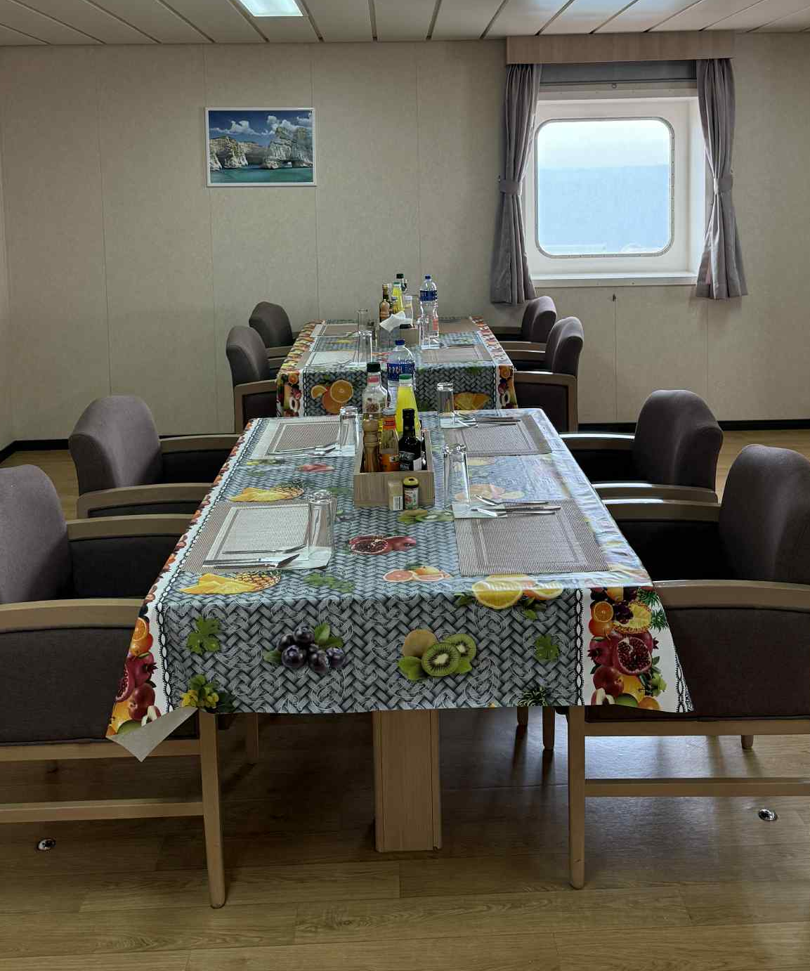
Action Planning Workshop Activity
Τhe concept behind an onboard workshop is that experiential learning strengthens understanding.
A structured exercise involves crew teams drafting a simplified personal health, wellbeing or sustainability plan relevant to their department—galley, housekeeping, or engine room. Participants thus define a specific goal, outline steps, assign responsibilities, and predict potential challenges.
Such exercises encourage critical thinking and reinforce how sustainability intersects with daily routines. Even without formal workshops, crews can conduct informal evaluations of their processes, applying the same logical structure: assess, plan, act, and review.

Slide 20
Simulation Exercise
Developing a Sustainable Nutrition Action Plan
Title: “Operation Green Galley” Duration: 60–90 minutes
Objective: To design a realistic, data-driven sustainability action plan that improves healthy eating habits and reduces food waste onboard a training vessel or simulated galley.
Scenario: You are a cadet team assigned to a 20-day voyage on the training vessel MV Horizon. The ship’s last galley audit revealed:25% of food prepared was discarded daily. Crew meals were high in processed meat and low in fresh vegetables. Several crew members complained of fatigue and digestive issues. The captain has asked your team to propose a Sustainability and Nutrition Action Plan for the next voyage cycle.
Tasks: Assess Current Situation AND Identify sources of waste (menu design, portion control, storage). Discuss crew meal preferences and challenges in maintaining a balanced diet at sea. Review inventory and food delivery constraints.
Set SMART Goals: “Reduce galley food waste by 30% within one voyage.” “Increase use of fresh vegetables and fruits by 20% without raising cost.” “Introduce one ‘Healthy Meal Day’ per week featuring balanced nutrition.”

Slide 21
Simulation Exercise
Developing a Sustainable Nutrition Action Plan (cont.)
Develop the Plan: Assign roles (Chief Cook, Galley Cadet, Chief Steward, Environmental Officer).
List specific actions: menu redesign, portion control policy, leftover reuse guidelines, crew feedback system.
Define metrics: kg of food waste per day, meal satisfaction survey, budget impact.
Present to Command Team:Prepare a short 5-minute presentation using PowerPoint or flipchart.
Include a cost-benefit summary and timeline.
Debrief: Instructors simulate the Captain and officers, asking critical questions.
Reflect on teamwork, feasibility, and clarity of the plan.
Learning Outcomes: Understand how sustainability and nutrition intersect in real ship operations. Practice structured planning (assessment → goals → actions → monitoring). Develop teamwork, time management, and problem-solving soft skills.

Slide 22
Evaluation and Discussion
After implementing an action plan, the team should consider what went well and what could improve. Evaluative summaries might note increased awareness, reduced waste quantities, or better cooperation between departments.
They might also highlight obstacles such as supply limitations or competing priorities.
Documenting these evaluations in voyage reports creates valuable institutional knowledge that future crews can reference.
At the management level, aggregated reflections reveal broader trends across the fleet, helping companies refine their training and procurement strategies.
Evaluation also reinforces accountability: when individuals see the impact of their actions recorded and shared, they are more likely to maintain good practices.
Ultimately, this final stage closes the loop between planning and learning, ensuring sustainability becomes an evolving element of maritime professionalism.

Slide 23
Chapter 2 – Communicating Initiatives
The Power of Communication
Communication transforms sustainability from a technical goal into a shared value.
Even the most well-designed action plan depends on how effectively it is communicated to the people who must carry it out. At sea, where crews come from diverse cultural and linguistic backgrounds, clear communication becomes vital.
Messages about personal health, wellbeing and sustainability should be simple, relevant, and actionable. Rather than using abstract environmental terminology, communication should focus on daily behaviors—turning off unused equipment, sorting waste correctly, or planning meals efficiently. When crew members understand why a procedure exists, they are more likely to follow it consistently.
In maritime leadership, communication is not just about issuing instructions; it is about inspiring participation, commitment and accountability across the ship’s community.

Slide 24
Understanding the Audience
Before communicating, it is essential to understand the audience—who they are, what motivates them, and what barriers they might face. Onboard crews are often multicultural, multilingual, and hierarchical. Engineers, cooks, stewards, and officers may view sustainability through different lenses, shaped by their professional roles and personal experiences. For example, a galley team may respond best to messages about reducing food waste for cost and hygiene reasons, while deck officers might connect more with energy efficiency and regulatory compliance.
Tailoring communication to each group’s priorities increases relevance and engagement. Visual aids, bilingual posters, and short briefings often work better than lengthy written directives. Recognizing these differences demonstrates respect for diversity and improves cooperation.
When people feel that messages are designed for them, not at them, communication becomes inclusive, motivating, and effective.

Slide 25
Crafting Clear Messages
Messages should be concise, consistent, and easy to understand, regardless of technical background. A clear message defines the goal, the action required, and the reason it matters. For instance: “Sort biodegradable waste into the green bin to reduce disposal costs and protect marine life.” The message avoids jargon, emphasizes action, and links behavior to impact.
Repetition across different formats—briefings, visual cues, and signage—reinforces memory.
Consistency is also critical: contradictory or changing instructions undermine trust.
Every department should deliver the same message, framed within the company’s sustainability policy.
Visual storytelling—charts, symbols, or photographs—can enhance understanding, especially for multinational crews.

Slide 26
Choosing Communication Channels
Different messages require different communication channels. In maritime settings, available options include daily briefings, noticeboards, safety meetings, posters, internal newsletters, and digital dashboards.
Selecting the right channel depends on urgency, audience size, and purpose. A new recycling rule might be introduced during a formal safety meeting, while reminders can appear on galley walls or crew mess tables.
Informal communication—such as short conversations or feedback rounds—can reinforce official messages.
Digital platforms, where available, enable real-time data sharing and recognition of achievements, such as tracking reductions in food waste or energy use.
Blending formal and informal channels ensures that communication reaches everyone, regardless of rank or shift schedule.
Ultimately, the success of a message lies not only in its content but also in where and how it is delivered.

Slide 27
Visual and Multilingual Communication
Given the diversity of maritime crews, visual and multilingual communication greatly enhances understanding.
Pictograms, color-coded bins, and illustrated instructions transcend language barriers and simplify complex information.
Posters showing “Do’s and Don’ts” for waste handling or portion control can be more effective than text-heavy notices.
Translations should be accurate and culturally sensitive, avoiding idioms or expressions that might confuse non-native speakers.
Combining text with visuals ensures inclusivity and reduces misinterpretation, particularly in time-pressured environments like galleys.
Digital displays or laminated cards can further reinforce messages during shift rotations.
Clear visuals not only guide behavior but also communicate a sense of professionalism and commitment to safety, personal health, wellbeing and sustainability.

Slide 28
Encouraging Two-Way Communication
Communication should never be one-directional. Two-way dialogue allows management to identify barriers, gather ideas, and gauge understanding.
Inviting feedback from crew members transforms communication into collaboration. For example, crew members might suggest adjustments to waste collection schedules or improvements to storage procedures that leadership hadn’t considered.
Encouraging feedback also builds psychological safety—people feel comfortable raising concerns or admitting mistakes without fear of reprimand.
This openness creates a continuous improvement cycle: communication informs action, and action informs communication.
Tools like suggestion boxes, digital forms, or debrief meetings can formalize feedback mechanisms. Involving the crew in shaping solutions not only improves effectiveness but also strengthens engagement and morale. When people feel heard, company policies become a shared responsibility rather than a managerial directive.

Slide 29
Overcoming Communication Barriers
Effective communication requires awareness of common barriers such as language differences, hierarchical distance, workload pressures, and cultural attitudes.
Onboard, junior crew may hesitate to question procedures, while others may feel personal health, wellbeing and sustainability are a “shore concern” unrelated to ship operations. To overcome these barriers, leaders must adopt an open and supportive tone.
Messages should be repeated across shifts, and follow-ups should confirm understanding rather than assume it.
Visual tools and demonstrations help bridge literacy or language gaps. Creating informal discussion opportunities—such as “green coffee breaks” or shared briefings—reduces hierarchy and encourages honest participation.
Building a communication climate rooted in respect and mutual learning ensures that company policy messages are received, understood, and acted upon by everyone on board.

Slide 30
The Role of Cultural and Gender Sensitivity
Cultural and gender sensitivity ensures that company messages are understood and respected across national and cultural lines. Crews represent a variety of traditions, religions, and social norms that influence their attitudes toward food, waste, and the environment. For example, discussions about diet or meat reduction must be framed carefully to avoid cultural insensitivity.
Communication should emphasize shared global values—health, respect, efficiency, and stewardship—rather than imposing one cultural perspective.
Recognizing and celebrating cultural diversity can actually enhance sustainability, as traditional practices from different regions often embody resource efficiency and respect for nature.
By approaching communication with humility and openness, leaders build trust and cohesion within the multicultural shipboard environment.

Slide 31
Storytelling as a Communication Tool
Storytelling humanizes sustainability goals by turning data into meaning. Sharing real-life examples—such as how a galley reduced waste or how a crew initiative improved recycling—creates emotional engagement.
Stories connect actions to human experiences, making personal health, wellbeing and sustainability relatable and memorable. They can be shared during meetings, newsletters, or casual conversations. A well-told story should highlight a challenge, an action, and a result, inspiring others to emulate success.
Visual storytelling through photos or short videos can further amplify impact. Onboard, storytelling builds community pride and reinforces the message that sustainability is achievable, rewarding, and personally significant.

Slide 32
Using Data to Communicate Results
Numbers speak powerfully when presented clearly. Quantitative data—like reductions in fuel use, kilograms of waste avoided, or improved meal efficiency—provide tangible evidence of progress.
Communicating results visually, through graphs or dashboard displays, helps crew see the direct impact of their efforts.
Celebrating milestones reinforces motivation and accountability. For example, posting a personal health, wellbeing or sustainability Sustainability Scoreboard in the mess hall can show week-to-week achievements.
Transparency builds trust: when people can see measurable outcomes, they are more likely to maintain good practices. However, data must be contextualized—percentages and figures should be translated into meaningful insights, such as “Our galley reduced 25 kg of waste this week, equivalent to saving meals for three crew members.”

Slide 33
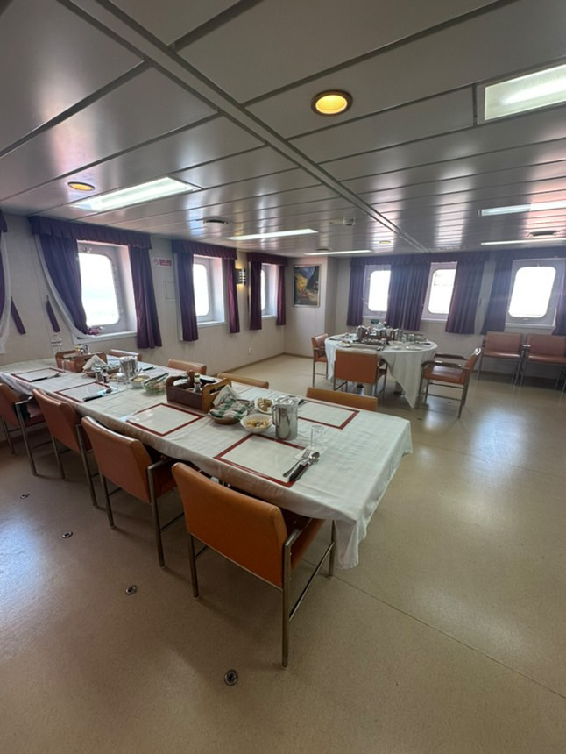
Recognition and Rewards
Positive reinforcement is a powerful communication strategy. Recognition can be formal—certificates, awards, or commendations
Or informal, such as public acknowledgment during briefings. For example, highlighting the galley’s role in reducing food waste by 15% gives visibility and encouragement. Even small tokens, like thank-you notes or features in the ship’s newsletter, can significantly boost morale.
Recognition must be genuine and tied to real results; empty praise diminishes credibility. Some vessels integrate sustainability into performance reviews, ensuring long-term accountability.

Slide 34
Training for Effective Communication
Ongoing training ensures that communication remains effective and professional.
Training should cover both technical knowledge—such as waste management protocols or energy-efficient galley operations—and soft skills like listening, teamwork, and intercultural communication.
Workshops, e-learning modules, or onboard mini-seminars can strengthen understanding of new company principles and how to convey them clearly.
Role-playing exercises help crew practice explaining initiatives or addressing resistance constructively. Special attention should be given to middle managers, who often act as communication bridges between officers and crew.
Training enhances confidence and consistency, preventing mixed messages.

Slide 35
Motivating the Crew
Enthusiasm for sustainability requires continuous motivation. Crew members often work long hours under demanding conditions, and motivation must go beyond compliance. Linking personal health, wellbeing and sustainability goals to personal and collective benefits—such as a cleaner work environment, improved health, or smoother operations—creates intrinsic motivation.
Recognition and visible results also fuel morale; when crew members see that their actions matter, they take pride in maintaining them.
Communication should highlight success stories regularly and show appreciation for contributions, no matter how small.
Rotating “Sustainability Champions” or team recognition schemes can provide friendly competition and ownership.
Motivation also depends on fairness: responsibilities and rewards should be shared across departments.

Slide 36
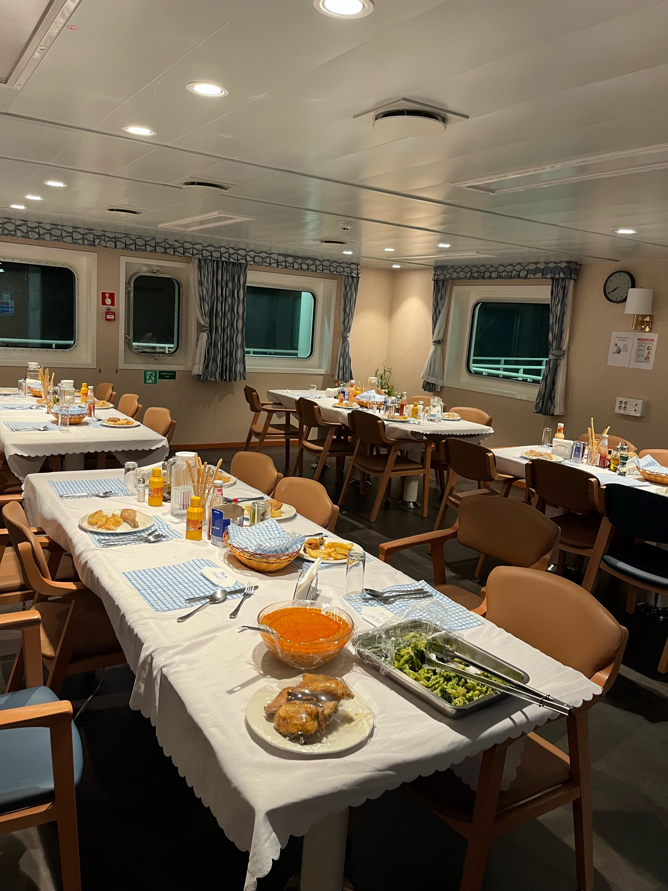
Celebrating Success and Milestones
Celebrating milestones keeps momentum alive. Whether it’s reducing waste by 25%, completing a training cycle, or implementing a new procedure, success should be acknowledged publicly.
Celebrations can be simple—a poster, an announcement, or a shared meal prepared sustainably.
Success stories should also be shared fleet-wide to inspire other vessels.

Slide 37
Simulation 2 –
Communicating Sustainability and Healthy Eating Initiatives
Title: “The Crew Briefing Challenge”
Duration: 45–60 minutes
Objective: To practice effective, inclusive, and culturally sensitive communication when introducing sustainability or health initiatives to a diverse crew.
Scenario: You are a group of cadets acting as the “Sustainability Communication Team” aboard the MS Ocean Star. The galley has recently switched to healthier and more sustainable meal plans (e.g., more vegetables, less fried food, reduced red meat). Some crew m embers have reacted negatively, saying: “The food isn’t as tasty.” “Vegetarian meals don’t fill us up.”“Why change what’s already working?”
Your mission: deliver a short, persuasive crew briefing to explain the changes, motivate participation, and handle questions respectfully.

Slide 38
Simulation 2 –
Communicating Sustainability and Healthy Eating Initiatives (contd.)
Roles: Cadet Communicators (2–3): Present the new initiative in a 3–5 minute talk.
Crew Members (played by classmates): React with realistic skepticism, humor, or curiosity.
Facilitator (Instructor): Observes and provides feedback on delivery and tone.
Guidelines for Cadets:
Use the “3R Formula”: Reason: Why the change matters (health, cost, environment). Relevance: How it benefits them personally (energy, wellbeing, pride). Respect: Acknowledge habits and preferences before suggesting change.
Use Multiple Frames: Efficiency: “Better nutrition reduces fatigue and errors.” Cost-saving: “Less waste keeps our catering budget healthy.” Stewardship: “Eating smart means protecting our oceans too.” Encourage Participation: Ask for ideas (“What recipes would you like on the new menu?”).
Invite a volunteer “Nutrition Ambassador” from the crew.

Slide 39
Simulation 2 –
Communicating Sustainability and Healthy Eating Initiatives (contd.)
Debrief and Reflection:After each group presents:Discuss clarity, engagement, tone, and adaptability to cultural differences.Ask crew participants how they felt — convinced or resistant? Why?Instructor summarizes key lessons on active listening, empathy, and persuasive storytelling.
Learning Outcomes: Develop confidence in public speaking and persuasion. Practice framing sustainability messages for diverse audiences. Learn to handle questions, objections, and cultural sensitivity gracefully.

Slide 40
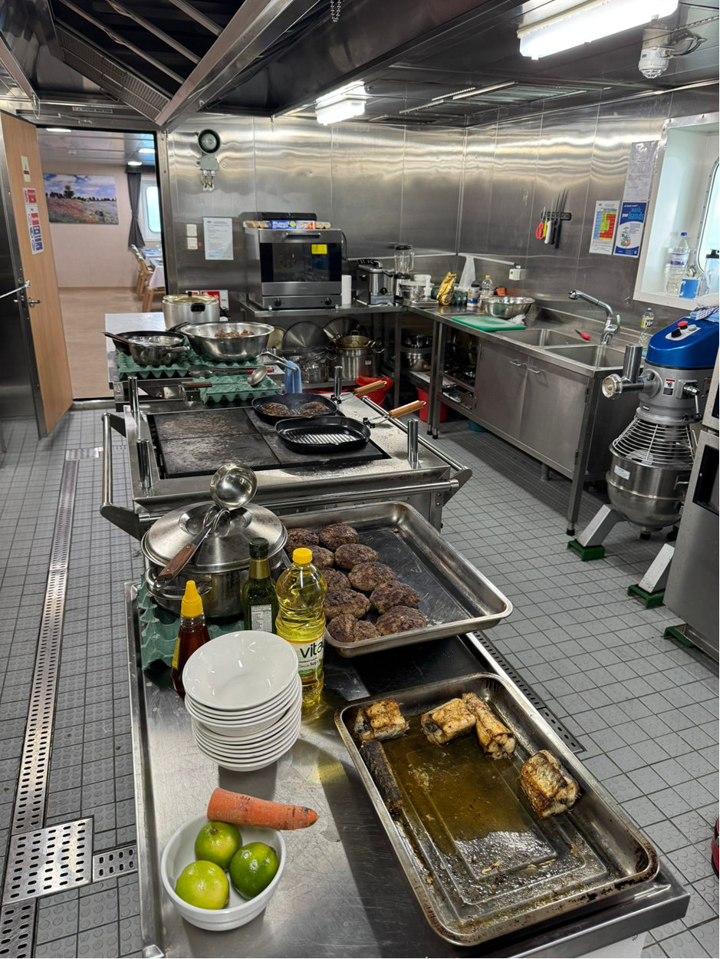
Chapter 3 – Fostering a Culture of wellbeing: defining a New Culture Onboard
A culture of sustainability means that environmental responsibility, efficient resource use, and respect for health and wellbeing become everyday habits, not isolated projects.
Onboard vessels, culture emerges from shared routines and beliefs reinforced by leadership and peer behavior. A sustainable ship culture values stewardship, cooperation, and awareness—where each decision, from food preparation to waste disposal, reflects collective responsibility.
Establishing this culture requires consistency: sustainability must be embedded in policies, briefings, and informal conversations alike.

Slide 41

From Compliance to Commitment
While regulations and audits are necessary, they only sustain change when internalized as shared values. This transition happens when individuals see personal and operational benefits: improved health, reduced workload, or smoother coordination.
Communication and example play key roles here, turning abstract rules into visible, meaningful actions.
When commitment replaces compliance, any policy becomes self-sustaining, resilient to personnel changes and external pressure.

Slide 42
Understanding the Notions of Values and Ethics in Maritime personal health, wellbeing and sustainability
A culture of personal health, wellbeing and sustainability is rooted in ethics—respect for the personal health, the environment, for others, and for future generations.
Ethical decision-making involves choosing long-term ecological wellbeing over short-term convenience. This moral dimension gives any new policy or goal depth and purpose.
For seafarers, this might mean resisting wasteful habits or advocating for more sustainable procurement.
Linking sustainability to professional ethics strengthens accountability and aligns with maritime traditions of duty and stewardship. Ethical discussions during training or meetings encourage reflection: “How do my actions today affect my health? How does affect the the sea tomorrow?”

Slide 43
Empowering Crew Commitment
For a new culture to thrive, every crew member must feel empowered to contribute. Commitment and accountability grow when people believe their actions matter and that their voices are valued.
Practical empowerment includes assigning specific roles—waste monitors, galley efficiency coordinators, health or energy champions.
Encouraging suggestions and innovation keeps the initiative dynamic.
Recognition programs further reinforce engagement by linking ownership with pride.
Empowered crews move from passive compliance to active participation, identifying new opportunities and taking responsibility for continuous improvement.

Slide 44
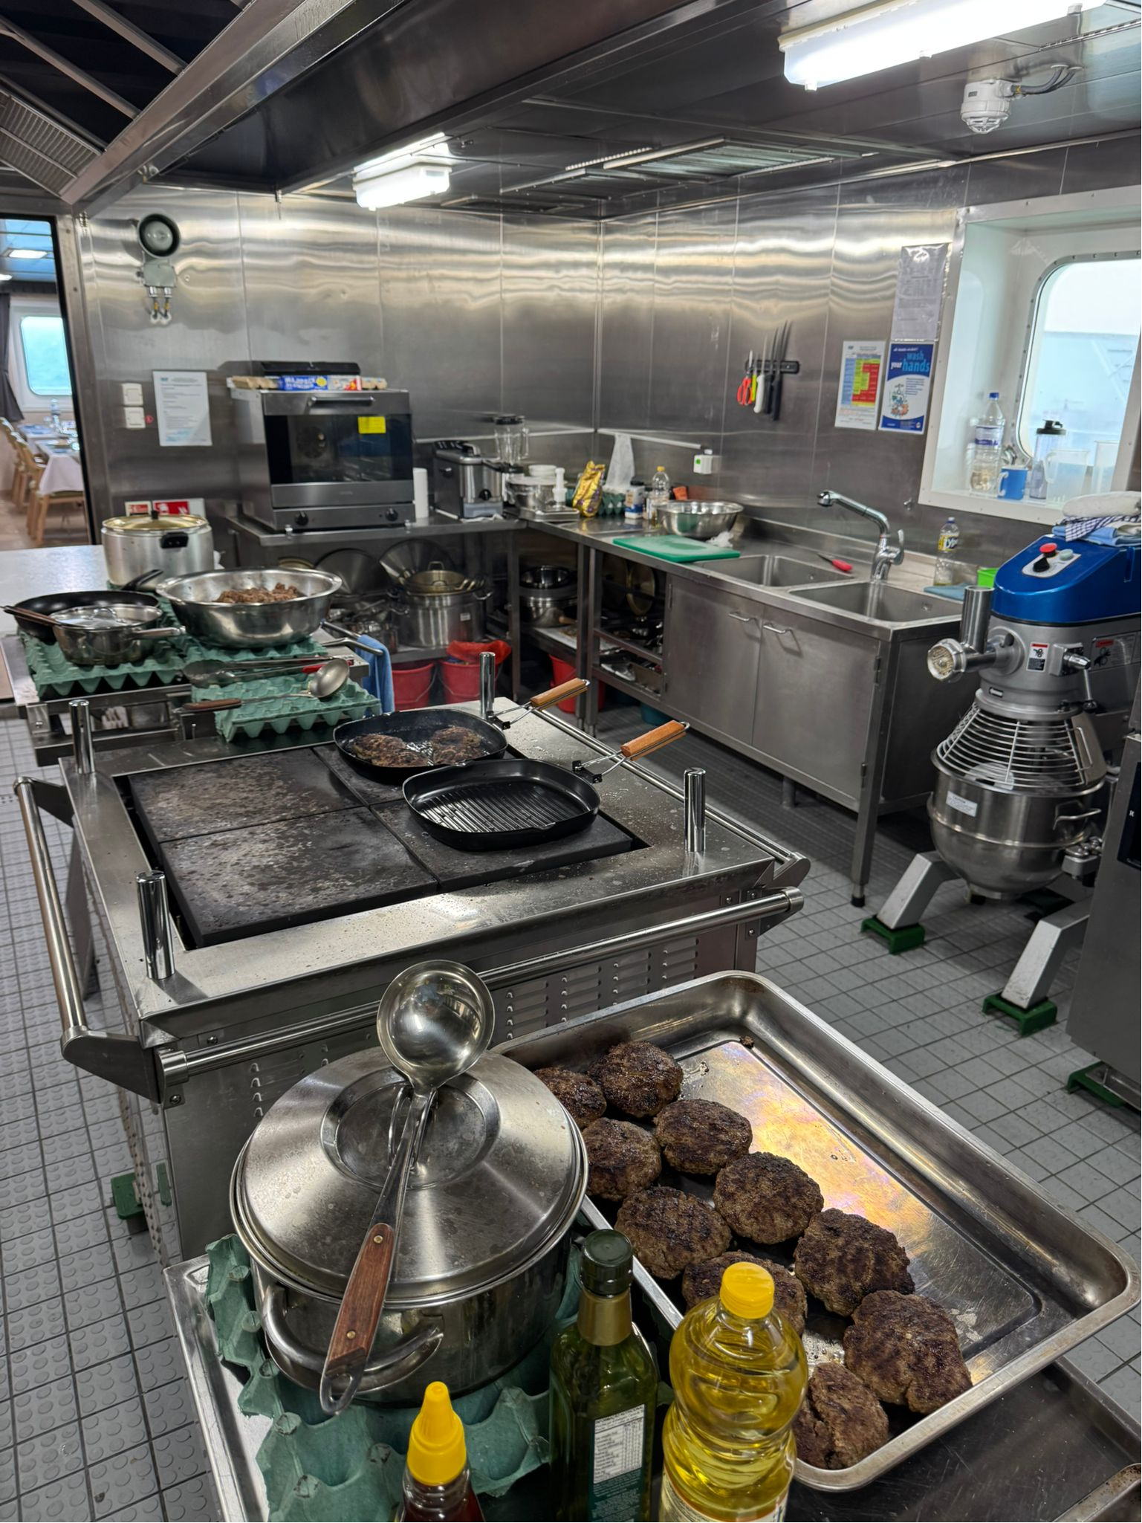
Integrating a new health and sustainable culture into Daily Routines
Embedding new personal health and sustainability cultures into routine operations ensures longevity. When health and is part of daily checklists, maintenance rounds, and galley procedures, it ceases to feel like an extra task.
Examples include waste segregation during cleanup, turning off equipment after use, and optimizing meal preparation based on real-time headcount.
Integration also means linking personal health and sustainability to safety, hygiene, and operational efficiency—the pillars of shipboard life.

Slide 45
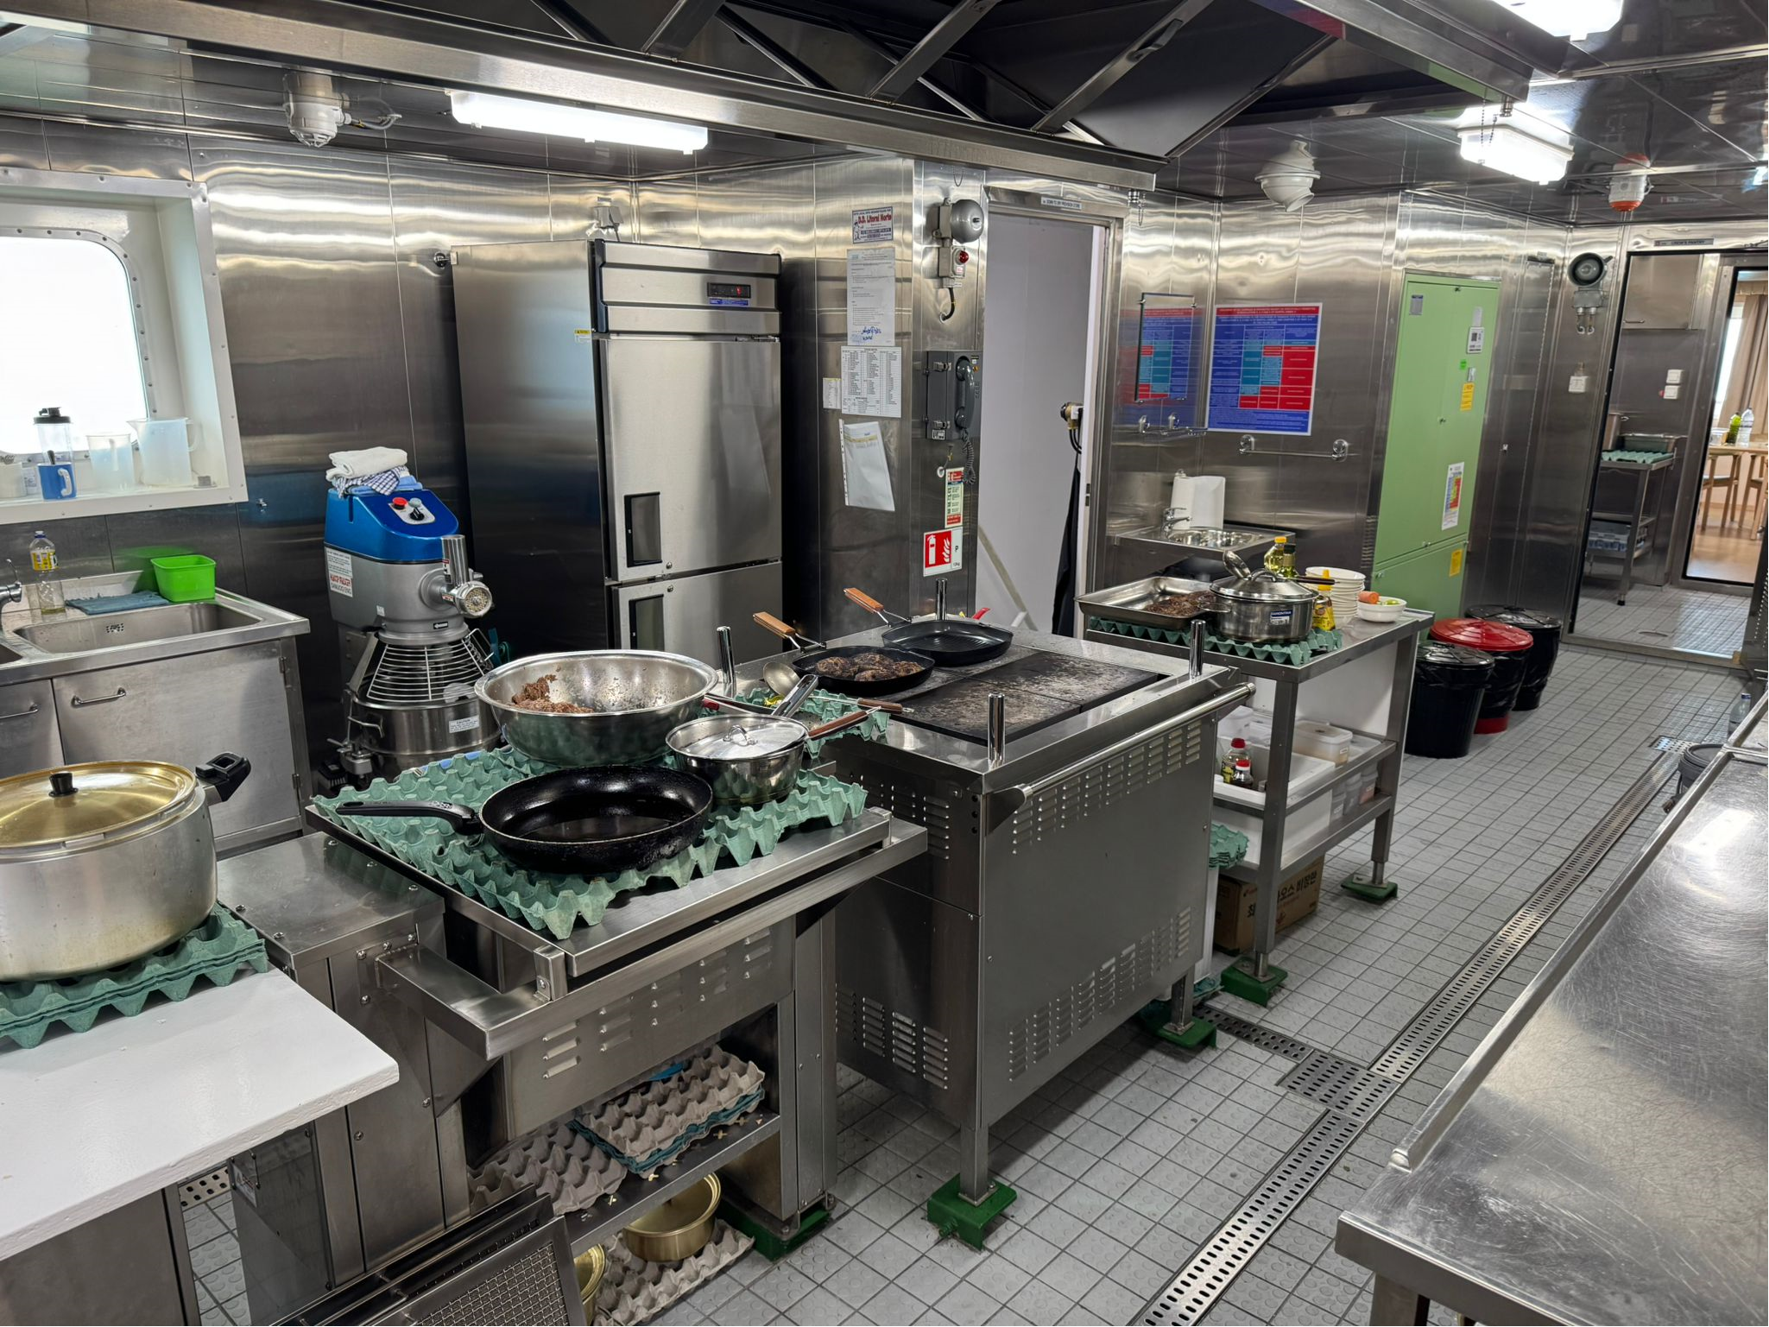
Teamwork and Collaboration
A culture depends on teamwork.
Crews from diverse backgrounds bring different perspectives, skills, and ideas. Effective collaboration harnesses this diversity to improve problem-solving and innovation. Joint projects, like ship-wide “health challenges”, “better life”, “green challenges” or collaborative energy audits, strengthen bonds and foster shared accountability.
Communication that emphasizes team success over individual achievement reinforces unity. When teamwork becomes the foundation of better life efforts, it not only enhances personal health, well being and environmental outcomes but also improves morale and cooperation across the vessel.

Slide 46
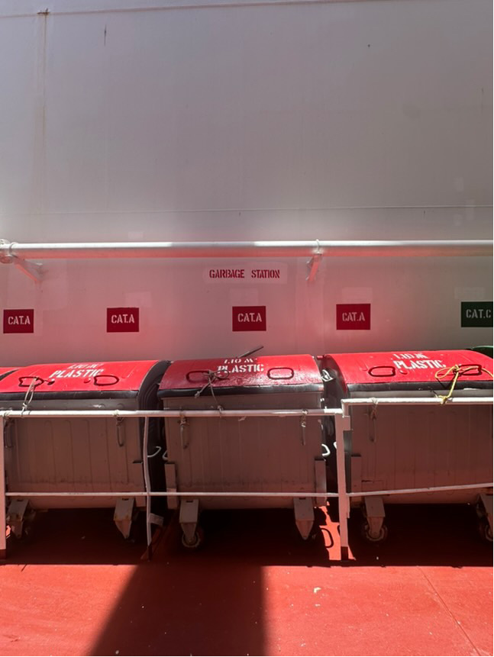
Learning from Mistakes
Mistakes—such as poor diets, improper waste sorting or energy overuse—should be treated as opportunities for reflection and improvement. The focus is on identifying causes and preventive measures, not assigning fault.
Documenting lessons learned creates valuable reference material for future crews. A blame-free learning culture promotes honesty, resilience, and innovation, allowing employee practices to evolve through shared experience rather than fear of error.

Slide 47
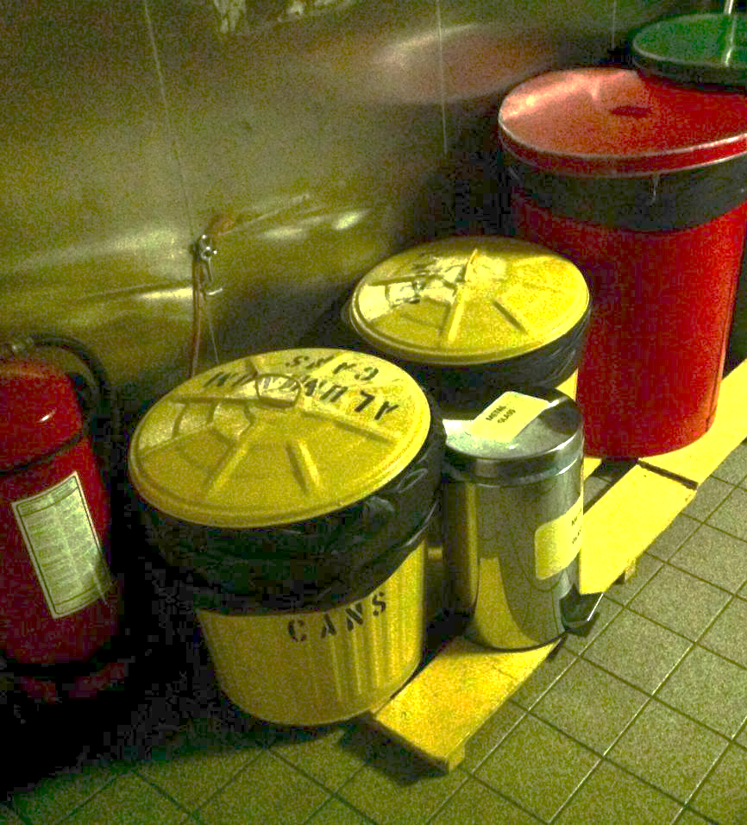
Behavioral Change and Habits
Cultural transformation ultimately depends on changing habits. Small, consistent behaviors create cumulative impact.
Behavior change theories suggest that repetition, feedback, and positive reinforcement are key. Clear cues, such as visible reminders or scheduled sustainability tasks, help establish new routines.
Over time, repeated behaviors form habits that persist even when external pressure fades. Recognizing and celebrating habit formation encourages long-term adherence.

Slide 48
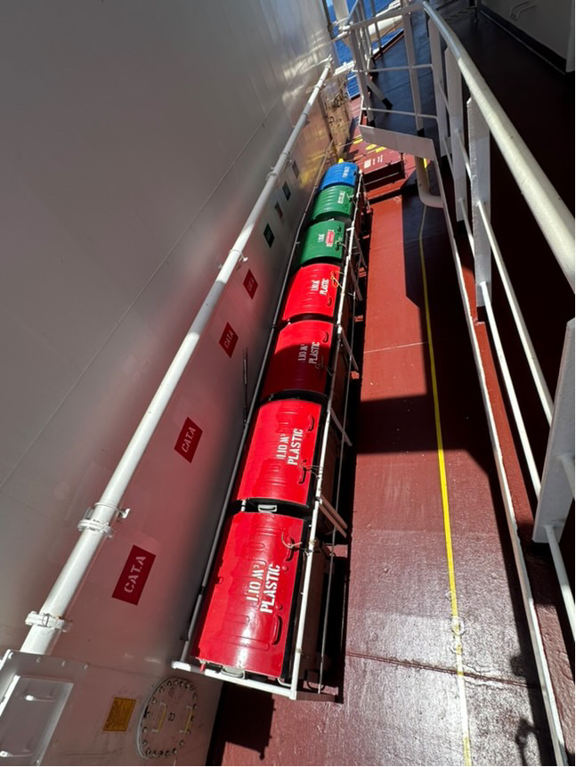
Measuring Cultural Change
Assessing cultural change requires both qualitative and quantitative tools.
Surveys, interviews, and focus groups can capture shifts in attitudes, while operational data reveal behavioral trends.
Regular assessments help leadership identify gaps and reinforce progress.
Sharing results transparently reinforces trust and motivates further improvement.
Measuring culture may seem abstract, but it is vital for understanding whether a company’s set of values have truly taken root. What gets measured, improves.

Slide 49
Overcoming Resistance to Change
Resistance is natural in any cultural shift. Some may view new personal health, well being or sustainability policies as extra work or temporary.
Addressing resistance requires empathy and inclusion.
Listening to concerns, clarifying misunderstandings, and demonstrating tangible benefits help reduce skepticism.
Pilot projects can show proof of concept before full-scale implementation.
Transparency about challenges and compromises builds credibility.
Leaders must remain patient yet firm, reinforcing the message that personal health, wellbeing and sustainability are shared values, not a passing trend.

Slide 50
Simulation 3 – Leading and Fostering a Culture of Wellbeing and Sustainability
Title: “Green Watch Leadership Scenario”
Duration: 75–90 minutes
Objective: To experience how leadership behavior and crew culture influence sustainability and wellbeing onboard.
Scenario: You are part of the deck department on the MV Blue Spirit, a training vessel sailing a 14-day route. The captain has noticed declining morale and rising waste levels: food scraps are left unsegregated, crew skip vegetables at meals, and galley hygiene checks are inconsistent. A new “Healthy Crew & Clean Ship” initiative is being launched. Your watch group must lead by example for the next 7 days and inspire others to follow — without formal authority.

Slide 51
Simulation 3 – Leading and Fostering a Culture of Wellbeing and Sustainability
Phase 1: Strategy Planning (20 minutes)-Define what kind of sustainability culture you want onboard. Agree on 3–4 behavioral commitments (e.g., waste separation, balanced meals, reducing sugar drinks). Assign rotating leadership roles (“Health Champion,” “Waste Watcher,” “Motivator”). Plan how to engage others — peer encouragement, friendly competitions, positive reinforcement.
Phase 2: Implementation Simulation (30 minutes)-Roleplay daily onboard situations: Meal Time: A crew member jokes about avoiding salads — how do you encourage them positively? Waste Sorting: A colleague throws plastic into food waste — how do you respond respectfully? Fatigue & Morale: A cook says “Too busy for this sustainability nonsense” — how do you motivate without lecturing? Cadets act out responses demonstrating soft skills: empathy, confidence, and example-setting.
Phase 3: Reflection & Debrief (20 minutes)Discuss as a group: Which actions built trust and influence?What resistance did you face, and how did leadership style affect it? What habits would help make this culture sustainable long-term?
Learning Outcomes: Practice leading through influence, not authority. Understand how everyday behavior shapes culture. Connect wellbeing, nutrition, and environmental care as integrated leadership values.

Slide 52
Conclusion
The journey toward personal health, wellbeing and sustainability begins with awareness, grows through communication, and matures into culture.
For young mariners and cadets, fostering these priorities is not just a professional skill—it is a moral responsibility and a contribution to the global maritime community.
As the final reflection, crew members should ask: How can I lead by example? What small change can I start today? The answers to these questions form the living foundation of sustainability at sea.
Every vessel, every meal, and every decision matters. Together, these actions shape a maritime culture that protects people, resources, and the planet—ensuring that the oceans we rely on today remain healthy for generations to come.

Slide 53
STUDENT SELF-ASSESSMENT
Section 1: Developing Action Plans
1.1. I can clearly identify the key personal wellbeing, environmental and social sustainability challenges onboard a vessel.
Strongly Disagree
Disagree
Neutral / Not Sure
Agree
Strongly Agree
1.2. I feel confident creating a step-by-step personal health, wellbeing and sustainability action plans for my department or vessel.
Strongly Disagree
Disagree
Neutral / Not Sure
Agree
Strongly Agree

Slide 54
Section 1: Developing Action Plans
1.3. I understand how to set SMART (Specific, Measurable, Achievable, Relevant, Time-bound) goals for personal health, wellbeing and sustainability initiatives.
Strongly Disagree
Disagree
Neutral / Not Sure
Agree
Strongly Agree
1.4. I actively involve other crew members when developing new plans.
Strongly Disagree
Disagree
Neutral / Not Sure
Agree
Strongly Agree
1.5. I can identify realistic resources (time, equipment, support) needed to implement personal health, wellbeing and sustainability actions.
Strongly Disagree
Disagree
Neutral / Not Sure
Agree
Strongly Agree

Slide 55
Section 2: Communicating personal health, wellbeing and sustainability Initiatives
2.1. I communicate personal health, wellbeing and sustainability messages clearly and confidently to people from different cultural backgrounds.
Strongly Disagree
Disagree
Neutral / Not Sure
Agree
Strongly Agree
2.2. I use both verbal and visual methods (posters, signs, briefings) to share information effectively.
Strongly Disagree
Disagree
Neutral / Not Sure
Agree
Strongly Agree
2.3. I believe communication is as important as technical knowledge in promoting personal health, wellbeing and sustainability onboard.
Strongly Disagree
Disagree
Neutral / Not Sure
Agree
Strongly Agree

Slide 56
Section 2: Communicating personal health, wellbeing and sustainability Initiatives
2.4. I listen to feedback from crew members and adjust sustainability initiatives based on their suggestions.
Strongly Disagree
Disagree
Neutral / Not Sure
Agree
Strongly Agree
2.5. I recognize and celebrate personal health, wellbeing and sustainability achievements to motivate others.
Strongly Disagree
Disagree
Neutral / Not Sure
Agree
Strongly Agree

Slide 57
Section 3: Fostering a Culture of Sustainability
3.1. I see personal health, wellbeing and sustainability as part of my professional duty on board, not just a company requirement.
Strongly Disagree
Disagree
Neutral / Not Sure
Agree
Strongly Agree
3.2. I model sustainable behaviors that others can follow (e.g., waste sorting, portion control, energy saving).
Strongly Disagree
Disagree
Neutral / Not Sure
Agree
Strongly Agree
3.3. I feel empowered to suggest new personal health, wellbeing and sustainability practices to my supervisors or officers.
Strongly Disagree
Disagree
Neutral / Not Sure
Agree
Strongly Agree

Slide 58
Section 3: Fostering a Culture of Sustainability
3.4. I encourage teamwork and cooperation when solving environmental or health-related challenges onboard.
Strongly Disagree
Disagree
Neutral / Not Sure
Agree
Strongly Agree
3.5. I can identify barriers that prevent crew members from adopting personal health, wellbeing and sustainability behaviors.
Strongly Disagree
Disagree
Neutral / Not Sure
Agree
Strongly Agree

Slide 59
Course References
IMO. (2025). MARPOL Convention: An Overview. IMO.
2. https://www.haw-hamburg.de/fileadmin/LS/FTZ-NK/PDF/Publications/2024-Handling_the_growing_problem_of_offshore_food_waste__Marine_Policy.pdf
2. Healthy eating onboard: https://britanniapandi.com/2024/12/healthy-eating-on-board-simple-tips-for-seafarers/
3. Food and Diet of Seafarers: Challenges, Guidance and MLC 2006: https://www.ukpandi.com/news-and-resources/news/article/food-and-diet-of-seafarers-challenges-guidance-and-mlc-2006/
4. Quench Hydration posters - Improving hydration on board: https://www.iswan.org.uk/wp-content/uploads/Quench-Posters-5.pdf
5. Food safety - a guide for seafarers: https://www.iswan.org.uk/wp-content/uploads/SHIP-Food_Safety_A5_LR-4.pdf

