Slide 1





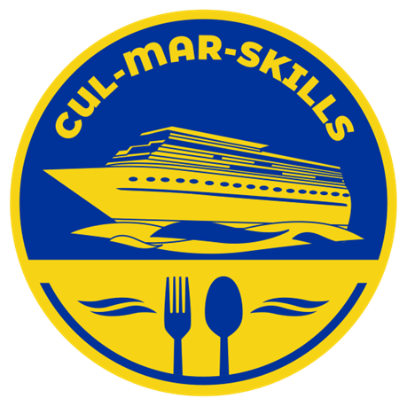

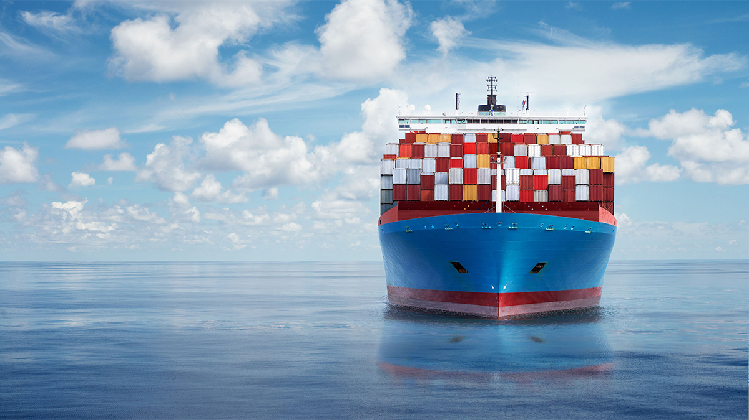
MARitime Soft Skills for Onboard Healthy Nutrition and CULinary Arts in Seagoing Services – CUL-MAR-Skills
KA220-VET - Cooperation partnerships in vocational education and training
2023-1-RO01-KA220-VET-000156711
Green Transition in Blue Galleys
Module 1:
INTRODUCTION TO SUSTAINABILITY IN THE MARITIME INDUSTRY
Disclaimer: “Funded by the European Union. Views and opinions expressed are however those of the author(s) only and do not necessarily reflect those of the European Union or the ANPCDEFP. Neither the European Union nor the ANPCDEFP can be held responsible for them”

Slide 2
Learning Objectives
WEEK 1 – INTRODUCTION TO SUSTAINABILITY IN THE MARITIME INDUSTRY
Learning Outcomes
Upon completing this module, you will be able to:
Explain the three pillars of sustainability: environmental stewardship, social responsibility, and economic viability.
Distinguish between proactive and reactive approaches to sustainability and evaluate the risks and benefits of each.
Analyze how regulatory frameworks (such as those from the IMO) influence the maritime industry's sustainability efforts.
Evaluate a company's sustainability strategy based on its financial, reputational, and environmental impacts.
Formulate a compelling argument for or against a specific sustainability measure based on critical thinking and evidence-based reasoning.
INTRODUCTION TO SUSTAINABILITY IN THE MARITIME INDUSTRY

Slide 3
Contents of the course
Introduction
The Importance of Sustainability in the Maritime Industry
Environmental Impact of Maritime Operations
Relevant Regulations and Standards
The Business Case for Sustainability
Real-World Scenario & Collaborative Activity
Multimedia and Online Resources
A short simulation
A Critical Thinking Activity: Proactive vs Reactive
Conclusion
Key Takeaways
Quiz
Course References
.
INTRODUCTION TO SUSTAINABILITY IN THE MARITIME INDUSTRY

Slide 4
1. Introduction
Welcome to Module 1: INTRODUCTION TO SUSTAINABILITY IN THE MARITIME INDUSTRY
Sustainability isn't just a buzzword; it's a fundamental part of modern maritime operations.
The maritime industry, the backbone of global trade, is at a pivotal moment, facing an unprecedented challenge and opportunity in its history. With over 90% of the world's goods transported by sea, its scale is immense, as is its environmental footprint. For decades, the primary focus has been on maximizing efficiency in terms of speed and cost, a model that has enabled the globalized economy we know today. However, this has come at a significant cost to the environment. Today, a new, equally critical metric has emerged: sustainability. This is no longer a peripheral concern but a central pillar of operational strategy, driven by a convergence of heightened environmental awareness, evolving consumer and stakeholder expectations, and a complex, rapidly expanding web of international and regional regulations. The industry is moving from a reactive stance, where it simply responds to new rules, to a proactive one, where it seeks to innovate and lead in the transition to a greener future.
INTRODUCTION TO SUSTAINABILITY IN THE MARITIME INDUSTRY

Slide 5
1. Introduction
This module provides a comprehensive introduction to the concept of sustainability as it applies specifically to the maritime sector. We will delve into the fundamental reasons why sustainability matters, dissect the multifaceted environmental impacts of maritime operations in granular detail, and navigate the intricate landscape of global and regional regulations designed to steer the industry toward a greener future. By the end of this week, you will not only possess a foundational understanding of the challenges and opportunities ahead but will also be equipped to contribute meaningfully to the industry’s ongoing, transformative journey. The knowledge you gain will be essential for making informed decisions on board and for understanding your role in this critical shift.
INTRODUCTION TO SUSTAINABILITY IN THE MARITIME INDUSTRY

Slide 6
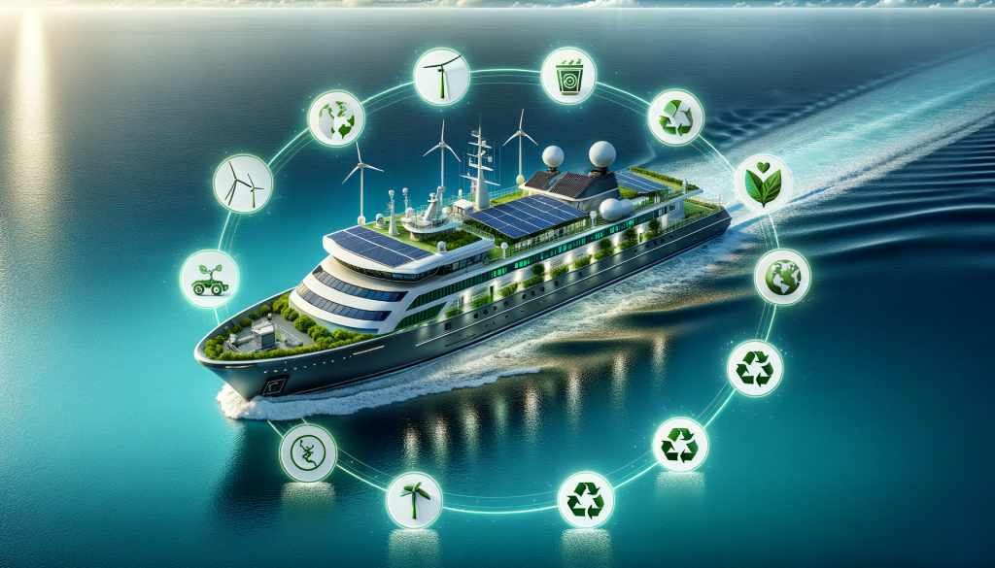
2. The Importance of Sustainability in the Maritime Industry
INTRODUCTION TO SUSTAINABILITY IN THE MARITIME INDUSTRY

Slide 7
2. The Importance of Sustainability in the Maritime Industry
Sustainability in the maritime context encompasses a commitment to long-term economic, environmental, and social viability, often referred to as the "triple bottom line." It is a fundamental paradigm shift away from a "business-as-usual" approach, recognizing that the health of the oceans and the planet are inextricably linked to the industry's own prosperity and long-term survival. The imperative to act is driven by several key, interconnected factors:
INTRODUCTION TO SUSTAINABILITY IN THE MARITIME INDUSTRY

Slide 8
2. The Importance of Sustainability in the Maritime Industry
2.1 Environmental Stewardship: As stewards of the world's oceans and vital components of the global supply chain, the maritime industry has a moral and professional obligation to minimize its impact. This obligation extends beyond simply avoiding harm; it requires actively protecting delicate marine ecosystems, reducing air and water pollution, and playing a leading role in the global fight against climate change. For example, maritime operations directly threaten sensitive habitats like coral reefs and mangroves through physical impacts and pollution, and contribute to the problem of plastic waste in the oceans. A commitment to sustainability means implementing measures to protect these fragile environments and preserve the biodiversity they support for future generations. On a personal level, this means practicing proper waste management in your daily work, from segregating plastic waste in the galley to ensuring chemicals are handled responsibly.
INTRODUCTION TO SUSTAINABILITY IN THE MARITIME INDUSTRY

Slide 9
2. The Importance of Sustainability in the Maritime Industry
2.2 Economic Resilience: Proactive sustainability measures are no longer just an ethical choice; they are increasingly becoming a source of competitive advantage and a foundation for long-term economic resilience. Investing in energy-efficient technologies, adopting cleaner fuels, and optimizing operational practices can lead to significant and sustained reductions in fuel consumption and operational costs. For instance, a vessel equipped with an air lubrication system or wind-assisted propulsion can reduce its fuel consumption by a substantial percentage, translating into millions of dollars in savings annually for a large fleet. This investment not only offers a strong return on investment (ROI) but also insulates the company from volatile fuel price fluctuations, a critical factor in a high-cost industry. As a crew member, your actions directly support this. The conscientious use of energy in the galley, such as turning off equipment when not in use, or minimizing food waste, directly contributes to a more resilient and profitable operation.
INTRODUCTION TO SUSTAINABILITY IN THE MARITIME INDUSTRY

Slide 10
2. The Importance of Sustainability in the Maritime Industry
2.3. Regulatory Compliance: The regulatory landscape is evolving at a rapid pace. An ever-expanding body of international, regional, and national regulations is imposing increasingly strict limits on emissions and waste. Non-compliance can result in severe financial penalties, operational restrictions such as port state control detentions, and the inability to operate in specific Emission Control Areas (ECAs). The consequences of non-compliance can be catastrophic for a shipping company's bottom line and its reputation, underscoring the necessity of a proactive and agile approach to regulatory change. Your adherence to onboard procedures, like correct waste logbook entries, is critical for a smooth inspection and avoids serious penalties.
INTRODUCTION TO SUSTAINABILITY IN THE MARITIME INDUSTRY

Slide 11
2. The Importance of Sustainability in the Maritime Industry
2.4. Reputation and Social License: In an era of heightened public awareness and instant information sharing, a company's reputation is a valuable asset. Companies that demonstrate a genuine commitment to sustainability build trust with clients, investors, and the wider public. A strong sustainability profile can attract high-value business from corporate clients who have their own sustainability mandates, secure investment from funds with Environmental, Social, and Governance (ESG) criteria, and attract the best talent in the industry. Conversely, a poor environmental record, highlighted by incidents or a lack of action, can lead to public backlash, boycotts from environmentally conscious consumers, and a loss of market share. This social license to operate is now a fundamental requirement for success. The way you manage waste, consume resources, and handle consumables on board directly reflects on the company's commitment and public image.
INTRODUCTION TO SUSTAINABILITY IN THE MARITIME INDUSTRY

Slide 12
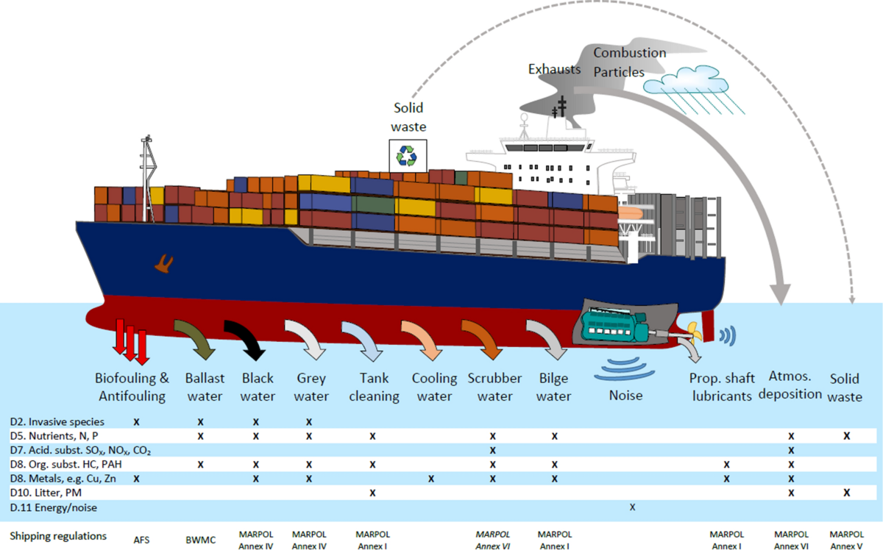
3. Environmental Impact of Maritime Operations
The sheer scale of global shipping means that even minor inefficiencies can have a monumental cumulative impact on the planet. The key environmental challenges can be categorized as follows:
INTRODUCTION TO SUSTAINABILITY IN THE MARITIME INDUSTRY

Slide 13
3.1 Air Pollution
• Air Pollution:
Shipping is a major source of harmful air pollutants, including sulfur oxides (SOx), nitrogen oxides (NOx), particulate matter (PM), and greenhouse gases (GHG) like carbon dioxide (CO2). The combustion of heavy fuel oil (HFO), a common fuel in the industry, releases high concentrations of SOx, which contributes to acid rain and has a direct link to respiratory diseases and other health issues in coastal communities and port cities. Nitrogen oxides (NOx) are a precursor to ground-level ozone, a harmful air pollutant. The IMO has introduced stringent regulations, such as the global sulfur cap of 0.5% and even stricter limits (0.1%) in Emission Control Areas (ECAs), to combat these emissions. Additionally, GHG emissions, particularly CO2, are a primary driver of climate change. The IMO has set ambitious goals to reduce shipping's total annual GHG emissions, with a long-term target of net-zero emissions by 2050, requiring a complete transformation of the industry's energy sources and operational practices.
INTRODUCTION TO SUSTAINABILITY IN THE MARITIME INDUSTRY

Slide 14
3.2 Marine Pollution
•Marine Pollution:
The deliberate or accidental discharge of harmful substances poses a significant threat to marine ecosystems. This includes oil spills, which can devastate marine life and coastal habitats for decades, as exemplified by historical events like the Exxon Valdez and Deepwater Horizon disasters. Chemical runoff from cargo, improper waste disposal, and the release of ballast water are also major concerns. Ballast water, in particular, is a silent but potent threat. When a ship takes on ballast water in one port and releases it in another, it can introduce non-native species to new environments. These invasive species, such as the zebra mussel in the Great Lakes, can outcompete native organisms, disrupt local biodiversity, and cause severe economic damage to fisheries and infrastructure. Your role in the galley, for example, directly impacts marine pollution. MARPOL Annex V on garbage management is a critical regulation that requires the proper segregation, processing, and disposal of all waste, particularly plastic and food waste. Improper disposal of even a single plastic bag can lead to severe penalties and harm to marine life.
INTRODUCTION TO SUSTAINABILITY IN THE MARITIME INDUSTRY

Slide 15
3.3 Physical and Noise Pollution
Physical and Noise Pollution:
Vessels create a constant source of underwater noise pollution from engines, propellers, and onboard machinery. This acoustic smog can interfere with the communication, echolocation, and migration patterns of a wide range of marine mammals, including whales, dolphins, and porpoises, causing stress, disorientation, and even hearing loss. Furthermore, the physical impacts of maritime operations are significant. Ship strikes on marine animals, particularly large whales, are a serious problem. The dredging required for port expansion and the physical presence of ships in sensitive areas can also lead to the degradation of coastal habitats and seabed ecosystems.
INTRODUCTION TO SUSTAINABILITY IN THE MARITIME INDUSTRY

Slide 16
Questions
The text describes sustainability as the "triple bottom line" of economic, environmental, and social viability. From a crew member's perspective, how can a single action you take in the galley, such as managing food inventory, contribute to both economic resilience and environmental stewardship?
The text outlines several environmental impacts of maritime operations. Can you name the three key impacts and provide a specific example from your daily duties of how you can help reduce one of them?
The document states that a company's reputation is a valuable asset. Why is your individual adherence to a regulation like MARPOL Annex V on garbage management so critical for the company's "social license to operate" and for avoiding penalties?
Sustainable Practices Onboard: A Maritime Industry Perspective

Slide 17

4. Relevant Regulations and Standards
To address these profound impacts, a robust and ever-evolving regulatory framework has been developed over recent decades. Understanding and adhering to these standards is not just a legal requirement but a fundamental aspect of professional responsibility for all maritime professionals.
:
INTRODUCTION TO SUSTAINABILITY IN THE MARITIME INDUSTRY

Slide 18
4.1 IMO, MARPOL, SOLAS
International Maritime Organization (IMO) Conventions: The International Maritime Organization (IMO) is the primary global regulator for the shipping industry. Its key conventions, which set the foundation for environmental governance, include:
  MARPOL (International Convention for the Prevention of Pollution from Ships): This is the most important international treaty on marine pollution, with six annexes covering oil, noxious liquid substances, harmful substances carried in packaged form, sewage, garbage, and air pollution. MARPOL has been instrumental in driving major changes, such as the implementation of the global sulfur cap, which drastically reduced sulfur content in marine fuel, and the establishment of Emission Control Areas (ECAs) with even stricter limits. Recent amendments have also introduced new tools to combat climate change, such as the Ship Energy Efficiency Management Plan (SEEMP), the Energy Efficiency Existing Ship Index (EEXI), and the Carbon Intensity Indicator (CII), all of which require vessels to track and improve their energy efficiency over time. The requirements of MARPOL Annex IV on sewage and Annex V on garbage are especially relevant to all crew members, and compliance with these rules is essential for avoiding penalties and protecting the marine environment.
  SOLAS (International Convention for the Safety of Life at Sea): While primarily a safety convention, SOLAS includes provisions on energy efficiency and operational measures. For example, its regulations require vessels to have a SEEMP, which provides a framework for operators to manage and continuously improve the energy efficiency of their fleet.
INTRODUCTION TO SUSTAINABILITY IN THE MARITIME INDUSTRY

Slide 19
4.2 REGIONAL AND NATIONAL REGULATIONS
Regional and National Regulations: In addition to these global standards, many regions and nations have implemented their own, often more stringent, regulations to address specific local concerns.
  The European Union's FuelEU Maritime: This regulation aims to reduce the GHG intensity of energy used by ships, encouraging the adoption of low-carbon fuels and penalizing inefficient practices. It is a key part of the EU's broader "Fit for 55" climate package, applying to ships of a certain size calling at EU ports.
  The U.S. Environmental Protection Agency (EPA): The EPA enforces national air and water pollution standards that often supplement or exceed international requirements, particularly in U.S. waters. The Vessel General Permit (VGP), for example, regulates discharges from vessels into U.S. waters.
  The Ballast Water Management Convention (BWMC): This IMO convention requires ships to manage their ballast water to prevent the spread of invasive species, a global problem with significant ecological and economic consequences. Compliance often involves the installation of complex onboard treatment systems that use filtration, ultraviolet (UV) treatment, or chemical processes to neutralize harmful organisms.
INTRODUCTION TO SUSTAINABILITY IN THE MARITIME INDUSTRY

Slide 20


5. The Business Case for Sustainability
Beyond mere compliance and reputation management, sustainability offers a compelling and robust business case for the maritime industry. The initial investment in green technologies and crew training can yield substantial returns over the long term, creating a virtuous cycle of economic and environmental improvement.
INTRODUCTION TO SUSTAINABILITY IN THE MARITIME INDUSTRY

Slide 21
5. The Business Case for Sustainability
  5.1 Operational Cost Reduction: The most direct and tangible benefit comes from reduced fuel consumption. With fuel being the single largest operational expense for most vessels, a 1-2% saving can translate into millions of dollars annually for a large fleet. This is achieved through a combination of technological and operational measures. Technological solutions include advanced hull coatings that reduce drag, more efficient engine designs, and the retrofitting of exhaust gas scrubbers. Operational practices, such as optimized routing using weather data, slow steaming, and just-in-time arrivals, minimize time spent idling and maximize fuel efficiency across the voyage. For galley and accommodation staff, this also means being mindful of energy use. Simple actions like using energy-efficient cooking equipment, defrosting refrigerators and freezers regularly to maintain efficiency, and reducing food waste through careful inventory management and menu planning, all directly contribute to these significant cost savings.
INTRODUCTION TO SUSTAINABILITY IN THE MARITIME INDUSTRY

Slide 22
5. The Business Case for Sustainability
  5.2 Risk Management: Proactive adherence to regulations and a robust sustainability strategy minimizes the risk of costly fines, detentions by port state control, and legal liabilities from environmental incidents. It also insulates companies from future regulatory changes, ensuring they are well-positioned for an increasingly carbon-conscious future. By getting ahead of the curve, companies avoid the costly scramble to comply with new regulations and can instead plan their long-term fleet renewal and investment strategies with greater certainty. The rise of ESG investing also means that a poor environmental record can lead to a higher cost of capital and difficulty securing loans.
  .
INTRODUCTION TO SUSTAINABILITY IN THE MARITIME INDUSTRY

Slide 23
5. The Business Case for Sustainability
  5.3 Market Advantage: Charterers and cargo owners are increasingly factoring a vessel's environmental performance into their selection criteria. Leading global brands, under pressure from their own customers, are demanding transparency and accountability in their supply chains. A strong sustainability record can make a vessel more attractive in a competitive market, allowing for premium rates and long-term contracts. This creates a powerful market incentive for shipping companies to invest in their fleet's environmental performance.
  .
INTRODUCTION TO SUSTAINABILITY IN THE MARITIME INDUSTRY

Slide 24
5. The Business Case for Sustainability
  5.4 Ιnnovation and Human Capital: Embracing sustainability fosters a culture of innovation and continuous improvement. It challenges maritime professionals, engineers, and seafarers to think creatively about old problems, leading to new solutions that enhance both efficiency and safety. This includes the development of new propulsion systems, digital platforms for route optimization, and advanced ship designs. Furthermore, companies with a strong sustainability ethos are more attractive to a new generation of maritime professionals who prioritize purpose and environmental responsibility in their careers. A commitment to sustainability helps companies recruit and retain the best talent, building a more skilled and dedicated workforce for the future. As a crew member, your firsthand knowledge and ideas about efficient practices can be a source of valuable innovation for the entire fleet.
  .
INTRODUCTION TO SUSTAINABILITY IN THE MARITIME INDUSTRY

Slide 25
5. The Business Case for Sustainability
Questions
How do proactive sustainability measures, such as reducing food waste or using energy-efficient equipment in the galley, contribute to a company's financial success?
The text mentions that a strong sustainability record can give a vessel a "market advantage." How does this advantage benefit the shipping company, and who are the stakeholders (clients, investors, etc.) that are increasingly demanding this?
Beyond financial benefits and compliance, how does a company's commitment to sustainability improve its "human capital"? What is your role as a crew member in this aspect, and why is it important for both you and the company?
INTRODUCTION TO SUSTAINABILITY IN THE MARITIME INDUSTRY

Slide 26
6. Real-World Scenario & Collaborative Activity
Real-World Activity: The Sustainable Ship Challenge
To apply your knowledge, please read the following scenario and then participate in the discussion forum.
Scenario: The Plastic Waste Crisis
You are a crew member on a vessel that frequently travels to ports with very strict environmental regulations, especially regarding plastic waste. During a recent port state inspection, the vessel received a warning for improper segregation of plastic and food waste. The inspector noted several plastic bags mixed in with the food scraps designated for the ship's compactor.
Your Chief Steward holds a crew meeting to address the issue. They state that the warning, if it escalates, could lead to a fine and a bad reputation for the company. They also explain that the company is aiming to get a "green shipping" certification, which requires a proven track record of impeccable environmental practices. The crew seems resistant, complaining that it's too much extra work and that "a few plastic bags won't make a difference."
Based on your observations and the knowledge you have gained from this module's reading materials, answer the following questions on the discussion forum:
Problem Identification: What are the three main problems presented in this scenario (e.g., environmental, regulatory, and social/crew-related)?
Solution & Regulation: Propose at least two specific actions you can take as a crew member to solve the problem of plastic and food waste segregation. In your answer, reference at least one specific IMO regulation that makes this effort mandatory, and explain why that regulation is so important.
Convincing the Crew: Drawing from the "Business Case for Sustainability" section of the module, how would you respond to the crew member who said, "a few plastic bags won't make a difference?" What specific points would you make to convince them that their individual effort is crucial for the company's economic resilience and reputation?
INTRODUCTION TO SUSTAINABILITY IN THE MARITIME INDUSTRY

Slide 27
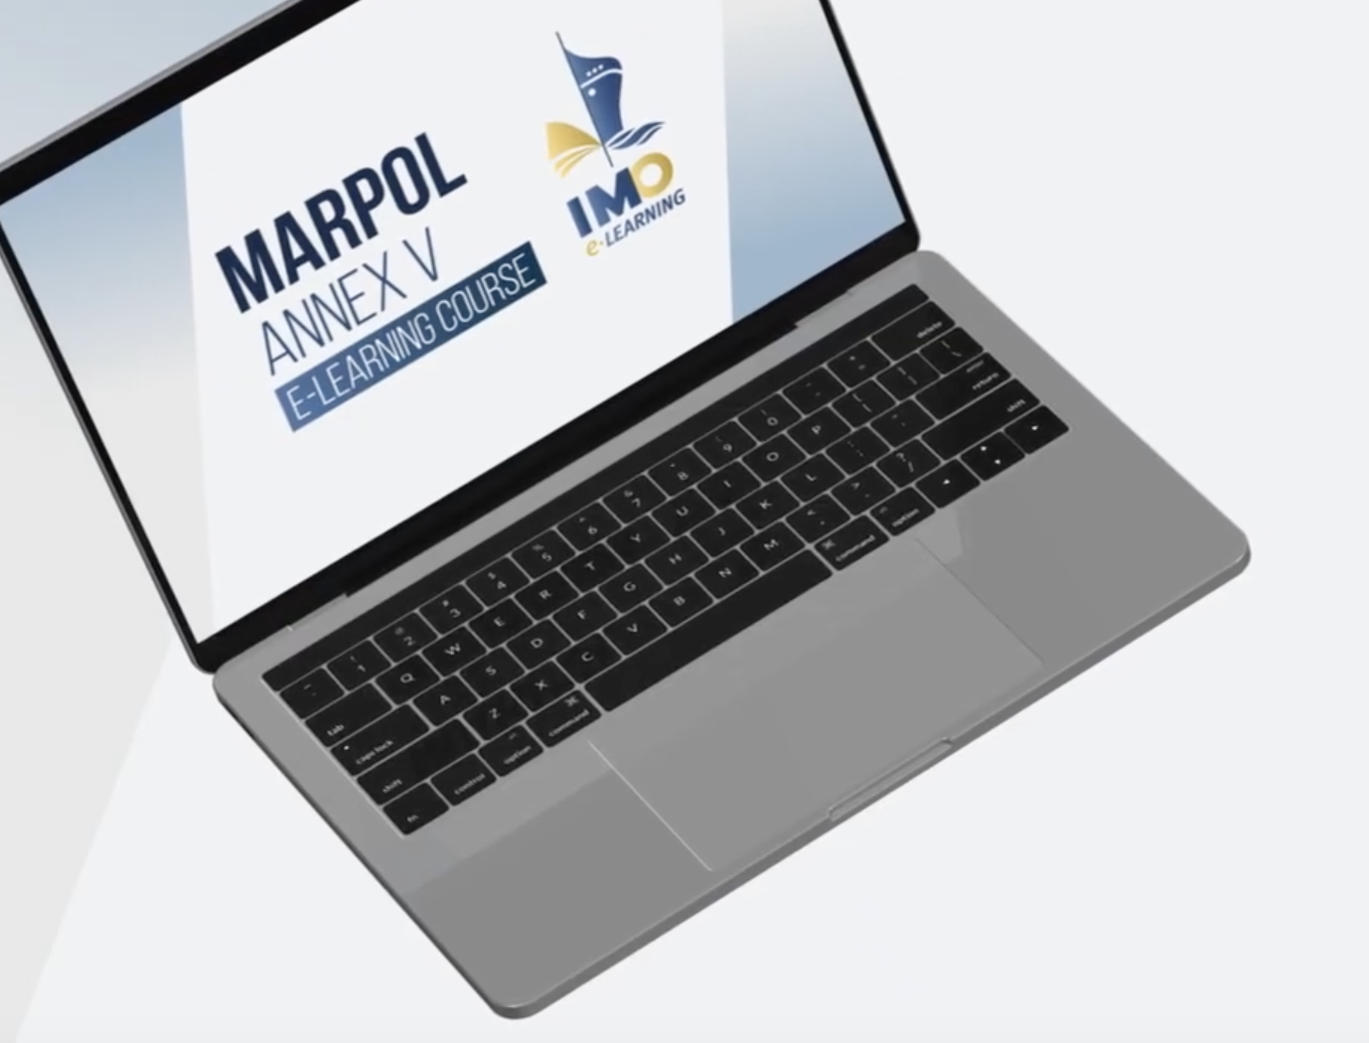
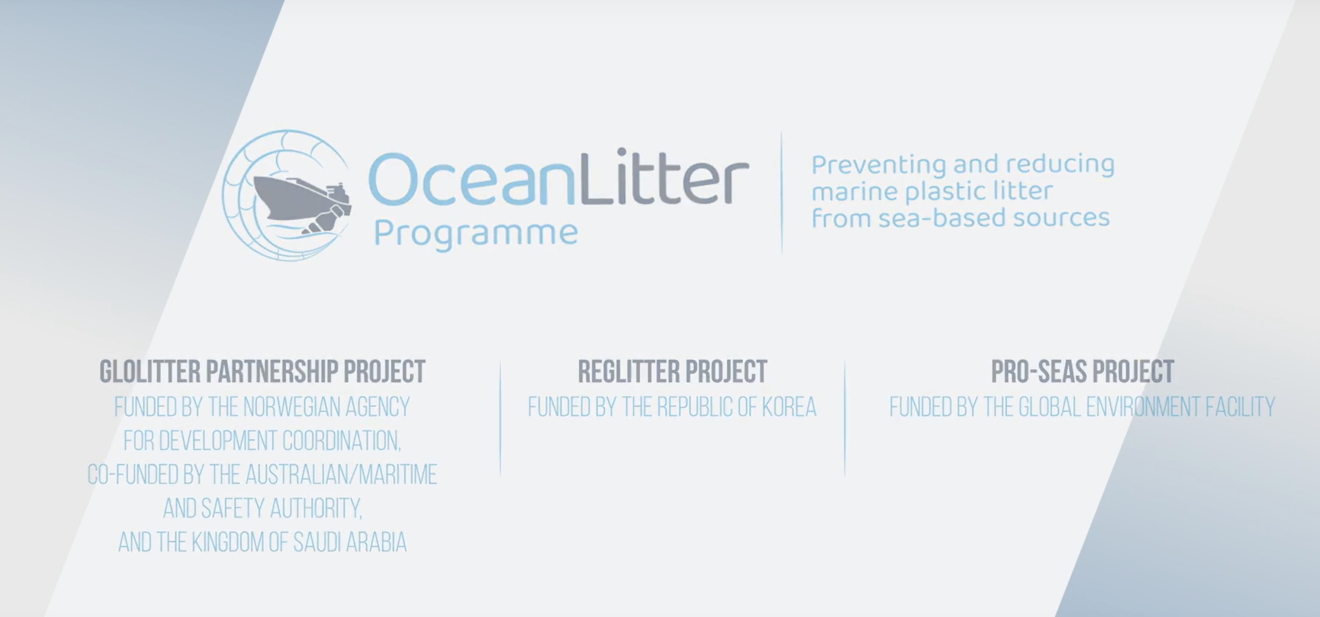
7. Multimedia and Online Resources
Watch
https://www.youtube.com/watch?v=GCazLt5hTZ4
The course is freely available on the IMO e-Learning platform: https://lms.imo.org/moodle310/. It is currently available in English, with plans to expand to French and Spanish in the near future, in line with IMO’s focus on multilingualism.
INTRODUCTION TO SUSTAINABILITY IN THE MARITIME INDUSTRY

Slide 28
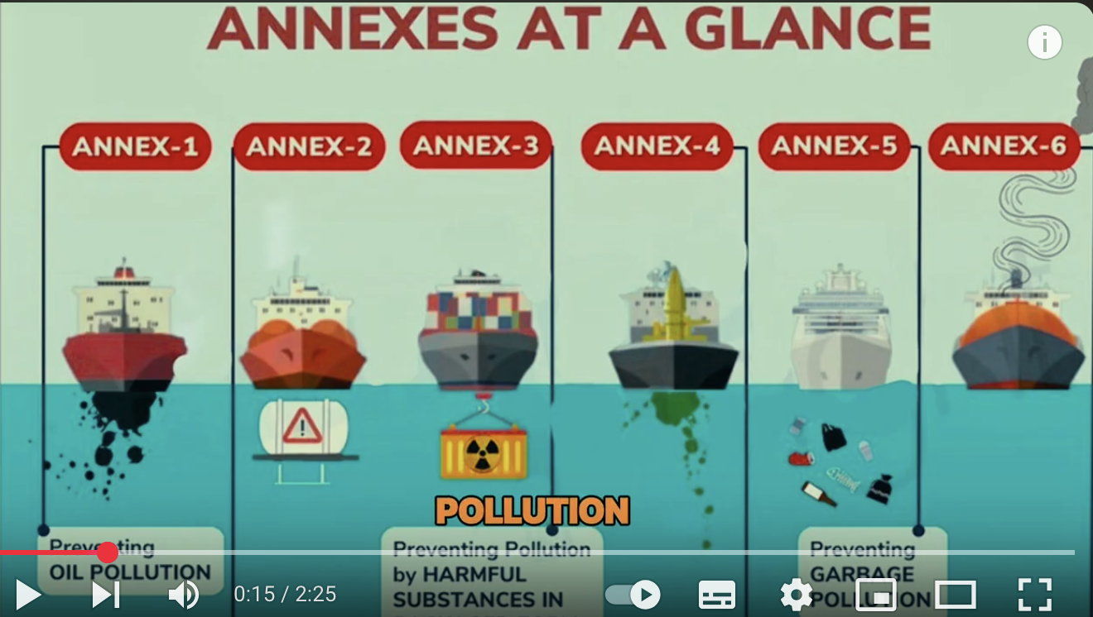
7. Multimedia and Online Resources
Watch
https://www.youtube.com/watch?v=ztnQzXucheE
Summary of MARPOL: This video provides a high-level summary of all six annexes of the MARPOL Convention, giving a broad overview of the key regulations that are central to the module's content.
INTRODUCTION TO SUSTAINABILITY IN THE MARITIME INDUSTRY

Slide 29
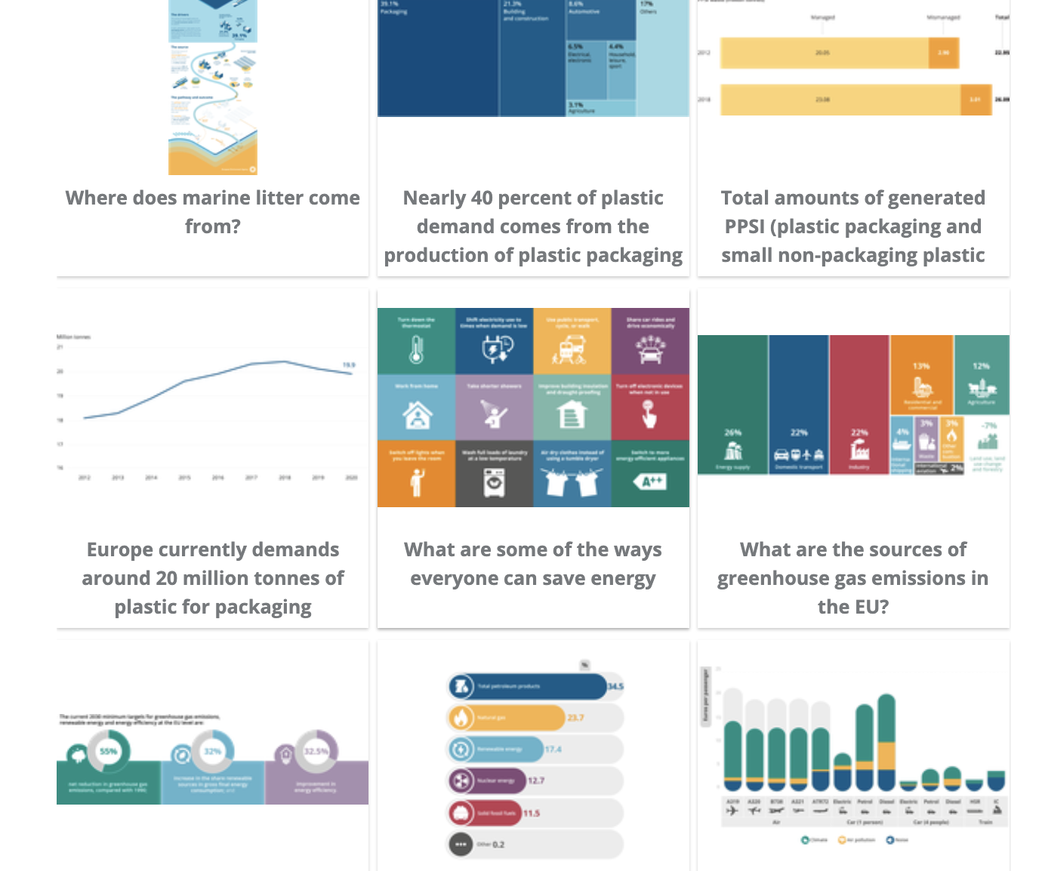
7. Multimedia and Online Resources
Infographics
https://www.eea.europa.eu/media/infographics/infographics
European Environment Agency Infographics: This collection includes visuals on marine pollution, plastic waste, and the impacts of greenhouse gas emissions from transport, providing a quick and easy-to-digest summary of the environmental challenges discussed in the module.
https://varunamarine.eu/maritime-infographics/
Varuna Marine Services Infographics: These infographics offer clear overviews of regulations like FuelEU Maritime and the Ballast Water Management Convention, making complex regulatory frameworks easier to understand.
INTRODUCTION TO SUSTAINABILITY IN THE MARITIME INDUSTRY

Slide 30
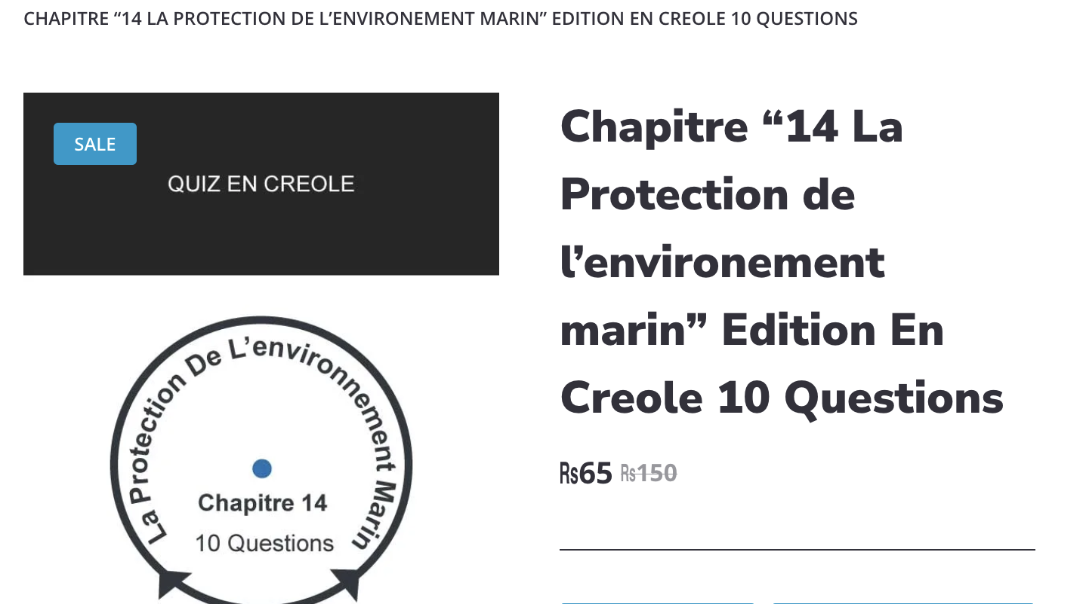
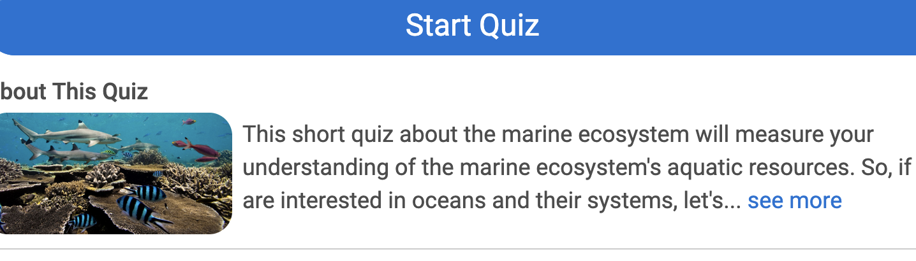
7. Multimedia and Online Resources
Interactive Quizzes
https://sailing.mu/free-maritime-quizzes/
Sailing.mu Maritime Quizzes: This site offers various quizzes, including one on environmental awareness, which can be a useful tool for self-assessment.
https://www.proprofs.com/quiz-school/story.php?title=pp-mza2mzu0nagbok
ProProfs Quiz on Marine Environment: This quiz includes questions specifically related to MARPOL annexes, such as Annex V, allowing learners to test their knowledge of the regulations covered in the module.
INTRODUCTION TO SUSTAINABILITY IN THE MARITIME INDUSTRY

Slide 31

8. A Short Simulation
Real-World Activity: The Sustainability Self-Audit
Scenario
Imagine you are the "sustainability officer" of your own home, apartment, or a shared living space. Your task is to apply the principles of sustainability that you've learned in Module One to your personal life.
The goal is to move from a reactive approach to a proactive one, just as the maritime industry is doing. By identifying areas of inefficiency and creating a plan to address them, you can build a more sustainable routine.
Sustainable Practices Onboard: A Maritime Industry Perspective

Slide 32
8. A Short Simulation
Instructions
For one day, become a "human logbook" and track your personal sustainability. At the end of the day, answer the following questions:
1. Environmental Impact:
Problem: Identify at least three "pollutants" or sources of environmental impact in your daily routine. This could be anything from the waste you produce to the energy you consume.
Solution: For each problem you identified, propose a specific and tangible solution. For example, if you identified food waste, a solution could be to compost.
2. Reputation and Social License:
Problem: Think about a habit you have that, if it were publicly known, could negatively impact your "reputation" as a responsible person (e.g., constantly leaving lights on, throwing recyclables in the trash).
Solution: What small, consistent change would you implement to improve your "social license to operate"? How would you "communicate" this change to those around you to show your commitment?
3. Regulatory Compliance (Self-Imposed):
Problem: Choose one "regulation" from your personal life that you sometimes disregard (e.g., a community rule about recycling, a household rule about turning off appliances).
Solution: Propose a simple, proactive system to ensure you comply with this rule 100% of the time. What is the "business case" for this personal compliance? How will it save you time, money, or energy in the long run?
This exercise will help you see that sustainability is not just about grand, large-scale actions, but about small, consistent changes that accumulate over time.
Sustainable Practices Onboard: A Maritime Industry Perspective

Slide 33
9. A Critical Thinking Activity: Proactive vs Reactive
This activity is designed to help you analyze the complex business case for sustainability and understand that the issue is not just about environmentalism, but about strategy, finance, and long-term viability.
Scenario
You are a strategic advisor to a major shipping company. The company has a decision to make regarding its approach to sustainability. There are two competing philosophies within the leadership team, and your job is to help the company navigate this core challenge.
Instructions
First, read the articles below. They present different perspectives on the role of innovation and regulation in the maritime industry.
Innovation and maritime transport: A systematic review
How the Marine Industry Is Adapting to Sustainability Challenges
Proactive and Reactive Approaches towards Sustainable Practices in Manufacturing Companies
INTRODUCTION TO SUSTAINABILITY IN THE MARITIME INDUSTRY

Slide 34
9. A Critical Thinking Activity: Proactive vs Reactive
Next, organize an online group with two sub-groups to debate the following statement:
"The maritime industry should only embrace sustainability measures when legally mandated, as a proactive approach beyond compliance is an unnecessary financial risk."
The Brown Group (Proponents of Reactive Compliance)
The "Brown Group" argues for a reactive, compliance-focused approach. They will support their argument with the following points:
Financial Prudence: The high cost of new, unproven technologies is a significant financial burden that can put the company at a competitive disadvantage.
Regulatory Uncertainty: Regulations change, and investing heavily in a technology that may become obsolete is a bad business decision.
Focus on Core Business: The primary goal is efficient and safe transport; sustainability should only be a factor when it directly impacts compliance or profitability.
This activity is designed to help you analyze the complex business case for sustainability and understand that the issue is not just about environmentalism, but about strategy, finance, and long-term viability.
The Green Group (Proponents of Proactive Action)
The "Green Group" argues that a proactive approach is not a risk but a strategic necessity. They will support their argument with the following points:
Market Advantage: Companies that innovate beyond regulations can capture new market segments and attract environmentally conscious clients.
Talent Attraction: A strong sustainability reputation can help in attracting and retaining top talent.
Reduced Long-Term Risk: Proactive investments in green technology can mitigate future financial and reputational risks associated with stricter regulations and changing public opinion.
INTRODUCTION TO SUSTAINABILITY IN THE MARITIME INDUSTRY

Slide 35

10. Conclusion:
INTRODUCTION TO SUSTAINABILITY IN THE MARITIME INDUSTRY

Slide 36
10. Conclusion
Sustainability in the maritime industry is not a fleeting trend but a fundamental and enduring shift in how business is conducted. It is a multi-faceted challenge that requires a holistic approach, integrating technological innovation with robust operational practices and a committed crew. By understanding the profound environmental impacts of our operations and the complex regulatory landscape that governs them, we can move forward with purpose and confidence. The journey toward a more sustainable maritime industry is an ongoing one, and as maritime professionals, you play a vital role in building a more resilient, responsible, and profitable future for the industry and the planet.
INTRODUCTION TO SUSTAINABILITY IN THE MARITIME INDUSTRY

Slide 37

11. Key Takeaways
INTRODUCTION TO SUSTAINABILITY IN THE MARITIME INDUSTRY

Slide 38
11. Key Takeaways
Key Takeaways
Sustainability is a strategic imperative, not just a regulatory burden. Companies that embrace it proactively can gain a competitive advantage.
The maritime industry must navigate a complex landscape of environmental, social, and economic factors.
Balancing initial investment costs with long-term savings and reputational benefits is a central challenge for businesses.
A proactive approach can lead to innovation, market leadership, and a stronger brand reputation.
A reactive approach risks being left behind by evolving regulations and losing business to more forward-thinking competitors.
INTRODUCTION TO SUSTAINABILITY IN THE MARITIME INDUSTRY

Slide 39
12. Quiz for Introduction to Sustainability
1. Which of the following is considered a core pillar of sustainability? a) Financial Prudence b) Market Dominance c) Social Responsibility d) Regulatory Compliance
2. What is a primary benefit of a proactive approach to sustainability in the maritime industry? a) Avoiding all future regulations b) Gaining a competitive market advantage c) Reducing immediate operating costs d) Eliminating the need for social license
3. The IMO's regulations on emissions are an example of what? a) A voluntary industry standard b) A proactive business strategy c) A regulatory framework d) A social license to operate
4. A company that only implements sustainability measures when legally required is adopting a: a) Proactive strategy b) Reactive strategy c) Innovative strategy d) Reputational strategy
5. Which of the following is a potential risk of a reactive approach to sustainability? a) Higher long-term operating costs b) Excessive initial investment c) Being a market leader d) Attracting a new customer base
6. Why is talent attraction linked to a company's sustainability reputation? a) Employees only work for green companies b) A strong reputation can help retain top talent c) Sustainability is not a factor in attracting talent d) It reduces the need for employee training
7. When a company invests in a technology that goes beyond current regulations, it is primarily focused on: a) Maximizing immediate profit b) Mitigating long-term risk c) Maintaining the status quo d) Following a competitor's lead
8. Which argument would the "Brown Group" most likely use in their debate? a) "The cost of new technology is a worthwhile investment." b) "We should always exceed regulatory requirements." c) "High upfront costs are a significant barrier." d) "Sustainability is a new source of revenue."
INTRODUCTION TO SUSTAINABILITY IN THE MARITIME INDUSTRY

Slide 40
12. Quiz for Introduction to Sustainability
9. The concept of "social license to operate" refers to what? a) A legal permit granted by the government b) A company's ability to operate based on public and community approval c) The right to pollute within legal limits d) The financial stability of a company
10. What is a key reason a company might hesitate to invest in unproven green technologies? a) They are not interested in innovation b) The technology may become obsolete c) The public doesn't care about new technology d) It doesn't align with their core business of transport
11. The core tension in the provided scenario is between: a) Environmentalism and social responsibility b) Proactive action and reactive compliance c) Market advantage and talent attraction d) Regulation and innovation
12. A company's long-term viability is most directly influenced by its ability to balance: a) Financial returns and market share b) Safety records and brand reputation c) Short-term costs and long-term benefits d) Employee morale and customer satisfaction
13. In the context of the maritime industry, a proactive company is likely to be a what in the future? a) A follower b) A market leader c) A struggling company d) An unprofitable company
14. What is the central purpose of this critical thinking activity? a) To prove that the "Green Group" is correct b) To analyze the business case for sustainability c) To list all maritime regulations d) To debate the specifics of new technology
INTRODUCTION TO SUSTAINABILITY IN THE MARITIME INDUSTRY

Slide 41
13. Course References
IMO. (2025). MARPOL Convention: An Overview. IMO.
European Commission. (2024). FuelEU Maritime Regulation. European Commission.
United States Environmental Protection Agency. (2025). Vessel General Permit (VGP). EPA.
Rodrigue, J. P. (2024). The Geography of Transport Systems. Routledge.
Notteboom, T., Pallis, A. A., & Woxenius, J. (2023). Global Maritime Transport and Logistics. Routledge.
Smith, S., & Johnson, A. (2025). The Business Case for Sustainability in Shipping. Journal of Maritime Economics, 15(2), 45-60.
Marine Conservation Society. (2025). Impact of Underwater Noise Pollution on Marine Life. Marine Conservation Society.
Anderson, P. (2024). Beyond Compliance: ESG and the Future of Maritime Finance. Maritime Today Journal, 3(4), 112-128.
INTRODUCTION TO SUSTAINABILITY IN THE MARITIME INDUSTRY

