Slide 1








MARitime Soft Skills for Onboard Healthy Nutrition and CULinary Arts in Seagoing Services – CUL-MAR-Skills
KA220-VET - Cooperation partnerships in vocational education and training
2023-1-RO01-KA220-VET-000156711
ONBOARD COOKING SKILLS
Week VIII
Adapting Menus to Special Conditions Onboard
Disclaimer: “Funded by the European Union. Views and opinions expressed are however those of the author(s) only and do not necessarily reflect those of the European Union or the ANPCDEFP. Neither the European Union nor the ANPCDEFP can be held responsible for them”

Slide 2
Learning outcomes of the course
1. Identify how different weather and sea conditions affect galley operations and the physical and emotional impact these conditions can have on the crew’s dietary needs and appetites.
2. Adapt menus and cooking methods to ensure safe food preparation and delivery during calm, rough, or extreme weather scenarios, prioritizing both nutrition and efficiency.
3. Develop contingency plans for meal service during storms or extended periods of rough seas, including preparation and simplified service options.
4. Implement strategies to maintain nutritional balance and food safety when traditional cooking methods are compromised or resources are limited due to weather disruptions.
NAVAL COMMUNICATIONS
ADAPTING MENUS TO SPECIAL CONDITIONS ONBOARD

Slide 3
Learning outcomes of the course
5. Accommodate special dietary requirements—such as allergies, religious practices, or medical needs—even when working under constrained or unstable conditions.
6. Demonstrate effective communication and planning techniques with the crew and support team to ensure smooth meal service during dynamic operational challenges.
7. Evaluate and adjust provisioning plans to account for potential delays or difficulties in resupply during prolonged adverse weather.
NAVAL COMMUNICATIONS
ADAPTING MENUS TO SPECIAL CONDITIONS ONBOARD

Slide 4
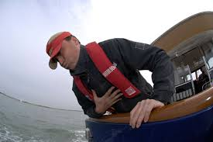
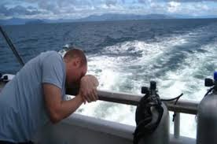
THE IMPORTANCE OF ADJUSTING MENUS TO WEATHER AND SEA CONDITIONS
Adjusting menus to weather and sea conditions is essential for maintaining the comfort and well-being of both passengers and crew, especially in maritime environments like cruise ships, yachts, and offshore platforms. When the sea is rough, many individuals are prone to motion sickness. In such cases, serving rich, greasy, or spicy foods can worsen nausea. Instead, offering lighter and bland meals like plain rice, crackers, applesauce, or clear broths can help settle the stomach. For example, switching from fried fish to a simple steamed white fish with boiled potatoes can make a big difference for queasy passengers,
NAVAL COMMUNICATIONS
ADAPTING MENUS TO SPECIAL CONDITIONS ONBOARD

Slide 5
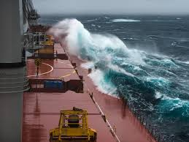
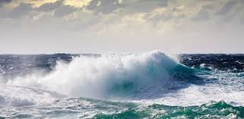
THE IMPORTANCE OF ADJUSTING MENUS TO WEATHER AND SEA CONDITIONS
Weather conditions also have a direct impact on food safety. Hot and humid climates can cause perishable items—such as dairy, seafood, and meats—to spoil more quickly, especially if refrigeration is compromised during long voyages or in older vessels. In these conditions, menus should include items that have a longer shelf life or are preserved, such as pickled vegetables, canned tuna, or vacuum-sealed deli meats. Conversely, in colder weather, passengers may need higher-calorie meals to stay warm and energized. Dishes like beef stew, casseroles, or pasta bakes are more appropriate in such scenarios, offering both warmth and satiety.
NAVAL COMMUNICATIONS
ADAPTING MENUS TO SPECIAL CONDITIONS ONBOARD

Slide 6
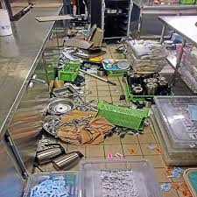
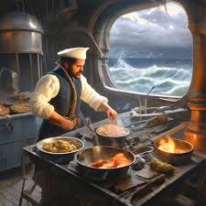
THE IMPORTANCE OF ADJUSTING MENUS TO WEATHER AND SEA CONDITIONS
Operational safety is another important factor. When seas are choppy, working in the galley (kitchen) can be dangerous. Knives, boiling liquids, and hot surfaces become much riskier in a rocking environment. To reduce hazards, the menu should be simplified during such times. Instead of offering made-to-order omelets or flambé dishes, a buffet with pre-prepared items like sandwiches, baked goods, and slow-cooked meals can be safer and more practical. This also eases the workload on the kitchen staff and allows them to serve meals efficiently without compromising their own safety.
NAVAL COMMUNICATIONS
ADAPTING MENUS TO SPECIAL CONDITIONS ONBOARD

Slide 7
THE IMPORTANCE OF ADJUSTING MENUS TO WEATHER AND SEA CONDITIONS
Weather and sea conditions also influence the availability of fresh ingredients. Stormy conditions can delay deliveries or prevent fishing boats from supplying fresh catch. In such cases, it’s wise to design menus with flexibility, using frozen seafood, dried legumes, or shelf-stable grains as substitutes. For instance, if fresh shrimp isn’t available due to a storm, a pasta dish with preserved clams or anchovies could be used instead.
Finally, adapting menus to the current weather improves the overall guest experience. On a hot, sunny day at sea, passengers might appreciate refreshing, hydrating meals like chilled fruit salads, cold soups (like gazpacho), or citrus-marinated grilled chicken. On a cold and rainy evening, comfortable foods such as creamy soups, mashed potatoes, and warm desserts like bread pudding can lift morale and provide a sense of coziness. By adjusting the menu based on the weather and sea, chefs show attentiveness and care, which can significantly enhance the perception of service and hospitality on board.
NAVAL COMMUNICATIONS
ADAPTING MENUS TO SPECIAL CONDITIONS ONBOARD

Slide 8
  WHAT HAPPENS IF THE MENU IS NOT ADJUSTED TO WEATHER AND SEA CONDITIONS?
If a menu is not adjusted to weather and sea conditions, several negative consequences can occur, affecting passenger comfort, food safety, crew efficiency, and the overall quality of service. Here are the key risks and impacts:
1. Increased Seasickness and Discomfort
When rough seas cause motion sickness, serving heavy, greasy, or rich foods—such as fried meats, creamy sauces, or spicy dishes—can worsen symptoms like nausea and dizziness. If the menu isn't adjusted, more passengers may feel ill, leading to complaints, reduced appetite, and in some cases, medical intervention. For example, a buffet full of rich curries or fried items during a storm could cause widespread discomfort.
NAVAL COMMUNICATIONS
ADAPTING MENUS TO SPECIAL CONDITIONS ONBOARD

Slide 9

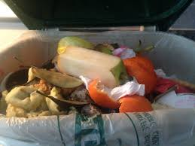
  WHAT HAPPENS IF THE MENU IS NOT ADJUSTED TO WEATHER AND SEA CONDITIONS?
2. Food Spoilage and Safety Risks
In hot or humid weather, perishable ingredients can spoil quickly, especially if refrigeration is strained or there are delays in resupply. If menus include sensitive items like fresh dairy, raw seafood, or egg-based sauces (e.g., hollandaise) without proper consideration, it raises the risk of foodborne illness. For instance, serving fresh oysters or mayonnaise-based salads in tropical heat without temperature control could result in food poisoning.
NAVAL COMMUNICATIONS
ADAPTING MENUS TO SPECIAL CONDITIONS ONBOARD

Slide 10
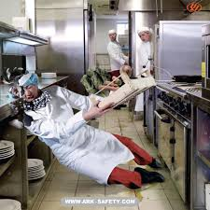
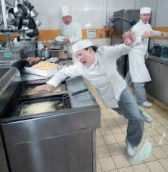
  WHAT HAPPENS IF THE MENU IS NOT ADJUSTED TO WEATHER AND SEA CONDITIONS?
3. Kitchen Hazards and Crew Fatigue
During rough sea conditions, cooking becomes physically challenging and even dangerous. Using sharp knives, hot oil, or boiling liquids while the ship is pitching increases the risk of injuries. If the menu is not simplified—requiring complex preparation like deep-frying, flambéing, or fine chopping—the galley staff could be overworked, stressed, or injured. This also increases the chance of food quality suffering due to rushed or unsafe preparation.
NAVAL COMMUNICATIONS
ADAPTING MENUS TO SPECIAL CONDITIONS ONBOARD

Slide 11
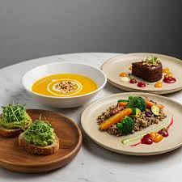
  WHAT HAPPENS IF THE MENU IS NOT ADJUSTED TO WEATHER AND SEA CONDITIONS?
4. Disrupted Meal Service and Delays
Unrealistic menus during unstable weather can lead to service delays or inconsistencies. For example, trying to serve multi-course plated meals during a storm might be impractical, as dishes can spill, trays can slide, and passengers may not even want to eat. If guests can’t eat or receive meals late, their dining experience is negatively impacted, and satisfaction drops.
NAVAL COMMUNICATIONS
ADAPTING MENUS TO SPECIAL CONDITIONS ONBOARD

Slide 12

  WHAT HAPPENS IF THE MENU IS NOT ADJUSTED TO WEATHER AND SEA CONDITIONS?
5. Wasted Food and Supply Problems
Bad weather often disrupts deliveries or fishing schedules, limiting access to certain fresh ingredients. If the menu is rigid and doesn't account for these supply issues, chefs may be unable to prepare key dishes. This can lead to food shortages, forced substitutions, or excessive waste. For instance, planning a seafood-heavy menu when storms are forecasted can backfire if the fresh catch doesn’t arrive.
NAVAL COMMUNICATIONS
ADAPTING MENUS TO SPECIAL CONDITIONS ONBOARD

Slide 13
  WHAT HAPPENS IF THE MENU IS NOT ADJUSTED TO WEATHER AND SEA CONDITIONS?
6. Lower Guest Satisfaction
Ultimately, not adjusting the menu reduces the quality of the dining experience. Passengers may feel that their comfort isn’t being considered, especially if meals seem out of place—like hot soups on a sweltering day, or chilled salads in cold, windy weather. A mismatch between meals and the environment can make the experience feel thoughtless and mechanical.
Conclusion:
Failing to adjust the menu to sea and weather conditions results in a cascade of problems: from seasick passengers and food safety risks, to kitchen accidents and dissatisfied guests. Thoughtful menu planning isn’t just a culinary concern—it’s an essential part of delivering safe, smooth, and enjoyable service at sea.
NAVAL COMMUNICATIONS
ADAPTING MENUS TO SPECIAL CONDITIONS ONBOARD

Slide 14
RELATIONSHIP BETWEEN WEATHER AND SEA CONDITIONS AND SEAFARERS’ PERFORMANCE AND MOTIVATION
Extreme weather and sea conditions can significantly affect the performance, motivation, and overall well-being of seafarers, both physically and mentally. The combination of environmental stressors, physical strain, and emotional fatigue can lead to reduced efficiency, lower morale, and increased risk of accidents or errors on board (3).
Firstly, physical fatigue is one of the most immediate effects. During storms or heavy seas, ships move violently, making simple tasks—like walking, eating, or sleeping—challenging and exhausting. Sleep is often disrupted due to constant motion, noise, and vibrations. Over time, lack of rest can lead to chronic fatigue, slowing reaction times, and impairing judgment, which is dangerous in high-risk environments like the engine room, bridge, or galley.
NAVAL COMMUNICATIONS
ADAPTING MENUS TO SPECIAL CONDITIONS ONBOARD

Slide 15
RELATIONSHIP BETWEEN WEATHER AND SEA CONDITIONS AND SEAFARERS’ PERFORMANCE AND MOTIVATION
Extreme conditions also cause mental stress and anxiety. Seafarers may feel vulnerable or fearful during hurricanes, typhoons, or icy storms—especially when visibility is low, navigation is difficult, or safety is at risk. Prolonged exposure to such stress, combined with the isolation of life at sea, can lead to mood swings, irritability, or feelings of helplessness. This mental strain not only reduces motivation but can also affect teamwork and communication, which are vital for safe operations.
Motivation is further undermined when seafarers feel uncomfortable or unsafe. Rough seas can make eating difficult, increase the risk of seasickness, and limit access to normal routines or recreational activities. When meals are skipped, rest is poor, and there’s no time to recover, morale drops. For example, crew members may begin to lose enthusiasm for their duties or avoid tasks that require physical effort or coordination in unstable conditions. This decline in engagement affects productivity and the quality of work performed.
NAVAL COMMUNICATIONS
ADAPTING MENUS TO SPECIAL CONDITIONS ONBOARD

Slide 16
RELATIONSHIP BETWEEN WEATHER AND SEA CONDITIONS AND SEAFARERS’ PERFORMANCE AND MOTIVATION
Additionally, safety risks increase, which places further pressure on seafarers. Tasks that are usually routine—such as maintenance, inspections, or cargo handling—become far more hazardous in bad weather. The stress of having to work carefully under dangerous conditions, coupled with the fear of injury, often leads to slower task execution or even avoidance, which can delay ship operations or compromise safety standards.
From a leadership and management perspective, team cohesion can suffer. When everyone is physically and mentally drained, conflicts may arise more easily, and communication may break down. Supervisors may find it harder to maintain order or encourage discipline, especially if the crew feels overworked or under-supported. In such moments, effective leadership and empathy are crucial to keeping morale afloat.
NAVAL COMMUNICATIONS
ADAPTING MENUS TO SPECIAL CONDITIONS ONBOARD

Slide 17
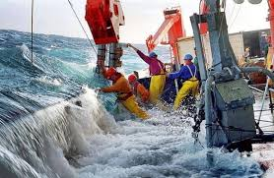
RELATIONSHIP BETWEEN WEATHER AND SEA CONDITIONS AND SEAFARERS’ PERFORMANCE AND MOTIVATION
In summary, extreme weather and sea conditions can degrade seafarers’ performance by causing physical fatigue, emotional stress, reduced motivation, and increased risk of error. Supporting crew members with adequate rest, safe working conditions, access to comfort (like warm meals and dry clothes), and strong team communication can help mitigate these effects and maintain morale and operational efficiency during harsh conditions.
NAVAL COMMUNICATIONS
ADAPTING MENUS TO SPECIAL CONDITIONS ONBOARD

Slide 18
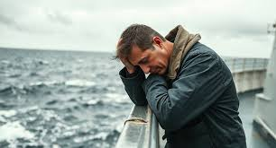
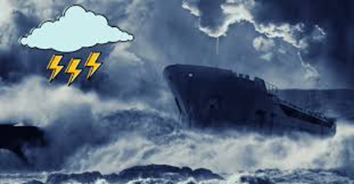
  CHANGING DEMANDS OF SEAFARERS DEPENDING ON THE WEATHER AND SEA CONDITIONS
Increased Physical Demands During Rough Seas
In harsh weather—such as storms, heavy rain, or strong winds—everyday tasks become physically more strenuous. Simple actions like walking on deck, securing equipment, or handling tools require greater effort due to constant ship movement and slippery surfaces. Seafarers must use more energy to maintain balance and complete tasks, increasing fatigue. They may also be required to secure loose cargo, check watertight doors, or tie down equipment more frequently during these times, adding to their workload.
NAVAL COMMUNICATIONS
ADAPTING MENUS TO SPECIAL CONDITIONS ONBOARD

Slide 19
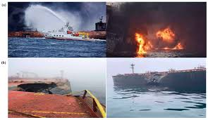
  CHANGING DEMANDS OF SEAFARERS DEPENDING ON THE WEATHER AND SEA CONDITIONS
Greater Focus on Safety and Emergency Preparedness
As sea conditions worsen, safety becomes the top priority, and seafarers are expected to be more vigilant. They may need to conduct additional safety checks, monitor weather updates, secure lifeboats or hatches, and ensure all safety protocols are followed. Emergency drills or actual emergency responses may be required more often during storms or rough seas. This adds pressure to remain alert and responsive at all times, often with less rest or recovery time.
NAVAL COMMUNICATIONS
ADAPTING MENUS TO SPECIAL CONDITIONS ONBOARD

Slide 20
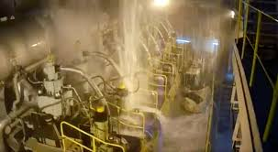
  CHANGING DEMANDS OF SEAFARERS DEPENDING ON THE WEATHER AND SEA CONDITIONS
Adjusted Work Routines and Reduced Downtime
Bad weather disrupts normal work schedules. Maintenance tasks, cleaning, or deck operations may be postponed or modified for safety, while other duties—like navigation monitoring, watchkeeping, or equipment inspection—are intensified. Seafarers may have to work longer shifts or remain on standby, reducing their personal time and rest. For example, engineers may be called to frequently check engine systems during turbulent conditions, while navigators must maintain constant awareness of the vessel’s course and stability.
NAVAL COMMUNICATIONS
ADAPTING MENUS TO SPECIAL CONDITIONS ONBOARD

Slide 21

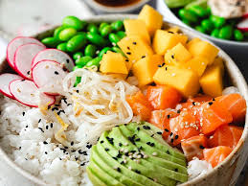
  CHANGING DEMANDS OF SEAFARERS DEPENDING ON THE WEATHER AND SEA CONDITIONS
Changes in Meal Preparation and Consumption
In stormy conditions, meal service is impacted—both for galley staff and crew. Cooks may need to simplify menus and prepare meals that are safe to serve on a moving ship. Meanwhile, seafarers might experience reduced appetite or nausea, leading to skipped meals or dehydration. This puts pressure on kitchen staff to provide safe, easily digestible food, and on officers to ensure crew members are eating and staying nourished despite discomfort.
NAVAL COMMUNICATIONS
ADAPTING MENUS TO SPECIAL CONDITIONS ONBOARD

Slide 22

  CHANGING DEMANDS OF SEAFARERS DEPENDING ON THE WEATHER AND SEA CONDITIONS
Increased Mental and Emotional Strain
Poor weather and unstable sea conditions can heighten mental fatigue. Seafarers are often more anxious during storms, especially if visibility is low or vessel movement is severe. Watchkeeping during rough conditions requires sharper focus and more sustained attention, increasing mental strain. This stress is compounded by the disruption of sleep and daily routines, which can lead to irritability, low morale, or emotional exhaustion.
NAVAL COMMUNICATIONS
ADAPTING MENUS TO SPECIAL CONDITIONS ONBOARD

Slide 23
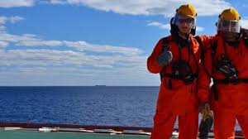
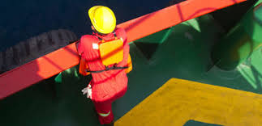
  CHANGING DEMANDS OF SEAFARERS DEPENDING ON THE WEATHER AND SEA CONDITIONS
Higher Risk of Isolation and Reduced Social Interaction
In calm conditions, crew members often gather for meals, recreation, or socializing. In contrast, rough weather isolates individuals, either due to seasickness, fatigue, or the need to stay in cabins for safety. The reduction in social interaction can negatively affect team cohesion and morale, placing an additional emotional demand on the crew
NAVAL COMMUNICATIONS
ADAPTING MENUS TO SPECIAL CONDITIONS ONBOARD

Slide 24
  CHANGING DEMANDS OF SEAFARERS DEPENDING ON THE WEATHER AND SEA CONDITIONS
Extra Pressure on Leadership and Decision-Making
Captains and officers face higher demands in bad weather, as they are responsible for making quick, informed decisions regarding navigation, safety, and crew welfare. They must monitor forecasts, reroute if needed, and ensure all safety measures are in place. Leadership demands increase as crew members rely on clear communication and strong direction during uncertain conditions.
In bad weather and rough seas, the demands on seafarers shift dramatically. Physical work becomes more demanding, mental focus intensifies, and safety responsibilities increase. Schedules are disrupted, rest is reduced, and meals and morale can suffer. To cope, seafarers must be highly adaptable, resilient, and well-trained, while support from leadership and
NAVAL COMMUNICATIONS
ADAPTING MENUS TO SPECIAL CONDITIONS ONBOARD

Slide 25
  HOW CAN MENUS AND COOKING METHODS BE ADAPTED TO CHANGING CONDITIONS?
Adapt Menu Choices for Passenger Comfort
In rough seas: Offer bland, light foods that are easier to digest and less likely to trigger nausea. For example:
  Boiled rice, plain pasta, toast, broths, applesauce, crackers
In hot weather: Serve cool, refreshing meals to maintain hydration and prevent overheating.
  Salads, chilled soups (e.g., gazpacho), fresh fruits, grilled lean meats
In cold weather: Provide hearty, warming meals with higher caloric value.
  Stews, casseroles, baked pasta, creamy soups
NAVAL COMMUNICATIONS
ADAPTING MENUS TO SPECIAL CONDITIONS ONBOARD

Slide 26
  HOW CAN MENUS AND COOKING METHODS BE ADAPTED TO CHANGING CONDITIONS?
Optimize for Storage and Spoilage Prevention
Adapt menu planning to ensure perishable items are used first, and preserved ingredients are on hand for emergencies:
Hot weather: Avoid cream-based sauces and raw seafood if refrigeration may be challenged.
Use fermented, pickled, or dried items to add flavor without spoilage risk.
  E.g., swap fresh cheese for hard-aged cheese or yogurt.
5. Adjust Portion Sizes and Presentation
During rough seas, offer smaller portions in more stable dishware to avoid spills or wasted food.
Consider serving pre-portioned meals in containers that are easy to carry and hold.
NAVAL COMMUNICATIONS
ADAPTING MENUS TO SPECIAL CONDITIONS ONBOARD

Slide 27

  HOW CAN MENUS AND COOKING METHODS BE ADAPTED TO CHANGING CONDITIONS?
Streamline Kitchen Operations
To reduce risks in the galley during bad weather:
Prepare meals in advance and reheat safely when needed.
Use batch cooking methods like stews, casseroles, or baked trays to minimize movement and multitasking.
NAVAL COMMUNICATIONS
ADAPTING MENUS TO SPECIAL CONDITIONS ONBOARD

Slide 28
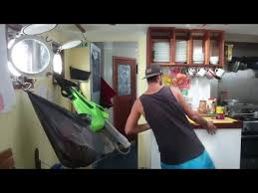
  HOW CAN MENUS AND COOKING METHODS BE ADAPTED TO CHANGING CONDITIONS?
Communicate with Suppliers and Monitor Forecasts
Staying informed about weather patterns helps plan menu changes in advance:
Order extra non-perishable items before a storm.
Adjust planned menus proactively based on expected conditions.
As a result, adapting menus and cooking methods to changing sea and weather conditions is about balancing safety, comfort, and practicality. By offering suitable meals for the climate, using safer cooking methods, and planning for supply disruptions, food service teams can maintain a high standard of care and satisfaction, even when conditions are unpredictable.
NAVAL COMMUNICATIONS
ADAPTING MENUS TO SPECIAL CONDITIONS ONBOARD

Slide 29
  STRATEGIES FOR PROVIDING NUTRITIOUS MEALS DURING CHALLENGING WEATHER
Providing nutritious meals during challenging weather conditions requires careful planning and adaptability. When fresh food deliveries are disrupted due to storms or rough seas, it becomes essential to rely on shelf-stable but nutrient-rich ingredients. Items like canned beans, lentils, tuna, and powdered eggs can serve as reliable sources of protein. Whole grains such as oats, brown rice, and whole-wheat pasta offer complex carbohydrates and fiber. For fruits and vegetables, frozen, canned, or vacuum-sealed options can substitute for fresh produce while still providing essential vitamins and minerals. For example, a chickpea and vegetable stew made from canned legumes and frozen vegetables can be both hearty and nutritious (5, 6).
NAVAL COMMUNICATIONS
ADAPTING MENUS TO SPECIAL CONDITIONS ONBOARD

Slide 30

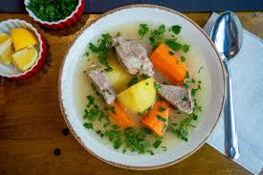
  STRATEGIES FOR PROVIDING NUTRITIOUS MEALS DURING CHALLENGING WEATHER
Cooking methods also play a key role in maintaining the nutritional quality of meals. Steaming, baking, and stewing are preferable to frying, as they help preserve vitamins and minimize the use of unhealthy fats. It's also important to avoid overcooking vegetables, which can lead to the loss of water-soluble vitamins like vitamin C. For instance, lightly steaming frozen mixed vegetables instead of boiling them retains more nutrients while still offering a comforting side dish during poor weather conditions.
.
NAVAL COMMUNICATIONS
ADAPTING MENUS TO SPECIAL CONDITIONS ONBOARD

Slide 31
  STRATEGIES FOR PROVIDING NUTRITIOUS MEALS DURING CHALLENGING WEATHER
Preparing meals in advance is another smart strategy, especially when severe weather is forecasted. By cooking large batches of nutrient-rich meals and storing them in portions, kitchen staff can ensure consistent food availability even if cooking becomes difficult during storms. One-pot meals like lentil and sweet potato curry or pasta bakes are ideal because they are easy to reheat and offer a balanced mix of carbohydrates, protein, and fiber.
When fresh produce or other perishable ingredients are limited, meals can be fortified with nutrient-dense add-ons. Powdered milk can be mixed into oatmeal, protein powders can be added to smoothies, and nut butters or seeds can boost the nutritional value of snacks and meals. For example, adding chia seeds or a spoonful of peanut butter to oatmeal provides a good source of protein, fiber, and healthy fats.
NAVAL COMMUNICATIONS
ADAPTING MENUS TO SPECIAL CONDITIONS ONBOARD

Slide 32
  STRATEGIES FOR PROVIDING NUTRITIOUS MEALS DURING CHALLENGING WEATHER
Hydration is another critical concern, especially in hot or stormy weather. Nutritious fluids such as vegetable broths, herbal teas, and electrolyte drinks help maintain hydration while also delivering essential nutrients. A simple broth-based soup with noodles and beans, for instance, provides hydration, sodium, and protein in a single dish.
Portion size and energy density should also be adjusted based on the climate. Cold weather typically increases caloric needs, so meals should be hearty and satisfying. Including complex carbs, healthy fats (like olive oil or nuts), and lean proteins ensures that energy demands are met without compromising health. For example, whole-grain pasta tossed with olive oil, canned salmon, and frozen peas makes for a filling and balanced meal.
NAVAL COMMUNICATIONS
ADAPTING MENUS TO SPECIAL CONDITIONS ONBOARD

Slide 33
  STRATEGIES FOR PROVIDING NUTRITIOUS MEALS DURING CHALLENGING WEATHER
It’s equally important to consider those with special dietary needs. Even in tough conditions, individuals with allergies, diabetes, or dietary restrictions must be accommodated. Stocking alternative products—such as gluten-free grains, dairy-free items, or plant-based proteins—and clearly labeling all meals helps avoid confusion and ensures inclusivity.
Finally, kitchen staff should be trained in emergency nutrition planning. They need to understand how to rotate stock to prevent spoilage, adapt recipes based on available ingredients, and maintain nutritional standards when resources are limited. This level of preparedness ensures that even during the most difficult weather, everyone on board receives safe, satisfying, and nourishing meals.
NAVAL COMMUNICATIONS
ADAPTING MENUS TO SPECIAL CONDITIONS ONBOARD

Slide 34

  PLANNING FOR SPECIAL DIETARY NEEDS DURING ROUGH SEAS
Planning for special dietary needs during rough seas begins with early identification and documentation. Before a voyage sets off, it’s essential to collect detailed dietary information from both passengers and crew. This includes not only common food allergies like nuts, dairy, or shellfish, but also medical dietary requirements such as low-sodium or diabetic-friendly diets, as well as religious or ethical food restrictions like vegetarian, vegan, Halal, or Kosher preferences. Compiling this information into a centralized and accessible list helps kitchen staff know exactly who requires what, ensuring accuracy and safety even when the environment becomes unstable.
NAVAL COMMUNICATIONS
ADAPTING MENUS TO SPECIAL CONDITIONS ONBOARD

Slide 35

  PLANNING FOR SPECIAL DIETARY NEEDS DURING ROUGH SEAS
NAVAL COMMUNICATIONS
ADAPTING MENUS TO SPECIAL CONDITIONS ONBOARD

Slide 36
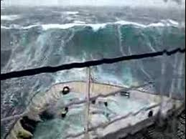
  PLANNING FOR SPECIAL DIETARY NEEDS DURING ROUGH SEAS
In anticipation of turbulent weather, pre-portioning and labelling meals for those with special dietary needs can be extremely helpful. Preparing these meals during calm conditions allows staff to focus on accuracy, using safe preparation methods to prevent contamination. Clearly labeling each meal with the passenger's or crew member’s name and dietary restriction (e.g., “Low Sodium – Anna M.” or “Gluten-Free – Mike R.”) ensures that the correct meal can be delivered quickly and confidently, even when full meal service is disrupted or unsafe. These pre-packaged meals can also be stored for easy reheating and streamlining service when kitchen movement is limited.
NAVAL COMMUNICATIONS
ADAPTING MENUS TO SPECIAL CONDITIONS ONBOARD

Slide 37
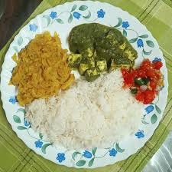
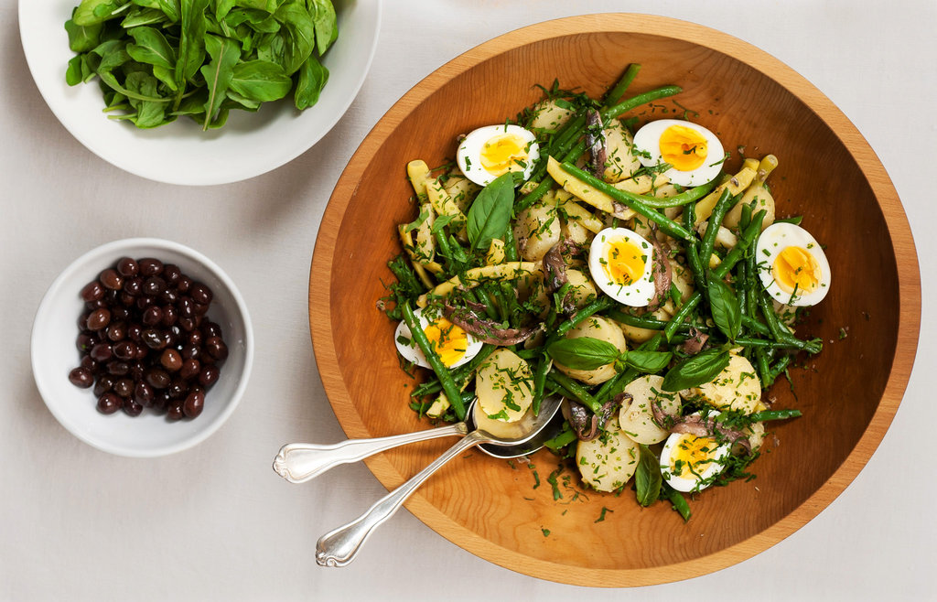
  PLANNING FOR SPECIAL DIETARY NEEDS DURING ROUGH SEAS
Using a base menu structure that can easily be customized is another practical approach. Offering meals with neutral bases—like plain rice, baked potatoes, or salad greens—enables cooks to adapt meals based on individual dietary requirements. For example, a pasta dish can be topped with different sauces or proteins depending on whether someone is vegetarian, requires low sodium, or avoids gluten. This system minimizes complexity for the kitchen team while still allowing guests with dietary needs to enjoy satisfying and varied meals.
NAVAL COMMUNICATIONS
ADAPTING MENUS TO SPECIAL CONDITIONS ONBOARD

Slide 38


  PLANNING FOR SPECIAL DIETARY NEEDS DURING ROUGH SEAS
Maintaining strict hygiene and avoiding cross-contamination is critical, particularly when rough seas make galley work more dangerous. Allergen-free and specialty items should be stored separately in clearly labeled containers, and kitchen staff should use color-coded utensils and cutting boards to prevent accidental exposure. In high-risk cases—like severe nut or shellfish allergies—designating a dedicated prep area for those meals may be necessary. During rough conditions, it’s safer to prepare special meals ahead of the general service period to avoid mistakes when staff are under pressure or movement is restricted.
NAVAL COMMUNICATIONS
ADAPTING MENUS TO SPECIAL CONDITIONS ONBOARD

Slide 39

  PLANNING FOR SPECIAL DIETARY NEEDS DURING ROUGH SEAS
Equally important is staff training. Crew members working in the galley should be educated on different dietary requirements, food allergy protocols, and how to safely store, handle, and serve specialty items. In case of emergencies or supply shortages, they should also know how to make acceptable substitutions, such as using canned legumes in place of fresh meat for vegetarian meals. This preparation ensures that service remains smooth and safe, even when unexpected situations arise due to weather.
NAVAL COMMUNICATIONS
ADAPTING MENUS TO SPECIAL CONDITIONS ONBOARD

Slide 40
  PLANNING FOR SPECIAL DIETARY NEEDS DURING ROUGH SEAS
Lastly, clear communication is essential during meal service in rough conditions. Special meals should be delivered first, and staff should double-check labeling before handing them out, especially if meals are brought directly to cabins instead of served in a central dining area. Daily briefings for the serving team can help keep everyone informed about any changes to the dietary list or specific meal instructions. Guests with restrictions should also know whom to contact if there’s an issue with their meal, ensuring that any concerns can be addressed quickly and discreetly.
In summary, meeting special dietary needs during rough seas is entirely achievable with proper planning and awareness. By identifying requirements early, stocking appropriate ingredients, preparing meals in advance, and maintaining strong food safety practices, kitchens can continue to provide nutritious, safe, and appropriate meals for all individuals onboard, regardless of the weather conditions.
NAVAL COMMUNICATIONS
ADAPTING MENUS TO SPECIAL CONDITIONS ONBOARD

Slide 41

  CONSIDERING WEATHER AND SEA CONDITIONS WHEN PREPARING THE MENUS
Cooks on cruisers definitely take weather and sea conditions into account when preparing menus. The changing environment at sea can have a big impact on what’s practical, safe, and appealing to serve. For example, during rough seas or bad weather, the galley team often opts for simpler, more stable dishes that are easy to prepare and less likely to cause accidents in a moving kitchen. Heavy or greasy foods might be avoided because they can contribute to nausea or discomfort among passengers and crew who are already feeling seasick.
NAVAL COMMUNICATIONS
ADAPTING MENUS TO SPECIAL CONDITIONS ONBOARD

Slide 42
  CONSIDERING WEATHER AND SEA CONDITIONS WHEN PREPARING THE MENUS
Additionally, cooks consider the availability and shelf life of ingredients. Fresh produce and delicate items may be used more sparingly or replaced with frozen, canned, or shelf-stable alternatives if bad weather is expected to delay resupply. They also tend to focus on meals that provide sufficient energy and warmth during cold or stormy conditions, such as hearty soups, stews, and casseroles, which are comforting and nutritious while being easier to serve safely.
In calmer weather, the menu can be more diverse, incorporating lighter dishes, fresh salads, and more elaborate presentations. Overall, cruise cooks balance nutritional needs, safety in preparation, and passenger comfort by adapting menus thoughtfully to the prevailing sea and weather conditions.
NAVAL COMMUNICATIONS
ADAPTING MENUS TO SPECIAL CONDITIONS ONBOARD

Slide 43
  CHANGING MENU DEMANDS OF SEAFARERS IN PARALLEL WITH THE CHANGING WEATHER AND SEA
the demands and preferences of seafarers regarding the menu often change in parallel with the weather and sea conditions. When the sea is rough or the weather is cold and stormy, seafarers typically crave hearty, warm, and comforting meals that provide energy and help maintain body warmth. In such conditions, heavier dishes like stews, soups, casseroles, and carbohydrate-rich foods become more popular because they’re filling and easier to digest when seasickness is a concern.
Conversely, during calm seas and warm weather, the demand usually shifts toward lighter, fresher meals—such as salads, grilled fish, and fresh fruits—which are more refreshing and easier on the stomach. Seafarers might also prefer more variety and elaborate dishes when conditions allow for smoother food preparation and service
NAVAL COMMUNICATIONS
ADAPTING MENUS TO SPECIAL CONDITIONS ONBOARD

Slide 44

  CHANGING MENU DEMANDS OF SEAFARERS IN PARALLEL WITH THE CHANGING WEATHER AND SEA
Additionally, rough weather can affect appetite—some may experience nausea or reduced hunger, which means cooks need to offer simple, easily digestible foods that can be eaten in smaller portions but still provide sufficient nutrition. So, the galley often adapts both the menu content and portion sizes to meet the changing physical and psychological needs of the crew based on the sea and weather conditions.
In short, yes—the demands of seafarers regarding the menu do shift alongside changing weather and sea conditions, and effective galley teams respond by adjusting meals to keep the crew nourished, comfortable, and motivated.
NAVAL COMMUNICATIONS
ADAPTING MENUS TO SPECIAL CONDITIONS ONBOARD

Slide 45


  CHANGING MENU DEMANDS OF SEAFARERS IN PARALLEL WITH THE CHANGING WEATHER AND SEA
Cruise ship passengers’ food preferences and demands also tend to change with the weather and sea conditions, much like those of the crew. When the seas are calm and the weather is pleasant, passengers often look forward to lighter, fresher fare—think crisp salads, chilled seafood, fresh fruit platters, and vibrant, colorful dishes that match the relaxed, sunny vibe of being on vacation. They might also be more adventurous with trying new cuisines or indulging in elaborate multi-course meals, enjoying the full dining experience
NAVAL COMMUNICATIONS
ADAPTING MENUS TO SPECIAL CONDITIONS ONBOARD

Slide 46
  CHANGING MENU DEMANDS OF SEAFARERS IN PARALLEL WITH THE CHANGING WEATHER AND SEA
However, when rough seas or bad weather hit, passengers usually shift toward comfort foods that feel warm, filling, and soothing. Hot soups, stews, casseroles, and baked dishes become more appealing, offering not only nourishment but also a sense of coziness when stuck indoors or feeling the ship’s movement. Additionally, seasickness or reduced appetite caused by turbulent waters can make lighter, bland, or easy-to-digest foods more popular—such as crackers, toast, or simple broths.
Moreover, the galley often adjusts menus during rough conditions to focus on dishes that are safer and easier to prepare on a moving ship, which passengers might notice as more straightforward, less elaborate meals. Special care is taken to provide nutritious options that help maintain energy and hydration since physical discomfort and anxiety can affect passengers’ eating habits.
NAVAL COMMUNICATIONS
ADAPTING MENUS TO SPECIAL CONDITIONS ONBOARD

Slide 47
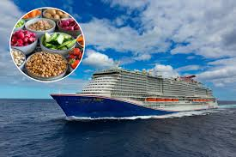
  CHANGING MENU DEMANDS OF SEAFARERS IN PARALLEL WITH THE CHANGING WEATHER AND SEA
In summary, cruise passengers’ demands around food vary with the weather and sea conditions, and cruise ship kitchens adapt their menus accordingly to ensure passengers remain comfortable, satisfied, and well-nourished throughout their journey—rain or shine.
NAVAL COMMUNICATIONS
ADAPTING MENUS TO SPECIAL CONDITIONS ONBOARD

Slide 48
  ADAPTING MENUS TO SPECIAL CONDITIONS ONBOARD
. Bujisic, M., Bogicevic, V., & Parsa, H. G. (2016). The effect of weather factors on restaurant sales. Journal of Foodservice Business Research, 20(3), 350–370. https://doi.org/10.1080/15378020.2016.1209723
2. Neumann, F.A., Belz, L., Dengler, D. et al. Seafarers’ attitudes and chances to improve the nutrition on merchant ships from the crews’ and cooks’ perspective. J Occup Med Toxicol 19, 13 (2024). https://doi.org/10.1186/s12995-024-00412-x
3. Neumann, F.A., Belz, L., Dengler, D. et al. Eating behaviour and weight development of European and Asian seafarers during stay on board and at home. J Occup Med Toxicol 16, 41 (2021). https://doi.org/10.1186/s12995-021-00329-9
4. Ibe, K. K., & Kollur, S. P. (2024). Challenges towards the adoption and use of sustainable cooking methods: a comprehensive review. Sustainable Environment, 10(1). https://doi.org/10.1080/27658511.2024.2362509
NAVAL COMMUNICATIONS
ADAPTING MENUS TO SPECIAL CONDITIONS ONBOARD

Slide 49
  ADAPTING MENUS TO SPECIAL CONDITIONS ONBOARD
How to Adapt Kitchen Operations to Meet Changing Menu Demands (2025). https://www.europeanbusinessreview.com/how-to-adapt-kitchen-operations-to-meet-changing-menu-demands/
6. How to Adapt Recipes for Dietary Restrictions (2024). https://www.escoffier.edu/blog/recipes/how-to-adapt-recipes-for-dietary-restrictions/
7. Coskun, A., Genç, H. U., & Coskun, A. (2023, August). How sustainable is your menu? Designing and assessing an interactive artefact to support chefs’ sustainable recipe-planning practices. In Proceedings of the 6th ACM SIGCAS/SIGCHI Conference on Computing and Sustainable Societies (pp. 90-98).
NAVAL COMMUNICATIONS
ADAPTING MENUS TO SPECIAL CONDITIONS ONBOARD

