Slide 1





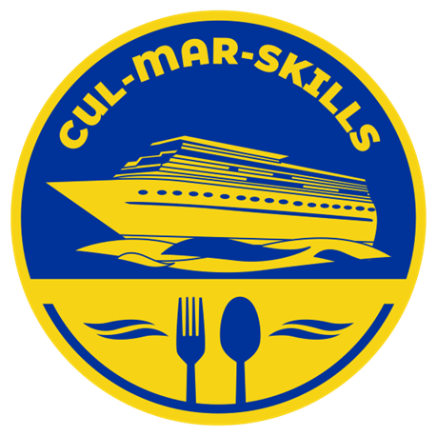


MARitime Soft Skills for Onboard Healthy Nutrition and CULinary Arts in Seagoing Services – CUL-MAR-Skills
KA220-VET - Cooperation partnerships in vocational education and training
2023-1-RO01-KA220-VET-000156711
ONBOARD COOKING SKILLS
Week VII
Cooking Dishes from Different Cultures
Disclaimer: “Funded by the European Union. Views and opinions expressed are however those of the author(s) only and do not necessarily reflect those of the European Union or the ANPCDEFP. Neither the European Union nor the ANPCDEFP can be held responsible for them”

Slide 2
Learning outcomes of the course
Identify and describe key characteristics of international cuisines, including typical ingredients, flavor profiles, and common cooking techniques from various world regions.
Explore and apply traditional cooking styles from a variety of global cultures, including but not limited to Asian, Mediterranean, Latin American, Middle Eastern, and African cuisines.
Recognize and source regional and authentic ingredients, understanding their culinary uses, seasonal availability, and possible substitutions when sourcing is limited.
Analyze the cultural and historical context of different cuisines, appreciating how geography, climate, and tradition shape food practices. practicesaround the world.
NAVAL COMMUNICATIONS
COOKING DISHES FROM DIFFERENT CULTURES

Slide 3
Learning outcomes of the course
5. Prepare culturally diverse dishes using authentic methods, ensuring attention to traditional flavor balancing, presentation, and plating techniques.
6. Adapt international recipes for practical use in specific environments, such as limited-space or onboard kitchens, while preserving the essence of each dish.
7. Create culturally diverse menus that integrate multiple global cuisines in a balanced and cohesive way suitable for a hospitality or travel setting (e.g., cruise ship, airline, luxury train).
8. Demonstrate safe and efficient kitchen practices while working with unfamiliar ingredients and methods, including proper handling, storage, and preparation
NAVAL COMMUNICATIONS
COOKING DISHES FROM DIFFERENT CULTURES

Slide 4
INTERNATIONAL CUISINES AND COOKING STYLES
Exploring international cuisines and cooking styles is essential for chefs working in multicultural environments, especially when serving guests from diverse cultural backgrounds. When chefs take the time to understand the culinary traditions of other cultures, they demonstrate cultural sensitivity and respect. For example, preparing a traditional Indian curry with the correct spice blend and cooking method shows appreciation for the cuisine and avoids oversimplification or misrepresentation that could offend guests familiar with the dish.
Understanding global cuisines also helps chefs accommodate a wide range of dietary needs and cultural preferences. Many people follow religious or cultural food restrictions, such as avoiding pork in Islamic cuisine or preparing kosher meals for Jewish guests. A chef with knowledge of Middle Eastern cuisine, for instance, might prepare a halal-compliant lamb tagine using authentic spices like cumin and cinnamon, ensuring that it meets both the guest's dietary needs and cultural expectations.
NAVAL COMMUNICATIONS
COOKING DISHES FROM DIFFERENT CULTURES

Slide 5
INTERNATIONAL CUISINES AND COOKING STYLES
Moreover, offering authentic international dishes can significantly enhance the dining experience. Guests often feel more welcomed and valued when they see familiar foods prepared with care and accuracy. For example, a Japanese guest on a cruise may appreciate finding a properly made miso soup and fresh sushi, while a Latin American traveler may find comfort in seeing arroz con pollo on the menu—both experiences contributing to a positive, memorable impression.
For the chef, exploring global cuisines expands their culinary versatility and creativity. Knowing how to prepare Thai green curry, French ratatouille, or Moroccan couscous gives them a broader toolkit of flavors, techniques, and presentation styles. This versatility is especially valuable in dynamic settings like cruise ships or international hotels, where the guest demographic can change weekly, and menu variety is key to satisfaction.
NAVAL COMMUNICATIONS
COOKING DISHES FROM DIFFERENT CULTURES

Slide 6
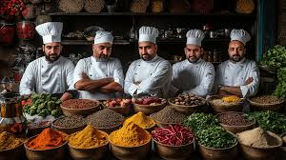
INTERNATIONAL CUISINES AND COOKING STYLES
Finally, in today’s globalized hospitality industry, chefs with a deep understanding of international cuisines are more competitive and sought after. Employers look for professionals who can confidently execute a wide range of dishes, adapt to different cultural contexts, and innovate by fusing global flavors. A chef who can plan a multicultural dinner featuring Mediterranean appetizers, Southeast Asian entrées, and Caribbean desserts shows not only skill but also an ability to cater to a world-class clientele.
NAVAL COMMUNICATIONS
COOKING DISHES FROM DIFFERENT CULTURES

Slide 7

BENEFITS OF MASTERING INTERNATIONAL CUISINES
A cook who is competent in preparing international food brings significant benefits to both their career and the organization they work for. Here are the main benefits, each explained with practical examples:
Greater Career Opportunities: Cooks skilled in international cuisines are more competitive in the job market, especially in global hospitality settings like hotels, airlines, cruise ships, or international restaurants. For instance, a chef who can prepare authentic Italian pasta, Japanese sushi, and Indian curry is more likely to be hired by a high-end resort that serves guests from around the world.
NAVAL COMMUNICATIONS
COOKING DISHES FROM DIFFERENT CULTURES

Slide 8
BENEFITS OF MASTERING INTERNATIONAL CUISINES
Increased Customer Satisfaction: Being able to prepare dishes that reflect guests' cultural preferences leads to a more enjoyable dining experience. For example, a guest from Mexico might appreciate seeing tacos al pastor on the menu, prepared authentically, while an Asian guest may feel welcomed with familiar dishes like stir-fried noodles or miso soup. This boosts customer satisfaction and loyalty.
Versatility in the Kitchen: Cooks competent in international cuisines can adapt easily to different menus and cooking scenarios. This is especially useful in buffet settings, theme nights, or when cooking for diverse groups. For example, during an “Around the World” dinner event, a versatile cook can contribute dishes from multiple regions without the need for outside specialists.
NAVAL COMMUNICATIONS
COOKING DISHES FROM DIFFERENT CULTURES

Slide 9

BENEFITS OF MASTERING INTERNATIONAL CUISINES
Innovation and Creativity: Knowledge of global flavors and techniques gives cooks the ability to experiment and create unique fusion dishes. A chef might combine Mediterranean and Asian elements to develop a sesame-crusted tuna served over couscous with a miso glaze—something that excites modern diners looking for new culinary experiences.
Cultural Awareness and Respect: Being able to prepare international food correctly demonstrates cultural respect and awareness. This reduces the risk of misrepresentation and helps build a more inclusive kitchen and dining environment. For example, knowing that traditional Moroccan tagine is cooked slowly in a clay pot helps preserve authenticity and respect for the dish’s cultural roots.
NAVAL COMMUNICATIONS
COOKING DISHES FROM DIFFERENT CULTURES

Slide 10

BENEFITS OF MASTERING INTERNATIONAL CUISINES
Ability to Meet Dietary Needs: International cuisines often offer naturally vegetarian, vegan, halal, kosher, or gluten-free options. A cook familiar with these traditions can more easily accommodate special diets. For instance, understanding Indian vegetarian cooking helps meet vegetarian needs without simply removing meat from a standard dish.
Business Growth and Reputation: For restaurants and hospitality businesses, having cooks who can prepare high-quality international cuisine attracts a broader customer base and enhances the business’s reputation. A diverse and well-executed menu draws in locals and tourists alike, boosting both brand image and revenue.
NAVAL COMMUNICATIONS
COOKING DISHES FROM DIFFERENT CULTURES

Slide 11

BENEFITS OF MASTERING INTERNATIONAL CUISINES
NAVAL COMMUNICATIONS
COOKING DISHES FROM DIFFERENT CULTURES

Slide 12
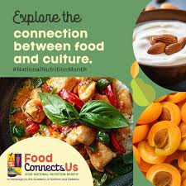
BENEFITS OF MASTERING INTERNATIONAL CUISINES
NAVAL COMMUNICATIONS
COOKING DISHES FROM DIFFERENT CULTURES

Slide 13

THE BENEFITS OF SAILORS’ EATING THEIR FAVORITE FOODS DURING LONG-TERM DUTIES
Reduces Stress and Mental Fatigue: Comfort foods and familiar tastes help reduce mental fatigue caused by routine, stress, and long working hours at sea. Good meals act as a small daily reward and provide psychological breaks from the demanding environment of ship life.
Example: A crew member might look forward to a weekly “favorite meal night” featuring dishes from their home country, helping them recharge mentally.
NAVAL COMMUNICATIONS
COOKING DISHES FROM DIFFERENT CULTURES

Slide 14
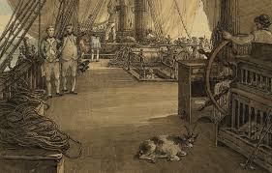
THE BENEFITS OF SAILORS’ EATING THEIR FAVORITE FOODS DURING LONG-TERM DUTIES
Boosts Morale and Emotional Well-Being: Eating familiar foods brings comfort and emotional relief, especially when sailors are away from home for extended periods. A simple dish like a home-made pasta or cultural food can produce a sense of connection to home, reducing feelings of loneliness and isolation.
Example: A Filipino sailor enjoying adobo or sinigang on board feels a stronger sense of cultural identity and comfort, which helps them cope better with the challenges of long voyages
NAVAL COMMUNICATIONS
COOKING DISHES FROM DIFFERENT CULTURES

Slide 15
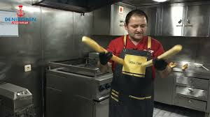
THE BENEFITS OF SAILORS’ EATING THEIR FAVORITE FOODS DURING LONG-TERM DUTIES
Encourages Better Appetite and Nutrition: When sailors are served meals they enjoy, they are more likely to eat regularly and maintain proper nutrition. This is important for their energy levels, immune system, and overall health.
Example: A sailor who might otherwise skip meals is more likely to eat a balanced plate when it includes foods they are familiar with and enjoy, like spicy stews, rice dishes, or grilled meats.
NAVAL COMMUNICATIONS
COOKING DISHES FROM DIFFERENT CULTURES

Slide 16

THE BENEFITS OF SAILORS’ EATING THEIR FAVORITE FOODS DURING LONG-TERM DUTIES
Supports Physical Performance: A well-fed crew is a more effective crew. Favorite and familiar meals, when prepared in a balanced and nutritious way, help sailors stay energized, focused, and physically capable of performing demanding tasks.
Example: Properly nourished sailors are more alert during shifts, better able to handle physical tasks like lifting, navigating, or emergency drills.
NAVAL COMMUNICATIONS
COOKING DISHES FROM DIFFERENT CULTURES

Slide 17
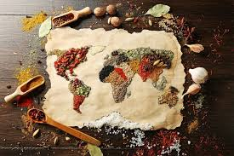
THE BENEFITS OF SAILORS’ EATING THEIR FAVORITE FOODS DURING LONG-TERM DUTIES
Strengthens Team Bonding and Cultural Appreciation: Sharing and enjoying favorite meals can strengthen camaraderie among crew members and promote cultural exchange. Theme nights or cultural meal days can help build mutual respect and reduce interpersonal tensions on board.
Example: Celebrating a sailor’s birthday with a traditional dish from their country can boost team spirit and show appreciation for diversity in the crew.
NAVAL COMMUNICATIONS
COOKING DISHES FROM DIFFERENT CULTURES

Slide 18

THE BENEFITS OF SAILORS’ EATING THEIR FAVORITE FOODS DURING LONG-TERM DUTIES
Reduces Homesickness and Improves Retention: Serving favorite foods helps reduce homesickness and can improve long-term job satisfaction. This can result in better crew retention and a more stable, experienced team.
Example: A shipping company that offers flexible menus with international options may find their crew happier and more loyal compared to those serving repetitive or unfamiliar meals.
NAVAL COMMUNICATIONS
COOKING DISHES FROM DIFFERENT CULTURES

Slide 19
THE BENEFITS OF SAILORS’ EATING THEIR FAVORITE FOODS DURING LONG-TERM DUTIES
Boosts Morale and Emotional Well-being
Reduces Stress and Mental Fatigue
Strengthens Team Bonding and Cultural Appreciation
Encourages Better Appetite and Nutrition
Supports Physical Performance
Reduces Homesickness and Improves Retention
NAVAL COMMUNICATIONS
COOKING DISHES FROM DIFFERENT CULTURES

Slide 20
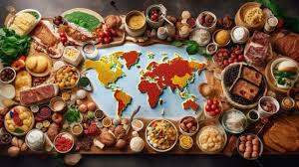
EXPLORING INTERNATIONAL CUISINES AND COOKING STYLES
Cooks onboard can explore international cuisines and cooking styles in many practical and meaningful ways, even within the limited space and resources of a ship’s galley. One of the most accessible methods is by engaging with the multinational crew. Ships often bring together people from diverse cultural backgrounds, and cooks can learn a great deal simply by speaking with fellow crew members about their traditional dishes, ingredients, and cooking methods. For example, a cook might learn to prepare authentic Indian butter chicken from a colleague or gain insights into Chinese dumpling-making techniques from a steward.
NAVAL COMMUNICATIONS
COOKING DISHES FROM DIFFERENT CULTURES

Slide 21
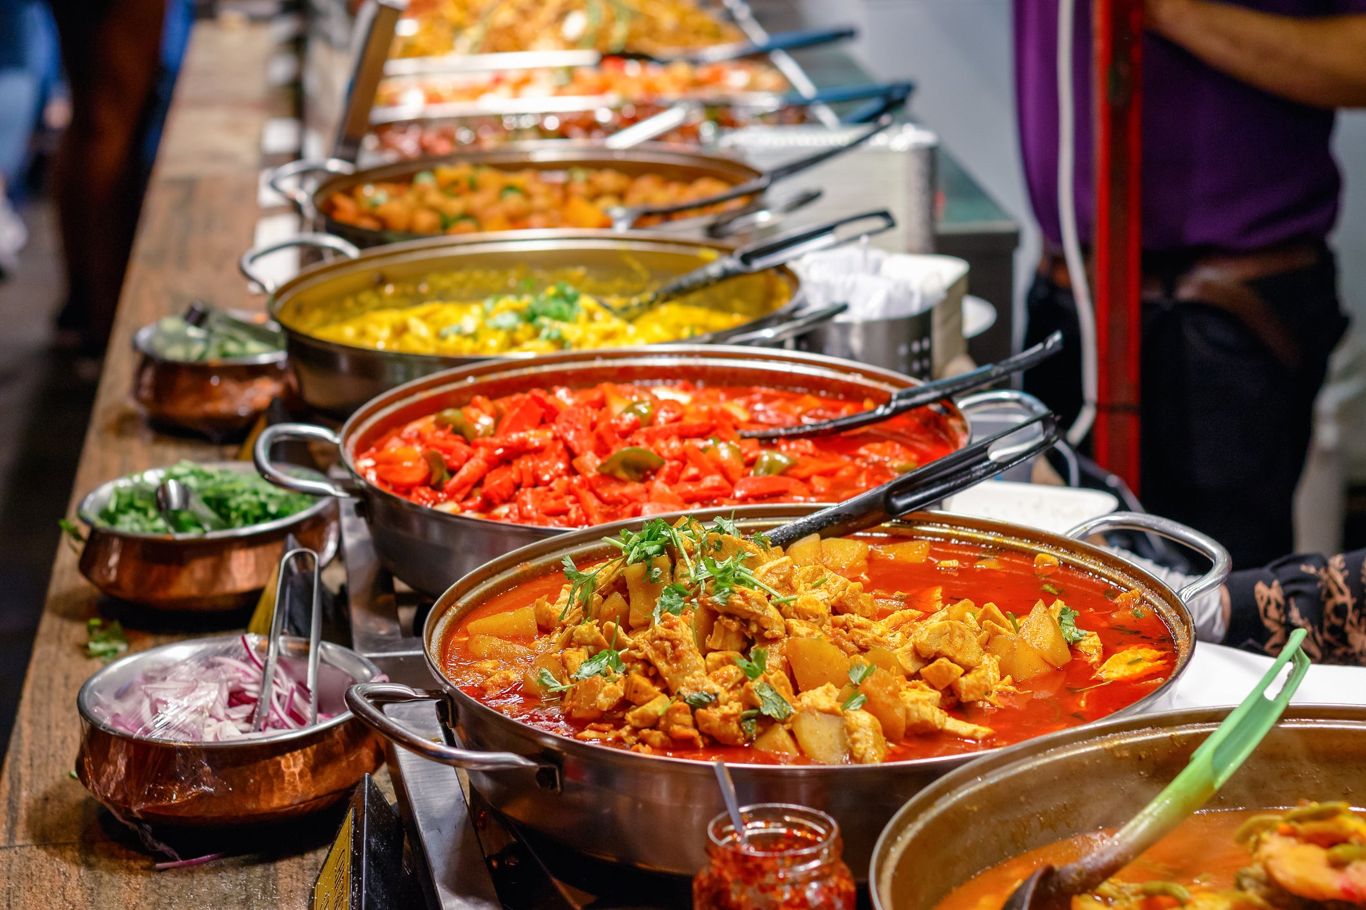
EXPLORING INTERNATIONAL CUISINES AND COOKING STYLES
Participating in international theme nights is another effective way to develop global cooking skills. Many ships organize themed dinners or cultural celebrations for guests and crew, such as “Italian Night” or “Asian Cuisine Night.” These events provide opportunities for cooks to research and experiment with regional dishes, understand flavor combinations, and practice different presentation styles. Preparing risotto, sushi, or Moroccan tagines for such events not only broadens culinary skills but also enhances the onboard dining experience.
NAVAL COMMUNICATIONS
COOKING DISHES FROM DIFFERENT CULTURES

Slide 22
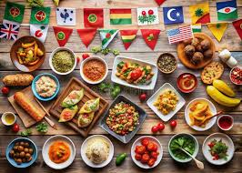
EXPLORING INTERNATIONAL CUISINES AND COOKING STYLES
Where internet access is available, cooks can take advantage of online resources to watch videos, read recipes, or even enroll in virtual cooking classes. Platforms like YouTube, Coursera, or dedicated culinary websites offer step-by-step tutorials in international cooking. Cooks can download materials for offline use, ensuring they continue learning even when internet access is limited. Additionally, having international cookbooks or recipe manuals on board provides a valuable offline reference for trying new dishes and understanding traditional cooking techniques.
NAVAL COMMUNICATIONS
COOKING DISHES FROM DIFFERENT CULTURES

Slide 23
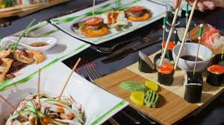
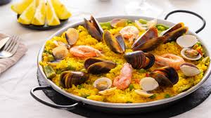
EXPLORING INTERNATIONAL CUISINES AND COOKING STYLES
Cooks can also explore new cuisines by experimenting with available ingredients. While not all regional ingredients may be stocked onboard, cooks can creatively substitute or adapt using what’s on hand. For instance, if fresh lemongrass is unavailable for a Thai soup, a blend of lime and ginger might be used to achieve a similar flavor profile. This approach encourages problem-solving and adaptability—key skills for any chef working at sea.
NAVAL COMMUNICATIONS
COOKING DISHES FROM DIFFERENT CULTURES

Slide 24
EXPLORING INTERNATIONAL CUISINES AND COOKING STYLES
Another opportunity for growth comes from onboard culinary training, when available. Some ships offer development sessions or encourage senior chefs to share their expertise with junior staff. These sessions may include demonstrations of international dishes or lessons in plating and presentation techniques, allowing cooks to learn directly in a hands-on environment. Additionally, preparing meals for cultural celebrations like Diwali, Chinese New Year, or Ramadan enables cooks to gain firsthand experience with traditional dishes while honoring the diverse backgrounds of their crewmates.
Lastly, maintaining a culinary journal can help cooks document what they’ve learned, track successful recipes, and reflect on feedback from guests and colleagues. Over time, this journal becomes a personalized resource for improving and expanding their international cooking repertoire.
NAVAL COMMUNICATIONS
COOKING DISHES FROM DIFFERENT CULTURES

Slide 25
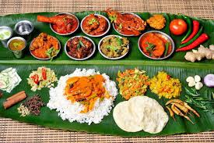
UNDERSTANDING REGIONAL INGREDIENTS AND FLAVOR PROFILES
Understanding regional ingredients and flavor profiles is a key skill for any cook or chef, especially in multicultural or international settings. This knowledge enhances cooking in many important ways—flavor accuracy, cultural authenticity, and guest satisfaction. Here's a detailed explanation of its uses:
Authentic Taste and Presentation: Knowing the ingredients and flavor combinations that define a region allows cooks to recreate dishes that taste and look authentic. Every culture has specific herbs, spices, fats, and cooking methods that shape its cuisine. For example, Southeast Asian food often balances sweet, sour, salty, and spicy flavors using ingredients like lemongrass, fish sauce, lime, and chili. Without this understanding, dishes may taste generic or off-balance.
NAVAL COMMUNICATIONS
COOKING DISHES FROM DIFFERENT CULTURES

Slide 26
UNDERSTANDING REGIONAL INGREDIENTS AND FLAVOR PROFILES
Cultural Respect and Accuracy: Using the right regional ingredients shows respect for the culinary traditions of different cultures. This is especially important when serving guests from those regions. For instance, preparing Middle Eastern dishes with ingredients like sumac, za’atar, or tahini signals cultural knowledge and appreciation. It helps avoid unintentional mistakes, such as using pork in a traditionally halal dish or omitting key flavor elements.
Better Ingredient Substitution Skills: When cooks understand the role and function of regional ingredients, they can make smart substitutions when needed. For example, if a specific Mexican chili isn’t available, a cook who understands its heat level and flavor can replace it with something close. This helps maintain the integrity of the dish even when working with limited supplies, like onboard a ship.
NAVAL COMMUNICATIONS
COOKING DISHES FROM DIFFERENT CULTURES

Slide 27
UNDERSTANDING REGIONAL INGREDIENTS AND FLAVOR PROFILES
Enhanced Menu Diversity: Understanding different flavor profiles helps cooks create more balanced and varied menus. They can introduce dishes from around the world while ensuring that each item has a unique identity. For example, a menu might include a spicy Korean bulgogi, a rich French coq au vin, and a refreshing Greek salad—all using appropriate flavors and ingredients that distinguish them.
Improved Guest Satisfaction: When guests recognize familiar flavors that are prepared properly, it enhances their dining experience. A well-seasoned curry, a perfectly sour ceviche, or a sweet and spicy Thai dish can instantly connect a guest to home or a cherished memory. This emotional satisfaction is especially meaningful on long voyages or in hospitality settings.
NAVAL COMMUNICATIONS
COOKING DISHES FROM DIFFERENT CULTURES

Slide 28
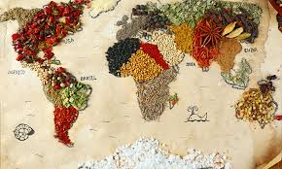
UNDERSTANDING REGIONAL INGREDIENTS AND FLAVOR PROFILES
Greater Culinary Creativity: Once cooks understand how flavor profiles work, they can experiment with fusion dishes or new interpretations. For instance, combining Mediterranean herbs with Asian sauces in a creative way can lead to innovative and exciting menu items—something increasingly valued in modern culinary settings.
In summary, understanding regional ingredients and flavor profiles empowers cooks to prepare authentic, satisfying, and culturally appropriate dishes. It also makes them more flexible, creative, and respected in any professional kitchen—especially in diverse or international environments.
NAVAL COMMUNICATIONS
COOKING DISHES FROM DIFFERENT CULTURES

Slide 29
INCORPORATING DIVERSE CULINARY TRADITIONS
Incorporating diverse culinary traditions into onboard meals is highly significant, particularly in the multicultural environment of ships. With crews and passengers often coming from various nationalities, offering meals that reflect different culinary traditions promotes a strong sense of cultural inclusivity and respect. When a sailor sees a familiar dish from home—like Indian biryani, Filipino adobo, or Nigerian jollof rice—it not only satisfies their palate but also makes them feel seen and valued.
Food has a powerful emotional impact, and eating culturally familiar meals can greatly improve morale and emotional well-being during long voyages. For many sailors, food is one of the few comforts of home they can enjoy while at sea. Serving their favorite traditional dishes helps reduce homesickness and provides emotional support, contributing to a more positive onboard atmosphere.
NAVAL COMMUNICATIONS
COOKING DISHES FROM DIFFERENT CULTURES

Slide 30
INCORPORATING DIVERSE CULINARY TRADITIONS
Diverse menus also make mealtime more enjoyable and satisfying. Rotating meals from different culinary traditions keeps food from becoming repetitive, especially during long-term duties. A well-balanced menu that includes dishes from Asia, Latin America, Europe, and Africa introduces variety in taste, texture, and presentation—making each meal feel fresh and interesting.
In addition to satisfying individual preferences, culturally diverse meals strengthen social bonds among the crew. Sharing food from different backgrounds opens the door to conversations and encourages mutual appreciation. For example, a Thai crew member might help prepare a traditional curry, allowing others to learn about the dish while building camaraderie through a shared experience.
NAVAL COMMUNICATIONS
COOKING DISHES FROM DIFFERENT CULTURES

Slide 31
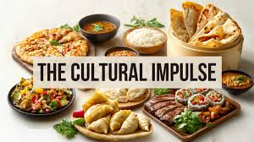
INCORPORATING DIVERSE CULINARY TRADITIONS
Health and nutrition also benefit from incorporating global cuisines. Different cultures offer a range of healthy ingredients and preparation methods—from the vegetable-rich Mediterranean diet to the fermented foods found in Korean cuisine or the grain-based staples of Latin American meals. This variety helps ensure a more balanced and nutritious diet for the crew.
For cooks, preparing meals from various traditions encourages skill development and culinary growth. Learning to cook international dishes not only broadens their professional abilities but also makes them more adaptable and valuable in global kitchens. It keeps their work engaging and allows them to take pride in creating meals that truly matter to others onboard.
NAVAL COMMUNICATIONS
COOKING DISHES FROM DIFFERENT CULTURES

Slide 32
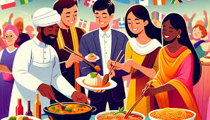
INCORPORATING DIVERSE CULINARY TRADITIONS
Finally, on passenger ships or in high-standard hospitality operations, incorporating diverse cuisines demonstrates professionalism and attention to guest satisfaction. Travelers often expect a wide range of options, and serving authentic, well-prepared international meals enhances their overall experience and reflects the ship's commitment to quality service.
In summary, incorporating diverse culinary traditions into onboard meals goes far beyond variety—it fosters inclusion, improves morale, supports well-being, and elevates both crew and guest experiences. It transforms food from a basic necessity into a meaningful and powerful part of life at sea.
NAVAL COMMUNICATIONS
COOKING DISHES FROM DIFFERENT CULTURES

Slide 33
INCORPORATING DIVERSE CULINARY TRADITIONS
DIVERSE CULINARY TRADITIONS
Cultural Inclusivity
Balanced Nutrition
Skilled Cooks
Social Unity
Meal Enjoyment
Emotional Wellbeing
NAVAL COMMUNICATIONS
COOKING DISHES FROM DIFFERENT CULTURES

Slide 34
REFERENCES
1. Banerjee-Dube, I. (Ed.). (2016). Cooking Cultures. Cambridge University Press.
2. Sproesser, G., Ruby, M. B., Arbit, N., Akotia, C. S., dos Santos Alvarenga, M., Bhangaokar, R., ... & Renner, B. (2022). Similar or different? Comparing food cultures with regard to traditional and modern eating across ten countries. Food Research International, 157, 111106.
3. Kaufmann, J. C. (2010). The meaning of cooking. Polity.
4. Cook, I., & Crang, P. (1996). The world on a plate: culinary culture, displacement and geographical knowledges. Journal of material culture, 1(2), 131-153.
5. Gatenby, L. A., Donnelly, J., & Connell, R. (2011). Cooking Communities: using multicultural after‐school cooking clubs to enhance community cohesion
NAVAL COMMUNICATIONS
COOKING DISHES FROM DIFFERENT CULTURES

Slide 35
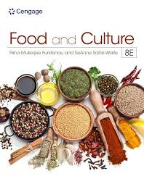
REFERENCES
1. 6. Harrington, R. J. (2005). Defining gastronomic identity: The impact of environment and culture on prevailing components, texture and flavors in wine and food. Journal of culinary science & technology, 4(2-3), 129-152.
7. Kulshrestha, R. (2025). Changing Tastes: How Globalization Is Shaping Regional Cuisines-Culinary Innovation and Fusion Cuisine, Variety, and Availability of Ingredients. In Global Sustainable Practices in Gastronomic Tourism (pp. 231-242). IGI Global Scientific Publishing.
8. Maffei, M. C. (2012). Culinary traditions as cultural intangible heritage and expressions of cultural diversity. In Cultural Heritage, Cultural Rights, Cultural Diversity (pp. 223-249). Brill Nijhoff.
NAVAL COMMUNICATIONS
COOKING DISHES FROM DIFFERENT CULTURES

