Slide 1





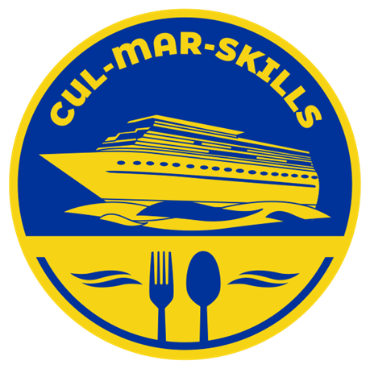


MARitime Soft Skills for Onboard Healthy Nutrition and CULinary Arts in Seagoing Services – CUL-MAR-Skills
KA220-VET - Cooperation partnerships in vocational education and training
2023-1-RO01-KA220-VET-000156711
ONBOARD COOKING SKILLS
Week VI
Optimizing Flavor and Nutrition in Cooking Onboard
Disclaimer: “Funded by the European Union. Views and opinions expressed are however those of the author(s) only and do not necessarily reflect those of the European Union or the ANPCDEFP. Neither the European Union nor the ANPCDEFP can be held responsible for them”

Slide 2
Learning outcomes of the course
Identify healthy ingredients and explain how they can be used to enhance the natural flavors of meals prepared at sea.
Demonstrate effective use of seasoning, herbs, and spices to create balanced, flavorful dishes without relying on excessive salt, sugar, or fat.
Apply cooking methods such as steaming, grilling, and sautéing that preserve nutritional value while maintaining taste and texture.
Prepare meals that are not only nutritious and flavorful but also visually appealing, using efficient techniques suited to maritime kitchens.
Evaluate the impact of cooking choices on both nutritional outcomes and crew wellbeing, recognizing the role of food in maintaining morale and performance at sea.
NAVAL COMMUNICATIONS
OPTIMIZING FLAVOR AND NUTRITION IN COOKING ONBOARD

Slide 3
Content of the course
ENHANCING THE FLAVOR OF NUTRITIOUS MEALS USING HEALTHY INGREDIENTS
SEASONING, HERBS, AND SPICES IN PROMOTING BALANCED FLAVORS
RETAINING NUTRITIONAL VALUE (e.g., steaming, grilling)
HOW TO PREPARE TASTY, VISUALLY APPEALING, & NUTRITIOUS MEALS ONBOARD
OPTIMIZING FLAVOR AND NUTRITION IN COOKING ONBOARD

Slide 4
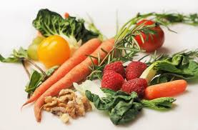
ENHANCING THE FLAVOR OF NUTRITIOUS MEALS USING HEALTHY INGREDIENTS
Enhancing flavor while maintaining nutrition is a cornerstone of successful maritime cooking. With limited space, storage, and ingredients at sea, it is essential to make the most of healthy foods by preparing them in ways that are both satisfying and nourishing. Rather than relying on excess salt, sugar, or fats, cooks can draw out natural tastes and aromas through smart preparation methods. The following techniques highlight practical and creative approaches that elevate the flavor of nutritious meals, ensuring that food remains enjoyable, balanced, and restorative for those on board.
OPTIMIZING FLAVOR AND NUTRITION IN COOKING ONBOARD

Slide 5
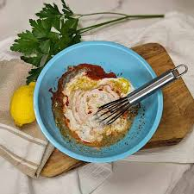
ENHANCING THE FLAVOR OF NUTRITIOUS MEALS USING HEALTHY INGREDIENTS
1. Caramelization and Browning
Using dry-heat methods (roasting, searing, grilling) allows natural sugars in vegetables, fish, and meats to caramelize, creating deeper, richer flavors without added fats or sugars.
2. Marinating with Citrus, Herbs, and Yogurt
Lemon, lime, vinegar, or yogurt-based marinades tenderize proteins and infuse them with fresh, tangy flavors. Herbs and spices in the marinade add complexity without excess salt.
OPTIMIZING FLAVOR AND NUTRITION IN COOKING ONBOARD

Slide 6
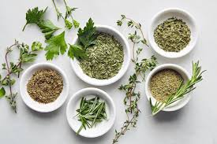
ENHANCING THE FLAVOR OF NUTRITIOUS MEALS USING HEALTHY INGREDIENTS
3. Layering Flavors
Building dishes step by step—starting with aromatics like onions, garlic, or ginger, then adding spices, and finally fresh herbs—creates depth and balance in otherwise simple meals.
4. Using Fresh and Dried Herbs
Fresh herbs like parsley, cilantro, or basil brighten flavors, while dried herbs (oregano, thyme, rosemary) add warmth and richness. Combining both can bring out complexity.
OPTIMIZING FLAVOR AND NUTRITION IN COOKING ONBOARD

Slide 7
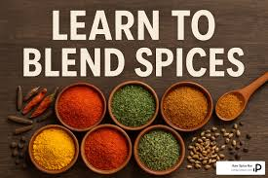
ENHANCING THE FLAVOR OF NUTRITIOUS MEALS USING HEALTHY INGREDIENTS
5. Spice Blends and Toasting Spices
Toasting whole spices or spice blends before use intensifies aroma and flavor. This reduces the need for heavy sauces or added salt.
6. Natural Flavor Boosters
Ingredients like garlic, ginger, chili, citrus zest, and fermented foods (e.g., soy sauce, miso, yogurt) can add bold tastes while also offering health benefits.
OPTIMIZING FLAVOR AND NUTRITION IN COOKING ONBOARD

Slide 8

ENHANCING THE FLAVOR OF NUTRITIOUS MEALS USING HEALTHY INGREDIENTS
7. Healthy Stocks and Broths
Vegetable, fish, or lean chicken broths made from scratch provide a rich base for soups, stews, and grains without relying on bouillon cubes high in sodium.
8. Acid Balance
Adding a splash of vinegar or citrus juice at the end of cooking brightens dishes and balances richness, making meals taste fresher.
OPTIMIZING FLAVOR AND NUTRITION IN COOKING ONBOARD

Slide 9
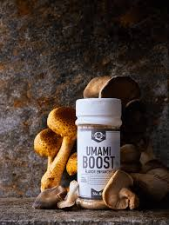
ENHANCING THE FLAVOR OF NUTRITIOUS MEALS USING HEALTHY INGREDIENTS
9. Texture Contrast
Pairing crunchy elements (nuts, seeds, crisp vegetables) with softer foods enhances the eating experience and makes dishes more satisfying without extra fat or salt.
10. Umami Enhancement
Nutrient-rich foods like mushrooms, tomatoes, seaweed, or aged cheeses (in moderation) naturally boost savory depth, reducing the need for less healthy flavor enhancers.
OPTIMIZING FLAVOR AND NUTRITION IN COOKING ONBOARD

Slide 10
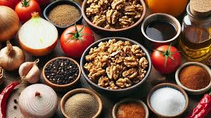
FLAVOR-ENHANCING TECHNIQUES WITH HEALTHY INGREDIENTS
Incorporating flavor-enhancing techniques when cooking with healthy ingredients offers a practical way to make nutritious meals more appealing without compromising their health benefits. By using methods such as seasoning, marinating, roasting, or pairing complementary flavors, natural ingredients can be transformed into satisfying dishes that encourage healthier eating habits. These techniques not only improve taste and texture but also help reduce reliance on excessive salt, sugar, or unhealthy fats, making it easier to enjoy wholesome foods as part of a balanced lifestyle.
OPTIMIZING FLAVOR AND NUTRITION IN COOKING ONBOARD

Slide 11
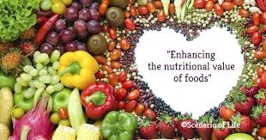
FLAVOR-ENHANCING TECHNIQUES WITH HEALTHY INGREDIENTS
Improved Nutritional Quality
By replacing excess salt, sugar, and unhealthy fats with herbs, spices, and fresh ingredients, cooks ensure that meals remain nutrient-dense and supportive of health. This approach reduces the risk of diet-related illnesses such as high blood pressure or obesity, while still keeping food enjoyable and satisfying for the crew.
Enhanced Taste and Satisfaction
When meals are prepared with techniques that highlight natural flavors—such as roasting vegetables for caramelization or using bright citrus marinades—they become far more enjoyable. This satisfaction makes crew members less likely to crave unhealthy condiments or processed flavor enhancers, fostering healthier eating habits.
OPTIMIZING FLAVOR AND NUTRITION IN COOKING ONBOARD

Slide 12
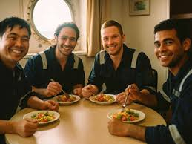
FLAVOR-ENHANCING TECHNIQUES WITH HEALTHY INGREDIENTS
Better Crew Morale and Wellbeing
Food plays a central role in maintaining morale at sea. Nutritious meals that taste good boost energy, improve mood, and create a sense of comfort, which is especially important during long and demanding voyages. A flavorful meal can serve as a much-needed source of motivation and relief for the entire crew.
Preservation of Nutrients
Healthy cooking methods such as steaming, grilling, and light sautéing allow ingredients to retain much of their vitamins and minerals. This ensures that the nutritional value of fresh or stored foods is not lost in the cooking process, allowing every dish to contribute fully to the crew’s health and endurance.
OPTIMIZING FLAVOR AND NUTRITION IN COOKING ONBOARD

Slide 13

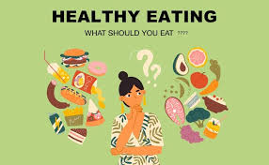
FLAVOR-ENHANCING TECHNIQUES WITH HEALTHY INGREDIENTS
Efficient Use of Ingredients
With limited storage and supply options on board, maximizing the value of each ingredient is crucial. Techniques like layering flavors or making stocks and broths from vegetable trimmings turn simple provisions into rich, satisfying meals, helping cooks stretch resources without sacrificing quality.
Support for Healthy Eating Habits
When healthy food is prepared in a way that tastes delicious, it encourages crew members to consistently choose balanced meals over less nutritious options. Over time, this reinforces positive eating habits that not only benefit health during the voyage but can also carry over into life on shore.
OPTIMIZING FLAVOR AND NUTRITION IN COOKING ONBOARD

Slide 14
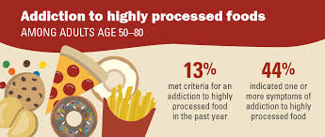
FLAVOR-ENHANCING TECHNIQUES WITH HEALTHY INGREDIENTS
Cultural and Culinary Variety
Herbs and spices drawn from global cuisines—such as turmeric, cumin, rosemary, or chili—bring diversity to otherwise repetitive menus. This culinary variety prevents monotony, introduces new flavors, and makes mealtimes more engaging, all of which are vital to sustaining interest and enjoyment in shipboard dining.
Reduction of Dependency on Processed Additives
Relying on natural flavor enhancers instead of processed bouillons, sauces, or seasonings reduces sodium intake and exposure to artificial ingredients. This not only makes meals healthier but also promotes a cleaner, more authentic taste that highlights the quality of the core ingredients.
OPTIMIZING FLAVOR AND NUTRITION IN COOKING ONBOARD

Slide 15
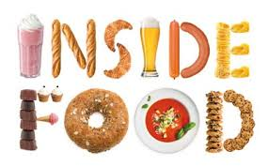
FLAVOR-ENHANCING TECHNIQUES ONBOARD
In the unique environment of ship galleys, the way food is prepared has a significant impact on both the health and morale of the crew. Long voyages and demanding working conditions make it essential to provide meals that are not only nutritious but also enjoyable. By applying flavor-enhancing techniques to healthy ingredients, galley staff can create dishes that support physical well-being while also boosting the overall atmosphere on board (3).
One of the main benefits is the promotion of better health. Nutritious meals that are seasoned and prepared in flavorful ways reduce the need for processed foods, excess salt, sugar, or unhealthy fats. This helps prevent diet-related problems such as fatigue, poor concentration, and long-term health risks, enabling seafarers to perform their duties effectively.
OPTIMIZING FLAVOR AND NUTRITION IN COOKING ONBOARD

Slide 16
FLAVOR-ENHANCING TECHNIQUES ONBOARD
Another advantage is the positive effect on morale. Food plays an important role in daily life at sea, and meals that taste good provide comfort and a sense of care. When healthy ingredients are made more appealing, crew members are more satisfied and motivated, which contributes to a more positive onboard environment.
Flavor-enhancing techniques also encourage healthier eating habits. By making vegetables, lean proteins, and whole grains more flavorful, seafarers are more likely to choose these options over less nutritious alternatives. This not only supports consistent energy levels but also helps maintain focus and resilience during long working hours.
Finally, enjoyable meals have a social and psychological impact. Sharing flavorful, well-prepared food strengthens bonds among the crew and provides a sense of normalcy, which is especially valuable in the isolated and demanding conditions of life at sea. Good meals reduce stress, break monotony, and promote a sense of community, all of which are vital for maintaining teamwork and harmony on board.
.
OPTIMIZING FLAVOR AND NUTRITION IN COOKING ONBOARD

Slide 17
FLAVOR-ENHANCING TECHNIQUES ONBOARD
Another advantage is the positive effect on morale. Food plays an important role in daily life at sea, and meals that taste good provide comfort and a sense of care. When healthy ingredients are made more appealing, crew members are more satisfied and motivated, which contributes to a more positive onboard environment.
Flavor-enhancing techniques also encourage healthier eating habits. By making vegetables, lean proteins, and whole grains more flavorful, seafarers are more likely to choose these options over less nutritious alternatives. This not only supports consistent energy levels but also helps maintain focus and resilience during long working hours.
Finally, enjoyable meals have a social and psychological impact. Sharing flavorful, well-prepared food strengthens bonds among the crew and provides a sense of normalcy, which is especially valuable in the isolated and demanding conditions of life at sea. Good meals reduce stress, break monotony, and promote a sense of community, all of which are vital for maintaining teamwork and harmony on board.
.
OPTIMIZING FLAVOR AND NUTRITION IN COOKING ONBOARD

Slide 18
FLAVOR-ENHANCING TECHNIQUES ONBOARD
BENEFITS FOR THE CREW
Supports Mental Health
Boosts Morale and Satisfaction
Encourages Healthy Eating Habits
Enhances Efficiency in Meal Preparation
Promotes Crew Health and Wellbeing
Improves Team Cohesion
Figure 1. Benefits of Using Flavor-Enhancing Techniques
OPTIMIZING FLAVOR AND NUTRITION IN COOKING ONBOARD

Slide 19
THE BENEFITS OF SAILORS’ EATING THEIR FAVORITE FOODS
Sailors spending extended periods at sea often face physical and psychological challenges due to the demanding nature of their work and the isolation of life onboard. Providing opportunities for them to enjoy their favorite foods offers more than simple pleasure; it plays an important role in maintaining health, morale, and efficiency during long-term duties (4, 5).
One of the most significant benefits is the psychological comfort that favorite foods provide. Familiar dishes evoke memories of home and family, which can ease feelings of homesickness. For example, a sailor from the Philippines may feel comforted when adobo or pancit is served, as these dishes remind them of family gatherings. An Indian seafarer might find relaxation in tasting a fragrant curry with rice, while a Greek crew member may feel uplifted when enjoying a traditional moussaka or a simple plate of olives, bread, and feta cheese. These familiar flavors create a sense of belonging and continuity with home life, helping sailors cope better with the emotional strain of long voyages.
OPTIMIZING FLAVOR AND NUTRITION IN COOKING ONBOARD

Slide 20
THE BENEFITS OF SAILORS’ EATING THEIR FAVORITE FOODS
Favorite foods also play a vital role in boosting morale and motivation. Meals are often the highlight of the day onboard, and the anticipation of a dish one enjoys can lift spirits. A sailor from Latin America may find joy in eating arroz con pollo (chicken with rice) or empanadas, while an Italian seafarer may feel content when pasta with tomato sauce or risotto appears on the menu. Even something as simple as freshly baked bread, pizza night, or a slice of chocolate cake can transform the mood of the entire crew. These shared moments of enjoyment foster camaraderie, teamwork, and a stronger sense of community.
In addition, offering favorite foods can encourage sailors to maintain healthy eating habits and ensure better nutrition. On long voyages, repetitive or unfamiliar meals can sometimes reduce appetite, leading to skipped meals and low energy. When familiar favorites are included, sailors are more likely to eat well. For example, a Japanese crew member may feel more inclined to eat when miso soup or sushi rice is available, while a Turkish sailor might eagerly enjoy lentil soup or kebabs. These culturally familiar meals not only satisfy individual tastes but also ensure that sailors get the nourishment and energy needed for physically demanding tasks at sea.
OPTIMIZING FLAVOR AND NUTRITION IN COOKING ONBOARD

Slide 21
THE BENEFITS OF SAILORS’ EATING THEIR FAVORITE FOODS
Finally, incorporating favorite foods into meal planning demonstrates care and attentiveness from galley staff and ship management. Preparing a Filipino-style fiesta meal, offering Mediterranean specialties such as hummus or falafel for Middle Eastern sailors, or celebrating cultural holidays with traditional desserts like gulab jamun for Indian crew or tres leches cake for Latin Americans shows respect for cultural diversity. These thoughtful gestures strengthen the bond between the crew and leadership, reinforcing trust, loyalty, and overall job satisfaction. (6, 7).
In short, favorite foods do more than satisfy hunger: they bring comfort, foster unity, encourage healthy eating, and show respect for cultural identities. Together, these benefits contribute to sailors’ physical wellbeing and mental resilience, which are essential for maintaining high morale and effective teamwork during long-term duties at sea.
OPTIMIZING FLAVOR AND NUTRITION IN COOKING ONBOARD

Slide 22
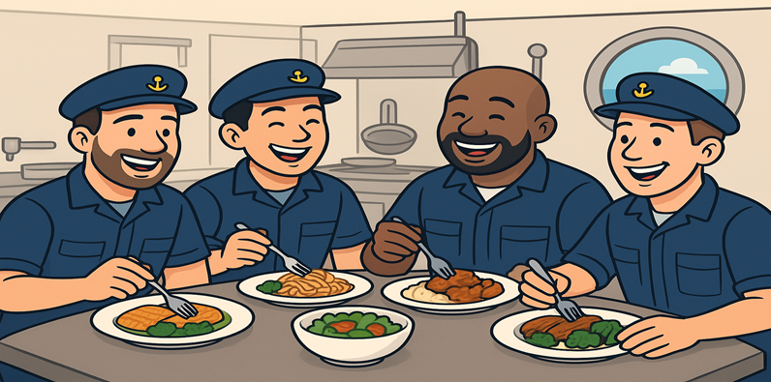
THE BENEFITS OF SAILORS’ EATING THEIR FAVORITE FOODS
In short, favorite foods do more than satisfy hunger: they bring comfort, foster unity, encourage healthy eating, and show respect for cultural identities. Together, these benefits contribute to sailors’ physical wellbeing and mental resilience, which are essential for maintaining high morale and effective teamwork during long-term duties at sea.
OPTIMIZING FLAVOR AND NUTRITION IN COOKING ONBOARD

Slide 23
SEASONING, HERBS, AND SPICES IN PROMOTING BALANCED FLAVORS
Seasoning, herbs, and spices play a crucial role in promoting balanced flavors in cooking. Seasoning, such as salt and pepper, enhances the natural taste of ingredients. Salt can amplify sweetness, reduce bitterness, and intensify overall flavor, making the dish more harmonious. For example, a pinch of salt in a fresh tomato salad can bring out the tomatoes’ natural sweetness, while a dash of pepper can add a subtle kick that complements the freshness. These basic seasonings provide a foundation upon which all other flavors can build.
Herbs and spices add depth and complexity to dishes, turning simple ingredients into multidimensional meals. Herbs like basil, rosemary, thyme, and parsley contribute fresh and aromatic notes, while spices such as cumin, cinnamon, paprika, and turmeric provide warmth, heat, and a variety of flavor layers. For instance, in a classic Italian pasta sauce, oregano and basil enhance the tomato’s natural flavor, while garlic adds savory depth. Similarly, in Indian cuisine, a combination of cumin, coriander, and turmeric transforms lentils into a flavorful dal, each spice contributing to a balanced and rich taste. Even a simple roasted chicken can be elevated with rosemary and thyme, giving the meat a fragrant and savory complexity.
OPTIMIZING FLAVOR AND NUTRITION IN COOKING ONBOARD

Slide 24
SEASONING, HERBS, AND SPICES IN PROMOTING BALANCED FLAVORS
Balancing flavors is another essential function of herbs and spices. A well-rounded dish typically incorporates a mix of sweet, sour, salty, bitter, and umami tastes, and herbs and spices help to achieve this balance. Acidic herbs, like tarragon or lemon balm, brighten dishes and reduce heaviness, while sweet spices, such as cinnamon or nutmeg, can soften bitterness or add warmth to a savory dish. Bitter herbs like rosemary or sage counterbalance rich or fatty foods, creating a pleasing harmony. For example, adding a squeeze of lemon and a sprinkle of fresh herbs to a creamy pasta dish can lighten the richness and make the flavors more balanced.
Aromatics from herbs and spices also enhance the sensory appeal of food. The smell of fresh herbs sizzling in a pan or spices toasting before cooking stimulates the appetite and increases enjoyment. Since taste and smell are closely linked, the aroma of rosemary in roasted potatoes or basil in a tomato soup can make these dishes feel more complex and satisfying, even if the ingredients themselves are simple.
OPTIMIZING FLAVOR AND NUTRITION IN COOKING ONBOARD

Slide 25
SEASONING, HERBS, AND SPICES IN PROMOTING BALANCED FLAVORS
Moreover, herbs and spices carry cultural and emotional significance. They often define a cuisine’s identity, such as cilantro in Mexican dishes, basil in Italian cuisine, or cumin in Middle Eastern recipes. This connection to tradition and culture adds layer of appreciation for the flavors. Using herbs and spices also allows cooks to reduce reliance on salt, sugar, or fat without compromising taste, promoting healthier cooking while maintaining flavorful dishes. For example, a curry can be rich and aromatic with a blend of spices like turmeric, ginger, and garam masala, requiring minimal additional salt or fat.
In summary, seasoning, herbs, and spices are essential for creating flavorful, balanced, and aromatic dishes. They enhance natural flavors, add complexity, balance taste elements, and provide cultural and emotional depth. Through examples like tomato salads, pasta sauces, roasted meats, and curries, it is clear that the thoughtful use of these flavoring agents transforms simple ingredients into cohesive, enjoyable, and memorable culinary experiences (8).
OPTIMIZING FLAVOR AND NUTRITION IN COOKING ONBOARD

Slide 26
SPICES AND SEAFARERS
Seafarers faced long voyages with limited access to fresh food, which made nutrition and health a critical concern. Certain spices were highly valued for their ability to promote strength, preserve food, and prevent illnesses. Here’s a breakdown.
Pepper
One of the most commonly used spices on ships.
It helps stimulate digestion and can improve appetite, which is essential when food becomes bland or stale.
Also believed to have mild antimicrobial properties that could reduce spoilage in stored foods.
Ginger
Known for preventing seasickness, which was a major problem for sailors.
Ginger improves circulation and digestion, helping maintain energy levels on long voyages.
It also has anti-inflammatory and immune-supporting properties.
OPTIMIZING FLAVOR AND NUTRITION IN COOKING ONBOARD

Slide 27
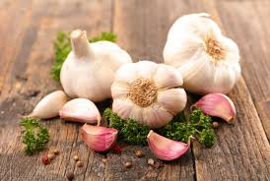
SPICES AND SEAFARERS
Cloves
Used as a preservative and for fighting infections due to their antiseptic properties.
Cloves can also help relieve digestive discomfort, keeping seafarers healthier when fresh produce was scarce.
Cinnamon
Has antimicrobial properties and can help preserve foods.
Supports digestion and helps maintain energy, which was crucial during long periods at sea.
Garlic
Valued for its immune-boosting effects, protecting sailors from infections.
Can also act as a natural preservative in certain dishes.
OPTIMIZING FLAVOR AND NUTRITION IN COOKING ONBOARD

Slide 28
SPICES AND SEAFARERS
Nutmeg and Mace
These were considered tonics, believed to strengthen the body and provide warmth in cold, damp conditions aboard ships.
They also add flavor to monotonous rations, improving appetite.
Turmeric
Known for its anti-inflammatory and digestive benefits.
Can help maintain overall health when fresh vegetables are scarce.
In summary, spices like ginger, cloves, cinnamon, pepper, garlic, nutmeg, and turmeric were not only used to flavor food but also to preserve it, aid digestion, prevent seasickness, and support overall health. Their combined effects helped seafarers stay stronger, healthier, and more resilient during long, demanding voyages.
OPTIMIZING FLAVOR AND NUTRITION IN COOKING ONBOARD

Slide 29
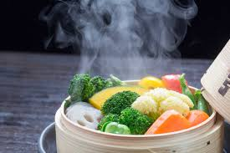
RETAINING NUTRITIONAL VALUE (e.g. steaming, grilling)
Retaining the nutritional value of food during cooking is essential to maximize the health benefits of the ingredients. Different cooking methods affect vitamins, minerals, and other nutrients differently. Here’s a detailed explanation of effective methods:
1. Steaming
How it works: Food is cooked using steam from boiling water without direct contact with water.
Nutritional benefits: Steaming preserves water-soluble vitamins (like vitamin C and B vitamins) and minerals because the food is not submerged in water where nutrients can leach out.
Example: Steaming broccoli or carrots keeps them crisp and nutrient-rich.
OPTIMIZING FLAVOR AND NUTRITION IN COOKING ONBOARD

Slide 30
RETAINING NUTRITIONAL VALUE (e.g. steaming, grilling)
2. Grilling
How it works: Food is cooked over direct heat, usually on a grill.
Nutritional benefits: Grilling can preserve fat-soluble vitamins (A, D, E, K) and reduces the need for added fats. Excess fat from meats drips away, making the food healthier.
Example: Grilled chicken or fish retains protein quality and flavor without needing heavy oils.
3. Microwaving
How it works: It uses electromagnetic waves to heat water molecules in food quickly.
Nutritional benefits: Quick cooking minimizes nutrient loss, especially vitamin C and other heat-sensitive vitamins. Minimal water usage also prevents leaching.
Example: Microwaving spinach or green beans keeps them tender and nutrient-rich.
OPTIMIZING FLAVOR AND NUTRITION IN COOKING ONBOARD

Slide 31
RETAINING NUTRITIONAL VALUE (e.g. steaming, grilling)
4. Sautéing/Stir-Frying
How it works: Food is cooked quickly in a small amount of healthy oil at moderate heat.
Nutritional benefits: Short cooking time reduces nutrient loss, and using oils like olive or canola can help the absorption of fat-soluble vitamins.
Example: Stir-fried vegetables maintain crunchiness and vitamin content.
5. Poaching
How it works: Food is gently cooked in simmering water or broth at low temperatures.
Nutritional benefits: Gentle heat preserves delicate nutrients and proteins, and using broth instead of water can retain minerals.
Example: Poached eggs or fish retain their protein quality and essential nutrients.
OPTIMIZING FLAVOR AND NUTRITION IN COOKING ONBOARD

Slide 32
RETAINING NUTRITIONAL VALUE (e.g. steaming, grilling)
6. Blanching
How it works: Food is briefly boiled or steamed, then immediately cooled in ice water.
Nutritional benefits: Stops enzyme activity that can degrade nutrients and color. This is especially useful before freezing vegetables.
Example: Blanching green beans before freezing preserves vitamins and texture.
Tips to Maximize Nutrient Retention:
Use minimal water and short cooking times.
Cook with lids on pots to trap steam and heat.
Cut food into larger pieces to reduce the surface area exposed to heat.
Avoid overcooking, which destroys heat-sensitive vitamins.
OPTIMIZING FLAVOR AND NUTRITION IN COOKING ONBOARD

Slide 33
PRACTICAL COOKING METHODS, SPECIALLY USED ONBOARD SHIPS
Steaming
Feasible: Steam can be generated using onboard boilers or large cooking pots.
Limitations: Requires enough fuel and equipment; may be more common on modern ships than historical ones.
Grilling
Feasible in some cases: On larger ships with galley grills or open fires.
Limitations: Open flames can be dangerous, and wind or space constraints may make it difficult.
Microwaving
Only on modern ships: Historical ships didn’t have this option. Modern vessels with electricity can use microwaves efficiently.
Sautéing/Stir-Frying
Feasible: Can be done in pans over stoves or small burners.
Limitations: Requires oil and careful heat control to avoid smoke or fire hazards.
OPTIMIZING FLAVOR AND NUTRITION IN COOKING ONBOARD

Slide 34
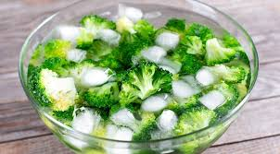
PRACTICAL COOKING METHODS, SPECIALLY USED ONBOARD SHIPS
Poaching
Feasible: Simple to do in a pot of simmering water.
Advantages: Doesn’t require high heating or complex equipment, making it ideal for ships.
Blanching
Feasible: Can be done in boiling water followed by cooling in stored water or ice.
Limitations: Requires ice or very cold water for the cooling step, which might be limited on older ships.
OPTIMIZING FLAVOR AND NUTRITION IN COOKING ONBOARD

Slide 35
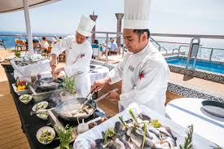
PRACTICAL COOKING METHODS, SPECIALLY USED ONBOARD SHIPS
Key Takeaways:
Most practical for historical ships: Poaching, boiling/steaming, and sautéing.
Modern ships can use microwaving and more controlled grilling.
Safety, fuel, and equipment limitations were the main constraints at sea.
Even with limited methods, careful cooking could help retain nutrients and improve sailors’ health.
In the following lines, a guide for cooking methods, nutrient retention, and historical seafaring practices can be found.
OPTIMIZING FLAVOR AND NUTRITION IN COOKING ONBOARD

Slide 36
HOW TO PREPARE TASTY, VISUALLY APPEALING, & NUTRITIOUS MEALS ONBOARD
Creating practice sessions for preparing meals that are delicious, visually appealing, and nutritious requires planning, structure, and repetition. To make the most of these sessions, it helps to set clear goals, follow a structured process, and build skills progressively.
The first step is to define clear objectives. Decide what you want to achieve during each session. For example, you might aim to improve knife skills and presentation, learn to balance flavors and textures, or focus on nutrient retention while cooking efficiently. Objectives should be measurable, such as preparing three colorful, balanced meals in under 45 minutes.
OPTIMIZING FLAVOR AND NUTRITION IN COOKING ONBOARD

Slide 37
HOW TO PREPARE TASTY, VISUALLY APPEALING, & NUTRITIOUS MEALS ONBOARD
Once your goals are set, plan the menu strategically. Incorporate a variety of cooking techniques like steaming, sautéing, grilling, or poaching. Aim for balance by including proteins, carbohydrates, healthy fats, and plenty of vegetables or fruits. Consider visual appeal as well—use a mix of leafy greens, bright vegetables, and contrasting textures. Start with simple recipes and gradually add more complexity as your confidence and skill grow.
Preparation is key to efficient cooking, so gather and organize ingredients in advance. This might include pre-measuring spices and oils, washing and chopping vegetables, and storing ingredients properly to maintain freshness and nutrients. Having everything ready will help streamline the cooking process.
OPTIMIZING FLAVOR AND NUTRITION IN COOKING ONBOARD

Slide 38
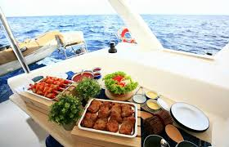
HOW TO PREPARE TASTY, VISUALLY APPEALING, & NUTRITIOUS MEALS ONBOARD
During cooking, focus on efficiency. Use multitasking strategies, such as boiling water while chopping vegetables or preheating the oven while preparing protein. Group similar tasks together—for instance, steaming multiple vegetables at once. Keep track of how long each step takes to identify where you can improve your time management.
Presentation also plays a big role in making meals appealing. Choose plates or bowls that highlight color contrasts and arrange portions with balance—protein, grains, and vegetables should look harmonious on the plate. Simple garnishes like fresh herbs, seeds, or a drizzle of sauce can elevate the look of your dish.
OPTIMIZING FLAVOR AND NUTRITION IN COOKING ONBOARD

Slide 39
HOW TO PREPARE TASTY, VISUALLY APPEALING, & NUTRITIOUS MEALS ONBOARD
As you cook, remember to taste and adjust. Sampling at each stage helps you balance salt, spices, and acidity. Make adjustments gradually, since it’s easier to add flavor than to fix an over-seasoned dish. After the meal, take time to evaluate and reflect. Photograph your dishes for visual feedback, note what worked well, and record areas that need improvement. Pay attention to how your cooking methods affect nutrition, such as using steaming instead of boiling to preserve vitamins.
Finally, repeat sessions and build complexity over time. Introduce new ingredients, techniques, or plating styles to keep challenging yourself. You can also set themed sessions, such as “Mediterranean Meal Night,” “Protein-Packed Lunches,” or “Vegetarian Colorful Plates.” Work on efficiency by gradually reducing prep and cooking time without sacrificing nutrition or presentation. Keeping a cooking journal is a great way to track favorite flavor combinations, plating ideas, and nutrient-conscious methods. For further inspiration, watch tutorials on plating and seasoning strategies to refine your skills.
OPTIMIZING FLAVOR AND NUTRITION IN COOKING ONBOARD

Slide 40
REFERENCES
Chen, X., Zhang, W., Quek, S. Y., & Zhao, L. (2023). Flavor–food ingredient interactions in fortified or reformulated novel food: Binding behaviors, manipulation strategies, sensory impacts, and future trends in delicious and healthy food design. Comprehensive Reviews in Food Science and Food Safety, 22(5), 4004-4029.
Hossain, M. S., Wazed, M. A., Asha, S., Hossen, M. A., Fime, S. N. M., Teeya, S. T., ... & Shimul, I. M. (2025). Flavor and Well‐Being: A Comprehensive Review of Food Choices, Nutrition, and Health Interactions. Food Science & Nutrition, 13(5), e70276.
Vasilaki, A., Panagiotopoulou, E., Koupantsis, T., Katsanidis, E., & Mourtzinos, I. (2022). Recent insights in flavor-enhancers: Definition, mechanism of action, taste-enhancing ingredients, analytical techniques and the potential of utilization. Critical reviews in food science and nutrition, 62(32), 9036-9052.
OPTIMIZING FLAVOR AND NUTRITION IN COOKING ONBOARD

Slide 41
REFERENCES
4. Khapekar, S., Jadhav, R., Jadhav, S., & Ahire, R. (2025). FLAVOUR FUSION: A SMART MEAL PLANNING SYSTEM.
5. Jeżewska, M., Babicz-Zielińska, E., Leszczyńska, I., & Grubman, M. (2009). Promotion of healthy nutrition of seafarers. International maritime health, 60(1-2), 48-50.
6. Neumann, F. (2019). Nutritional status, dietary intake and factors influencing the eating behavior of seafarers working on merchant vessels: results from the “e-healthy ship” cross-sectional study (Doctoral dissertation, Hochschule für angewandte Wissenschaften Hamburg).
7. Hjarnoe, L., & Leppin, A. (2014). What does it take to get a healthy diet at sea? A maritime study of the challenges of promoting a healthy lifestyle at the workplace at sea. International Maritime Health, 65(2), 79-86.
OPTIMIZING FLAVOR AND NUTRITION IN COOKING ONBOARD

Slide 42
REFERENCES
8. Zyriax, B. C., von Katzler, R., Jagemann, B., Westenhoefer, J., Jensen, H. J., Harth, V., & Oldenburg, M. (2018). Food offerings on board and dietary intake of European and Kiribati seafarers: cross-sectional data from the seafarer nutrition study. Journal of occupational medicine and toxicology, 13(1), 9.
OPTIMIZING FLAVOR AND NUTRITION IN COOKING ONBOARD

