Slide 1





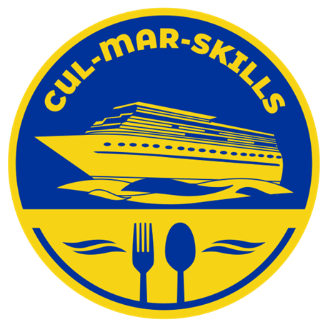


MARitime Soft Skills for Onboard Healthy Nutrition and CULinary Arts in Seagoing Services – CUL-MAR-Skills
KA220-VET - Cooperation partnerships in vocational education and training
2023-1-RO01-KA220-VET-000156711
ONBOARD COOKING SKILLS
Week I –
Introduction to Maritime Culinary Arts
Disclaimer: “Funded by the European Union. Views and opinions expressed are however those of the author(s) only and do not necessarily reflect those of the European Union or the ANPCDEFP. Neither the European Union nor the ANPCDEFP can be held responsible for them”

Slide 2
Learning outcomes of the course
Define and explain the scope of maritime culinary arts and identify the unique challenges of shipboard galleys.
Demonstrate competency in essential culinary skills adapted to limited space, constant motion, and restricted resources at sea.
Plan and design menus that meet the nutritional, cultural, and psychological needs of seafarers on long voyages.
Apply food safety and hygiene standards in compliance with international maritime regulations.
NAVAL COMMUNICATIONS
INTRODUCTION TO MARITIME CULINARY ARTS

Slide 3
Learning outcomes of the course
5. Collaborate effectively within multicultural galley teams, showing strong communication and teamwork skills.
6. Adopt sustainable practices by applying Blue Skills for Green Galleys: portion control, waste reduction, eco-friendly sourcing, and energy efficiency.
7. Reflect on the role of food in enhancing morale, cultural inclusivity, and operational efficiency on board.
NAVAL COMMUNICATIONS
INTRODUCTION TO MARITIME CULINARY ARTS

Slide 4
Content of the course
DEFINITION AND SCOPE OF MARITIME CULINARY ARTS
UNIQUE CHALLENGES OF WORKING IN SHIPBOARD GALLEYS
CORE RESPONSIBILITIES OF GALLEY STAFF
ROLE OF FOOD IN MORALE AND OPERATIONAL EFFICIENCY
NUTRITIONAL REQUIREMENTS
IMPACT OF DIET ON HEALTH, PERFORMANCE, AND SAFETY
PSYCHOLOGICAL AND CULTURAL VALUE OF MEALS IN MARITIME LIFE
MENU PLANNING FOR LONG VOYAGES WITH LIMITED PROVISIONS
SUSTAINABILITY AND WASTE REDUCTION IN MARITIME KITCHENS
REVIEW QUESTIONS TO REINFORCE KEY KNOWLEDGE
REFERENCES FROM ACADEMIC AND PROFESSIONAL SOURCES
INTRODUCTION TO MARITIME CULINARY ARTS

Slide 5
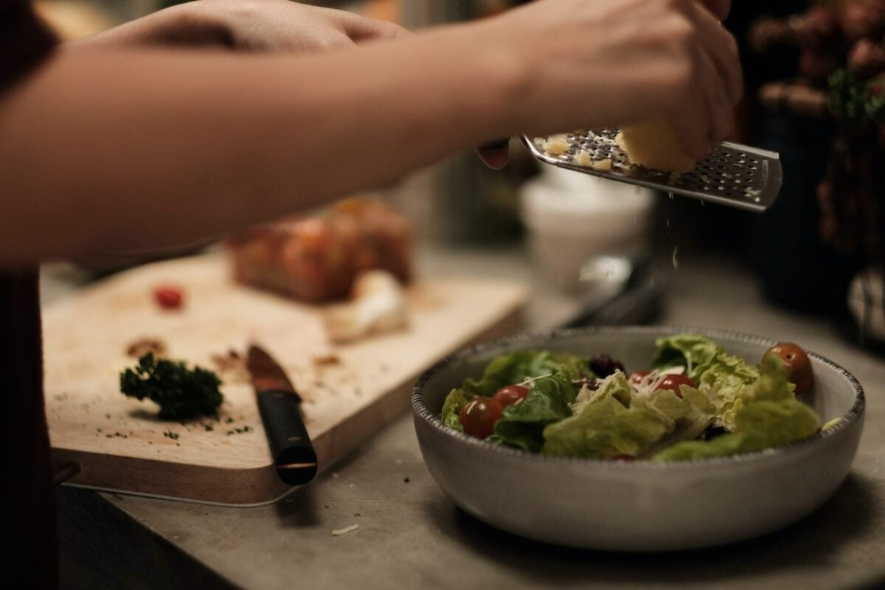
1. COURSE OVERVIEW
Specialized branch of gastronomy at sea.
Integrates food preparation, nutrition, logistics, and safety.
Extends beyond cooking → menu planning, preservation, and cultural inclusivity.
Supports health, morale, and operational success.
INTRODUCTION TO MARITIME CULINARY ARTS

Slide 6
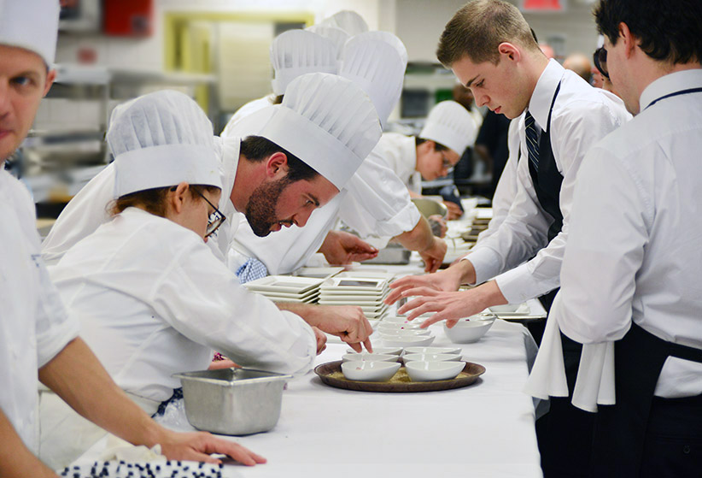
Unique Challenges of a Galley
Working Conditions at Sea
Compact kitchens with restricted space.
Constant ship motion → safety risks, cooking adaptations.
Limited supply chains → reliance on preserved foods.
Strict hygiene standards under international regulations.
Multicultural crews with diverse food needs.
INTRODUCTION TO MARITIME CULINARY ARTS

Slide 7
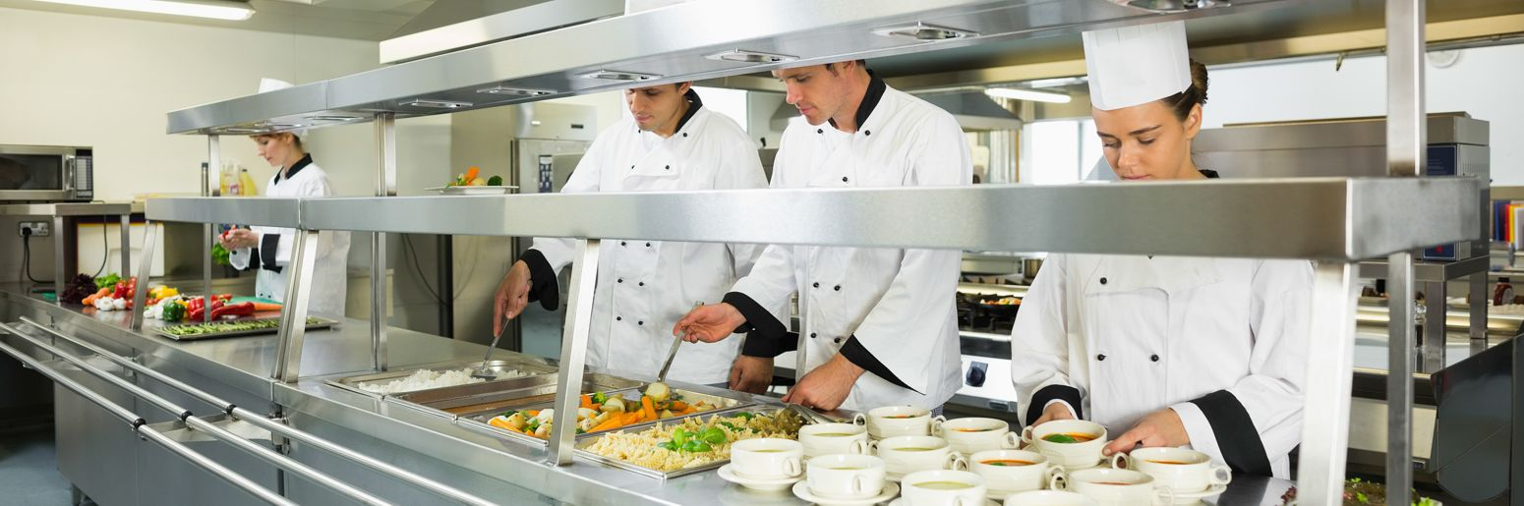
Core Responsibilities of Galley Staff
Key Duties
Prepare and serve meals for crew and passengers.
Design balanced menus for long voyages.
Manage inventory, storage, and food preservation.
Maintain hygiene (HACCP compliance).
Collaborate and problem-solve under pressure.
INTRODUCTION TO MARITIME CULINARY ARTS

Slide 8

Food and Crew Morale
Why Meals Matter
Provide comfort, routine, and stability.
Reduce stress and homesickness.
Strengthen team spirit and unity.
Celebratory meals mark holidays and milestones.
Good food = motivated, focused crew
INTRODUCTION TO MARITIME CULINARY ARTS

Slide 9
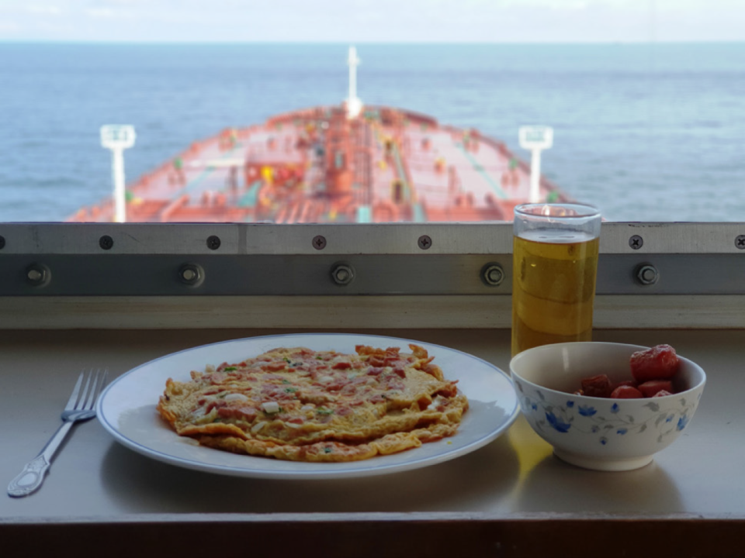
Nutrition for Seafarers
Macronutrients, Micronutrients, Hydration
Carbohydrates: fuel for energy-demanding tasks.
Proteins: muscle repair, immune defense.
Fats: long-term energy, brain function.
Vitamins & minerals: prevent deficiencies (e.g., scurvy, anemia).
Hydration: water, soups, fruits for fluid balance.
CULINARY TECHNIQUES AND MENTORSHIP

Slide 10
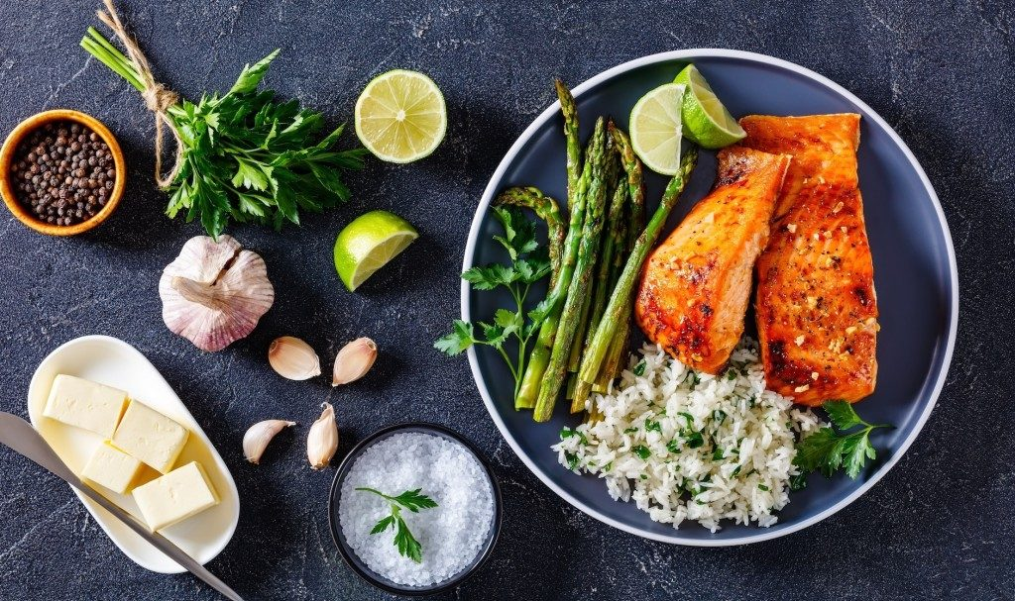
Diet and Health at Sea
Impact on Performance and Safety
Poor diet → fatigue, illness, low concentration.
Balanced diet → better reaction times and fewer accidents.
Nutrition acts as a safety measure, not just comfort.
Well-fed crews maintain operational efficiency.
INTRODUCTION TO MARITIME CULINARY ARTS

Slide 11
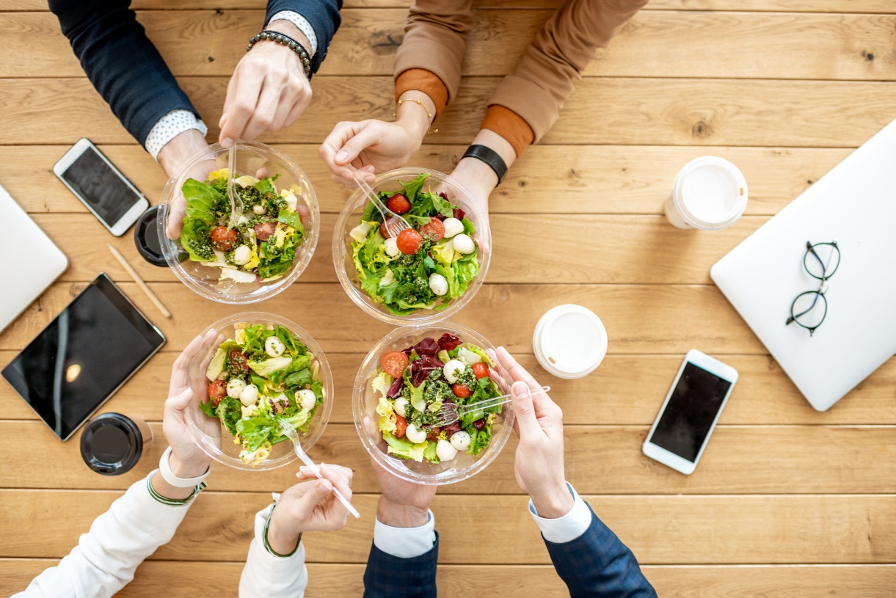
Food Beyond Nutrition
Psychological and Cultural Value
Meals ease isolation and build community.
Mealtime routines = stability in unpredictable life at sea.
Culturally inclusive menus respect diversity.
Shared dining enhances cooperation in multinational crews.
INTRODUCTION TO MARITIME CULINARY ARTS

Slide 12
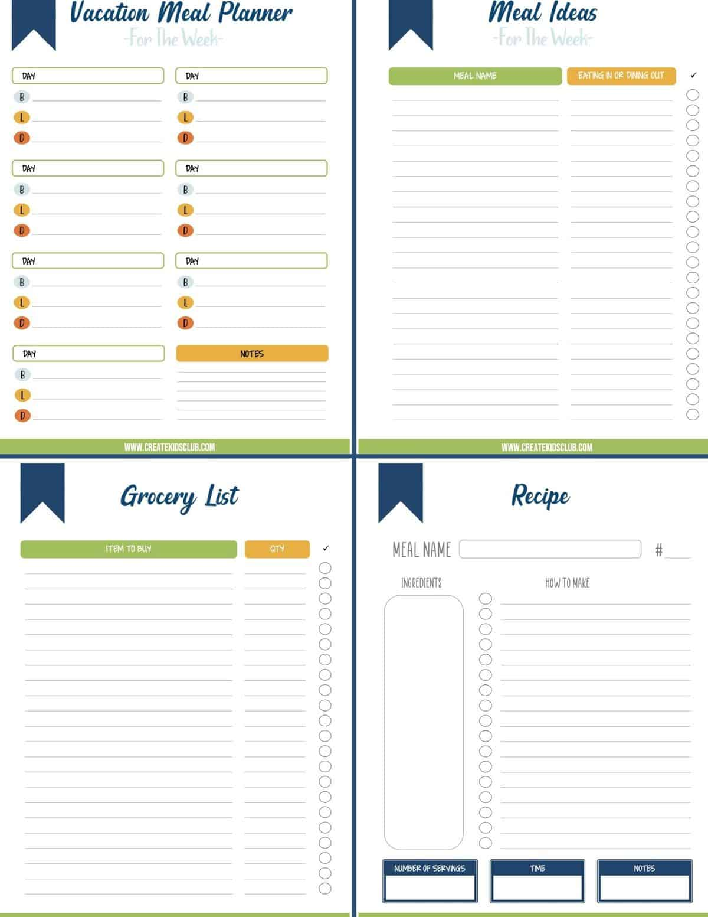
Menu Planning for Voyages
Strategies for Limited Provisions
Use fresh items first, preserved goods later.
Preservation methods: freezing, canning, vacuum-sealing.
Structured menu cycles to avoid monotony.
Adaptability → substitutions when supplies are low.
INTRODUCTION TO MARITIME CULINARY ARTS

Slide 13

Sustainability in Galleys
Eco-Friendly Practices
Portion control to reduce waste.
Reuse leftovers creatively (soups, stews, breads).
Sustainable sourcing and seasonal ingredients.
Waste segregation and recycling onboard.
Nutrition and sustainability work hand in hand.
INTRODUCTION TO MARITIME CULINARY ARTS

Slide 14
REFERENCES
Grappasonni, I., Petrelli, F., Scuri, S., Mahdi, S. S., & Kracmarova, L. (2013). Knowledge and attitudes on food hygiene among ship’s catering staff: Results from an international survey. International Maritime Health, 64(4), 199–204.
Günüşen, N., & Seferoğlu, S. S. (2020). Food and nutrition management on ships: Challenges and best practices. Journal of Maritime Studies, 12(3), 45–59.
International Labour Organization (ILO). (2006). Maritime Labour Convention (MLC 2006). Geneva: ILO.
International Maritime Organization (IMO). (2016). International Convention on Standards of Training, Certification and Watchkeeping for Seafarers (STCW), including the Manila Amendments. IMO Publishing.
International Maritime Organization (IMO). (2017). MARPOL consolidated edition 2017: Articles, protocols, annexes and unified interpretations of the International Convention for the Prevention of Pollution from Ships, 1973, as modified by the 1978 and 1997 Protocols. IMO Publishing.
Oldenburg, M., & Jensen, H. J. (2012). Food and nutrition on board: The neglected safety factor. International Maritime Health, 63(4), 210–216.
Rahman, S., Hasan, M., & Karim, M. (2022). Sustainable food sourcing and waste reduction strategies in maritime catering. Journal of Marine and Island Cultures, 11(2), 85–97.
Sampson, H., & Ellis, N. (2019). Seafarer’s mental health and wellbeing: The role of food and social life at sea. Maritime Policy & Management, 46(7), 861–875.
INTRODUCTION TO MARITIME CULINARY ARTS

