Slide 1
SHIP HANDLING AND MANEUVERING
ANCHORING OF THE SHIP
ROMANIAN NAVAL ACADEMY

Slide 2
The anchor plan
The Ship’s Master/Captain
Offshore Installation Manager
The Officer in Charge of the anchor party
Master of Anchor Handling Vessel
ROMANIAN NAVAL ACADEMY
Notes:
The anchor is a heavy object designed to prevent a ship or structure from drifting from a desired position.
This objective is achieved by lowering the anchor to the sea bed by a length of chain cable or warp. The design of anchors differs to allow, usually, a spade or hook effect into the sea bed.
An anchor plan should be established between the interested parties, namely:
The Ship’s Master/Captain or Offshore Installation Manager, the Officer in Charge of the anchor party, or the Master of Anchor Handling Vessel.

Slide 3
The anchor plan
1. The intended position of anchoring of the vessel.
2. The available swinging room at the intended position.
3. The depth of water at the position, at both High and Low water times.
4. That the defined position is clear of through traffic.
5. That a reasonable degree of shelter is provided at the intended position.
6. The holding ground for the anchor is good and will not lend to ‘dragging’.
7. The position as charted is free of any underwater obstructions.
8. The greatest rate of current in the intended area of the anchorage.
9. The arrival draught of the vessel in comparison with the lowest depth to ensure
adequate underkeel clearance.
10. The choice of anchor(s) to be used.
ROMANIAN NAVAL ACADEMY
Notes:
In the construction of any anchor plan the following items must be worthy of consideration:
The intended position of anchoring of the vessel.
The available swinging room at the intended position.
The depth of water at the position, at both High and Low water times.
That the defined position is clear of through traffic.
That a reasonable degree of shelter is provided at the intended position.
The holding ground for the anchor is good and will not lend to ‘dragging’.
The position as charted is free of any underwater obstructions.
The greatest rate of current in the intended area of the anchorage.
The arrival draught of the vessel in comparison with the lowest depth to ensure
adequate underkeel clearance.
The choice of anchor(s) to be used.

Slide 4
The anchor plan
11. Whether to go to ‘single anchor’ or an alternative mooring.
12. The position of the anchor at point of release.
13. The amount of cable to pay out (scope based on several variables).
14. The ship’s course of approach towards the anchorage position.
15. The ship’s speed of approach towards the anchorage position.
16. Defined positions of stopping engines, and operating astern propulsion
(Single Anchor Operation).
17. Position monitoring systems confirmed.
18. State of tide ebb/flood determined for the time of anchoring.
19. Weather forecast obtained prior to closing the anchorage.
20. Time to engage manual steering established.
ROMANIAN NAVAL ACADEMY
Notes:
Whether to go to ‘single anchor’ or an alternative mooring.
The position of the anchor at point of release.
The amount of cable to pay out (scope based on several variables).
The ship’s course of approach towards the anchorage position.
The ship’s speed of approach towards the anchorage position.
Defined positions of stopping engines, and operating astern propulsion (Single
Anchor Operation).
Position monitoring systems confirmed.
State of tide ebb/flood determined for the time of anchoring.
Weather forecast obtained prior to closing the anchorage.
Time to engage manual steering established.
When anchoring the vessel, it would be the usual practice to have communications
by way of anchor signals prepared for day and/or night scenarios. Port and harbour
authorities may also have to be kept informed if the anchorage is inside harbour
limits or inside national waters.

Slide 5
Bringing the vessel to a single anchor
Fundamental principle of anchoring, is that it is the weight of cable and the lay of the ‘scope’ that anchors the vessel successfully, not just the weight or design of the anchor.
ROMANIAN NAVAL ACADEMY
Notes:
It would be normal procedure for a ship’s master to consider the approach towards an anchorage, and discuss the operation with the Officer in Charge of the anchor party, namely the Chief Officer of the vessel. Probably the most common of all uses of anchors is to bring a vessel into what is known as a ‘single anchor’ where the ship has adequate swinging room to turn about her one anchor position, with the turn of the tide and/or influence of the prevailing weather.
A planned approach to the intended position should be employed with the Master or Marine Pilot holding the ‘con’ of the vessel. The anchor party, on the orders of the Master, should clear away the anchor lashings and ‘walk back’ the intended anchor for use in ample time, before the vessel reaches the anchor position. The readiness of the anchor to be ‘Let Go’ should be communicated to the bridge by the intercom/phone system or ‘Walkie Talkie’ radio.
The Master would turn the vessel into a position of stemming the tide and manoeuvre the ship towards that position where he intends to let go the anchor. By necessity, the ship will still be making ‘headway’ in order to attain this position.
Headway is taken off at this point by using astern propulsion but it will be noticed that sternway will not take an immediate effect. Masters will have to estimate when the vessel is moving astern and this is not always readily observed. One method is to sight the wake from the propeller moving past the midship’s point towards the forward part of the vessel. This is a positive indication that sternway is on the vessel.

Slide 6
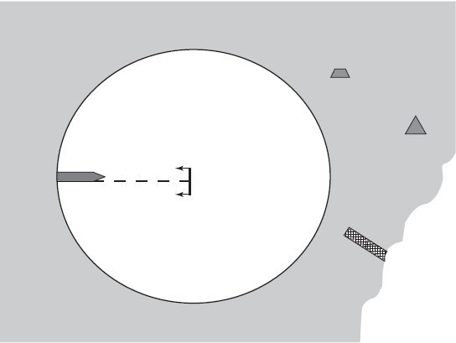
Bringing the vessel to a single anchor
Surface obstructions must be significantly clear of the swinging circle, e.g. piers, buoys, navigation marks, etc.
Swinging room – vessel lying to a single anchor
ROMANIAN NAVAL ACADEMY
Notes:
Once sternway is positively identified on the vessel, and the position of letting go the anchor is achieved, the Master would order the anchor to be released. The astern movement of engines would be reduced to an amount that the anchor cable could be payed out on the windlass brake, as the vessel continues to drop astern, slowly. The Officer in Charge of the anchor party would check the run of cable by using the gypsy braking system in order to achieve a lay of cable length along the sea bed.
The experience of the Master will always influence the amount of anchor cable to be employed for a single anchor operation. Most masters would work on the premise that 4 X Depth of water would be considered as the absolute minimum. The nature of the holding ground, the range and strength of tide, the current and expected weather conditions will all be factors that influence the optimum scope.
Swinging room for a vessel at the single anchor will occur at the maximum scope of cable when at long stay. This circle of swing could be practically reduced by employing two anchors in the form of either a running or standing moor. Although these moorings are not generally common they are suitable when a large swinging circle is not permitted like within a canal or river, where sea room is restricted.

Slide 7
Operational safety when anchoring
Routine operations:
Check that the overside surface area is clear of small craft or other obstructions under the flare of the bow;
Adequate time to walk the anchor back clear of the ‘Hawse Pipe’, prior to actually letting go.
Designated, experienced persons should operate the windlass and braking system.
All parties to the operation should have inter-related communications.
The marine pilot or ship’s Master who has the ‘con’ of the vessel should be continually informed as to the ‘Lead of Cable’ and the number of shackles in use.
All recognition and sound signals should be employed promptly and correctly to highlight the status of the vessel.
ROMANIAN NAVAL ACADEMY
Notes:
Certain precautions when anchoring may seem obvious to the experienced seafarer.
Routine operations should therefore
include the following items:
1. Always check that the overside surface area is clear of small craft or other obstructions under the flare of the bow, at the intended area of letting go the anchor.
2. Routine operations should provide adequate time to walk the anchor back clear of the ‘Hawse Pipe’, prior to actually letting go.
3. Designated, experienced persons should operate the windlass and braking system. They should also be protected by suitable clothing including ‘hard hat’ and ‘eye goggles’.
4. All parties to the operation should have inter-related communications. These should be tested prior to employing the ship’s anchors. In the case of ‘walkietalkie’ radios being used, these should operate on a clearly identified shipboard frequency and seen not to interfere with other local shipping operations.
5. The marine pilot or ship’s Master who has the ‘con’ of the vessel should be continually informed as to the ‘Lead of Cable’ and the number of shackles in use. It would also be expected that the Officer in Charge of the anchor party would keep the bridge informed of any untoward occurrence, e.g. fouled anchor or windlass/power defects.
6. All recognition and sound signals should be employed promptly and correctly to highlight the status of the vessel.

Slide 8
The watch at anchor
Precaution about:
own ship dragging anchor
another ship dragging towards own ship
Watch duties, inclusive of keeping the lookout include monitoring:
the performance of the weather particularly closely;
keeping a listening watch for radio traffic.
ROMANIAN NAVAL ACADEMY
Notes:
It should be clearly understood by any and all watchkeeping personnel, that when the vessel goes to anchor, she is still considered ‘at sea’. As such, an effective and proper lookout must continue to be kept from the navigation bridge.
The officer of the anchor watch will be responsible directly to the ship’s Master for the well being of the ship, and should be familiar with the two greatest dangers, namely: own ship dragging anchor or another ship dragging towards own ship.
In either of these cases the Master would be expected to come to the bridge and take the ‘con’ of the vessel.

Slide 9
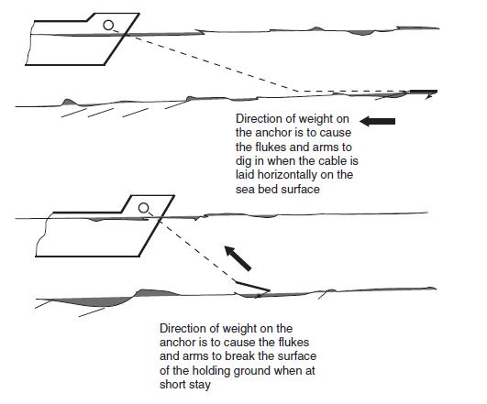
Anchoring principles
ROMANIAN NAVAL ACADEMY
Notes:
The amount of anchor cable employed has always been considered the critical factor when bringing a vessel into an anchorage. The anchor itself acts as a holding point from which the cable can be laid in a line on the sea bed. Ideally, this line should be at a narrow angle from the sea bed to generate a near horizontal direction of pull on the anchor; the position lending to the term ‘Long stay’.
Short stay is usually where the cable is at an acute angle to the surface and such a deployment would have a tendency to pull the anchor upwards, possibly causing it to break its holding of the surface at the sea bed.

Slide 10
Detection of dragging anchor
The movement of the ship may be ascertained by any or all of the following methods:
Check the anchor bearings of the fixed landmarks.
Obtain an immediate positional check from the GPS operation, to ensure that the instrument co-ordinates correspond to the Latitude and Longitude of the ship’s anchored position.
Engage the variable range marker of the ship’s radar on to a fixed land object
Direct observation and hand contact with the anchor cable may give further indication that the ship is dragging its anchor.
ROMANIAN NAVAL ACADEMY
Notes:
One of the fundamental principles of the anchor watch is to ensure that the vessel does not break her anchor out and drag away from the anchor position. To this end, the weather conditions, state of currents and tides should be continuously monitored throughout the watch period.
Normal procedure for the watch officer at anchor would be to regularly verify the ship’s position. Where dragging is suspected, the ship’s position would be expected to change.
The movement of the ship may be ascertained by any or all of the following methods:
- Check the anchor bearings of the fixed landmarks. These references should be retained on the chart during the period of the anchorage; they should also be entered in the ship’s deck logbook. If they are changing, the ship’s position is changing and the vessel must be assumed to be dragging.
- Obtain an immediate positional check from the GPS operation, to ensure that the instrument co-ordinates correspond to the Latitude and Longitude of the ship’s anchored position. Any discrepancy in position, the vessel must be assumed to be dragging its anchor.
- Engage the variable range marker of the ship’s radar on to a fixed land object. If the range between ship and landmark opens or closes then the vessel can be assumed to be dragging its anchor.
- Direct observation and hand contact with the anchor cable may give further indication that the ship is dragging its anchor. A dragging anchor would usually generate excessive vibration through the length of the cable, which could also indicate dragging (depending on the nature of the holding ground).

Slide 11
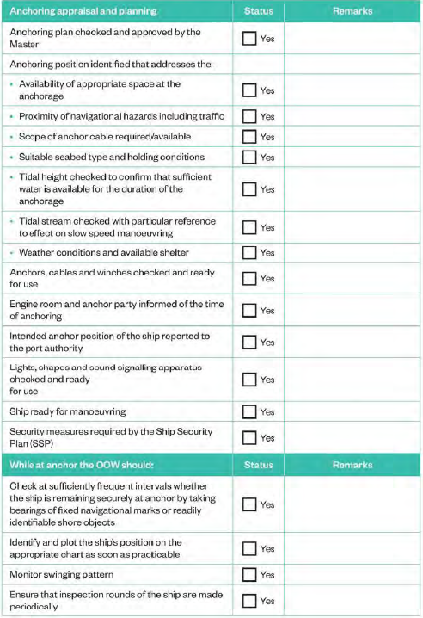
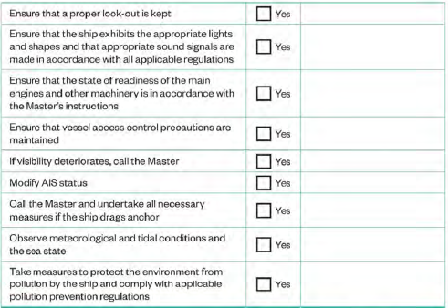
Anchoring and anchor watch checklist
ROMANIAN NAVAL ACADEMY
Notes:
This is an exemple for anchoring and anchor watch checklist

