Slide 1








MARitime Soft Skills for Onboard Healthy Nutrition and CULinary Arts in Seagoing Services – CUL-MAR-Skills
KA220-VET - Cooperation partnerships in vocational education and training
2023-1-RO01-KA220-VET-000156711
VICTUALLING ONBOARD COURSE
Week I-VIII/B
General Review with an Emphasis on Challenges in the Pantry and Digitalization in the Galley
Disclaimer: “Funded by the European Union. Views and opinions expressed are however those of the author(s) only and do not necessarily reflect those of the European Union or the ANPCDEFP. Neither the European Union nor the ANPCDEFP can be held responsible for them”

Slide 2
Learning outcomes of the course
Identify common challenges in pantry management and explain their potential impact on food quality, cost, and efficiency onboard.
Apply strategies to cope with pantry-related challenges, including overstocking, spoilage, and limited storage space.
Explain the principles of risk management in pantry operations, including hazard identification, contingency planning, and inventory control.
Develop a basic pantry risk assessment plan to ensure food availability and safety during normal and disrupted operations.
Explain the Concept of Digitalization in the Maritime Galley Context
NAVAL COMMUNICATIONS
GENERAL REVIEW / CHALLENGES & DIGITALIZATION IN THE PANTRY

Slide 3
Learning outcomes of the course
Identify Common Digital Applications Used in Victualling
Assess the Benefits and Challenges of Digital Tools in the Galley
Evaluate the Impact of Digitalization on Food Safety and Cost Control
Evaluate real-world scenarios or case studies to propose informed solutions that improve pantry management practices in maritime settings and digitalization.
NAVAL COMMUNICATIONS
GENERAL REVIEW / CHALLENGES & DIGITALIZATION IN THE PANTRY

Slide 4
Content of the course
Relating Pantry to Menu Planning
Principles of Menu Planning
Pantry Management
Risk Management in the Pantry
Digitalization in the Galleys
General Review
GENERAL REVIEW / CHALLENGES & DIGITALIZATION IN THE PANTRY

Slide 5
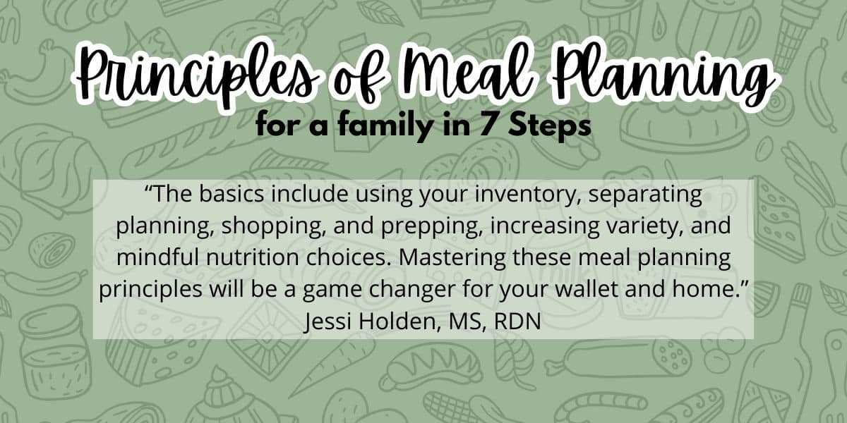
PRINCIPLES of MENU PLANNING
Menu planning onboard a ship should be guided by the principles of nutrition, efficiency, cost-effectiveness, and adaptability. These principles are essential to ensure the health and satisfaction of the crew while accounting for the logistical constraints of maritime operations. First and foremost, nutritional balance must be maintained. Meals should provide the necessary dietary intake of calories, proteins, vitamins, and other nutrients
GENERAL REVIEW / CHALLENGES & DIGITALIZATION IN THE PANTRY

Slide 6
PRINCIPLES of MENU PLANNING
Another key consideration is the availability of ingredients. Menu plans should be based on food items that are storable and suitable for long voyages.
Cultural sensitivity is also critical. Cultural and dietary preferences must be respected, especially given the multinational nature of many maritime crews. Menus should include vegetarian, halal, or allergy-friendly options where needed.
Food safety and storage compatibility are equally important. Meal options should align with the vessel’s storage capabilities, such as freezer or dry storage availability.
Portion control is another key aspect. Serving appropriate quantities helps reduce waste and manage food budgets effectively.
The menu should also have flexibility for emergencies. Plans must account for rough weather, equipment failure, or unexpected delays.
Meals should be designed using sustainable ingredients and methods that reduce food waste.
GENERAL REVIEW / CHALLENGES & DIGITALIZATION IN THE PANTRY

Slide 7
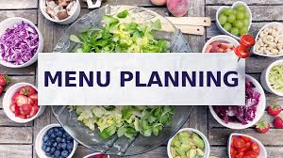
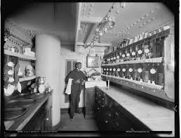
  PANTRY IN RELATION TO MENU PLANNING
In the unique environment of a seafaring vessel, where resupply opportunities are limited and storage space is at a premium, the relationship between pantry management and menu planning is both fundamental and complex. The pantry acts as the backbone of all culinary operations onboard; it dictates the range, variety, and feasibility of meals that can be served. Therefore, successful menu planning cannot be conducted in isolation—it must be rooted in a deep understanding of what is currently available in the pantry, in what quantities, and how long those items will remain usable.
GENERAL REVIEW / CHALLENGES & DIGITALIZATION IN THE PANTRY

Slide 8
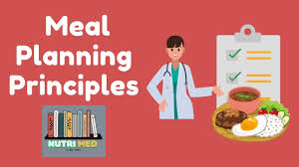
  PANTRY IN RELATION TO MENU PLANNING
The inventory held in the pantry directly informs meal choices,
Stock rotation, particularly the use of the First-In, First-Out (FIFO) principle.
Preventing overstocking and reducing waste,
Cost efficiency,
Emergency situations or unexpected changes in voyage conditions,
GENERAL REVIEW / CHALLENGES & DIGITALIZATION IN THE PANTRY

Slide 9

PANTRY MANAGEMENT in TIMES of CRISIS
Supply Chain Disruptions
Delays in the delivery of provisions due to factors such as adverse weather, port congestion, customs issues, or logistical breakdowns can severely impact the availability of essential food items onboard.
GENERAL REVIEW / CHALLENGES & DIGITALIZATION IN THE PANTRY

Slide 10
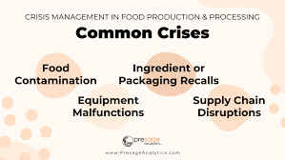
PANTRY MANAGEMENT in TIMES of CRISIS
Extended Voyages
Unexpected extensions of a voyage can occur due to rerouting caused by geopolitical tensions, mechanical breakdowns, or extended waiting periods outside crowded ports. These unplanned days at sea increase pressure on existing food reserves, requiring careful rationing and adjustments to meal plans.
GENERAL REVIEW / CHALLENGES & DIGITALIZATION IN THE PANTRY

Slide 11



PANTRY MANAGEMENT in TIMES of CRISIS
Mechanical or Technical Failures
Failure of refrigeration units, freezers, or dry storage ventilation can lead to the spoilage of perishable goods, significantly reducing available food supplies.
GENERAL REVIEW / CHALLENGES & DIGITALIZATION IN THE PANTRY

Slide 12


PANTRY MANAGEMENT in TIMES of CRISIS
Health Emergencies
Outbreaks of illnesses such as foodborne pathogens, influenza, or gastrointestinal viruses onboard can elevate food safety concerns and may necessitate changes to both food handling procedures and dietary planning.
GENERAL REVIEW / CHALLENGES & DIGITALIZATION IN THE PANTRY

Slide 13
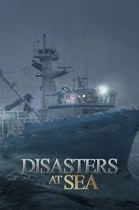
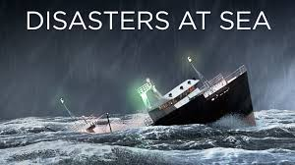
PANTRY MANAGEMENT in TIMES of CRISIS
Natural Disasters
Severe weather conditions—like hurricanes, cyclones, or prolonged rough seas—not only disrupt sailing schedules but also affect the ability to cook and serve meals. High seas can make it unsafe to use open flames or heavy equipment in the galley.
GENERAL REVIEW / CHALLENGES & DIGITALIZATION IN THE PANTRY

Slide 14
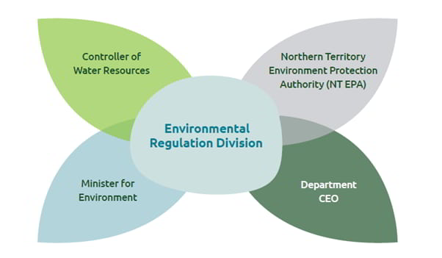
PANTRY MANAGEMENT in TIMES of CRISIS
Environmental Regulations Enforcement
Ships must comply with international conventions such as MARPOL, which govern waste disposal and food waste management at sea. Sudden inspections or updated regulations can require changes in how food waste is handled.
GENERAL REVIEW / CHALLENGES & DIGITALIZATION IN THE PANTRY

Slide 15

PANTRY MANAGEMENT in TIMES of CRISIS
Crew Changes or Labor Issues
Delays in crew rotations, shortages in catering personnel, or labor disputes can affect the efficiency of galley operations and pantry management. If a trained cook is unavailable due to a delayed crew change, an understaffed galley team may struggle to keep up with meal preparation and food safety standards
GENERAL REVIEW / CHALLENGES & DIGITALIZATION IN THE PANTRY

Slide 16
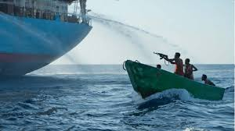
PANTRY MANAGEMENT in TIMES of CRISIS
. Piracy or Security Threats
In regions prone to piracy or maritime security concerns, vessels may be rerouted to avoid danger zones, leading to longer travel times and limited access to resupply ports. In extreme cases, ships may need to operate under blackout conditions, reducing galley operations for safety.
GENERAL REVIEW / CHALLENGES & DIGITALIZATION IN THE PANTRY

Slide 17
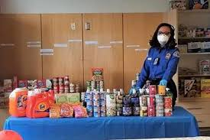
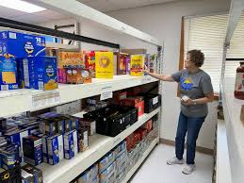
PANTRY MANAGEMENT in TIMES of CRISIS
Managing a ship’s pantry during times of crisis—whether due to unforeseen delays, disruptions in the supply chain, or emergencies at sea—demands a strategic and flexible approach. In these high-pressure scenarios, the ability to maintain adequate food supplies without generating waste or encountering shortages is essential for safeguarding crew welfare and ensuring operational continuity. This process involves not only prioritizing essential resources but also adapting procurement, storage, and consumption practices in real time to reflect the new constraints.
One of the foremost strategies in crisis pantry management is prioritizing the use and preservation of essential supplies. During emergencies, it is critical to shift focus toward non-perishable staples that offer long shelf lives and reliable nutritional value.
GENERAL REVIEW / CHALLENGES & DIGITALIZATION IN THE PANTRY

Slide 18
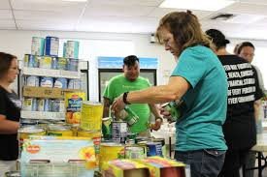
PANTRY MANAGEMENT in TIMES of CRISIS
Adapting the onboard menu is another key aspect of effective crisis pantry management. Menus must become flexible and responsive to current inventory levels, with a clear focus on meals that use preserved and shelf-stable items. Instead of following a preset plan that relies on a full range of ingredients, cooks should create simple, resource-efficient meals that maintain nutrition while using what is already available. For instance, if fresh meat stocks are low but there is a surplus of canned tuna and rice, dishes such as tuna casserole or rice salad can be introduced to keep meals satisfying without depleting dwindling fresh supplies.
GENERAL REVIEW / CHALLENGES & DIGITALIZATION IN THE PANTRY

Slide 19

PANTRY MANAGEMENT in TIMES of CRISIS
In parallel with adjusting menus, waste prevention must be significantly heightened during crisis conditions. Every effort should be made to reduce food spoilage, conserve resources, and make full use of every ingredient. Strict portion control becomes more important than ever, with servings adjusted to meet energy needs without excess. Leftovers should be creatively repurposed—such as turning roast chicken into soup or sandwich fillings the next day—ensuring that no edible food is discarded unnecessarily. This not only helps stretch limited supplies but also maintains variety and morale among the crew.
GENERAL REVIEW / CHALLENGES & DIGITALIZATION IN THE PANTRY

Slide 20

PANTRY MANAGEMENT in TIMES of CRISIS
Clear communication and crew training are essential components of successful pantry management during crises. All galley and pantry personnel should be briefed on the nature of the emergency, the expected duration, and the protocols being put in place to manage food wisely. Training sessions or briefings can cover topics such as rationing procedures, alternative cooking methods, proper storage techniques, and hygienic food handling under stress. When the entire team understands the situation and their role in mitigating it, efficiency and cooperation improve significantly.
GENERAL REVIEW / CHALLENGES & DIGITALIZATION IN THE PANTRY

Slide 21

PANTRY MANAGEMENT in TIMES of CRISIS
Reverse logistics and redistribution options should be explored to manage surplus or unused goods. If the ship unexpectedly docks or resupply operations are adjusted, pantry managers might coordinate with suppliers to return non-perishables such as canned goods or unopened packaging. Alternatively, if vessels in the same fleet are nearby, redistribution of resources may help balance supplies between ships facing different challenges. This kind of logistical flexibility enhances resilience across the maritime operation.
GENERAL REVIEW / CHALLENGES & DIGITALIZATION IN THE PANTRY

Slide 22
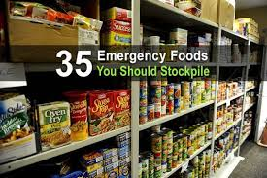
PANTRY MANAGEMENT in TIMES of CRISIS
A strong crisis management plan must include preparations for contingencies. Ships should carry emergency stockpiles of long-life staples—such as vacuum-sealed grains, dried fruits, powdered milk, and canned proteins—that are stored separately and reserved specifically for emergencies. These supplies act as a buffer when voyages are extended or supply disruptions are prolonged. Having detailed protocols for rationing and emergency provisioning ensures that the crew remains fed, healthy, and calm even when normal operations are significantly disrupted.
GENERAL REVIEW / CHALLENGES & DIGITALIZATION IN THE PANTRY

Slide 23
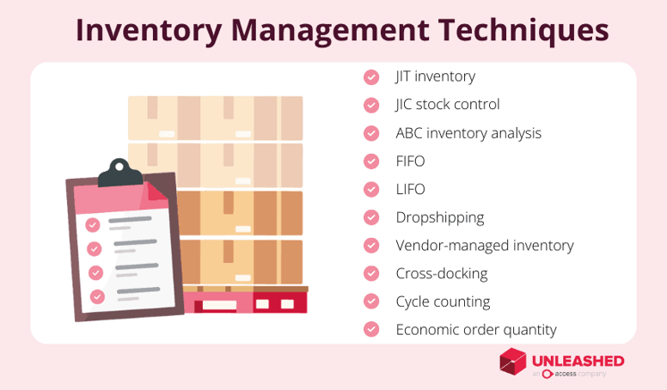
PANTRY MANAGEMENT in TIMES of CRISIS
GENERAL REVIEW / CHALLENGES & DIGITALIZATION IN THE PANTRY

Slide 24
PANTRY MANAGEMENT in TIMES of CRISIS
Prioritize Essential Supplies
Implement Strict Inventory Controls
Utilize Reverse Logistics When Possible
Adapt Menu Planning
Enhance Waste Prevention
Communicate and Train Crew
Prepare for Contingencies
GENERAL REVIEW / CHALLENGES & DIGITALIZATION IN THE PANTRY

Slide 25
RISK MANAGEMENT IN THE PANTRY
Risks in pantry management onboard ships typically include:
Food Spoilage and Contamination: Due to improper storage, temperature fluctuations, or poor handling, leading to health hazards.
Overstocking or Understocking: Causing either waste from expired goods or shortages that impact meal preparation.
Supply Chain Interruptions: Delays or disruptions in provisioning that may lead to running out of essential items.
Regulatory Non-Compliance: Failing to follow environmental or food safety regulations (like MARPOL or hygiene standards), which can result in fines or sanctions.
Waste Management Issues: Improper disposal of food waste can cause pollution and legal problems.
GENERAL REVIEW / CHALLENGES & DIGITALIZATION IN THE PANTRY

Slide 26
RISK MANAGEMENT IN THE PANTRY
Incorrect Inventory Tracking: Poor record-keeping can lead to ordering errors and mismanagement of stock.
Inadequate Staff Training: Lack of knowledge on proper handling and storage increases the risk of waste and safety breaches.
Equipment Failure: Refrigeration or storage system breakdowns that compromise food quality.
Health Risks to Crew: Serving spoiled or contaminated food can cause illness and lower morale.
Financial Risks: Waste and inefficiencies increase operational costs unnecessarily.
GENERAL REVIEW / CHALLENGES & DIGITALIZATION IN THE PANTRY

Slide 27
RISK HANDLING
Risk Identification:
Regularly assess potential risks like spoilage, contamination, stock shortages, equipment failure, and regulatory non-compliance. This includes monitoring storage conditions and supply chain vulnerabilities.
Risk Assessment:
Evaluate the likelihood and impact of each identified risk. For example, assess how a refrigeration failure might affect perishable goods or how supply delays could disrupt meal planning.
Preventive Measures:
Implement strict food storage protocols (temperature control, FIFO rotation), accurate inventory tracking, and staff training on hygiene and handling. Ensure backups for critical equipment and maintain good supplier relationships to mitigate supply risks.
GENERAL REVIEW / CHALLENGES & DIGITALIZATION IN THE PANTRY

Slide 28
RISK HANDLING
Monitoring and Control:
Use checklists, digital inventory systems, and regular audits to monitor pantry conditions. Track food waste and near-expiry items to adjust ordering and usage.
Crisis Preparedness:
Develop contingency plans for crises like delayed provisioning, equipment breakdowns, or contamination events. This might include stockpiling essential non-perishables and having emergency procedures for food safety incidents.
Compliance and Documentation:
Keep thorough records of inventory, waste logs, temperature checks, and corrective actions to meet regulatory requirements and support audits.
GENERAL REVIEW / CHALLENGES & DIGITALIZATION IN THE PANTRY

Slide 29
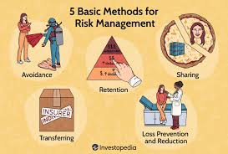
RISK HANDLING
Continuous Improvement:
Analyze past incidents or waste patterns to improve processes, update training, and refine risk management strategies regularly.
GENERAL REVIEW / CHALLENGES & DIGITALIZATION IN THE PANTRY

Slide 30
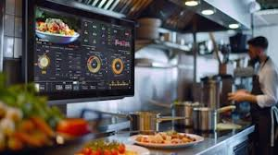
DIGITALIZATION IN THE GALLEYS
As ships face longer voyages, tighter budgets, and stricter international standards, adopting digital technologies in victualling is no longer optional but essential. Digital solutions enhance efficiency, accuracy, compliance, and crew welfare, transforming traditional catering practices into streamlined, data-driven processes.
GENERAL REVIEW / CHALLENGES & DIGITALIZATION IN THE PANTRY

Slide 31

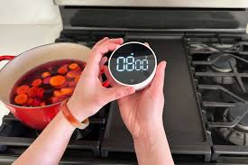
DIGITALIZATION IN THE GALLEYS
One of the most significant advantages of digital transformation in victualling is the improvement in inventory management. Traditional manual inventory systems are often prone to errors, making it difficult to maintain optimal stock levels throughout long voyages. Digital inventory management platforms provide real-time tracking of food supplies, allowing crews to monitor stocks continuously
GENERAL REVIEW / CHALLENGES & DIGITALIZATION IN THE PANTRY

Slide 32
DIGITALIZATION IN THE GALLEYS
Another vital aspect transformed by digital technology is menu planning and nutritional compliance. Maritime Labour Convention (MLC) regulations require ships to provide meals that meet specific dietary standards, taking into account cultural and health considerations. Digital meal planning software enables victualling staff to design balanced menus that respect these requirements. These tools calculate the nutritional content of meals and directly link to inventory databases, simplifying procurement and reducing errors. For instance, meal planning systems can alert cooks if a menu lacks certain nutrients or if substitutions are needed to accommodate dietary restrictions such as vegetarian or halal options. This ensures that crew members receive wholesome, culturally appropriate meals, promoting their well-being throughout their time at sea.
GENERAL REVIEW / CHALLENGES & DIGITALIZATION IN THE PANTRY

Slide 33
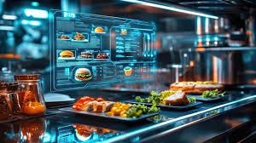
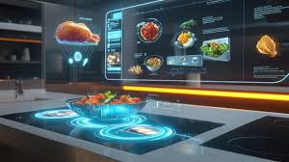
DIGITALIZATION IN THE GALLEYS
Procurement processes also benefit significantly from digital transformation. Historically, procurement involved manual comparisons of suppliers, order tracking, and budget management, all of which were time-consuming and prone to mistakes. Digital procurement platforms streamline these tasks by allowing victualling officers to compare vendors, place orders, and monitor budgets efficiently through a centralized system.
GENERAL REVIEW / CHALLENGES & DIGITALIZATION IN THE PANTRY

Slide 34
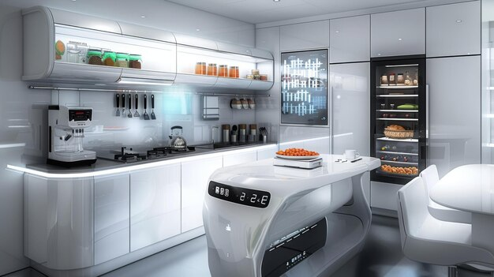
DIGITALIZATION IN THE GALLEYS
Maintaining food safety and regulatory compliance is another critical challenge addressed through digital tools. Foodborne illnesses onboard ships can have severe consequences, so strict adherence to hygiene protocols is mandatory. Digital applications such as iAuditor allow crew members to record refrigerator temperatures, cleaning schedules, and safety checks systematically.
GENERAL REVIEW / CHALLENGES & DIGITALIZATION IN THE PANTRY

Slide 35
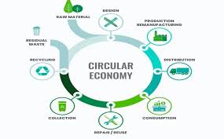

DIGITALIZATION IN THE GALLEYS
Digital transformation also supports environmental sustainability efforts, particularly in reducing food waste. Ships must comply with MARPOL regulations aimed at minimizing waste disposal into the ocean. Digital waste management tools enable crews to log and analyze food waste data, identifying patterns that contribute to excessive disposal. For instance, if a significant portion of bread or fresh produce consistently goes unused, the victualling team can adjust ordering quantities or portion sizes. This data-driven approach helps reduce environmental impact, cut costs, and promote responsible resource use onboard.
GENERAL REVIEW / CHALLENGES & DIGITALIZATION IN THE PANTRY

Slide 36

DIGITALIZATION IN THE GALLEYS
Crew satisfaction is another key benefit of digitizing victualling operations. Digital feedback platforms allow crew members to express their preferences and satisfaction levels regarding meals. These insights enable galley staff to adapt menus responsively, catering to diverse tastes and cultural backgrounds. Providing crew with a voice in their meals fosters a positive onboard atmosphere and boosts morale, which is crucial for overall productivity and retention.
GENERAL REVIEW / CHALLENGES & DIGITALIZATION IN THE PANTRY

Slide 37
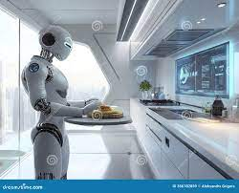
DIGITALIZATION IN THE GALLEYS
Digital platforms facilitate continuous training and learning for victualling personnel. Ships often operate with limited access to external training resources, but e-learning modules accessible onboard ensure staff remain up-to-date with hygiene practices, digital tools, and regulatory requirements. This ongoing education supports a competent, compliant crew capable of leveraging new technologies effectively.
GENERAL REVIEW / CHALLENGES & DIGITALIZATION IN THE PANTRY

Slide 38
DIGITALIZATION IN THE GALLEYS
the wealth of data generated by digital victualling systems enables managers to make informed, strategic decisions. Analytics and reports provide insights into budget trends, inventory usage, crew preferences, and operational efficiencies. These data-driven decisions reduce guesswork, optimize resource allocation, and improve the overall quality of food services on board.
In conclusion, digital transformation in shipboard victualling is essential to meet the demands of modern maritime operations. By enhancing inventory management, nutritional compliance, procurement, food safety, waste reduction, crew satisfaction, training, and decision-making, digital technologies ensure that catering services onboard are efficient, compliant, cost-effective, and responsive to crew needs. Embracing digital tools not only supports the health and well-being of seafarers but also aligns shipping operations with global standards and sustainability goals. In a fast-evolving industry, digital victualling systems are the foundation of a safe, modern, and well-managed galley.
GENERAL REVIEW / CHALLENGES & DIGITALIZATION IN THE PANTRY

Slide 39

DIGITAL TRANSFORMATION IN VICTUALLING
The maritime industry is steadily embracing digitalization across all departments, including the galley. One of the key areas where digital tools are making a significant impact is victualing the management of food supplies, meal planning, budgeting, and overall provisioning for crew welfare. As vessels become more technologically advanced, integrating digital applications into victualing processes is not just a trend but a necessity for efficiency, compliance, and crew satisfaction.
GENERAL REVIEW / CHALLENGES & DIGITALIZATION IN THE PANTRY

Slide 40
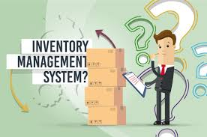
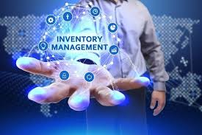
DIGITAL TRANSFORMATION IN VICTUALLING
A central benefit of digitalization in the galley lies in inventory management systems. Applications such as ShipNet, MXSuite, and Sertica allow for real-time tracking of food stocks, monitoring expiration dates, and managing reorder levels. These systems can utilize barcode scanning to streamline the process, reduce human error, and ensure that stock levels are maintained accurately, which is particularly vital for long voyages where resupply opportunities are limited.
GENERAL REVIEW / CHALLENGES & DIGITALIZATION IN THE PANTRY

Slide 41
DIGITAL TRANSFORMATION IN VICTUALLING
Another important aspect is menu planning and nutritional analysis. Software tools like CaterTrax and Seaware Catering enable galley personnel to create meal plans that are both nutritionally balanced and tailored to the diverse dietary needs of international crew members. These systems often integrate with inventory databases to automatically calculate portion sizes and nutritional content, thereby supporting compliance with health regulations and enhancing crew welfare.
The procurement process also benefits greatly from digital tools. Platforms such as ShipServ and MarineTraffic Procurement streamline the ordering of supplies, from submitting purchase orders to tracking deliveries and comparing vendor pricing. These applications improve transparency and help ensure that ships are well-provisioned without exceeding budget constraints.
GENERAL REVIEW / CHALLENGES & DIGITALIZATION IN THE PANTRY

Slide 42
DIGITAL TRANSFORMATION IN VICTUALLING
Moreover, waste management and regulatory compliance have become increasingly important, especially with the rise of environmental regulations such as MARPOL. Tools like Envirosuite and Food Waste Loggers help document food waste, identify inefficiencies, and promote sustainability practices onboard. They also support the necessary documentation for audits and inspections.
Food safety and hygiene are critical in ensuring the well-being of crew members. Digital checklist tools like iAuditor and various HACCP-compliant platforms enable systematic recording of temperature checks, cleaning routines, and safety inspections. These records help vessels maintain high standards of food hygiene and are easily accessible for review during audits.
GENERAL REVIEW / CHALLENGES & DIGITALIZATION IN THE PANTRY

Slide 43
DIGITAL TRANSFORMATION IN VICTUALLING
In addition to operational tools, crew satisfaction and feedback platforms such as Crew Care and Shipmate are valuable for gathering insights into meal preferences and overall dining satisfaction. This feedback loop allows catering teams to make informed adjustments to menus, contributing to higher morale and a better onboard experience.
Finally, for galley personnel to effectively use these digital tools, digital training and e-learning platforms are essential. Programs offered by providers like Seagull Maritime and Onboard Training Group (OTG) equip staff with the necessary digital literacy and operational knowledge. These platforms ensure that all crew members involved in victualling are competent in using the systems that support their daily work.
GENERAL REVIEW / CHALLENGES & DIGITALIZATION IN THE PANTRY

Slide 44
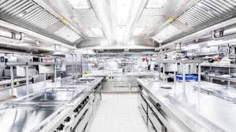
DIGITAL TRANSFORMATION IN VICTUALLING
In conclusion, the transformation to digitalization in victualling represents a vital step toward modernizing galley operations. From inventory tracking to hygiene management and budget control, digital tools enhance the efficiency, compliance, and quality of service onboard. With the right combination of applications and proper training, ships can ensure that their catering services meet the highest standards while also adapting to the evolving demands of maritime operations.
GENERAL REVIEW / CHALLENGES & DIGITALIZATION IN THE PANTRY

Slide 45
DIGITAL TRAINING FOR THE STAFF
Victualling staff must be equipped with digital competencies tailored to their roles, balancing practical food service duties with system-based management. Regular training and hands-on practice ensure they remain effective in modern galley operations, support regulatory compliance, and contribute to operational efficiency.
Digital training is essential to ensure that the staff can efficiently use modern tools for inventory, meal planning, procurement, and compliance. In the following part, the key areas where digital training is needed are given:
Digital Literacy
Inventory Management Software Training
Menu Planning and Nutritional Tools
Digital Procurement and Ordering Platforms
Food Safety & Hygiene Applications
GENERAL REVIEW / CHALLENGES & DIGITALIZATION IN THE PANTRY

Slide 46

DIGITAL TRAINING FOR THE STAFF
Waste Management and Reporting Tools
Data Security and Compliance Awareness
Onboard E-learning and Continuous Training
GENERAL REVIEW / CHALLENGES & DIGITALIZATION IN THE PANTRY

Slide 47
REFERENCES
McVety, P. J., Ware, B. J., & Ware, C. L. (2008). Fundamentals of menu planning. John Wiley & Sons.
Seyitoğlu, F. (2016). A Conceptual Study on Menu Planning and The Selection of Menu Items. Publication name, 183.
Casellas Connors, J. P., Safayet, M., Rosenheim, N., & Watson, M. (2023). Assessing changes in food pantry access after extreme events. Agriculture and Human Values, 40(2), 619-634.
4. Rooney, R. M., Cramer, E. H., Mantha, S., Nichols, G., Bartram, J. K., Farber, J. M., & Benembarek, P. K. (2004). A review of outbreaks of foodborne disease associated with passenger ships: evidence for risk management. Public health reports, 119(4), 427-434.
GENERAL REVIEW / CHALLENGES & DIGITALIZATION IN THE PANTRY

Slide 48
REFERENCES
5. Martín-Martín, D., García, J. M., & Romero, I. (2022). Determinants of digital transformation in the restaurant industry. Amfiteatru Economic, 24(60), 430-446.
6. Oliinyk, N., Podolskyi, M., Velykochyy, V., Albeshchenko, O., & Domashenko, S. (2024). Enhancing hotel and restaurant business efficiency through digital technologies. Multidisciplinary Reviews, 8.
7. Keskin, S. N. (2025). Digital Transformation in Gastronomy Applications Used in the Restaurant Industry. In Revolutionizing Hospitality Management Systems With AI, VR, and Machine Learning (pp. 131-160). IGI Global Scientific Publishing.
8. Hay, T. K., & Slater, K. (2014). Victualling for Future Royal Australia Navy Platforms-Alternative Technologies (No. DSTOTR1379).
GENERAL REVIEW / CHALLENGES & DIGITALIZATION IN THE PANTRY

