Slide 1








MARitime Soft Skills for Onboard Healthy Nutrition and CULinary Arts in Seagoing Services – CUL-MAR-Skills
KA220-VET - Cooperation partnerships in vocational education and training
2023-1-RO01-KA220-VET-000156711
VICTUALLING ONBOARD COURSE
Week I-VIII
Revision of Victualling Onboard with an Emphasis on Food Storage, Processing, Nutrition, and First Aid
Disclaimer: “Funded by the European Union. Views and opinions expressed are however those of the author(s) only and do not necessarily reflect those of the European Union or the ANPCDEFP. Neither the European Union nor the ANPCDEFP can be held responsible for them”

Slide 2
Learning outcomes of the course
Learn the basics of victualling onboard in depth and explain the significance of this service.
Define and differentiate between types of convenience foods (semi-processed, fully processed, dried, canned, frozen, and ready-to-eat foods).
Identify the nutritional impact of various food processing and storage methods on food quality and safety.
Explain the correct usage, handling, and storage of different types of convenience foods to maintain food safety and nutritional value.
Compare and contrast the advantages and disadvantages of different food preservation and processing methods
Recognize and interpret common packaging types used for convenience foods
NAVAL COMMUNICATIONS
VICTUALLING / FOOD STORAGE / PROCESSING / NUTRITION / FIRST AID

Slide 3
Learning outcomes of the course
Evaluate food labels
Demonstrate proper storage techniques for each category of convenience food to minimize spoilage and nutrient loss.
Assess the role of convenience foods in a balanced diet, particularly in institutional or limited-resource environments (e.g., ships, remote worksites).
Apply critical thinking to select appropriate convenience foods based on operational needs, dietary requirements, and budget constraints
NAVAL COMMUNICATIONS
VICTUALLING / FOOD STORAGE / PROCESSING / NUTRITION / FIRST AID

Slide 4
Content of the course
Key concepts of victualling onboard
Types of convenience foods food preservation and storage.
The nutritional impact of food processing and storage methods
Convenience food
Risk management at the galley
Basic first aid information
VICTUALLING / FOOD STORAGE / PROCESSING / NUTRITION / FIRST AID

Slide 5


KEY CONCEPTS OF VICTUALLING ONBOARD
Port Operations and Cargo Handling
In real-world maritime operations, logistics terminology plays a crucial role in ensuring the smooth and efficient movement of goods. For instance, when shipping perishable items like seafood, companies utilize reefer containers—refrigerated units that help maintain proper temperature throughout the journey. This process is part of cold chain logistics, which ensures that temperature-sensitive cargo remains within required conditions from origin to destination
VICTUALLING / FOOD STORAGE / PROCESSING / NUTRITION / FIRST AID

Slide 6


KEY CONCEPTS OF VICTUALLING ONBOARD
International Trade and Freight Forwarding
In international shipping proper documentation is essential for legal and logistical purposes. For example, when a company ships electronics from China to Europe, it uses a Bill of Lading (B/L) to serve as a legal record of the shipment and to facilitate the transfer of ownership. This document is also critical for freight forwarding and helps ensure smooth customs clearance at international borders, enabling goods to move efficiently across countries.
VICTUALLING / FOOD STORAGE / PROCESSING / NUTRITION / FIRST AID

Slide 7

KEY CONCEPTS OF VICTUALLING ONBOARD
Vessel Management and Fuel Efficiency
When planning a transatlantic voyage, a shipping company must carefully manage ballast water to ensure the vessel's stability and comply with international environmental regulations. This process also involves monitoring the ship’s deadweight tonnage (DWT) and staying within the designated load line to maintain safe and efficient sailing conditions. During the journey, the vessel may stop at a designated port to refuel through bunkering services. This step is a critical part of port logistics, ensuring the ship has sufficient fuel for the next leg of its route while also supporting overall fuel efficiency and voyage planning.
VICTUALLING / FOOD STORAGE / PROCESSING / NUTRITION / FIRST AID

Slide 8
KEY CONCEPTS OF VICTUALLING ONBOARD
Supply Chain Resilience and Crisis Management
During the COVID-19 pandemic, supply chain management faced major challenges as global logistics disruptions led to shortages of essential goods and food supplies. To adapt, companies were forced to find alternative shipping routes, which affected lead times and required rapid adjustments in logistics planning. Similarly, when the Ever-Given container ship blocked the Suez Canal, it caused significant delays across international shipping networks. Many companies had to reroute vessels around the Cape of Good Hope, which increased freight rates, led to port congestion, and required additional transshipment to maintain delivery schedules.
VICTUALLING / FOOD STORAGE / PROCESSING / NUTRITION / FIRST AID

Slide 9

KEY CONCEPTS OF VICTUALLING ONBOARD
https://aavenir.com/glossary/supply-chain-resilience/
VICTUALLING / FOOD STORAGE / PROCESSING / NUTRITION / FIRST AID

Slide 10


KEY CONCEPTS OF VICTUALLING ONBOARD
Sustainability and Green Shipping
The maritime industry is increasingly embracing green logistics initiatives to reduce its environmental impact. One key approach is the use of low-emission fuels, which significantly cut down on greenhouse gas emissions during voyages and contribute to cleaner ocean transport.
In addition, shipping companies are implementing sustainable bunkering practices, aligning their operations with international standards such as IMO regulations. These efforts reflect a broader commitment to green shipping, aiming to create a more environmentally responsible and sustainable future for global maritime trade.
VICTUALLING / FOOD STORAGE / PROCESSING / NUTRITION / FIRST AID

Slide 11

TYPES OF CONVENIENCE FOODS
Semi-Processed Foods
Semi-processed foods are products that have undergone partial preparation or treatment to make final cooking quicker and easier. These foods are not ready to eat but help reduce the time and labor required during meal preparation. Common examples include peeled and chopped vegetables, marinated meats, pre-washed salad mixes, and instant soup bases. While these foods save valuable preparation time, they still require further cooking or handling before consumption. They are typically stored under refrigeration or frozen to maintain their quality and prevent spoilage.
VICTUALLING / FOOD STORAGE / PROCESSING / NUTRITION / FIRST AID

Slide 12
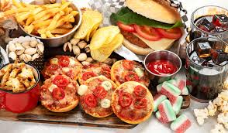
TYPES OF CONVENIENCE FOODS
Fully Processed Foods
Fully processed foods are completely cooked and prepared by manufacturers, making them convenient for consumers who only need to reheat or serve the food. Examples of such foods include canned stews, frozen lasagna, microwaveable meals, and pre-packaged sandwiches. These foods are either shelf-stable or require freezing for preservation.
VICTUALLING / FOOD STORAGE / PROCESSING / NUTRITION / FIRST AID

Slide 13


TYPES OF CONVENIENCE FOODS
Dried (Dehydrated) Foods
Dried or dehydrated foods are those from which most of the moisture has been removed to prevent microbial growth and prolong shelf life. This method of preservation results in lightweight products that are easy to store and transport. Examples include dried fruits, instant noodles, powdered soups, and dried beans. These foods have an extended shelf life and are ideal for long-term storage, although they usually need to be rehydrated or cooked before consumption. Despite some loss of heat-sensitive vitamins, most nutrients are retained in dried foods.
VICTUALLING / FOOD STORAGE / PROCESSING / NUTRITION / FIRST AID

Slide 14
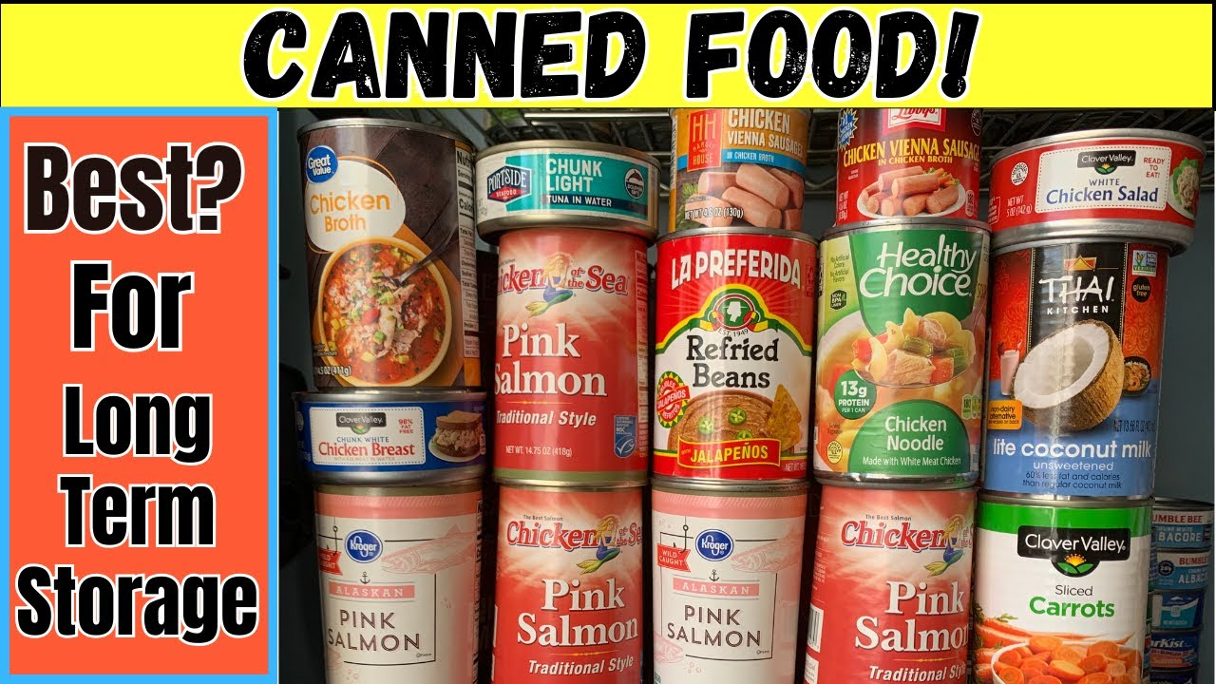
TYPES OF CONVENIENCE FOODS
Canned Foods
Canned foods are preserved in airtight containers using heat processing, which destroys harmful bacteria and allows for safe, long-term storage. Common examples are canned tuna, beans, tomatoes, and fruits. These foods can last anywhere from one to five years if stored properly. Many canned foods are ready to eat or require only minimal heating. However, they may contain high levels of salt, sugar, or preservatives, which should be considered when consumed regularly. Canned foods offer convenience and extended shelf life, making them useful in both domestic and commercial kitchens.
VICTUALLING / FOOD STORAGE / PROCESSING / NUTRITION / FIRST AID

Slide 15

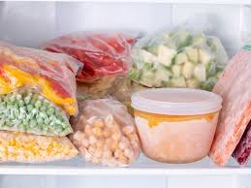
TYPES OF CONVENIENCE FOODS
Frozen Foods
Frozen foods are preserved by storing them at very low temperatures, usually below -18°C, to halt bacterial growth and maintain freshness. This category includes frozen vegetables, meats, seafood, ready-made meals, and pastries. Freezing helps retain the nutritional value of food better than many other preservation methods. However, to remain safe and palatable, frozen foods must be continuously stored at the proper temperature. While some items can be reheated directly, others require cooking before consumption. Frozen foods are a staple for maintaining a nutritious diet with convenience.
VICTUALLING / FOOD STORAGE / PROCESSING / NUTRITION / FIRST AID

Slide 16
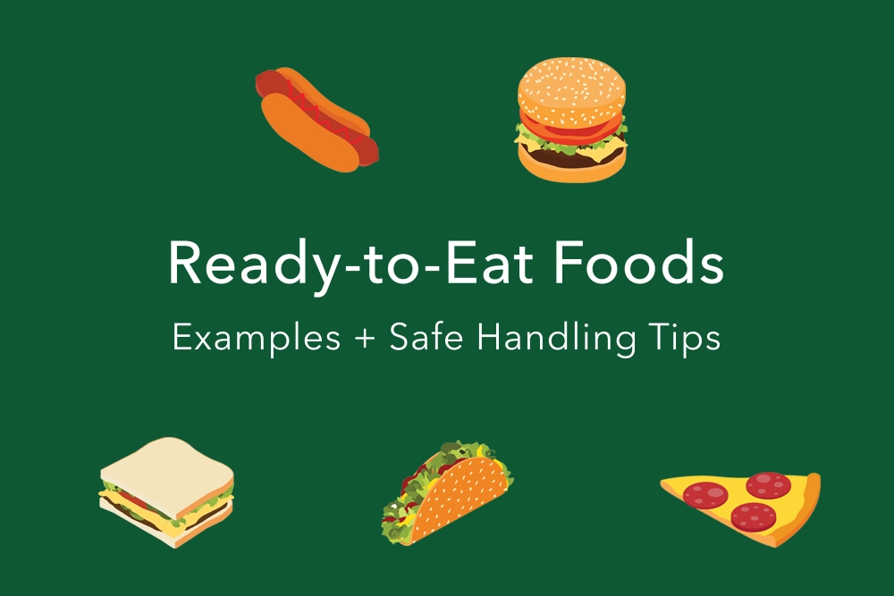
TYPES OF CONVENIENCE FOODS
Ready-to-Eat (RTE) Foods
Ready-to-eat (RTE) foods are fully prepared and can be consumed immediately without the need for any additional cooking or heating. Examples include packaged sandwiches, cold pasta salads, snack bars, and cereals with milk. These foods are ideal for people seeking quick and easy meals, particularly in busy settings like ships, offices, or during travel. RTE foods offer maximum convenience but often have a shorter shelf life and may contain high levels of salt, sugar, or additives. As with all convenience foods, they should be balanced with fresh options when possible to ensure good nutrition.
VICTUALLING / FOOD STORAGE / PROCESSING / NUTRITION / FIRST AID

Slide 17
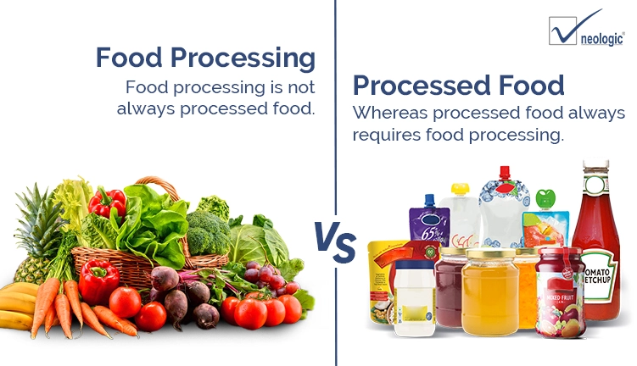
THE NUTRITIONAL IMPACT OF FOOD PROCESSING AND STORAGE METHODS
Food processing and storage methods play a crucial role in extending shelf life, improving convenience, and ensuring food safety. However, they also influence the nutritional quality, taste, texture, and health impact of food products. Each method affects food differently depending on the degree of heat, moisture removal, or chemical preservation involved.
VICTUALLING / FOOD STORAGE / PROCESSING / NUTRITION / FIRST AID

Slide 18
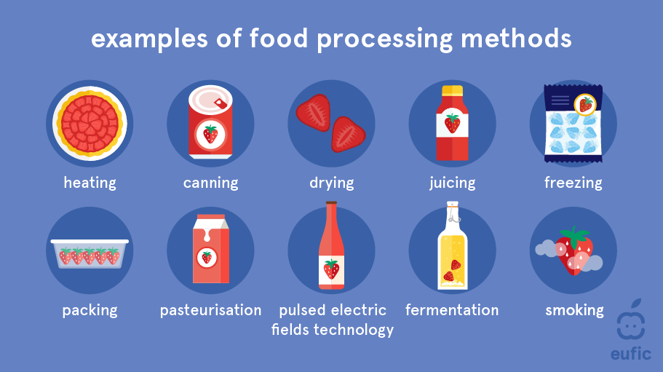
THE NUTRITIONAL IMPACT OF FOOD PROCESSING AND STORAGE METHODS
Drying (or dehydration) is a method used to remove moisture from foods, which helps prevent microbial growth and spoilage. While this technique is effective in preserving food for long periods and making it lighter for storage and transport, it can cause a loss of heat-sensitive vitamins such as vitamin C and some B vitamins. However, most minerals, fiber, and calories are retained. Dried foods are safe if kept properly sealed and dry, but poor storage can lead to mold or pest contamination.
VICTUALLING / FOOD STORAGE / PROCESSING / NUTRITION / FIRST AID

Slide 19
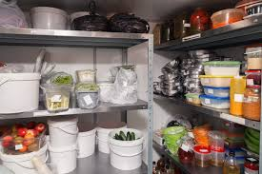
THE NUTRITIONAL IMPACT OF FOOD PROCESSING AND STORAGE METHODS
Canning involves sealing food in airtight containers and subjecting it to high heat to destroy bacteria and other pathogens. This method greatly extends shelf life—often up to five years—but also leads to significant nutrient loss, particularly for vitamins like vitamin C and folate. Protein, fat, and carbohydrates are largely unaffected. Canned foods often contain added salt and preservatives, which can impact health when consumed excessively. They are generally safe when the packaging is intact, but damaged or improperly sealed cans may pose a risk of botulism, a rare but serious illness.
VICTUALLING / FOOD STORAGE / PROCESSING / NUTRITION / FIRST AID

Slide 20
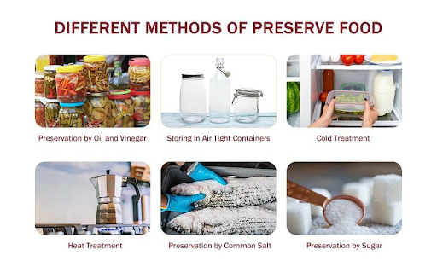
THE NUTRITIONAL IMPACT OF FOOD PROCESSING AND STORAGE METHODS
Freezing is one of the most effective ways to preserve both the nutritional content and safety of food. It halts bacterial growth and retains most nutrients, especially when food is frozen shortly after harvest or preparation. While some texture changes can occur—especially in high-moisture items like fruits—the overall flavor and appearance remain largely intact. Frozen foods are safe as long as they are kept continuously at the proper temperature, but safety can be compromised if they thaw and are not used promptly.
VICTUALLING / FOOD STORAGE / PROCESSING / NUTRITION / FIRST AID

Slide 21

THE NUTRITIONAL IMPACT OF FOOD PROCESSING AND STORAGE METHODS
Ready-to-eat (RTE) and fully processed foods are convenient and require little to no preparation, but they often contain high levels of sodium, sugar, fat, and preservatives to improve taste and shelf stability. These foods may have lower amounts of fiber and naturally occurring vitamins compared to their fresh counterparts. Although safe when stored and handled properly, they are best consumed in moderation as part of a balanced diet due to their reduced nutritional quality and potential health risks from excess additives
VICTUALLING / FOOD STORAGE / PROCESSING / NUTRITION / FIRST AID

Slide 22
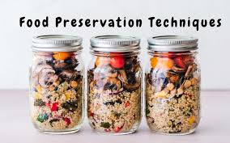

THE NUTRITIONAL IMPACT OF FOOD PROCESSING AND STORAGE METHODS
Vacuum packaging is another technique that preserves food by removing air from the packaging, slowing down oxidation and the growth of aerobic microorganisms. This method helps maintain the freshness, taste, and color of food and does not significantly affect nutrient content. However, vacuum-packed foods still need proper refrigeration or freezing to ensure safety and prevent spoilage.
VICTUALLING / FOOD STORAGE / PROCESSING / NUTRITION / FIRST AID

Slide 23
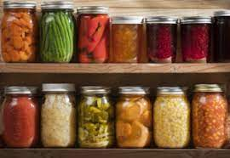
THE NUTRITIONAL IMPACT OF FOOD PROCESSING AND STORAGE METHODS
Pasteurization, commonly used for milk, juice, and other liquids, involves heating food briefly to kill harmful microorganisms without fully cooking the food. It results in minimal nutrient loss—mostly affecting heat-sensitive vitamins—but retains most of the food’s original flavor and nutritional content. Pasteurized products are generally safe when stored properly and consumed before their expiration dates.
VICTUALLING / FOOD STORAGE / PROCESSING / NUTRITION / FIRST AID

Slide 24
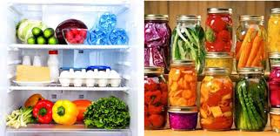
THE NUTRITIONAL IMPACT OF FOOD PROCESSING AND STORAGE METHODS
In summary, each food preservation and processing method has its own set of benefits and drawbacks. Methods like freezing and vacuum packaging do the best job at preserving both safety and nutritional value. In contrast, canning and drying are excellent for long shelf life but reduce some vitamins. Ready-to-eat foods are highly convenient but often less nutritious. Understanding these impacts helps in making informed choices about food use, especially in environments like ships or institutions where storage and access to fresh food may be limited.
VICTUALLING / FOOD STORAGE / PROCESSING / NUTRITION / FIRST AID

Slide 25
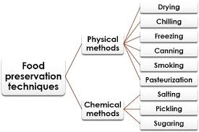
THE NUTRITIONAL IMPACT OF FOOD PROCESSING AND STORAGE METHODS
VICTUALLING / FOOD STORAGE / PROCESSING / NUTRITION / FIRST AID

Slide 26
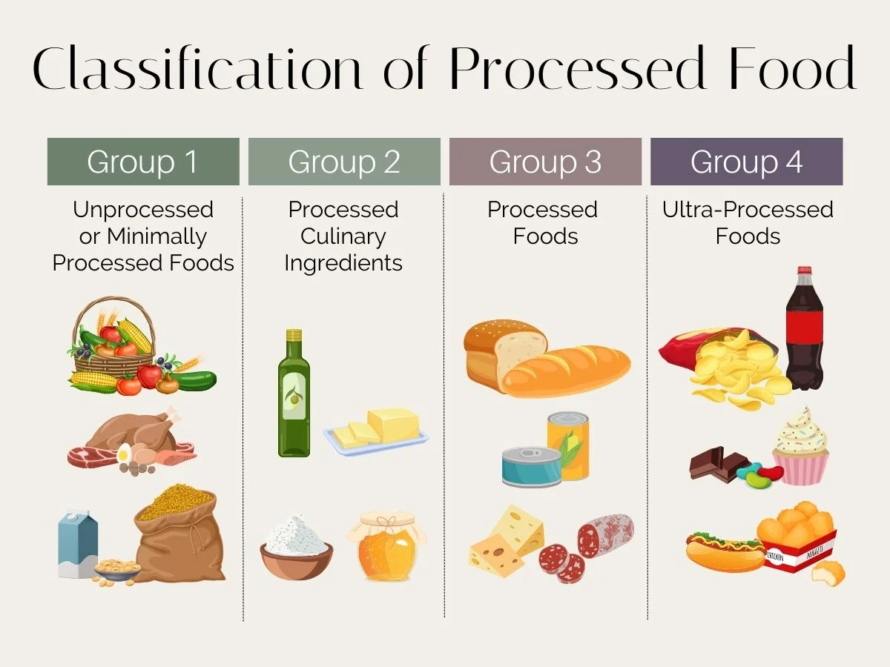
THE NUTRITIONAL IMPACT OF FOOD PROCESSING AND STORAGE METHODS
VICTUALLING / FOOD STORAGE / PROCESSING / NUTRITION / FIRST AID

Slide 27
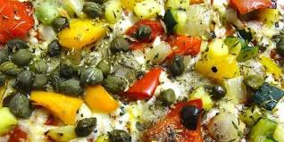
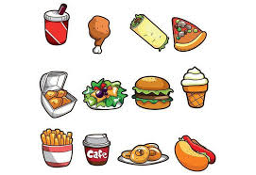
THE CORRECT PROCESSING OF DIFFERENT TYPES OF CONVENIENCE FOODS
Semi-Processed Foods
Usage: Semi-processed foods like chopped vegetables and marinated meats should be used promptly as they are perishable and prone to contamination.
Handling: Always handle with clean, sanitized utensils and wear gloves. Avoid cross-contamination by storing raw and cooked foods separately.
Storage: Keep refrigerated at 1–4°C. If frozen, store at -18°C. Observe use-by dates strictly, as these foods have a shorter shelf life than other preserved types.
VICTUALLING / FOOD STORAGE / PROCESSING / NUTRITION / FIRST AID

Slide 28
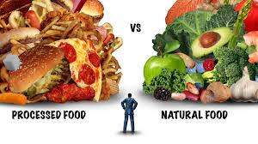
THE CORRECT PROCESSING OF DIFFERENT TYPES OF CONVENIENCE FOODS
Fully Processed Foods
Usage: These are typically reheated before serving. Follow manufacturer’s instructions for heating to ensure the food reaches safe internal temperatures (usually above 75°C).
Handling: Use tongs or serving utensils to avoid direct hand contact. Open the packaging just before heating/serving to minimize contamination.
Storage: Store frozen at -18°C or in dry storage if shelf-stable (e.g., retort pouches or vacuum-sealed meals). Keep away from direct heat and light. Monitor expiry dates.
VICTUALLING / FOOD STORAGE / PROCESSING / NUTRITION / FIRST AID

Slide 29

THE CORRECT PROCESSING OF DIFFERENT TYPES OF CONVENIENCE FOODS
Dried (Dehydrated) Foods
Usage: Dried foods require rehydration (e.g., adding water or broth) and often cooking before serving. Use potable water for rehydration.
Handling: Keep dry and sealed until use. Always check for signs of moisture, insects, or mold before use.
Storage: Store in a cool, dry place (below 25°C). Once opened, reseal tightly and use within the recommended timeframe or transfer to airtight containers.
VICTUALLING / FOOD STORAGE / PROCESSING / NUTRITION / FIRST AID

Slide 30
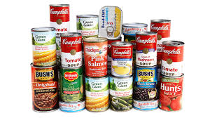
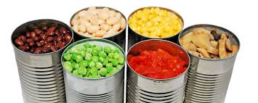
THE CORRECT PROCESSING OF DIFFERENT TYPES OF CONVENIENCE FOODS
Canned Foods
Usage: Canned foods can be used directly or with light heating. Inspect cans for damage or bulging before opening—discard any compromised cans.
Handling: Use a clean can opener and sanitize after each use. Transfer leftovers from opened cans into clean, covered containers and refrigerate.
Storage: Store unopened cans in a dry, cool area away from extreme temperatures. Once opened, refrigerate leftovers and consume within 2–3 days.
VICTUALLING / FOOD STORAGE / PROCESSING / NUTRITION / FIRST AID

Slide 31
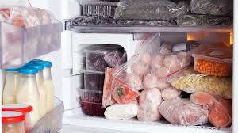

THE CORRECT PROCESSING OF DIFFERENT TYPES OF CONVENIENCE FOODS
Frozen Foods
Usage: Cook according to instructions, ensuring core temperature reaches at least 75°C. Thaw only when necessary and avoid partial thawing/refreezing.
Handling: Use gloves or tongs to handle frozen items. Thaw in the refrigerator or as directed—never at room temperature.
Storage: Maintain freezer temperature at -18°C or lower. Use FIFO (First In, First Out) to rotate stock. Label with dates of freezing and opening if repackaged.
VICTUALLING / FOOD STORAGE / PROCESSING / NUTRITION / FIRST AID

Slide 32
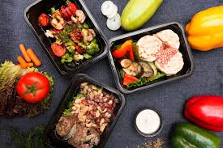
THE CORRECT PROCESSING OF DIFFERENT TYPES OF CONVENIENCE FOODS
Ready-to-Eat (RTE) Foods
Usage: Serve directly or chill as needed. Ideal for quick meals or snacks without kitchen preparation.
Handling: Must be handled with extreme care—use gloves and avoid bare-hand contact. Serve in clean, sanitized dishes.
Storage: Keep refrigerated at or below 4°C. Consume before the expiration date. Once opened, consume within 24 hours unless otherwise specified.
VICTUALLING / FOOD STORAGE / PROCESSING / NUTRITION / FIRST AID

Slide 33
THE CORRECT PROCESSING OF DIFFERENT TYPES OF CONVENIENCE FOODS
General Best Practices Onboard a Ship
Temperature Control: Use thermometers to regularly check refrigerators, freezers, and hot-holding equipment.
FIFO Method: Always use the First In, First Out method to minimize waste and spoilage.
Labeling: Date all opened products and leftovers. Label repackaged items.
Cleanliness: Maintain hygiene in storage areas. Clean spills immediately and regularly sanitize food contact surfaces.
Pest Control: Keep all storage areas sealed and regularly inspected to prevent infestations.
VICTUALLING / FOOD STORAGE / PROCESSING / NUTRITION / FIRST AID

Slide 34

COMPARISON AND CONTRAST OF DIFFERENT FOOD PRESERVATION METHODS
A comparison and contrast of the advantages and disadvantages of different food preservation and processing methods is given in terms of:
o Shelf life
o Nutritional retention
o Taste and texture
o Cost and convenience
VICTUALLING / FOOD STORAGE / PROCESSING / NUTRITION / FIRST AID

Slide 35
COMPARISON AND CONTRAST OF DIFFERENT FOOD PRESERVATION METHODS
Onboard a ship, selecting the right preservation method depends on the voyage duration, storage capacity, crew size, and available cooking facilities. Freezing and vacuum packing offer good nutrition and taste but require reliable equipment. Canned and dried foods are essential for emergencies and long shelf life, while RTE foods provide quick meals with minimal effort, but should be used in moderation due to their lower nutritional value.
Nutritional Content
Ingredients
Additives and preservatives
Expiration and best-before dates
Allergen warnings and storage instructions
VICTUALLING / FOOD STORAGE / PROCESSING / NUTRITION / FIRST AID

Slide 36
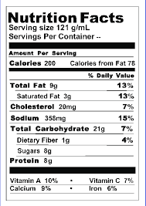
COMPARISON AND CONTRAST OF DIFFERENT FOOD PRESERVATION METHODS
Nutritional Content:
One of the primary purposes of reading a food label is to assess its nutritional value. The nutrition facts panel typically provides information per serving, including calories, fats (saturated and trans fats), carbohydrates (including sugars and fiber), proteins, and essential vitamins and minerals. When evaluating this section, it's important to compare the serving size to the actual portion consumed. Additionally, understanding the percentage of daily value (%DV) helps determine whether a food is high or low in a particular nutrient. Foods high in fiber, vitamins, and minerals and low in added sugars, sodium, and unhealthy fats are generally more beneficial, especially in controlled dietary environments like ships.
VICTUALLING / FOOD STORAGE / PROCESSING / NUTRITION / FIRST AID

Slide 37
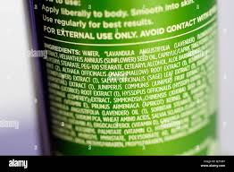
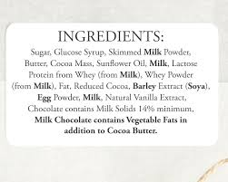
COMPARISON AND CONTRAST OF DIFFERENT FOOD PRESERVATION METHODS
Ingredients:
The ingredients list provides a detailed look at what the product is made of, usually in descending order by weight. This means the first few ingredients are the most abundant. Reading this list carefully helps determine the overall quality of the food. For example, products with whole foods listed first (like whole grains, vegetables, or lean meats) are typically healthier than those dominated by refined sugars or flours. Shorter ingredient lists with recognizable items tend to indicate less processed foods, which are often preferable for nutrition and digestion.
VICTUALLING / FOOD STORAGE / PROCESSING / NUTRITION / FIRST AID

Slide 38
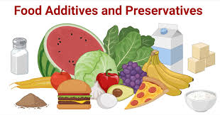
COMPARISON AND CONTRAST OF DIFFERENT FOOD PRESERVATION METHODS
Additives and Preservatives:
Food labels also disclose additives and preservatives used to enhance flavor, texture, appearance, or shelf life. Common additives include artificial sweeteners, coloring agents, and preservatives like sodium benzoate or nitrates. While many are considered safe in regulated amounts, frequent consumption of heavily processed foods with numerous additives may raise health concerns over time. It's advisable to be cautious with products listing several chemical names or codes (e.g., E-numbers), especially for individuals with sensitivities or dietary restrictions.
VICTUALLING / FOOD STORAGE / PROCESSING / NUTRITION / FIRST AID

Slide 39


COMPARISON AND CONTRAST OF DIFFERENT FOOD PRESERVATION METHODS
Expiration and Best-Before Dates:
Understanding the expiration and best-before dates on packaging is critical for food safety. The “expiration date” indicates the last date a food is considered safe to consume, especially for perishable items like dairy, meats, and ready-to-eat meals. In contrast, the “best-before” date refers to the period during which the product maintains its optimal quality, such as taste, texture, and nutritional value. While some items may still be edible after the best-before date, perishable items should never be used past their expiration date, particularly in shipboard environments where medical support is limited.
VICTUALLING / FOOD STORAGE / PROCESSING / NUTRITION / FIRST AID

Slide 40

COMPARISON AND CONTRAST OF DIFFERENT FOOD PRESERVATION METHODS
Allergen Warnings and Storage Instructions:
Labels must also highlight potential allergens, either within the ingredients or due to cross-contamination. Common allergens include nuts, dairy, gluten, soy, eggs, and shellfish. These are typically emphasized in bold or listed in a separate “contains” section to ensure visibility. For crew members or passengers with food allergies, careful attention to these warnings is essential to prevent serious health risks. Additionally, proper storage instructions—such as “keep refrigerated,” “store in a cool, dry place,” or “consume within X days of opening”—must be followed to ensure food safety and maintain quality throughout the voyage.
VICTUALLING / FOOD STORAGE / PROCESSING / NUTRITION / FIRST AID

Slide 41
CONVENIENCE FOOD
Convenience foods play a critical role in supporting nutrition and efficiency, especially in environments like ships where resources, time, and storage are often limited. While not a substitute for fresh, whole foods, they serve as a practical component in maintaining a balanced diet under constrained conditions.
1. Time and Labor Efficiency
One of the key advantages of convenience foods is that they reduce preparation time and labor. Onboard ships, where galley staff often prepare meals for large crews in a short period, semi-processed or ready-to-eat items help streamline operations. Pre-chopped vegetables, frozen meats, or heat-and-serve meals allow cooks to provide regular, timely meals with fewer personnel.
VICTUALLING / FOOD STORAGE / PROCESSING / NUTRITION / FIRST AID

Slide 42
CONVENIENCE FOOD
2.Nutritional Support
When chosen wisely, convenience foods can contribute significantly to nutrient intake. For example, frozen vegetables retain most of their vitamins and minerals, and canned legumes provide protein and fiber. These foods can help meet dietary needs when fresh supplies are unavailable due to extended voyages or limited port access.
3. Extended Shelf Life
Convenience foods such as dried, frozen, or canned items offer long shelf lives, which is essential for long-term storage at sea. This reduces food spoilage and waste, ensuring that the crew always has access to essential nutrients, even in emergencies or during long crossings where fresh resupply isn’t possible.
VICTUALLING / FOOD STORAGE / PROCESSING / NUTRITION / FIRST AID

Slide 43
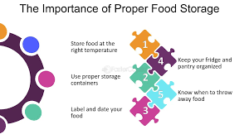
CONVENIENCE FOOD
4. Dietary Variety
They also help diversify meals and prevent menu fatigue, which is important for maintaining crew morale. With a range of products like frozen meals, pre-made sauces, and preserved fruits, cooks can offer varied and culturally appropriate menus without needing a wide range of fresh ingredients.
5. Storage and Safety Advantages
Convenience foods are designed for safe storage in different shipboard conditions (e.g., freezing, vacuum sealing, dehydration), which enhances food safety and reduces contamination risks. Properly handled and stored, these products ensure meals are safe to consume even in challenging conditions.
VICTUALLING / FOOD STORAGE / PROCESSING / NUTRITION / FIRST AID

Slide 44
CONVENIENCE FOOD
6. Budget and Resource Management
In limited-resource environments, convenience foods often offer cost efficiency when considering labor, fuel, and water usage. For instance, using dried or frozen foods reduces the need for constant refrigeration or large amounts of cooking fuel, making them ideal in managing onboard provisions effectively.
In a shipboard setting or any institutional environment with limited resources, convenience foods are not just a matter of convenience—they're a strategic component of food service management. When selected and used properly, they support a balanced, safe, and efficient diet, helping maintain crew health and operational readiness throughout the voyage.
VICTUALLING / FOOD STORAGE / PROCESSING / NUTRITION / FIRST AID

Slide 45
SELECTING APPROPRIATE CONVENIENCE FOODS
1. Assess Operational Needs
Ships often operate in isolated and unpredictable conditions, so the type of convenience food selected must match the voyage length, crew size, storage capacity, and equipment availability.
Voyage Duration: For long voyages, prioritize shelf-stable items like canned, dried, andfrozen foods.
Storage Conditions: Choose items that match available storage (e.g., refrigerated, frozen, or dry stores).
Kitchen Equipment: Select foods that match available galley equipment (e.g., microwaveable meals if ovens are limited).
Crew Skills: Where kitchen staff are limited, opt for foods that are easy to prepare with minimal cooking knowledge.
VICTUALLING / FOOD STORAGE / PROCESSING / NUTRITION / FIRST AID

Slide 46
SELECTING APPROPRIATE CONVENIENCE FOODS
2. Consider Dietary Requirements
Convenience foods should support the health and nutritional needs of a diverse crew.
Balanced Nutrition: Ensure a mix of macronutrients (carbohydrates, protein, and healthy fats) and micronutrients (vitamins and minerals).
Special Diets: Include options for common dietary restrictions (e.g., vegetarian, low-sodium, gluten-free).
Label Reading: Select products with clear labeling on nutritional content, allergens, and additives to avoid health risks and comply with food safety standards.
Meal Variety: Offer a mix of ready-to-eat meals, frozen dishes, and pre-prepped ingredients to maintain meal variety and prevent fatigue.
VICTUALLING / FOOD STORAGE / PROCESSING / NUTRITION / FIRST AID

Slide 47
SELECTING APPROPRIATE CONVENIENCE FOODS
3. Evaluate Budget Constraints
Managing food budgets onboard is essential, especially for extended voyages or when resupply opportunities are limited.
Cost per Serving: Choose bulk or multi-portion convenience foods when possible to lower per-serving costs.
Minimize Waste: Select foods with longer shelf lives or resealable packaging to reduce spoilage and waste.
Fuel and Time Savings: Ready-to-eat or quick-prep foods reduce cooking time and energy consumption, helping save operational costs.
Port Availability: Source locally available, budget-friendly convenience items when provisioning in different ports to cut import or delivery costs.
VICTUALLING / FOOD STORAGE / PROCESSING / NUTRITION / FIRST AID

Slide 48
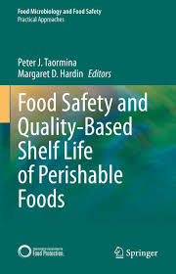


SELECTING APPROPRIATE CONVENIENCE FOODS
4. Plan for Safety and Shelf Life
Shelf Life and Rotation: Choose products with clear expiration dates and implement FIFO (First In, First Out) practices.
Food Safety: Select brands or products with a good safety record, proper certifications, and tamper-proof packaging.
Portion Control: Use pre-portioned packs to prevent overuse and ensure consistent serving sizes.
VICTUALLING / FOOD STORAGE / PROCESSING / NUTRITION / FIRST AID

Slide 49

SELECTING APPROPRIATE CONVENIENCE FOODS
5. Monitor Feedback and Adjust
Regular feedback from the crew helps refine selections:
Taste Preferences: Choose items that reflect cultural and regional preferences of the crew.
Satisfaction Surveys: Monitor acceptance and satisfaction levels to eliminate unpopular or underused items.
Inventory Reviews: Regularly assess stock levels and spoilage to adjust orders accordingly.
VICTUALLING / FOOD STORAGE / PROCESSING / NUTRITION / FIRST AID

Slide 50
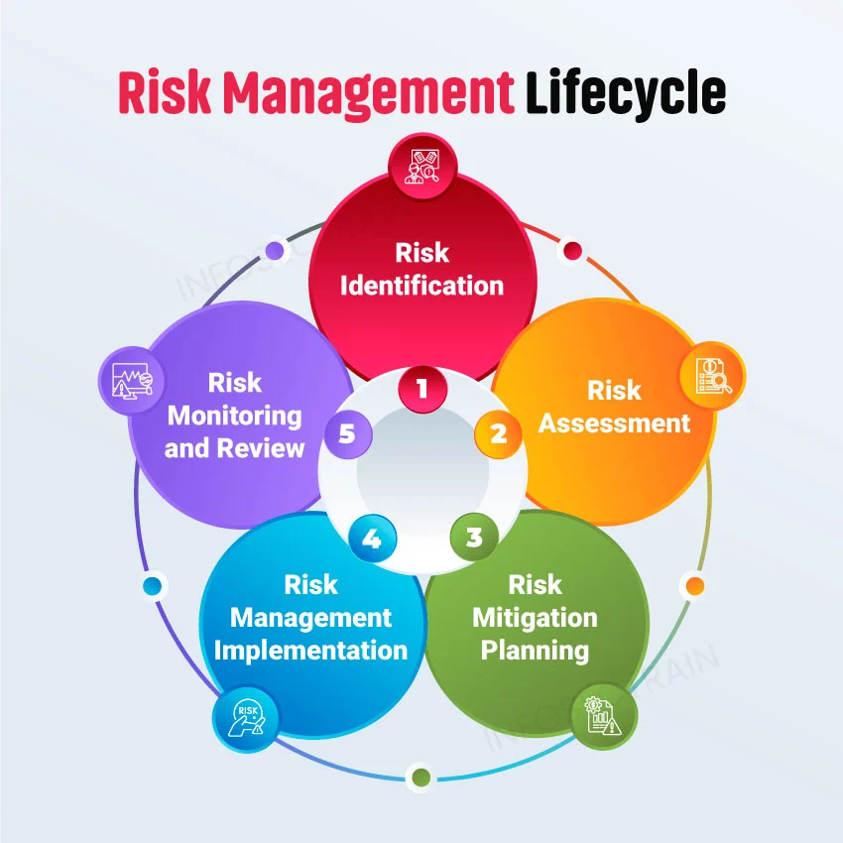
RISK MANAGEMENT AT THE GALLEY
VICTUALLING / FOOD STORAGE / PROCESSING / NUTRITION / FIRST AID

Slide 51
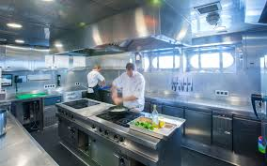
RISK MANAGEMENT AT THE GALLEY
IDENTIFYING AREAS THAT ARE AT RISK
Identifying risk areas in a pantry aboard a ship is essential to preventing emergencies and maintaining food safety and crew well-being. Below is a list of key areas at risk in a ship’s pantry, along with how they can be identified:
1. Storage Shelves and Racks
Risk: Items falling during rough seas or poor storage practices.
Identification: Look for overloaded shelves, unsecured containers, or missing restraints (like bars or nets). Any items not firmly fixed or stacked are a hazard.
VICTUALLING / FOOD STORAGE / PROCESSING / NUTRITION / FIRST AID

Slide 52
RISK MANAGEMENT AT THE GALLEY
2. Electrical Outlets and Lighting Fixtures
Risk: Short circuits, sparks, or overheating—fire hazards.
Identification: Inspect for exposed wiring, flickering lights, heat around plugs, or overloaded outlets. Regular electrical safety checks should be logged.
3. Flooring and Walkways
Risk: Slipping, tripping, or falling due to spills or wet surfaces.
Identification: Look for signs of moisture, spills, loose mats, or clutter in pathways. Areas near sinks, fridges, or doors are especially vulnerable.
VICTUALLING / FOOD STORAGE / PROCESSING / NUTRITION / FIRST AID

Slide 53
RISK MANAGEMENT AT THE GALLEY
4. Refrigerators and Freezers
Risk: Spoiled food due to power loss or malfunction.
Identification: Use temperature logs and alarm systems to monitor temperature fluctuations. Frost buildup or leaks are early signs of failure.
5. Cleaning Supply Area (if nearby or inside pantry)
Risk: Chemical leaks, spills, or fumes contaminating food.
Identification: Check that chemicals are properly labeled, sealed, and stored in a separate, ventilated, and secured cabinet—never next to food items.
VICTUALLING / FOOD STORAGE / PROCESSING / NUTRITION / FIRST AID

Slide 54
RISK MANAGEMENT AT THE GALLEY
6. Food Containers and Packaging
Risk: Pest access or contamination from damaged packaging.
Identification: Inspect for broken seals, holes, tears, or signs of gnawing. Look for droppings, unusual odors, or insect presence nearby.
7. Doors and Locks
Risk: Accidental entrapment or blocked access during emergencies.
Identification: Ensure door mechanisms function smoothly, can be opened from inside, and are not obstructed. Install emergency release mechanisms if possible.
.
VICTUALLING / FOOD STORAGE / PROCESSING / NUTRITION / FIRST AID

Slide 55
RISK MANAGEMENT AT THE GALLEY
8. Ventilation and Airflow
Risk: Mold growth, odor buildup, and poor air quality.
Identification: Check for musty smells, condensation on walls or ceilings, and clogged vents. Humidity meters can help monitor high-moisture risk.
9. Waste Disposal Area (if adjacent or inside pantry)
Risk: Attracting pests, spreading bacteria.
Identification: Monitor waste bins for overflow, strong odors, or signs of pest activity. Ensure regular cleaning schedules and keep bins covered.
VICTUALLING / FOOD STORAGE / PROCESSING / NUTRITION / FIRST AID

Slide 56
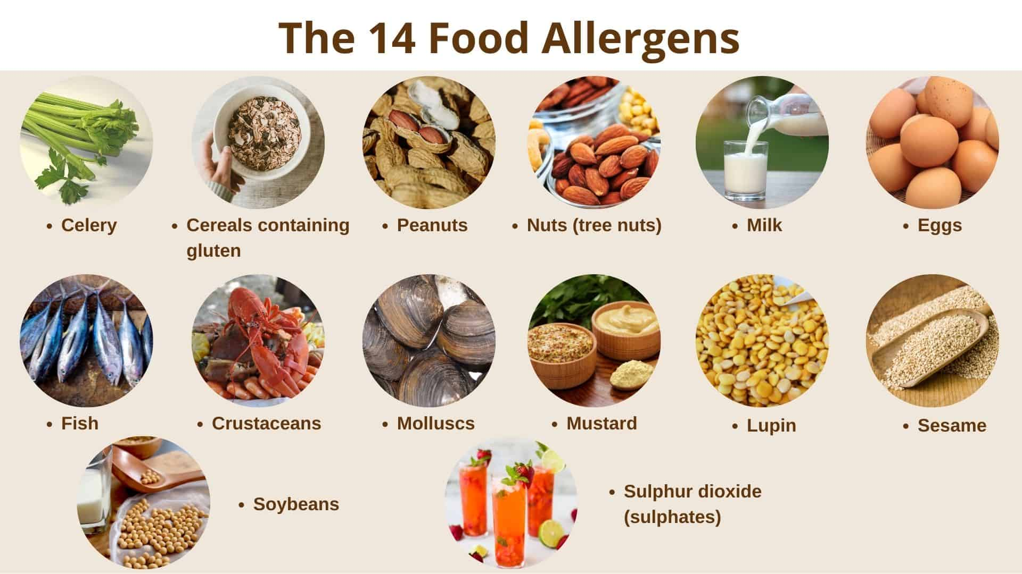
RISK MANAGEMENT AT THE GALLEY
10. Allergen Storage Zones
Risk: Cross-contamination of allergens with general food items.
Identification: Ensure that allergen-containing products are stored separately, clearly labeled, and kept away from open food and shared surfaces.
VICTUALLING / FOOD STORAGE / PROCESSING / NUTRITION / FIRST AID

Slide 57
PANTRY EMERGENCIES
1. Fire
Fires in ship pantries can start due to faulty wiring, nearby galley equipment, or flammable items like cooking oils and packaging. In confined ship spaces, fire spreads quickly and poses a serious threat to both the crew and vessel. Fire extinguishers and smoke detectors must be present and regularly checked.
2. Falling or Shifting Items
During rough seas, unsecured items like cans, utensils, or boxes can fall from shelves, causing injury or blocking access. Ship movement makes this a frequent hazard, so all items should be properly stowed with restraints, safety nets, or locking cabinets.
3. Chemical Spills
Cleaning chemicals stored in or near the pantry can leak or mix during ship motion, creating toxic fumes or contaminating food. These incidents are more dangerous at sea due to poor ventilation and limited medical help. Chemicals must be stored separately and securely.
VICTUALLING / FOOD STORAGE / PROCESSING / NUTRITION / FIRST AID

Slide 58
PANTRY EMERGENCIES
4. Pest Infestation
Rodents or insects can get onboard with supplies from port or through poor sealing. Once at sea, pest control is much harder. Infestation risks food contamination and disease, so tight food storage, regular inspections, and strict cleanliness are critical.
5. Refrigeration Failure
If cold storage breaks down due to power issues or equipment failure, perishable items can spoil quickly. This can lead to foodborne illness and disruption of meal service. Backup power systems, temperature logs, and routine maintenance help prevent this.
6. Water Leaks or Flooding
Leaks from pipes or seawater intrusion can damage food stores, cause mold, or create electrical hazards. Even small leaks can become big problems in ship environments. Regular checks for moisture and proper drainage systems are essential.
VICTUALLING / FOOD STORAGE / PROCESSING / NUTRITION / FIRST AID

Slide 59
PANTRY EMERGENCIES
7. Slip, Trip, and Fall Accidents
Spills, wet floors, or loose items are dangerous in any pantry but even more so aboard a moving ship. The rocking motion makes slips and falls more likely. Anti-slip mats, good lighting, and keeping pathways clear help reduce risk.
8. Cross-Contamination or Allergen Exposure
Improper storage or hygiene can cause allergens to mix or food to become contaminated. On a ship with limited medical support, even mild food reactions can escalate. Clearly labeling items and following safe food handling practices are crucial.
9. Food Poisoning Outbreak
Spoiled or poorly handled food can lead to multiple crew members getting sick. With no access to a hospital, foodborne illness is a serious emergency. Maintaining proper food temperatures and hygiene helps prevent outbreaks.
VICTUALLING / FOOD STORAGE / PROCESSING / NUTRITION / FIRST AID

Slide 60

PANTRY EMERGENCIES
10. Entrapment
Due to automatic locking doors or power failures, someone could become accidentally trapped in the pantry. This is especially dangerous if the area has no communication system. Panic and injury may result, so doors should have safety overrides or alarms.
VICTUALLING / FOOD STORAGE / PROCESSING / NUTRITION / FIRST AID

Slide 61
THE STEPS TO BE TAKEN IN THE CASE OF EMERGENCY
1. Fire
Causes: Electrical faults (e.g., faulty lighting, overloaded sockets), flammable materials (paper, plastic, oils), or improper storage of cleaning chemicals.
Risks: Fire can spread quickly in confined pantry areas with dry goods and cardboard packaging.
Prevention: Keep fire extinguishers accessible, ensure proper electrical maintenance, and avoid storing flammable materials improperly
VICTUALLING / FOOD STORAGE / PROCESSING / NUTRITION / FIRST AID

Slide 62

THE STEPS TO BE TAKEN IN THE CASE OF EMERGENCY
2. Pest Infestation
Causes: Rodents, insects, or other pests attracted by improperly sealed food or poor sanitation.
Risks: Contamination of food, health hazards, food loss.
Prevention: Regular inspections, sealed containers, pest control measures, and cleanliness.
VICTUALLING / FOOD STORAGE / PROCESSING / NUTRITION / FIRST AID

Slide 63

THE STEPS TO BE TAKEN IN THE CASE OF EMERGENCY
3. Spoiled or Contaminated Food
Causes: Expired food, broken refrigeration, poor rotation (FIFO), moisture or mold.
Risks: Foodborne illness, waste, cross-contamination.
Prevention: Regular inventory checks, temperature control, proper labeling, and humidity control.
VICTUALLING / FOOD STORAGE / PROCESSING / NUTRITION / FIRST AID

Slide 64

THE STEPS TO BE TAKEN IN THE CASE OF EMERGENCY
4. Chemical Spills
Causes: Leaking or improperly stored cleaning chemicals or pesticides.
Risks: Toxic exposure, contamination, risk of fire.
Prevention: Store chemicals away from food, use proper labeling and containment.
VICTUALLING / FOOD STORAGE / PROCESSING / NUTRITION / FIRST AID

Slide 65

THE STEPS TO BE TAKEN IN THE CASE OF EMERGENCY
5. Slip, Trip, and Fall Hazards
Causes: Spilled liquids, loose packaging, cluttered floors, poor lighting.
Risks: Physical injury, broken equipment, or supplies.
Prevention: Keep floors dry and clear, maintain good lighting, secure shelving.
VICTUALLING / FOOD STORAGE / PROCESSING / NUTRITION / FIRST AID

Slide 66

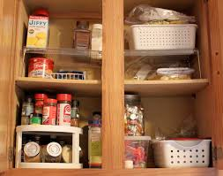
THE STEPS TO BE TAKEN IN THE CASE OF EMERGENCY
6. Structural Failures
Causes: Overloaded shelves, poor construction, old or damaged fixtures.
Risks: Collapse, injury, food damage.
Prevention: Use sturdy shelving, observe weight limits, conduct regular maintenance checks.
VICTUALLING / FOOD STORAGE / PROCESSING / NUTRITION / FIRST AID

Slide 67
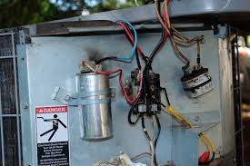

THE STEPS TO BE TAKEN IN THE CASE OF EMERGENCY
7. Power Outage
Causes: Electrical failure affecting lighting or refrigeration (if cold storage is part of the pantry).
Risks: Spoilage, difficulty navigating in the dark.
Prevention: Emergency lighting, backup power for critical refrigeration.
VICTUALLING / FOOD STORAGE / PROCESSING / NUTRITION / FIRST AID

Slide 68

THE STEPS TO BE TAKEN IN THE CASE OF EMERGENCY
8. Allergen Cross-Contamination
Causes: Improper storage of allergens near other food items.
Risks: Severe allergic reactions.
Prevention: Label and store allergens separately, and train staff in allergy-safe procedures.
VICTUALLING / FOOD STORAGE / PROCESSING / NUTRITION / FIRST AID

Slide 69
BASIC FIRST AID INFORMATION
Providing basic first aid on board a ship is vital because immediate medical help is not always accessible at sea. Every crew member should have at least a working knowledge of basic first aid procedures to respond quickly and stabilize a person until professional care is available.
When a medical emergency arises onboard a ship, it is critical to respond swiftly, calmly, and with caution. The first step is to assess the scene. Ensure that the environment is safe for both the casualty and the responder. Avoid hazards such as fire, electrical risks, chemicals, or unstable footing. If the area poses a danger, move the injured person only if absolutely necessary.
VICTUALLING / FOOD STORAGE / PROCESSING / NUTRITION / FIRST AID

Slide 70
BASIC FIRST AID INFORMATION
Next, conduct a primary survey using the DRABC method. Begin by checking for Danger to yourself and the casualty. Then assess the Response by gently shaking the person and asking questions to determine consciousness. Ensure the Airway is open and not obstructed. Check for Breathing by looking, listening, and feeling for breath for no more than 10 seconds. Finally, check for Circulation, such as signs of bleeding or other indicators that the heart is functioning.
If the casualty is not breathing, begin Cardiopulmonary Resuscitation (CPR). For adults, perform 30 chest compressions followed by 2 rescue breaths. Maintain a rhythm of 100–120 compressions per minute with a depth of 5–6 cm. Continue CPR until the casualty shows signs of life or professional help takes over. If an Automated External Defibrillator (AED) is available and you are trained, use it as soon as possible.
VICTUALLING / FOOD STORAGE / PROCESSING / NUTRITION / FIRST AID

Slide 71
BASIC FIRST AID INFORMATION
To control bleeding, apply direct pressure to the wound using a clean cloth or dressing. Elevate the injured area if you can do so safely, and secure the dressing with a bandage. Monitor the casualty for signs of shock. In the case of severe bleeding, a tourniquet may be used if the responder is trained in its application.
For burns and scalds, immediately cool the affected area under running cold water for at least 10 minutes. Remove any loose clothing or jewelry, but do not attempt to remove anything stuck to the burn. Cover the area with a sterile, non-stick dressing such as cling film. Do not apply ice or creams directly to the burn, as this can cause further damage.
VICTUALLING / FOOD STORAGE / PROCESSING / NUTRITION / FIRST AID

Slide 72

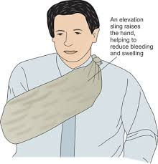
BASIC FIRST AID INFORMATION
If a person has a suspected fracture or sprain, immobilize the injury using a splint or sling. Apply a cold pack wrapped in cloth to reduce swelling, but do not try to move or realign the bones. Keep the casualty calm and still until further help arrives.
In the case of choking, ask the person if they can speak or cough. If they cannot, administer 5 firm back blows followed by 5 abdominal thrusts. Alternate between these actions until the blockage is cleared or the person becomes unconscious. If they lose consciousness, begin CPR immediately.
VICTUALLING / FOOD STORAGE / PROCESSING / NUTRITION / FIRST AID

Slide 73


BASIC FIRST AID INFORMATION
Shock can occur as a result of injury or trauma and presents symptoms such as pale, cold skin, a rapid pulse, dizziness, and confusion. If someone is in shock, lay them flat and elevate their legs unless there is a suspected injury that would prevent this. Keep the casualty warm and calm, and do not give them anything to eat or drink.
For heat exhaustion or heatstroke, move the affected person to a cool, shaded area. Remove any unnecessary clothing and apply cool, wet cloths to the skin. Offer small sips of water with electrolytes if they are conscious. If the person shows signs of heatstroke, such as confusion or unconsciousness, treat it as a medical emergency and seek help immediately.
VICTUALLING / FOOD STORAGE / PROCESSING / NUTRITION / FIRST AID

Slide 74

BASIC FIRST AID INFORMATION
In cases of chemical exposure or poisoning, remove any contaminated clothing and rinse the affected skin thoroughly with water. Do not induce vomiting unless instructed by a medical professional. Try to identify the chemical involved and notify the ship’s medical officer or captain without delay.
To support emergency care, vessels should be equipped with appropriate first aid equipment, including marine first aid kits that meet IMO/WHO standards, burn dressings, sterile gauze, and bandages. Other essential items include CPR masks, AEDs, splints, slings, eyewash solutions, gloves, scissors, and tweezers. Emergency medications may also be carried if permitted and prescribed.
VICTUALLING / FOOD STORAGE / PROCESSING / NUTRITION / FIRST AID

Slide 75


BASIC FIRST AID INFORMATION
Finally, all crew members should receive training in basic first aid and CPR. First aid posters and quick-reference guides should be displayed in strategic areas such as the galley, engine room, and bridge. A First Aid Logbook should be maintained to document all incidents and treatments, ensuring proper record-keeping and facilitating medical follow-up when necessary.
VICTUALLING / FOOD STORAGE / PROCESSING / NUTRITION / FIRST AID

Slide 76
BASIC FIRST AID INFORMATION
Use labels, logs, and color-coded zones for easy identification.
Train crew on what to report (e.g., leaks, smells, rodent signs, electrical issues).
Conduct daily visual inspections using a checklist
Assign trained crew to pantr safety duties and ensure all crew are trained in first aid with proper documentation a
Perform monthly safety audits using formal procedures
VICTUALLING / FOOD STORAGE / PROCESSING / NUTRITION / FIRST AID

Slide 77
GENERAL STEPS TO TAKE IN CASE OF EMERGENCY ONBOARD
1. Raise the Alarm
2. Follow Emergency Procedures
3. Isolate the Hazard
4. Protect Yourself and Others
5. Control the Scene
6. Inform the Master or Officer of the Watch
7. Log the Incident
VICTUALLING / FOOD STORAGE / PROCESSING / NUTRITION / FIRST AID

Slide 78
TO BE READY FOR EMERGENCIES
Conduct regular emergency drills including galley/pantry scenarios.
Keep an updated emergency contact and muster list
Train crew on fire safety, first aid, and emergency equipment use.
Ensure pantry equipment and fixtures are regularly maintained.
VICTUALLING / FOOD STORAGE / PROCESSING / NUTRITION / FIRST AID

Slide 79
REFERENCES
Felício, J. A., Rodrigues, R., & Caldeirinha, V. (2021). Green shipping effect on sustainable economy and environmental performance. Sustainability, 13(8), 4256.
Hay, T. K., & Slater, K. (2014). Victualling for Future Royal Australia Navy Platforms-Alternative Technologies (No. DSTOTR1379).
Hugos, M. H. (2024). Essentials of supply chain management. John Wiley & Sons.
Scholliers, P. (2015). Convenience foods. What, why, and when. Appetite, 94, 2-6.
Brunner, T. A., Van der Horst, K., & Siegrist, M. (2010). Convenience food products. Drivers for consumption. Appetite, 55(3), 498-506.
Reddy, M. B., & Love, M. (1999). The impact of food processing on the nutritional quality of vitamins and minerals. Impact of processing on food safety, 99-106. first-aid/kitchen-first-aid
VICTUALLING / FOOD STORAGE / PROCESSING / NUTRITION / FIRST AID

Slide 80
REFERENCES
7. Devi, R. (2015). Food processing and impact on nutrition. Sch. J. Agric. Vet. Sci, 2, 304-311.
8. Rahman, M. S. (2020). Food preservation: an overview. Handbook of food preservation, 7-18.
9. Leistner, L. (1992). Food preservation by combined methods. Food research international, 25(2), 151-158.
10. Stranieri, S., Ricci, E. C., & Banterle, A. (2017). Convenience food with environmentally-sustainable attributes: A consumer perspective. Appetite, 116, 11-20.
11. Wales, M. E. (2009). Understanding the role of convenience in consumer food choices: a review article. SURG Journal, 2(2), 40-48.
12. Akamangwa, N. (2016). Working for the environment and against safety: How compliance affects health and safety on board ships. Safety Science, 87, 131-143.
VICTUALLING / FOOD STORAGE / PROCESSING / NUTRITION / FIRST AID

Slide 81
REFERENCES
13. Food Safety for Food Banks, Pantries and Distribution Centers (2025). https://www.greatamericaninsurancegroup.com/content-hub/loss-control/details/food-safety-for-food-banks-pantries-and-distribution-centers
14. 11 things you should never store in a pantry, according to experts. (2023). https://www.homesandgardens.com/kitchens/items-you-should-never-store-in-a-pantry
15. Miller, M. (2021). Safe Food Handling and Storage in Food Pantries. https://www.lsuagcenter.com/profiles/aiverson/articles/page1617218705849
16. Watson, S. & DerSarkissan, C. (2025) First Aid for Kitchen Accidents. https://www.webmd.com/
VICTUALLING / FOOD STORAGE / PROCESSING / NUTRITION / FIRST AID

