Slide 1








MARitime Soft Skills for Onboard Healthy Nutrition and CULinary Arts in Seagoing Services – CUL-MAR-Skills
KA220-VET - Cooperation partnerships in vocational education and training
2023-1-RO01-KA220-VET-000156711
VICTUALLING ONBOARD
Week IV
Food and Food Service Equipment
Disclaimer: “Funded by the European Union. Views and opinions expressed are however those of the author(s) only and do not necessarily reflect those of the European Union or the ANPCDEFP. Neither the European Union nor the ANPCDEFP can be held responsible for them”

Slide 2
Learning outcomes of the course
Understand the fundamentals of proper food handling and Transportation.
Plan and manage the Galley Sanitation Guidelines.
Ensure Effective Cleaning Techniques are implemented by the galley staff.
Implement Personal Hygiene and Food Safety principles onboard
Comply with Safety Protocols in the Galley Pantry
Identify key health and safety regulations.
Comply with Health and Safety Regulations
NAVAL COMMUNICATIONS
FOOD AND FOOD SERVICE EQUIPMENT

Slide 3
Content of the course
The handling, transportation, and cleaning of food, food service equipment
Sanitary Guidelines: Maintaining proper galley sanitation
Safety Standards for Galley Pantry
FOOD AND FOOD SERVICE EQUIPMENT

Slide 4
1. FOOD, FOOD SERVICE EQUIPMENT
(The handling, transportation, and cleaning) The principles of Compliance with Health and Safety Regulations in food handling and galley operations are based on key food safety laws, industry standards, and best practices. The principles followed in the course of this process are as follows:
HAZARD ANALYSIS AND CRITICAL CONTROL POINTS (HACCP)
HACCP is a preventive approach to food safety that identifies potential hazards and implements control measures.
People have the right to expect the food that they eat to be safe and suitable for consumption. Foodborne illness and foodborne injury can be severe or fatal or hurt human health over the longer term. Furthermore, outbreaks of foodborne illness can damage trade and tourism. Food spoilage is wasteful, costly, threatens food security, and can adversely affect trade and consumer confidence.
FOOD AND FOOD SERVICE EQUIPMENT

Slide 5

1. FOOD, FOOD SERVICE EQUIPMENT
Effective food hygiene practices, therefore, are vital to avoid the adverse human health and economic consequences of foodborne illness, foodborne injury, and food spoilage. Everyone, including primary producers, importers, manufacturers and processors, food warehouse/logistics operators, food handlers, retailers, and consumers, has a responsibility to ensure that food is safe and suitable for consumption. Food business operators (FBOs) should be aware of and understand the hazards associated with the food they produce, transport, store, and sell, and the measures required to control those hazards relevant to their business, so that food reaching consumers is safe and suitable for use.
FOOD AND FOOD SERVICE EQUIPMENT

Slide 6
1. FOOD, FOOD SERVICE EQUIPMENT
THE GENERAL PRINCIPLES OF FOOD HYGIENE document outlines the general principles that should be understood and followed by FBOs at all stages of the food chain and that provide a basis for competent authorities to oversee food safety and suitability. Taking into account the stage in the food chain, the nature of the product, the relevant contaminants, and whether the relevant contaminants adversely affect safety, suitability or both, these principles will enable food businesses to develop their own food hygiene practices and necessary food safety control measures, while complying with requirements set by competent authorities. While it is the FBOs’ responsibility to provide safe food, for some FBOs, this may be as simple as ensuring that the WHO's five keys to safer food1 are adequately implemented.
FOOD AND FOOD SERVICE EQUIPMENT

Slide 7
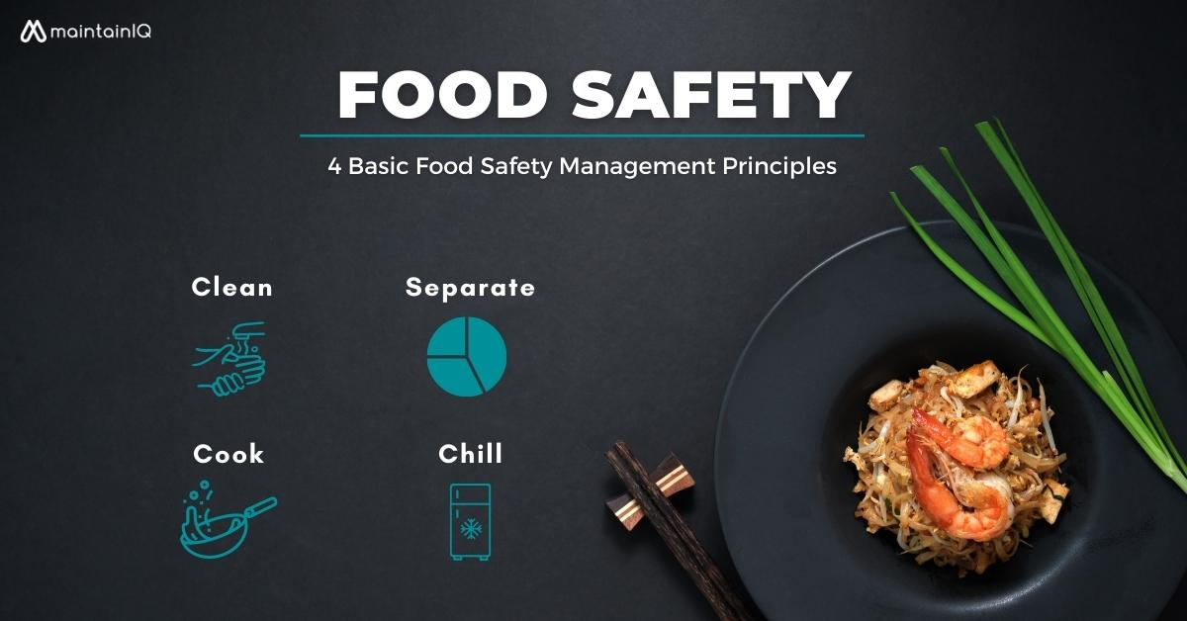
1. FOOD, FOOD SERVICE EQUIPMENT
The five keys are: “keep clean, separate raw and cooked, cook thoroughly, keep food at safe temperatures, and use safe water and raw materials”. FBOs need to be aware of hazards that may affect their food. FBOs need to understand the consequences of these hazards for consumer health and should ensure that they are properly managed. Good hygiene practices (GHPs) are the foundation of any effective control of hazards associated with their businesses.
FOOD AND FOOD SERVICE EQUIPMENT

Slide 8
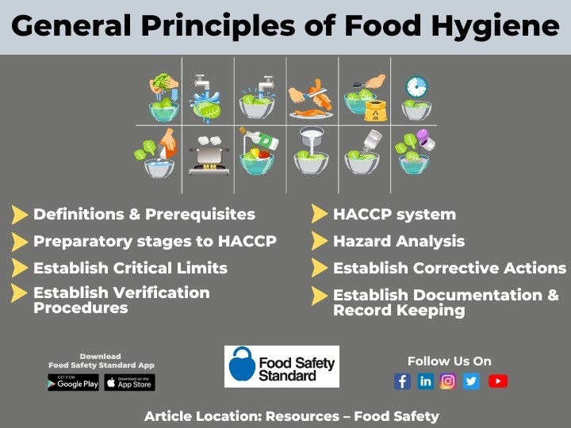
1. FOOD, FOOD SERVICE EQUIPMENT
FOOD AND FOOD SERVICE EQUIPMENT

Slide 9
1. FOOD, FOOD SERVICE EQUIPMENT
Thus, for some GHPs, based on safety concerns with food, greater attention may be needed to provide safe food. For example, the cleaning of equipment and surfaces that come into contact with ready-to-eat food should warrant greater attention than other areas, such as the cleaning of walls and ceilings, because if food contact surfaces are not properly cleaned, this could lead to direct contamination of food. Greater attention may include a higher frequency of application, monitoring, and of verification. In some circumstances, the implementation of GHPs may not be sufficient to ensure food safety due to the complexity of the food operation and/or specific hazards associated with the product or process, technological advances (e.g. extending shelf-life through modified atmosphere packaging) or end use of the product (e.g. products destined for a special dietary purpose). In such cases, when there are significant hazards identified through hazard analysis as not being controlled by GHPs, they should be addressed in the hazard analysis critical control point (HACCP) plan.
FOOD AND FOOD SERVICE EQUIPMENT

Slide 10
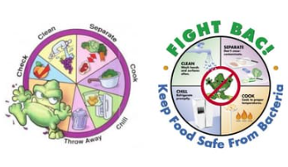
1. FOOD, FOOD SERVICE EQUIPMENT
This document has two parts: Good Hygiene Practices and Hazard Analysis and Critical Control Point (HACCP) System and Guidelines for its Application. The first covers the basis of all food hygiene systems to support the production of safe and suitable food, and the second deals with HACCP principles that can be applied throughout the food chain from primary production to final consumption, and whose implementation should be guided by scientific evidence of risks to human health.
FOOD AND FOOD SERVICE EQUIPMENT

Slide 11
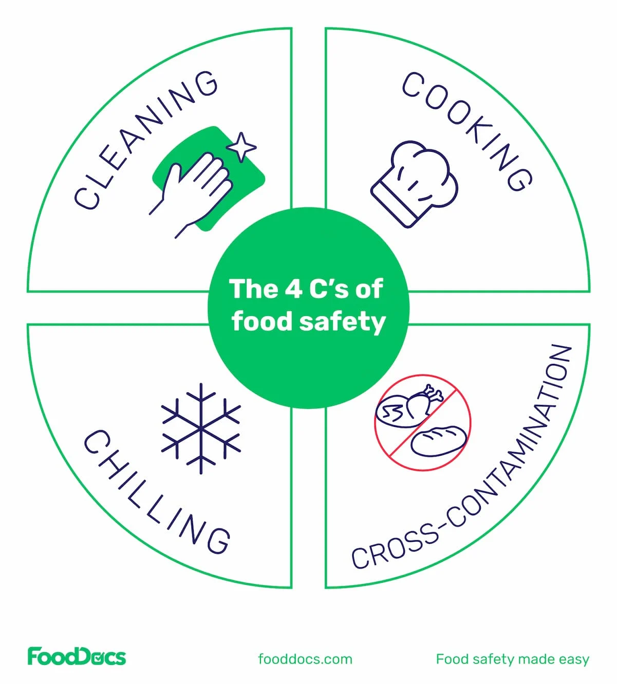
1. FOOD, FOOD SERVICE EQUIPMENT
The general principles of food hygiene: GHPs and the HACCP system aim to: • provide principles and guidance on the application of GHPs applicable throughout the food chain to provide food that is safe and suitable for consumption; • provide guidance on the application of HACCP principles; • clarify the relationship between GHPs and HACCP; and • provide the basis on which sector and product-specific codes of practice can be established
FOOD AND FOOD SERVICE EQUIPMENT

Slide 12
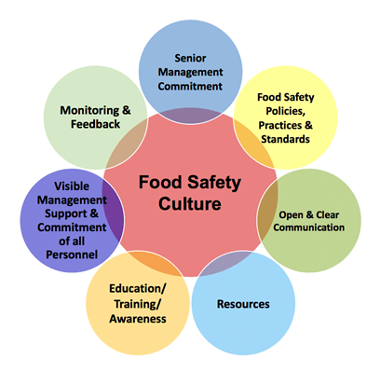
1. FOOD, FOOD SERVICE EQUIPMENT
FOOD AND FOOD SERVICE EQUIPMENT

Slide 13
2. SANITARY GUIDELINES
Maintaining proper galley sanitation onboard a ship is essential for safeguarding the health and well-being of the crew. One of the primary reasons is to prevent foodborne illnesses. Ships are closed environments, and if food becomes contaminated due to poor hygiene, illnesses such as norovirus, salmonella, or E. coli can spread rapidly among the crew. This can lead to widespread sickness, which is particularly dangerous at sea, where medical facilities are limited.
A clean and sanitary galley is also crucial for ensuring the overall health and efficiency of the crew. When crew members are healthy, they can perform their duties safely and effectively. In contrast, if several members fall ill due to unsanitary food preparation or storage, it can compromise the ship's operations, delay voyages, and increase the risk of accidents due to reduced alertness or manpower.
FOOD AND FOOD SERVICE EQUIPMENT

Slide 14
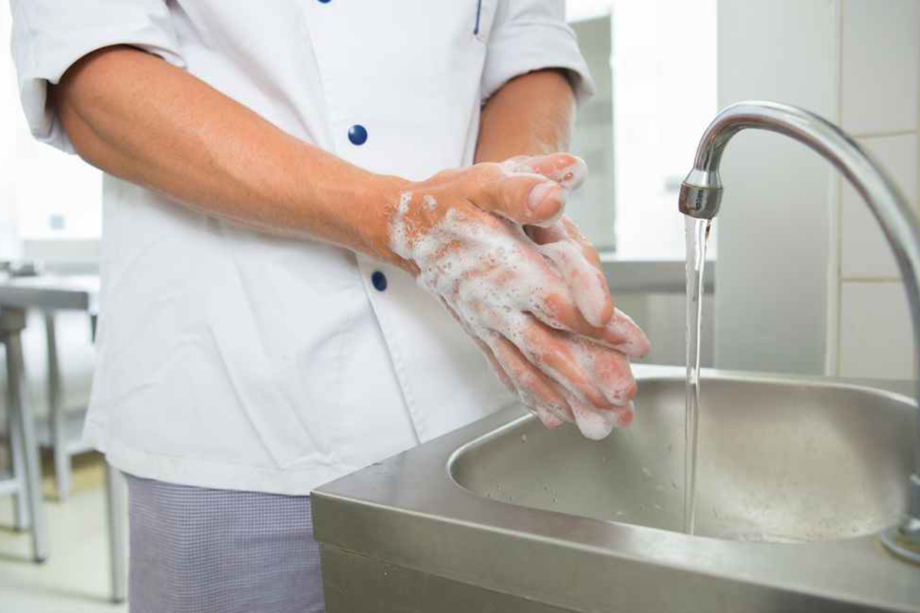
2. PROPER GALLEY SANITATION MAINTENANCE
1. Personal Hygiene of Food Handlers
Maintaining personal hygiene is essential for all food handlers onboard a ship to ensure food safety. Hands should be washed frequently, especially before handling food, after using the toilet, touching raw ingredients, or handling garbage. Food handlers must wear clean uniforms, aprons, and appropriate hair restraints such as hats or hairnets to prevent contamination. It is also important that anyone experiencing symptoms of illness—such as vomiting, diarrhea, or fever—avoids working in the galley to prevent the spread of infection. Additionally, fingernails should be kept short and clean, and jewelry should not be worn, as it can harbor bacteria and pose a risk of falling into food
FOOD AND FOOD SERVICE EQUIPMENT

Slide 15
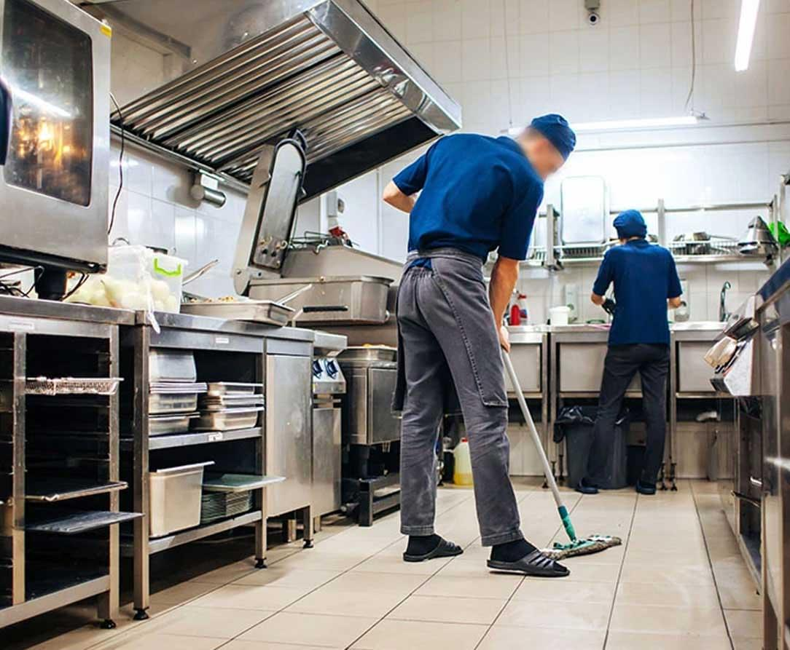
2. PROPER GALLEY SANITATION MAINTENANCE
2. Cleanliness of Galley Areas
To maintain a hygienic galley environment, it is important to clean and sanitize all food contact surfaces both before and after use. This helps prevent cross-contamination and ensures food safety. Separate cutting boards and utensils should be used for raw and cooked foods to avoid the transfer of harmful bacteria. A daily cleaning schedule should be implemented to ensure that equipment, countertops, walls, floors, and storage areas are consistently kept clean. In addition, cooking equipment such as grills, fryers, and ovens should be deep-cleaned and decreased on a regular basis to maintain their efficiency and prevent the buildup of grease and food residue.
FOOD AND FOOD SERVICE EQUIPMENT

Slide 16

2. PROPER GALLEY SANITATION MAINTENANCE
3. Food Storage
Proper food storage is essential to maintain safety and quality in the galley. Perishable items should be stored in refrigerators at or below 5°C (41°F) and in freezers at or below -18°C (0°F) to prevent spoilage and bacterial growth. Dry goods must be kept in cool, dry, well-ventilated, and pest-free storerooms to preserve their condition. All food items should be clearly labeled and dated, and the FIFO (First In, First Out) method should be followed to ensure older stock is used before newer items. Additionally, food should never be stored directly on the floor to avoid contamination and to facilitate proper cleaning and airflow.
FOOD AND FOOD SERVICE EQUIPMENT

Slide 17
2. PROPER GALLEY SANITATION MAINTENANCE
• 4. Temperature Control
Temperature control is a critical aspect of food safety in the galley. Foods must be cooked to their proper internal temperatures—for example, poultry should reach at least 74°C (165°F) to ensure harmful bacteria are destroyed. When reheating food, it should also be brought back up to a minimum of 74°C (165°F) before serving. To keep food safe during service, hot foods should be maintained above 60°C (140°F) and cold foods below 5°C (41°F). It is also important to regularly calibrate and properly use food thermometers to ensure accurate temperature readings throughout food preparation and storage.
FOOD AND FOOD SERVICE EQUIPMENT

Slide 18
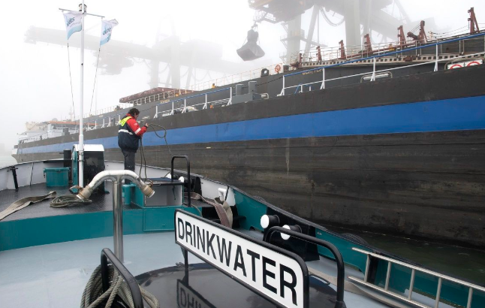
2. PROPER GALLEY SANITATION MAINTENANCE
5. Water Supply
A safe and reliable water supply is essential in maintaining hygiene standards onboard a ship. Only potable water should be used for cooking, cleaning, and drinking to prevent the spread of waterborne illnesses. Regular testing of water quality is necessary to ensure it remains safe for consumption and use. Additionally, water tanks must be properly sealed and protected from contamination to maintain the integrity of the ship’s water supply.
FOOD AND FOOD SERVICE EQUIPMENT

Slide 19
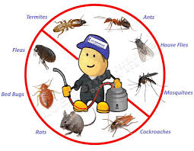
2. PROPER GALLEY SANITATION MAINTENANCE
6. Pest Control
Effective pest control is vital in maintaining a sanitary galley environment. Doors and windows should be kept closed or fitted with screens to prevent pests from entering. All food should be stored in sealed containers to protect it from contamination. Regular inspections should be conducted to check for signs of pests, and a detailed pest control log should be maintained. Additionally, waste must be disposed of properly and without delay to eliminate potential attractants and breeding grounds for insects and rodents.
FOOD AND FOOD SERVICE EQUIPMENT

Slide 20
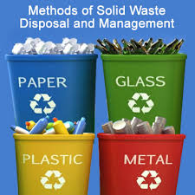
2. PROPER GALLEY SANITATION MAINTENANCE
7. Garbage and Waste Disposal
Proper waste management is essential for maintaining cleanliness and preventing contamination in the galley. Waste should be collected in clearly labeled, covered bins to contain odors and keep pests away. These bins need to be emptied frequently, with waste promptly removed from the galley and taken to designated disposal areas. To ensure hygiene, waste containers must be cleaned and disinfected daily. Additionally, it is important to separate food waste, recyclables, and hazardous materials to facilitate proper disposal and recycling processes.
FOOD AND FOOD SERVICE EQUIPMENT

Slide 21
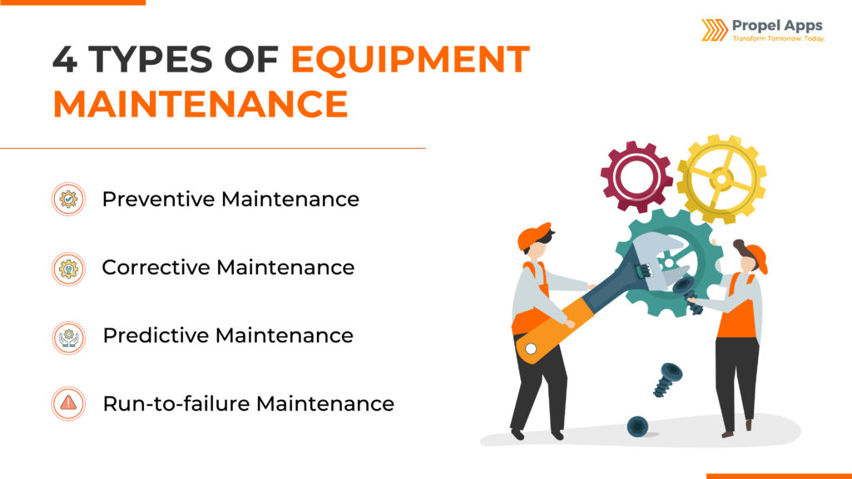
2. PROPER GALLEY SANITATION MAINTENANCE
8. Equipment Maintenance
It is important to keep all galley equipment in good working condition to maintain hygiene and efficiency. Any malfunctioning equipment should be reported and repaired immediately to prevent disruptions and potential safety hazards. Additionally, dishwashers and sanitizing machines must be regularly monitored to ensure they reach the required temperatures for effective cleaning and disinfection.
FOOD AND FOOD SERVICE EQUIPMENT

Slide 22
2. PROPER GALLEY SANITATION MAINTENANCE
9. Documentation and Training
Maintaining thorough cleaning logs and temperature records is essential for tracking sanitation efforts and ensuring food safety onboard. Regular hygiene and food safety training should be conducted for all galley staff to keep them informed about best practices and procedures. It is also important to implement and strictly follow ship sanitation protocols based on guidelines from the World Health Organization (WHO) or national maritime authorities to maintain high standards of cleanliness and prevent contamination
FOOD AND FOOD SERVICE EQUIPMENT

Slide 23
3. SAFETY STANDARDS FOR GALLEY PANTRY
The galley onboard a ship is a vital area responsible for preparing meals that sustain the crew throughout their journey. Given the critical role food plays in maintaining crew health and morale, ensuring safety in the galley is of utmost importance. Safety in this environment encompasses not only food hygiene and sanitation but also the prevention of accidents and the protection of both personnel and equipment. The unique setting of a ship—often isolated and with limited medical support—makes galley safety even more crucial than in land-based kitchens.
FOOD AND FOOD SERVICE EQUIPMENT

Slide 24
3. SAFETY STANDARDS FOR GALLEY PANTRY
Firstly, food safety is fundamental to preventing foodborne illnesses among the crew. Contaminated food can quickly lead to outbreaks of diseases such as salmonella or norovirus, which can incapacitate large portions of the crew. On a ship, where medical resources are limited and evacuation may not be immediately possible, such illnesses can have serious consequences, not only for individual health but for the operational capacity of the vessel. Ensuring that food is handled, stored, and cooked safely reduces these risks and protects the overall well-being of everyone onboard.
FOOD AND FOOD SERVICE EQUIPMENT

Slide 25
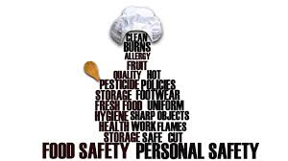
3. SAFETY STANDARDS FOR GALLEY PANTRY
In addition to food safety, physical safety within the galley is equally important. The galley is filled with potential hazards such as hot surfaces, sharp knives, and heavy equipment. The movement of the ship can cause sudden shifts or slips, increasing the risk of accidents. Proper safety procedures, including the use of protective clothing, clear walkways, secure storage of utensils, and regular maintenance of equipment, help prevent injuries. A single accident in the galley can not only harm a crew member but also reduce the workforce available for essential ship operations.
FOOD AND FOOD SERVICE EQUIPMENT

Slide 26
3. SAFETY STANDARDS FOR GALLEY PANTRY
Moreover, maintaining a safe galley environment supports compliance with international maritime regulations. Various standards, such as those outlined in the Maritime Labour Convention (MLC) and guidelines from the World Health Organization (WHO), mandate strict safety and hygiene protocols. Adhering to these standards is essential for passing inspections by port authorities and avoiding penalties, detentions, or delays that could disrupt the ship’s schedule and finances.
Beyond regulatory compliance, a safe and clean galley fosters a positive working atmosphere, boosting crew morale. Knowing that the food they eat is prepared in a hygienic and safe environment reassures the crew and contributes to their mental well-being. High morale, in turn, supports overall productivity and cooperation onboard.
FOOD AND FOOD SERVICE EQUIPMENT

Slide 27
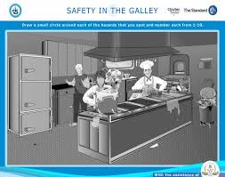
3. SAFETY STANDARDS FOR GALLEY PANTRY
In conclusion, safety in the galley onboard a ship is critical not only for protecting the health of the crew but also for ensuring smooth ship operations and regulatory compliance. By prioritizing food safety, accident prevention, and cleanliness, ships can create a secure environment that supports the physical and mental well-being of the crew, ultimately contributing to the success of every voyage.
FOOD AND FOOD SERVICE EQUIPMENT

Slide 28
3. SAFETY STANDARDS FOR GALLEY PANTRY
Fire safety is a critical concern in the galley due to the presence of open flames, hot surfaces, and grease, all of which increase the risk of fire onboard. To mitigate this risk, automatic fire suppression systems, such as CO₂ or wet chemical systems, should be installed in galley hoods and near cooking ranges. These systems can quickly extinguish fires before they spread. Additionally, accessible fire extinguishers suitable for grease and electrical fires—typically Class B and Class F extinguishers—must be strategically placed throughout the galley. Proper ventilation is also essential; regular cleaning of hoods and ducts prevents the accumulation of grease, a common fire hazard. It is equally important to never leave stoves or deep fryers unattended while in use, as unattended flames significantly increase the risk of an uncontrollable fire.
FOOD AND FOOD SERVICE EQUIPMENT

Slide 29
3. SAFETY STANDARDS FOR GALLEY PANTRY
When it comes to electrical and equipment safety, several precautions must be observed to prevent accidents or equipment failure. All electrical kitchen equipment should be properly grounded to reduce the risk of electrical shocks or short circuits. Regular inspection of cords, plugs, and outlets is necessary to identify any signs of damage or wear that could lead to hazards. Only marine-grade or approved galley equipment should be used, ensuring that appliances are designed to withstand the ship’s conditions and comply with safety standards. Furthermore, all electrical appliances should be turned off immediately after use or during emergencies to minimize risks.
FOOD AND FOOD SERVICE EQUIPMENT

Slide 30
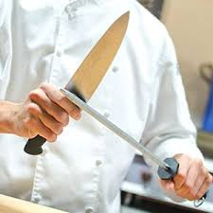
3. SAFETY STANDARDS FOR GALLEY PANTRY
Sharp tools and equipment pose another safety challenge in the galley. Proper knife storage is vital; knives should be kept on magnetic strips or in designated racks rather than loose in drawers, which can lead to accidental cuts. To further protect crew members, cut-resistant gloves should be provided and their use encouraged when handling slicing or grating tasks. Finally, thorough training is essential to ensure that all crew members understand how to safely handle kitchen tools and appliances, reducing the likelihood of injuries and maintaining a safer working environment overall.
FOOD AND FOOD SERVICE EQUIPMENT

Slide 31
3. SAFETY STANDARDS FOR GALLEY PANTRY
Housekeeping and organization play a vital role in maintaining a safe galley environment. Installing non-slip flooring and mats in areas prone to spills or moisture helps prevent slips and falls, which are common accidents onboard. Any spills should be cleaned up immediately, and “Wet Floor” signs used as warnings to alert crew members of potential hazards. To ensure safety during rough seas, all items such as cans, utensils, and appliances must be securely stored to prevent movement that could cause injury. Additionally, walkways and aisles should be kept clear of obstacles to avoid trips, collisions, and injuries in the confined space of the galley.
FOOD AND FOOD SERVICE EQUIPMENT

Slide 32
3. SAFETY STANDARDS FOR GALLEY PANTRY
Maintaining hygiene and sanitation safety is crucial for preventing food contamination and protecting crew health. Functional handwashing stations equipped with soap and disposable towels should be readily available to encourage frequent handwashing by galley staff. Personal protective equipment (PPE), including gloves, aprons, and hairnets, should be provided and worn at all times to reduce contamination risks. Food-safe cleaning agents and disinfectants must be used regularly, especially on food-contact surfaces, to maintain a clean environment. Furthermore, strict segregation of duties—separating raw food preparation areas from those used for ready-to-eat foods—helps prevent cross-contamination.
FOOD AND FOOD SERVICE EQUIPMENT

Slide 33
3. SAFETY STANDARDS FOR GALLEY PANTRY
Emergency preparedness is another key aspect of galley safety. Fire drills should include galley-specific scenarios to ensure that crew members know how to respond effectively to kitchen fires or related emergencies. Escape routes from the galley must be kept clear at all times and marked clearly to facilitate quick evacuation. In addition, alarm systems such as smoke and heat detectors should be installed and tested regularly to provide early warning in case of fire or smoke. Given the constant motion and confined spaces aboard cruise, cargo, and other ships, even small malfunctions can quickly escalate into dangerous emergencies. To help mitigate these risks, many regulatory bodies require emergency shutoff controls in galley kitchens. For example, the U.S. Coast Guard mandates that units using liquid propane have an emergency shutoff located near the appliance to contain gas leaks or cooking fires as soon as they start.
FOOD AND FOOD SERVICE EQUIPMENT

Slide 34
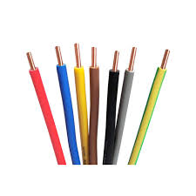
3. SAFETY STANDARDS FOR GALLEY PANTRY
Corrosion-Resistant Wiring is another important topic. A key element of galley kitchen equipment safety is protecting wiring from the damaging effects of water, salt, and humidity. According to Wiring Harness News, marine wiring standards set by organizations such as the American Boat and Yacht Council and the U.S. Coast Guard recommend using copper wiring with waterproof insulation onboard vessels. This helps protect your galley kitchen’s electrical connections from corrosion and reduces the risk of shock or fire in the event of a spill.
FOOD AND FOOD SERVICE EQUIPMENT

Slide 35
3. SAFETY STANDARDS FOR GALLEY PANTRY
Food Safety Standards. While not directly related to galley kitchen equipment, following food safety norms is important in any marine kitchen. For example, the Centers for Disease Control and Prevention’s Vessel Sanitation Program (VSP) sets standards and conducts inspections to reduce the risk of foodborne illness aboard cruise ships. By following VSP guidelines such as cleaning food preparation surfaces every 4 hours and storing food at least 6 inches (15CM) above the floor, staff members can foster a safety-first environment in the galley that protects everyone on board.
Clean & Clear Floors. Minimizing floor-related hazards is critical to overall galley safety. From wiping up spills immediately to prevent slips to putting away items to keep the area clear, dry floors and unobstructed paths not only improve operational efficiency but also decrease unexpected accidents that can damage equipment and injure staff
FOOD AND FOOD SERVICE EQUIPMENT

Slide 36

3. SAFETY STANDARDS FOR GALLEY PANTRY
Equipment Maintenance Plans. Although it’s easy to overlook until something goes wrong, regular equipment maintenance is essential for keeping both machines and crew safe in your ship’s kitchen. Checking electrical connections, cleaning key components, and scheduling regular inspections all play a crucial role in preventing accidents and malfunctions that could damage equipment or injure staff, so be sure to complete preventative maintenance tasks on time to maintain a safe, efficient galley.
FOOD AND FOOD SERVICE EQUIPMENT

Slide 37
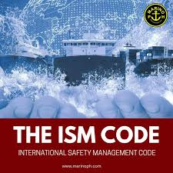
3. SAFETY STANDARDS FOR GALLEY PANTRY
Compliance with maritime safety codes is essential to ensure the galley meets international and local standards. The ship’s Safety Management System (SMS), as outlined by the International Safety Management (ISM) Code, should include procedures specific to galley operations and safety. The galley must also comply with SOLAS (Safety of Life at Sea) regulations regarding fire protection and emergency response. Additionally, adherence to port health regulations and flag state rules ensure the galley maintains proper food safety and hygiene standards, avoiding penalties and detention during inspections.
FOOD AND FOOD SERVICE EQUIPMENT

Slide 38
3. SAFETY STANDARDS FOR GALLEY PANTRY
Marine-Grade Equipment. One of the most important aspects of galley kitchen equipment safety is ensuring all units are built to withstand the conditions of nautical environments. Salt water and high humidity can cause corrosion over time, creating crevices where bacteria can take hold and multiply. To minimize these risks, choose units made from corrosion-resistant marine-grade 316 stainless steel and ensure electrical connections are equipped with waterproof insulation. In addition to durable materials, it’s also important to look for machines that can be secure when the ship is in open water. Rough seas and high winds can cause vessels to sway and pitch, which may cause refrigerator bases to shift, oven doors to swing open, or fryer oil to splash. That’s why the U.S. Code of Federal Regulations for marine kitchens requires equipment to be anchored securely, fitted with locking doors, and designed to contain grease, minimizing the risk of movement, openings, or spills
FOOD AND FOOD SERVICE EQUIPMENT

Slide 39
HAZARDS IN THE GALLEYS
Any food spoilage or contaminated food can cause food poisoning; therefore, it is vital for galleys to follow proper hygiene in order to maintain food of high quality. Even if the loaded food is safe, this does not ensure that it will remain safe during the storage, preparation, cooking, and serving activities that follow on board. The main risks to food safety in the galley, pantry, and service areas are related to the following:
Biological hazards like bacteria, viruses, fungi, and parasites occur when bacteria, viruses, moulds, yeasts, or parasites contaminate food. These organisms are commonly associated with humans and with raw products entering food preparation sites. Therefore, raw ingredients in the galley are high-risk factors. Storage time and temperature of food, and awareness and implementation of hygienic practices by food handlers on board a ship, also play a significant role in food safety.
FOOD AND FOOD SERVICE EQUIPMENT

Slide 40
HAZARDS IN THE GALLEYS
Chemical hazards (e.g., cleaning agents): Chemical contamination of food may inadvertently occur ‘naturally’ before loading or during processing (e.g., by the misuse of cleaning chemicals or pesticides). Examples of naturally occurring chemicals are mycotoxins (e.g., aflatoxin), scombrotoxin (histamine), ciguatoxin, and shellfish toxins.
The equipment and utensils contacting food are designed and constructed to ensure that, when necessary, they can be adequately cleaned, disinfected, and maintained to avoid the contamination of food. Equipment and containers are typically made of materials with no toxic effects when used as intended. Where necessary, equipment should be durable and movable, or capable of being disassembled to allow for maintenance, cleaning, disinfection, monitoring, and inspection for pests.
FOOD AND FOOD SERVICE EQUIPMENT

Slide 41
HAZARDS IN THE GALLEYS
Major risk factors that contribute to foodborne outbreaks on board ships are primarily associated with temperature control of food, infected food handlers, cross-contamination, heat treatment of perishable food, contaminated raw ingredients, and use of non-potable water in the galley. Some diseases can be transmitted from one country to another by infectious agents or contaminants due to poor control measures on board. Therefore, detecting contamination in the sources, preparation, and processing of food, as well as in the service of food in mess rooms, is crucial for the prevention and control of foodborne disease.
FOOD AND FOOD SERVICE EQUIPMENT

Slide 42
HAZARDS IN THE GALLEYS
To effectively address food-related issues onboard, it is essential to implement a comprehensive set of best practices. One of the most fundamental steps is to establish clear, written policies governing food loading, storage, and preparation. Developing a food safety plan is a highly recommended approach, as it provides a structured framework for maintaining hygiene and minimizing risks.
Equally important is the enforcement of stringent personal hygiene standards among catering staff. Clear posters and instructional materials placed in key locations can serve as constant reminders and guides, helping crew members adhere to proper hygiene protocols at all times.
Cleanliness of storage areas is another critical element. These compartments must be kept free of pests or insects and should be maintained at temperatures appropriate for the types of food being stored. Regular inspections and maintenance ensure these conditions are consistently met.
FOOD AND FOOD SERVICE EQUIPMENT

Slide 43
HAZARDS IN THE GALLEYS
Catering personnel must receive proper training and remain vigilant in following all established food safety procedures. Continuous education and supervision help reinforce these standards, ensuring that everyone understands their role in maintaining a hygienic food environment.
Health and safety considerations in the galley must be a priority, especially during food preparation and equipment use. Issues such as safe handling practices, appropriate ventilation, and the correct use of cleaning chemicals significantly reduce the risk of accidents and contamination. These points are highlighted by sources such as the U.S. CDC's Environmental Cleaning and Disinfection Recommendations and OSHA’s Food Service Safety Guidelines.
Finally, it is imperative to comply with all applicable local, national, and international food safety regulations. Adhering to these standards not only ensures legal compliance but also promotes a culture of accountability and professionalism in food service operations.
FOOD AND FOOD SERVICE EQUIPMENT

Slide 44
REFERENCES
1. World Health Organization. (2007). International medical guide for ships (3rd ed.). World Health Organization.
2. Codex Alimentarius – HACCP Principles and Guidelines (FAO/WHO).
3. International Labour Organization. (2006). Maritime Labour Convention (MLC), 2006. https://www.ilo.org/global/standards/maritime-labour-convention/lang--
4. https://www.ilo.org/global/standards/maritime-labour-convention/lang--en/index.htm3.
Guide to Ship Sanitation (2011) https://iris.who.int/bitstream/handle/10665/43193/9789241546690_eng.pdf?sequence=1
Vessel Sanitation Program Operations Manual (2018) https://www.cdc.gov/vessel-sanitation/media/files/vsp_operations_manual_2018-508.pdf)
Galley Kitchen Equipment Safety (2025). https://www.partstown.com/cm/resource-center/guides/gd2
FOOD AND FOOD SERVICE EQUIPMENT

Slide 45

REFERENCES
8. International Health Regulations (IHR) https://www.who.int/health-topics/international-health-regulations#tab=tab_1
9. International Safety Management ISM Code https://www.imo.org/en/ourwork/humanelement/pages/ISMCode.aspx
FOOD AND FOOD SERVICE EQUIPMENT

