Slide 1





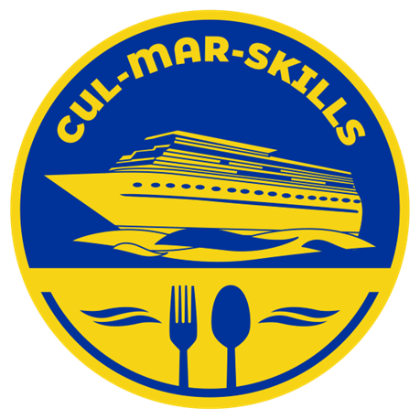


MARitime Soft Skills for Onboard Healthy Nutrition and CULinary Arts in Seagoing Services – CUL-MAR-Skills
KA220-VET - Cooperation partnerships in vocational education and training
2023-1-RO01-KA220-VET-000156711
VICTUALLING ONBOARD
WEEK III
Explanation of the terminology related to:
- Victualling,
- Food Supply Chain Management
- Logistics
Disclaimer: “Funded by the European Union. Views and opinions expressed are however those of the author(s) only and do not necessarily reflect those of the European Union or the ANPCDEFP. Neither the European Union nor the ANPCDEFP can be held responsible for them”

Slide 2
Learning outcomes of the course
Accurately define and apply key terminology related to victualling, food supply chain management, and logistics.
Analyze the critical processes involved in provisioning food for maritime operations.
Develop strategies for managing food safety, inventory control, and waste reduction.
Ensure compliance with international regulations
Optimize crew welfare and operational efficiency
NAVAL COMMUNICATIONS
VICTUALLING ONBOARD

Slide 3
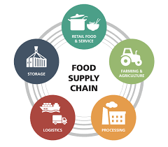
Content of the course
Key Terminology and Definitions
Key Concepts in Victualling.
Real-World Applications of Victualling Terminology
VICTUALLING ONBOARD

Slide 4
1. Key Terminology and Definitions
Victualling
The act of supplying food and beverages for the crew and passengers aboard a ship or vessel. It includes both the procurement of provisions and the preparation of meals.
Provisioning
The process of acquiring, storing, and managing the necessary food supplies on board a vessel. This includes purchasing food, inventory management, and ensuring the availability of essential items throughout the voyage.
Rations
The allocated amount of food and drink given to each crew member, typically measured and distributed over a set period. The term also refers to the process of determining the quantity of food needed for a particular voyage.
VICTUALLING ONBOARD

Slide 5
1. Key Terminology and Definitions
Catering
The service of preparing and delivering food on board a ship. Catering can be done by ship’s cooks or external contractors, depending on the size of the vessel and the length of the voyage
Galley
The kitchen or food preparation area on a ship, where meals are cooked and prepared for the crew and passengers. It is equipped with specialized equipment designed for cooking at sea.
Mess
The designated dining area on a ship where the crew gathers to eat. The mess may be separate for officers and the rest of the crew, depending on the vessel's hierarchy.
Scurvy
A disease resulting from a deficiency of vitamin C, commonly affecting sailors on long voyages in the past due to a lack of fresh fruits and vegetables. Proper victualling practices prevent such diseases by ensuring a balanced diet.
VICTUALLING ONBOARD

Slide 6
1. Key Terminology and Definitions
Food
The practices and procedures that ensure food remains safe to consume, preventing foodborne illnesses. This includes hygiene, proper storage, temperature control, and handling of food.
Stock Rotation
The practice of organizing and managing food stocks in a way that ensures older items are used before newer ones, minimizing food waste and ensuring that provisions remain fresh.
Preservation
Methods used to extend the shelf life of food, such as canning, freezing, dehydrating, and vacuum sealing. This is essential in maritime victualling due to the limited access to fresh food during long voyages.
VICTUALLING ONBOARD

Slide 7
2. Key Concepts in Victualling
Nutritional Balance
Victualling ensures that meals provided to the crew are nutritionally balanced, containing the right proportions of carbohydrates, proteins, fats, vitamins, and minerals to maintain health and energy levels.
Meal Planning
Effective meal planning is crucial to ensure a variety of meals that meet dietary needs while preventing food fatigue. It involves considering available resources, crew preferences, and nutritional requirements.
VICTUALLING ONBOARD

Slide 8
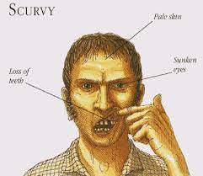
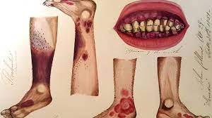

2. Key Concepts in Victualling
Nutritional Deficiencies
Long voyages without proper victualling can lead to deficiencies in essential nutrients. For example, scurvy (lack of Vitamin C) was a common problem for sailors in the past. Modern victualing ensures that such deficiencies are prevented by including vitamin-rich foods.
VICTUALLING ONBOARD

Slide 9
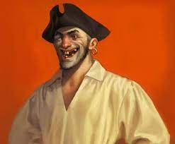

2. Key Concepts in Victualling
Food Storage
Proper food storage practices, including refrigeration, freezing, and drying, are critical in preserving the quality of food during the voyage. Temperature regulation and preventing cross-contamination are key components of food storage.
VICTUALLING ONBOARD

Slide 10
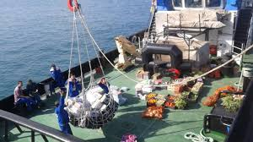
2. Key Concepts in Victualling
Regulatory Compliance
Maritime victualling is subject to regulations by international organizations such as the International Maritime Organization (IMO) and the International Labour Organization (ILO). These regulations ensure that the nutritional needs of the crew are met and that the ship operates in compliance with health and safety standards.
VICTUALLING ONBOARD

Slide 11
3. Real-World Application of Victualling Terminology
Victualling Contract
A ship may enter into a victualling contract with a supplier or catering service that ensures the timely delivery of provisions to the ship at the beginning of the voyage. Understanding the terms of the contract, such as the scope of supply and quality standards, is essential.
Onboard Food Supply Management
Crew members responsible for victualling must ensure that food is delivered on time, stored properly, and distributed in accordance with the dietary needs of the crew. This involves regular checks on the food supply, keeping track of inventory, and managing food waste.
VICTUALLING ONBOARD

Slide 12
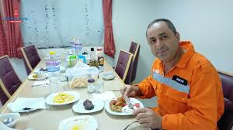
3. Real-World Application of Victualling Terminology
Meal Preparation and Crew Health
The cook or culinary team plays a vital role in meal preparation. They must not only be skilled in cooking but also ensure that meals are safe, balanced, and culturally appropriate. The meals can have a significant impact on the crew's physical health, mental well-being, and overall performance.
VICTUALLING ONBOARD

Slide 13
3. Real-World Application of Victualling Terminology
Here are some key real-world applications of logistics terminology in the maritime industry:
1. Port Operations and Cargo Handling
Example: A shipping company moving perishable goods (e.g., seafood) uses reefer containers to maintain temperature control.
Term Used: Reefer Container, Cargo Handling, Cold Chain Logistics.
Example: A logistics manager must ensure that vessels adhere to laytime to avoid demurrage charges for exceeding their port stay.
Term Used: Laytime, Demurrage, Port Operations.
VICTUALLING ONBOARD

Slide 14
3. Real-World Application of Victualling Terminology
International Trade and Freight Forwarding
Example: A company shipping electronics from China to Europe uses a Bill of Lading (B/L) to legally document the shipment and ownership transfer.
Term Used: Bill of Lading, Freight Forwarding, Customs Clearance.
Example: To minimize costs, a logistics company uses intermodal transport to combine shipping by sea, rail, and truck.
Term Used: Intermodal Transport, Freight Rate, TEU (Twenty-foot Equivalent Unit).
VICTUALLING ONBOARD

Slide 15
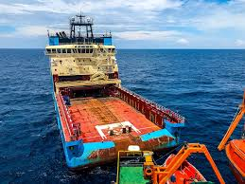
3. Real-World Application of Victualling Terminology
Vessel Management and Fuel Efficiency
Example: A shipping company plans a transatlantic journey and optimizes its ballast water to maintain vessel stability and comply with environmental regulations.
Term Used: Ballast Water, Deadweight Tonnage (DWT), Load Line.
Example: A cargo ship refuels at a designated port using bunkering services to ensure it has enough fuel for the next leg of the journey.
Term Used: Bunkering, Port Logistics, Fuel Efficiency.
VICTUALLING ONBOARD

Slide 16

3. Real-World Application of Victualling Terminology
Supply Chain Resilience and Crisis Management
Example: During the COVID-19 pandemic, global supply chain management was disrupted, causing shortages in essential supplies and food. Companies had to find alternative shipping routes.
Term Used: Supply Chain Management, Logistics Disruption, Lead Time.
Example: When the Ever Given container ship blocked the Suez Canal, shipping companies had to reroute via the Cape of Good Hope, increasing freight rates and delivery times.
Term Used: Freight Rate, Transshipment, Port Congestion.
VICTUALLING ONBOARD

Slide 17

3. Real-World Application of Victualling Terminology
Sustainability and Green Shipping
Example: The maritime industry is adopting green logistics initiatives, such as using low-emission fuels and sustainable bunkering to reduce carbon footprints.
Term Used: Green Shipping, Sustainable Bunkering, IMO Regulations
VICTUALLING ONBOARD

Slide 18
Course References
  What is ‘Victualling’ and what are the considerations? https://jollyparrot.co.uk/blog/what-is-victualling-and-what-are-the-considerations#:~:text=Victualling
  Theo Notteboom, Athanasios Pallis and Jean-Paul Rodrigue (2022) Port Economics, Management and Policy, New York: Routledge, 690 pages / 218 illustrations. ISBN 9780367331559. doi.org/10.4324/9780429318184
  What is the Maritime Supply Chain? (2022) https://sinay.ai/en/what-is-the-maritime-supply-chain/
  Tabaklar, T. Transformation in maritime supply chains: innovative strategies for disruption management. Dokuz Eylül Üniversitesi Denizcilik Fakültesi Dergisi, 16(2), 300-334.
VICTUALLING ONBOARD

