Slide 1









MARitime Soft Skills for Onboard Healthy Nutrition and CULinary Arts in Seagoing Services – CUL-MAR-Skills
KA220-VET - Cooperation partnerships in vocational education and training
2023-1-RO01-KA220-VET-000156711
Week I–VIII
Adapting an Entrepreneurial Perspective
Disclaimer: “Funded by the European Union. Views and opinions expressed are however those of the author(s) only and do not necessarily reflect those of the European Union or the ANPCDEFP. Neither the European Union nor the ANPCDEFP can be held responsible for them”

Slide 2
MARitime Soft Skills for Onboard Healthy Nutrition and CULinary Arts in Seagoing Services – CUL-MAR-Skills
KA220-VET - Cooperation partnerships in vocational education and training
2023-1-RO01-KA220-VET-000156711
ENTREPRENEURIAL OPPORTUNITIES IN PROCUREMENT
COURSE Week I–VIII
Adapting an Entrepreneurial Perspective
Disclaimer: “Funded by the European Union. Views and opinions expressed are however those of the author(s) only and do not necessarily reflect those of the European Union or the ANPCDEFP. Neither the European Union nor the ANPCDEFP can be held responsible for them”

Slide 3
FOREWORD
Week I–VIII - Adapting an Entrepreneurial Perspective
Navigating the open seas has always required flexibility, precision, and constant vigilance—qualities naturally aligned with entrepreneurial thinking. In Adapting an Entrepreneurial Perspective, we invite you to cultivate precisely this mindset, tailored specifically to the maritime sector. Our journey begins with ideas aimed at improving daily onboard operations and evolves into broader and more strategic approaches to innovation and new business models.
Throughout this hands-on course, you will learn how to transform your creative ideas into successful and sustainable maritime projects. You will examine real-world case studies, engage in simulations, and participate in interactive activities designed to help you identify opportunities and develop effective strategies for their realisation.
The course includes practical exercises for pitching ideas, inspiring examples from the maritime sector, and interactive case studies inspired by the "Shark Tank" format. These activities will boost your confidence and sharpen your business skills, preparing you to effectively propose and execute innovative projects within the maritime context.
Our ultimate goal is to enable you to see challenges as opportunities and transform your ideas into tangible, long-term business solutions within the maritime sector.
NAVAL COMMUNICATIONS
ENTREPRENEURIAL OPPORTUNITIES IN PROCUREMENT

Slide 4
Learning outcomes of the course
Week I–VIII - Adapting an Entrepreneurial Perspective
Learning Objectives by the end of Week I–VIII, learners will be able to:
− Identify and critically assess maritime-specific operational inefficiencies, regulatory constraints, and stakeholder needs, pinpointing clear entrepreneurial opportunities.
− Generate and validate innovative maritime venture ideas using structured ideation methods, market feasibility analyses, and iterative stakeholder feedback processes.
− Effectively utilize strategic communication techniques, including concise Elevator Pitch presentations and detailed Shark Tank-style proposal defences, tailored to maritime stakeholders.
− Apply specialized analytical tools such as Opportunity Mapping and the Maritime Innovation Matrix to systematically prioritize, evaluate, and plan viable maritime business initiatives.
− Develop comprehensive entrepreneurial roadmaps clearly outlining practical steps for implementing, piloting, and scaling innovative maritime ventures within realistic operational contexts.
NAVAL COMMUNICATIONS
ENTREPRENEURIAL OPPORTUNITIES IN PROCUREMENT

Slide 5
Content of the course
Week I–VIII - Adapting an Entrepreneurial Perspective
Part 1: Turning Creative Ideas into Profitable Enterprises in the Maritime Sector
In this part, you will examine how innovative concepts—from onboard service improvements to sustainability-driven ventures—can be rigorously tested, scaled, and transformed into viable business propositions. You will learn essential methods for evaluating market viability, forecasting financial outcomes, and developing go-to-market strategies specifically tailored to maritime operational environments.
Part 2: Role Models in the Maritime Sector
You will explore success stories of maritime entrepreneurs whose ideas significantly impacted their sector. These role models demonstrate how vision, resilience, and strategic thinking overcome maritime-specific challenges, such as regulatory compliance, logistical constraints, and operational limitations. The insights gained from these real-world examples will shape your entrepreneurial mindset and inspire practical, innovative thinking relevant to your context.
Part 3: Case Studies and Practical Simulations
We will apply theory to practice through interactive simulations and real-world-inspired scenarios. The Elevator Pitch Study will equip you to succinctly and persuasively present maritime-focused entrepreneurial ideas under time pressure. The Shark Tank Study provides hands-on experience, illustrating how maritime venture proposals are critically assessed from the perspectives of potential investors or senior onboard decision-makers.
ENTREPRENEURIAL OPPORTUNITIES IN PROCUREMENT

Slide 6

1. Turning Creative Ideas into Profitable Enterprises in the Maritime Sector
ENTREPRENEURIAL OPPORTUNITIES IN PROCUREMENT

Slide 7
1. Turning Creative Ideas into Profitable Enterprises in the Maritime Sector
Innovation within the maritime sector does not simply arise from spontaneous inspiration; it emerges through meticulous planning, rigorous analysis, and strategic evaluation. Transforming creative ideas into practical and profitable maritime ventures requires a structured approach. In this initial phase, our primary focus lies in identifying and thoroughly analysing the opportunities within the maritime operational environment. Such opportunities typically stem from complex realities faced daily by vessels, ports, and maritime businesses, ranging from logistical bottlenecks and safety challenges to crew management issues and environmental concerns.
ENTREPRENEURIAL OPPORTUNITIES IN PROCUREMENT

Slide 8
1. Turning Creative Ideas into Profitable Enterprises in the Maritime Sector
1.1. Analysing Current Operational Challenges and Constraints
. An analytical assessment begins by identifying primary pain points within day-to-day vessel management and port operations. These pain points often include:
Operational inefficiencies: Delays in cargo handling, ineffective inventory management, inefficient use of onboard space, and excessive operational downtime significantly impact profitability and performance. Such inefficiencies often result from outdated technologies, cumbersome administrative processes, and inadequate integration between onboard operational systems.
Safety and regulatory compliance issues: The maritime sector operates under stringent regulatory frameworks, imposing constraints on innovation. Complying with international standards, such as the International Maritime Organization (IMO) guidelines, as well as local port regulations, can create substantial barriers to implementing new solutions.
ENTREPRENEURIAL OPPORTUNITIES IN PROCUREMENT

Slide 9
1. Turning Creative Ideas into Profitable Enterprises in the Maritime Sector
1.1. Analysing Current Operational Challenges and Constraints
Environmental sustainability pressures: Increasingly strict environmental regulations and rising expectations from stakeholders push maritime companies toward sustainable operational practices. Issues such as waste management, fuel efficiency, carbon footprint reduction, and compliance with emissions standards require innovative thinking and strategic adaptation.
An accurate and comprehensive assessment of these operational limitations involves collecting qualitative and quantitative data directly from onboard operations, detailed discussions with operational management, crew members, and industry experts. Techniques such as root-cause analysis and SWOT (strengths, weaknesses, opportunities, threats) analysis further provide valuable insights into precisely where and how meaningful improvement opportunities can be identified.
ENTREPRENEURIAL OPPORTUNITIES IN PROCUREMENT

Slide 10

1. Turning Creative Ideas into Profitable Enterprises in the Maritime Sector
1.2. Evaluating the Needs of Key Stakeholder Groups
Crew needs analysis: Crew members play a pivotal role in daily functionality and the long-term sustainability of any maritime venture. Key considerations include their working conditions, safety, well-being, and usability of onboard equipment.
Passenger experience evaluation: Passenger satisfaction is crucial, particularly in maritime ventures related to cruise ships, ferries, and hospitality-focused maritime services..
Senior management and organizational requirements: Strategic objectives of senior maritime management typically include operational efficiency, cost reduction, improved safety standards, regulatory compliance, and enhanced reputation. Engaging senior stakeholders via structured interviews, workshops, and scenario planning aligns proposed innovations with strategic organizational goals, facilitating smoother implementation and higher acceptance rates.
ENTREPRENEURIAL OPPORTUNITIES IN PROCUREMENT

Slide 11
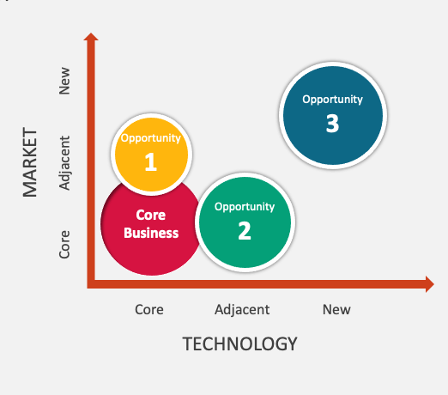
1. Turning Creative Ideas into Profitable Enterprises in the Maritime Sector
1.3. Practical Application: Systematic Opportunity Mapping
Applying analytical insights in practice requires more than intuition; it demands a structured and systematic approach to opportunity identification and evaluation. In the maritime sector, where complexity, operational constraints, and regulatory scrutiny define the environment, precise and methodical evaluation techniques are indispensable. To translate strategic thinking into actionable steps, we utilize a structured method known as Opportunity Mapping.
Opportunity Mapping involves a detailed, structured process explicitly designed to help maritime stakeholders clearly identify, categorize, and prioritize potential innovation opportunities. Rather than relying solely on ad-hoc decision-making or intuition, this structured approach ensures transparency, repeatability, and objectivity in the decision-making process, guiding stakeholders step-by-step through a rigorous framework for identifying viable innovations and strategically aligning them with organizational goals.
ENTREPRENEURIAL OPPORTUNITIES IN PROCUREMENT

Slide 12
1. Turning Creative Ideas into Profitable Enterprises in the Maritime Sector
1.3. Practical Application: Systematic Opportunity Mapping
1.3.1. Systematic Identification and Listing of Opportunities
1.3.2. Rigorous Categorization and Prioritization
1.3.3. Comprehensive Feasibility Screening
1.3.4. Employing Specialized Analytical Tools: The Maritime Innovation Matrix
1.3.5. Iterative Validation and Stakeholder Engagement
ENTREPRENEURIAL OPPORTUNITIES IN PROCUREMENT

Slide 13

2. Role Models in the Maritime Sector
ENTREPRENEURIAL OPPORTUNITIES IN PROCUREMENT

Slide 14
2. Role Models in the Maritime Sector
2. Role Models in the Maritime Sector
In any field, role models play a pivotal role by providing practical examples of success, illustrating how abstract entrepreneurial principles can be implemented effectively within specific contexts. Within the maritime sector—marked by stringent regulations, challenging logistics, and complex operational dynamics—learning from successful entrepreneurs is particularly valuable. The following detailed analysis will explore several prominent case studies from maritime entrepreneurs whose visionary ideas and strategic approaches have significantly reshaped their industry segments. Through these real-life examples, you will gain insights into overcoming challenges, fostering resilience, and pursuing strategic thinking crucial to driving sustainable maritime innovation.
ENTREPRENEURIAL OPPORTUNITIES IN PROCUREMENT

Slide 15
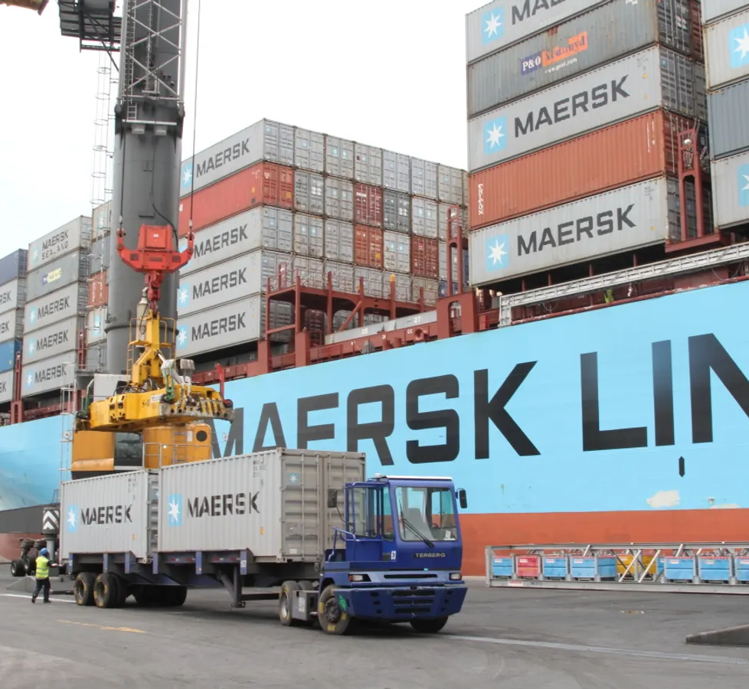
2. Role Models in the Maritime Sector
Case Study: Søren Skou and Maersk’s Digital Transformation
Background and Vision: Søren Skou, CEO of A.P. Møller-Maersk, spearheaded one of the maritime sector's most ambitious digital transformations. Recognizing traditional shipping inefficiencies, Skou envisioned digitizing operations to enhance transparency, efficiency, and customer satisfaction.
Challenges and Strategic Approach:
Impact and Lessons Learned: Maersk’s digital platform, TradeLens, revolutionized logistics, reducing delays and enhancing operational efficiency globally. The key lesson here is the importance of persistence in digital adoption despite initial scepticism and regulatory complexity.
ENTREPRENEURIAL OPPORTUNITIES IN PROCUREMENT

Slide 16
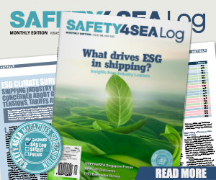
2. Role Models in the Maritime Sector
2.2. Pioneering Sustainability Initiatives in Maritime Transport
The maritime sector’s increasing focus on sustainability presents substantial entrepreneurial opportunities. Successful entrepreneurs leverage innovative approaches to comply proactively with environmental regulations and gain competitive advantages.
Case Study: Diane Gilpin and the Smart Green Shipping Alliance (SGSA)
• Background and Vision: Diane Gilpin, founder of SGSA, recognized early the shipping industry's substantial environmental footprint and set out to create solutions integrating renewable energy sources into commercial shipping operations.
ENTREPRENEURIAL OPPORTUNITIES IN PROCUREMENT

Slide 17
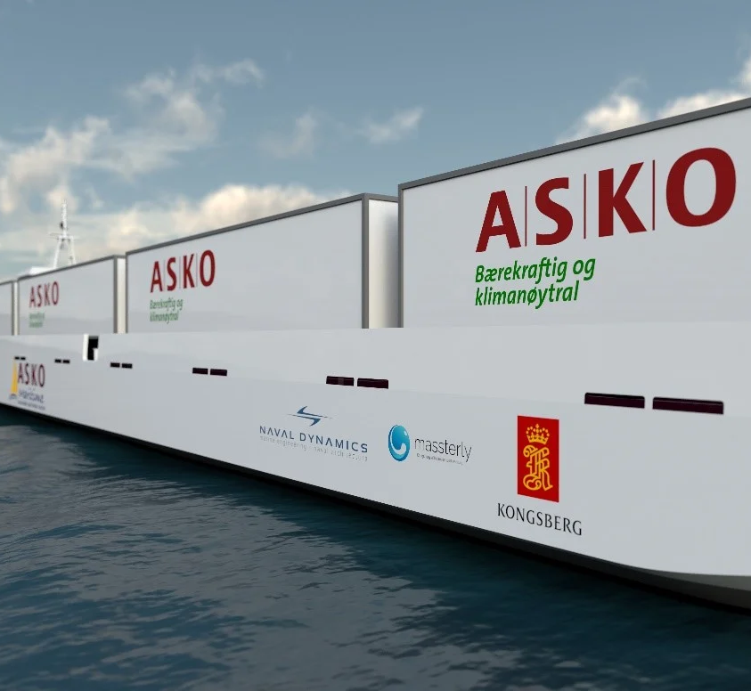
2. Role Models in the Maritime Sector
2.3. Revolutionizing Maritime Safety through Innovation
Safety remains a paramount concern in maritime operations. Entrepreneurs excelling in this area often introduce disruptive technologies enhancing maritime safety standards, thus proactively addressing operational limitations.
Case Study: Geir Håøy and Kongsberg Maritime’s Autonomous Vessel Initiative
Background and Vision: Geir Håøy, CEO of Kongsberg Maritime, championed autonomous vessel technology, aimed at enhancing maritime safety by reducing human error and operational risks.
hallenges and Strategic Approach: Implementing autonomous technology faced extensive regulatory scrutiny, technological complexity, and skepticism from industry veterans. Håøy addressed these challenges by closely collaborating with regulators, running rigorous pilot programs, and demonstrating practical benefits clearly.
ENTREPRENEURIAL OPPORTUNITIES IN PROCUREMENT

Slide 18
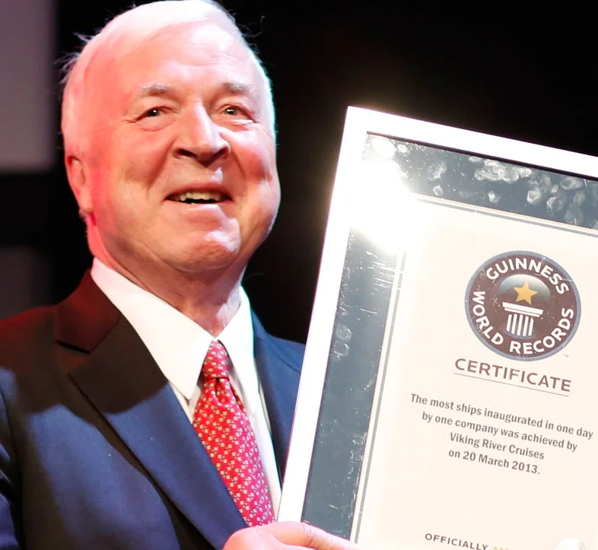
2. Role Models in the Maritime Sector
2.4. Transforming Maritime Hospitality and Passenger Experience
Passenger maritime industries, including cruises and ferries, demand constant innovation to meet evolving customer expectations and maintain competitive differentiation.
Case Study: Torstein Hagen and Viking Cruises’ Customer-Centric Innovation
Background and Vision: Torstein Hagen, founder and CEO of Viking Cruises, sought to redefine the cruise experience through an unwavering commitment to passenger comfort, cultural enrichment, and environmental responsibility.
Challenges and Strategic Approach: Hagen faced significant financial risks, industry competition, and rigorous environmental regulations. His strategy involved meticulous customer research, targeted niche marketing, and investment in eco-friendly vessels and innovative onboard experiences.
ENTREPRENEURIAL OPPORTUNITIES IN PROCUREMENT

Slide 19

2. Role Models in the Maritime Sector
2.5. Innovating Maritime Port Operations and Infrastructure
Ports form critical nodes in global maritime networks. Entrepreneurs operating here must overcome logistical complexities, limited space, and stringent environmental regulations, driving innovation in port operations and infrastructure.
Case Study: Sultan Ahmed Bin Sulayem and DP World’s Global Port Innovation
Background and Vision: Sultan Ahmed Bin Sulayem, Chairman and CEO of DP World, envisioned transforming ports from mere transport hubs into integrated, digitally connected logistics centers.
Challenges and Strategic Approach: DP World faced logistical bottlenecks, regulatory constraints, and infrastructure limitations. Bin Sulayem’s strategy emphasized heavy investment in digital technology, automated container terminals, and sustainable operational practices.
ENTREPRENEURIAL OPPORTUNITIES IN PROCUREMENT

Slide 20
2. Role Models in the Maritime Sector
2.6. Insights and Key Lessons from Maritime Role Models
Exploring these varied success stories provides valuable lessons applicable to entrepreneurs across maritime contexts. Key insights include:
Strategic Vision and Long-term Commitment: Successful maritime entrepreneurs consistently demonstrate a clear, forward-looking vision paired with patience and long-term strategic commitment.
Resilience in Facing Regulatory and Operational Constraints: The ability to withstand initial setbacks, navigate complex regulations, and persistently pursue innovative solutions is paramount for sustained success.
Embracing Partnerships and Collaborative Networks: Effective maritime entrepreneurs build extensive networks of strategic partnerships, enhancing credibility, market access, and resource availability.
Prioritizing Sustainability and Environmental.
Leveraging Technology as a Differentiator
ENTREPRENEURIAL OPPORTUNITIES IN PROCUREMENT

Slide 21

3. Case Studies and Practical Simulations
ENTREPRENEURIAL OPPORTUNITIES IN PROCUREMENT

Slide 22

3. Case Studies and Practical Simulations
Translating entrepreneurial theory into successful practice requires more than conceptual understanding—effective entrepreneurship significantly depends on practical skills, adaptability, and strategic communication. In the maritime sector, the complexity and dynamic nature of operations, regulatory requirements, and stakeholder relationships make practical experience essential. Recognizing this need, this section emphasizes immersive, interactive simulations and realistic case studies to bridge theory and real-world maritime contexts effectively. These practical components—the Elevator Pitch Study and the Shark Tank Study—are specifically designed to equip you with the strategic communication skills and confidence necessary to propose, defend, and implement innovative maritime solutions convincingly.
ENTREPRENEURIAL OPPORTUNITIES IN PROCUREMENT

Slide 23
3. Case Studies and Practical Simulations
3.1. The Importance of Case Studies and Simulations in Maritime Entrepreneurship
Entrepreneurial ideas, regardless of their creativity or novelty, often fail if not adequately communicated, validated, or understood by key stakeholders. The maritime sector amplifies these challenges due to its unique operational environment and stringent regulatory landscape. Case studies and practical simulations specifically address these gaps by providing:
Enhanced Realism:
Risk-Free Exploration
Development of Critical Communication Skills
Immediate Feedback and Reflection: Practical exercises facilitate immediate reflection and learning through structured feedback from instructors and peers, reinforcing insights gained from theoretical knowledge
ENTREPRENEURIAL OPPORTUNITIES IN PROCUREMENT

Slide 24
3. Case Studies and Practical Simulations
3.2. The Elevator Pitch Study
The Elevator Pitch is a structured communication method designed to succinctly and persuasively present business ideas, products, or services within an extremely limited timeframe—typically between one to five minutes. The concept derives its name from the idea of delivering a concise, impactful presentation within the duration of an elevator ride, during which entrepreneurs clearly communicate their proposals to stakeholders such as investors or senior executives. While the precise origins of the term remain debated, it gained significant popularity during the entrepreneurial boom of the 1980s and 1990s, particularly within Silicon Valley, where entrepreneurs needed rapid yet effective means to capture investor attention.
The Elevator Pitch method was systematically articulated by Philip B. Crosby, a renowned quality management expert, in his 1984 book The Art of Getting Your Own Sweet Way.
ENTREPRENEURIAL OPPORTUNITIES IN PROCUREMENT

Slide 25
3. Case Studies and Practical Simulations
3.2. The Elevator Pitch Study
3.2.1. Core Characteristics of the Elevator Pitch Method
This method is characterized by fundamental principles designed to enhance clarity, impact, and persuasion:
Conciseness: The pitch must be brief, omitting unnecessary details to retain only core arguments and essential information.
Clarity: Presenters must communicate clearly and straightforwardly, ensuring the audience easily grasps the idea regardless of prior knowledge.
Persuasiveness: The pitch should compellingly articulate benefits and advantages, rapidly generating interest and prompting follow-up engagement.
Structured Communication: Typically, the pitch structure involves:
− Clearly identifying the problem or opportunity.
− Introducing the proposed solution succinctly.
− Highlighting key benefits and unique selling points.
− Concluding with a clear call to action.
ENTREPRENEURIAL OPPORTUNITIES IN PROCUREMENT

Slide 26

3.3. The Shark Tank Study
ENTREPRENEURIAL OPPORTUNITIES IN PROCUREMENT

Slide 27
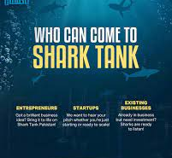
3.3. The Shark Tank Study
The Shark Tank Study provides participants with a comprehensive, in-depth simulation designed to replicate real-world entrepreneurial pitching scenarios within the maritime sector. Participants will present and rigorously defend their business proposals in front of a panel of senior decision-makers, simulating potential investors or key maritime stakeholders.
3.3.1. Purpose and Objectives
The Shark Tank Study is strategically designed to:
Equip participants with the skills to clearly communicate complex strategic, operational, and financial justifications for maritime entrepreneurial initiatives.
Provide hands-on experience in robustly defending proposals against rigorous questioning from informed stakeholders.
Develop the capability to convincingly articulate and defend the value, feasibility, and potential impacts of maritime innovation proposals.
ENTREPRENEURIAL OPPORTUNITIES IN PROCUREMENT

Slide 28
3.3. The Shark Tank Study
Simulation Structure and Methodology
This structured, interactive simulation involves:
Detailed Scenario and Proposal Development: Participants, either individually or in groups, create comprehensive maritime business proposals addressing realistic and relevant industry opportunities or challenges. Each proposal includes a detailed market analysis, financial viability assessment, operational strategy, and risk evaluation.
Role Definition and Stakeholder Representation: Participants interact with simulated panels representing maritime stakeholders—such as senior shipboard officers, investors, fleet managers, and regulatory officials. The panel poses critical, probing questions designed to rigorously evaluate the proposal’s validity, practical implementation strategies, financial realism, and regulatory alignment.
ENTREPRENEURIAL OPPORTUNITIES IN PROCUREMENT

Slide 29
3.3. The Shark Tank Study
Simulation Structure and Methodology
This structured, interactive simulation involves:
Detailed Scenario and Proposal Development: Participants, either individually or in groups, create comprehensive maritime business proposals addressing realistic and relevant industry opportunities or challenges. Each proposal includes a detailed market analysis, financial viability assessment, operational strategy, and risk evaluation.
Role Definition and Stakeholder Representation: Participants interact with simulated panels representing maritime stakeholders—such as senior shipboard officers, investors, fleet managers, and regulatory officials. The panel poses critical, probing questions designed to rigorously evaluate the proposal’s validity, practical implementation strategies, financial realism, and regulatory alignment.
Simulation Structure and Methodology
ENTREPRENEURIAL OPPORTUNITIES IN PROCUREMENT

Slide 30
3.3. The Shark Tank Study
3.3.3. Critical Skills Developed
Throughout the Shark Tank Study, participants actively refine several critical entrepreneurial skills:
Analytical rigor: The capability to quickly, clearly, and convincingly justify decisions and proposals based on thorough analysis.
Financial acumen: Realistic financial modeling, accurate revenue forecasting, detailed budgeting, and effective financial risk management.
Operational and regulatory competence: Practical understanding of maritime operational realities and regulatory requirements, enabling convincing proposals tailored specifically to sector-specific contexts.
Persuasive strategic communication: The ability to articulate and defend complex proposals clearly and persuasively to diverse stakeholder groups, significantly enhancing their likelihood of acceptance and support.
ENTREPRENEURIAL OPPORTUNITIES IN PROCUREMENT

Slide 31

3.3. The Shark Tank Study
3.5. Reflective Learning and Continuous Improvement
Integral to this training is the structured incorporation of reflective learning practices:
Participants maintain reflective journals to systematically document key insights, lessons learned, strengths, and areas for improvement throughout the training.
Regular feedback loops involving peer assessments, instructor evaluations, and collaborative discussions reinforce continuous learning and skill development, ensuring lasting impact and practical applicability of acquired knowledge.
ENTREPRENEURIAL OPPORTUNITIES IN PROCUREMENT

Slide 32

The Shark Tank Study
ENTREPRENEURIAL OPPORTUNITIES IN PROCUREMENT

Slide 33
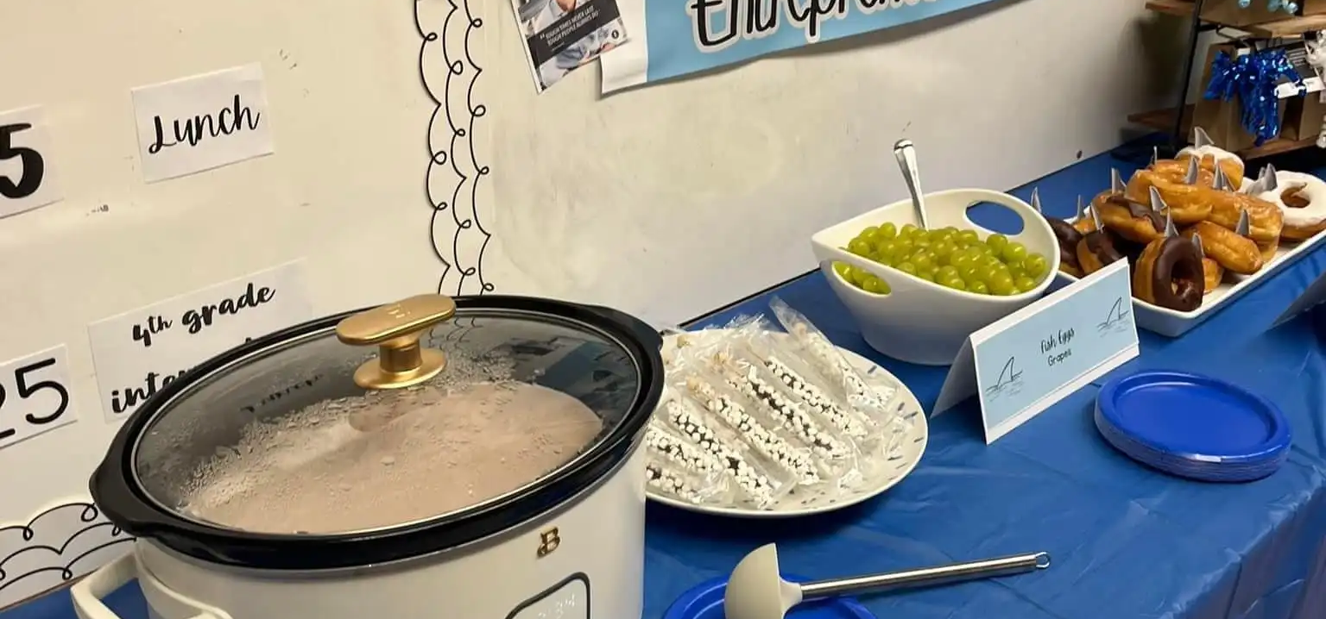
The Shark Tank Study
ENTREPRENEURIAL OPPORTUNITIES IN PROCUREMENT

Slide 34

The Shark Tank Study
ENTREPRENEURIAL OPPORTUNITIES IN PROCUREMENT

Slide 35
REVIEW QUESTIONS
What are the essential steps in systematically transforming creative ideas into financially viable maritime enterprises?
How does market feasibility analysis help maritime entrepreneurs minimize risk and enhance the success of their ventures?
Identify and describe three specific maritime-sector challenges that entrepreneurs commonly face. How have successful entrepreneurs overcome these obstacles?
Discuss how the Elevator Pitch method can be effectively adapted to communicate innovation clearly within the maritime context. What critical elements should a maritime-focused pitch contain?
What are the primary benefits of using structured analytical tools, such as the Maritime Innovation Matrix, when evaluating entrepreneurial ideas in the maritime sector?
ENTREPRENEURIAL OPPORTUNITIES IN PROCUREMENT

Slide 36
REVIEW QUESTIONS
Explain how regulatory compliance influences entrepreneurial innovation in maritime operations. Provide an example of a maritime entrepreneur who successfully managed regulatory challenges.
Why is it crucial for maritime entrepreneurs to thoroughly understand the needs and expectations of stakeholders, including crew members, passengers, and senior management?
Reflect on a maritime entrepreneurial role model discussed during the course. What key lesson did you take from their experience, and how could you practically apply it?
In the Shark Tank simulation, what were the most challenging aspects of defending your entrepreneurial proposal, and how can you address these challenges in a real-world setting?
How can continuous reflection and iterative improvement, derived from practical simulations, enhance your strategic effectiveness as an entrepreneur in the maritime sector?
ENTREPRENEURIAL OPPORTUNITIES IN PROCUREMENT

Slide 37
Course References
Blank, S., & Dorf, B. (2012). The startup owner's manual: The step-by-step guide for building a great company. K&S Ranch.
Christensen, C. M. (1997). The innovator's dilemma: When new technologies cause great firms to fail. Harvard Business School Press.
Drucker, P. F. (1985). Innovation and entrepreneurship: Practice and principles. Harper & Row.
Grant, R. M. (2019). Contemporary strategy analysis: Text and cases edition (10th ed.). Wiley.
Osterwalder, A., & Pigneur, Y. (2010). Business model generation: A handbook for visionaries, game changers, and challengers. John Wiley & Sons.
ENTREPRENEURIAL OPPORTUNITIES IN PROCUREMENT

Slide 38
Course References
Porter, M. E. (1985). Competitive advantage: Creating and sustaining superior performance. Free Press.
Ries, E. (2011). The lean startup: How today’s entrepreneurs use continuous innovation to create radically successful businesses. Crown Business.
Sarasvathy, S. D. (2008). Effectuation: Elements of entrepreneurial expertise. Edward Elgar Publishing.
Stopford, M. (2009). Maritime economics (3rd ed.). Routledge.
Timmons, J. A., & Spinelli, S. (2009). New venture creation: Entrepreneurship for the 21st century (8th ed.). McGraw-Hill Education.
ENTREPRENEURIAL OPPORTUNITIES IN PROCUREMENT

