Slide 1









MARitime Soft Skills for Onboard Healthy Nutrition and CULinary Arts in Seagoing Services – CUL-MAR-Skills
KA220-VET - Cooperation partnerships in vocational education and training
2023-1-RO01-KA220-VET-000156711
Week I–VIII
Pantry Innovation & Business Model Canvas
Disclaimer: “Funded by the European Union. Views and opinions expressed are however those of the author(s) only and do not necessarily reflect those of the European Union or the ANPCDEFP. Neither the European Union nor the ANPCDEFP can be held responsible for them”

Slide 2
MARitime Soft Skills for Onboard Healthy Nutrition and CULinary Arts in Seagoing Services – CUL-MAR-Skills
KA220-VET - Cooperation partnerships in vocational education and training
2023-1-RO01-KA220-VET-000156711
ENTREPRENEURIAL OPPORTUNITIES IN PROCUREMENT
COURSE Week I–VIII
Pantry Innovation & Business Model Canvas
Disclaimer: “Funded by the European Union. Views and opinions expressed are however those of the author(s) only and do not necessarily reflect those of the European Union or the ANPCDEFP. Neither the European Union nor the ANPCDEFP can be held responsible for them”

Slide 3
FOREWORD
Week I–VIII - Pantry Innovation & Business Model Canvas
We begin by identifying untapped innovation areas—pinpointing current pain points such as intermittent cold-chain breaks, underused storage capacity, and missed opportunities for localized sourcing. You will learn how to conduct rapid audits aboard any vessel to uncover waste hotspots, menu bottlenecks, and crew engagement gaps. From there, we will guide you through structured ideation techniques—brainstorming original pantry-centric solutions that range from zero-waste recipe development to mobile subscription snack kits tailored for rotating watch schedules.
Once your most promising ideas have emerged, Weeks III–VIII will show you how to mold them into a coherent business model using the Business Model Canvas. Each week, we will dissect one or two of the Canvas’s nine building blocks—Customer Segments, Value Propositions, Channels, Customer Relationships, Revenue Streams, Key Resources, Key Activities, Key Partnerships, and Cost Structure—always in the context of a ship’s pantry. By applying real-time consumption data, IoT-enabled temperature tracking, and port-adjacent sourcing networks, you will refine assumptions, quantify costs, and validate revenue opportunities. Along the way, sustainability remains central: we will emphasize eco-certifications, waste-diversion targets, and biodegradable packaging to ensure your pantry innovations align with broader environmental goals. This eight-week journey is not a passive “how-to” guide but a call to action. It demands that you question every routine grocery order, every menu rotation, and every waste stream—asking not just “Can we do this better?” but “Can we turn it into a self-sustaining business proposition?” You will be encouraged to pilot small-batch experiments at sea, gather crew and passenger feedback, and iterate your Canvas weekly. By the final week, you will possess a fully populated, maritime-specific Business Model Canvas that captures an entrepreneurial pantry concept ready to pilot on board.
Prepare to disrupt tradition, harness data-driven insights, and reframe the pantry as a vehicle for operational resilience and profit. These eight weeks offer a roadmap to transform a simple storeroom into a strategic asset—where innovation meets real-world constraints, and where every ration becomes a business opportunity.
NAVAL COMMUNICATIONS
ENTREPRENEURIAL OPPORTUNITIES IN PROCUREMENT

Slide 4
Learning outcomes of the course
Week I–VIII - Pantry Innovation & Business Model Canvas
Learning Objectives by the end of Week I–VIII, learners will be able to:
Diagnose pantry pain points by auditing onboard supply chains (spoilage, delivery delays, storage inefficiencies, crew engagement).
Generate original pantry-centric concepts using structured ideation techniques (e.g., zero-waste recipes, grab-and-go kits, IoT temperature alerts).
Validate entrepreneurial pantry ideas through rapid prototyping, small-batch pilots, and crew/passenger feedback loops.
Build a compelling business case to secure stakeholder buy-in (Captain, Catering Director) for pantry innovations.
Populate a maritime-specific Business Model Canvas by defining Customer Segments, Value Propositions, Channels, Customer Relationships, Revenue Streams, Key Resources, Key Activities, Key Partnerships, and Cost Structure.
Use real ship data (crew preferences, port-call schedules, spoilage metrics) to iterate and refine Canvas assumptions for sustainability and profitability.
Develop a pilot-ready entrepreneurial roadmap outlining actionable steps to implement, test, and scale pantry innovations at sea.
NAVAL COMMUNICATIONS
ENTREPRENEURIAL OPPORTUNITIES IN PROCUREMENT

Slide 5
Content of the course
Week I–VIII - Pantry Innovation & Business Model Canvas
Part 1: Identifying Innovation Areas in the Pantry
In this part, you’ll learn how to examine a ship’s pantry and uncover where improvements are most needed: tracking spoilage, spotting slow deliveries, or detecting low crew engagement. We’ll explore simple “low-hanging fruit” innovations—such as zero-waste recipes or basic temperature sensors—that can deliver immediate benefits.
Part 2: Basic Steps for Entrepreneurship in the Pantry
Here, you’ll move from idea to reality. You’ll apply ideation techniques to generate original pantry concepts—like subscription snack boxes or “Port-Fresh” meal kits—and test them with small pilots on board, gathering crew and passenger feedback. Finally, you’ll learn how to craft a concise, compelling business case to present to the Captain or Catering Director to secure their buy-in.
Part 3: Creating a Business Model Canvas Focused on Pantry Entrepreneurship
In this final part, you’ll integrate your tested ideas into a specialized Business Model Canvas for a ship’s pantry. You’ll work through each of the nine blocks—from “Customer Segments” and “Value Propositions” to “Revenue Streams” and “Cost Structure”—filling in each with your specific concepts. Then you’ll refine your assumptions using real ship data (crew preferences, itineraries, spoilage rates) to create a complete, pilot-ready business model.greater value for money.
ENTREPRENEURIAL OPPORTUNITIES IN PROCUREMENT

Slide 6
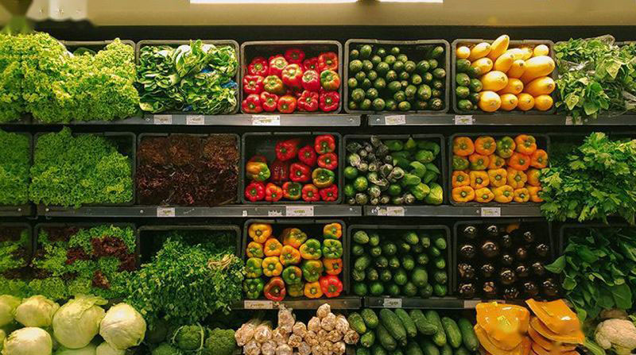
1. Identifying Innovation Areas in the Pantry
ENTREPRENEURIAL OPPORTUNITIES IN PROCUREMENT

Slide 7
1. Identifying Innovation Areas in the Pantry
Innovation in maritime provisioning begins with a rigorous, data-driven analysis of existing pantry workflows. By uncovering where spoilage, inefficiency, and low engagement occur, you can target high‐impact changes that deliver measurable savings and improved satisfaction. Below is a structured approach, broken into subpoints, that outlines how to identify innovation opportunities within a ship’s pantry.
Effective innovation within maritime pantry operations begins with a thorough understanding of existing processes, challenges, and hidden opportunities. Unlike conventional land-based foodservice operations, shipboard pantries face unique logistical and operational constraints such as limited storage spaces, varying quality of port-side suppliers, strict regulatory compliance, rapid crew turnover, and extreme sensitivity to product spoilage. Identifying areas for innovative interventions thus requires a systematic approach that merges quantitative data collection with qualitative insights from crew and galley personnel.
ENTREPRENEURIAL OPPORTUNITIES IN PROCUREMENT

Slide 8
1. Identifying Innovation Areas in the Pantry
1.1. Quantitative Spoilage Audit and Financial Impact
The initial step in identifying innovation areas involves the meticulous recording and analysis of spoilage rates and their financial implications. Food spoilage at sea can result from multiple factors, including extended transit times, ineffective refrigeration, inaccurate forecasting, or inadequate storage procedures. By conducting regular and detailed audits—logging precisely which items spoil, in what quantities, and at which stage of storage or preparation—operators can gain concrete insights into their most critical waste streams.
ENTREPRENEURIAL OPPORTUNITIES IN PROCUREMENT

Slide 9
1. Identifying Innovation Areas in the Pantry
1.1. Quantitative Spoilage Audit and Financial Impact
A critical first step is to compile hard data on exactly how much food is being wasted—and where. For at least two consecutive weeks (ideally longer, if schedules allow), maintain a detailed “Spoilage Log” for every perishable category. This should include:
• Category Name (e.g., leafy greens, soft cheeses, seafood, baked goods).
• Total Volume Received (in kilograms).
• Total Volume Consumed (actual usage).
• Total Volume Discarded (amount spoiled).
• Point of Failure (arrived spoiled, spoiled during staging, spoiled in pantry).
ENTREPRENEURIAL OPPORTUNITIES IN PROCUREMENT

Slide 10
1. Identifying Innovation Areas in the Pantry
Why quantify spoilage?
Financial Visibility: Converting spoilage into dollar terms (e.g., kilograms wasted × $/kg) reveals how much each item truly costs the operation.
Targeted Focus: Rather than guessing which product causes the biggest drain, you know exactly where to apply your innovation efforts.
Seasonal & Route Patterns: By tracking spoilage over multiple legs, you can detect whether certain climate zones (tropical vs. temperate) or longer provisioning intervals consistently drive higher waste.
ENTREPRENEURIAL OPPORTUNITIES IN PROCUREMENT

Slide 11
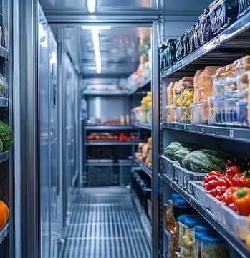
1. Identifying Innovation Areas in the Pantry
1.2. Mapping Cold-Chain Workflows & Identifying Bottlenecks
The cold-chain—maintaining optimal temperatures from supplier delivery through to storage and ultimately preparation—is fundamental to pantry effectiveness. Ship pantries rely heavily on temperature-sensitive products, and even brief disruptions can escalate spoilage. Creating detailed visual and data-driven mappings of cold-chain processes is thus an essential diagnostic step. Such workflow maps identify critical points of vulnerability, such as delays during port loading windows, inefficient onboard storage arrangements, or transitions between shore power and onboard generators.
ENTREPRENEURIAL OPPORTUNITIES IN PROCUREMENT

Slide 12
1. Identifying Innovation Areas in the Pantry
1.2. Mapping Cold-Chain Workflows & Identifying Bottlenecks
The typical steps are:
Quay Unloading. Food is removed from the supplier’s truck and staged in a dockside cold room (if available). Pantry stewards perform an initial visual and temperature inspection: check for physical damage, verify the shipment against the order, and use a handheld probe to confirm 0–4 °C for highly perishable items.
Transport to Ship. Goods are moved on forklifts or pallet jacks to the gangway. Transfer takes place either via a refrigerated “reefer” container docked against the hull or a temperature-controlled truck if the port lacks a dedicated reefer berth.
ENTREPRENEURIAL OPPORTUNITIES IN PROCUREMENT

Slide 13
1. Identifying Innovation Areas in the Pantry
1.2. Mapping Cold-Chain Workflows & Identifying Bottlenecks
The typical steps are:
Onboard Transfer & Cold-Hold Loading. Once on board, perishables are offloaded from the reefer container and transferred to the ship’s cold hold (shared with the galley if space is tight). This step often involves a brief 10–20 minute gap while switching from shore power (running reefer) to the ship’s generators.
Final Stowage in Pantry or Galley Fridge/Freezer. Pantry staff unload the cold hold, sort items according to category and status, and store them in designated refrigerators or freezers inside the pantry and galley area.
ENTREPRENEURIAL OPPORTUNITIES IN PROCUREMENT

Slide 14
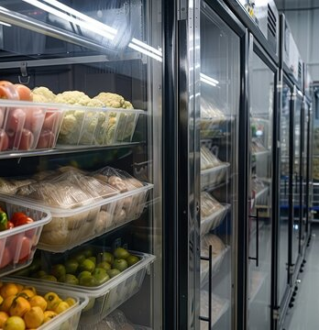
1. Identifying Innovation Areas in the Pantry
1.3. Gathering Qualitative Crew & Pantry Staff Insights
While quantitative data provides critical insights, comprehensive innovation strategies must also incorporate qualitative feedback. Crew members and galley staff are uniquely positioned to highlight inefficiencies and pain points that may not be immediately apparent through data alone. For instance, pantry stewards may observe that certain products are consistently rejected by crew due to poor quality or inappropriate selection, thereby increasing waste and reducing morale.
ENTREPRENEURIAL OPPORTUNITIES IN PROCUREMENT

Slide 15
1. Identifying Innovation Areas in the Pantry
1.3. Gathering Qualitative Crew & Pantry Staff Insights
Involving the pantry personnel early fosters buy-in and ensures that proposed innovations address genuine operational concerns. Crew engagement in this manner not only aids in identifying issues but also increases the likelihood that implemented solutions will be accepted and effectively utilized by the staff.
Quantitative data paints part of the picture. To capture the nuances of crew behavior, preferences, and on-the-ground frustrations, you must engage directly with the people who interact with the pantry daily.
Interviews and anonymous surveys. Develop a short, focused questionnaire (5–7 questions) for pantry stewards, galley cooks, and rank-and-file crew.
ENTREPRENEURIAL OPPORTUNITIES IN PROCUREMENT

Slide 16
1. Identifying Innovation Areas in the Pantry
1.3. Gathering Qualitative Crew & Pantry Staff Insights
Involving the pantry personnel early fosters buy-in and ensures that proposed innovations address genuine operational concerns. Crew engagement in this manner not only aids in identifying issues but also increases the likelihood that implemented solutions will be accepted and effectively utilized by the staff.
Quantitative data paints part of the picture. To capture the nuances of crew behavior, preferences, and on-the-ground frustrations, you must engage directly with the people who interact with the pantry daily.
Interviews and anonymous surveys. Develop a short, focused questionnaire (5–7 questions) for pantry stewards, galley cooks, and rank-and-file crew.
ENTREPRENEURIAL OPPORTUNITIES IN PROCUREMENT

Slide 17
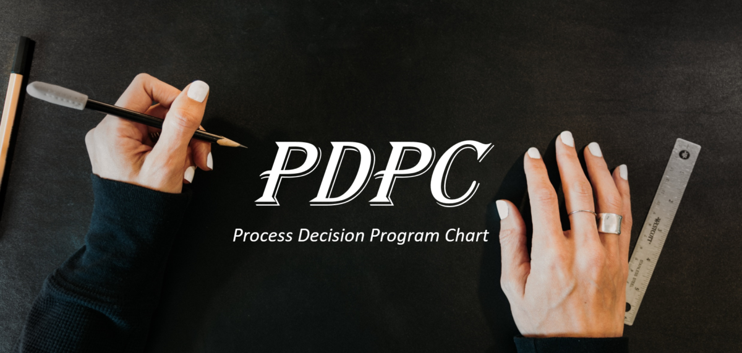
2. Basic Steps for Entrepreneurship in the Pantry
ENTREPRENEURIAL OPPORTUNITIES IN PROCUREMENT

Slide 18
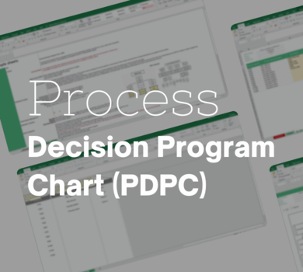
2. Basic Steps for Entrepreneurship in the Pantry
Basic Steps for Entrepreneurship in the Pantry - Process Decision Program Chart (PDPC)
The Process Decision Program Chart (PDPC) provides an ideal framework to guide you through the essential steps—ensuring potential issues are anticipated and proactively managed. Below are the detailed steps structured according to the PDPC methodology
ENTREPRENEURIAL OPPORTUNITIES IN PROCUREMENT

Slide 19

2. Basic Steps for Entrepreneurship in the Pantry
2.1. Ideation and Concept Generation
2.2. Rapid Prototyping and Pilot Testing
2.3. Data Analysis and Refinement
2.4. Securing Stakeholder Buy-in
By systematically applying the PDPC approach, pantry entrepreneurship concepts move efficiently from initial ideas to strategic reality. This structured methodology ensures innovation is not only creative but also robust, feasible, and fully supported by the key stakeholders responsible for onboard pantry operations.
ENTREPRENEURIAL OPPORTUNITIES IN PROCUREMENT

Slide 20
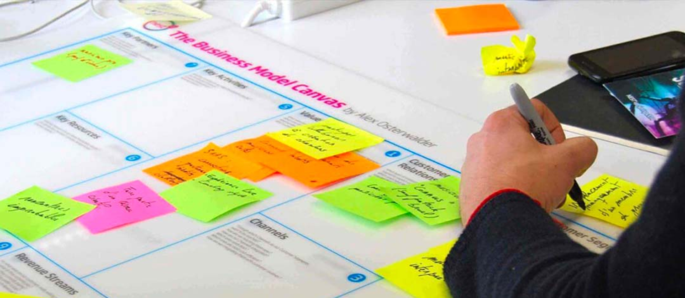
3. Creating a Business Model Canvas Focused on Pantry Entrepreneurship for Entrepreneurship in the Pantry
ENTREPRENEURIAL OPPORTUNITIES IN PROCUREMENT

Slide 21
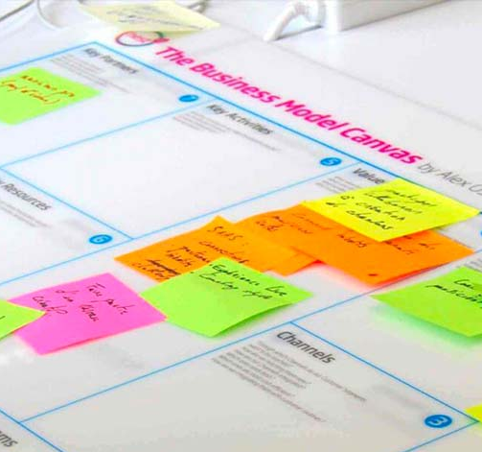
3. Creating a Business Model Canvas Focused on Pantry Entrepreneurship for Entrepreneurship in the Pantry
After identifying pantry innovations and piloting entrepreneurial concepts onboard, the next critical phase is to formalize your ideas into a practical and structured plan using the Business Model Canvas (BMC). Originally developed by Alexander Osterwalder, the BMC has become the gold standard in strategic planning and entrepreneurship, condensing complex ideas into nine clearly defined building blocks. In this module, you will adapt this powerful tool specifically to pantry operations onboard maritime vessels, ensuring your innovations are not just imaginative but financially and operationally feasible.
ENTREPRENEURIAL OPPORTUNITIES IN PROCUREMENT

Slide 22
3. Creating a Business Model Canvas Focused on Pantry Entrepreneurship for Entrepreneurship in the Pantry
3.1. Why a Business Model Canvas for Pantry Innovations?
Step 1: Defining Customer Segments
Step 2: Clarifying the Value Proposition
Step 3: Determining Effective Channels
Step 4: Establishing Customer Relationships
Step 5: Identifying Revenue Streams
Step 6: Pinpointing Key Resources
Step 7: Specifying Key Activities
Step 8: Forming Key Partnerships
Step 9: Evaluating Cost Structure
Step 10: Iteration and Refinement with PDPC (Process Decision Program Chart)
ENTREPRENEURIAL OPPORTUNITIES IN PROCUREMENT

Slide 23
3. Creating a Business Model Canvas Focused on Pantry Entrepreneurship for Entrepreneurship in the Pantry
Conclusion
Creating a Business Model Canvas tailored specifically to pantry entrepreneurship provides clarity, actionable insights, and strategic direction for your shipboard innovations. By systematically working through each of these steps—defining customers, articulating value propositions, selecting effective channels, managing customer relationships, identifying revenue streams, pinpointing essential resources, specifying activities, forming strategic partnerships, and evaluating your cost structure—you ensure your innovative pantry solutions are both viable and sustainable.
ENTREPRENEURIAL OPPORTUNITIES IN PROCUREMENT

Slide 24
REVIEW QUESTIONS
What are the key steps involved in quantifying spoilage rates within maritime pantry operations, and why is this step foundational to innovation?
Describe the primary challenges associated with maintaining an effective cold-chain onboard. How can detailed workflow mapping help overcome these issues?
Why is qualitative feedback from pantry staff and crew crucial in identifying true pantry inefficiencies?
How can employing the Impact-Effort Matrix help you prioritize innovation opportunities within pantry operations?
Explain the benefits of using structured ideation techniques such as brainstorming or mind-mapping when developing pantry entrepreneurship concepts.
ENTREPRENEURIAL OPPORTUNITIES IN PROCUREMENT

Slide 25
REVIEW QUESTIONS
What potential problems might you encounter during pilot testing onboard, and how could you proactively address these challenges?
Discuss the essential components of a compelling business case for pantry innovations. What key points should be highlighted when presenting to stakeholders like the Captain or Catering Director?
How can the Business Model Canvas be adapted specifically to the context of maritime pantry operations, and why is this adaptation necessary?
Identify at least three significant revenue streams that could emerge from implementing pantry innovations onboard, explaining how each stream would create financial value.
What role does the Process Decision Program Chart (PDPC) play in refining pantry entrepreneurship concepts, and why is anticipating potential problems essential in maritime provisioning contexts?
ENTREPRENEURIAL OPPORTUNITIES IN PROCUREMENT

Slide 26
Course References
Dora, M., & Kumar, M. (Eds.). (2022). Food supply chain management and logistics: Understanding the challenges of production, operation and sustainability in the food industry. Kogan Page.
Kitinoja, L., & Gustavsson, J. (Eds.). (2022). Cold chain management. Springer International Publishing. https://doi.org/10.1007/978-3-031-09566-5
Twilley, N. (2023). Frostbite: How refrigeration changed our food, our planet, and ourselves. Penguin Press.
Charis, M., & Kiran, M. (2023). Innovation strategies in the food industry: Tools for implementation. Academic Press. https://doi.org/10.1016/B978-0-323-90242-1.00010-5
Maurya, A. (2022). Running lean: Iterate from plan A to a plan that works (3rd ed.). O'Reilly Media.
ENTREPRENEURIAL OPPORTUNITIES IN PROCUREMENT

Slide 27
Course References
Ries, E. (2011). The lean startup: How today's entrepreneurs use continuous innovation to create radically successful businesses. Crown Business.
Osterwalder, A., & Pigneur, Y. (2010). Business model generation: A handbook for visionaries, game changers, and challengers. John Wiley & Sons.
Van der Pijl, P., Lokitz, J., & Solomon, L. K. (2020). Applying the business model canvas: A practical guide for small businesses. John Wiley & Sons.
Juliano, P. (Ed.). (2022). Food engineering innovations across the food supply chain. Academic Press. https://doi.org/10.1016/C2020-0-00433-7
Petrescu, D. C., & Ion, R. A. (Eds.). (2022). Scientific advancements for an innovative agri-food supply chain towards the 2030 sustainable development goals. MDPI. https://doi.org/10.3390/books978-3-0365-4954-3
ENTREPRENEURIAL OPPORTUNITIES IN PROCUREMENT

