Slide 1









MARitime Soft Skills for Onboard Healthy Nutrition and CULinary Arts in Seagoing Services – CUL-MAR-Skills
KA220-VET - Cooperation partnerships in vocational education and training
2023-1-RO01-KA220-VET-000156711
Industrial Property and Innovation Protection
in the Maritime Sector
Disclaimer: “Funded by the European Union. Views and opinions expressed are however those of the author(s) only and do not necessarily reflect those of the European Union or the ANPCDEFP. Neither the European Union nor the ANPCDEFP can be held responsible for them”

Slide 2
MARitime Soft Skills for Onboard Healthy Nutrition and CULinary Arts in Seagoing Services – CUL-MAR-Skills
KA220-VET - Cooperation partnerships in vocational education and training
2023-1-RO01-KA220-VET-000156711
ENTREPRENEURIAL OPPORTUNITIES IN PROCUREMENT
COURSE Week VII
Industrial Property and Innovation Protection in the Maritime Sector
Disclaimer: “Funded by the European Union. Views and opinions expressed are however those of the author(s) only and do not necessarily reflect those of the European Union or the ANPCDEFP. Neither the European Union nor the ANPCDEFP can be held responsible for them”

Slide 3
FOREWORD
WEEK 7 - Industrial Property and Innovation Protection in the Maritime Sector
The maritime sector increasingly relies on novel technological solutions, process improvements, and design adaptations developed directly on board or in port-related services. Securing these innovations through industrial property rights ensures not only operational advantage, but long-term business sustainability.
This week’s module focuses on the fundamentals and strategic application of industrial property protection—patents, utility models, trademarks, and designs—as they apply to maritime entrepreneurship. In an environment where solutions are often improvised under pressure, protecting original ideas helps foster a culture of professionalism, innovation, and accountability.
We will examine international frameworks such as the Paris Convention, the Patent Cooperation Treaty (PCT), and the role of WIPO, and how these systems can be leveraged by seafaring professionals. We will also explore national and international procedures for filing, registering, and maintaining industrial property rights—alongside the legal and criminal consequences of violations.
Beyond technical and legal knowledge, this module builds a mindset: to view innovation not only as a creative act, but as an asset worth defending. Participants will learn how to protect their ideas, how to avoid infringing others’ rights, and how to build value from originality in the specific context of maritime operations.
This is not just about intellectual property—it is about professional dignity, strategic thinking, and sustainable innovation in the modern maritime industry.
NAVAL COMMUNICATIONS
ENTREPRENEURIAL OPPORTUNITIES IN PROCUREMENT

Slide 4
Learning outcomes of the course
WEEK 7 – Industrial Property and Innovation Protection in the Maritime Sector
Upon completion of this training module, participants will be able to:
− Evaluate major international and national IP treaties (Paris Convention, TRIPS, PCT, EPC) to map out the rights and obligations relevant to maritime‐sector innovations.
− Draft and critically assess patent and utility‐model applications for shipboard technologies, ensuring that novelty, inventive step, and industrial applicability criteria are met in an international context.
− Navigate registration and post‐grant procedures—national phase entry, renewal deadlines, fee schedules, and ownership transfers—using digital filing platforms to maintain enforceable IP portfolios across key maritime jurisdictions.
− Analyse civil and criminal enforcement mechanisms against IP infringement in shipping—injunctions, damages calculations, border seizures, and criminal penalties—and formulate preventive strategies to mitigate legal and operational risks.
− Formulate licensing and collaboration models (exclusive, non‐exclusive, cross-licensing) that leverage patents, utility models, designs, and trademarks to generate revenue streams and accelerate R&D cycles in maritime operations.
− Integrate IP management into the R&D lifecycle by conducting freedom‐to‐operate searches, early novelty assessments, and modular patent filing strategies, thereby converting technical innovations into sustainable competitive advantages on board.
NAVAL COMMUNICATIONS
ENTREPRENEURIAL OPPORTUNITIES IN PROCUREMENT

Slide 5
Content of the course
WEEK 7 – Industrial Property and Innovation Protection in the Maritime Sector
The training is organized into five thematic parts, which bring together legal, strategic, and practical aspects of industrial property protection in a maritime context.
PART 1: UNDERSTANDING THE LEGAL FRAMEWORK OF INDUSTRIAL PROPERTY
This part outlines the core international and national IP regimes—Paris Convention, TRIPS Agreement, WIPO, and PCT procedures—and explains how these rules underpin strategic innovation management in shipboard logistics, catering, and procurement.
PART 2: PATENT AND UTILITY MODEL APPLICATIONS IN MARITIME PRACTICE
Here, we focus on drafting and filing patent or utility model applications for shipboard inventions, highlighting patentability requirements, the structure of maritime‐specific technical disclosures, and real‐world examples from the industry.
PART 3: REGISTRATION AND POST‐REGISTRATION PROCEDURES
This section covers the lifecycle of a granted right—national and international filing phases, renewal deadlines, fees, ownership transfers, and licensing—while emphasizing digital tools and portals that simplify these tasks for maritime entrepreneurs.
ENTREPRENEURIAL OPPORTUNITIES IN PROCUREMENT

Slide 6
Content of the course
WEEK 7 – INDUSTRIAL PROPERTY AND INNOVATION PROTECTION IN THE MARITIME SECTOR
PART 4: LEGAL AND CRIMINAL SANCTIONS FOR INFRINGEMENT
We examine civil and criminal remedies against IP violations—such as copying patented hull coatings or unlicensed use of navigation software—and review best‐practice prevention strategies to minimize legal exposure in maritime supply chains.
PART 5: STRATEGIC VALUE OF INDUSTRIAL PROPERTY ONBOARD
The final part explores how patents, utility models, designs, and trademarks translate into sustainable competitive advantages on board: from exclusive waste‐heat‐recovery systems to branded catering services, and offers guidance on licensing, cross‐collaboration, and R&D integration.
This structure provides a pragmatic view of industrial property as a tool for fostering innovation in the maritime environment.
ENTREPRENEURIAL OPPORTUNITIES IN PROCUREMENT

Slide 7

1. Legal Framework of Industrial Property
ENTREPRENEURIAL OPPORTUNITIES IN PROCUREMENT

Slide 8

1. Legal Framework of Industrial Property
In an environment of growing technological dependence and intense global competition, the ability to generate, leverage, and protect innovations becomes a strategic asset for any entrepreneurial venture, including those in the maritime sector. Whether we are talking about a new food preservation method, an advanced logistics system, or specialised kitchen equipment designed for shipboard use, every original technical or design contribution must be secured through the legal mechanisms of industrial property.
ENTREPRENEURIAL OPPORTUNITIES IN PROCUREMENT

Slide 9

1. Legal Framework of Industrial Property
1.1. Understanding the Legal Framework of Industrial Property
The legal framework governing Industrial Property is not merely a formal mechanism for safeguarding innovations—it is a strategic asset for any entrepreneur operating in the maritime sector. In a globalized environment where shipboard technologies, logistics solutions, and sustainability practices cross borders and jurisdictions, expertise in patent law and utility model registration forms the foundation for building competitive advantage while minimizing the risk of industrial espionage.
ENTREPRENEURIAL OPPORTUNITIES IN PROCUREMENT

Slide 10

1. Legal Framework of Industrial Property
1.2. International Legal Foundations of Industrial Property
1.2.1. Paris Convention
Adopted in 1883, the Paris Convention for the Protection of Industrial Property is the oldest multilateral treaty in this field. It enshrines several critical principles:
National Treatment: Each contracting state must grant to nationals of other member states the same IP protection it affords its own citizens. A shipowner or technology provider filing in one member country automatically gains equivalent procedural rights in all other member countries.
ENTREPRENEURIAL OPPORTUNITIES IN PROCUREMENT

Slide 11

1. Legal Framework of Industrial Property
Right of Priority:
An applicant who files a patent (or utility model) in one member country has a 12-month window to file in any other member state while preserving the original filing date. In practice, a maritime innovator can secure a preliminary filing in, say, Singapore, and then extend that filing date to the United Kingdom, Brazil, or Japan within one year—crucial for time‐sensitive shipboard inventions.
ENTREPRENEURIAL OPPORTUNITIES IN PROCUREMENT

Slide 12
1. Legal Framework of Industrial Property
1.2.2. TRIPS Agreement
The Agreement on Trade-Related Aspects of Intellectual Property Rights (commonly known as TRIPS) entered into force in 1995 under the auspices of the World Trade Organization (WTO). TRIPS elevates minimum IP‐protection standards and binds all WTO members to implement them in their domestic laws. Key provisions include:
Patentability Standards: Article 27 requires member states to make patents available for any inventions—products or processes—across all fields of technology, provided they meet criteria of novelty, inventive step (non-obviousness), and industrial applicability.
ENTREPRENEURIAL OPPORTUNITIES IN PROCUREMENT

Slide 13

1. Legal Framework of Industrial Property
1.2.2. TRIPS Agreement
Enforcement Obligations: TRIPS obliges member states to provide effective civil, administrative, and criminal remedies against IP infringement. A shipping firm can thus seek not only injunctions to block unauthorized shipboard equipment but also damages in jurisdictions where TRIPS-compliant enforcement mechanisms exist.
Compulsory Licensing and Exceptions: While TRIPS allows governments to grant compulsory licenses under certain public‐interest circumstances, these measures must adhere to narrow conditions to prevent abuse.
ENTREPRENEURIAL OPPORTUNITIES IN PROCUREMENT

Slide 14
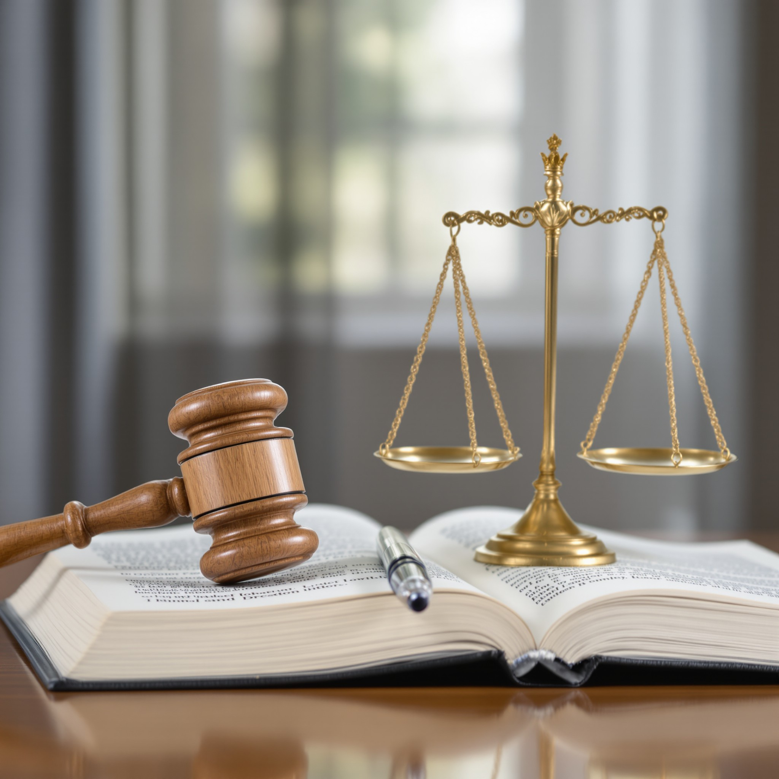
1. Legal Framework of Industrial Property
1.2.2. TRIPS Agreement
By setting these minimum standards, TRIPS ensures that a patented maritime technology enjoys a baseline level of protection in every major trading country, thereby strengthening the position of shipowners and maritime innovators in global markets.
ENTREPRENEURIAL OPPORTUNITIES IN PROCUREMENT

Slide 15
1. Legal Framework of Industrial Property
1.2.3. Patent Cooperation Treaty (PCT)
Single PCT Application: An applicant in the maritime sector can file one PCT application—describing, for instance, a novel marine navigation algorithm or an innovative fuel-efficiency device—rather than filing separate national applications in each desired territory.
International Search Report and Written Opinion: Within approximately 16 months of the initial filing, the PCT system issues a search report and an opinion on patentability. This early feedback allows maritime innovators to assess the strength of their claims before incurring the cost of national filings.
ENTREPRENEURIAL OPPORTUNITIES IN PROCUREMENT

Slide 16
1. Legal Framework of Industrial Property
1.2.3. Patent Cooperation Treaty (PCT)
National Phase Entry: After the 30- or 31-month priority window (measured from the PCT application’s priority date), the applicant chooses which PCT contracting states to enter for substantive examination. Critically, the PCT gives innovators extra time—compared to a straight-12-month Paris Convention priority claim—enabling them to refine technical disclosures and commercial strategies based on market or regulatory developments in target jurisdictions.
ENTREPRENEURIAL OPPORTUNITIES IN PROCUREMENT

Slide 17
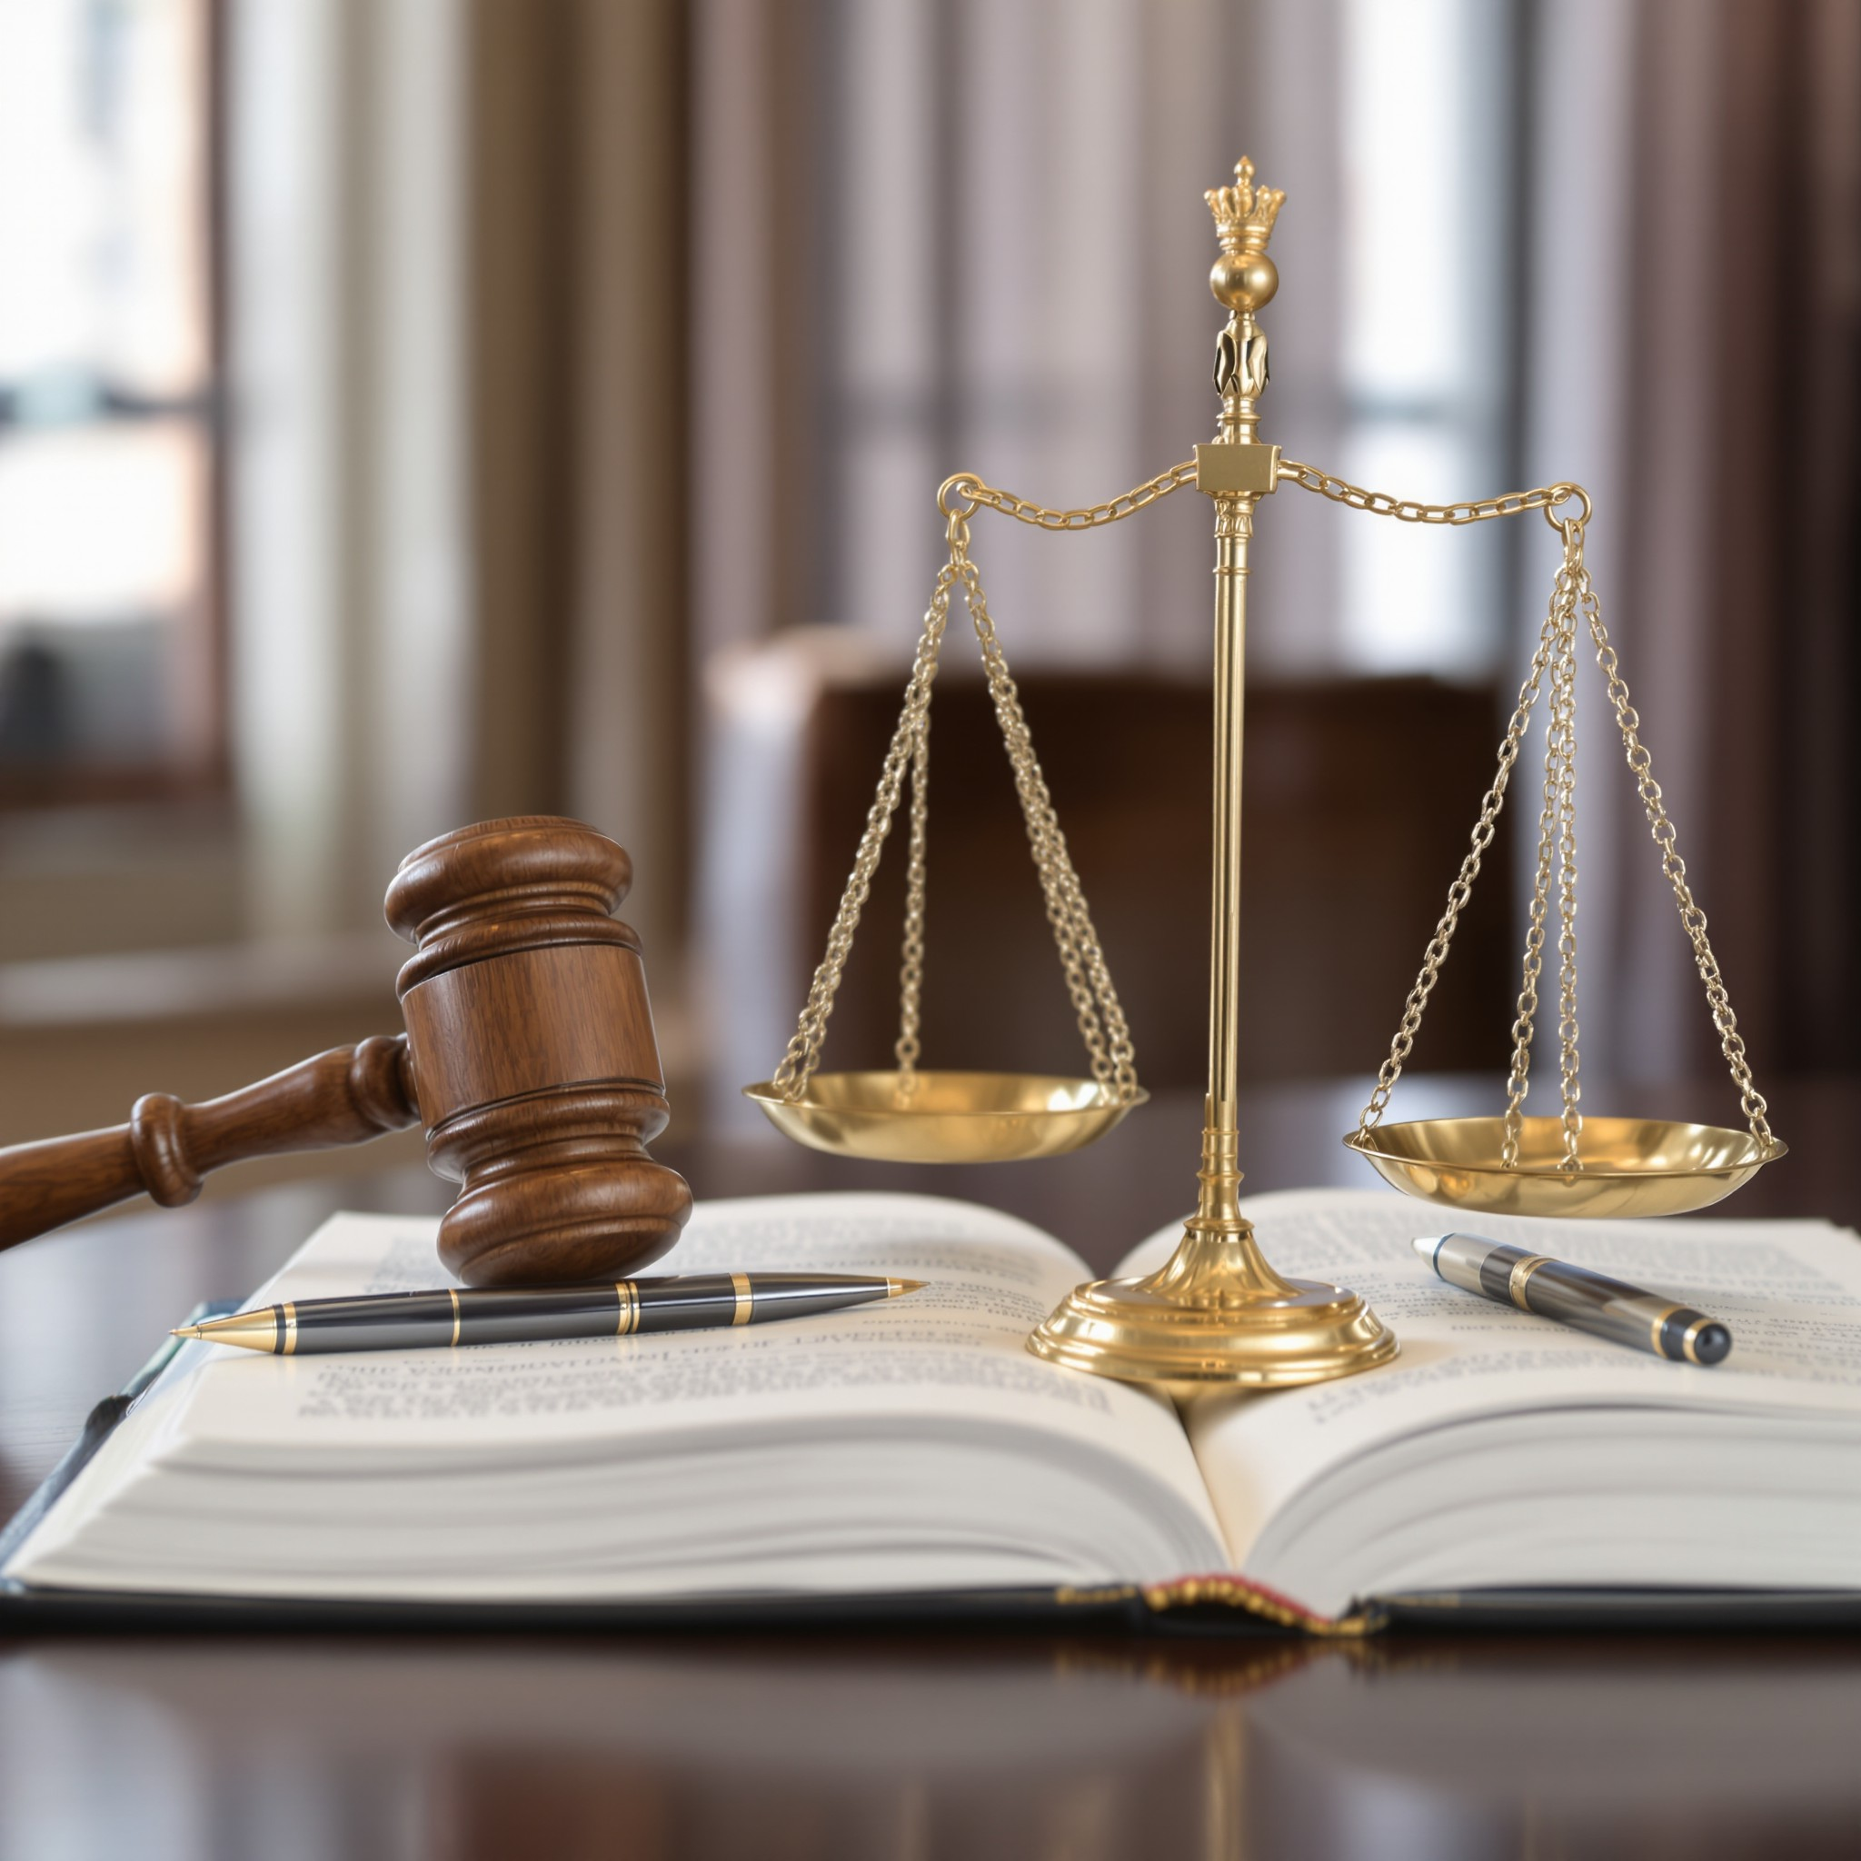
1. Legal Framework of Industrial Property
1.3. European and National Regulations
While the Paris Convention, TRIPS Agreement, and PCT establish a global backbone for patent protection, maritime entrepreneurs must also navigate the particularities of European and domestic industrial‐property regimes. In Europe, the European Patent Convention (EPC) provides a unified mechanism to secure patent rights across multiple member states; similarly, each coastal nation maintains its own national statutes, procedures, and enforcement practices that can affect how innovations are protected and commercialized within its jurisdiction.
ENTREPRENEURIAL OPPORTUNITIES IN PROCUREMENT

Slide 18

1. Legal Framework of Industrial Property
1.3. European and National Regulations
1.3.1. European Patent Convention (EPC)
The EPC—administered by the European Patent Office (EPO) since 1977—enables a single “European patent” application to be examined and, if granted, to produce a bundle of corresponding national patents in designated EPC member states. For maritime innovators, the EPC offers several significant strategic advantages:
Centralized Examination, Regional Outcome: Instead of filing separate applications in Germany, France, Italy, or the United Kingdom, a shipowner can file one EPC application describing
ENTREPRENEURIAL OPPORTUNITIES IN PROCUREMENT

Slide 19
1. Legal Framework of Industrial Property
1.3.1. European Patent Convention (EPC)
EPO’s Maritime‐Aware Examiners
Unitary Patent and Unified Patent Court (UPC) (anticipated developments
Limitations and Territorial Scope
ENTREPRENEURIAL OPPORTUNITIES IN PROCUREMENT

Slide 20
1. Legal Framework of Industrial Property
1.3.2. National Legislation and Procedures
Validation Requirements
Renewal Fees and Annuities
National Utility Model (“Petty Patent”) Systems: Many European countries (e.g., Germany, France, Spain) offer a secondary tier of protection via utility models (often termed “petty patents”).
National Courts and Enforcement
  Enforcement of patent and utility-model rights occurs before national courts, each with its own procedural rules and judicial philosophies.
ENTREPRENEURIAL OPPORTUNITIES IN PROCUREMENT

Slide 21
1. Legal Framework of Industrial Property
1.4. Types of Protectable Objects under Industrial Property
1.4.1. Patents
Patents grant the exclusive right to use, manufacture, or license a technical solution for a defined period (typically 20 years from the filing date), provided the invention meets three key criteria:
• Novelty – the invention is not already part of publicly available knowledge.
• Inventive Step – the technical solution is not obvious to someone skilled in the field.
• Industrial Applicability – the invention can be produced or used in industry (for example, a new method for energy-efficient ship navigation).
ENTREPRENEURIAL OPPORTUNITIES IN PROCUREMENT

Slide 22
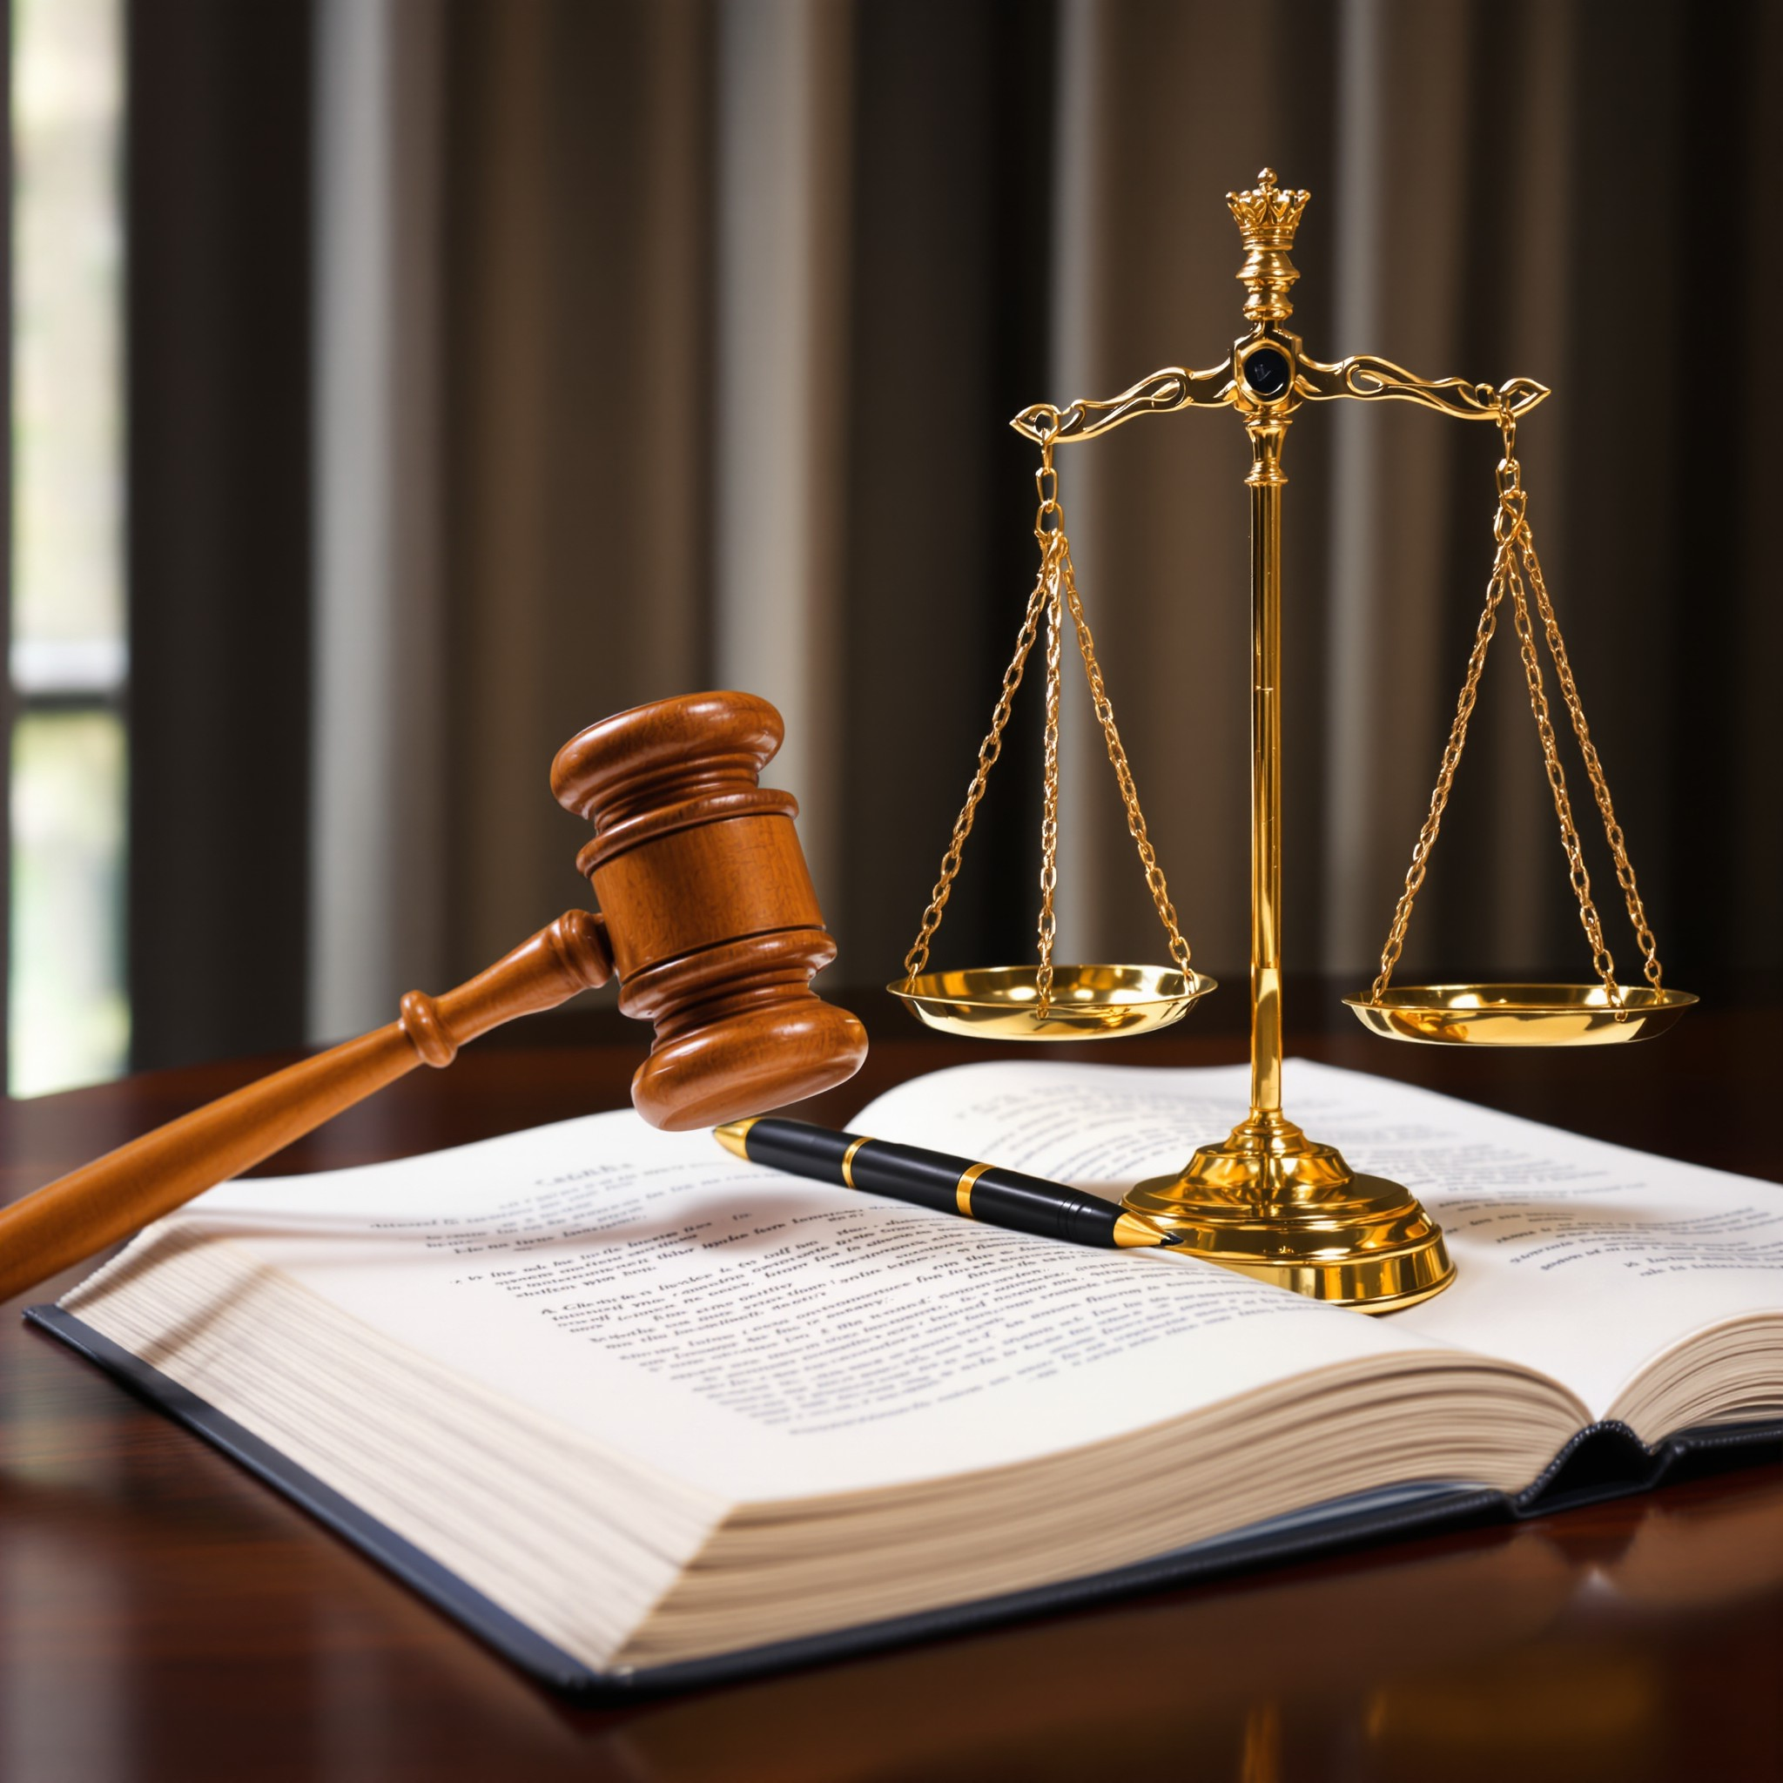
1. Legal Framework of Industrial Property
1.4. Types of Protectable Objects under Industrial Property
1.4.2. Utility Models
Utility Models (sometimes called “small patents” or “petty patents”) protect technical solutions that require a lower inventive threshold than regular patents but still meet criteria for novelty and industrial applicability. Their protection term is generally shorter (often 6–10 years), and the registration process is faster and less expensive than that for a standard patent.
ENTREPRENEURIAL OPPORTUNITIES IN PROCUREMENT

Slide 23
1. Legal Framework of Industrial Property
1.4. Types of Protectable Objects under Industrial Property
1.4.3. Industrial Designs
Industrial Designs protect the visual appearance of a product or part of a product—its shape, configuration, pattern, or colours—so long as that appearance is new and original. Industrial Designs do not cover functional or technical features; rather, they safeguard the aesthetic form by which users perceive innovation.
ENTREPRENEURIAL OPPORTUNITIES IN PROCUREMENT

Slide 24
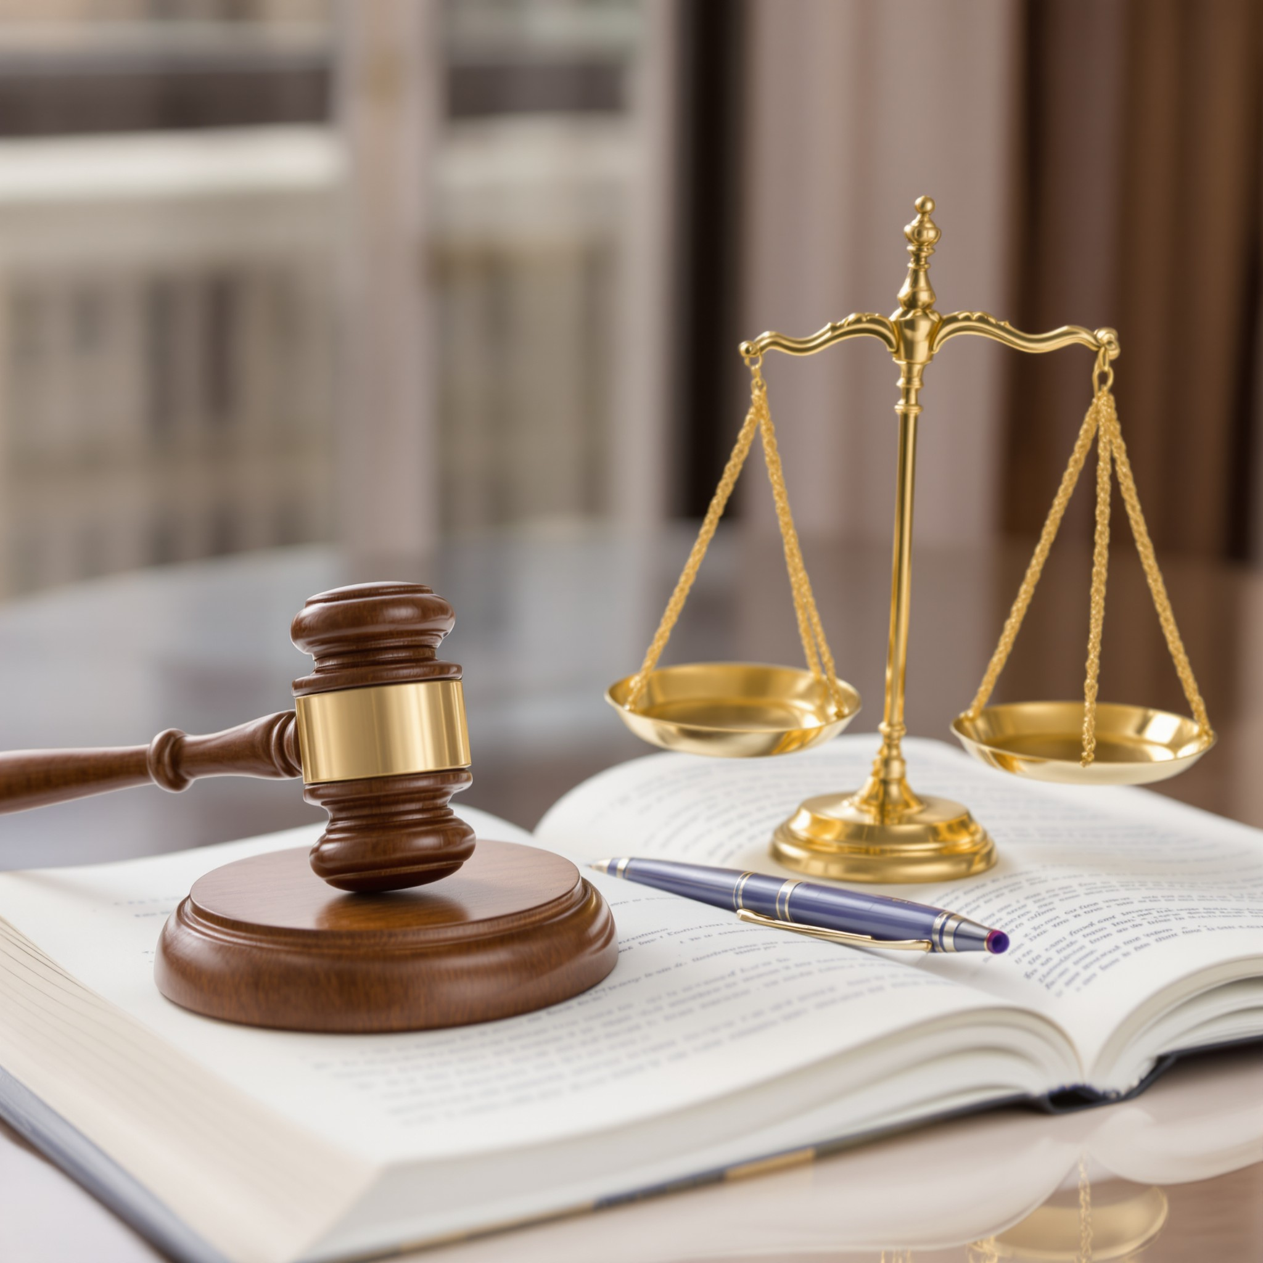
1. Legal Framework of Industrial Property
1.4. Types of Protectable Objects under Industrial Property
1.4.4. Trademarks
Trademarks protect signs—word marks (names, logos), graphic elements (colors, fonts, symbols), or combinations—used to distinguish one company’s goods or services from those of another. In the maritime sector, trademarks often cover:
A shipping company’s name and logo.
A branded onboard catering or restaurant service.
The brand for a digital cargo-booking platform.
ENTREPRENEURIAL OPPORTUNITIES IN PROCUREMENT

Slide 25
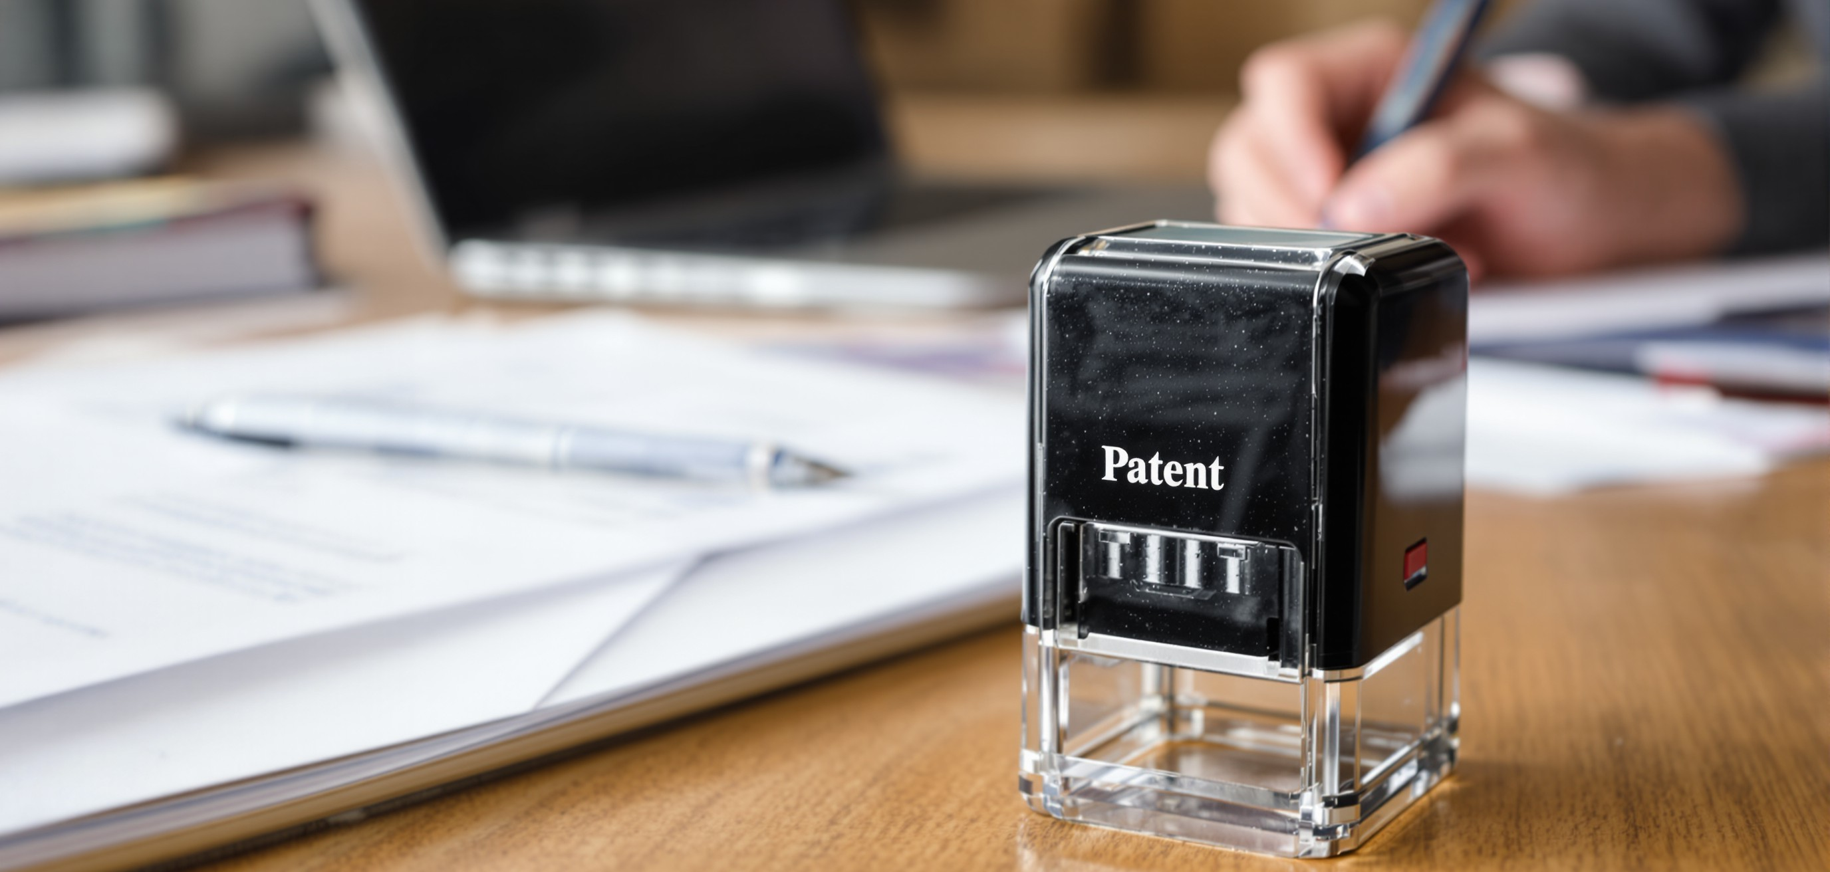
2. Patent and Utility Model Applications in Maritime Practice
ENTREPRENEURIAL OPPORTUNITIES IN PROCUREMENT

Slide 26
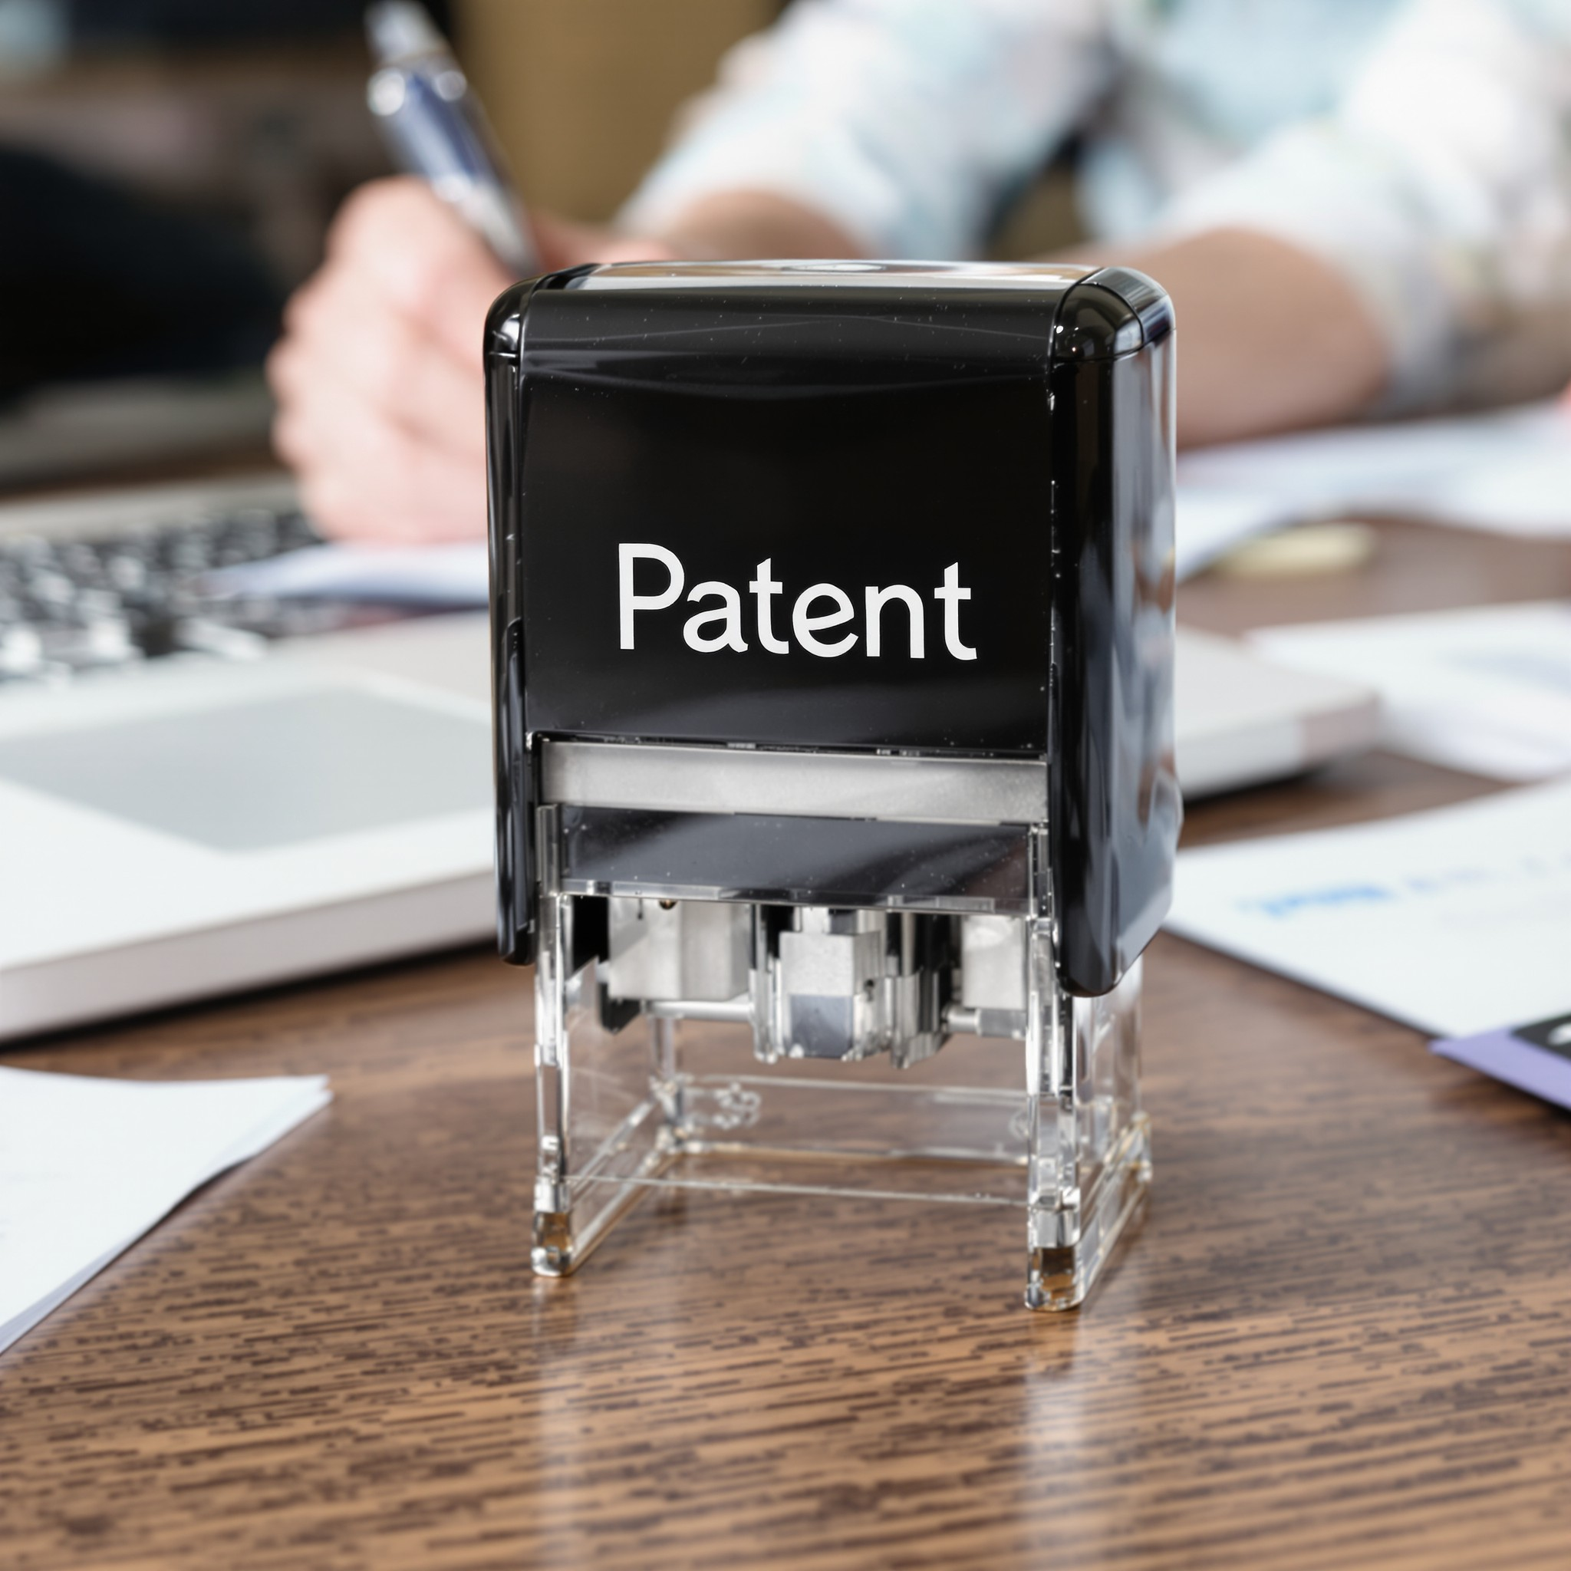
2. Patent and Utility Model Applications in Maritime Practice
Introducing innovations in shipbuilding, maritime logistics, and onboard technologies often requires years of R&D and substantial investment. Consequently, protecting these technical solutions through a timely and correctly prepared patent or utility model application is not merely a formality but a strategic tool for preserving competitive advantage. In the maritime sector, this takes on additional importance because technologies spread globally, and any missed or imprecise application can allow a competitor to capture key markets.
ENTREPRENEURIAL OPPORTUNITIES IN PROCUREMENT

Slide 27
2. Patent and Utility Model Applications in Maritime Practice
2.1. Preparation Process and Content of the Application
Scope of the Invention: The write‐up must delineate the essence of the novel maritime technology—for example, a system for optimizing a vessel’s fuel efficiency—while defining the boundaries of the claimed technical features.
Solving a Concrete Technical Problem: The specification should identify a specific challenge in maritime practice (e.g., elevated emissions from diesel engines) and explain how the proposed solution overcomes it.
ENTREPRENEURIAL OPPORTUNITIES IN PROCUREMENT

Slide 28
2. Patent and Utility Model Applications in Maritime Practice
2.1. Preparation Process and Content of the Application
Drawings and Diagrams: Technical illustrations (hydrodynamic hull schematics, waste‐management flowcharts, or CAD renderings of a new software interface) are essential for visualizing the new elements.
Claims: The centrepiece of every application consists of the claims, which precisely state which components, functionalities, and procedural steps are to be protected. In a maritime context, an independent claim might cover the overall architecture of an intelligent cargo‐tracking system, while dependent claims detail specific add‐ons—such as a particular predictive‐maintenance algorithm.
ENTREPRENEURIAL OPPORTUNITIES IN PROCUREMENT

Slide 29
2. Patent and Utility Model Applications in Maritime Practice
2.2. Conditions for Patentability and Utility Model Eligibility
For an application to be granted, the invention must meet the criteria of “Novelty,” “Inventive Step,” and “Industrial Applicability.”
In maritime practice, there is often debate over whether an improvement to a ship’s hull design exhibits a sufficient “Inventive Step” compared to known solutions. Registering such an invention requires confirming that the similar hydrodynamic shape is not already in the public domain.
ENTREPRENEURIAL OPPORTUNITIES IN PROCUREMENT

Slide 30
2. Patent and Utility Model Applications in Maritime Practice
2.4. Strategic Importance for Maritime Entrepreneurs
Creating Licensing Revenue: Patented technologies are often licensed to other shipyards or equipment suppliers—so a company that creates AI‐driven route‐optimization software might earn royalties on every sale or implementation.
Reducing Legal Risk: If a shipowner implements a third‐party technology without thorough IP due diligence, they risk costly litigation. Proactively filing an application prevents potential infringement claims and provides long‐term peace of mind.
ENTREPRENEURIAL OPPORTUNITIES IN PROCUREMENT

Slide 31

3. Registration and Post-Registration Procedures
ENTREPRENEURIAL OPPORTUNITIES IN PROCUREMENT

Slide 32

3. Registration and Post-Registration Procedures
Securing a granted patent or utility model is only the beginning of intellectual-property protection in the maritime sector. Equally critical are the subsequent steps—maintaining, enforcing, and licensing those rights across jurisdictions. A failure to observe deadlines or fees can render a once-valuable right void, leaving costly innovations unprotected. Below is an analytical overview of the key procedural stages and strategic considerations for maritime entrepreneurs.
3.1. National and Regional Filing Phases
National Phase Entry (PCT Applicants):
3.2. Deadlines, Fees, and Announcements
Official Filing Fees:
ENTREPRENEURIAL OPPORTUNITIES IN PROCUREMENT

Slide 33
3. Registration and Post-Registration Procedures
3.3. Post-Grant Oppositions and Invalidations
3.3.1. Opposition Proceedings (EPO Example):
Within 9 months of grant, any third party (e.g., a competitor shipyard) can file an opposition at the European Patent Office. Grounds include lack of novelty, lack of inventive step, or added subject matter.
For maritime inventions—such as an engine-efficiency improvement—competitors may search international databases and challenge claims if they believe prior art (e.g., a similar system described at a naval-engineering conference) was overlooked.
3.3.2. Post-Grant Challenges in National Offices
ENTREPRENEURIAL OPPORTUNITIES IN PROCUREMENT

Slide 34
3. Registration and Post-Registration Procedures
3.4. Assignment, Licensing, and Ownership Transfer
3.4.1. Assignment of Rights:
A shipbuilder or maritime-tech startup may choose to assign (sell) its entire patent/utility model portfolio to a larger consortium or to an investor.
Legally, assignments must be recorded at each national office (e.g., USPTO Assignment Recordation, JPO Register). If unrecorded, third parties may challenge the chain of title.
ENTREPRENEURIAL OPPORTUNITIES IN PROCUREMENT

Slide 35
3. Registration and Post-Registration Procedures
3.4. Assignment, Licensing, and Ownership Transfer
3.4.2. Licensing Agreements:
Licensing can take many forms: exclusive vs. non-exclusive, field-limited (e.g., only for offshore platforms), territory-limited (e.g., Baltic Sea vs. global), or royalty-based (e.g., per-vessel deployment fee).
Well-drafted license agreements should address warehousing, sublicensing, quality control of licensed products (e.g., specific thresholds for hull coatings), and audit rights to verify royalty payments.
3.5. Strategic Use of Digital Tools and Portals
ENTREPRENEURIAL OPPORTUNITIES IN PROCUREMENT

Slide 36
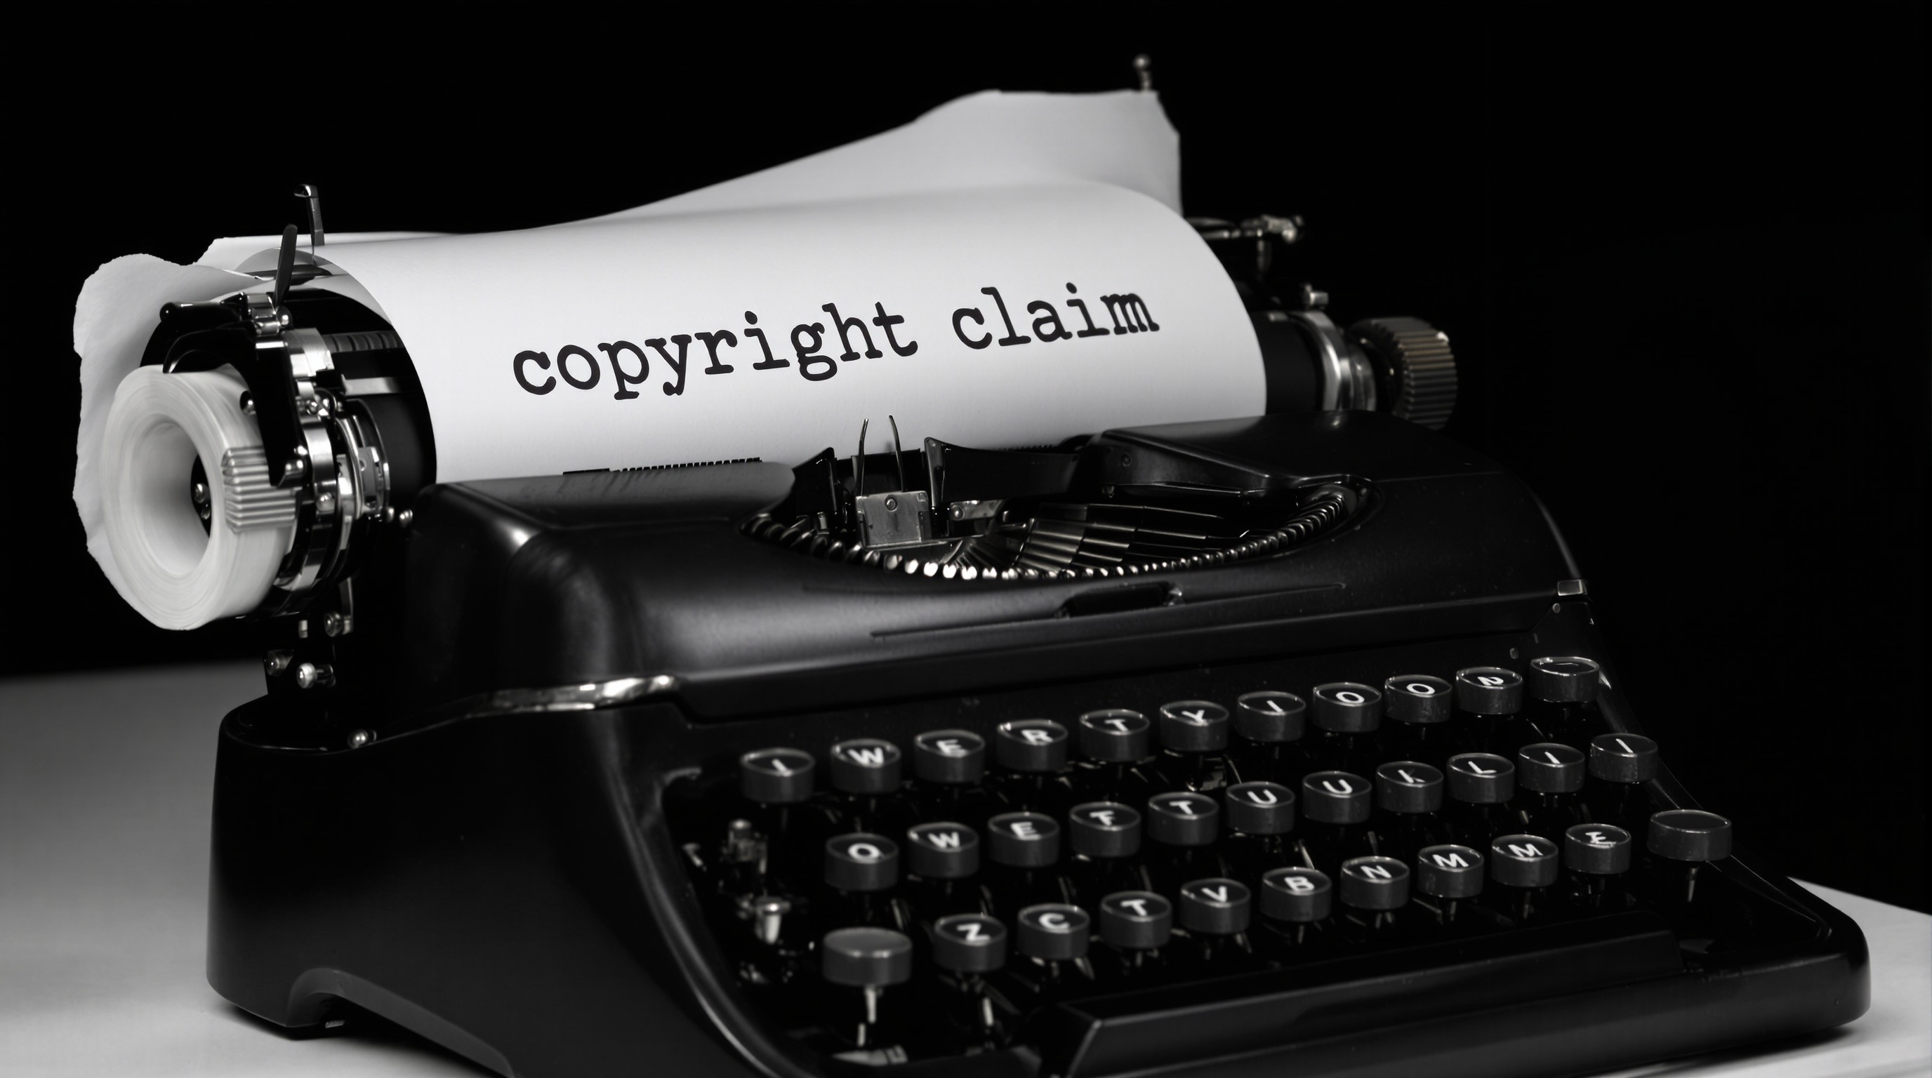
4. Legal and Criminal Sanctions for Infringement
ENTREPRENEURIAL OPPORTUNITIES IN PROCUREMENT

Slide 37
4. Legal and Criminal Sanctions for Infringement
In the maritime sector, unauthorized use of protected innovations can cause serious economic, safety, and reputational damage. Shipowners, equipment manufacturers, and service providers rely on clear legal deterrents to discourage infringing acts—whether deliberate or unwitting. This section dissects the spectrum of civil and criminal remedies available when industrial‐property rights are violated, with a focus on typical scenarios in shipping logistics, on‐board systems, and supply‐chain processes.
4.1. Civil Remedies and Enforcement Actions
4.1.1. Cease‐and‐Desist Letters (Injunction Requests)
ENTREPRENEURIAL OPPORTUNITIES IN PROCUREMENT

Slide 38
4. Legal and Criminal Sanctions for Infringement
4.2. Criminal Sanctions and Administrative Penalties
4.2.1. Criminal Penalties for Counterfeiting and Willful Infringement:
4.2.2. Administrative Fines and Shutdown Orders:
4.2.3. Border Detainment and Destruction Orders
ENTREPRENEURIAL OPPORTUNITIES IN PROCUREMENT

Slide 39
4. Legal and Criminal Sanctions for Infringement
4.3. Case Studies of Typical Maritime Infringements
4.3.1. Case A: Unlicensed Hull‐Coating Technology
4.3.2. Case B: Knock‐off Marine Safety Helmets Bearing a Registered Trademark
4.3.3. Case C: Infringing Navigation Software on Commercial Vessel
ENTREPRENEURIAL OPPORTUNITIES IN PROCUREMENT

Slide 40
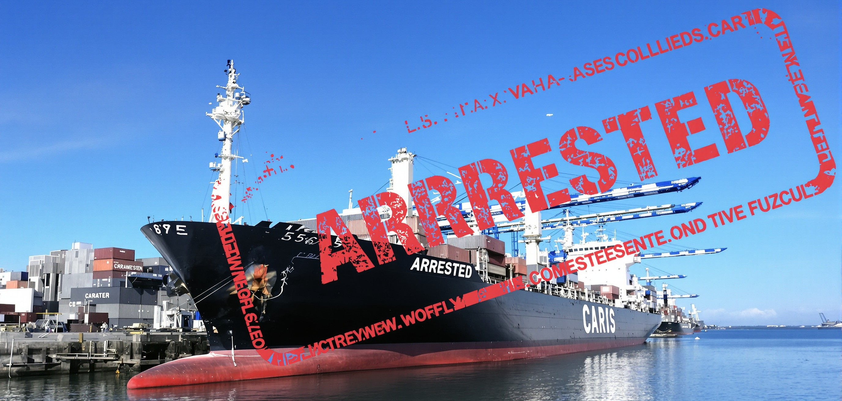
5. Strategic Value of Industrial Property Onboard
ENTREPRENEURIAL OPPORTUNITIES IN PROCUREMENT

Slide 41

5. Strategic Value of Industrial Property Onboard
In the maritime sector, innovation does not reside solely in ship design or route optimization; it permeates every aspect of onboard operations, from procurement to safety systems. When managed correctly, industrial property (IP) becomes a strategic asset that delivers both immediate operational benefits and long-term competitive advantage. In this section, we examine how shipowners, operators, and maritime entrepreneurs can leverage patents, utility models, industrial designs, and trademarks to strengthen their position in an intensely competitive market.
ENTREPRENEURIAL OPPORTUNITIES IN PROCUREMENT

Slide 42
5. Strategic Value of Industrial Property Onboard
First, securing patent and utility-model protection enables ship operators to offer truly unique services or technologies. For example, implementing a patented waste-heat recovery system in the galley not only yields significant energy savings but also allows the shipowner to market that technology as an exclusive feature unavailable to competitors without a license. In practice, this exclusivity can justify higher charter rates or form the basis of partnership agreements in which the presence of that patented system becomes a contractual requirement. Only through clearly defined rights over an invention can a technical innovation be transformed into a powerful selling point that attracts clients willing to pay a premium for guaranteed quality and efficiency.
ENTREPRENEURIAL OPPORTUNITIES IN PROCUREMENT

Slide 43
5. Strategic Value of Industrial Property Onboard
Second, licensing and collaboration agreements built on IP rights open additional revenue streams and accelerate the innovation cycle. Consider a startup that has developed a compact wastewater-treatment module specifically designed for small vessels. By securing patent protection, the company can license this technology to large shipyards or offshore platform operators. Instead of selling the physical module outright, the innovator earns royalties on each unit produced, allowing a single R&D investment to generate revenue repeatedly. At the same time, shipbuilders gain the advantage of integrating a proven solution without incurring the high costs and risks of in-house development.
ENTREPRENEURIAL OPPORTUNITIES IN PROCUREMENT

Slide 44
5. Strategic Value of Industrial Property Onboard
Third, trademarks and industrial designs allow maritime businesses to build a consistent brand identity that travels from ship to ship. A vessel-catering company, for instance, might register a trademark for its onboard food products along with a distinctive packaging design. As that trademark appears across multiple vessels, passengers and crew come to associate the name and visual style with superior quality and innovation. Similarly, when a shipping company protects the design of its deck panels, heating controls, or waste-management systems, each new vessel that adopts identical visual elements reinforces the operator’s reputation and prestige. In this way, visual identity and trademarks are not mere cosmetic flourishes but key components of an overarching competitive strategy.
ENTREPRENEURIAL OPPORTUNITIES IN PROCUREMENT

Slide 45
5. Strategic Value of Industrial Property Onboard
Fourth, integrating IP considerations at the earliest stages of R&D ensures that novel solutions remain unique and shields the company from costly redesigns if it later emerges that a competitor’s patent already covers a similar concept. Suppose an R&D team is developing an automated fuel-metering system: early involvement by an IP specialist would trigger comprehensive searches in patent databases to confirm whether the underlying concept is truly novel. By identifying potential conflicts before investing heavily, the team can redirect its efforts toward genuinely original solutions instead of pursuing ideas that no longer meet novelty requirements.
ENTREPRENEURIAL OPPORTUNITIES IN PROCUREMENT

Slide 46
5. Strategic Value of Industrial Property Onboard
Fifth, protecting software and digital innovations has become increasingly critical as algorithms for route-optimization, emissions monitoring, and automated inventory management have evolved into essential shipboard systems. Although software was once deemed abstract and often ineligible for patent protection, many jurisdictions now permit patents on software that produces a concrete technical effect. For example, a system that automatically calibrates ballast-water treatment by interfacing with physical sensors and engine controls inherently involves hardware-software integration—meeting the criteria for patentability. Consequently, patent claims must be crafted with precision to highlight the interaction between code and physical devices on board, maximizing protection for software modules without requiring full disclosure of source code.
ENTREPRENEURIAL OPPORTUNITIES IN PROCUREMENT

Slide 47
5. Strategic Value of Industrial Property Onboard
Sixth, developing industrial designs constitutes a powerful way to create a memorable visual identity—whether in crew galleys, passenger cabins, or recreation areas. If the unique shape of a dish rack or a multifunctional light fixture is registered as an industrial design, no other pantry or liner can replicate it without a license. Such visual distinctiveness not only cements the operator’s brand in customers’ minds but also prevents competitors from offering unlicensed copies of the design that has become synonymous with a superior experience.
ENTREPRENEURIAL OPPORTUNITIES IN PROCUREMENT

Slide 48
5. Strategic Value of Industrial Property Onboard
Finally, accelerating design registrations in key jurisdictions—under the Geneva Act (CNC), the European Patent Convention (EPC), or national design registers—allows ship operators to secure rights over their visual identity before unveiling a new liner. This preemptive strategy prevents competitors from registering identical or confusingly similar designs and blocking adoption in strategically important markets. Rapid design filings are particularly critical when introducing innovative deck flooring, novel lifeboat structures, or cutting-edge cabin layouts that capture the imagination of investors and passengers alike.
ENTREPRENEURIAL OPPORTUNITIES IN PROCUREMENT

Slide 49
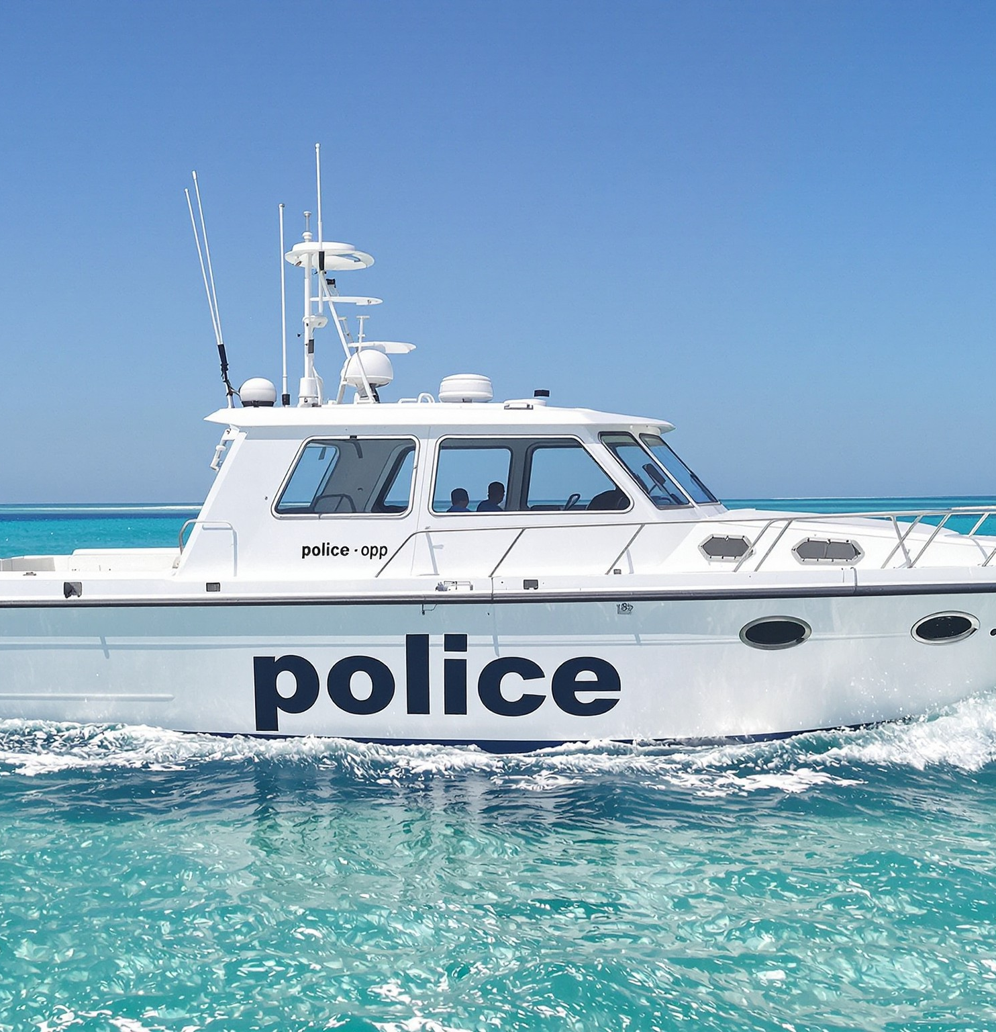
Conclusion
In the maritime sector, the capacity to develop, protect, and strategically leverage industrial property is essential for transforming technical ingenuity into enduring competitive advantage. Throughout this week’s module, we have examined how shipowners, technology providers, and entrepreneurial ventures can harness the five pillars of IP management—legal foundations, application drafting, registration processes, enforcement mechanisms, and strategic deployment on board—to secure innovation and drive long‐term growth.
ENTREPRENEURIAL OPPORTUNITIES IN PROCUREMENT

Slide 50
REVIEW QUESTIONS
Which principle of the Paris Convention ensures that a maritime innovator can extend a first‐filing date to multiple countries, and why is this critical for time‐sensitive shipboard technologies?
How does the “inventive step” requirement differ between patent and utility‐model applications, and what practical implications does this have for protecting a small mechanical improvement on a vessel?
Describe two advantages of using the PCT route rather than direct national filings when seeking patent protection for a novel cargo‐tracking device.
What key factors should a shipping company consider when deciding whether to validate a European patent in specific member states?
Outline three proactive measures a maritime entrepreneur can take to minimise the risk of inadvertently infringing a competitor’s patent before installing new onboard equipment.
ENTREPRENEURIAL OPPORTUNITIES IN PROCUREMENT

Slide 51
REVIEW QUESTIONS
In a scenario where an unlicensed hull‐coating technology is discovered on a vessel, what civil and administrative remedies can the patent owner pursue, and in which order?
Explain how registering an industrial design for a distinctive cabin interior contributes to both brand identity and competitive differentiation in cruise operations.
What strategic benefits arise from integrating IP‐landscape searches into the R&D phase of developing an automated fuel‐metering system for ships?
When crafting a licensing agreement for a patented waste‐heat recovery system, what clauses should be included to ensure timely royalty payments and quality control of licensed units?
How can port‐state authorities and customs collaborate with a shipowner to enforce IP rights on imported infringing spare parts, and what procedural steps are involved?
ENTREPRENEURIAL OPPORTUNITIES IN PROCUREMENT

Slide 52
Course References
European Patent Office. (1973). European Patent Convention. Retrieved from https://www.epo.org/law-practice/legal-texts/html/epc/2016/e/index.html
The official text of the European Patent Convention (EPC), which governs the centralized granting procedure through the European Patent Office (EPO). It details requirements for validation, payment of annual fees, and opposition procedures under the European patent framework.
World Intellectual Property Organization. (1970). Patent Cooperation Treaty (PCT). Retrieved from https://www.wipo.int/treaties/en/text.jsp?file_id=288637
The full text of the Patent Cooperation Treaty, administered by WIPO. It describes the international mechanism for filing a single PCT application and the subsequent “national phase” entries in chosen countries. Useful for understanding how to establish a global patent family and obtain the International Search Report and Written Opinion.
ENTREPRENEURIAL OPPORTUNITIES IN PROCUREMENT

Slide 53
Course References
World Intellectual Property Organization. (1979). Paris Convention for the Protection of Industrial Property. Retrieved from https://www.wipo.int/treaties/en/ip/paris/
The official text of the Paris Convention, introducing the principles of “national treatment” and “right of priority” for patents, industrial designs, and trademarks. This document outlines minimum standards for member countries, including the 12-month priority period and basic harmonization rules.
World Trade Organization. (1994). Agreement on Trade‐Related Aspects of Intellectual Property Rights (TRIPS). Retrieved from https://www.wto.org/english/docs_e/legal_e/27-trips.pdf The full text of the TRIPS Agreement. It sets minimum protection and enforcement standards that WTO member states must incorporate into their domestic laws. Critical for understanding how patented maritime technologies receive baseline protection in all major trading nations.
ENTREPRENEURIAL OPPORTUNITIES IN PROCUREMENT

Slide 54
Course References
World Intellectual Property Organization. (1979). Paris Convention for the Protection of Industrial Property. Retrieved from https://www.wipo.int/treaties/en/ip/paris/
The official text of the Paris Convention, introducing the principles of “national treatment” and “right of priority” for patents, industrial designs, and trademarks. This document outlines minimum standards for member countries, including the 12-month priority period and basic harmonization rules.
World Trade Organization. (1994). Agreement on Trade‐Related Aspects of Intellectual Property Rights (TRIPS). Retrieved from https://www.wto.org/english/docs_e/legal_e/27-trips.pdf
The full text of the TRIPS Agreement. It sets minimum protection and enforcement standards that WTO member states must incorporate into their domestic laws. Critical for understanding how patented maritime technologies receive baseline protection in all major trading nations.
ENTREPRENEURIAL OPPORTUNITIES IN PROCUREMENT

Slide 55
Course References
World Intellectual Property Organization. (2021). WIPO Handbook on Industrial Property Information and Documentation. Retrieved from https://www.wipo.int/standards/en/pdf/standards_ipid_en.pdf
A technical guide for using patent databases, classification schemes (IPC, CPC), and monitoring competitors—especially relevant for marine engineers and entrepreneurs conducting freedom‐to‐operate searches.
World Intellectual Property Organization. (2020). Madrid System for the International Registration of Marks. Retrieved from https://www.wipo.int/madrid/en/
The official resource on the Madrid System for international trademark registration, which simplifies filing and maintaining brand identity across multiple countries, including for shipping fleets, shipbuilders, and international logistics operators.
European Union Intellectual Property Office. (2022). EU Design Directive (98/71/EC) and EU Design Regulation (6/2002). Retrieved from https://euipo.europa.eu/ohimportal/en/designs
ENTREPRENEURIAL OPPORTUNITIES IN PROCUREMENT

Slide 56
Course References
United States Patent and Trademark Office. (2023). Patent and Trademark Resource Centers (PTRCs). Retrieved from https://www.uspto.gov/learning-and-resources/support-centers/patent-and-trademark-resource-centers-ptrcs
Official information on the U.S. patent and trademark regime. Includes statutory texts, manuals, sample patent applications, and practical search strategies adaptable to marine technologies and ship logistics.
European Commission. (2022). Study on the Economic Impact of the Unitary Patent and Unified Patent Court on Innovation in the Maritime Sector. Retrieved from https://ec.europa.eu/growth/industry/intellectual-property/
An analytical report assessing how the Unitary Patent and Unified Patent Court will affect R&D investments in shipbuilding, digital navigation solutions, and environmental technologies on board.
Organisation for Economic Co‐operation and Development (OECD). (2021). Patent Licensing Practices in High‐Technology Industries: Implications for the Maritime Sector. Retrieved from https://www.oecd.org/sti/inno/patent-licensing.htm
ENTREPRENEURIAL OPPORTUNITIES IN PROCUREMENT

