Slide 1



European Initiative
for the exchange of young officers inspired by Erasmus
LoD 11 Session International Naval Semester
56th IG Meeting, Gdynia, Poland
The Initiative
Erasmus
Militaire
Military
Erasmus
Colonel Catalin POPA
Associate Professor PhD
Chairperson LoD 11
EMILYO

Slide 2
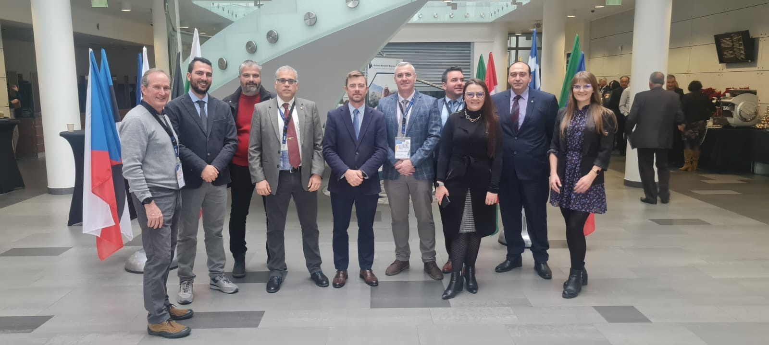
INTERNATIONAL NAVAL SEMESTER
LoD 11 – participant BOEI: 10 participants, 7 partner institutions
Polish Naval Academy “Heroes of Westerplatte”, Poland;
Romanian Naval Academy “Mircea cel Batran”, Romania;
“Nikola Vaptsarov Naval Academy”, Bulgaria;
Hellenic Naval Academy, Greece;
Italian Naval Academy, Italy;
Spanish Naval Academy, Spain;
United States Naval Academy, USA – observers.

Slide 3
INTERNATIONAL NAVAL SEMESTER - Roadmap
LoD 11 – discussions on the status of the agreed roadmap:
The syllabuses have been drafted on 1st version, syllabuses have been concluded and agreed in a prior join version;
The partners will proceed with the course implementation based on a joint plan for the upcoming academic year 2023-2024;
The consortium for applying to E+ strategic partnerships has been established for eligible and available partners;
The plan for joint activities has been disseminated.

Slide 4


INTERNATIONAL NAVAL SEMESTER – Course package
Course assignment/syllabuses approval:
Naval Leadership – Polish Naval Academy (Hellenic Naval Academy)
Power Plants – Italian Naval Academy (Romanian Naval Academy)
Computer network – Polish Naval Academy (Romanian Naval Academy)
Naval Electronics – Hellenic Naval Academy (Italian Naval Academy)
Naval Sensors – INA Italian Naval Academy (Hellenic Naval Academy)
Maritime Security – Bulgarian Naval Academy (Polish Naval Academy)
Naval Cyber Threats – Bulgarian Naval Academy (Italian Naval Academy)
Oceanography – Romanian Naval Academy
Naval Architecture – Romanian Naval Academy
Naval Communication – Hellenic Naval Academy/ Romanian Naval Academy
New course proposal – has been agreed to be part of INS:
CSDP module
Deadlines (updated!):
February 2023 – syllabuses approval, working group development, start of course development;
March 2023 – project submission for INS
September 2023 – course content development;
October 2023 – submit the final modules offer for each partner.

Slide 5
INTERNATIONAL NAVAL SEMESTER – Joint modules/events
Training modules/events offer for 2022-2023:
Training modules
Navy Warfare Tactics Module – RNA (Romania, April 2023)
Navigation Simulation Module/ Engine Room Watchkeeping – RNA (Romania, April-May 2023)
Ship Handling Module – NVNA (Bulgaria, April-May 2023)
Seamanship Training Stages – RNA/NVNA/PNA (July 2023)
Maritime Security – HNA (Greece, March 27th 2023)
International Training Week – SNA (Spain, March and November 2023)
Leadership – PNA (Poland, May 2023)
Events
CadetNav Students’ Conference – RNA (Romania, April 2023)
SeaConf International Conference – RNA (Romania, May 2023)
Leadership Conference (January 2023), International Affairs Conference (April 2023) - USNA

Slide 6
INTERNATIONAL NAVAL SEMESTER – Strategic projects
LoD 11 – Joint projects for INS
1. Joint projects currently under implementation – RNA, PNA, NVNA:
MARS-NET – simulators’ network implementation (2022-2024)
SEA MENTORS – mentorship platform to be implemented (2022-2024);
2. LoD 11 – Joint projects are to be prepared (RNA guidance):
KA203 Common Curriculum Harmonization for Navy Education – curriculum framework development (March 2023) – RNA, HNA, NVNA, PNA, INA – next IG meeting the project application will be revised and approved.
KA203 - Integrated Training Programs Network for EU Naval Academies (february 2024).

Slide 7
INTERNATIONAL NAVAL SEMESTER
Roadmap updates – way to go:
by February 2023 – approval of the final format of syllabuses for 12 joint modules;
March 2023 – projects proposal preparation and submission (RNA coordination)
March - December 2023 – drafting the course content and approving the modules organization in the academic plan for 2023-2024/partners;
INS is planned to be started as joint modules offer during 2023-2024.

Slide 8

INTERNATIONAL NAVAL SEMESTER
QUESTIONS?

