Slide 1
Co-simulation platform in NTNU ---Vico workshop
Norwegian University of Science and Technology
Lecturer: Tongtong Wang
tongtong.wang@ntnu.no
6 September 2022

Slide 2
Outline
Introduction to Vico
Installation of Vico
Running co-simulations in Vico using the command line interface (CLI)
Scenarios
LogConfig
ChartConfig
VisualConfig
Examples

Slide 3
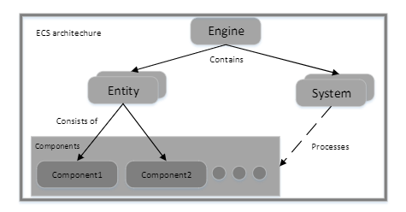
Vico
Vico is a co-simulation framework based on the Entity-Component-System (ECS) architecture.
Supports FMI 1.0 & 2.0 for co-simulation.
Supports SSP 1.0
Written in Kotlin (JVM target)
Available through Maven
Comes with a powerful command line interface CLI

Slide 4
Vico as FMI co-simulation master
Vico itself is a totally generic (co-simulation) software
In the context of the CLI however, Vico behaves as an FMI master.
Vico currently only supplies one type of master algorithm:
A parallel multi-rate fixed-step master with no rollback
Slaves are always stepped with the same constant step-size, however, individual slaves may be stepped at different rates.

Slide 5
Installing Vico
Clone https://github.com/NTNU-IHB/Vico
Run ./gradlew installDist
Add cli/build/install/bin to Path

Slide 6
Software requirements
Windows or Linux
Git bash https://gitforwindows.org/
A JDK (1.8) https://www.oracle.com/java/technologies/javase-downloads.html
Python 3.6+ (64bit) https://www.python.org/downloads/windows/
IntelliJ IDE https://www.jetbrains.com/idea/download
Notepad++ https://notepad-plus-plus.org/downloads/
7zip https://www.7-zip.org/
https://github.com/NTNU-mechlab/vico_workshop

Slide 7
Vico command line interface (CLI)
The Vico CLI allows single FMUs or network of FMUs (SSP) to be simulated.
It also allows arbitrary Kotlin scripts to be executed.

Slide 8
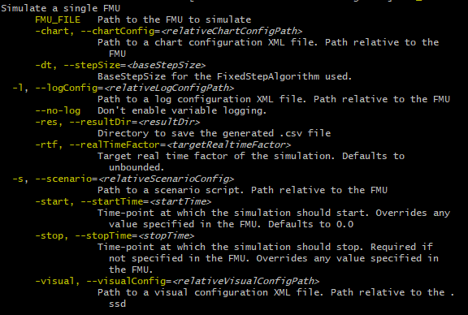
Vico CLI: simulate-fmu
This is mostly useful for testing an FMU that would normally be used as a building block in a larger system.

Slide 9
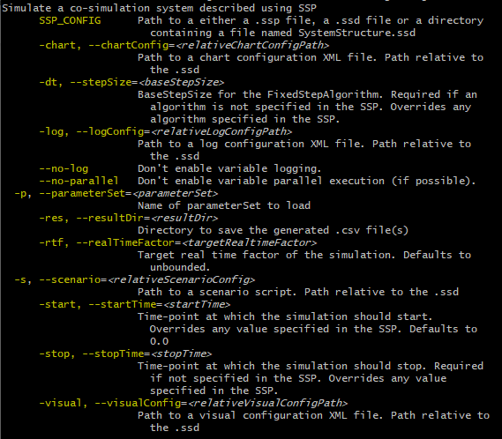
Vico CLI: simulate-ssp
It takes an SSP archive as input and simulates it.

Slide 10
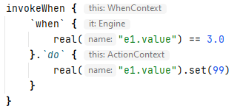
Vico scenarios
Scenarios in Vico are actions to be executed at
Initialization (init)
A particular point in time (invokeAt)
When a certain condition is meet (invokeWhen)
InvokeAt
Takes a timepoint in seconds as argument
InvokeWhen
Takes a predicate as argument

Slide 11
Vico scenarios cont.
Specified as Kotlin scripts (.kts)
Can use the entire power of the JVM eco-system!
Variable evaluations!
Specifying variables:
real(“entity.component.variableName”)
Variable type,
real, int, str or bool
Entity name, e.g.,
the name of the FMU instance (component in SSP)
Can be omitted..
Variable name

Slide 12
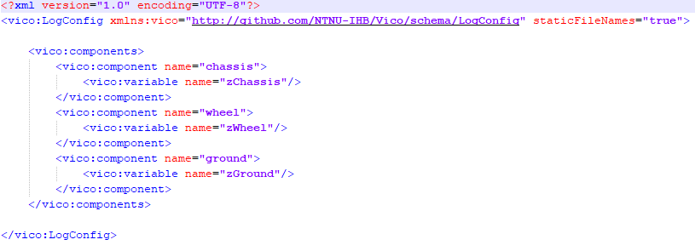
Time-series export
Simulation data can be exported to CSV
Currently limited to an FMI/SSP context only
Configured using XML (schema/LogConfig.xsd)

Slide 13
Plotting
Vico allows real-valued variables to be plotted
While the simulation is in progress;
or after the simulation has ended.
Configured using XML (schema/ChartConfig.xsd)

Slide 14
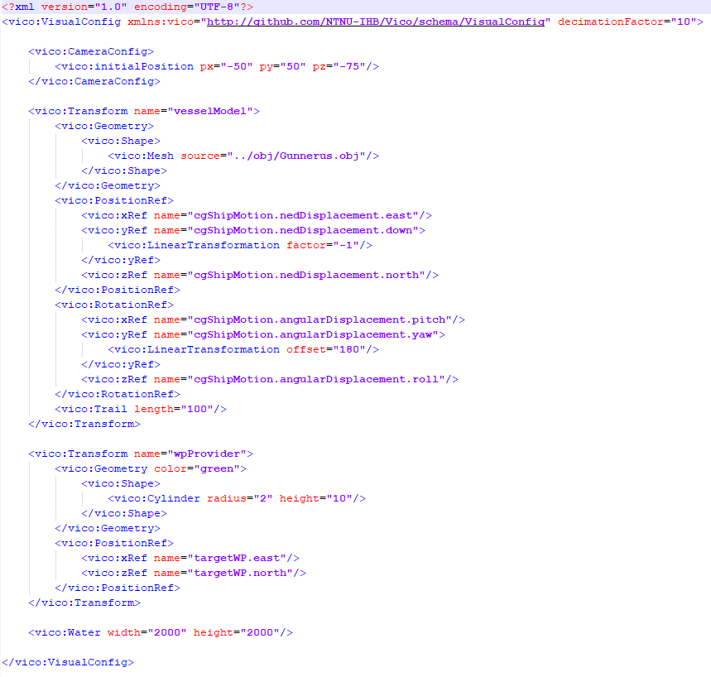
3D visuals
Vico simulations can be extended with 3D visualizations.
Configured using an XML (schema/VisualConfig.xsd)

Slide 15
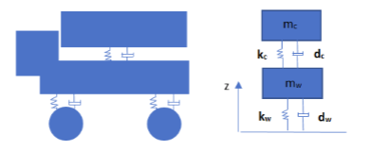
Example: Quarter-truck
1.Chassis including the suspension;
2. Wheel including tyre;
3. The ground
Mass of chassis
Mass of wheel
Both masses have a single vertical degree of freedom coupled by a linear spring–damper system representing the chassis suspension and wheel tyres.
The ground profile is given as external input.

Slide 16
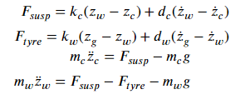
Example: Quarter-truck
https://github.com/NTNU-IHB/Vico/tree/master/examples

Slide 17
Q & A

