Slide 1
Co-simulation The Fundamental of Digital Twin System
Norwegian University of Science and Technology
Lecturer: Motoyasu Kanazawa
6 September 2022

Slide 2
Outline
Why do we model?
What is co-simulation technology?

Slide 3
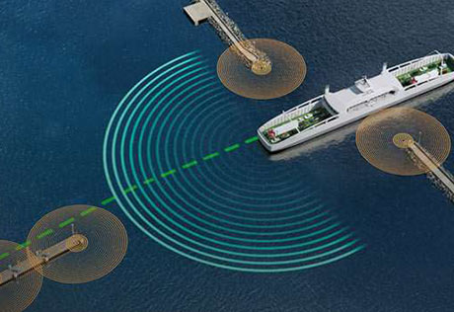
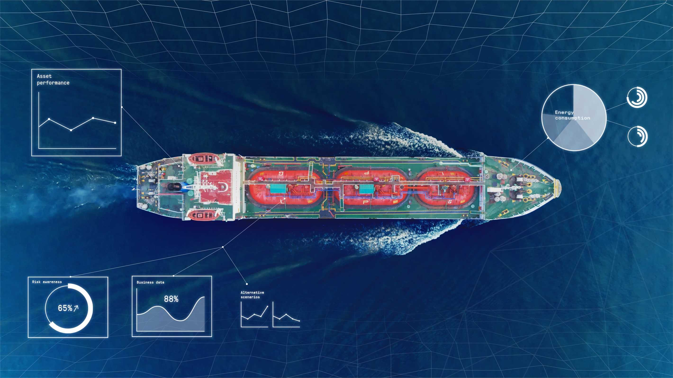
Why do we model?
A scientific model is a physical, conceptual, or mathematical representation of a real phenomenon that is difficult to observe directory. Britannica
It is used to explain and predict the behavior of real objects or systems. Britannica
Copyright: Kongsberg Maritime
Copyright: Kongsberg Maritime

Slide 4
Why do we model?
Scientific models are simplified representation of the real phenomena.
Different models could be derived for different purposes.
“The highest performance” does not mean “the best model”.
E.g., The highest performance with three-year development.
Performance
Time & Cost

Slide 5
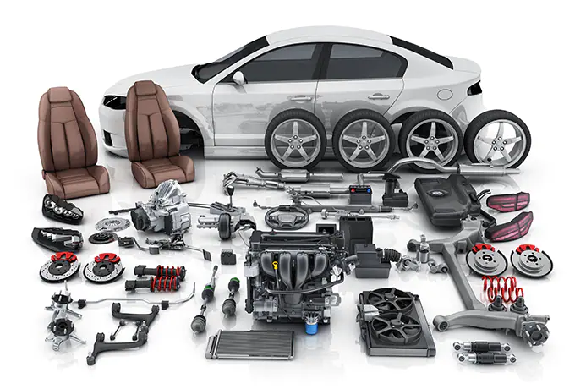
What is co-simulation technology?
Copy right: https://www.keyence.com/
Notes:
Picture: we compose a comprehensive system by assembling sub systems.
For example: car. It is very hard to be understood as a one monolithic system,
however, if you think it is composed of different sub systems, such as tires, engines, wheels…. That makes you easy to comprehend and maintain the whole system.

Slide 6
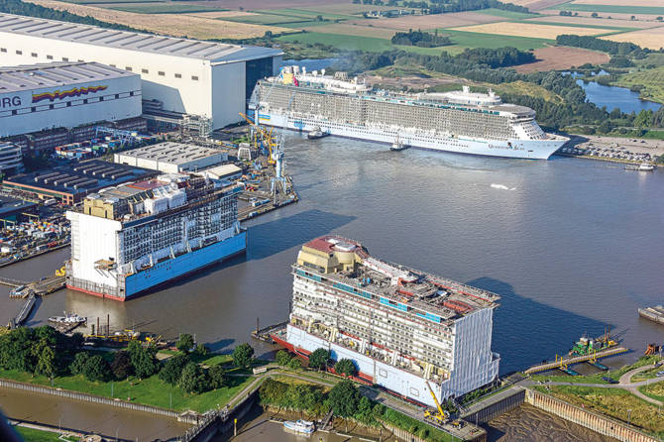
What is co-simulation technology?
Copy right: https://www.cadmatic.com/en/resources/articles/the-evolution-of-modularisation-and-partitioning-in-shipbuilding/
A comprehensive system
Subsystems / Modules
Notes:
Here is an another example in the maritime domain.
Ship is a comprehensive system.
Hence, it is pretty common and useful for us to view a comprehensive system as a combination of different subsystems / modules, which are easy to be developed and understood in one basic principle.

Slide 7
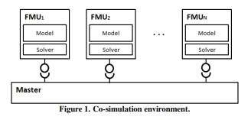
What is co-simulation technology?
Co-simulation refers to an enabling technique, where different sub-systems making up a global simulation are modeled and run in a distributed fashion.
Adapted from https://dl.acm.org/doi/abs/10.5555/2872965.2872993
Each sub-system is a simulator and is broadly defined as a black-box capable of exhibiting behavior, consuming inputs, and producing output.
C. Gomes et.al. “Cosimulation: A survey”, 2018
Inputs
Black-box
Output
Notes:
These backgrounds bring us to the co-simulation technology.
Co-simulation refers to an enabling technique, where different sub-systems making up a global simulation are modelled and run in a distributed fashion.
For instance, a car is a very comprehensive system.
If you were working in the car manufacturer, you would not be responsible for everything composing a car.
Probably, you would be in charge of only some components of the car. For instance, you would be in charge of only engines, and have a very limited understanding about wheels.
But you need a model for a whole system for evaluating car’s behaver.
Then, you might be able to focus on developing a sub model of engines, and you can connect your sub model to the other models with each other.
That is the idea of the co-simulation technology. If it were not for co-simulation technology, you would lose a lot of time and money communicating with people in the different departments.
Each sub-system is a simulator and is broadly define as a black-box capable of exhibiting behavior, consuming inputs, and producing outputs.
That means, you don’t have to open up the sub system for running a simulation, at the same time, your model will not be opened up by someone else.

Slide 8
What are advantages of using co-simulation?
Similar model
can be shared…
Model D
(Python)
Competitors
Model E
(Python)
Model C
(20sim)
Model A
(Fortran)
Model B
(Matlab)
Model B’
(Matlab)
Notes:
Then, what are advantages of using co-simulation?
It could be easily understood by taking a look at the situation where we have no co-simulation technology.
Say, imagine you are building a model for a comprehensive system for some purposes.
Without using co-simulation technology, you would need to ask people to help you build some models for your comprehensive system.
Explaining….

Slide 9
What are advantages of using co-simulation?
Compared to more traditional monolithic simulations, co-simulation encourages re-usability, model sharing and fusion of simulation domains.
A crucial point is that co-simulation allows users to simulate models exported from different tools/languages/domains together.
In turn, this provides a compelling way of realizing complex cyber physical systems, which require interaction between models from different domains and sources.
Standardized co-simulation, using e.g., established and open standards like the Function Mock-up Interface (FMI) enables a consistent and field-tested way of accomplishing this.
Notes:
Advantages.

Slide 10
What are the standards for co-simulation?
Modelica association
The Functional Mock-up Interface (FMI)
FMI for embedded systems (eFMI)
Distributed Co-simulation Protocol (DCP)
System Structure & Parameterization (SSP)
Open Simulation Platform (OSP)
OSP Interface Specification (OPS-IS)

Slide 11
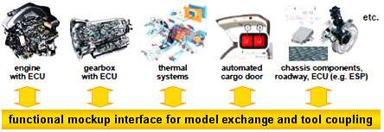
Standards for co-simulation: FMI
FMI is a tool independent standard for the exchange of dynamic models and co-simulation.
FMI for Co-simulation
Solver included.
FMI for Model Exchange
Solver provided by the execution environment.
It has been widely adopted since its initial release in 2010.
FMI 2.0 released in 2014.
FMI 3.0 in the works.

Slide 12
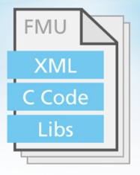
Standards for co-simulation: FMU
A component that implements the FMI interface is called a Functional Mock-up Unit (FMU)
Separation of
Description of interface data (XML file)
Functionality (C code or binary)
Platform dependent code
An FMU may run on one or more of these variations: 32/64 bit- linux/windows/mac.
Additionally, an FMU may contain additional data and functionality
Spreadsheets etc.

Slide 13
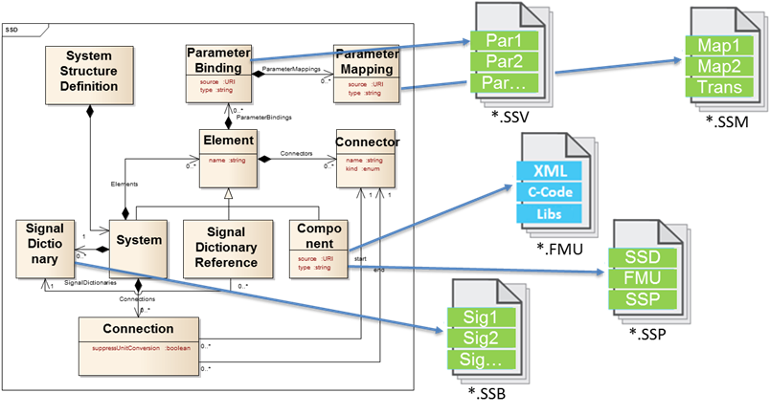
Standards for co-simulation: SSP
Tool independent standard to define complete systems consisting of one or more components (e.g., FMUs), including their parameterization.
SSP standardizes the way simulations are described.
Which models are included.
How they are connected.
Parameter-sets.

Slide 14
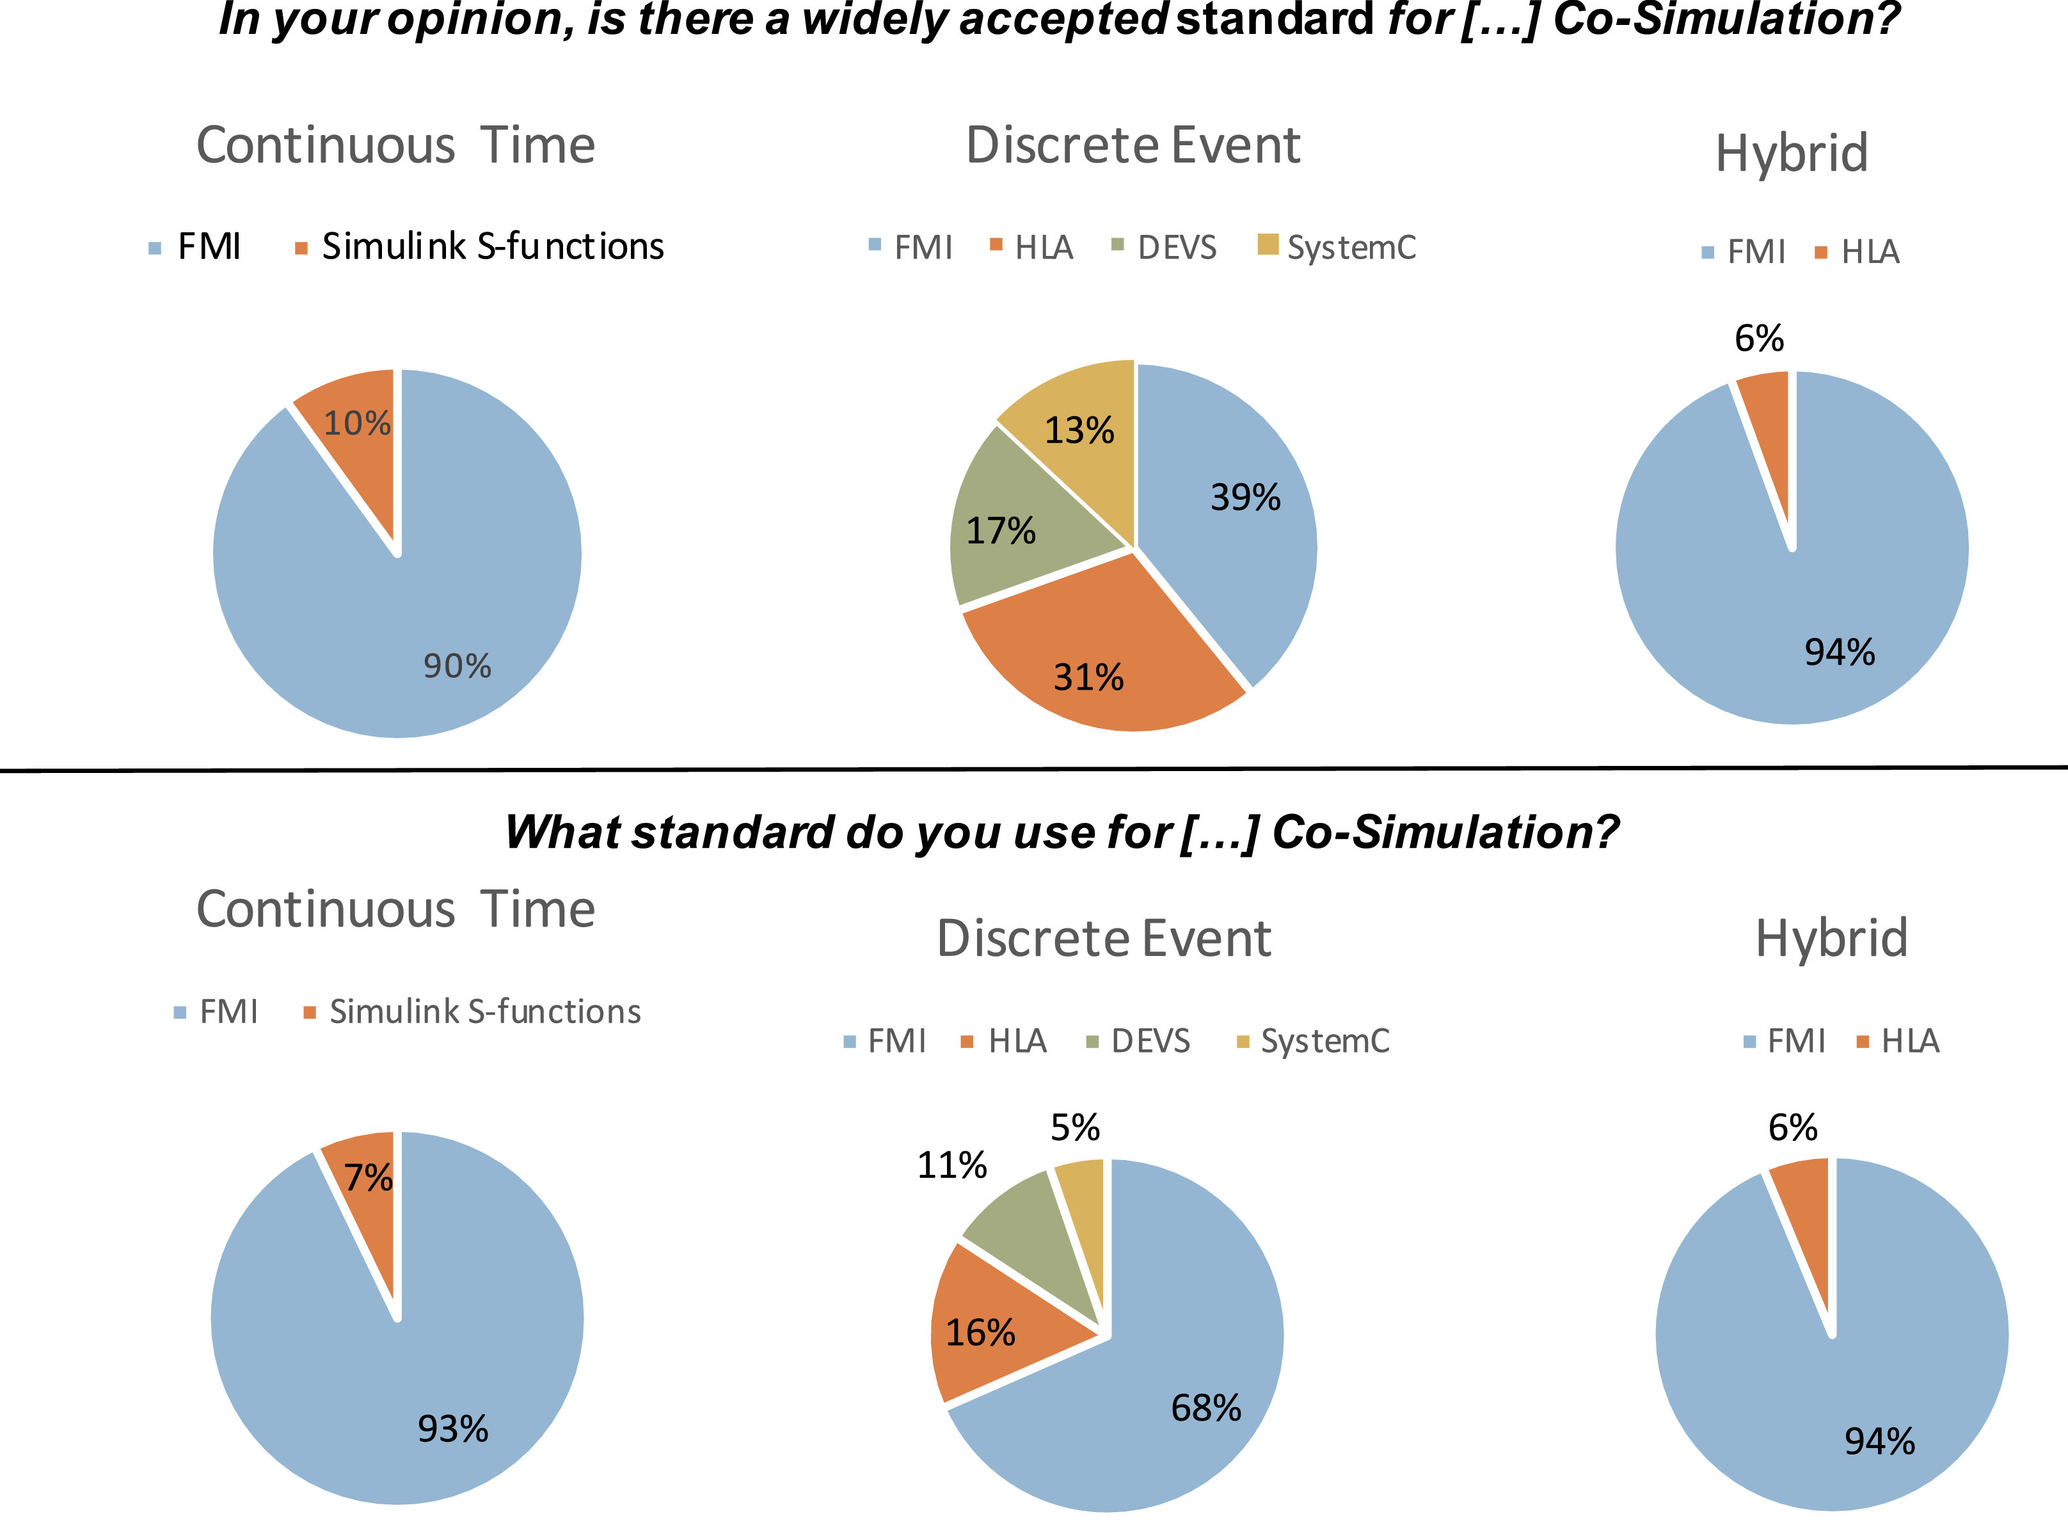
What is a widely accepted standard?
With well over 100 supported tools*, the FMI has become the de-facto standard for model exchange and co-simulation.
Schweiger et. al. showed that experts consider the FMI standard as the most promising standard for continuous time, discrete event and hybrid co-simulation*².
*1 https://fmi-standard.org/tools/
*² G. Schweiger et. al. “An empirical survey on co-simulation: Promising standards, challenges and research needs”, 2019

Slide 15
Co-simulation applications: smart cities
https://geistt.com/2021/04/30/multiplayer-cosimulation-project/

Slide 16
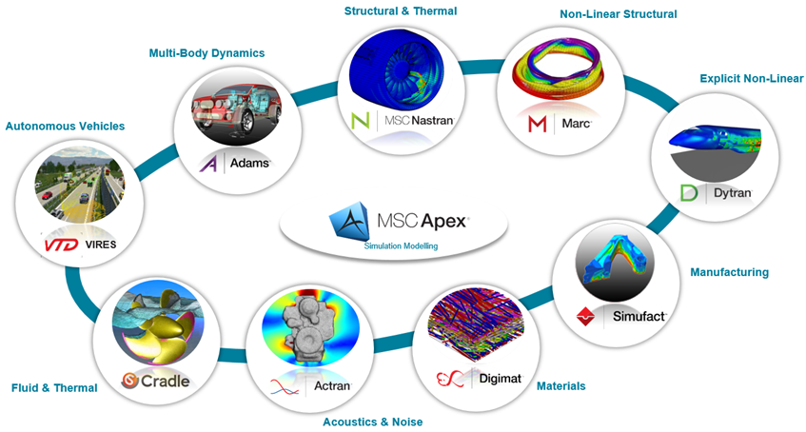
Co-simulation applications: holistic performance
https://www.mscsoftware.com/product/co-simulation

Slide 17
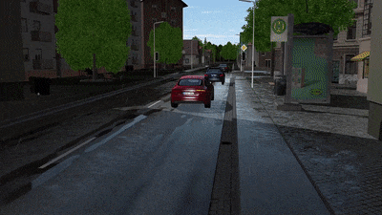
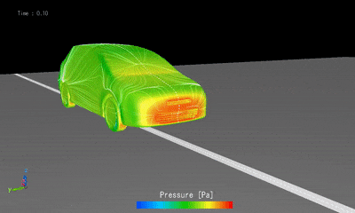
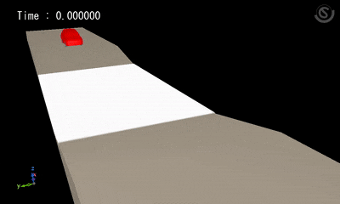
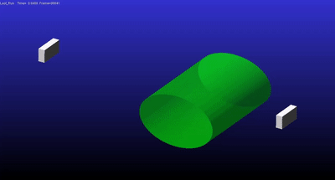
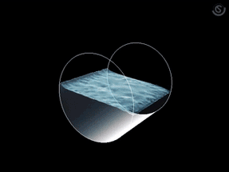
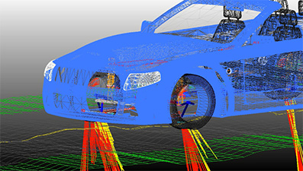
Co-simulation applications: holistic performance
https://www.mscsoftware.com/product/co-simulation

Slide 18
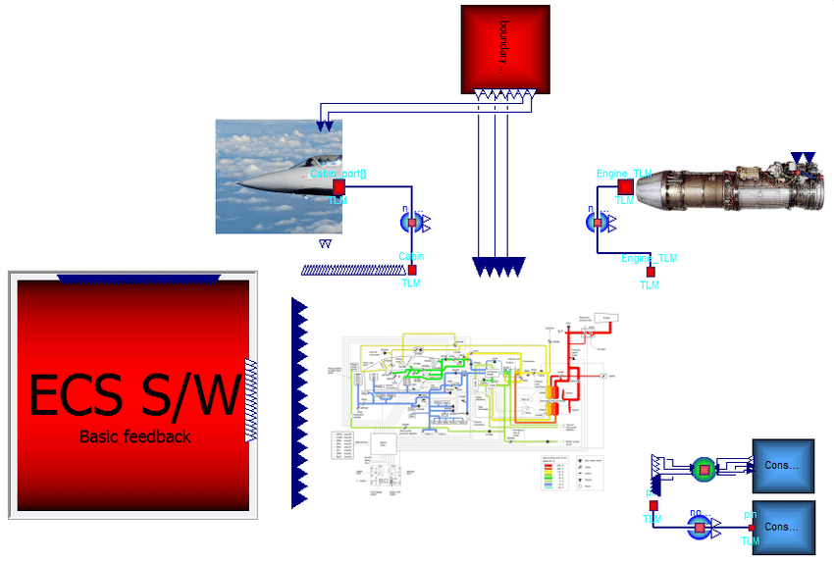
Co-simulation applications: aerospace
“Early Insights on FMI-based Co-Simulation of Aircraft Vehicle Systems”, (2017), Hällqvist et. al.

Slide 19
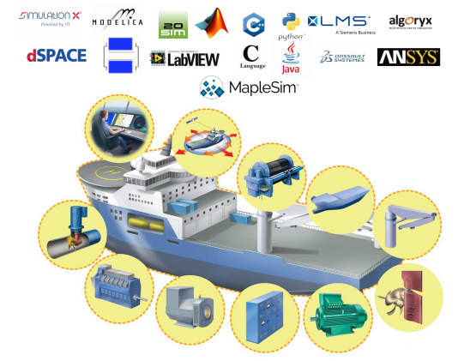
Co-simulation applications: maritime
In “Virtual prototyping of maritime systems and operations: applications of distributed co-simulations”, (2017), Skjong et.al.
Lessons learned is that co-simulation enables:
Shipyards to obtain mathematical models of equipment from third party vendors for testing purposes thanks to black-box modelling that protects IPR.
Vessel designers and customers to design vessels on the fly by choosing different concepts from a model library containing many different vessel designs, systems and equipment's
Simulation-based commissioning of vessels and virtual sea trials to remove design flaws and implementation errors at an early stage.

Slide 20
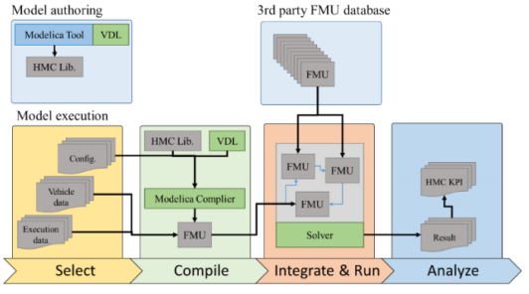
Co-simulation applications: automotive
In the automotive there is a need to to be able to broadly deploy models to accelerate innovation and design.
In “Hyundai Framework for Vehicle Dynamics Engineering based on Modelica and FMI”, (2018), Ko et.al addresses this need by developing a framework for systems engineering with primary application in the field of vehicle dynamics.
Using the developed framework, they can set up a stable and consistent simulation tool for Ride and Handling performance using FMI technology.

Slide 21
Q&A
Norwegian University of Science and Technology

