Slide 1
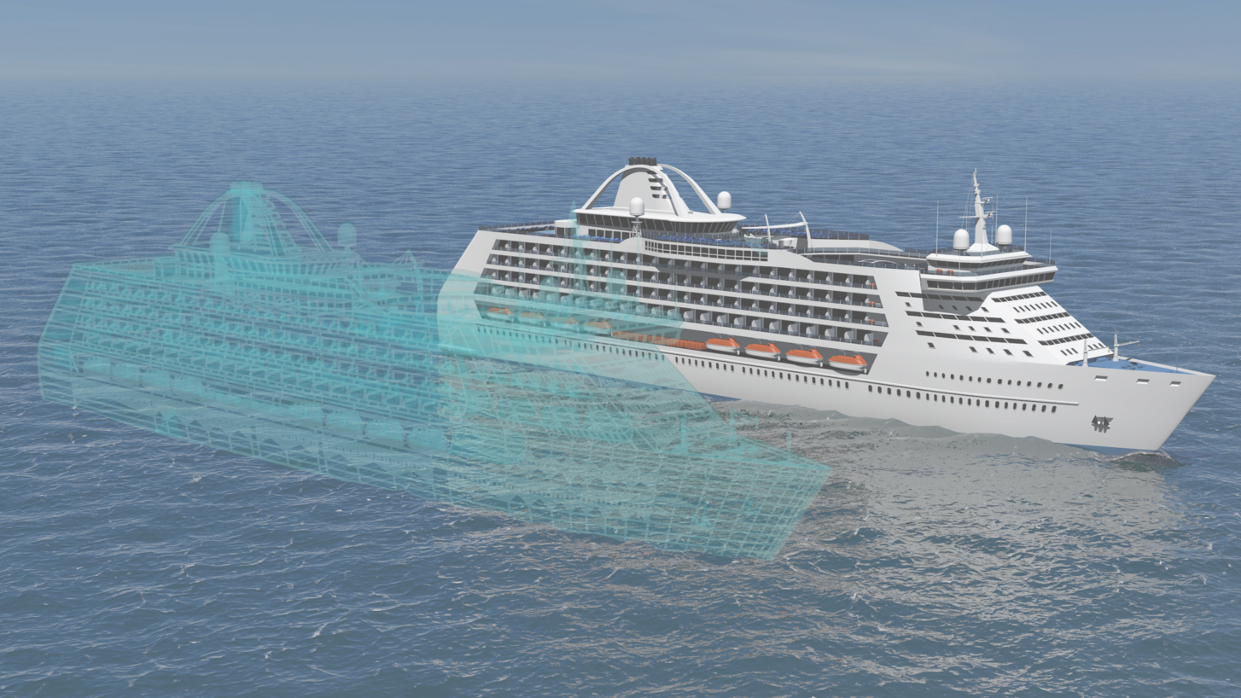
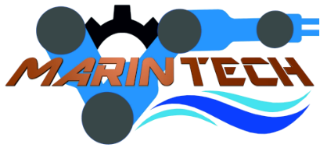
Practical applications in marine robotics
“Romanian - Norwegian Strategic Cooperation in Maritime Higher Education”
Lecturer Tongtong Wang
tongtong.wang@ntnu.no
Department of Ocean Operations and Civil Engineering
Norwegian University of Science and Technology
05/09/2022

Slide 2
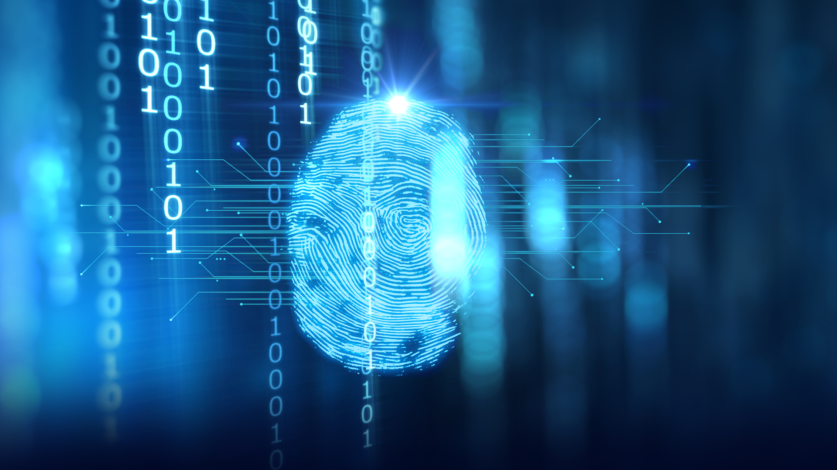
Outline
Day 1:
Digital twin (DT) concept and function
DT systems in NTNU Ålesund
Day 2:
Co-simulation: the fundamental of DT.
Co-simulation platform in NTNU Ålesund
Day 3:
Co-simulation of marine system
Examples of a research vessel.
Day 4:
Ship motion prediction introduction
Ship motion prediction in co-simulation
Day 5:
Summary and final project

Slide 3
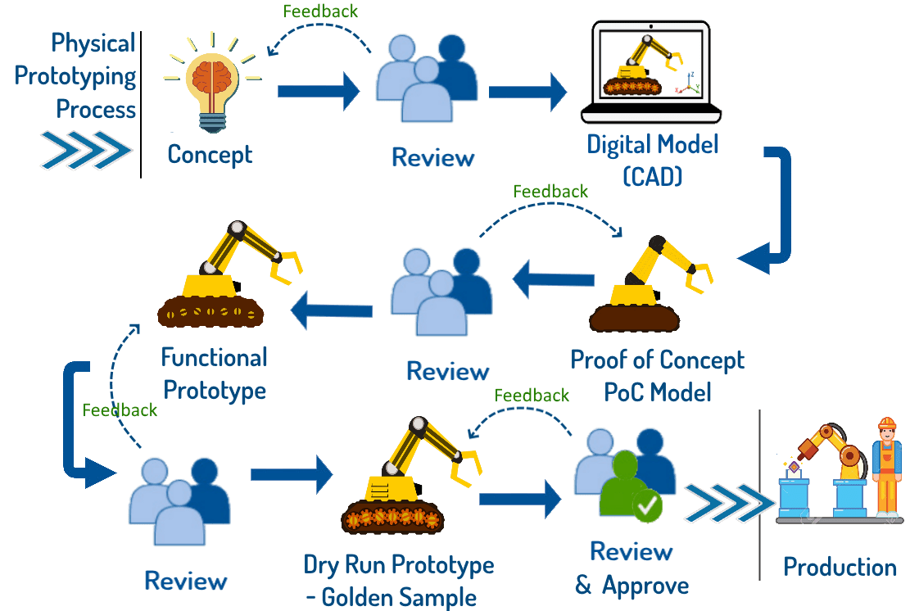
Introduction Introduction of VP
Prototyping:
is an integral step of product design & development. New products that are developed from scratch and also enhancements to existing products traditionally involve physical prototyping.
Various types of physical prototypes are needed.
Each prototype requires a review meeting to proceed to the next stage.
Traditional machining is both reliable and a perfected process.
The downside is the time and cost involved as mentioned above.
Notes:
Note: Product Design is never a linear process. It always has feedback loops which bring back changes in the design requiring previous stages to be redone. This implies that the prototyping used for that design stage also has to be updated as per changes in the design.
https://exxar.cloud/cad-to-vr/prototyping-trends-physical-to-digital-to-virtual/

Slide 4
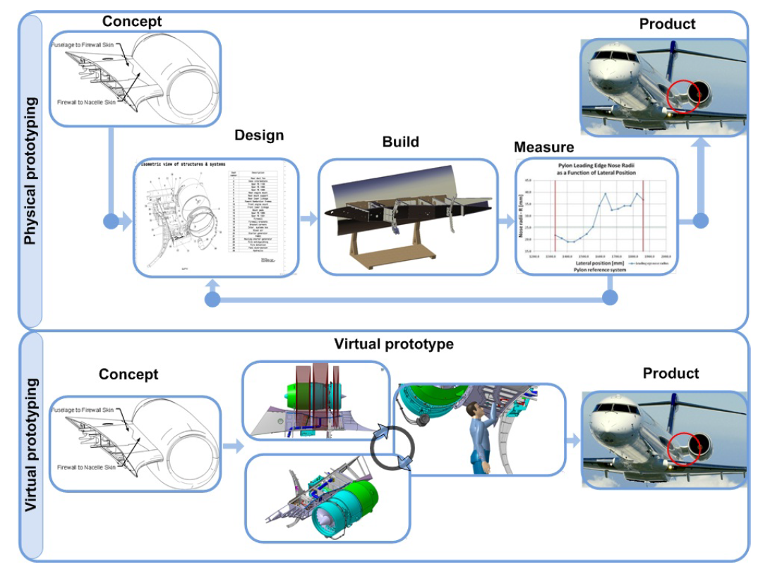
Introduction Introduction of VP
Virtual prototyping (VP):
is a software-based engineering discipline which involves modelling a system, simulating and visualizing its behavior under real-world operating conditions, and refining its design through an iterative process.

Slide 5
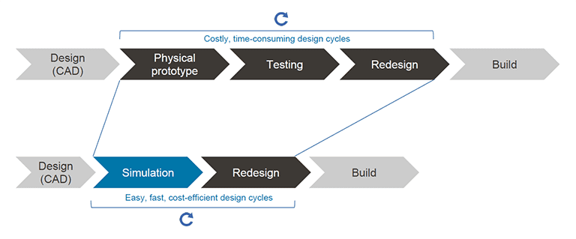
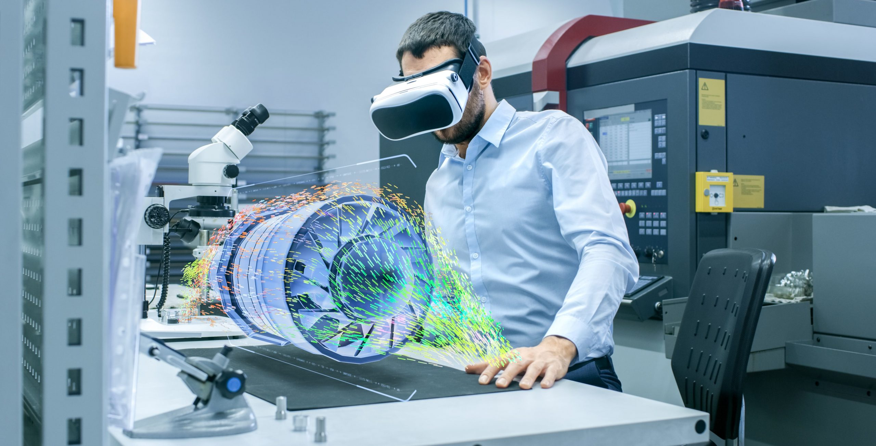
Introduction Introduction of VP
VP allows:
engineering teams to build and test virtual prototypes and realistically simulate them on their computers.
the full-motion behavior of complex mechanical systems to be analyzed before building.
test “what if” scenarios, users can quickly explore multiple design variations, testing and refining until system performance is optimized.
communicate design ideas more clearly.
shorten time to market.
Notes:
VP allows engineering teams to build and test virtual prototypes and realistically simulate them on their computers, both visually and mathematically. The full-motion behaviour of complex mechanical systems can be analysed before building an actual hardware prototype. Users can quickly explore multiple design variations, testing and refining until system performance is optimised. This can help reduce the time and cost of new product development, whilst significantly improving the quality of overall system designs.
https://www.simscale.com/blog/2018/06/virtual-prototyping-benefit/

Slide 6
Introduction Introduction of VP
Industries using VP include automotive, shipbuilding, aerospace, oil & gas, transport and defence.
Virtual prototyping in immersive vehicle environment.
Notes:
https://www.twi-global.com/technical-knowledge/faqs/faq-what-is-virtual-prototyping

Slide 7
Application
Virtual prototyping of marine engineering through the marine life cycle.
In offshore operations, VPs find usages in design, proof of concept for new equipment or method, control system testing, procedure planning, and expert crew training.
Examples are:
Offshore Infrastructure
Shipping and Port Logistics
Town Planning
Resource Industry
Renewables
Notes:
Ref: A framework for rapid virtual prototyping: a case study with the Gunnerus research vessel

Slide 8
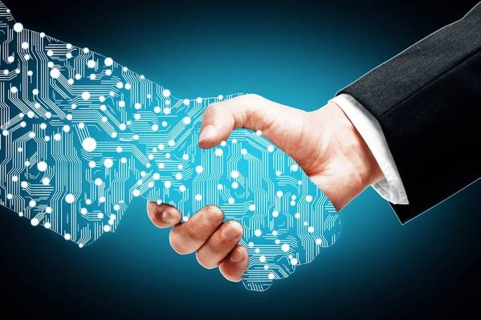
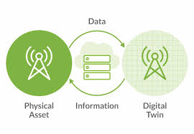
Introduction What is it?
Digital twin:
A Digital Twin (DT) is a virtual representation that serves as the real-time digital counterpart of a physical object or process.
It is a digital or virtual copy of physical assets or products.
Prof. Michael Grieves at University of Michigan defined a DT comprises three dimensions: a physical product in real space, virtual product in virtual space and the required interconnection between these two.
Notes:
https://www.youtube.com/watch?v=iVS-AuSjpOQ
https://www.youtube.com/watch?v=PJLCDbTZl80

Slide 9
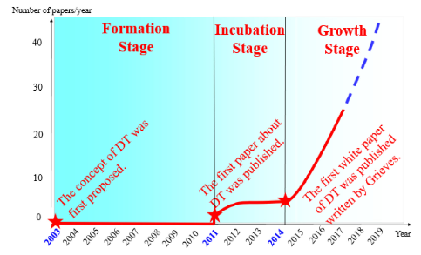
Introduction history of DT
In 2002, Dr Michael Grieves from the University of Michigan introduces the concept of digital twin within product lifecycle management.
In 2012, the NASA was one of the first to use this technology for space exploration missions. “(..) an integrated multiphysics, multiscale simulation of a vehicle or system that uses the best available physical models, sensor updates, fleet history, etc., to mirror the life of its corresponding flying twin”.
In 2014, the DTs have grown from conceptual idea to numerous practical applications.
One of most promising technological trends in the next decade.
Notes:
From 2003 to 2011, the rapid development of the communication technology, Internet of Things (IoT), sensor technology, big data analytics, and simulation technologies contributed to the rise of DTs. In 2011, the first journal article was published.
In 2014, the first white paper was published, which reflected the growth of DTs from one conceptual idea to numerous practical applications

Slide 10
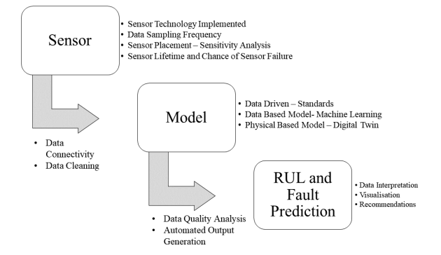
Introduction Key technologies
Modeling and simulation:
Extracting, defining, and describing the key features of a physical entity.
The virtual model should be a mirror reflection of the physical model.
Continuously evolving model with new data coming in.
Data fusion:
DTs must process a massive volume of data collected from a variety of channels.
Such as machine, physical environment, virtual space, historical database, etc.
The amount of data acquired would be of a substantial size and containing both unstructured and diverse information.
Interaction and Collaboration:
Physical–physical, virtual–virtual, and virtual–physical
Through physical–physical interaction and collaboration, multiple physical entities can communicate, coordinate, and collaborate with each other to perform a complex task that cannot be performed by any individual device.
Through virtual–virtual interaction and collaboration, multiple virtual models can be connected to form a network for information sharing.
Through virtual–physical interaction and collaboration, the virtual model can be optimized in synchronization with the physical object, while the physical object can be dynamically adjusted based on direct orders from the virtual model.
Notes:
Ref: Digital Twin in Industry: State-of-the-art

Slide 11
Introduction How the industries benefits from it?
A digital twin is a digital or virtual copy of physical assets or products.

Slide 12
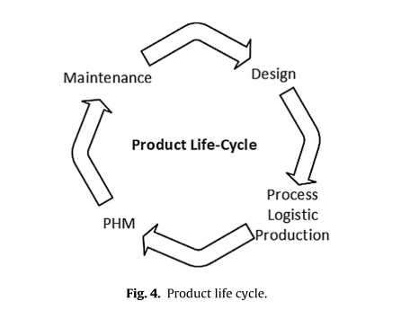
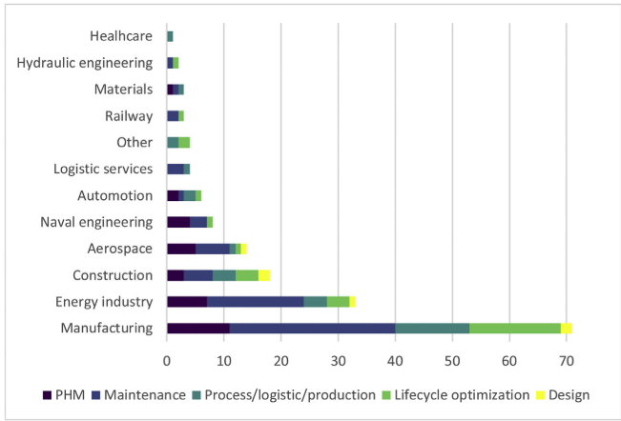
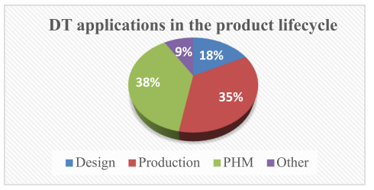
Application
Product life cycle
Notes:
Ref: Digital Twin for maintenance: A literature review

Slide 13
Application
A digital twin in manufacturing.
The Use of a Data-Driven Digital Twin of a Smart City: A Case Study of Ålesund, Norway

Slide 14
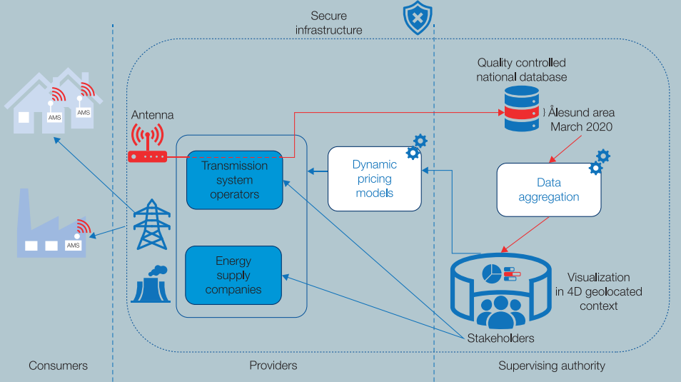
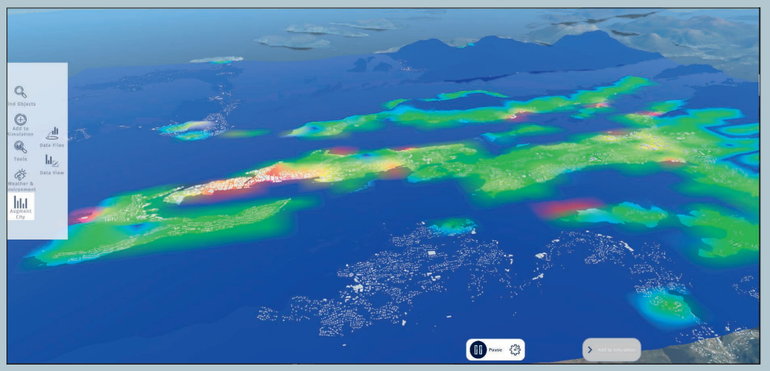
Application
Digital Twins for smart city.
Measuring and visualizing the energy consumption.
The transfer of the data from the consumers is handled by an advanced measuring and control system (AMS). It is installed at the premises and centralized in a nationwide datahub.
Industrial districts
Residential areas
Ålesund Heatmap of energy usage per day, March 2020.
Electricity Data Infrastructure.
Notes:
<The Use of a Data-Driven Digital Twin of a Smart City: A Case Study of Ålesund, Norway>

Slide 15
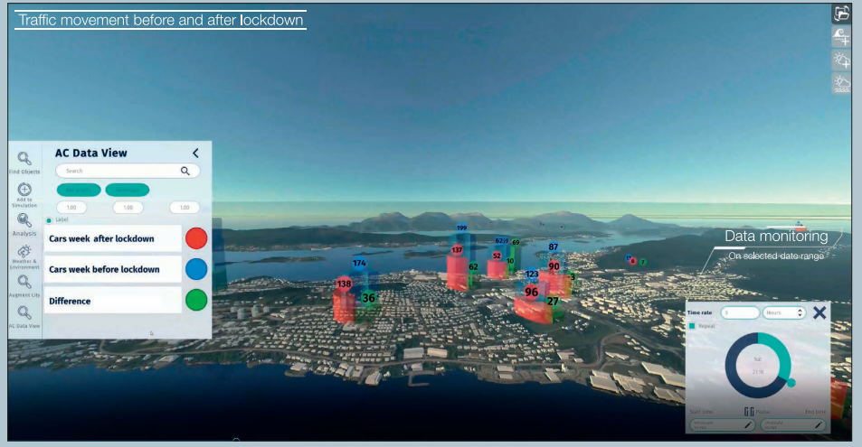
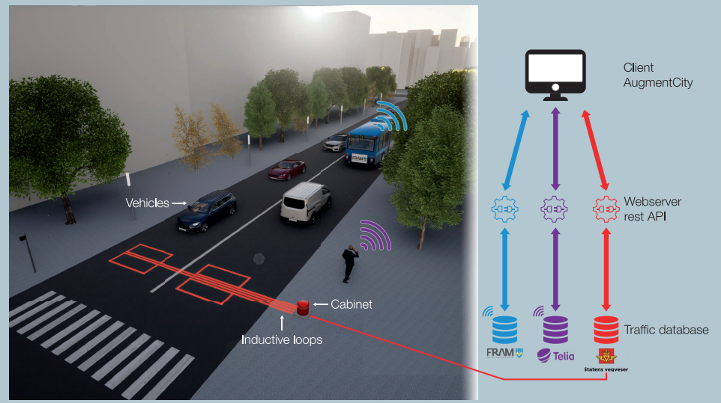
Application
Digital Twins for smart city.
Measuring and visualizing the flow of persons and vehicles.
Mobility data can be gathered in many ways: IoT Data, cameras, GPS-data from mobile phones, manual counting and surveys, Bluetooth and Wi-Fi beacons, and cellular triangulation.
Traffic visualization, March 2020.
Traffic Data Infrastructure.
Notes:
<The Use of a Data-Driven Digital Twin of a Smart City: A Case Study of Ålesund, Norway>

Slide 16
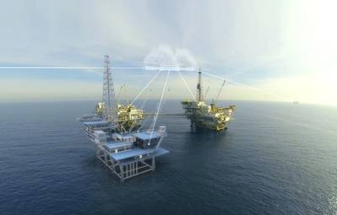
Application
Maritime
Drilling operations and production
Offshore infrastructure
Renewable energy
Vessel navigation and control

Slide 17
Application
Maritime
Drilling operations and production

Slide 18
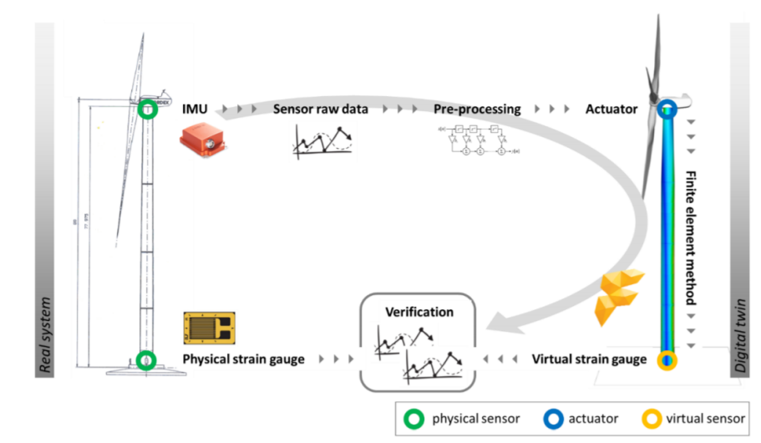
Application
Maritime
Offshore wind turbines.
Notes:
Figure 1 shows how the physical system ”twins” with the digital representation through intercommunicating with online sensor condition monitoring.

Slide 19
Application
Maritime
Vessel navigation and control
NTNU digital twin technology.

Slide 20
Application
Maritime
Vessel navigation and control
NTNU Gunnerus live link.

Slide 21
Application
Maritime are benefiting from digital twins：
Predictive system behaviour
Simulations of rough environments
Less downtime
Less man hours for maintenance and improved lifespan for their systems

