Slide 1


European Initiative
for the exchange of young officers inspired by Erasmus
LoD 11 Session International Naval Semester
54 IG Meeting, Larnaca, Cyprus
The Initiative
Erasmus
Militaire
Colonel Catalin POPA
Associate Professor PhD
Chairperson LoD 11
Military
Erasmus
EMILYO

Slide 2


INTERNATIONAL NAVAL SEMESTER
LoD 11 – identified issues against the initial roadmap:
There are several different educational systems that follow up radically different panels of curriculum:
  vocational education,
  technical/engineering orientation and
  integrated academic programs supported by external university;
The national curriculum is very different to cumulate 30 ECTS based on agreed courses - need more flexibility;
Different subordination - issues on decision making process;
Several BOEI are not registered as Erasmus+ institutions on HEI;

Slide 4
INTERNATIONAL NAVAL SEMESTER
LoD 11 – Main pillars for INS revival:
Increase the INS curricular flexibility;
Better dissemination among the partners;
Enlarge the INS networking;
Joint projects to be applied (focus on training and research).

Slide 5
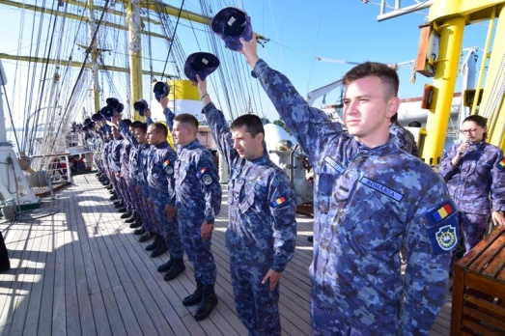
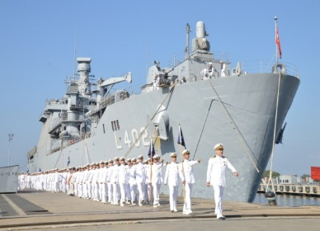

INTERNATIONAL NAVAL SEMESTER
LoD 11 – INS curricular flexibility:
a1. by valuing the common INS courses as joint modules
a2. by enlarging the course offer for incoming students on 3 specialties
For a better compatibility, the INS should be centred on 3 pillars & curricular frames:
  Navigation and Naval Equipment, Mechanical/Electric Engineering, Logistics;
The INS common courses as approved could be further implemented as joint modules and distributed among the partners for content development – 2 alternatives to implement it:
  National level: then we can have the entire offer along 1 semester or
  Joint level: shared modules among the partners, for 1-2 weeks, exchanging students on short time.

Slide 6
INTERNATIONAL NAVAL SEMESTER
a. LoD 11 – INS curricular flexibility (cont.):
More flexible course catalogue to stimulate 1 semester mobility among the partners – flexible ECTS recognition;
  Use the Erasmus+ English taught courses for incoming students;
  Interfere with Technical Semester on Engineering programs.
Orientation toward English taught programs;
Hybrid system for Erasmus+ joint modules implementation;
Promote the training modules/military practical stages under placement mobilities alternatively to the study stages (easier to be harmonized) – naval training network.

Slide 7


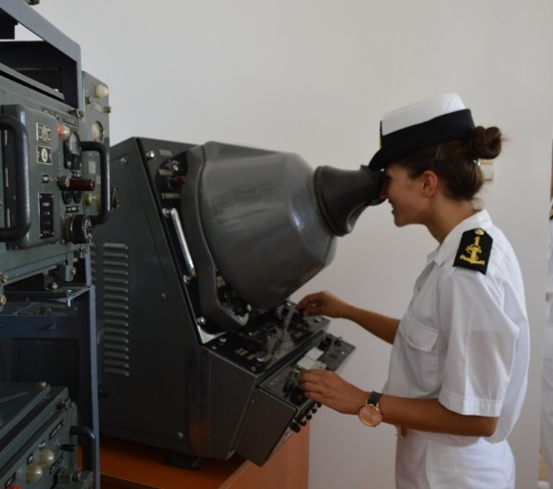
INTERNATIONAL NAVAL SEMESTER
b. LoD 11 – INS dissemination and advertising:
Is a strong need to promote the INS advantadges and the EMILYO/ERASMUS+ opportunities for our students
Chief of Navies Seminar in Bucharest, May 2022;
EU Naval Academies Superintendents Seminar (ENASC), Nov.2022;
Erasmus+ inter-institutional bilateral agreements to be initiated;
Other events to be valued .

Slide 8
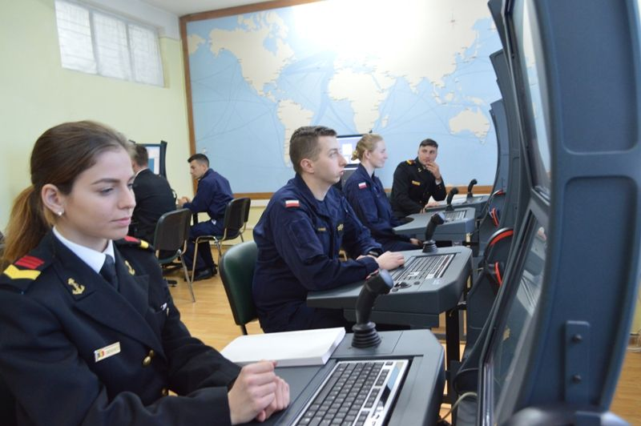
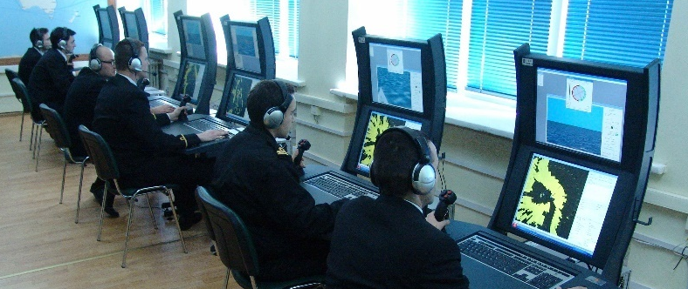
INTERNATIONAL NAVAL SEMESTER
c. LoD 11 – Enlarge the INS networking under EMILYO:
New Navy BOEI to be attracted in the network (i.e. France, Germany);
Regular guidance/assistance for Erasmus+ program to be provided for partners;
Technical assistance provided for partners for Erasmus+ program implementation to value the opportunities;
Online resources to be allocated to facilitate the communication.

Slide 9
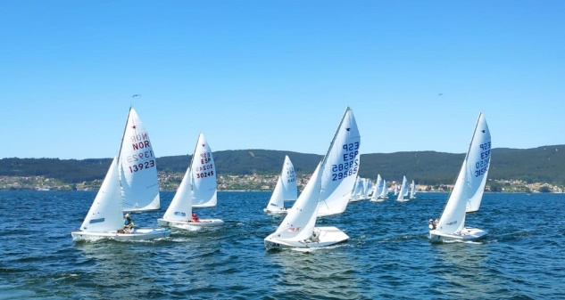
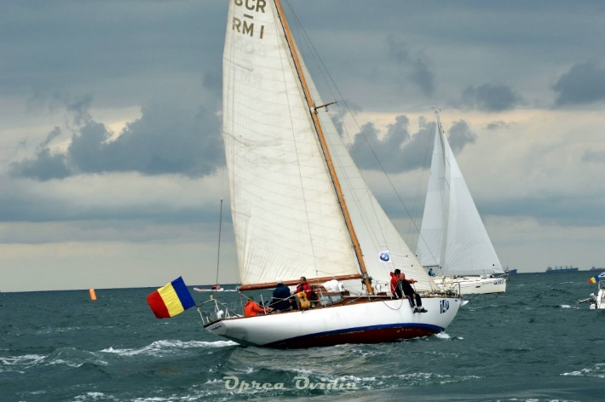
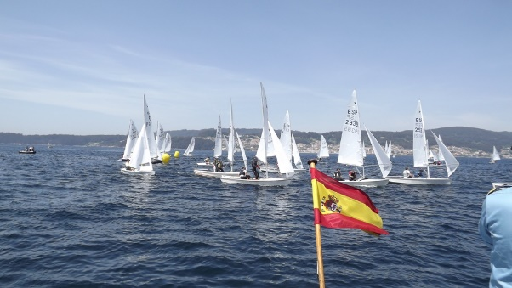
INTERNATIONAL NAVAL SEMESTER
d. LoD 11 – Joint projects to be implementer
or further applied:
MARS-NET – simulators’ network implementation (2022-2024);
SEA MENTORS – mentorship platform to be implemented (2022-2024);
Integrated Training Programs Network for EU Naval Academies (future 2023);
Common Curriculum Harmonization for Navy Education – curriculum framework development (future 2024).

Slide 10
INTERNATIONAL NAVAL SEMESTER
New roadmap proposal – way to go:
by December 2023 – enlarging the BOEI pool for LoD-11;
by December 2023 – enclosing bilateral IIA under Erasmus+ on bilateral level;
by June 2022 - assign the courses/partners and building the working teams for common modules development (learning, teaching materials);
by June 2023 - developing the 12 joint modules in working groups;
during January-October 2023 – building the course portofolio and approving the modules organization in the academic plan for 2023-2024/partner;
by January 2023 – project proposal for Joint Naval Training Program – to value the common curricular frame for cadets

Slide 11
INTERNATIONAL NAVAL SEMESTER
QUESTIONS?

