Slide 1





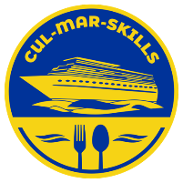


MARitime Soft Skills for Onboard Healthy Nutrition and CULinary Arts in Seagoing Services – CUL-MAR-Skills
KA220-VET - Cooperation partnerships in vocational education and training
2023-1-RO01-KA220-VET-000156711
ONBOARD HEALTHY NUTRITION
COURSE 3
Training on Sustainability and Waste Management
Disclaimer: “Funded by the European Union. Views and opinions expressed are however those of the author(s) only and do not necessarily reflect those of the European Union or the ANPCDEFP. Neither the European Union nor the ANPCDEFP can be held responsible for them”

Slide 2

Learning outcomes of the course
Understand the importance of sustainability training in ship galleys: Participants will recognize the critical need for continuous education on sustainability, addressing specific challenges faced by galley crews across diverse maritime environments, including cargo ships, cruise liners, and military vessels (item 3.1).
Master essential sustainability practices for shipboard operations: Participants will develop practical knowledge in key areas such as food safety, sustainable sourcing, and efficient storage of supplies within limited spaces. They will learn to implement effective waste management systems, including segregation of recyclables, safe disposal of hazardous materials, and energy-efficient water use strategies (item 3.2).
Design and implement comprehensive training programs: Participants will gain skills in structuring and delivering sustainability training tailored to various ship types. This includes facilitating hands-on workshops, scenario-based learning, and drills to ensure galley crews are equipped to manage waste and handle emergencies effectively (item 3.3).
Monitor sustainability efforts and drive continuous improvement: Participants will understand how to track sustainability progress using key performance indicators (KPIs) such as waste reduction, water conservation, and energy savings. They will explore new technologies, such as energy-efficient appliances and advanced composters, to enhance sustainability in ship galley operations (item 3.4).
Develop actionable sustainability plans: Through collaborative activities and discussions, participants will learn to create practical, ship-specific action plans that integrate sustainability into daily operations. The program concludes with a focus on the long-term environmental and operational benefits of sustainability practices (item 3.5).These outcomes will empower participants to effectively integrate sustainability training into ship galley operations, fostering a culture of environmental responsibility and operational efficiency.
NAVAL COMMUNICATIONS
ONBOARD HEALTHY NUTRITION

Slide 3
Content of the course
3. Training on Sustainability and Waste Management
3.1. The Need for Sustainability Training in Ship Galleys
Importance of continuous education on sustainability for galley crews across ship types
Addressing unique sustainability challenges in different maritime environments (cargo, cruise, military)
3.2. Key Areas for Sustainability Training
Food safety, sustainable sourcing, and storage of supplies in limited spaces
Practical waste management systems: segregating recyclables, safe disposal of hazardous materials
Efficient use of energy and water in galley operations to minimize environmental impact
3.3. Developing a Comprehensive Training Program
How to structure and implement sustainability training programs for galley staff on various types of ships
Engaging the crew in hands-on training: workshops, scenario-based training, and drills for waste management and emergency planning
3.4. Monitoring and Continuous Improvement
Tracking sustainability efforts using key performance indicators (KPIs) such as waste reduction, water conservation, and energy savings
Incorporating new technologies and innovations (e.g., energy-efficient appliances, advanced composters) to improve sustainability in ship galleys
3.5. Final Discussion and Action Plan
Encouraging participants to share ideas on how they can implement sustainable practices and training on their ships
Closing remarks on the long-term benefits of sustainability for both the environment and ship operations
ONBOARD HEALTHY NUTRITION

Slide 4

Training on Sustainability and Waste Management
ONBOARD HEALTHY NUTRITION

Slide 5
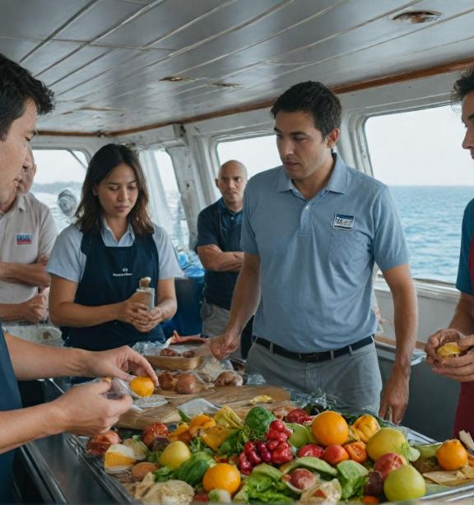
Training on Sustainability and Waste Management
The third part of our training will focus on the importance of sustainability and waste management training, looking at why it is necessary and how it can be implemented on different ship types.
Sustainability training provides galley staff with important knowledge and skills to help them manage resources more efficiently, minimise waste and tackle environmental challenges specific to the marine environment.
ONBOARD HEALTHY NUTRITION

Slide 6
Training on Sustainability and Waste Management
3.1 The Need for Sustainability Training in Ship Galleys
Importance of continuous education on sustainability for galley crews across ship types
Addressing unique sustainability challenges in different maritime environments (cargo, cruise, military)
ONBOARD HEALTHY NUTRITION

Slide 7
Training on Sustainability and Waste Management
The importance of continuous sustainability training for galley teams on different types of ships
Improving efficiency and sustainability through education.
The marine industry is constantly changing and evolving, with new technologies, regulations and sustainable practices being introduced to minimise harmful environmental impacts. This means that galley teams need to be well informed and trained on these changes to be able to implement best practice and ensure effective resource management.
ONBOARD HEALTHY NUTRITION

Slide 8
Training on Sustainability and Waste Management
Ongoing training is critical as it helps keep chefs and galley staff informed about new technologies and methods for waste, energy and water management. In addition, they learn how to reduce food waste and optimise the use of provisions, which not only reduces costs but also improves the environmental efficiency of ship operations.
ONBOARD HEALTHY NUTRITION

Slide 9
Training on Sustainability and Waste Management
Adaptation to new regulations and technologies
International regulations such as MARPOL, which govern waste management and emissions, are becoming increasingly stringent, and new technologies for sustainable resource management are developing rapidly. Without proper training, the galley team can be ineffective in implementing these new regulations and technologies.
ONBOARD HEALTHY NUTRITION

Slide 10
Training on Sustainability and Waste Management
Example: on cruise ships that have large volumes of food and household waste, galley teams need to know how to properly separate waste for recycling, composting and safe disposal. If modern technology and regulations are not applied, these ships can generate unnecessary amounts of waste and increase their carbon footprint.
ONBOARD HEALTHY NUTRITION

Slide 11
Training on Sustainability and Waste Management
Developing skills to better plan and manage provisions
Provisioning planning and stock management is an essential part of the daily tasks of the galley teams.
Through continuous training, staff can develop better inventory management, menu planning and portion control skills, which significantly reduces food waste and improves efficiency.
ONBOARD HEALTHY NUTRITION

Slide 12
Training on Sustainability and Waste Management
Dealing with the unique challenges of sustainability in different maritime environments (cargo, cruise, military ships
Cargo ships. Cargo ships usually have smaller crews and long periods of sailing without access to ports. This poses challenges in terms of provision planning and waste management. In addition, cargo ships often lack sufficient space for provisioning and waste storage, requiring more stringent resource management strategies.
ONBOARD HEALTHY NUTRITION

Slide 13
Training on Sustainability and Waste Management
Training should focus on long-term provisioning planning skills, the use of durable and stable products, and waste reduction techniques through recycling and composting whenever possible.
Example: cooks on cargo ships can be trained in the application of food vacuuming and leftover freezing technologies to extend product shelf life and minimize wastage.
ONBOARD HEALTHY NUTRITION

Slide 14
Training on Sustainability and Waste Management
Cruise ships. Cruise ships, with large crews and passengers, face significant challenges in terms of sustainability. They produce large amounts of food waste and require significant resources to feed all the people on board. Waste management on such ships is more complex and usually involves more phases, from recycling to organic waste disposal.
Training of galley staff should focus on separate waste collection, efficient use of resources (water and energy), and techniques to minimize food waste through portion control and reuse of leftovers.
ONBOARD HEALTHY NUTRITION

Slide 15
Training on Sustainability and Waste Management
Warships. Warships face unique challenges due to the nature of their missions, which require long periods of autonomy and tight control of resources. Warship crews often have limited storage space and must deal with hazardous wastes such as fuels and chemicals.
Training of galley personnel on warships should focus on efficient use of available resources, hazardous waste management, and safe storage of provisions.
ONBOARD HEALTHY NUTRITION

Slide 16
Training on Sustainability and Waste Management
Sustainability training for galley teams is a key factor in successful resource management and waste reduction on ships. Every marine environment has its own specific challenges, but by continuously learning and adapting to new regulations and technologies, teams can significantly improve the sustainability of ship operations. This will not only reduce the negative impact on the environment, but also improve the overall efficiency of daily activities on board.
ONBOARD HEALTHY NUTRITION

Slide 17
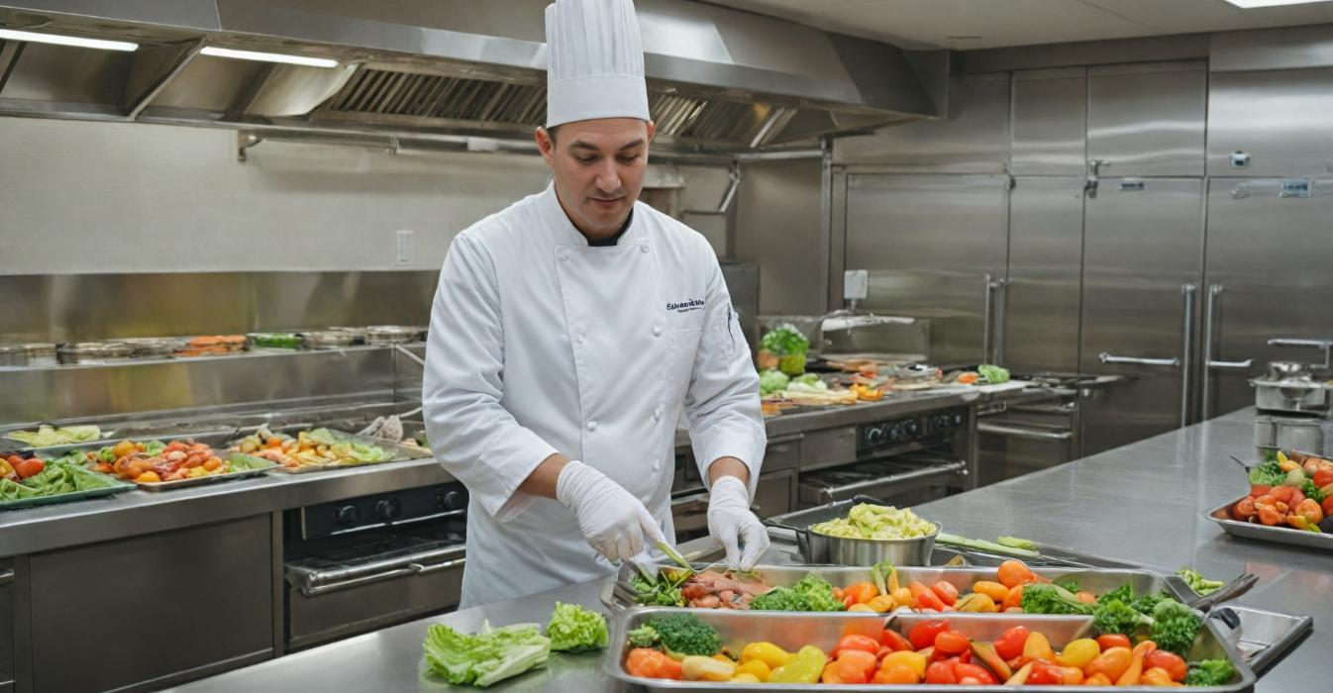
3.2 Key Areas for Sustainability Training
ONBOARD HEALTHY NUTRITION

Slide 18
3.2 Key Areas for Sustainability Training
Food safety, sustainable sourcing, and storage of supplies in limited spaces
Practical waste management systems: segregating recyclables, safe disposal of hazardous materials
Efficient use of energy and water in galley operations to minimize environmental impact
ONBOARD HEALTHY NUTRITION

Slide 19
3.2 Key Areas for Sustainability Training
Proper food storage. The team should be trained on how to properly store foods at different temperatures to prevent spoilage and ensure product safety. It is especially important to properly store meat, fish and other perishable products that require refrigeration or freezing.
First in, first out (FIFO) technique. The approach is important to reduce spoilage. Training should include how to apply the FIFO technique to ensure that older products are used first.
ONBOARD HEALTHY NUTRITION

Slide 20
3.2 Key Areas for Sustainability Training
Sustainable supply. Sustainable sourcing means using products that are produced with minimal impact on the environment and provide durability and quality. Campus staff should be trained on how to select such products and how to work with suppliers who respect the principles of sustainability.
Choosing local and seasonal products: using local and seasonal products can reduce the carbon footprint of shipping operations. Crew should be informed of the benefits of sourcing local produce where possible.
Sustainable seafood: On ships that serve seafood, it is important to train chefs on how to select fish and seafood that are not endangered and are sustainably caught.
ONBOARD HEALTHY NUTRITION

Slide 21
3.2 Key Areas for Sustainability Training
Storage of provisions in confined spaces
Efficient use of ship storage space is a major challenge. Galley teams need to be trained on how to optimize provision storage to maximize space utilization and prevent product spoilage.
Smart product stacking: cooks should be trained on how to organize the storage of provisions in a way that allows easy access to products and minimizes the risk of spoilage or mixing of incompatible foods.
Use of shelf-life extension technologies: training should include the use of vacuum packaging, freezing and other storage technologies that extend the shelf-life of food without taking up too much space.
ONBOARD HEALTHY NUTRITION

Slide 22
3.2 Key Areas for Sustainability Training
Separate waste collection and recycling
Proper waste sorting is essential for recycling and reducing the volume of waste that has to be thrown away.
Separate collection training: teams need to know how to properly separate waste - paper, plastics, metals, glass and organic waste. This not only makes it easier to recycle these materials, but also reduces the amount of waste that ends up in the ocean or dumped in harbours.
Composting of organic waste: food waste composting systems can be implemented in galleys. Training should include how to compost organic waste such as vegetable peelings and food scraps that cannot be reused.
ONBOARD HEALTHY NUTRITION

Slide 23
3.2 Key Areas for Sustainability Training
Safe disposal of hazardous materials
Hazardous materials, such as chemicals and cleaning agents, must be managed in a special way to prevent pollution of the marine environment and to protect the health of the crew.
Safe disposal training: staff should be trained on how to safely dispose of chemicals and oils to prevent water contamination. This includes both proper storage of hazardous materials and procedures for their disposal at ports.
ONBOARD HEALTHY NUTRITION

Slide 24
3.2 Key Areas for Sustainability Training
Energy efficiency in the galley
The galley is one of the places where a significant amount of energy is used for cooking, cooling and lighting. Energy efficiency training can help the team reduce energy consumption and minimise the ship's carbon footprint.
Use of energy saving appliances
Cooks should be trained on how to use energy efficient appliances such as induction hobs and convection ovens that reduce energy consumption.
Planning of cooking processes
The team can be trained to plan the cooking so as to use the energy most efficiently. For example, cooking several dishes at once in the oven or using residual heat from appliances to reheat food.
ONBOARD HEALTHY NUTRITION

Slide 25
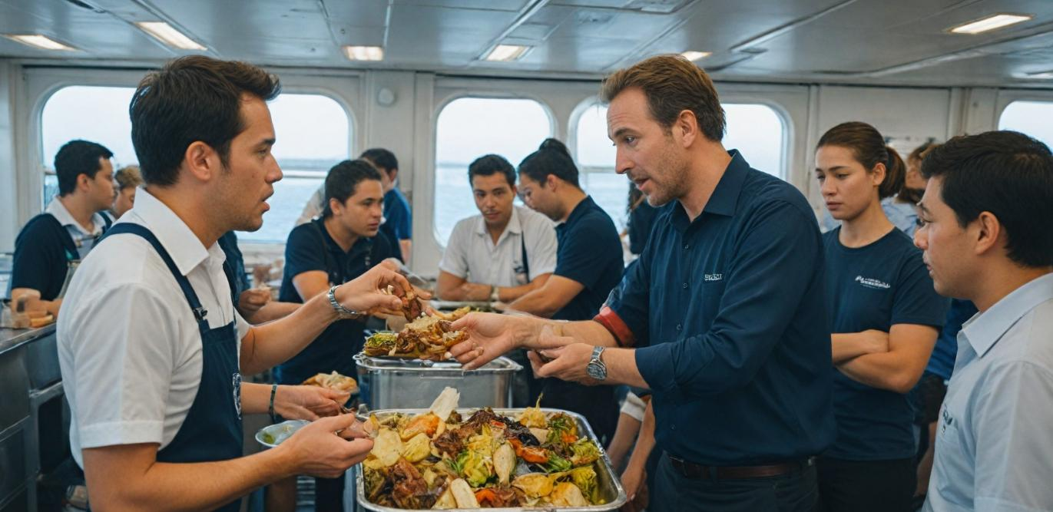
3.3 Developing a Comprehensive Training Programme
ONBOARD HEALTHY NUTRITION

Slide 26
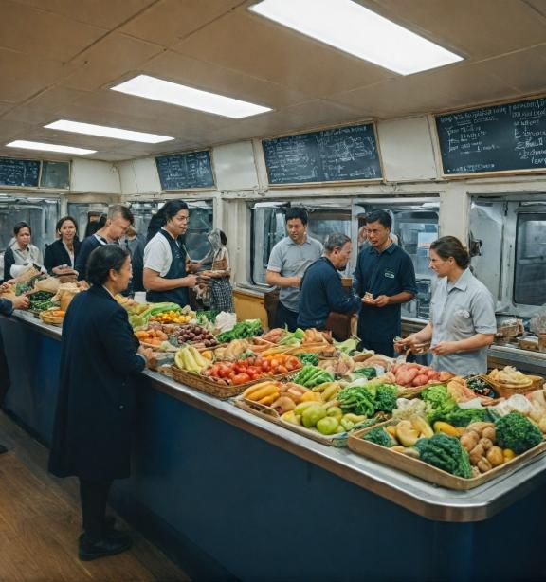
3.3 Developing a Comprehensive Training Programme
How to structure and implement sustainability training programs for galley staff on various types of ships
Engaging the crew in hands-on training: workshops, scenario-based training, and drills for waste management and emergency planning
ONBOARD HEALTHY NUTRITION

Slide 27
3.3 Developing a Comprehensive Training Programme
Develop a comprehensive sustainability training programme
Developing a comprehensive sustainability training program for galley personnel on different types of ships is an important step towards efficient resource management, waste reduction and minimizing the environmental footprint of ship operations. For the program to be successful, it must be carefully structured and customized for the specific needs of each ship type - cruise, cargo, military, etc. Also, active crew participation through hands-on training, scenario-based drills and exercises is key to the long-term success of the program.
ONBOARD HEALTHY NUTRITION

Slide 28
3.3 Developing a Comprehensive Training Programme
How to structure and implement sustainability training programmes for galley staff on different ship types. Analysis of the specific needs and challenges of each ship type
The first step in developing a sustainability training program is to analyze the unique needs and challenges for each ship type. For example, cruise ships have different requirements and resources compared to cargo or military ships.
The programme must reflect differences in waste volumes, resources and types of operations to be effective. Example: cargo ships face long periods without access to fresh provisions, requiring specific skills to store food and minimise waste. In this case, training could include long-term storage technologies.
ONBOARD HEALTHY NUTRITION

Slide 29
3.3 Developing a Comprehensive Training Programme
The training programme should be organised in modules covering different aspects of sustainability - food safety, waste management, energy and water efficiency, sustainable sourcing, etc. Each module should include theoretical knowledge and practical exercises.
Module 1: Food Safety and Sustainable Sourcing: Focus on proper food storage, selecting sustainable sources of provisions, and minimizing food waste.
Module 2: Waste management: practical strategies for separate waste collection, composting and safe disposal of hazardous materials.
Module 3: Energy and Water Efficiency: training on optimising the use of energy resources and minimising the water footprint.
ONBOARD HEALTHY NUTRITION

Slide 30
3.3 Developing a Comprehensive Training Programme
Implementation of the training in the fieldFor the programme to be successful, it must be implemented not only in theory but also in practice. This involves organising on-site training sessions where the crew can apply their knowledge in real-life conditions. It is important to have clearly defined responsibilities for each member of the galley staff.
Example: Cruise ships can organise weekly crew training sessions where chefs and support staff are taught how to implement sustainable practices in food and waste management.
ONBOARD HEALTHY NUTRITION

Slide 31
3.3 Developing a Comprehensive Training Programme
Scenario-based training
Scenario-based training provides the crew with the opportunity to react to realistic situations and apply sustainable solutions under conditions of stress or constraints. For example, scenarios can be created where the ship remains without fresh provisions for a long period, and the crew must find a solution to manage food supplies and minimize waste.
Example: warships may conduct drills in which the crew is faced with a resource-constrained situation, expecting them to apply their skills to conserve provisions and reduce waste while waiting for the next resupply.
ONBOARD HEALTHY NUTRITION

Slide 32
3.3 Developing a Comprehensive Training Programme
Waste and emergency management exercises
Waste management is essential, especially in emergency situations, such as a failure in recycling systems or a sharp reduction in resources. The training programme should include exercises to prepare the crew to respond to such situations.
Example: the exercise may include a simulated hazardous material release where the crew must quickly and effectively implement procedures for the safe disposal and management of these materials.
ONBOARD HEALTHY NUTRITION

Slide 33
3.3 Developing a Comprehensive Training Programme
Developing and implementing a comprehensive sustainability training program for galley personnel requires strategic planning, customizing training modules to the specific needs of different ship types, and actively engaging crew in hands-on exercises.
Through scenario drills and waste and resource management exercises, galley personnel will be well prepared to implement sustainable practices that will contribute to the long-term efficiency and environmental sustainability of ship operations.
ONBOARD HEALTHY NUTRITION

Slide 34
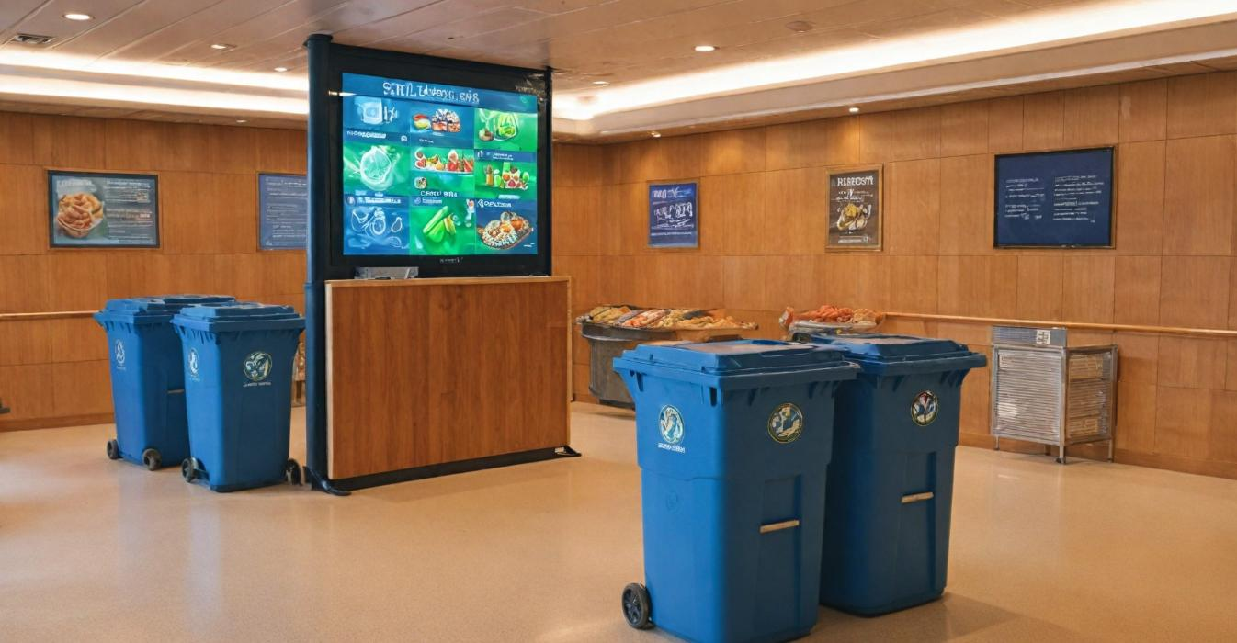
3.4 Monitoring and Continuous Improvement
ONBOARD HEALTHY NUTRITION

Slide 35
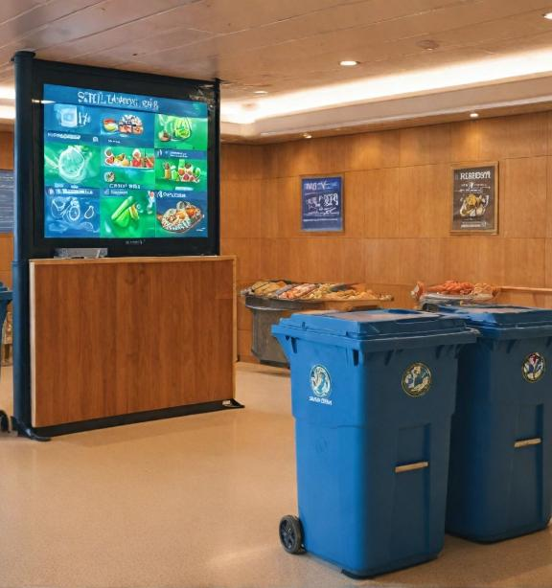
3.4 Monitoring and Continuous Improvement
Tracking sustainability efforts using key performance indicators (KPIs) such as waste reduction, water conservation, and energy savings
0Incorporating new technologies and innovations (e.g., energy-efficient appliances, advanced composters) to improve sustainability in ship galleys
ONBOARD HEALTHY NUTRITION

Slide 36
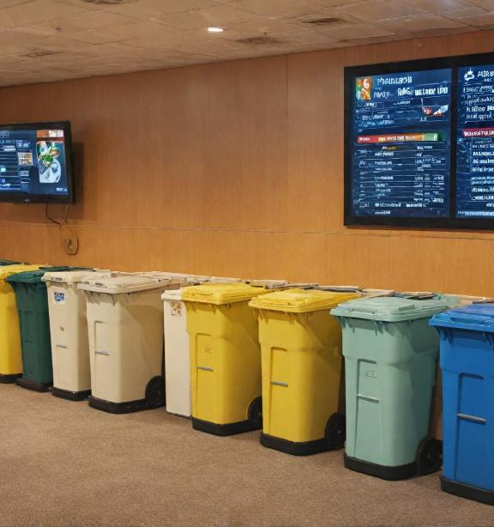
3.4 Monitoring and Continuous Improvement
One of the key aspects of effective implementation of sustainable practices in ships' galleys is the ability to monitor performance and continuously improve these practices. To ensure continued success in sustainable resource management, key performance indicators (KPIs) must be used and new technologies and innovations must be implemented. These measures not only ensure compliance with environmental standards, but also improve the overall efficiency of the galley operations.
Track sustainability efforts using key performance indicators (KPIs) such as waste reduction, water conservation and energy savings
Monitoring sustainable practices in the galley requires the use of clear and measurable key performance indicators (KPIs) that enable ship management to assess progress in reducing the environmental footprint.
ONBOARD HEALTHY NUTRITION

Slide 37
3.4 Monitoring and Continuous Improvement
Waste reduction
Waste generated in the galley is a major aspect of sustainability, as inefficient waste management leads to pollution and unnecessary costs. Measuring the amount of food waste and its proper management can give an accurate picture of the efficiency of the galley.
KPI for food waste:
One of the important monitoring indicators is the amount of food waste generated over a certain period (per week or month). This includes both spoiled food waste and leftovers from food preparation. By reducing this waste, the galley can demonstrate progress in sustainable resource management.
ONBOARD HEALTHY NUTRITION

Slide 38
3.4 Monitoring and Continuous Improvement
Example: on a cruise ship, where the volume of food waste is high due to the many passengers, the KPI can be set as a percentage reduction of waste generated from the galley per week or month. If the goal is to reduce food waste by 15% in three months, the crew can use vacuum packing and portion planning to achieve this goal.
Saving water
Water is a critical resource on ships, and its proper use in the galley is critical to sustainability. Tracking water consumption and implementing water conservation measures can reduce excess use and ensure long-term efficiency.
ONBOARD HEALTHY NUTRITION

Slide 39
3.4 Monitoring and Continuous Improvement
Water consumption KPI: Measuring the amount of water used in the galley on a daily or weekly basis is an important monitoring indicator. The aim is to reduce the water used by optimising the washing, cooking and cleaning processes.
Example: on a warship, a rainwater harvesting system can be used to clean the galley and vessels, reducing the overall potable water consumption. A KPI for water consumption could be a reduction in potable water used by 10% per month.
ONBOARD HEALTHY NUTRITION

Slide 40
3.4 Monitoring and Continuous Improvement
Energy saving
The galley is one of the places where a large amount of energy is used for cooking, lighting and food storage. Efficient energy use and tracking energy savings are key to reducing the ship's environmental footprint.Energy Saving KPIs:Energy monitoring metrics can include total galley electricity consumption on a daily, weekly or monthly basis. By implementing energy efficient appliances and optimizing appliance operation, significant energy savings can be achieved.
Example: induction hobs can be used on a cargo ship, which are more energy efficient than traditional stoves. KPIs for energy savings could include reducing energy consumption by 5-10% by using these appliances and optimising cooking processes.
ONBOARD HEALTHY NUTRITION

Slide 41
3.4 Monitoring and Continuous Improvement
Introduction of new technologies and innovations (e.g. energy saving appliances, modern composters) to improve sustainability in galleys
Technology and innovation play a crucial role in improving sustainability in shipping galleys. Implementing new appliances and resource management systems can significantly reduce waste, energy consumption and environmental impact.
Energy efficient appliances
Energy efficient appliances such as induction hobs, convection ovens and energy efficient refrigerators can reduce energy costs and improve overall galley efficiency. As well as reducing energy consumption, they also offer faster and more even cooking, which improves workflow.
ONBOARD HEALTHY NUTRITION

Slide 42
3.4 Monitoring and Continuous Improvement
Example: induction hobs can be implemented on cruise ships, which use less energy and offer a more efficient cooking method while reducing food preparation time. This not only saves energy but also increases galley productivity.
Modern composting and waste management systems
Modern organic waste composting and recycling systems can significantly reduce the volume of waste that is dumped in ports or at sea. Composting organic waste such as vegetable peelings and food scraps can create biodegradable products that can be used for soil enrichment in ports or in agriculture.
ONBOARD HEALTHY NUTRITION

Slide 43
3.4 Monitoring and Continuous Improvement
Example: composting systems can be installed on cargo ships to process food waste on board and turn it into organic compost that can be used for agricultural purposes in ports. This solution reduces the amount of waste and provides an environmental benefit.
Intelligent resource management systems
Real-time monitoring systems of energy consumption and water use can help optimise resources in the galley. These systems can alert staff to excessive resource use and suggest solutions for improvement.
Example: a water and energy monitoring system could be implemented on a military ship to monitor galley consumption in real time and notify cooks when preset norms are exceeded. This allows a quick response and implementation of corrective measures.
can
ONBOARD HEALTHY NUTRITION

Slide 44
3.4 Monitoring and Continuous Improvement
Conclusion
Monitoring and continuously improving sustainable practices in shipping galleys requires a systematic approach that includes the use of key performance indicators (KPIs) and the implementation of new technologies. By tracking waste, water, and energy performance, as well as implementing innovations such as energy-efficient appliances and advanced composters, shipping operations can
ONBOARD HEALTHY NUTRITION

Slide 45

3.5 Final Discussion and Action Plan
ONBOARD HEALTHY NUTRITION

Slide 46

3.5 Final Discussion and Action Plan
Encouraging participants to share ideas on how they can implement sustainable practices and training on their ships
Closing remarks on the long-term benefits of sustainability for both the environment and ship operations
ONBOARD HEALTHY NUTRITION

Slide 47
3.5 Final Discussion and Action Plan
To support the active participation of the crew and participants in the training, I suggest a few specific tasks that can be included within the final discussion and action plan development. These assignments will stimulate participants to think critically about the applicability of what they have learned and to create practical steps for implementing sustainable practices on their ships.
ONBOARD HEALTHY NUTRITION

Slide 48
3.5 Final Discussion and Action Plan
Task 1: Assess current practices and identify challenges
Goal: Participants should assess the current state of sustainable practices in their ship's galley and identify key challenges.
Description: Each participant should assess the existing practices in their galley related to waste management, energy efficiency, water conservation and provisioning.
How is food and hazardous waste managed?
What energy saving measures are implemented?
What challenges do you face in terms of conservation and saving resources?
Outcome: Participants will need to identify at least three main challenges they face in their operations.
ONBOARD HEALTHY NUTRITION

Slide 49
3.5 Final Discussion and Action Plan
Task 2: Develop concrete improvement steps
Goal: Participants should create a concrete action plan that includes steps to improve sustainability.
Description: Once participants identify the challenges, they are asked to compile a list of three to five specific improvement steps that can be implemented on their ship.
What measures can be taken to reduce waste?
How can energy efficiency be improved?
What training should be conducted for the crew?
Outcome: Each participant must present their action plan to the group, explaining the steps for improvement and how they will be implemented.
Example: the crew of a cargo ship may suggest the implementation of a separate waste collection system and the use of a composting system for organic waste.
ONBOARD HEALTHY NUTRITION

Slide 50
3.5 Final Discussion and Action Plan
Conclusion
These assignments provide participants with the opportunity to apply what they have learned through practical steps and the creation of real action plans. Through discussion and collaborative work, participants will be able to generate solutions that are specific to their ships while preparing for the successful implementation of sustainable practices.
ONBOARD HEALTHY NUTRITION

Slide 51
ASSESSMENT
Multiple Choice Questions (MCQs)
Why is continuous education on sustainability important for galley crews?
  To improve the speed of food preparation
  To address unique sustainability challenges across ship types
  To ensure uniform food quality across all ships
  To minimize the need for waste segregation
  2. Which of the following is NOT a unique sustainability challenge for maritime environments?
  Cargo ship waste management
  Military vessel logistics
  Lack of passenger amenities on luxury cruise ships
  Limited storage capacity on ships
ONBOARD HEALTHY NUTRITION

Slide 52
ASSESSMENT
Multiple Choice Questions (MCQs)
3. What is a key focus in waste management systems for ship galleys?
  Increasing fuel consumption
  Segregating recyclables and safely disposing of hazardous materials
  Using plastic materials for all packaging
  Reducing the use of fresh ingredients
4. What is a priority in energy and water use for ship galley operations?
  Maximizing energy consumption for efficiency
  Minimizing environmental impact through efficient practices
  Using single-use water bottles
  Encouraging staff to use more water for cleaning
ONBOARD HEALTHY NUTRITION

Slide 53
ASSESSMENT
Short Answer Questions
Why is it important for galley crews to undergo continuous sustainability training across different ship types?
What are two key practices that can help reduce waste and minimize the environmental impact in ship galleys?
Describe one hands-on training activity that can effectively engage crew members in sustainability practices.
How can tracking key performance indicators (KPIs) like waste reduction and energy savings improve sustainability in ship operations?
What innovative solutions or technologies can be implemented to enhance sustainability in ship galley operations?
ONBOARD HEALTHY NUTRITION

Slide 54
ASSESSMENT
Case Study
Background:The management of a cruise ship „Harmony“ decided to implement a sustainability program in its galley operations to reduce environmental impact and comply with maritime sustainability regulations. The ship caters to over 2,000 passengers daily, creating significant challenges related to food waste, energy consumption, and waste disposal.
Scenario: The head chef and the ship's environmental officer collaborated to develop a comprehensive sustainability plan, focusing on the following areas:
Food Waste Management: Introducing portion control measures and a system to reuse food scraps creatively, such as turning vegetable peels into stocks.
Energy and Water Efficiency: Installing energy-efficient cooking appliances and teaching the crew water conservation techniques, such as reusing water for cleaning purposes.
Training and Engagement: Conducting hands-on workshops for galley staff on waste segregation, safe disposal of hazardous materials, and scenario-based drills for emergency waste handling.
ONBOARD HEALTHY NUTRITION

Slide 55
ASSESSMENT
Case Study
Monitoring and Improvement: Using a digital dashboard to track sustainability KPIs, such as daily waste generated, water consumption, and energy usage, with weekly reviews to identify areas for improvement.
Challenge:
Despite initial enthusiasm, the crew faced difficulties adjusting to the new procedures, particularly in segregating waste during busy service hours. Additionally, some of the older appliances consumed more energy than anticipated, making it hard to meet energy-saving goals.
Tasks:
Identify the key sustainability challenges in the case study.
Propose specific solutions to address the difficulties faced during waste segregation.
Suggest a plan for upgrading older appliances while staying within a limited budget.
How can the management ensure the long-term success of the sustainability program?
Discuss the potential benefits of this program for the environment and the cruise line's operations.
ONBOARD HEALTHY NUTRITION

Slide 56

ASSESSMENT
ONBOARD HEALTHY NUTRITION

Slide 57
Course References
Demydyuk, G. V., Kaurav, R. P. S., Carlbäck, M., & Vejlgaard, H. (2024). From galley to gourmet: experience accounting perspective on the evolving dining choices of cruise passengers. Journal of Foodservice Business Research, 1-33.
Durlik, I., Miller, T., Kostecka, E., Łobodzińska, A., & Kostecki, T. (2024). Harnessing AI for Sustainable Shipping and Green Ports: Challenges and Opportunities. Applied Sciences, 14(14), 5994.
Shoaib, M., Zhang, S., & Ali, H. (2023). Assessment of sustainable green logistics enablers: A robust framework using fuzzy DEMATEL and ISM approach. International Journal of Environmental Science and Technology, 20(10), 11407-11426.
Dewan, M. H., & Godina, R. (2024). Unveiling seafarers' awareness and knowledge on energy-efficient and low-carbon shipping: A decade of IMO regulation enforcement. Marine Policy, 161, 106037.
Jang, Y. L., Jeong, J., Eo, S., Hong, S. H., & Shim, W. J. (2024). Occurrence and characteristics of microplastics in greywater from a research vessel. Environmental Pollution, 341, 122941.
ONBOARD HEALTHY NUTRITION

Slide 58
Course References
Baum-Talmor, P., & Şahin, Ç. E. (2024). Employment Practices, Cost Minimization, and Their Implications for Food Provisions and Seafarers’ Wellbeing on board Ships–A Qualitative Analysis. INQUIRY: The Journal of Health Care Organization, Provision, and Financing, 61
Yazdani, M., Ariza-Montes, A., Arjona-Fuentes, J. M., & Radic, A. (2024). Cruise hotel sustainable supplier management using a grey-based decision support framework. Journal of Travel & Tourism Marketing, 41(4), 538-558.
Nittari, G., Gibelli, F., Bailo, P., Sirignano, A., & Ricci, G. (2024). Factors affecting mental health of seafarers on board merchant ships: a systematic review. Reviews on environmental health, 39(1), 151-160.
De Beukelaer, C. (2023). What is wrong with the shipping industry?. In Trade winds (pp. 48-74). Manchester University Press.
Kizielewicz, J. (2024). The commitment of global cruise shipping companies to sustainable development. Current Issues in Tourism, 27(11), 1683-1699.
ONBOARD HEALTHY NUTRITION

