Slide 1





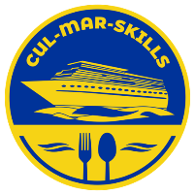


MARitime Soft Skills for Onboard Healthy Nutrition and CULinary Arts in Seagoing Services – CUL-MAR-Skills
KA220-VET - Cooperation partnerships in vocational education and training
2023-1-RO01-KA220-VET-000156711
ONBOARD HEALTHY NUTRITION
COURSE 2
How to Support Sustainability in the Galleys
Disclaimer: “Funded by the European Union. Views and opinions expressed are however those of the author(s) only and do not necessarily reflect those of the European Union or the ANPCDEFP. Neither the European Union nor the ANPCDEFP can be held responsible for them”

Slide 2

Learning outcomes of the course
Upon successful completion of the course, participants will acquire the following knowledge and skills:
Develop strategies for sustainable operations in ship galleys: Participants will learn to plan menus that minimize waste by incorporating seasonal, local, and durable supplies, as well as manage limited resources such as water, fuel, and energy efficiently (item 2.1).
Master techniques for reducing food waste at sea: Participants will gain practical skills in portion control, smart provisioning, and creative reuse of food scraps, along with techniques such as vacuum sealing, freezing, and pickling to minimize spoilage (item 2.2).
Foster crew engagement in sustainability efforts: Participants will understand how to actively involve crew members in reducing personal waste, energy consumption, and adopting sustainable habits, while recognizing the role of ship management in supporting these practices (item 2.3).
Collaborate to solve sustainability challenges: Through interactive group activities, participants will develop critical problem-solving skills by identifying specific sustainability challenges and proposing actionable solutions tailored to their ship types (item 2.4).
These outcomes will empower participants to enhance sustainability in shipboard galley operations
NAVAL COMMUNICATIONS
ONBOARD HEALTHY NUTRITION

Slide 3
Content of the course
2.How to Support Sustainability in the Galleys
2.1. Strategies for Supporting Sustainability
Menu planning to reduce waste: using seasonal, local, and durable supplies
Efficient resource management (water, fuel, energy) in galleys with limited access to resupply
2.2. Reducing Food Waste at Sea
Portion control and smart provisioning: ensuring the right quantities are cooked based on crew size and duration of voyages
Techniques to reuse leftovers and minimize spoilage (vacuum sealing, freezing, pickling)
Creative uses of food scraps for stocks, soups, and other dishes
2.3. Crew Engagement and Sustainable Practices
How to engage the crew in sustainability efforts: reducing personal waste, energy use, and fostering a culture of sustainability
Role of ship management in supporting sustainable galley operations
2.4. Interactive Group Activity
Participants collaborate to identify sustainability challenges and propose solutions for galleys on their types of ships
ONBOARD HEALTHY NUTRITION

Slide 4
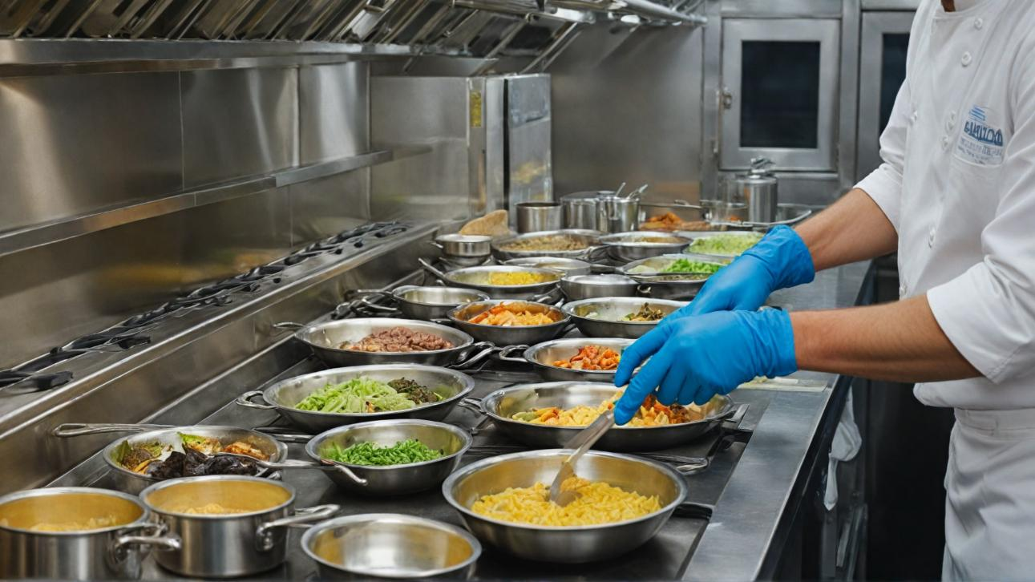
How to Support Sustainability in the Galleys
ONBOARD HEALTHY NUTRITION

Slide 5
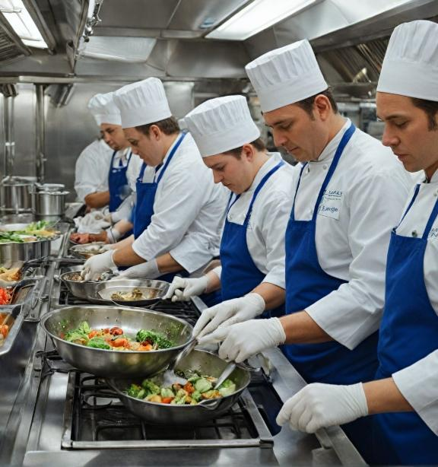
How to Support Sustainability in the Galleys
This section will explore the importance of sustainability in the galleys of different types of ships including merchant ships, cruise liners, military vessels and ferries. The scope of sustainable practices that can be implemented in different maritime environments will be explored, as well as ways in which the negative environmental effects of galley operations can be minimized.
ONBOARD HEALTHY NUTRITION

Slide 6

How to Support Sustainability in the Galleys
In the second part we will focus on reducing food waste at sea. Through portion control and clever provisioning planning, we can ensure that the right amount of food is prepared based on the number of crew and the length of the voyage.
We will look at techniques for reusing leftovers and reducing waste, such as vacuum sealing, freezing and pickling, as well as creative ways to use food scraps.
ONBOARD HEALTHY NUTRITION

Slide 7
How to Support Sustainability in the Galleys
We will discuss how using seasonal, local and long-lasting products not only reduces waste but also leads to more efficient management of resources such as water, fuel and energy that are limited on long voyages. We will also look at ship waste management, one of the biggest environmental challenges in the maritime industry.
This lecture is designed not only to present practical approaches to sustainability, but also to encourage active participation and collaboration to improve sustainable board practices.
ONBOARD HEALTHY NUTRITION

Slide 8

2.1 Strategies for Supporting Sustainability
ONBOARD HEALTHY NUTRITION

Slide 9
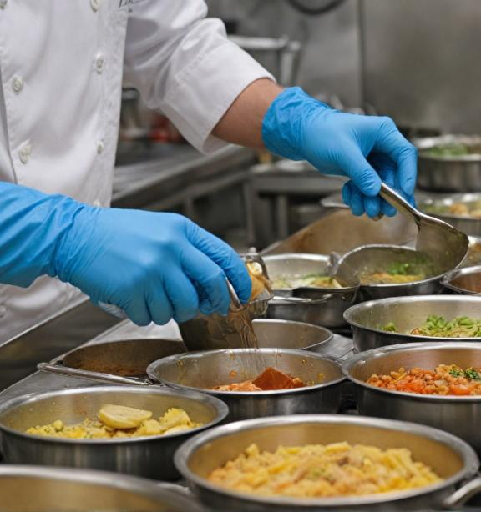
2.1 Strategies for Supporting Sustainability
Menu planning to reduce waste: using seasonal, local, and durable supplies
Efficient resource management (water, fuel, energy) in galleys with limited access to resupply
Waste management systems on ships: recycling, composting, and minimizing single-use products
ONBOARD HEALTHY NUTRITION

Slide 10
2.1 Strategies for Supporting Sustainability
Use of seasonal products
Seasonal produce is usually more affordable, fresher and of better quality as it is available in the particular season when it is most abundant. Including seasonal foods in the menu means a lower carbon footprint as they do not require prolonged transport and storage. In addition, seasonal produce is often cheaper, allowing for better budget management.
ONBOARD HEALTHY NUTRITION

Slide 11
2.1 Strategies for Supporting Sustainability
Example:
On a ship that passes through tropical areas, the chef may include fruits such as mango, pineapple and papaya, which are in season and readily available in the local market. Not only does this reduce the need to import produce from distant destinations, but it also provides fresher and tastier foods for the crew and passengers.
ONBOARD HEALTHY NUTRITION

Slide 12
2.1 Strategies for Supporting Sustainability
Use of local products
Incorporating locally produced foods into the menu significantly reduces the transportation costs and carbon footprint associated with food procurement. Locally produced products are less processed and of higher quality as they do not require long-term storage. In addition, supporting local producers stimulates the economy of the regions through which the ship passes.
ONBOARD HEALTHY NUTRITION

Slide 13
2.1 Strategies for Supporting Sustainability
Example: a cruise ship docked in a Mediterranean port can stock up on local seafood, fresh fish and locally grown vegetables. This not only reduces the carbon footprint but also offers passengers authentic flavours from the region they are travelling through.
ONBOARD HEALTHY NUTRITION

Slide 14
2.1 Strategies for Supporting Sustainability
Use of durable products
Durable products such as cereals, pulses, canned and frozen goods are critical to menu planning on ships, especially on long voyages. They provide the flexibility needed when fresh provisions are limited or difficult to access. It is important to select such long-life products that can be combined with fresh ingredients for a balanced and varied menu.
ONBOARD HEALTHY NUTRITION

Slide 15
2.1 Strategies for Supporting Sustainability
Example: on a long voyage with no access to fresh provisions, the cook might use frozen vegetables to combine with fresh fish caught by the crew to create a nutritious meal. In this way, available products are used without loss of nutritional quality.
ONBOARD HEALTHY NUTRITION

Slide 16
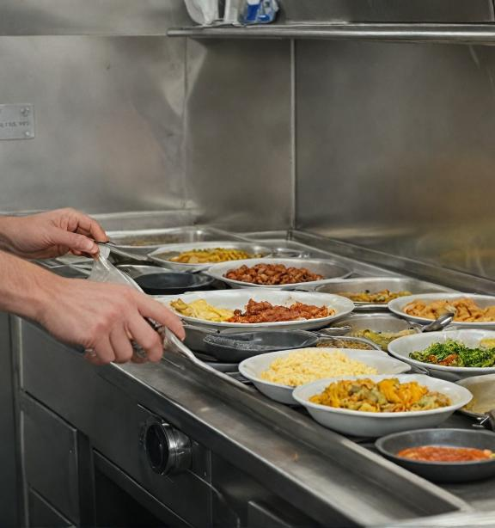
2.1 Strategies for Supporting Sustainability
Waste reduction planning
One of the biggest problems in ship galleys is the excess food preparation that leads to waste. Through intelligent menu and portion planning, food waste can be significantly reduced.
Advance planning with regard to the number of crew and passengers, as well as the duration of the trip, is essential to minimize losses.
ONBOARD HEALTHY NUTRITION

Slide 17
2.1 Strategies for Supporting Sustainability
Example: if there are exactly 100 crew members on board, the chef must calculate the portions so that exactly the right amount of food is prepared for these people without leaving large surpluses. The use of technology solutions, such as food needs forecasting systems, can help with this.
ONBOARD HEALTHY NUTRITION

Slide 18
2.1 Strategies for Supporting Sustainability
Menu planning with a focus on sustainability not only improves the efficiency of the galley but also contributes to the global environmental strategy. By using seasonal, local and long-lasting produce, ship chefs can significantly reduce food waste and carbon footprint while providing quality meals for crew and passengers.
ONBOARD HEALTHY NUTRITION

Slide 19
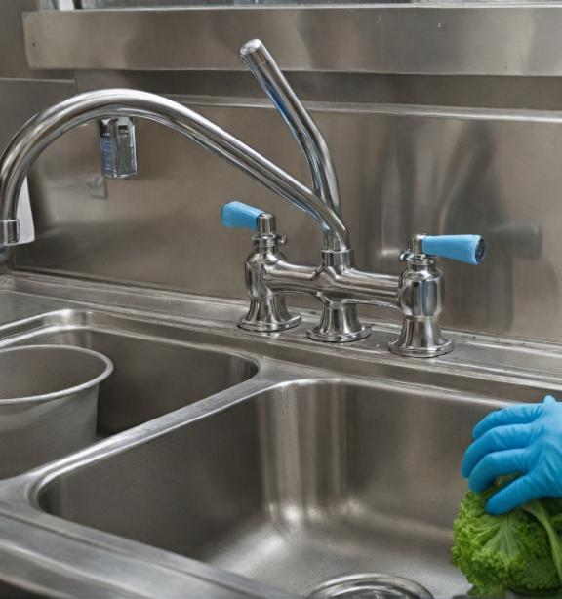
2.1 Strategies for Supporting Sustainability
Water management in the galley
Water is a vital resource on ships and its management in the galley is critical, especially on long voyages where fresh water refuelling is limited. Improper use of galley water can lead to its depletion, posing a risk to the health and hygiene of the crew.
Water reuse technique: One of the best practices is the use of water reuse systems.
ONBOARD HEALTHY NUTRITION

Slide 20

2.1 Strategies for Supporting Sustainability
For example, water used to wash vegetables can be collected and used to clean floors or for other hygienic purposes. In addition, galleys can use specialised dishwashers with low water and energy consumption that use advanced water purification technologies.
Pre-cleaning products: planning hygiene procedures in the galley can also help reduce water consumption. For example, frozen or packaged produce that has already been cleaned and cut can reduce the need for additional washing, saving water and time.
ONBOARD HEALTHY NUTRITION

Slide 21
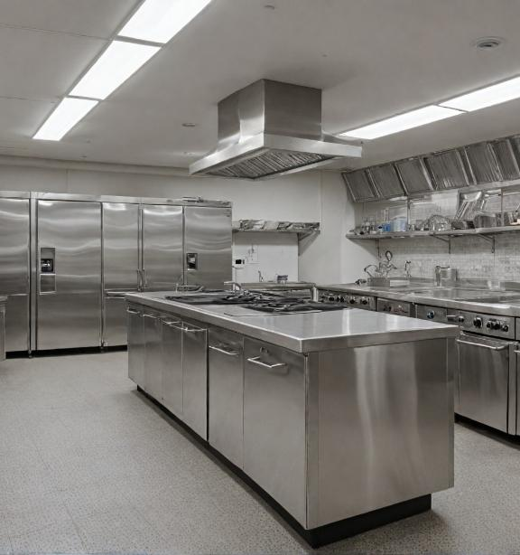
2.1 Strategies for Supporting Sustainability
Energy management
Energy efficiency is critical in the galley as kitchen equipment such as stoves, ovens and refrigerators consume significant amounts of energy. On long voyages, limited fuel requires that energy resources be managed wisely.
Using energy efficient appliances: the new generation of energy saving galley appliances can significantly reduce energy consumption. Induction cooktops, for example, use less electricity as they heat the vessel directly rather than the surface. In addition, convection ovens reduce cooking time and also contribute to energy savings.
ONBOARD HEALTHY NUTRITION

Slide 22
2.1 Strategies for Supporting Sustainability
Energy consumption optimisation programmes: many ships implement real-time energy monitoring and control systems. These systems allow tracking of galley energy needs and optimizing appliance usage based on galley occupancy. This can include cooking at certain times when energy consumption is lower and using economical equipment settings.
ONBOARD HEALTHY NUTRITION

Slide 23

2.1 Strategies for Supporting Sustainability
Fuel and transport management
On ships, fuel is not used directly in the galley, but the energy required to keep the galley running is directly linked to the ship's fuel. Reducing the overall energy consumption of the ship reduces the need for fuel.
Planning of the horseradish preparation processes:
Cooks can plan the workflow to make the most of the time and energy of the appliances. For example, cooking larger quantities of food at a time, which can then be stored and used, reduces the frequency of switching on stoves and ovens.
ONBOARD HEALTHY NUTRITION

Slide 24
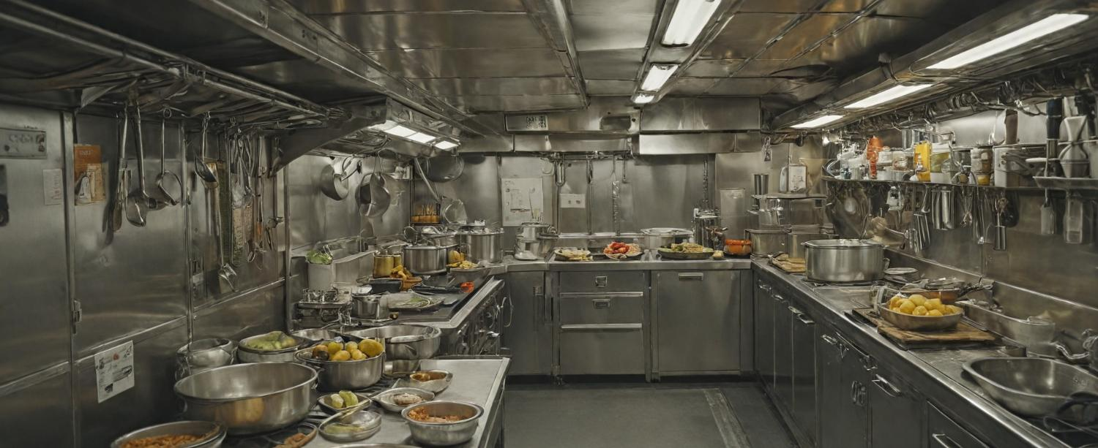
2.2 Reducing Food Waste at Sea
ONBOARD HEALTHY NUTRITION

Slide 25
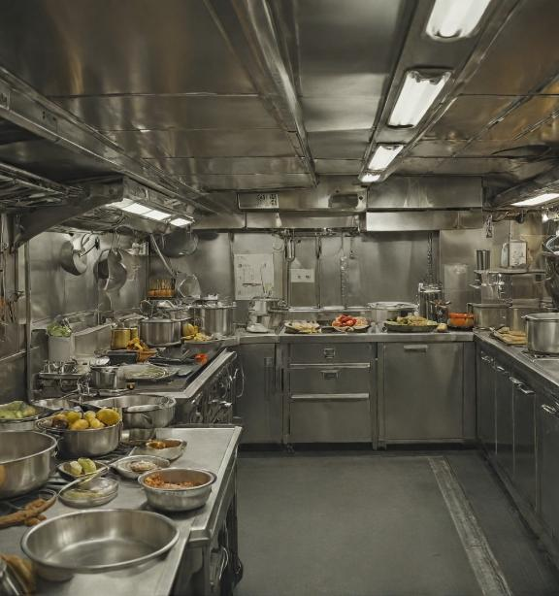
2.2 Reducing Food Waste at Sea
Managing food waste on ships is critical to the sustainability of galley operations.
Due to limited resources and space on board, chefs and teams need to implement smart waste reduction strategies, which includes precise portion planning, efficient use of leftover food and preventing product spoilage.
Here are some key approaches to reducing food waste at sea.
ONBOARD HEALTHY NUTRITION

Slide 26
2.2 Reducing Food Waste at Sea
Portion control and smart provisioning: ensuring the right amount of food for the number of crew and the length of the trips
Portion control One of the most important aspects of reducing food waste is portion control. Overcooking or preparing too large portions leads to inevitable food waste, especially when the cooked food cannot be stored safely for later use. Portion control requires careful planning of each meal to suit the appetite of the crew and the length of the voyage.
ONBOARD HEALTHY NUTRITION

Slide 27
2.2 Reducing Food Waste at Sea
Track crew preferences:
Ship chefs can use information about the crew's eating habits to plan portions more accurately. For example, if it is known that certain crew members prefer lighter meals, this can lead to preparing smaller portions for them, which reduces excesses.
Use of digital tools: some ships use software systems that allow menu planning and accurate calculation of the quantities of food required according to the number of crew and the length of the voyage. This includes calculating daily food requirements, which prevents the preparation of extra food.
ONBOARD HEALTHY NUTRITION

Slide 28
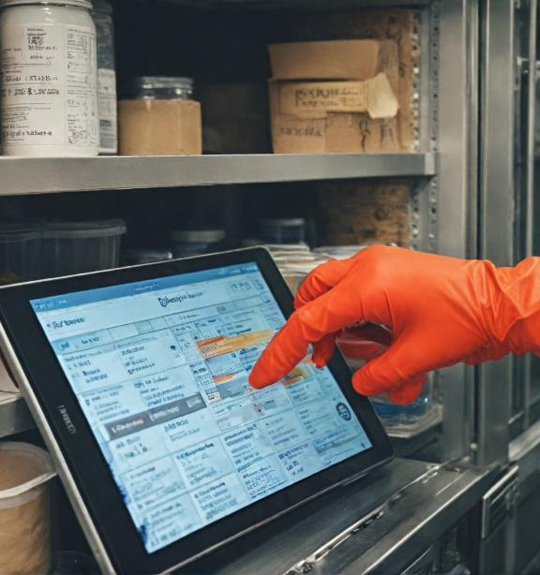
2.2 Reducing Food Waste at Sea
Smart Provisioning Planning
Provision planning is essential to reduce food waste on long journeys. With limited access to fresh produce and limited storage space, it is important to ensure the right amounts of food are available for the crew throughout the trip.
Forecasting food consumption: accurate forecasting of required stocks can prevent food surpluses and shortages. To do this, cooks can use data from previous voyages to plan the quantities needed for different crews under different conditions.
ONBOARD HEALTHY NUTRITION

Slide 29
2.2 Reducing Food Waste at Sea
First-in, first-out strategy: To prevent products from spoiling, it is important to apply a first-in, first-out (FIFO) strategy, where older products are used first to avoid wastage due to expiry.
ONBOARD HEALTHY NUTRITION

Slide 30

2.2 Reducing Food Waste at Sea
Techniques to reuse leftovers and minimize spoilage (vacuuming, freezing, pickling)
Vacuuming of food products
Vacuuming is one of the most effective techniques for extending the shelf life of food products, especially on ships where storage conditions may be limited. Vacuumed foods are preserved longer as contact with air, which leads to spoilage, is minimised.
ONBOARD HEALTHY NUTRITION

Slide 31
2.2 Reducing Food Waste at Sea
Freezing
Freezing food is a standard way to extend the shelf life of products, especially on longer voyages. To prevent fresh produce from spoiling, it can be frozen, thus preserving its nutritional value.
Freezing plan: cooks should develop a freezing plan that includes what products to freeze, when and for how long. For example, leftover soups and sauces can be frozen in small portions and used later.
ONBOARD HEALTHY NUTRITION

Slide 32
2.2 Reducing Food Waste at Sea
Pickling
Marinating is another technique that can help preserve foods for longer. Pickled products have a longer shelf life and can add variety to a crew's menu.
Marinating vegetables and meat: Vegetables, such as cucumbers and carrots, can be marinated and stored for longer, while meat can be marinated for later use in dishes. This not only prevents the products from spoiling but also enriches the menu.
ONBOARD HEALTHY NUTRITION

Slide 33

2.2 Reducing Food Waste at Sea
Creative ways to use food scraps for broths, soups and other dishes
Creative use of food scraps is an important part of reducing food waste in the galley. Instead of being thrown away, leftovers can be used to make new meals that are delicious and nutritious.
ONBOARD HEALTHY NUTRITION

Slide 34

2.2 Reducing Food Waste at Sea
Preparation of broths and soups
Leftover meat, fish and vegetables can be used to make broths and soups. For example, the bones of chicken or fish can be boiled to make stock, which can then be used as a base for soups or sauces.
Using peelings and leftovers: peelings from carrots, onions and other vegetables can also be used to make stock. This is an excellent way to get the most out of food and reduce waste.
ONBOARD HEALTHY NUTRITION

Slide 35

2.2 Reducing Food Waste at Sea
Using leftovers for new dishes
Leftovers from cooked meals can be used to create new creative dishes.
For example, leftover roast meat can be used to make sandwiches or fillings for pasta.
Creative recipes: leftover potatoes can be made into mashed potatoes or croquettes, while leftover cooked vegetables can be used in salads or casseroles. This not only reduces waste but also provides variety in the crew's daily menu.
ONBOARD HEALTHY NUTRITION

Slide 36

2.2 Reducing Food Waste at Sea
Reducing food waste at sea requires careful portion planning, smart provisioning management and creative use of food scraps. By applying techniques such as vacuuming, freezing and pickling, as well as using leftovers for new dishes, galleys can significantly reduce surpluses and increase the efficiency of their operations.
ONBOARD HEALTHY NUTRITION

Slide 37
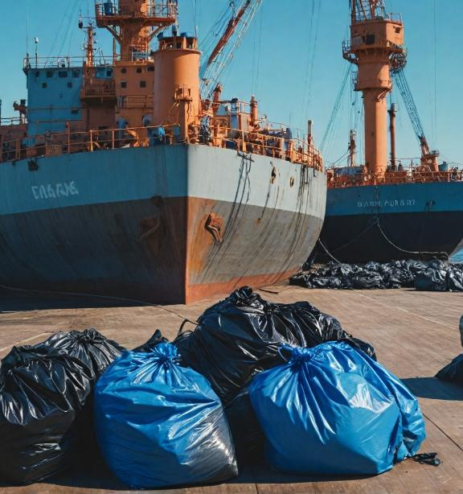
2.2 Reducing Food Waste at Sea
Recycling of waste
Recycling is one of the most effective ways to reduce the amount of waste on ships. Galleys can implement strict waste separation procedures that allow for the recycling of plastics, glass, metals and paper.
Waste collection and sorting systems: many modern ships already have integrated waste separation systems. These include special containers for different materials, as well as plastic and paper baling machines, which reduce the volume of waste and facilitate its transportation and recycling at ports.
ONBOARD HEALTHY NUTRITION

Slide 38
2.2 Reducing Food Waste at Sea
Building recycling habits in the crew:
For successful recycling, it is essential that the crew is trained on how to properly sort the waste. Camps can introduce specific training for staff on separate collection and recycling rules, which will increase the efficiency of the process.
ONBOARD HEALTHY NUTRITION

Slide 39
2.2 Reducing Food Waste at Sea
Composting of organic waste
Composting is one of the best ways to manage food waste on board. Many ships now have technologies that allow organic waste to be composted on board instead of being disposed of at sea or on land.Ship composting systems:These systems use technology to rapidly break down organic waste, turning it into compost that can be used to improve soil in ports or in agricultural activities. Composting also reduces the amount of waste that has to be transported to the port.
ONBOARD HEALTHY NUTRITION

Slide 40
2.2 Reducing Food Waste at Sea
Reducing single-use products
The use of plastics and other single-use products is a major challenge for ships. Plastic utensils, plates and packaging not only generate waste but also contribute to ocean pollution.
Switch to reusable products: one of the most effective strategies is to replace single-use products with reusable alternatives. This includes using metal utensils and plates, glass cups and reusable containers. This practice not only reduces waste but also improves the overall sustainability of the galley.
ONBOARD HEALTHY NUTRITION

Slide 41
2.2 Reducing Food Waste at Sea
Use of biodegradable products:
In cases where the use of disposable products is unavoidable, a switch to biodegradable alternatives can be made. For example, instead of plastic straws, paper straws or other natural materials that degrade in the environment can be used.
ONBOARD HEALTHY NUTRITION

Slide 42
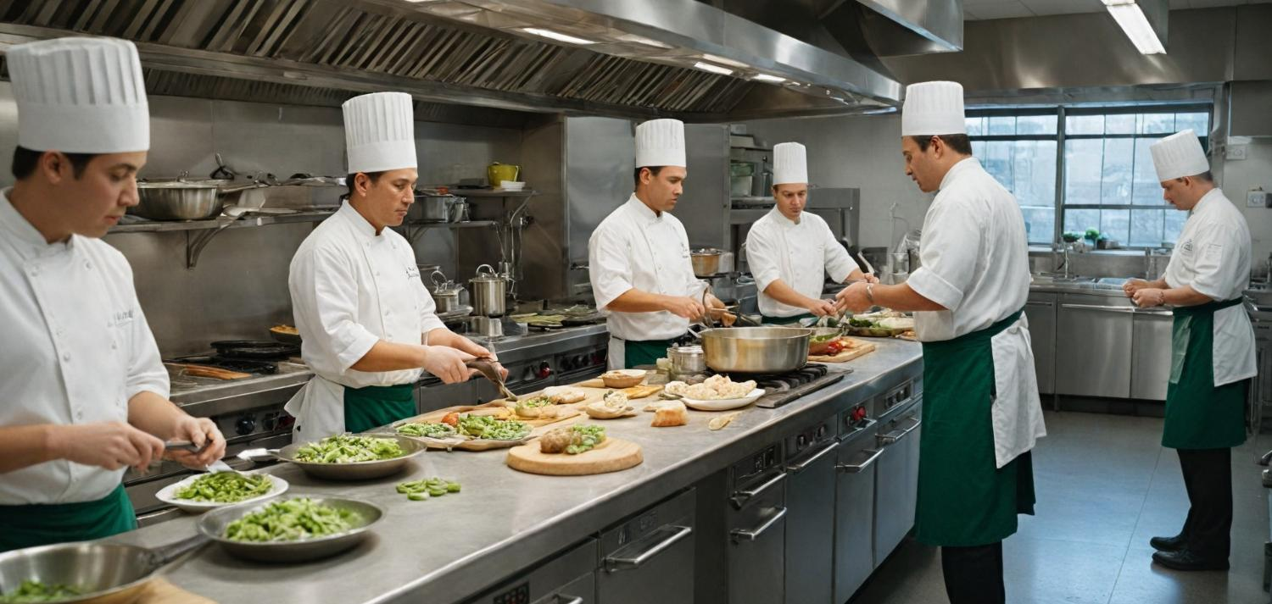
2.3 Crew Engagement and Sustainable Practices
ONBOARD HEALTHY NUTRITION

Slide 43
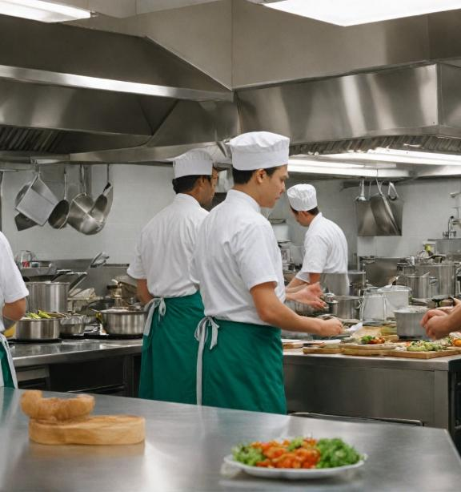
2.3 Crew Engagement and Sustainable Practices
How to engage the crew in sustainability efforts: reducing personal waste, energy use, and fostering a culture of sustainability
Role of ship management in supporting sustainable galley operations
ONBOARD HEALTHY NUTRITION

Slide 44
2.3 Crew Engagement and Sustainable Practices
How to engage crew in sustainability efforts: reducing personal waste, energy consumption and fostering a culture of sustainability
Reducing personal waste
In order to achieve waste reduction on the ship, the crew must be directly involved in the process by changing their habits. Personal waste, such as single-use plastics and unnecessary packaging, can be drastically reduced through everyday sustainable solutions.
ONBOARD HEALTHY NUTRITION

Slide 45
2.3 Crew Engagement and Sustainable Practices
Promote the use of reusable products: it is important to encourage crew to use reusable water bottles, cups, plates and cutlery instead of single-use plastic products. Cooks and galley staff can distribute reusable containers for each crew member to use daily.
Reduce packaging materials: Crew members can be encouraged to choose products with minimal or no packaging whenever possible, especially with regard to personal products such as hygiene items or groceries.
ONBOARD HEALTHY NUTRITION

Slide 46
2.3 Crew Engagement and Sustainable Practices
Example: a cruise ship could implement a policy that requires crew members to use only reusable water bottles and metal utensils, with plastic alternatives eliminated or minimized.
ONBOARD HEALTHY NUTRITION

Slide 47
2.3 Crew Engagement and Sustainable Practices
Reducing energy consumption
Energy is a critical ship resource that must be managed effectively. Every crew member can contribute to reducing energy consumption through conscious behaviour and choices.
Turn off unnecessary appliances: Encouraging crew to turn off lights, appliances and air conditioners when not in use can result in significant energy savings. The galley can establish a schedule for the use of energy-consuming appliances to avoid unnecessary consumption.
ONBOARD HEALTHY NUTRITION

Slide 48
2.3 Crew Engagement and Sustainable Practices
Optimisation of appliance use:
Chefs can train the crew how to use the galley's energy resources in the most efficient way - for example, cooking several meals at once in the oven or using induction hobs, which are more efficient than traditional hobs.
Example: a warship may implement a system to automatically turn off lights in common areas of the ship when these areas are not in use, thereby reducing unnecessary energy consumption.
ONBOARD HEALTHY NUTRITION

Slide 49
2.3 Crew Engagement and Sustainable Practices
Fostering a culture of sustainability
Sustainability needs to be part of the daily life of the crew, creating a culture of responsibility towards resources and the environment. In order to achieve this, training sessions should be held to inform the crew of the importance of sustainable practices and how they can be incorporated into daily activities.
Education and Awareness: Regular seminars and training focused on sustainable resource management can raise crew awareness of global environmental challenges and their role in solving them. Topics can include water efficiency, recycling and reducing personal waste.
ONBOARD HEALTHY NUTRITION

Slide 50
2.3 Crew Engagement and Sustainable Practices
Incentive programs: introducing incentive programs that encourage crew members to implement sustainable practices can create positive motivation. This could include rewards for the crew that best implements waste reduction or energy conservation measures.
Example: on a cruise ship, a system could be set up to evaluate the sustainability of each department, with the most successful department receiving a reward or recognition at the end of the voyage.
ONBOARD HEALTHY NUTRITION

Slide 51
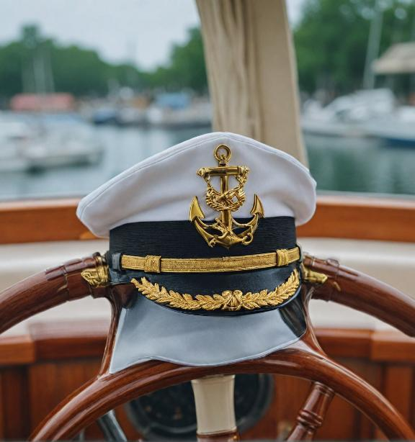
2.3 Crew Engagement and Sustainable Practices
The role of ship management in supporting sustainable galley operations
Management support is critical to the success of sustainable board practices. Management must establish a sustainability policy that is embedded in the day-to-day operations of the ship and provide resources and support for these efforts.
Investment in sustainable equipment and technology
To achieve sustainability in the galley, ship management must provide the necessary equipment and technology to support sustainable cooking and resource management efforts.
ONBOARD HEALTHY NUTRITION

Slide 52
2.3 Crew Engagement and Sustainable Practices
Install energy efficient appliances:
Management should provide modern, energy-saving appliances to be used in the galley. This includes induction hobs, convection ovens and energy efficient refrigeration systems. These investments not only reduce energy consumption but also reduce operating costs.
Appliance maintenance and monitoring: management should also ensure regular maintenance of kitchen appliances to ensure they are operating at optimum efficiency. Faulty appliances often consume more energy, leading to increased costs and a greater impact on the environment.
ONBOARD HEALTHY NUTRITION

Slide 53
2.3 Crew Engagement and Sustainable Practices
Example: cargo ship management can replace outdated refrigeration systems with new, more efficient appliances that maintain optimal temperatures with minimal energy consumption.
Provide training and support resources
Successful implementation of sustainable practices depends on crew education. Management must provide resources for regular training and promote a culture of sustainability on board.
Organise training and seminars: management can organise training on sustainable cooking, energy efficiency and waste management to be held regularly on board.
ONBOARD HEALTHY NUTRITION

Slide 54
2.3 Crew Engagement and Sustainable Practices
These trainings should include both galley staff and other crew members to maximise the impact.
Provide sustainability guides and materials:
In addition to training, management can provide written guides and manuals on sustainable practices that are accessible to every crew member. These could include instructions on proper recycling, energy conservation, and personal waste management.
Example: on a warship, management could introduce mandatory sustainability workshops for new crew members to help them adapt.
ONBOARD HEALTHY NUTRITION

Slide 55
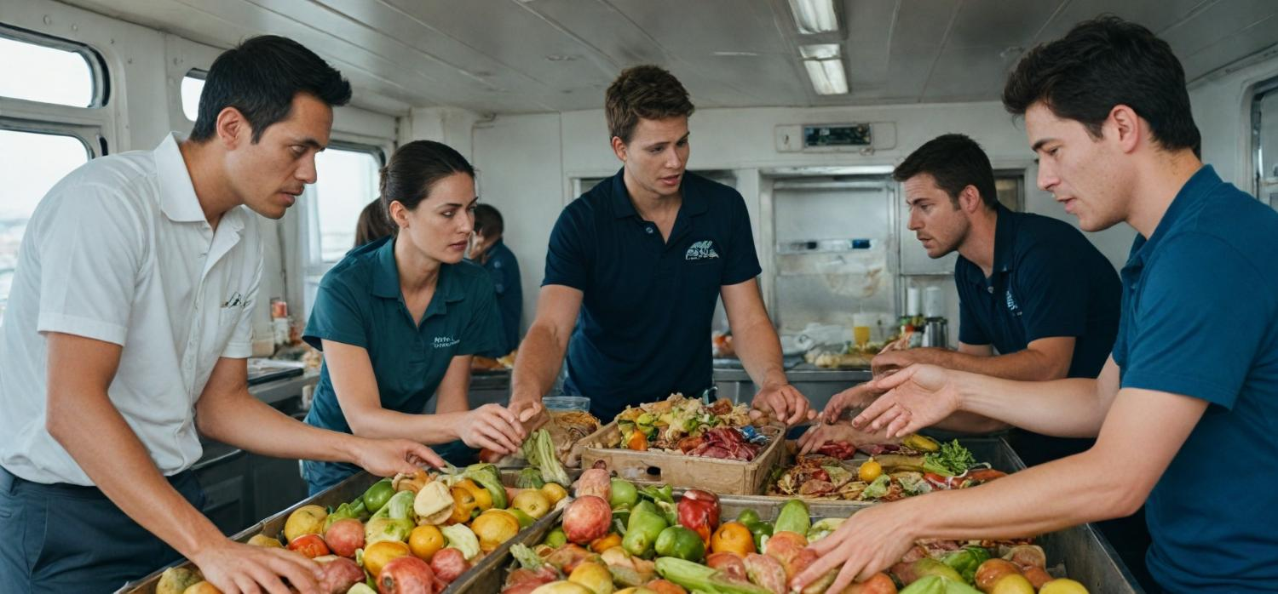
2.4. Interactive Group Activity
ONBOARD HEALTHY NUTRITION

Slide 56
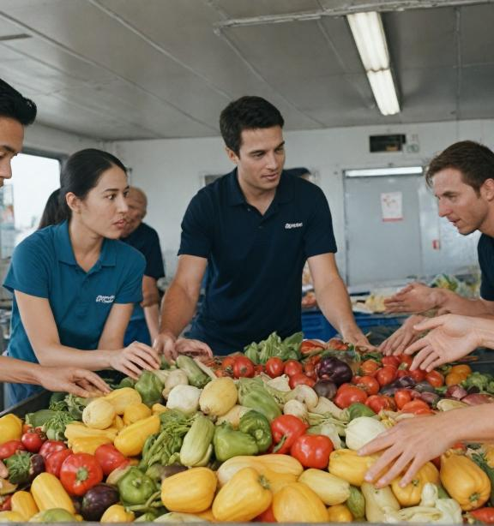
2.4. Interactive Group Activity
2.4. Interactive Group Activity
Participants collaborate to identify sustainability challenges and propose solutions for galleys on their types of ships
ONBOARD HEALTHY NUTRITION

Slide 57
2.4. Interactive Group Activity
The aim of this session is to encourage participants to use their knowledge and experience to identify sustainability challenges in the galleys of different ship types and to propose practical solutions to address these challenges. Collaboration and exchange of ideas among participants will be key components of the activity, with the aim of generating innovative and realistic strategies to improve sustainability on board.
ONBOARD HEALTHY NUTRITION

Slide 58
ASSESSMENT
Multiple Choice Questions (MCQs)
Why is continuous education on sustainability important for galley crews? Correct Answer: B
  To maintain food hygiene standards only
  To address unique sustainability challenges in different maritime environments
  To reduce workload on galley crews
  To comply with port customs regulations
  2. Why is monitoring important in sustainability training? Correct Answer: B
  To penalize staff for errors
  To evaluate the effectiveness of training programs and make improvements
  To reduce the number of training sessions
  To ensure galley crews follow the same menu daily
ONBOARD HEALTHY NUTRITION

Slide 59
ASSESSMENT
Short Answer Questions
The Need for Sustainability Training in Ship Galleys
Why is sustainability training important for galley crews working on different types of ships?
What are some unique sustainability challenges faced in maritime environments, such as cruise ships and cargo vessels?
2. Key Areas for Sustainability Training
How can proper food storage in limited galley spaces contribute to sustainability?
Describe two methods for segregating waste in a ship’s galley and explain their importance.
What are some practices for minimizing water and energy use in galley operations?
ONBOARD HEALTHY NUTRITION

Slide 60
ASSESSMENT
Case Study
Scenario:
You are the head chef on a cargo ship that is embarking on a 45-day voyage with a crew of 25. The ship has limited storage space, restricted access to fresh provisions during the trip, and strict international regulations for waste disposal at sea. Your goal is to implement sustainability practices in the galley to minimize food waste, conserve water and energy, and ensure compliance with maritime regulations.
Challenges:
Limited storage space requires efficient use of supplies.Fresh provisions will only be available at one stop midway through the voyage.Waste disposal at sea is regulated under MARPOL guidelines, requiring careful segregation of waste types.
Tasks:
Menu Planning:Outline a sustainable menu for the first two weeks, considering the crew’s dietary needs, available provisions, and the need to minimize waste.
Waste Management:Design a waste management system that includes segregation, recycling, and safe disposal of organic and hazardous waste.
ONBOARD HEALTHY NUTRITION

Slide 61
ASSESSMENT
Case Study
Conservation Practices:
Propose methods to reduce water and energy consumption in galley operations.
Sustainability Training:
Develop a short training plan for your galley team to ensure they understand and follow sustainable practices.
Questions:
How would you prioritize supplies to ensure the most perishable items are used first while maintaining variety in the menu?
What steps can you take to reuse leftovers and minimize spoilage during the voyage?
How will you ensure compliance with MARPOL regulations when managing waste in the galley?
What strategies can you implement to engage your crew in sustainability efforts throughout the voyage?
Expected Outcome:
Participants should present a detailed solution that highlights innovative strategies for waste reduction, efficient resource use, and crew engagement, tailored to the unique challenges of the maritime environment.
ONBOARD HEALTHY NUTRITION

Slide 62
ASSESSMENT
Group Discussion
Sustainability and Waste Management in Ship Galleys
Topic:
"Developing Practical Solutions for Sustainability Challenges in Ship Galleys“
Objective:
Facilitate a collaborative discussion to identify practical strategies for improving sustainability in ship galley operations, focusing on waste reduction, resource conservation, and compliance with maritime regulations.
Guiding Questions: Menu and Resource
Planning:
What methods can be used to minimize food waste through effective menu and portion planning?
How can limited storage space on ships be better utilized to prevent spoilage?
Waste Management:
What are the best practices for segregating and safely disposing of waste, including recyclables and hazardous materials, under MARPOL regulations?
ONBOARD HEALTHY NUTRITION

Slide 63
ASSESSMENT
How can waste be reused or repurposed to reduce environmental impact?
Sustainability Training:
What training techniques (e.g., hands-on workshops, drills, scenario-based training) are most effective for engaging galley crews in sustainability efforts?
How can crews be motivated to adopt and maintain sustainable habits over long voyages?
Continuous Improvement:
How can monitoring systems be implemented to track and improve sustainability practices in the galley?
What role does feedback from the crew play in refining sustainability efforts?
Format:
Introduction (5 minutes): Moderator introduces the topic and outlines the key challenges in ship galley sustainability.
ONBOARD HEALTHY NUTRITION

Slide 64
ASSESSMENT
Group Discussion (20–30 minutes):
Participants share experiences, propose solutions, and respond to the guiding questions.
Conclusion (5 minutes): The group summarizes key insights and actionable ideas.
Expected Outcomes:
Practical, implementable ideas for minimizing waste and conserving resources in ship galleys.
Enhanced understanding of the importance of sustainability training and compliance with regulations.
Collaborative solutions for overcoming maritime-specific sustainability challenges.
This discussion encourages critical thinking, teamwork, and the application of sustainability principles in real-world maritime contexts.
ONBOARD HEALTHY NUTRITION

Slide 65
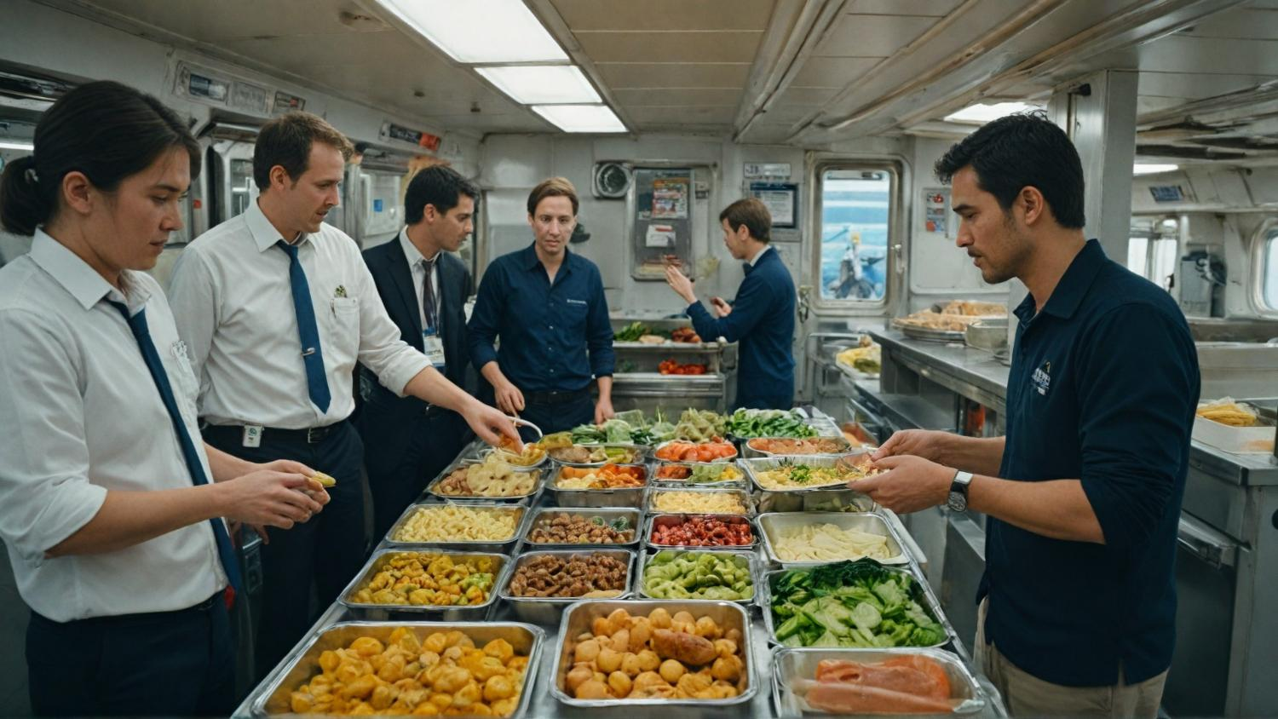
ASSESSMENT
ONBOARD HEALTHY NUTRITION

Slide 66
Course References
Demydyuk, G. V., Kaurav, R. P. S., Carlbäck, M., & Vejlgaard, H. (2024). From galley to gourmet: experience accounting perspective on the evolving dining choices of cruise passengers. Journal of Foodservice Business Research, 1-33.
Durlik, I., Miller, T., Kostecka, E., Łobodzińska, A., & Kostecki, T. (2024). Harnessing AI for Sustainable Shipping and Green Ports: Challenges and Opportunities. Applied Sciences, 14(14), 5994.
Shoaib, M., Zhang, S., & Ali, H. (2023). Assessment of sustainable green logistics enablers: A robust framework using fuzzy DEMATEL and ISM approach. International Journal of Environmental Science and Technology, 20(10), 11407-11426.
Dewan, M. H., & Godina, R. (2024). Unveiling seafarers' awareness and knowledge on energy-efficient and low-carbon shipping: A decade of IMO regulation enforcement. Marine Policy, 161, 106037.
Jang, Y. L., Jeong, J., Eo, S., Hong, S. H., & Shim, W. J. (2024). Occurrence and characteristics of microplastics in greywater from a research vessel. Environmental Pollution, 341, 122941.
ONBOARD HEALTHY NUTRITION

Slide 67
Course References
Baum-Talmor, P., & Şahin, Ç. E. (2024). Employment Practices, Cost Minimization, and Their Implications for Food Provisions and Seafarers’ Wellbeing on board Ships–A Qualitative Analysis. INQUIRY: The Journal of Health Care Organization, Provision, and Financing, 61
Yazdani, M., Ariza-Montes, A., Arjona-Fuentes, J. M., & Radic, A. (2024). Cruise hotel sustainable supplier management using a grey-based decision support framework. Journal of Travel & Tourism Marketing, 41(4), 538-558.
Nittari, G., Gibelli, F., Bailo, P., Sirignano, A., & Ricci, G. (2024). Factors affecting mental health of seafarers on board merchant ships: a systematic review. Reviews on environmental health, 39(1), 151-160.
De Beukelaer, C. (2023). What is wrong with the shipping industry?. In Trade winds (pp. 48-74). Manchester University Press.
Kizielewicz, J. (2024). The commitment of global cruise shipping companies to sustainable development. Current Issues in Tourism, 27(11), 1683-1699.
ONBOARD HEALTHY NUTRITION

