Slide 1








MARitime Soft Skills for Onboard Healthy Nutrition and CULinary Arts in Seagoing Services – CUL-MAR-Skills
KA220-VET - Cooperation partnerships in vocational education and training
2023-1-RO01-KA220-VET-000156711
ONBOARD HEALTHY NUTRITION
COURSE 1
Scope and Importance of Sustainability in the Galleys.
Disclaimer: “Funded by the European Union. Views and opinions expressed are however those of the author(s) only and do not necessarily reflect those of the European Union or the ANPCDEFP. Neither the European Union nor the ANPCDEFP can be held responsible for them”

Slide 2
Learning outcomes of the course
Upon successful completion of the course, participants will acquire the following knowledge and skills:
Understand sustainability in ship galleys: They will be able to define and explain the principles of sustainability and their relevance to galleys of different ship types, based on global environmental challenges (items 1.1 and 1.2).
Assess impacts and challenges: They will assess the environmental and operational challenges related to sustainability, including sourcing, waste management and limited resources on different ship types (item 1.3).
Application of good practice: They will apply examples from international regulations, such as MARPOL, and good sustainability practices in ships' galleys while developing process improvements (item 1.4).
Collaborative problem solving skills: They will actively participate in discussions, sharing experiences and proposing innovative solutions for sustainability in the specific context of the maritime industry (item 1.5).
These outcomes will provide participants with the opportunity to apply what they have learned to improve sustainability in shipboard cooking operations.
NAVAL COMMUNICATIONS
ONBOARD HEALTHY NUTRITION

Slide 3
Content of the course
1. Scope and Importance of Sustainability in the Galleys
1.1. Introduction to Sustainability in Galleys
Definition and understanding of sustainability in the context of galleys on various ships (cargo, cruise ships, ferries, military vessels, etc.)
Overview of global environmental challenges faced by maritime industries
1.2. Significance of Sustainability in Ship Galley Operations
Environmental impacts specific to the maritime industry
Role of galley teams (chefs, kitchen staff) in contributing to a ship's overall sustainability strategy
Importance of sustainability for crew health and operational efficiency on long voyages
1.3. Sustainability Challenges Across Different Types of Ships
Differences in provision sourcing and waste management between types of ships (cargo, cruise, military, etc.)
Impact of long voyages, space constraints, and limited access to fresh supplies
Sustainability challenges faced by chefs working with limited storage and varying levels of provisioning access
1.4. Global Perspective: Sustainability Practices Across the Shipping Industry
Examples of best practices in maritime sustainability from various ship types
How international regulations (such as MARPOL) shape sustainable practices in ship galleys
1.5. Discussion
Open dialogue on sustainability challenges participants have encountered in different types of ship galleys
Brainstorming potential improvements
ONBOARD HEALTHY NUTRITION

Slide 4

1. Concept of Sustainability Management
This section will explore the importance of sustainability in the galleys of different types of ships including merchant ships, cruise liners, military vessels and ferries. The scope of sustainable practices that can be implemented in different maritime environments will be explored, as well as ways in which the negative environmental effects of galley operations can be minimized.
ONBOARD HEALTHY NUTRITION

Slide 5

1. Concept of Sustainability Management
This section will explore the importance of sustainability in the galleys of different types of ships including merchant ships, cruise liners, military vessels and ferries. The scope of sustainable practices that can be implemented in different maritime environments will be explored, as well as ways in which the negative environmental effects of galley operations can be minimized.
ONBOARD HEALTHY NUTRITION

Slide 6
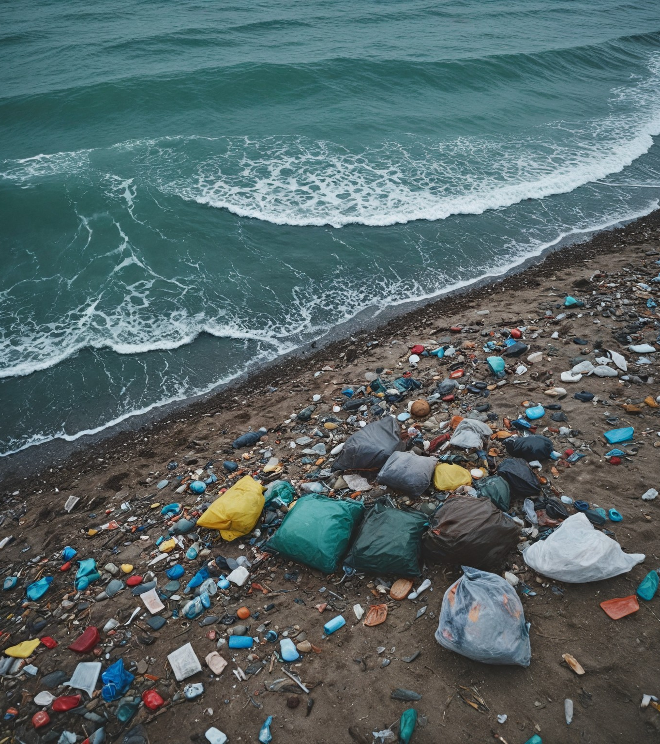
1. Concept of Sustainability Management
Climate change is the biggest and largest market failure in the history of the world.
Sir Nicholas Stern (British economist)
ONBOARD HEALTHY NUTRITION

Slide 7
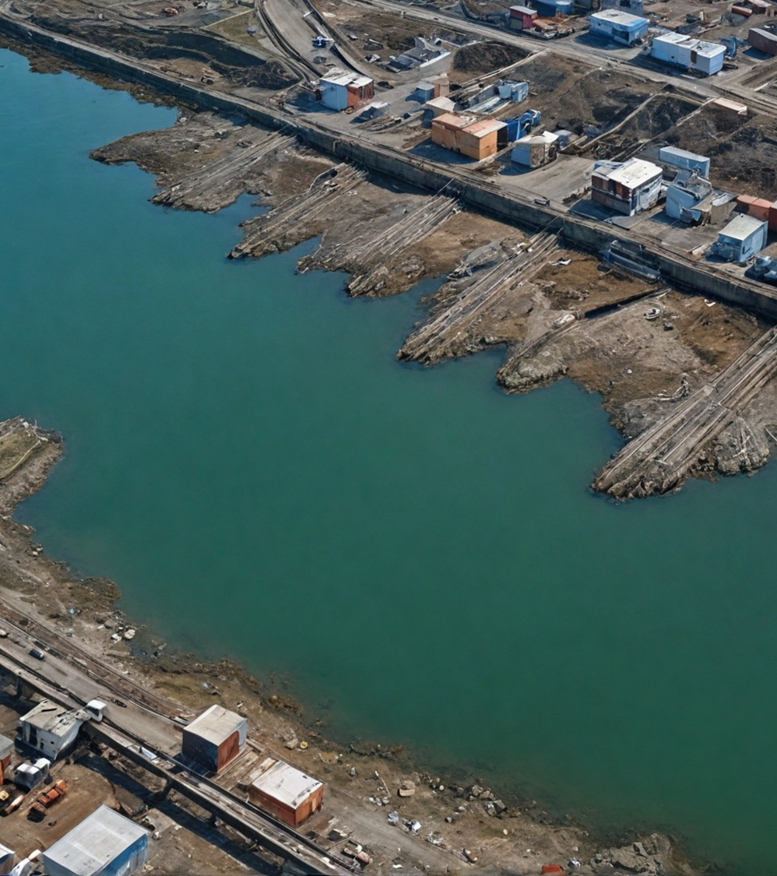
1. 1. Introduction to sustainability in galleys
Defining and understanding sustainability in the context of galleys.
Sustainability can be defined as the management of resources and processes that seeks to minimise negative impacts on the environment, social structures and economies while maintaining a balance between the needs of current and future generations. In the context of maritime operations, sustainability involves using natural resources in a way that reduces pollution, reduces emissions of harmful substances and improves the efficiency of the materials used.
ONBOARD HEALTHY NUTRITION

Slide 8
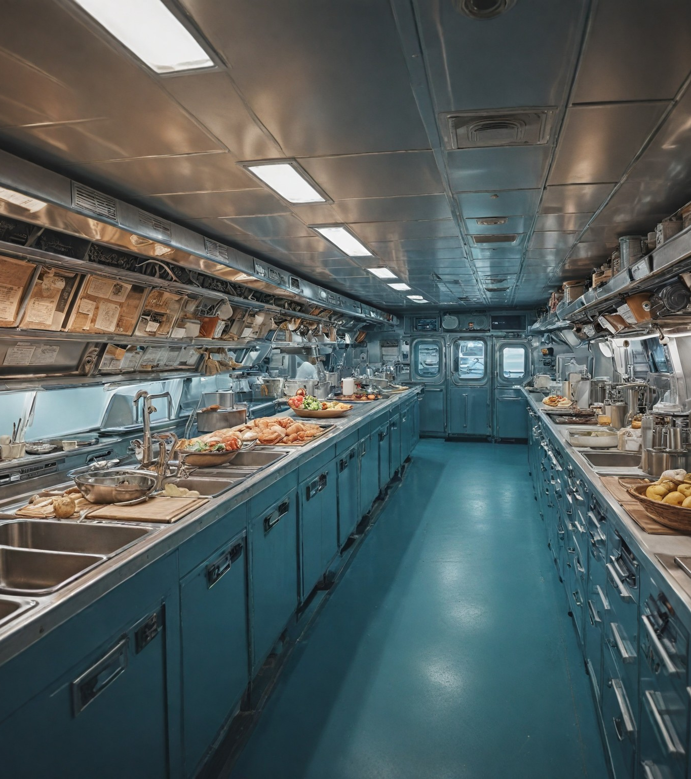
1. 1. Introduction to sustainability in galleys
Ship galleys play a central role in maritime operations as they provide the necessary food and support for crew and passengers. Although galleys are typically small and with limited resources for storage and operation, they generate a significant amount of waste, including food scraps, plastics, packaging and harmful substances.
ONBOARD HEALTHY NUTRITION

Slide 9
1. 1. Introduction to sustainability in galleys
Sustainability opportunities in the galleys cover several key areas:
Reduce food waste - Camps can introduce food scrap recycling and composting systems to reduce the amount of organic waste that is disposed of at sea or on land.
Designing menus based on the needs of the crew and guests, as well as careful portion planning, can contribute to a significant reduction in food waste.
ONBOARD HEALTHY NUTRITION

Slide 10
1. 1. Introduction to sustainability in galleys
Water and energy management - Ships are limited in the supply of fresh water and energy resources.
Optimal water management in galleys includes water recycling technologies, such as grey water recycling systems, and minimizing water consumption for washing and cooking. Similarly, energy efficiency can be achieved through the use of energy-saving appliances and technologies.
ONBOARD HEALTHY NUTRITION

Slide 11
1. 1. Introduction to sustainability in galleys
Minimise plastic waste
Plastic is one of the most common types of waste on ships, being used mainly for packaging food and products. Sustainable practices include the replacement of plastic packaging with biodegradable or recyclable materials, and the establishment of policies to minimize the use of plastic in galleys.
ONBOARD HEALTHY NUTRITION

Slide 12
1. 1. Introduction to sustainability in galleys
Using local and seasonal produce - Where possible, sourcing locally produced and seasonal food on board can significantly reduce the carbon footprint associated with transporting produce from distant destinations.
This is especially important for cruise ships, which often stop in different ports where they can source fresh and environmentally responsible produce.
ONBOARD HEALTHY NUTRITION

Slide 13
1. 1. Introduction to sustainability in galleys
Responsible management of chemicals and cleaning agents
Cambias require the use of various cleaning and disinfecting agents that can be harmful to the environment, especially when disposed of at sea. The use of environmentally friendly products and their proper storage and disposal is an important part of any ship's sustainable practices.
ONBOARD HEALTHY NUTRITION

Slide 14
1. 1. Introduction to sustainability in galleys
Each of these practices requires not only good planning and organization, but also specialized staff training to ensure that processes are carried out efficiently and in accordance with international standards and regulations.
ONBOARD HEALTHY NUTRITION

Slide 15
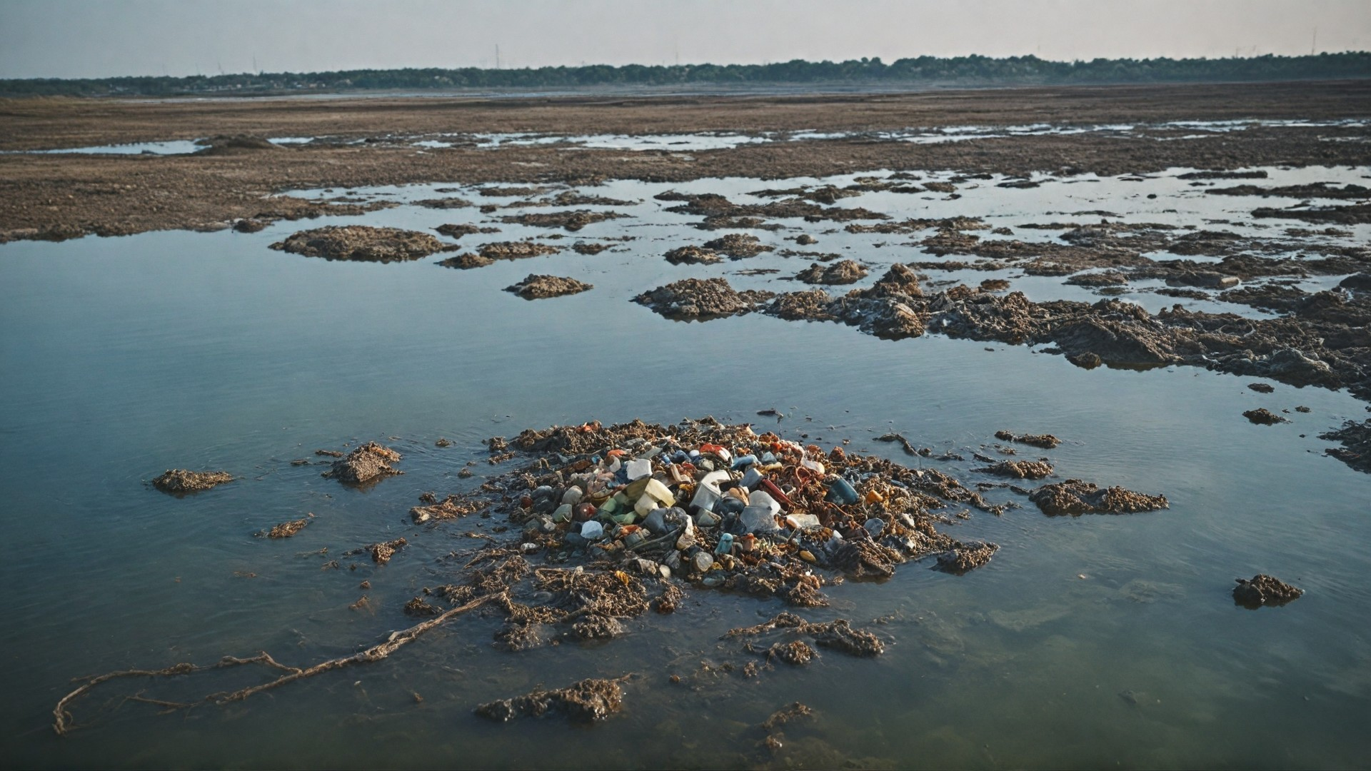
1. 1.2. Introduction to sustainability in galleys
ONBOARD HEALTHY NUTRITION

Slide 16
1.1.2. Overview of the global environmental challenges facing the maritime industries
A new study reveals that poultry eggs contain on average 40 times higher levels of lead (heavy metals) than commercial eggs - from hens raised in controlled conditions on farms. https://doi.org/10.1016/j.envpol.2022.119798
(science experiment )
ONBOARD HEALTHY NUTRITION

Slide 17
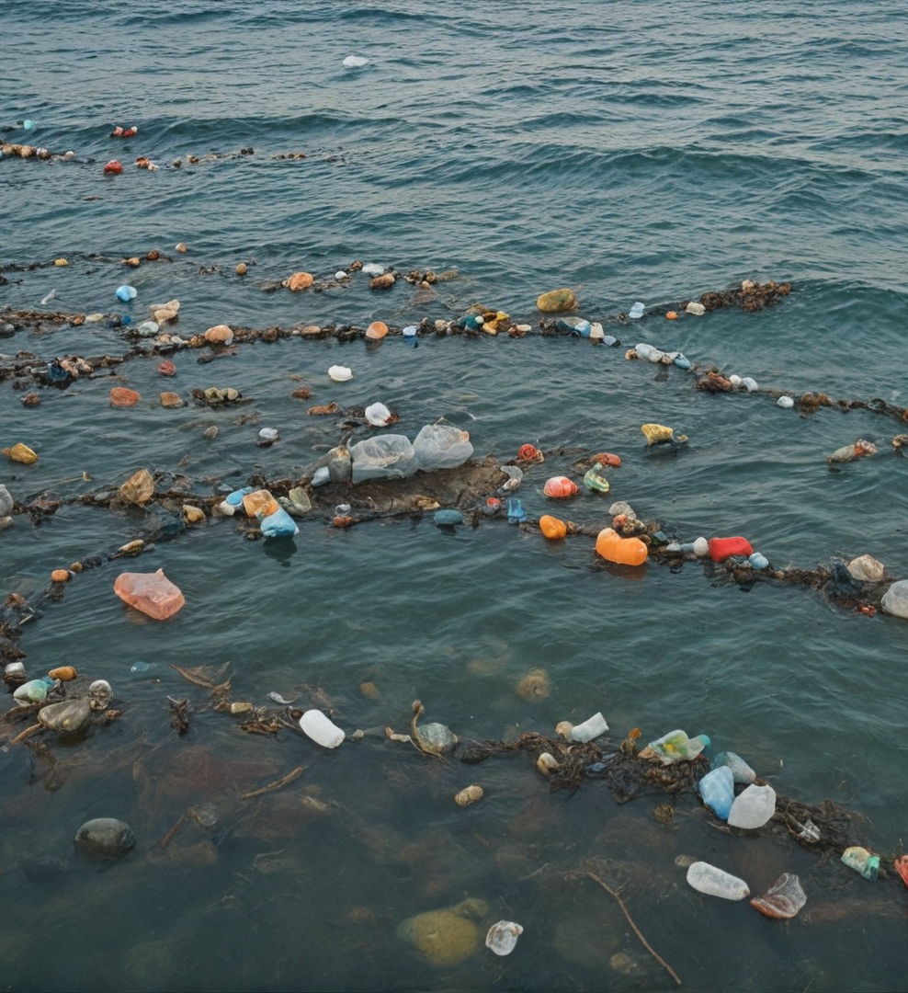
1. 1.2. Overview of the global environmental challenges facing the maritime industries
The maritime industry, which encompasses merchant ships, cruise liners, ferries, military vessels as well as fishing and cargo vessels, is of enormous importance to the world economy. As world trade grows and sea travel increases, it is increasingly clear that the environmental impact of this sector is significant.
International environmental challenges related to shipping range from marine pollution to global warming and the depletion of natural resources.
ONBOARD HEALTHY NUTRITION

Slide 18
1.1.3. Key environmental challenges
Key environmental challenges
1. Polluting the oceans with waste and plastic
One of the most serious challenges facing the maritime industry is waste management. Every day, millions of tonnes of plastic waste and other non-degradable materials end up in the oceans, with a significant proportion coming from shipping. Plastic packaging used in galleys to store food and other products often ends up at sea, where it poses a threat to marine ecosystems.
ONBOARD HEALTHY NUTRITION

Slide 19
1.1.3. Key environmental challenges
Key environmental challenges
2. Depletion of natural resources
The maritime industry consumes significant amounts of resources, including fuel, water and food. Resource consumption on ships is intense, especially on long voyages where provisions need to be provided for large crews or tourists for extended periods of time. The depletion of natural resources is a global problem that is getting worse every year.
ONBOARD HEALTHY NUTRITION

Slide 20
1.1.3. Key environmental challenges
One way to reduce resource use is by optimising water consumption in galleys. For example, when cleaning fruit and vegetables, a water reuse technique can be used, first using the water for washing and then for cleaning the floor. In addition, modern ship dishwashers are designed to consume a minimal amount of water and energy, making them an important tool in sustainable resource management on board.
ONBOARD HEALTHY NUTRITION

Slide 21
1.1.3. Key environmental challenges
3. Air pollution and greenhouse gas emissions
Shipping is a significant source of carbon emissions, contributing around 2.5% of global CO2 emissions. The fuels used for ships' engines are often high in sulphur, which also contributes to air pollution. The maritime industry is under pressure to reduce its carbon footprint by switching to cleaner fuels and optimising energy consumption.
ONBOARD HEALTHY NUTRITION

Slide 22
1.1.3. Key environmental challenges
3. Air pollution and greenhouse gas emissions
Example: Energy efficiency in galleys can be increased by using energy-saving appliances. For example, cookers and ovens on ships can be replaced with induction hobs, which use less energy and heat up faster. In addition, clever menu planning that includes foods that cook faster or at lower temperatures can also reduce energy consumption.
ONBOARD HEALTHY NUTRITION

Slide 23
1.1.3. Key environmental challenges
4. Water pollution by chemicals and wastewater
Chemicals used on ships for cleaning, maintenance and cooking also pose a serious threat to the oceans. Cleaning products, cooking grease and galley wastewater can enter seawater if not handled properly. This pollution causes serious environmental damage and disrupts the balance of marine ecosystems.
ONBOARD HEALTHY NUTRITION

Slide 24
1.1.3. Key environmental challenges
Example: Large quantities of oils and fats are often used in cooking in ship galleys. To reduce grease pollution, ships can implement a system to recycle used oils, which can then be used to produce biofuels. In addition, switching to environmentally friendly cleaning products reduces chemical pollution in the water.
ONBOARD HEALTHY NUTRITION

Slide 25
1.1.3. Key environmental challenges
Unreasonable consumption and lack of sustainability in the sourcing of products
On ships, especially cruise liners and cargo ships, there is a practice of sourcing large quantities of food and goods from different parts of the world. This process not only increases the carbon footprint associated with transporting goods, but often does not support the local economy and sustainable production.
ONBOARD HEALTHY NUTRITION

Slide 26
1.1.3. Key environmental challenges
Example: instead of importing large quantities of food from remote areas, galleys can encourage the use of local and seasonal produce from the ports where they call. This not only reduces CO2 emissions but also supports local producers. For example, on cruise ships visiting Mediterranean ports, it is possible to buy fresh fish and seafood from local fishermen instead of importing it from afar.
ONBOARD HEALTHY NUTRITION

Slide 27
1.1.3. Key environmental challenges
Global initiatives to tackle environmental challenges
Various international organizations and governments have put in place regulations and guidelines to minimize the environmental damage caused by the maritime industry. These include:
International Convention for the Prevention of Pollution from Ships (MARPOL) - This convention regulates various aspects of marine pollution, including sewage, plastics, chemicals and emissions from ship engines.
ONBOARD HEALTHY NUTRITION

Slide 28
1.1.3. Key environmental challenges
UN Sustainable Development Agenda - The UN Sustainable Development Goals (SDGs) promote greener and more sustainable shipping practices as part of a global strategy to reduce marine and climate pollution.
Plastic reduction initiatives - Various programmes, such as Plastic Free Seas, encourage ships to reduce their use of plastic products and switch to recyclable and biodegradable alternatives.
ONBOARD HEALTHY NUTRITION

Slide 29
1.1.3. Key environmental challenges
Global Environmental Challenges in the Maritime Industry demonstrates how specific practices in galleys can contribute to minimising these issues. Sustainable resource management, optimisation of energy consumption and waste reduction in galleys can make a significant contribution
ONBOARD HEALTHY NUTRITION

Slide 30
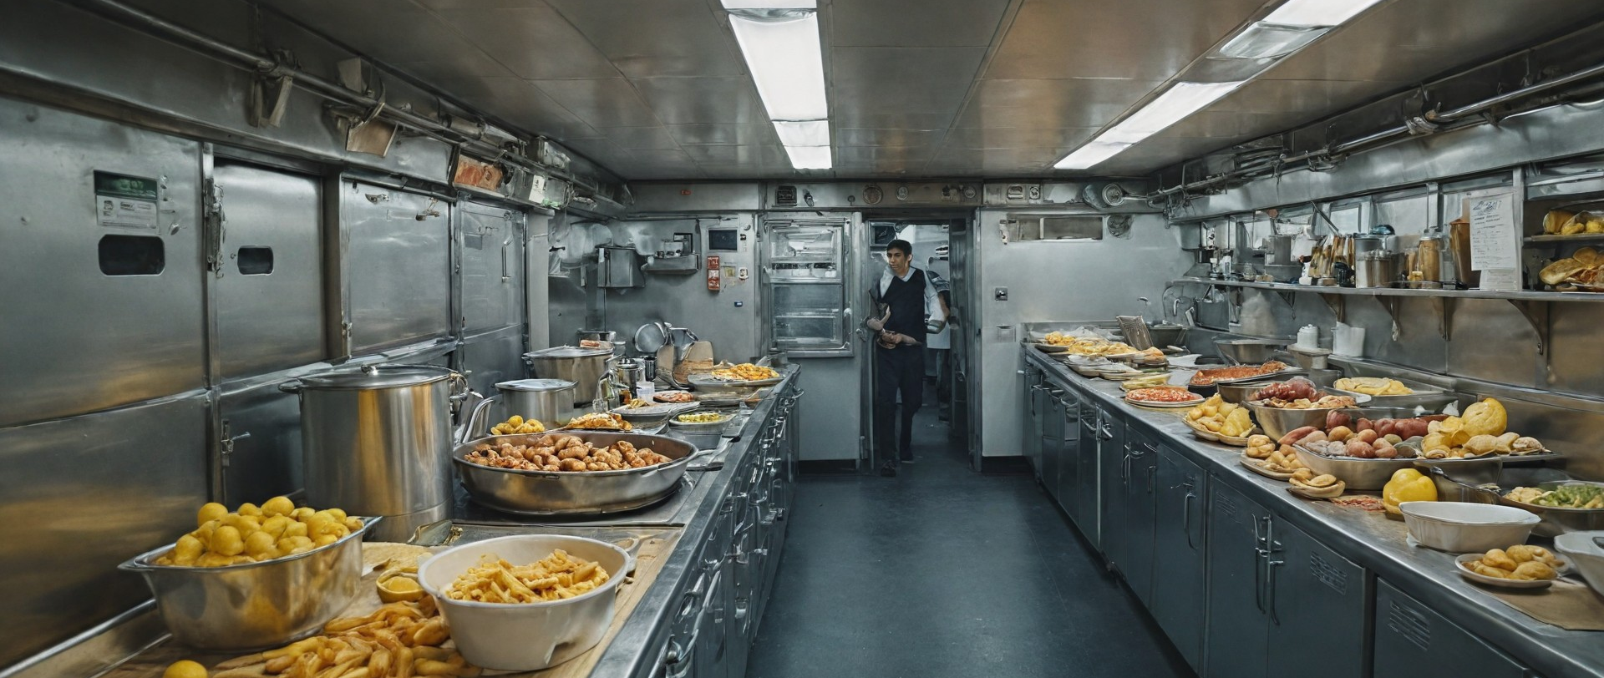
1.2. The importance of sustainability in ships' galley operations
ONBOARD HEALTHY NUTRITION

Slide 31
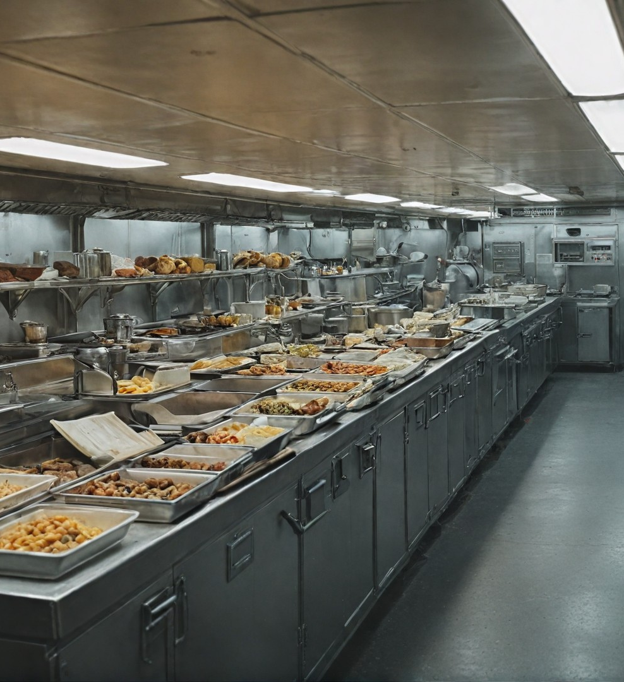
1.2. The importance of sustainability in ships' galley operations
The maritime industry faces many environmental challenges related to the day-to-day operation of ships and especially galleys. Although ships' galleys are critical to maintaining the health and well-being of crews and passengers, they also generate significant amounts of waste and consume resources that contribute to environmental degradation.
ONBOARD HEALTHY NUTRITION

Slide 32
1.2. The importance of sustainability in ships' galley operations
1.2.1. Food waste
Food waste is among the most serious environmental problems in the maritime industry. Large quantities of food are often prepared in ships' galleys, especially on cruise liners that serve hundreds or thousands of guests and crew. Inadequate portion planning and inaccurate provisioning management can lead to excess food that is then thrown away. Food waste, if not properly managed, can end up in the ocean, leading to pollution and disruption of the marine ecosystem.
ONBOARD HEALTHY NUTRITION

Slide 33
1.2. The importance of sustainability in ships' galley operations
Example:
On cruise ships, which often have buffets available, much of the unused food is thrown away, even though it is edible. To reduce this problem, cruise companies can implement composting or food scrap reuse technologies through donations to local communities in ports.
ONBOARD HEALTHY NUTRITION

Slide 34
1.2. The importance of sustainability in ships' galley operations
Example:
To reduce plastic waste, galleys can switch to using biodegradable or recyclable packaging. For example, reusable containers or compostable paper could be used instead of single-use plastic containers for food storage.
ONBOARD HEALTHY NUTRITION

Slide 35
1.2. The importance of sustainability in ships' galley operations
Example:
To reduce plastic waste, galleys can switch to using biodegradable or recyclable packaging. For example, reusable containers or compostable paper could be used instead of single-use plastic containers for food storage.
ONBOARD HEALTHY NUTRITION

Slide 36
1.2. The importance of sustainability in ships' galley operations
1.2.2 The role of the galley team (chefs, kitchen staff) in contributing to the overall sustainability strategy of the ship
Chefs and kitchen staff play a central role in implementing sustainable practices on ships. Not only do they ensure quality and safe food for crew and passengers, but they also have a responsibility to minimise the environmental impact of their operations.
ONBOARD HEALTHY NUTRITION

Slide 37
1.2. The importance of sustainability in ships' galley operations
Planning menus and portions
Effective menu planning can reduce food waste and ensure that the quantities of food prepared are adequate for the crew's needs. Chefs can use data on passenger and crew preferences to plan food portions more accurately and avoid unnecessary cooking.
ONBOARD HEALTHY NUTRITION

Slide 38
1.2. The importance of sustainability in ships' galley operations
Food waste management
The galley team can implement sustainable waste management practices such as recycling, composting and reusing food scraps. For example, vegetable peelings and meat scraps can be used to make broths or sauces instead of being thrown away.
ONBOARD HEALTHY NUTRITION

Slide 39
1.2. The importance of sustainability in ships' galley operations
Food waste management
Example: when making soups and broths, cooks can use leftover vegetables and bones that would otherwise be thrown away. This not only reduces waste, but also optimizes the use of the products on board.
ONBOARD HEALTHY NUTRITION

Slide 40
1.2. The importance of sustainability in ships' galley operations
Staff training
It is important that the entire galley team is trained in sustainable practices so that every member can contribute to reducing waste and optimizing resources.
Regular training and awareness of new technologies and regulations will improve the sustainability of galleys.
ONBOARD HEALTHY NUTRITION

Slide 41
1.2. The importance of sustainability in ships' galley operations
Example:
Holding regular workshops and training on topics such as food waste reduction, water and energy efficiency will prepare the galley team to implement sustainability best practices.
ONBOARD HEALTHY NUTRITION

Slide 42
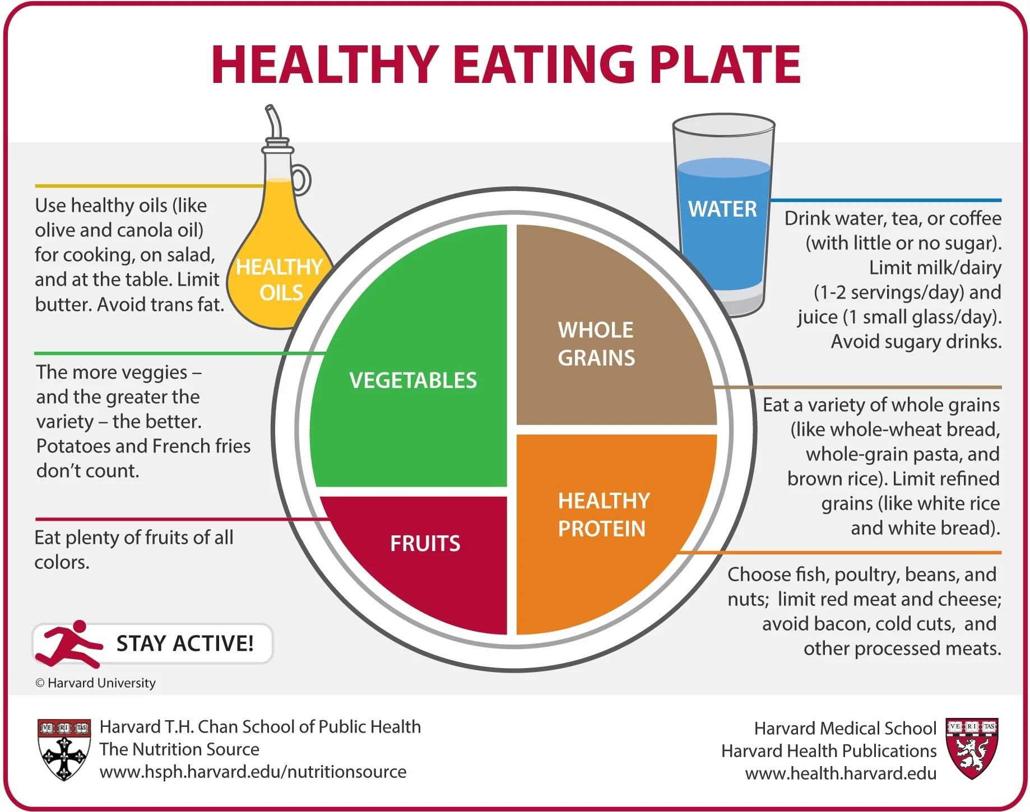
1.2. The importance of sustainability in ships' galley operations
1.2.3. The importance of resilience for crew health and operational efficiency on long voyages
Sustainable practices in ships' galleys not only help protect the environment, but also directly impact the health and well-being of the crew, as well as the efficiency of ship operations.
Maintaining a healthy diet
On long journeys it is essential that the crew receives a balanced and healthy diet. Sustainable food management ensures that products are used efficiently without compromising their quality and nutritional value.
ONBOARD HEALTHY NUTRITION

Slide 43

1.2. The importance of sustainability in ships' galley operations
ONBOARD HEALTHY NUTRITION

Slide 44
1.2. The importance of sustainability in ships' galley operations
Half of each meal should include vegetables and fruits to provide vitamins, minerals and fiber.
A quarter of the diet should be made up of whole grains such as barley and quinoa, which help maintain stable blood sugar. The remaining quarter should be a source of protein, such as fish, chicken or legumes.
It is also recommended to use healthy oils such as olive oil in small amounts, and to prefer water, tea or coffee over sugary drinks.
ONBOARD HEALTHY NUTRITION

Slide 45
1.2. The importance of sustainability in ships' galley operations
To ensure a variety of provisions on ships, it is important to put in place a system that offers a variety of food options, including for people with certain dietary needs and restrictions. This contributes to improving the social sustainability of provisioning by providing opportunities for healthier and more balanced diets.
To support the health and well-being of crews, Harvard University's Healthy Eating Plate recommendations can serve as a useful model.
ONBOARD HEALTHY NUTRITION

Slide 46
1.2. The importance of sustainability in ships' galley operations
Preparing meals with fresh, local and seasonal produce provides the crew with a variety of nutrients to maintain their health and energy during long voyages. Cooks can plan menus that include vitamin-rich fruits and vegetables with minimal use of canned or processed foods, which often have lower nutritional value.
ONBOARD HEALTHY NUTRITION

Slide 47
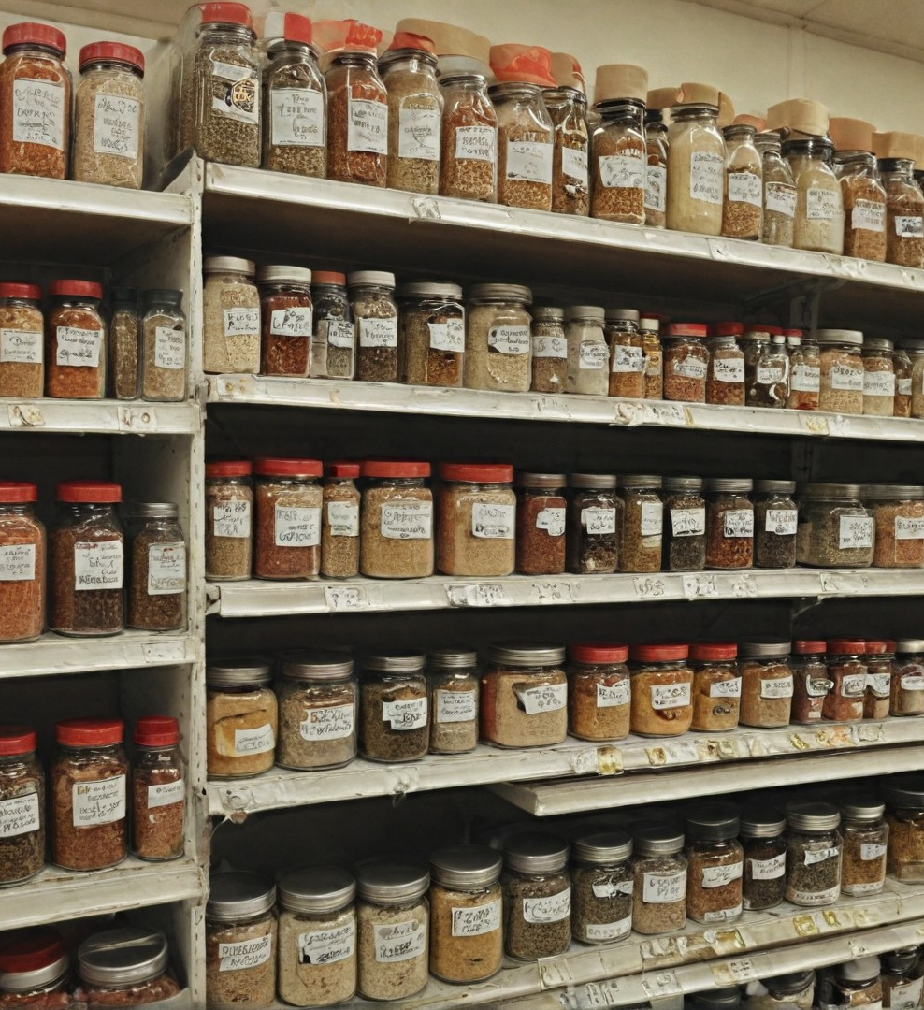
1.2. The importance of sustainability in ships' galley operations
Optimisation of resources and extension of ship autonomy
On long voyages, especially when the ship is unable to refuel with fresh food and water, sustainable practices in the galley play a key role in efficient resource management. Skilful planning and management of food supplies, water and energy help to extend the time a ship can remain autonomous.
ONBOARD HEALTHY NUTRITION

Slide 48
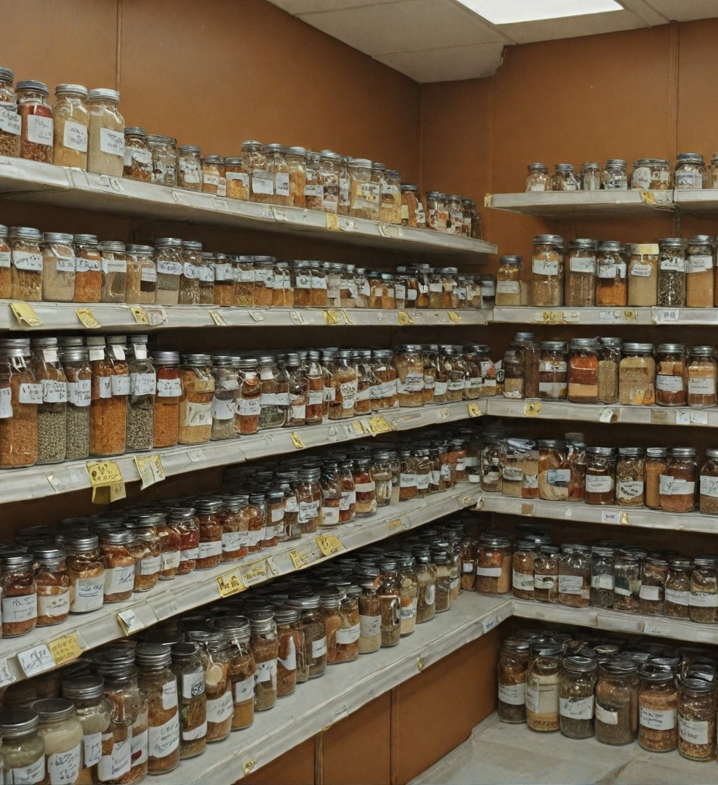
1.2. The importance of sustainability in ships' galley operations
Preventing disease and improving hygiene
Effective food and waste management in galleys has a direct impact on crew health. Galley cleanliness and proper food storage are essential to prevent food poisoning and the spread of disease. Sustainable practices, such as proper waste separation and recycling, also reduce the risk of spreading harmful bacteria.
ONBOARD HEALTHY NUTRITION

Slide 49
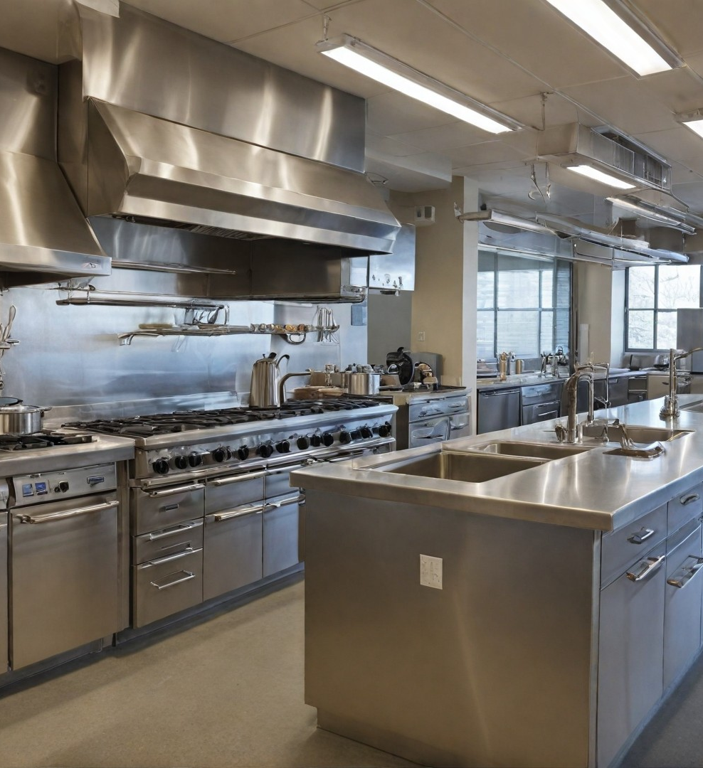
Preventing disease and improving hygiene
Effective food and waste management in galleys has a direct impact on crew health. Galley cleanliness and proper food storage are essential to prevent food poisoning and the spread of disease. Sustainable practices, such as proper waste separation and recycling, also reduce the risk of spreading harmful bacteria.
ONBOARD HEALTHY NUTRITION

Slide 50
Preventing disease and improving hygiene
Implementing strict hygiene standards, such as regular cleaning with environmentally friendly disinfectants, helps maintain a safe working environment in the galley. This is especially important on ships where limited space and long hours of work increase the risk of contamination and disease.
ONBOARD HEALTHY NUTRITION

Slide 51

1.3 Sustainability Challenges Across Different
ONBOARD HEALTHY NUTRITION

Slide 52
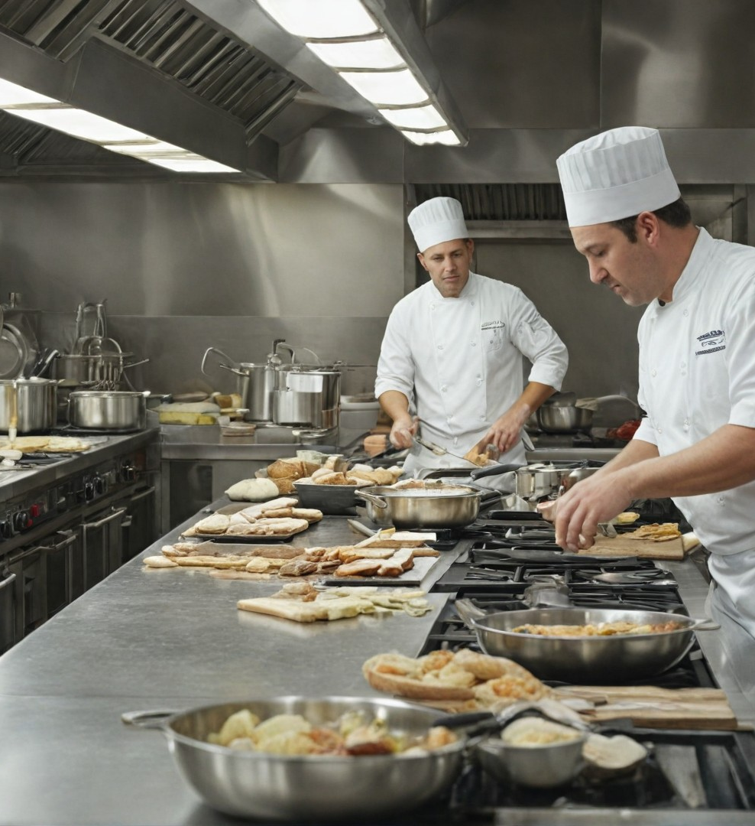
1.3 Sustainability Challenges Across Different
1.3 Sustainability Challenges Across Different Types of Ships
- Differences in provision sourcing and waste management between types of ships (cargo, cruise, military, etc.)
- Impact of long voyages, space constraints, and limited access to fresh supplies
Sustainability challenges faced by chefs working with limited storage and varying levels of provisioning access
ONBOARD HEALTHY NUTRITION

Slide 53
1.3 Sustainability Challenges Across Different
The marine industry encompasses a variety of ship types, each with their own specific challenges related to provisioning, waste management and sustainability of galley operations. Each type of ship - be it cargo, cruise, military or fishing - has different requirements and constraints that impact how sustainability is maintained on board.
ONBOARD HEALTHY NUTRITION

Slide 54
1.3 Sustainability Challenges Across Different
1.3.1. Differences in provisioning and waste management for different ship types (cargo, cruise, military, etc.)
Cargo ships. Cargo ships, which mainly transport goods and materials, have small crews compared to cruise ships, but still require sufficient provisions for long voyages. The main challenge here is ensuring sufficient food and water for long periods without access to new supplies. Cargo ships often pass through different climate zones, which can affect food storage, especially if refrigeration systems are not fully effective.
ONBOARD HEALTHY NUTRITION

Slide 55
1.3 Sustainability Challenges Across Different
Provisioning: cargo ships usually rely on frozen and canned products, as fresh supplies are only possible on arrival in port. This limits the options for including fresh fruit and vegetables on the menu.
Waste management: as there is usually less food waste on cargo ships due to the small crew, the main waste is related to packaging used to store the food. Managing this waste effectively is a challenge, especially when ships are at sea for extended periods.
ONBOARD HEALTHY NUTRITION

Slide 56
1.3 Sustainability Challenges Across Different
Cruise ships. Cruise ships, which carry hundreds to thousands of passengers, are under enormous pressure in terms of provisions and waste management. Guests expect a high level of service and a variety of food, which increases both the demand for provisions and the amount of waste.
Provisioning: Cruise ships regularly call at various ports, enabling them to stock up on fresh produce, including local fruit, vegetables and fish.
ONBOARD HEALTHY NUTRITION

Slide 57
1.3 Sustainability Challenges Across Different
Cruise ships.
However, the need for a constant variety of food leads to the use of large quantities of canned, frozen and imported products, which increases the carbon footprint.
Waste management: the large number of passengers leads to huge amounts of waste, including food scraps and packaging. Cruise ships must implement sophisticated waste management systems including recycling, composting and proper waste disposal according to international standards such as MARPOL
ONBOARD HEALTHY NUTRITION

Slide 58
1.3 Sustainability Challenges Across Different
Warships. Warships, such as battleships or submarines, have unique challenges related to provisioning and sustainability. These ships must often remain at sea for extended periods of time, which limits them in terms of access to new supplies.
Provisioning: warships typically rely on well-planned provisioning that includes large quantities of long-lasting foods such as canned, dehydrated and frozen items.
ONBOARD HEALTHY NUTRITION

Slide 59
1.3 Sustainability Challenges Across Different
Unlike cruise ships, warships don't have the luxury of stocking up on fresh food during missions, which necessitates more rigorous planning of food supplies.
Waste management: waste management on military ships is particularly challenging due to space constraints and strict hygiene requirements. These ships often use waste reduction systems, such as garbage reduction and strict control of food waste, to reduce the load on storage systems.
ONBOARD HEALTHY NUTRITION

Slide 60
1.3 Sustainability Challenges Across Different
1.3.2. Impact of sailing duration, space constraints and limited access to fresh provisions
Long and continuous sailings and limited access to fresh produce
One of the main factors that influence the stability of galleys on different ships is voyage duration. On long ocean voyages, when access to new supplies is limited or completely absent, cooks must work with available supplies, which often means frozen, canned or dehydrated products. This poses additional challenges for nutritious food preparation and resource management.
ONBOARD HEALTHY NUTRITION

Slide 61
1.3 Sustainability Challenges Across Different
Example: on a cargo ship making a transatlantic crossing, the crew may be without access to fresh provisions for several weeks. This means chefs need to plan menus carefully, making the best use of long-life products and optimising the use of existing resources.
Storage space restrictions
Ship storage space is very limited, especially on military and fishing vessels. This necessitates the use of compact storage solutions and careful inventory management
ONBOARD HEALTHY NUTRITION

Slide 62
1.3 Sustainability Challenges Across Different
Lack of sufficient space can make it difficult to store a variety of produce and fresh foods, making it even more important to use available provisions efficiently.
Example: on a submarine, where space is extremely limited, chefs rely heavily on compact, long-lasting foods and use creative ways to prepare a variety of dishes with minimal supplies.
ONBOARD HEALTHY NUTRITION

Slide 63
1.3 Sustainability Challenges Across Different
Shipping challenges
Some ships, especially cruise liners, have the ability to refuel during a voyage when calling at different ports. However, it is often the case that there are supply bottlenecks due to logistical problems, weather conditions or lack of quality products in local markets. This leads to the need for additional planning and management of provisions.
ONBOARD HEALTHY NUTRITION

Slide 64
1.3 Sustainability Challenges Across Different
Example: a cruise ship that stops at a small island may not be able to find the amount of fresh produce it needs. In this case, chefs must use available resources and adapt to the situation while maintaining quality standards.
ONBOARD HEALTHY NUTRITION

Slide 65
1.3 Sustainability Challenges Across Different
1.3.3. Challenges for cooks when working with limited storage space and different levels of access to provisions
Limited storage space
Storage space on board ships is one of the biggest challenges for chefs. Food must be stored properly to keep it fresh and safe to eat. In the absence of sufficient storage space, especially smaller vessels such as military vessels or fishing boats, chefs often have to be extremely creative and well-organized to optimize the available space.
ONBOARD HEALTHY NUTRITION

Slide 66
1.3 Sustainability Challenges Across Different
This requires careful planning of provisions, stock management skills and ingenuity in food storage.
Example: on small fishing vessels that spend long periods at sea, chefs often rely on precisely planned stocks that must take up minimal space. They may use methods such as dehydrating foods to reduce the volume of products, or freezing large quantities of meat and fish in small freezers, while having to comply with safe storage requirements.
ONBOARD HEALTHY NUTRITION

Slide 67
1.3 Sustainability Challenges Across Different
Unevenness of supply
On a variety of ships, especially those that sail in remote areas or don't have frequent port calls, cooks can face unpredictable supplies of provisions. Sometimes ships may not receive scheduled deliveries on time or the products delivered may not meet quality standards. This requires galley teams to adapt quickly and improvise when preparing the menu.
ONBOARD HEALTHY NUTRITION

Slide 68
1.3 Sustainability Challenges Across Different
Example: warships often face irregular supplies of fresh food during missions. Cooks must adapt to this by using pre-frozen and canned products, but they also need to know how to maintain variety on the menu and preserve the nutritional value of meals to keep crew morale and health up.
ONBOARD HEALTHY NUTRITION

Slide 69
1.3 Sustainability Challenges Across Different
Inventory management and menu planning skills
Chefs on ships must not only be good cooks, but also skilled logisticians. They must plan food supplies so that they are sufficient for all crew and passengers without creating a surplus that could lead to food waste. In addition, they must manage the available products in view of space constraints and the length of the journey.
ONBOARD HEALTHY NUTRITION

Slide 70
1.3 Sustainability Challenges Across Different
Example: Preparing menus on a cargo ship making long voyages requires careful planning of weekly or even monthly meals. The cook must ensure variety and sufficient nutritional value of the meals while using frozen or canned products that can be stored for a long time without taking up too much space.
ONBOARD HEALTHY NUTRITION

Slide 71
1.3 Sustainability Challenges Across Different
Food waste management challenges
The management of food waste on ships is extremely important, especially with limited space and strict regulations for waste disposal at sea. Chefs need to develop effective strategies to reduce waste through proper portion planning, utilizing food scraps and finding sustainable garbage disposal solutions.
ONBOARD HEALTHY NUTRITION

Slide 72
1.3 Sustainability Challenges Across Different
Example: on cruise ships, where there is a high volume of food waste due to the variety and quantity of meals prepared, chefs can implement systems to compost and reuse food scraps. For example, vegetable peelings and meat bones can be used to make broths that are used in soups and sauces.
ONBOARD HEALTHY NUTRITION

Slide 73
1.3 Sustainability Challenges Across Different
Summary of 1.3.
Challenges to sustainability in the galleys of different ship types are multifaceted and depend on the specific needs and conditions of each ship. Whether a cargo ship with limited access to fresh provisions, a cruise liner with huge volumes of waste, or a warship with minimal storage space, all of these vessels have unique needs in terms of ensuring sustainability. Chefs and galley teams play a key role in addressing these challenges through planning, innovation and effective resource and waste management, while maintaining high standards of food quality and hygiene.
ONBOARD HEALTHY NUTRITION

Slide 74
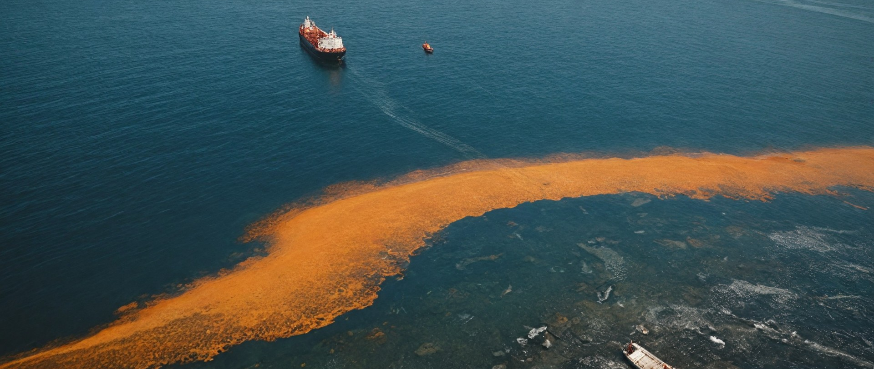
1.4 Global Perspective: Sustainability Practices Across the Shipping Industry
ONBOARD HEALTHY NUTRITION

Slide 75
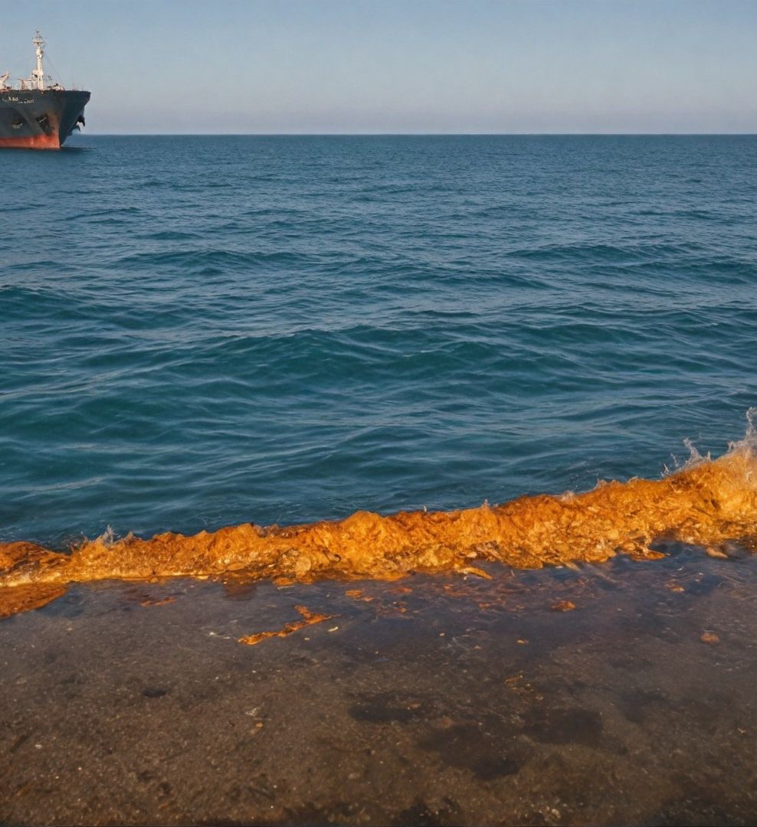
1.4 Global Perspective: Sustainability Practices Across the Shipping Industry
1.4 Global Perspective:
Sustainability Practices Across the Shipping Industry
Examples of best practices in maritime sustainability from various ship types
How international regulations (such as MARPOL) shape sustainable practices in ship galleys
ONBOARD HEALTHY NUTRITION

Slide 76
1.4 Global Perspective: Sustainability Practices Across the Shipping Industry
Sustainable practices applied in shipping are vital to reducing negative environmental impacts and ensuring long-term efficiency.
In this context, the galleys of different types of ships are also striving to implement innovations and regulations to ensure sustainable resource management
ONBOARD HEALTHY NUTRITION

Slide 77
1.4 Global Perspective: Sustainability Practices Across the Shipping Industry
1.4.1. Examples of best sustainability practices in the maritime industry from different ship types
Cruise Ships: Recycling and Waste Management Systems Cruise ships, with their large crews and many passengers, are major waste generators, but they are also leaders in sustainable practices, especially in recycling and waste management. Many of these ships have implemented innovative recycling systems for plastics, metal packaging, glass and paper, thus drastically reducing the waste that is dumped in the ocean or on land.
ONBOARD HEALTHY NUTRITION

Slide 78
1.4 Global Perspective: Sustainability Practices Across the Shipping Industry
Example: major cruise companies such as Royal Caribbean and Carnival are implementing waste separation systems that allow up to 85% of solid waste to be recycled. In addition, some ships use compostable materials for packaging and utensils, which reduces plastic waste.
.
ONBOARD HEALTHY NUTRITION

Slide 79
1.4 Global Perspective: Sustainability Practices Across the Shipping Industry
Cargo ships: energy efficiency and emission reduction.
Cargo ships, which carry significant quantities of goods around the world, are also beginning to implement sustainable practices to reduce their carbon footprint. Many of these ships use more energy-efficient engines and energy management systems that reduce fuel consumption and greenhouse gas emissions.
.
ONBOARD HEALTHY NUTRITION

Slide 80
1.4 Global Perspective: Sustainability Practices Across the Shipping Industry
Example: some cargo ships use hybrid engines or even wind systems to help propel the vessel. This allows significant reductions in carbon dioxide emissions and other pollutants. Technologies such as route optimisation systems also help reduce fuel consumption by choosing the most efficient route across the ocean.
ONBOARD HEALTHY NUTRITION

Slide 81
1.4 Global Perspective: Sustainability Practices Across the Shipping Industry
Military ships: Strict hygiene standards and hazardous waste management
Warships face challenges related to waste management, including hazardous materials such as chemicals and oils that must be stored and disposed of safely. Despite their stringent operational needs, many military vessels have implemented innovative waste management systems that minimize environmental impact.
ONBOARD HEALTHY NUTRITION

Slide 82
1.4 Global Perspective: Sustainability Practices Across the Shipping Industry
Example: some warships have sewage treatment plants that allow water to be treated on board before it is discharged back into the ocean. In addition, they have solid waste recycling systems, which reduces the volume of waste that is transported to ports for further treatment.
ONBOARD HEALTHY NUTRITION

Slide 83
1.4 Global Perspective: Sustainability Practices Across the Shipping Industry
Fishing Vessels: Sustainable Fisheries and Bycatch Minimisation
In the fishing industry, sustainable practices are becoming increasingly important, especially in terms of maintaining fish stocks and protecting marine ecosystems. Many fishing vessels are beginning to use more selective fishing techniques that minimise by-catch (incidental catch of unwanted species) and thus protect biodiversity.
ONBOARD HEALTHY NUTRITION

Slide 84
1.4 Global Perspective: Sustainability Practices Across the Shipping Industry
Example: In Norway and Iceland, fishing vessels use new technologies such as cameras and sensors to monitor catches in real time. This helps avoid by-catch and ensures that only authorised species are caught. In addition, vessels implement systems to collect and process fish residues that can be used to produce fishmeal and other products.
ONBOARD HEALTHY NUTRITION

Slide 85
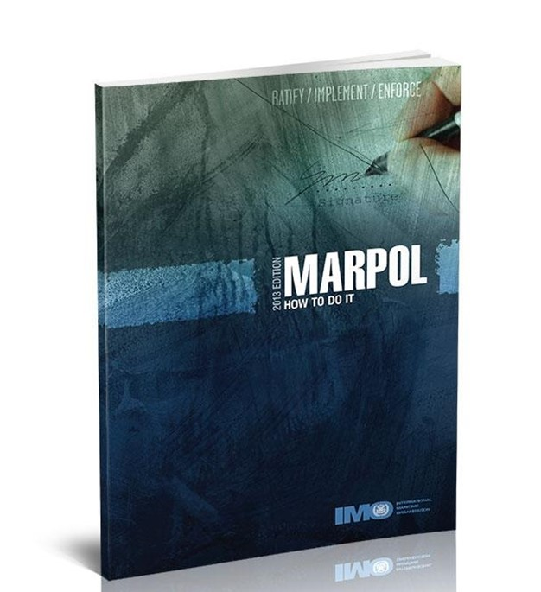
1.4 Global Perspective: Sustainability Practices Across the Shipping Industry
How international regulations (such as MARPOL) shape sustainable practices in ships' galleys
International regulations play a major role in setting sustainability standards in the maritime industry. One of the most important regulatory frameworks is the International Convention for the Prevention of Pollution from Ships (MARPOL), which imposes strict rules on the management of waste and pollution from ships.
ONBOARD HEALTHY NUTRITION

Slide 86
1.4 Global Perspective: Sustainability Practices Across the Shipping Industry
MARPOL includes various annexes that regulate the management of waste and wastewater on board ships. Under these provisions, ships are not allowed to discharge waste into the ocean except in strictly defined areas and subject to certain conditions. This requires ships to implement waste handling and storage systems that minimise their impact on the environment.
ONBOARD HEALTHY NUTRITION

Slide 87
1.4 Global Perspective: Sustainability Practices Across the Shipping Industry
Example: according to MARPOL, ships must have systems in place to treat sewage before it is discharged into the sea. This ensures that harmful substances such as chemicals, fats and oils do not end up in the oceans and threaten marine ecosystems.
Control of air emissions
MARPOL also regulates emissions of harmful gases from ships, including sulphur oxides (SOx) and nitrogen oxides (NOx), which contribute to air pollution and acid rain. In this regard, ships need to use cleaner fuels and implement technologies to reduce emissions.
ONBOARD HEALTHY NUTRITION

Slide 88
1.4 Global Perspective: Sustainability Practices Across the Shipping Industry
Example: many shipping companies are starting to switch to using low sulphur fuels or even hybrid systems that use a combination of electric propulsion and traditional fuels. In addition, some ships use "scrubbers" - exhaust gas cleaning devices that significantly reduce emissions.
Sustainable management of chemicals and hazardous waste
MARPOL also regulates the management of hazardous materials and chemicals on board ships, including cleaning agents and fuels. Ships must follow strict protocols for the storage, use and disposal of these substances to avoid pollution of the marine environment.
ONBOARD HEALTHY NUTRITION

Slide 89
1.4 Global Perspective: Sustainability Practices Across the Shipping Industry
Example: many cruise ships use biodegradable cleaners that are safe for the marine environment. In addition, ships have special facilities for the storage and disposal of hazardous materials to ensure that these substances are not discharged into the sea.
ONBOARD HEALTHY NUTRITION

Slide 90
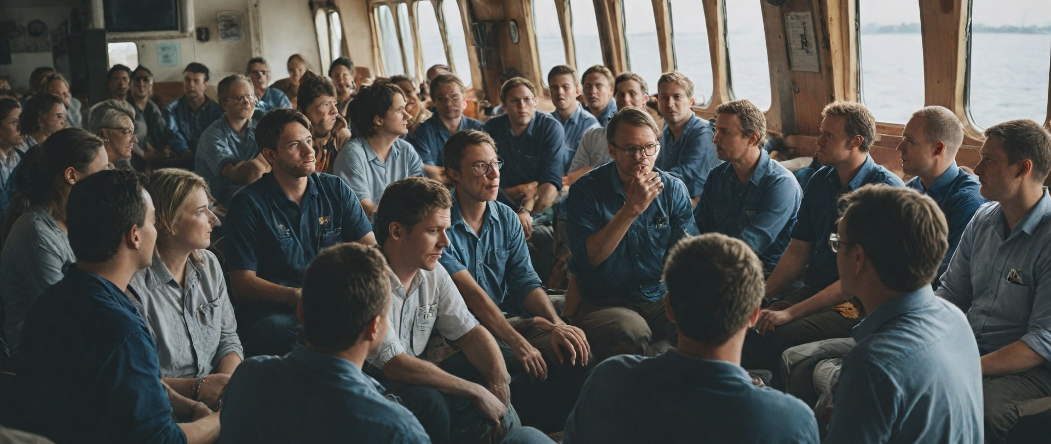
1.5 Discussion
ONBOARD HEALTHY NUTRITION

Slide 91
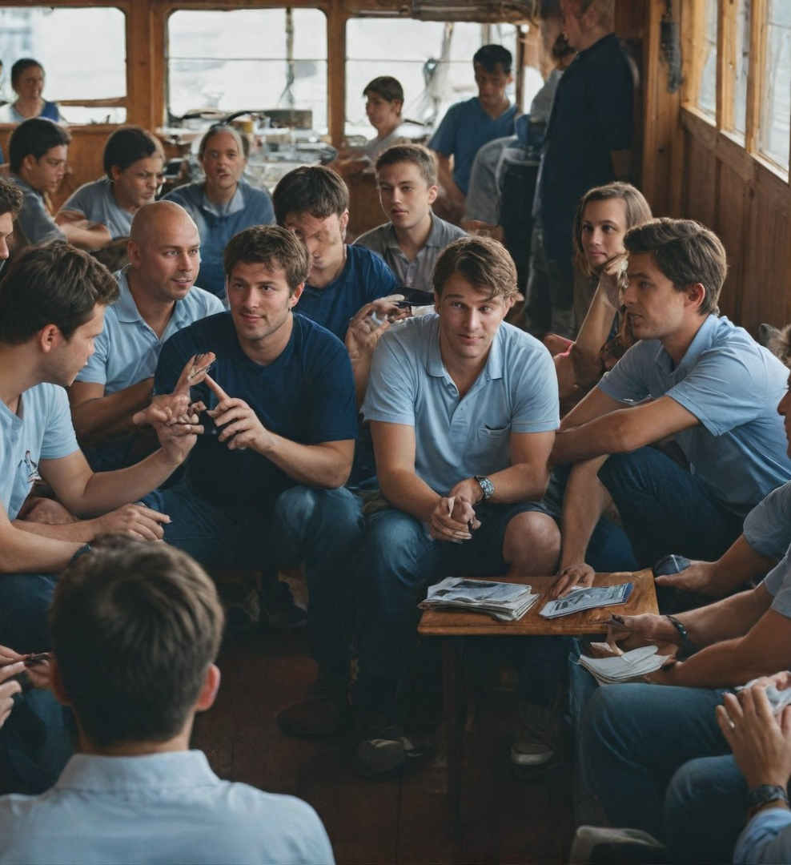
1.5 Discussion
Discussion
Open dialogue on sustainability challenges participants have encountered in different types of ship galleys
Brainstorming potential improvements
ONBOARD HEALTHY NUTRITION

Slide 92
ASSESSMENT
Multiple Choice Questions (MCQs)
Which of the following is NOT a principle of sustainability in galley operations?
  Resource efficiency
  Waste reduction
  Unrestricted use of non-renewable resources
  Improved crew well-being
Which international regulation governs waste management in maritime operations?
  MARPOL
  SOLAS
  STCW
  UNCLOS
What is a common challenge for sustainability in military ship galleys?
  Access to local marketsLimited space for provisioning
  Varied culinary preferences
  Excessive crew turnover
ONBOARD HEALTHY NUTRITION

Slide 93
ASSESSMENT
Short Answer Questions
Explain how sustainability in ship galleys contributes to the operational efficiency of the vessel.
Describe one innovative approach for reducing food waste in a cruise ship galley.
ONBOARD HEALTHY NUTRITION

Slide 94
ASSESSMENT
Case Study
Scenario:
You are the head chef on a cargo vessel embarking on a 60-day voyage. Provisioning is limited due to port restrictions, and waste disposal regulations are strict.
Task:
Identify three sustainability challenges you might face.
Propose practical solutions to address these challenges while ensuring efficient galley operations.
ONBOARD HEALTHY NUTRITION

Slide 95
ASSESSMENT
Group Discussion
Topic:
How can small adjustments in daily galley operations significantly contribute to sustainability goals in the maritime industry?
Participants will be graded on their ability to provide examples, cite best practices, and engage constructively with peers.
This diverse assessment structure ensures that participants demonstrate understanding, application, and problem-solving skills related to sustainability in galleys.
ONBOARD HEALTHY NUTRITION

Slide 96
ASSESSMENT
Group Discussion
Topic:
"Balancing Sustainability and Operational Challenges in Ship Galleys: Practical Solutions for the Maritime Industry„
Guiding Questions:
What are the most significant barriers to implementing sustainable practices in ship galleys?
How can galley teams effectively balance limited resources with the need for sustainability?
Can international regulations like MARPOL be adapted to address specific challenges faced by different ship types?
Objective:
Participants will collaboratively explore practical strategies to overcome sustainability challenges while maintaining operational efficiency, considering the perspectives of various stakeholders such as galley staff, ship operators, and regulatory bodies.
Evaluation Criteria:
Contribution of relevant examples and experiencesAbility to propose innovative and practical solutionsEngagement in constructive dialogue with peers
Demonstration of understanding of sustainability principles and regulatory frameworks
ONBOARD HEALTHY NUTRITION

Slide 97
Course References
Demydyuk, G. V., Kaurav, R. P. S., Carlbäck, M., & Vejlgaard, H. (2024). From galley to gourmet: experience accounting perspective on the evolving dining choices of cruise passengers. Journal of Foodservice Business Research, 1-33.
Durlik, I., Miller, T., Kostecka, E., Łobodzińska, A., & Kostecki, T. (2024). Harnessing AI for Sustainable Shipping and Green Ports: Challenges and Opportunities. Applied Sciences, 14(14), 5994.
Shoaib, M., Zhang, S., & Ali, H. (2023). Assessment of sustainable green logistics enablers: A robust framework using fuzzy DEMATEL and ISM approach. International Journal of Environmental Science and Technology, 20(10), 11407-11426.
Dewan, M. H., & Godina, R. (2024). Unveiling seafarers' awareness and knowledge on energy-efficient and low-carbon shipping: A decade of IMO regulation enforcement. Marine Policy, 161, 106037.
Jang, Y. L., Jeong, J., Eo, S., Hong, S. H., & Shim, W. J. (2024). Occurrence and characteristics of microplastics in greywater from a research vessel. Environmental Pollution, 341, 122941.
ONBOARD HEALTHY NUTRITION

Slide 98
Course References
Baum-Talmor, P., & Şahin, Ç. E. (2024). Employment Practices, Cost Minimization, and Their Implications for Food Provisions and Seafarers’ Wellbeing on board Ships–A Qualitative Analysis. INQUIRY: The Journal of Health Care Organization, Provision, and Financing, 61
Yazdani, M., Ariza-Montes, A., Arjona-Fuentes, J. M., & Radic, A. (2024). Cruise hotel sustainable supplier management using a grey-based decision support framework. Journal of Travel & Tourism Marketing, 41(4), 538-558.
Nittari, G., Gibelli, F., Bailo, P., Sirignano, A., & Ricci, G. (2024). Factors affecting mental health of seafarers on board merchant ships: a systematic review. Reviews on environmental health, 39(1), 151-160.
De Beukelaer, C. (2023). What is wrong with the shipping industry?. In Trade winds (pp. 48-74). Manchester University Press.
Kizielewicz, J. (2024). The commitment of global cruise shipping companies to sustainable development. Current Issues in Tourism, 27(11), 1683-1699.
ONBOARD HEALTHY NUTRITION

