Slide 1








MARitime Soft Skills for Onboard Healthy Nutrition and CULinary Arts in Seagoing Services – CUL-MAR-Skills
KA220-VET - Cooperation partnerships in vocational education and training
2023-1-RO01-KA220-VET-000156711
ONBOARD HEALTHY NUTRITION
COURSE 7
Healthy Cooking Dishes from Different Cultures
Disclaimer: “Funded by the European Union. Views and opinions expressed are however those of the author(s) only and do not necessarily reflect those of the European Union or the ANPCDEFP. Neither the European Union nor the ANPCDEFP can be held responsible for them”

Slide 2
Learning outcomes of the course
Upon successful completion of this course, participants will be able to:
Identify and describe the principles of healthy food preparation of different international cuisines.
Analyse the nutritional and flavour profiles of different regional ingredients and their application in healthy cooking.
To apply knowledge of different culinary traditions to create balanced and sustainable meals suitable for onboard dining
Develop skills to adapt international recipes to meet nutritional and logistical requirements in a marine environment.
Demonstrate the ability to create a multicultural, healthy menu that promotes well-being and meets the needs of diverse crews.
NAVAL COMMUNICATIONS
ONBOARD HEALTHY NUTRITION

Slide 3
Content of the course
Exploring international healthy dishes and cooking styles in the ship's galley
Introduction
1.1. Examples of healthy dishes from different cultures
1.2. Techniques for preparing healthy food in a board kitchen environment
1.3. Influence of cultural traditions on cooking styles in board cuisine.
2. Understanding regional ingredients and flavour profiles 14
2.1. Understanding regional ingredients and flavour profiles in the context of artificial intelligence 2.2. Regional ingredients and flavour profiles
2.3. Flavour and aroma profiles: sweet, savoury, sour, bitter, umami and characteristic aromas for dishes in the board kitchen
3. Incorporating different culinary traditions into the food on board
3.1. Adapting regional dishes for the ship's kitchen environment
3.2. Healthy menu planning tailored to the needs of the crew
3.3. Practical tips for healthy menu planning
Sources and Literature
ONBOARD HEALTHY NUTRITION

Slide 4
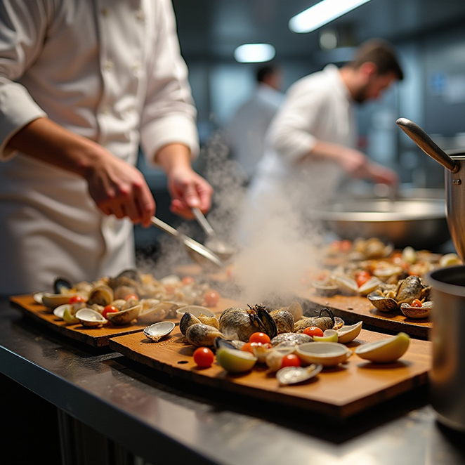
1. Exploring international healthy dishes and cooking styles in the ship's galley
  Introduction
  Food is not just a way of satisfying physiological needs - it is a cultural phenomenon that reflects historical experience, social traditions and culinary innovations accumulated over the centuries. As Massimo Montanari, a world-renowned food historian, points out, every dish, even the simplest, is a cultural artefact. The choice of ingredients, the methods of preparation and the presentation of food reflect social, economic and historical processes.
ONBOARD HEALTHY NUTRITION

Slide 5
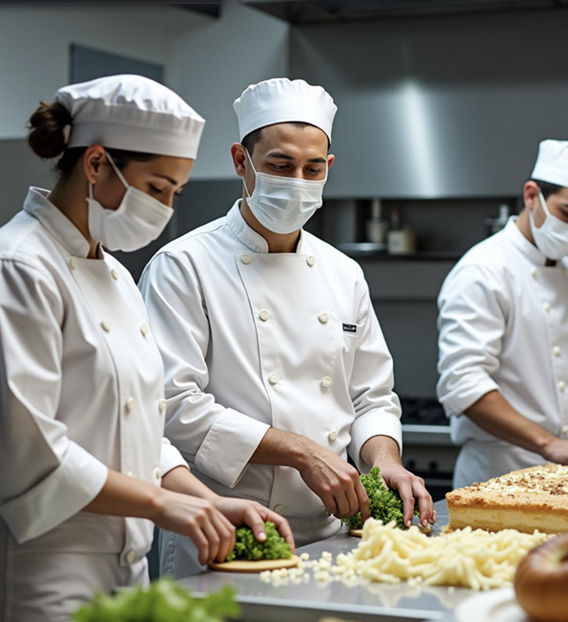
  Food is not just a way of satisfying physiological needs - it is a cultural phenomenon that reflects historical experience, social traditions and culinary innovations accumulated over the centuries. As Massimo Montanari, a world-renowned food historian, points out, every dish, even the simplest, is a cultural artefact. The choice of ingredients, the methods of preparation and the presentation of food reflect social, economic and historical processes.
ONBOARD HEALTHY NUTRITION

Slide 6
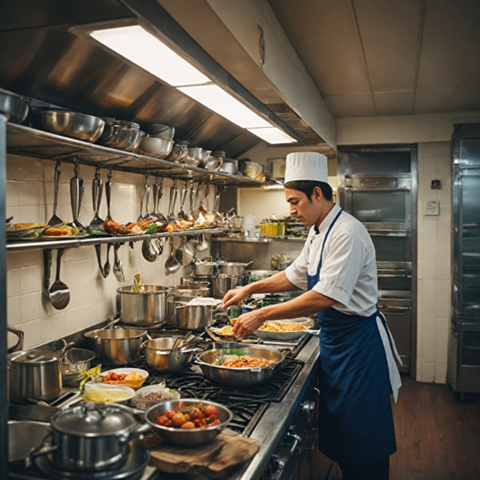
  Creativity and sustainability
  Through the appropriate selection of ingredients and the efficient use of resources, the ship's kitchen can offer innovative solutions that combine the traditional and the modern. The food consumed is not just a means of sustaining energy - it is an expression of identity, communication and care for the crew. Food preparation occupies an important role in the daily life of the crew. Food preparation in this context is not just a process of mixing ingredients but an opportunity for cultural interaction and creating community.
ONBOARD HEALTHY NUTRITION

Slide 7
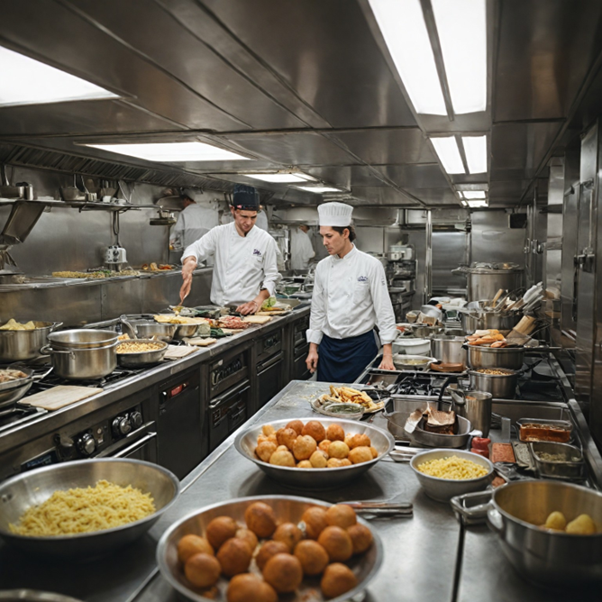
  Food becomes a culture as soon as the ingredients are chosen, and although the ingredients may be of natural origin, their use in the ship's kitchen is the result of adaptation, transformation and reinterpretation. Basic ingredients are transformed using specific techniques that are adapted to the conditions of the ship. The limited space, the availability of preservatives, and the requirements for the durability of products require creative approaches that link traditional recipes with modern practices.
ONBOARD HEALTHY NUTRITION

Slide 8
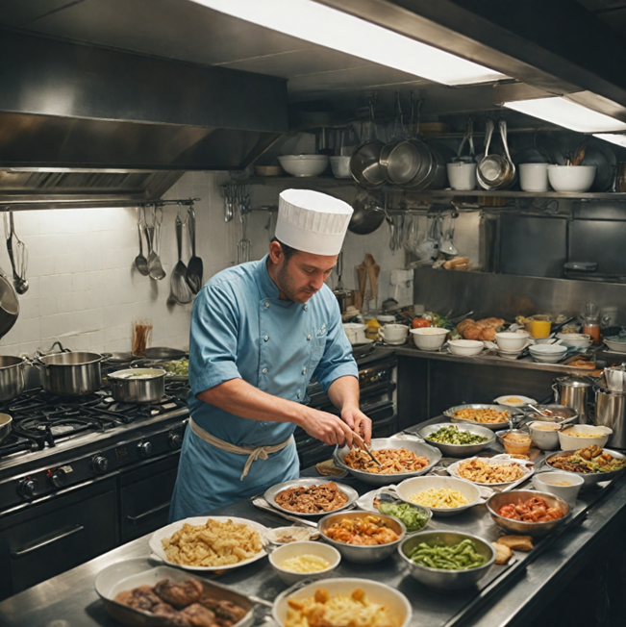
  Food and taste - good or bad choice?
  Food in itself cannot be categorised as good or bad. Food that is a delicacy to one crew member may be dismissed by another as strange or even unpleasant. Therefore, the ship's kitchen plays an important role in creating menus to suit the different tastes and cultural preferences of the crew.
ONBOARD HEALTHY NUTRITION

Slide 9
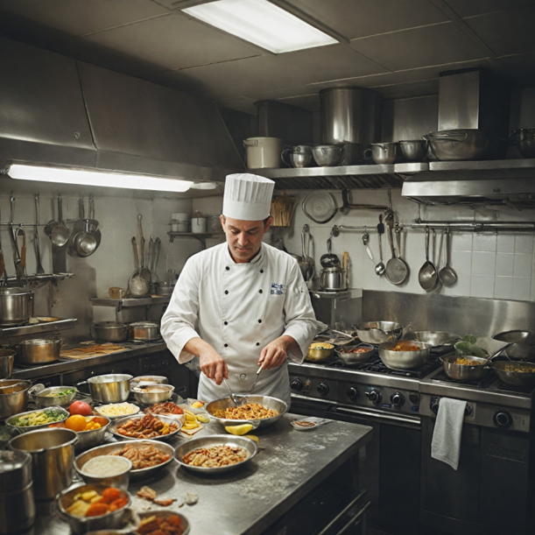
Food as a right of choice. The choice of food on board brings together the cultural characteristics of different nationalities. Even when the choice is not restricted, and there are no objective physiological reasons for avoiding foods to which the consumer has an intolerance, it has been found that he will subconsciously consciously select food that suits his personal tastes and cultural preferences. This makes eating on board not only a biological necessity but also a social and cultural act.
ONBOARD HEALTHY NUTRITION

Slide 10
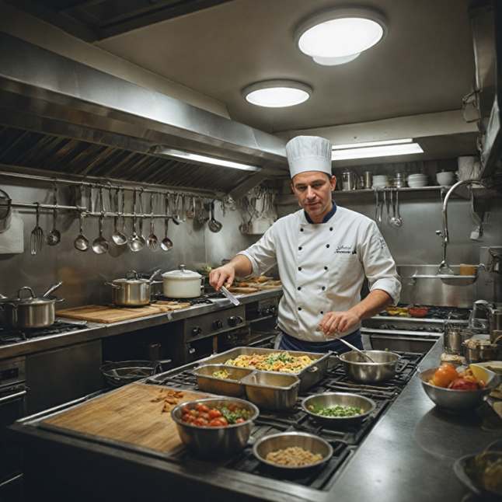
1.1. Examples of healthy dishes from different cultures
1.1.1. Dietary principles as culture
Dietary principles, seen as a structural element in building a gastronomic culture, play an important role in ensuring quality nutrition on board. They go beyond the traditional perception of dietary restrictions by offering a scientifically based approach to meal planning. Techniques such as braising, roasting, and boiling preserve nutrients and reduce excess fat and salt content.
ONBOARD HEALTHY NUTRITION

Slide 11

Mediterranean cuisine. Mediterranean dishes are known for their high nutritional value and rich taste. The main ingredients include olive oil, fresh vegetables, olives, legumes and seafood. An example is a salad with quinoa, tomatoes and olive oil, which provides a combination of fibre, vitamins and healthy fats. These dishes bring a sense of freshness and healthy living.
ONBOARD HEALTHY NUTRITION

Slide 12
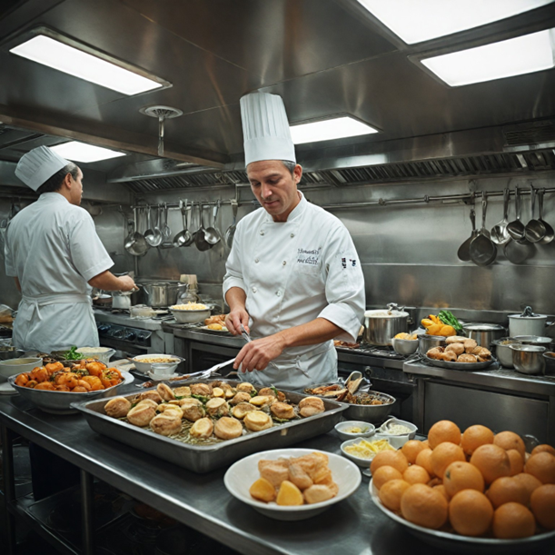
Asian cuisine. Asian cuisine offers a variety of dishes prepared through techniques such as sautéing and steaming. An example is rice noodles with vegetables and soy sauce, which combine lightness and nutritional value. This cuisine stands for creativity and sustainability, offering healthy and delicious solutions.
Latin American cuisine. Typical of this cuisine are dishes such as lentil soup or quinoa with avocado. They provide a high content of protein and healthy fats. These recipes can be easily adapted to the conditions on board while promoting the use of sustainable ingredients.
ONBOARD HEALTHY NUTRITION

Slide 13
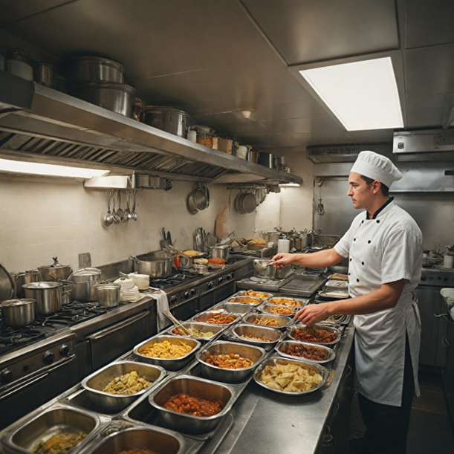
    1.1.2.. Menu planning on board ship.
The process requires a strategic approach that takes into account both the diversity of crew cultures and the specific conditions of the maritime environment. Careful selection of dishes to reflect the cultural characteristics and gastronomic preferences of different nationalities while ensuring a balanced and healthy diet.
Consistency in serving dishes. Distribution of meals throughout the day (breakfast, lunch, dinner) that provide energy and maintain the physical condition of the crew. Inclusion of fresh salads, soups, main courses and desserts in a balanced order according to the needs of the crew
ONBOARD HEALTHY NUTRITION

Slide 14
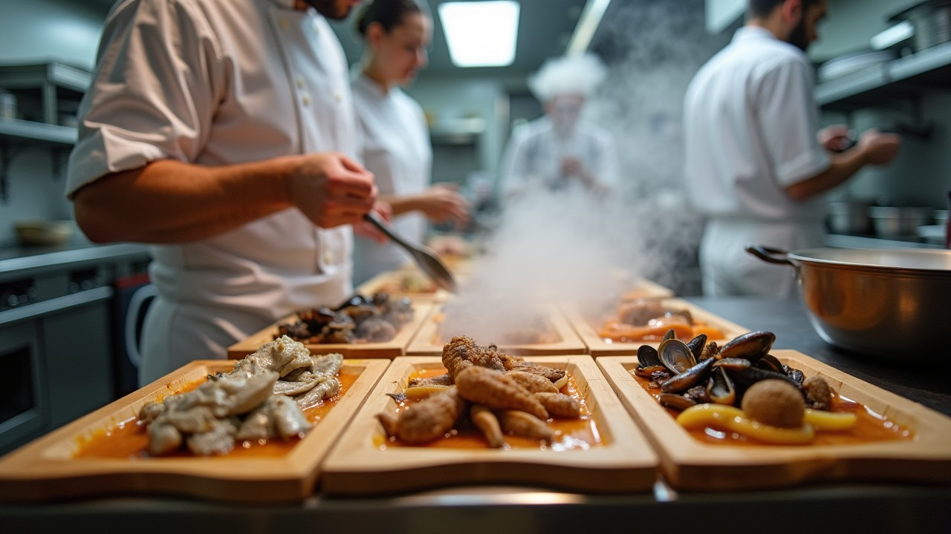
1.2. Techniques for preparing healthy food in a board kitchen environment
ONBOARD HEALTHY NUTRITION

Slide 15
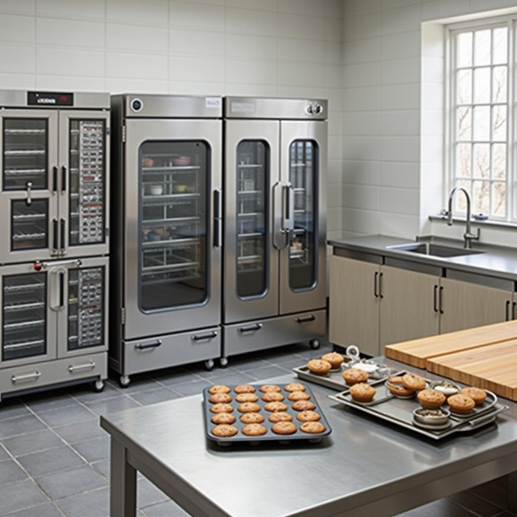
    1.2.1. Baking
Baking is one of the most common methods of preparing food on board ships. It provides the opportunity to prepare a variety of dishes such as bread, pastries, meat and vegetables. However, the use of this method has its advantages and disadvantages for the crew, the ship operator and the environment.
ONBOARD HEALTHY NUTRITION

Slide 16
    Advantages in terms of prepared foods for crew and health
Preservation of nutritional value: Baking uses dry heat, which minimises the loss of vitamins and minerals, especially compared to methods such as boiling.
Variety of dishes: Baking allows the preparation of a variety of healthy foods such as wholemeal breads, roasted vegetables and low-fat meats.
Lower Fat: Compared to frying, baking requires minimal or no fat, contributing to a healthy diet for the crew.
Good texture and taste: the method produces a pleasant texture and taste that are suitable for a long-term menu on board.
ONBOARD HEALTHY NUTRITION

Slide 17
Benefits in terms of efficiency for the ship operator and the environment:
Versatility: combination ovens can operate in different modes, including baking, steaming and grilling, which optimises space on board.
Energy efficiency: convection ovens use hot air circulation to speed up the baking process and reduce energy consumption.
Minimal environmental impact: with proper maintenance and optimal use, ovens have a lower environmental impact than methods that use a lot of energy or emit emissions.
ONBOARD HEALTHY NUTRITION

Slide 18
Disadvantages
Food drying out: baking can cause food to dry out if the process is not carefully monitored, reducing its juiciness.
Restrictions for certain foods: some products, such as tender vegetables or seafood, are not suitable for baking, which limits the variety of the menu.
High initial costs: the purchase and maintenance of equipment such as combi or convection ovens require a significant investment.
Energy intensity: although convection ovens are energy efficient, traditional ovens (bakers' ovens) can consume more energy.
Food waste: if baking is not planned properly, waste can be generated, especially when products are burned or not handled properly.
ONBOARD HEALTHY NUTRITION

Slide 19
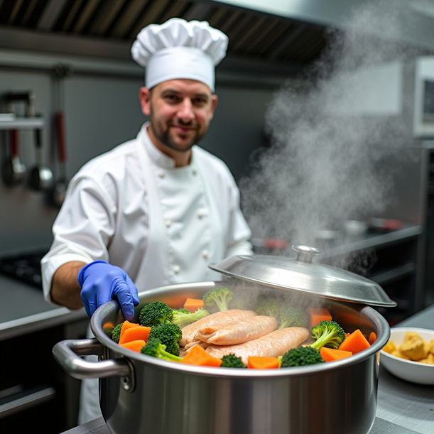
    1.2.2. Boiling - Advantages and disadvantages
Boiling is one of the simplest and most widely used cooking methods on board ships. This method is suitable for preparing large quantities of food and provides efficiency in the marine environment. However, boiling has its advantages and disadvantages for both the crew, the ship operator and the environment.
ONBOARD HEALTHY NUTRITION

Slide 20
In terms of food prepared for the crew and health:
Preserving texture and softness: Boiling is ideal for preparing foods such as pasta, rice, vegetables and soups, ensuring they are soft and easy to eat.
Healthy method: no fat is added when cooking, making it suitable for dietary dishes.
Safety: the high temperature destroys harmful microorganisms, ensuring safety for consumption.
Large quantity of cooked meals: large boiling pans allow you to cook meals for the whole crew at once.
ONBOARD HEALTHY NUTRITION

Slide 21
In terms of efficiency for the ship operator and the environment:
Ease of execution: the method does not require complicated techniques, which reduces the training time for chefs.
Flexibility: Boiling is suitable for different types of food, allowing for variety in the menu.
Energy efficiency at high volumes: steam-jacketed boilers and Bratt pans ensure efficient use of energy when cooking large quantities of food.
ONBOARD HEALTHY NUTRITION

Slide 22
Disadvantages
Loss of nutrients: water can extract water-soluble vitamins and minerals from foods, reducing their nutritional value.
Monotony: Foods cooked by boiling can have a more neutral taste, which reduces their appeal.
Precision requirement: overcooking can cause the texture of the products to soften or break down.
High Water Consumption: Boiling requires large amounts of water, which can be a limited resource across the board.
Energy intensity: maintaining a high temperature for extended periods increases energy costs.
Waste water: water used for brewing must be disposed of or treated, which adds to operating costs and can create environmental challenges.
ONBOARD HEALTHY NUTRITION

Slide 23
Disadvantages
Loss of nutrients: water can extract water-soluble vitamins and minerals from foods, reducing their nutritional value.
Monotony: Foods cooked by boiling can have a more neutral taste, which reduces their appeal.
Precision requirement: overcooking can cause the texture of the products to soften or break down.
High Water Consumption: Boiling requires large amounts of water, which can be a limited resource across the board.
Energy intensity: maintaining a high temperature for extended periods increases energy costs.
Waste water: water used for brewing must be disposed of or treated, which adds to operating costs and can create environmental challenges.
ONBOARD HEALTHY NUTRITION

Slide 24
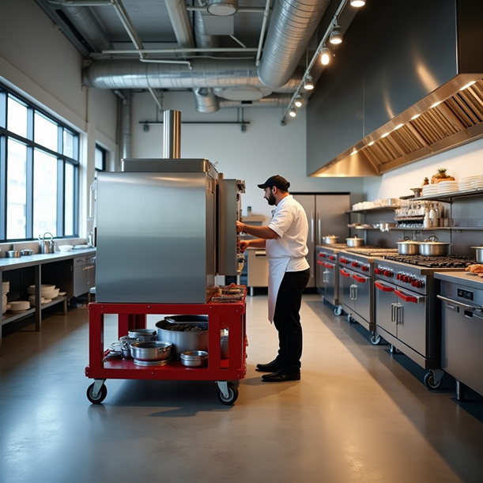
    1.2.3. Braising - Advantages and disadvantages
Braising is a combination cooking method that combines dry and wet heat. Often used on board to cook tougher and stringier meats, vegetables and dishes with rich sauces, this method is efficient and suitable for long journeys. It provides rich flavour and texture but also has its own specific equipment and process requirements.
ONBOARD HEALTHY NUTRITION

Slide 25
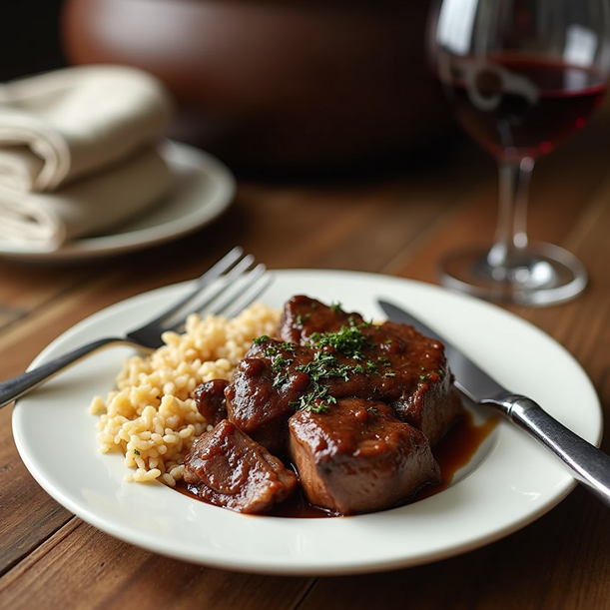
In terms of food prepared for the crew and health:
Improving texture: braising is ideal for tougher meats that become tender and juicy when slow-cooked.
Rich flavours: the combination of dry heat and cooking in liquid (water, broth or wine) creates complex and intense flavours.
Nutrient retention: because the cooking is done in a closed container, the nutrients that are released from the products remain in the sauce and are consumed.
Variety of dishes: suitable for preparing traditional dishes such as stews, casseroles, and other dishes that provide nutritious and energy value to the crew.
ONBOARD HEALTHY NUTRITION

Slide 26
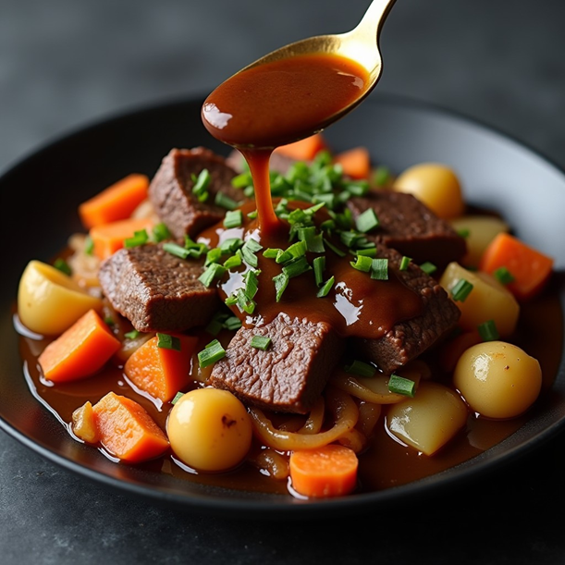
In terms of efficiency for the ship operator and the environment:
Energy Efficiency: Braising requires a moderate temperature for an extended period, which reduces peak loads on energy systems.
Equipment flexibility: different appliances, such as bratt pans and casserole dishes, can be used for braising, which optimises equipment costs.
Minimal environmental impact: low energy consumption compared to methods such as frying.
ONBOARD HEALTHY NUTRITION

Slide 27
Disadvantages
Long cooking time: braising requires prolonged cooking, which may not be appropriate when a quick service is needed.
Risk of overeating: rich sauces and fats in meals can contribute to increased calorie intake if not properly controlled.
Variety limitations: the method is best suited to certain types of food, which limits the possibility of a broader menu.
Space requirements: Casserole dishes and specialised tubs require a significant amount of space in the kitchen.
Equipment cost: High-quality braising equipment, such as Braising pans, can be expensive.
ONBOARD HEALTHY NUTRITION

Slide 28
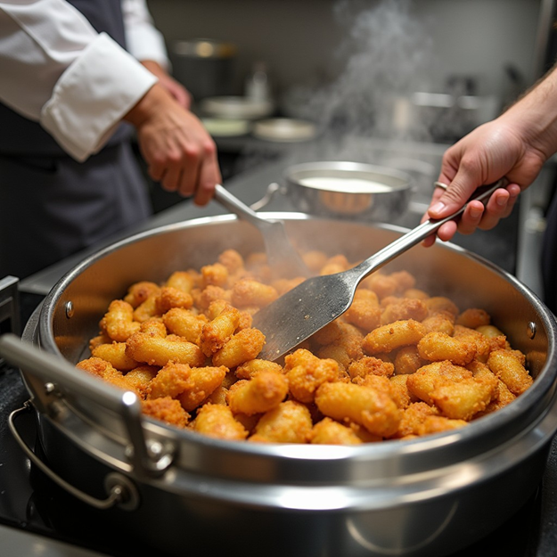
    1.2.4. Deep Frying:
Advantages and disadvantages. Deep frying is a cooking method that uses fat as the primary medium. This method is widespread for preparing foods with crispy textures and rich flavour. Onboard ships it provides a quick and efficient way to prepare a variety of dishes, but it also has its limitations and risks.
ONBOARD HEALTHY NUTRITION

Slide 29
In terms of food prepared for the crew and health:
Rich in texture and flavour: Fried foods have a crunchy texture and rich flavour, making them popular with the crew.
Fast preparation: the method allows large quantities of food to be prepared in a short time, which is important when serving a large crew.
Variety of products: suitable for potatoes, seafood, breaded meats and vegetables.
Temperature control: thermostat-controlled cool-zone fryers provide a stable temperature that prevents food and grease from burning.
ONBOARD HEALTHY NUTRITION

Slide 30
In terms of efficiency for the ship operator and the environment
Equipment efficiency: computerised fryers optimise cooking time and minimise fat consumption.
Speed and productivity: pressure fryers reduce cooking time, which increases kitchen efficiency.
Flexibility: Suitable for preparing a wide variety of foods, helping to add variety to your menu.
ONBOARD HEALTHY NUTRITION

Slide 31
Disadvantages
Increased fat: Deep-fried foods contain more fat, which can contribute to obesity, increased cholesterol and other health problems.
Risk of improper temperature: if the fat is too hot, this can lead to the formation of harmful compounds such as acrylamides.
Monotony: Excessive use of deep frying in the menu can lead to a lack of healthy variety.
High-fat consumption: deep frying requires large amounts of fat, which must be replaced frequently, increasing costs.
ONBOARD HEALTHY NUTRITION

Slide 32
Disadvantages
Waste management: used grease must be disposed of properly, which can be a challenge in the marine environment.
Energy consumption: fryers consume a significant amount of energy, especially when operated for long periods.
Fire hazard: Improper operation of the equipment can create a risk of fires, especially if the grease overheats.
ONBOARD HEALTHY NUTRITION

Slide 33
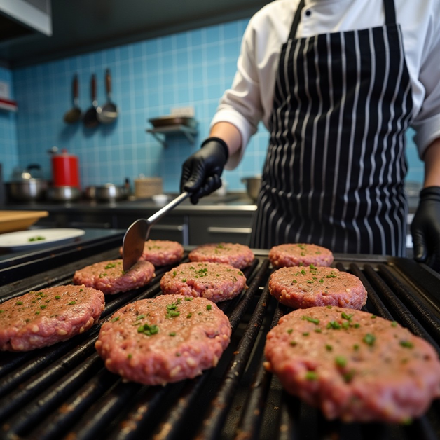
      1.2.5. Grilling - Advantages and disadvantages
  Grilling is a versatile and popular cooking method that uses direct or indirect heat to cook foods. Aboard ships, this method is preferred for creating dishes with rich flavour, minimal fat content and attractive texture. Different types of grilling, such as top-heating (salamanders), barbecuing and contact grilling, offer flexibility in preparing a variety of foods.
ONBOARD HEALTHY NUTRITION

Slide 34
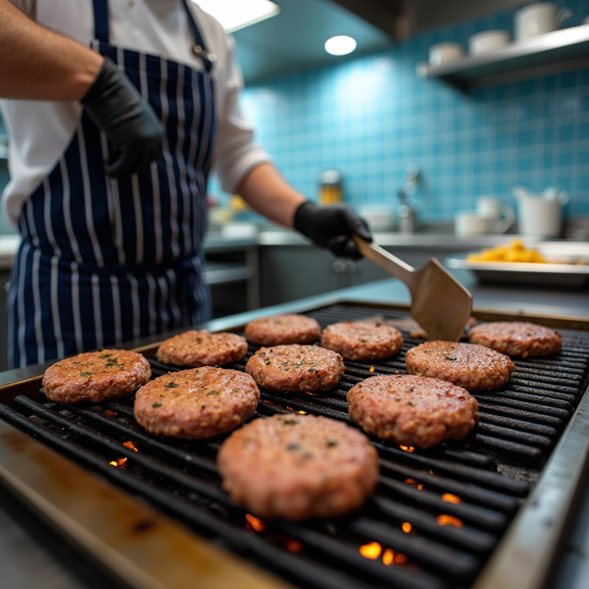
Advantages in terms of food prepared for the crew and health:
Reduced fat: grilling allows the fat from the meat to drain off during cooking, making it a healthier method than frying.
Rich taste and texture: direct heating creates a characteristic caramelised taste and crispy texture that make food more appetising.
Suitable for a variety of foods: can be used for meat, fish, vegetables, sandwiches and bread.
Quick cooking: especially with contact grilling, which speeds up the process by direct contact with the heat source.
ONBOARD HEALTHY NUTRITION

Slide 35
Benefits in terms of efficiency for the ship operator and the environment:
Flexibility of equipment: different types of grills (top-heating, barbecue) provide options for preparing multiple dishes.
Energy efficiency: top-heating grills (salamanders) and contact grills use less energy than other methods, such as deep-frying.
Easy maintenance: grills are relatively easy to clean, especially if the right trays and pans are used to collect the grease.
ONBOARD HEALTHY NUTRITION

Slide 36
Disadvantages
Risk of burnout: excessive exposure to heat can cause foods to burn, which not only reduces their quality but can also create harmful compounds.
Limitations for certain foods: some more delicate products, such as certain types of fish or green vegetables, may lose their texture when grilled.
Uneven cooking: with the barbecue and the top heat, it is possible for food to cook unevenly, requiring extra attention.
Smoke emissions and odours: Grilling, especially over an open fire, can create smoke pollution, which is a problem in confined spaces on board.
ONBOARD HEALTHY NUTRITION

Slide 37
Disadvantages
Increased energy consumption: high-temperature barbecues and grills can increase energy costs if not used efficiently.
Cleaning requirements: Grill trays and pans should be cleaned regularly to avoid grease and residue build-up, which requires more time and resources.
Grilling is an excellent method of preparing healthy and tasty meals that are popular among the crew. It provides efficiency and versatility in the onboard kitchen, especially with proper management of equipment and temperatures.
ONBOARD HEALTHY NUTRITION

Slide 38
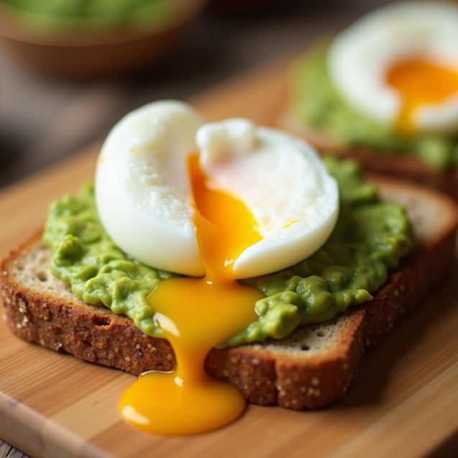
  1.2.6. Poaching: Advantages and disadvantages
  Poaching is a cooking method that uses a low-temperature liquid (water, broth, or wine) to gently cook foods. On board the ship, this method is suitable for preparing delicate foods such as fish, eggs, and chicken, and it provides healthy and tasty meals for the crew. The technique requires specialised equipment and careful temperature control.
ONBOARD HEALTHY NUTRITION

Slide 39
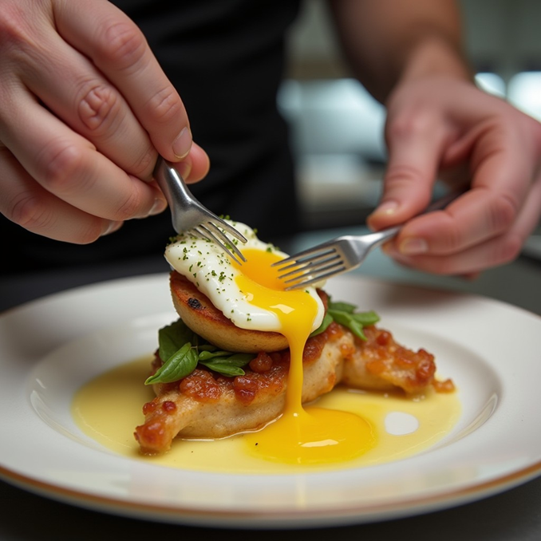
Advantages in terms of prepared foods for crew and health
Texture preservation: poaching is a gentle method that preserves the texture of delicate products such as fish and eggs without drying them out.
Healthy Approach: does not require the use of fat, making foods lower in calories and suitable for a healthy menu.
Nutrient retention: low temperature reduces the loss of vitamins and minerals compared to methods such as boiling.
Flexibility: It can be used for a variety of products, including fish, chicken, fruit, and vegetables.
ONBOARD HEALTHY NUTRITION

Slide 40
Benefits in terms of efficiency for the ship operator and the environment:
Energy efficiency: low temperatures require less energy than methods such as frying.
Minimal waste: poaching in stock or flavoured liquid allows the liquid to be used in sauces, reducing product waste.
Easy to manage: the method is relatively simple and does not require sophisticated skills or long staff training time.
ONBOARD HEALTHY NUTRITION

Slide 41
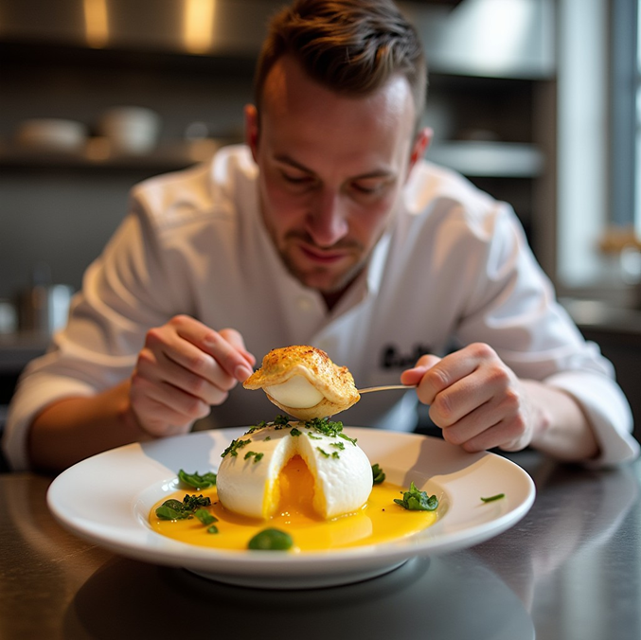
Disadvantages
Absence of strong flavour: Compared to methods such as grilling, poaching does not add a caramelised or smoky taste.
Limited range of products: the method is best suited for delicate products and is not effective for foods that require more intensive processing.
Risk of overcooking: lack of precise temperature control can lead to overcooking and texture deterioration.
Water Consumption: Poaching requires sufficient liquid, which can increase the cost of water on board.
Limited productivity: the method is slower and less suitable for mass production than baking or boiling.
ONBOARD HEALTHY NUTRITION

Slide 42
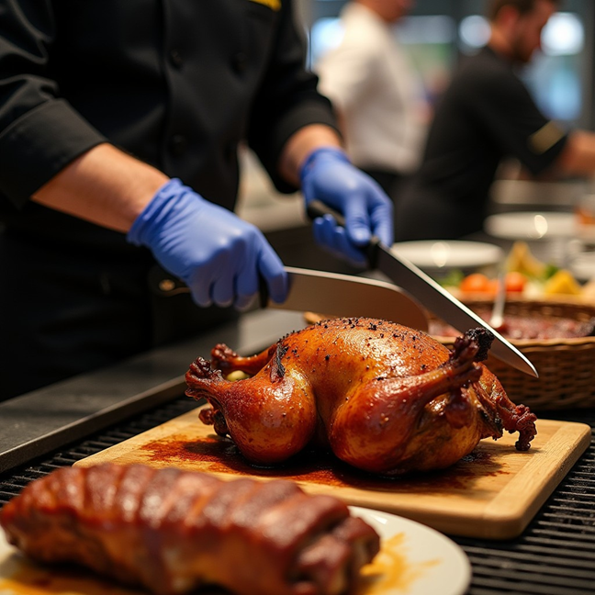
  1.2.7. Roasting:
  Roasting is a cooking method that uses dry heat to evenly cook foods such as meats, vegetables and baked goods. This method is particularly suitable for ships as it provides the opportunity to cook large quantities of nutritious and flavoursome food. Roasting in modern ovens, such as convection and combi ovens, offers precise control over temperature and food quality.
ONBOARD HEALTHY NUTRITION

Slide 43
Advantages in terms of food prepared for the crew and health:
Preserving the natural taste: roasting allows the natural flavours of the products to develop without adding a lot of extra seasoning.
Healthy method: when roasting, the fat from the meat can be drained, making the food lower in fat and suitable for a healthy menu.
Variety of foods: roasting is suitable for a wide variety of foods, including meat, poultry, vegetables and even potatoes.
Caramelisation and texture: dry heat creates a golden and crispy crust that is attractive and enhances the flavour.
ONBOARD HEALTHY NUTRITION

Slide 44
Benefits in terms of efficiency for the ship operator and the environment:
Energy efficiency: convection ovens and combination ovens use air circulation to cook evenly and quickly, reducing energy consumption.
Easy organisation: large ovens allow large quantities of food to be cooked at once, saving time.
Reduced waste: juices from roasting can be used to make sauces, minimising food waste.
ONBOARD HEALTHY NUTRITION

Slide 45
Disadvantages of Roasting:
Risk of drying out: if the process is not carefully monitored, meat or vegetables can become too dry.
Loss of nutrients: the high temperature of roasting can destroy some vitamins, such as vitamins C and B, especially in vegetables.
Limited flavour: Compared to other methods, such as grilling, roasting does not add a smoky or caramelised flavour unless additional techniques are used.
High energy consumption: prolonged roasting of large quantities of food can increase energy consumption.
ONBOARD HEALTHY NUTRITION

Slide 46
Disadvantages of Roasting:
Equipment requirements: Specialised equipment, such as convection ovens and roasting spits, can be expensive to purchase and maintain.
Time requirements: Roasting is a slower process than other methods such as deep frying or boiling.
ONBOARD HEALTHY NUTRITION

Slide 47
Roasting is an efficient and healthy method of preparing foods on board that combines rich flavours and textures with relatively low-fat content. In order to minimise disadvantages, it is important to use modern energy-efficient equipment and to carefully monitor the cooking process. Roasting is an excellent choice for ships that want to offer high-quality and nutritious meals for their crew.
ONBOARD HEALTHY NUTRITION

Slide 48
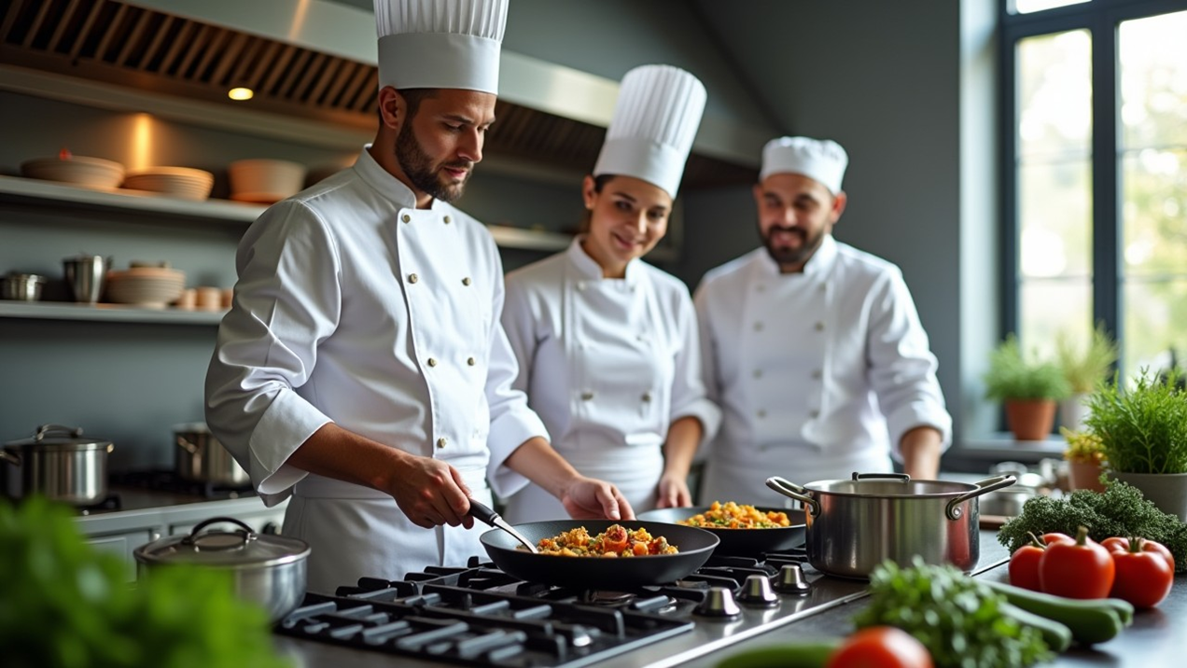
1.3. Influence of cultural traditions on cooking styles in board cuisine
ONBOARD HEALTHY NUTRITION

Slide 49
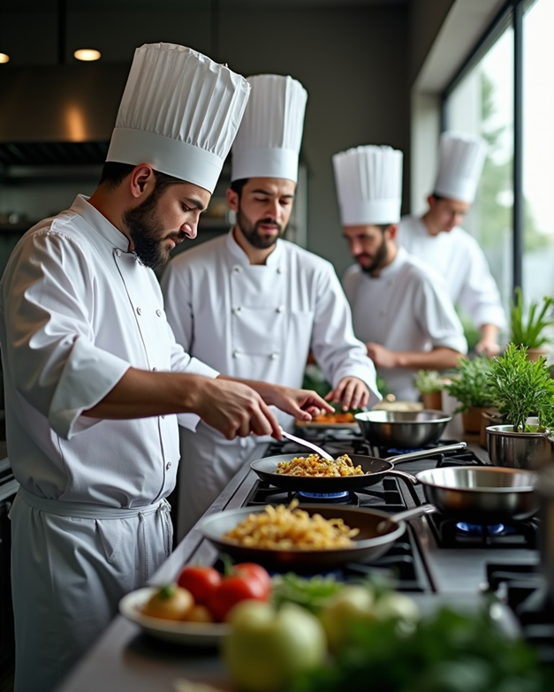
  1.3. Influence of cultural traditions on cooking styles in board cuisine.
Cultural traditions are influential in determining cooking styles in the galley on board, especially in an environment where the crew is often made up of people with different backgrounds, customs and tastes. The influence of these traditions manifests itself in the choice of cooking methods, the ingredients used and the presentation of dishes.
ONBOARD HEALTHY NUTRITION

Slide 50
  1.3.1. Cooking methods and cultural influences
Baking: In cultures where bread is a staple food (e.g. in Europe and North America), baking is a widespread method. On board, this influences the availability of baking ovens and the preparation of a variety of bakery products to suit crew preferences.
Boiling: Boiling is a universal method, but the way it is used varies by culture. For example, Asian cultures emphasise cooked soups and rice, while in Eastern Europe, cooked dishes often include meat and vegetables.
ONBOARD HEALTHY NUTRITION

Slide 51
  1.3.1. Cooking methods and cultural influences
Braising: traditions from French and Chinese cuisine often include braising, which combines flavours and textures. Across the board, this method is popular for preparing dishes with rich sauces that satisfy a variety of cultural preferences.
Deep Frying: Deep frying is particularly popular in American, South Asian and Southern European cuisine. Across the board, this influences the inclusion of foods such as French fries, tempura or breaded items on the menu.
ONBOARD HEALTHY NUTRITION

Slide 52
  1.3.1. Cooking methods and cultural influences
Grilling: Grilling is often associated with cultures where barbecue is an important part of the tradition (e.g. South America, Australia and the USA). On board, this method is used to create familiar and delicious meals for the crew.
Poaching: Associated with the European cuisine, poaching is used to prepare delicate products such as eggs and fish. On board, this allows for healthy meal alternatives.
Cultural diversity and menu adaptation. Creating balance on the menu. For example, a menu might include Western roasted dishes, Asian stir-fried noodles and Mediterranean steamed vegetables.
ONBOARD HEALTHY NUTRITION

Slide 53
  1.3.2. Influence of cultural traditions on cooking styles in board cuisine.
Adaptation to specific requirements: cultural and religious traditions influence the method of preparation and the choice of ingredients. For example, Halal or Kosher food may require specific techniques and equipment.
Using regional and international methods: the influence of different cultures enriches the style of cooking, making food on board not only a necessity but an experience.
ONBOARD HEALTHY NUTRITION

Slide 54
Cultural traditions greatly enrich and diversify the cooking methods on board a ship.
Adapting these traditions to the specific conditions of the maritime environment not only improves the crew's nutrition but also creates a sense of community and cultural appreciation. The ability to combine different cooking methods and styles is critical to the success of a ship's kitchen.
ONBOARD HEALTHY NUTRITION

Slide 55

2. 2. Understanding regional ingredients and flavour profiles
ONBOARD HEALTHY NUTRITION

Slide 56

The onboard kitchen is where culinary traditions from different regions come together to create a varied and nutritious menu for the crew. Mediterranean, Asian and Latin American cuisines offer a wide choice of ingredients that not only enrich the flavours and aromas of the dishes but also contribute to a healthy and balanced diet. This chapter will explore the main ingredients from these culinary traditions, focusing on their flavour and aroma profiles, nutritional value and sustainability in the shipping environment. This will help in optimal menu planning to meet the requirements for taste, variety and durability.
ONBOARD HEALTHY NUTRITION

Slide 57

Understanding regional ingredients and flavor profiles
ONBOARD HEALTHY NUTRITION

Slide 58

  2.1. Understanding regional ingredients and flavour profiles in the context of artificial intelligence (AI)
  With the advent of Artificial Intelligence (AI), the opportunities to improve onboard food practices are becoming more real and practical. In the context of crew kitchens, AI technology can provide innovative solutions to create customised meals that combine variety and efficiency and cater to the cultural and taste preferences of the multinational crew.
ONBOARD HEALTHY NUTRITION

Slide 59

AI in menu planning for the board
Predicting crew preferences: AI can analyse data on crew food preferences and cultural characteristics. This enables menu planning that combines ingredients and flavour profiles (such as sweet, salty, sour, bitter, and umami) according to individual and group requirements. For example, AI can recognise that a certain crew prefers more Asian flavours and adapt dishes to include ingredients such as soy sauce, ginger or cilantro.
ONBOARD HEALTHY NUTRITION

Slide 60

Product and recipe optimisation. Using machine learning algorithms and natural language processing (NLP), AI can gather feedback from the crew on previous menus and suggest improvements to recipes.
AI for efficiency and sustainability across the board. AI analytics enable accurate planning of ingredient quantities, minimisation of food waste and optimal use of available resources. For example, instead of purchasing perishables, AI can recommend ingredients with a long shelf life, such as legumes or frozen vegetables.
ONBOARD HEALTHY NUTRITION

Slide 61
Enhancing flavours: Using sensors and tools that measure flavour profiles, AI can assist chefs in creating dishes that achieve the ideal balance of flavours. This is especially useful on board, where variety and flavour are important to maintaining crew energy and morale.
AI technology has the potential to transform the onboard kitchen by integrating commodity science with advanced analytics and optimisation technologies. By tailoring menus to crew needs, reducing costs and improving taste, AI not only enhances the quality of meals onboard but also contributes to sustainability and efficiency in the marine environment. Implementing these technologies can make food on board not just a means of survival but a cultural and taste experience.
ONBOARD HEALTHY NUTRITION

Slide 62
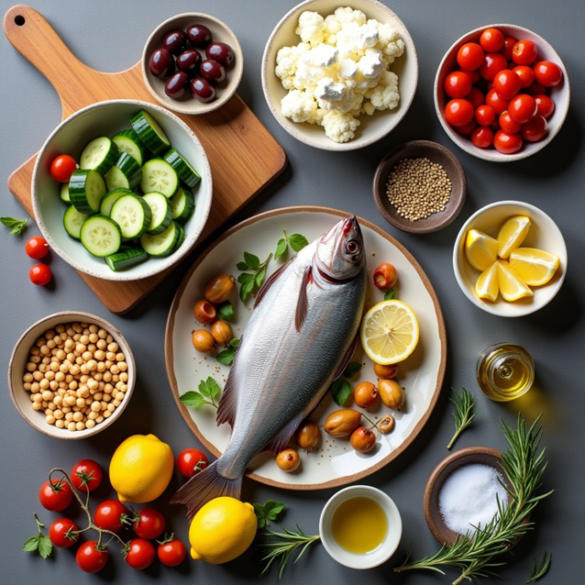
  2.2. Regional ingredients and flavour profiles
Study of the ingredients of dishes by region
  2.2.1. Mediterranean cuisine
Main ingredients: olive oil, oregano, thyme, vegetables (tomatoes, zucchini, eggplant), legumes (chickpeas, lentils), seafood (fish, shrimp).
Flavour profiles: lightness, freshness, balanced sour-sweet notes, aroma of herbs.
Benefit: High in healthy fats, fibre and antioxidants.
ONBOARD HEALTHY NUTRITION

Slide 63
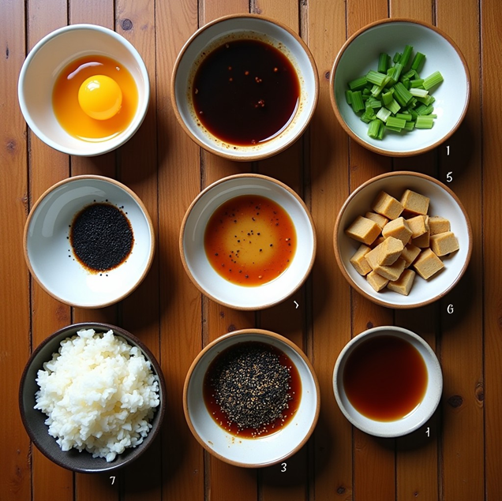
  2.2.2. Mediterranean cuisine
Main ingredients: olive oil, oregano, thyme, vegetables (tomatoes, zucchini, eggplant), legumes (chickpeas, lentils), seafood (fish, shrimp).
Flavour profiles: lightness, freshness, balanced sour-sweet notes, aroma of herbs.
Benefit: High in healthy fats, fibre and antioxidants.
ONBOARD HEALTHY NUTRITION

Slide 64
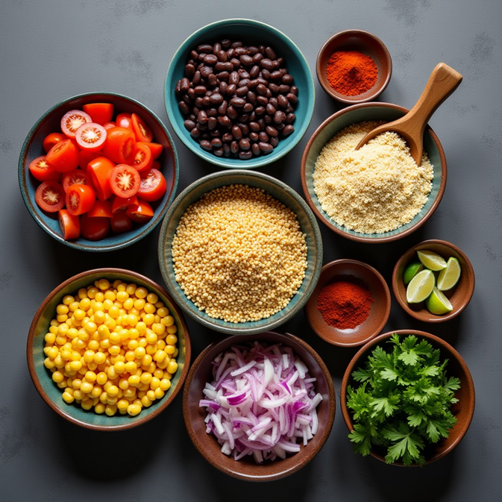
  2.2.3. The cuisine of Latin America
Main ingredients: corn, beans, avocado, tomatoes, quinoa.
Flavour profiles: earthy, spicy notes with creamy textures from avocado and beans.
Benefit: High in fibre, protein and antioxidants, suitable for energy meals.
ONBOARD HEALTHY NUTRITION

Slide 65
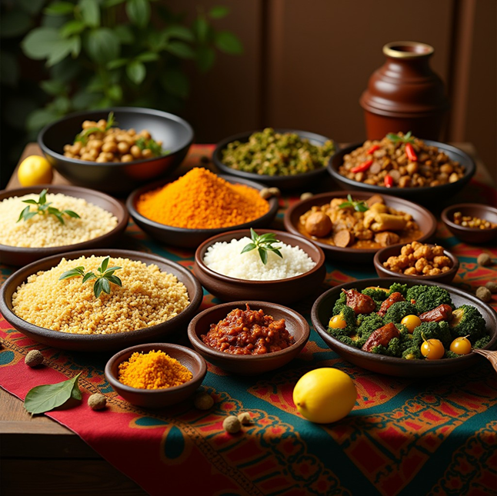
  2.2.4. African Cuisine
Main ingredients: millet, sorghum, yam, leafy greens, spices (cumin, turmeric, cardamom).
Flavour profiles: warm, earthy and spicy, with exotic notes.
Benefit: Rich in vitamins and minerals, long shelf life, suitable for onboard stock.
ONBOARD HEALTHY NUTRITION

Slide 66
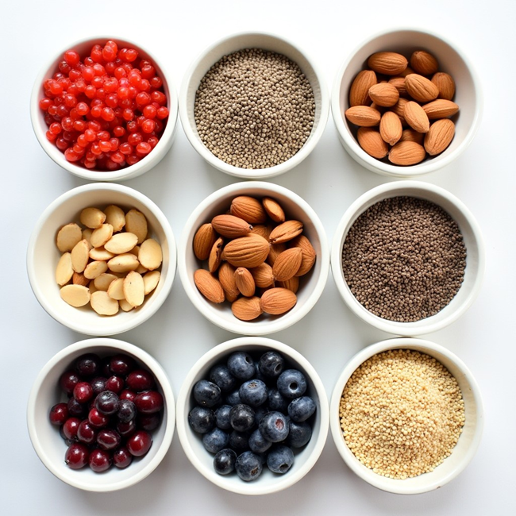
  2.2.5. Regional superfoods and their benefits
Examples: goji berries (antioxidants), chia seeds (rich in Omega-3 fatty acids), quinoa (high-protein grain).
Benefits: boost immunity, antioxidant action, long-lasting energy. Key ingredients suitable for the kitchen on board.
Mediterranean products such as olive oil and dried herbs have a long shelf life and sustainability.
Asian ingredients such as soy sauce and rice offer variety and are economical.
Latin American products such as quinoa and corn are easy to store and high-energy.
ONBOARD HEALTHY NUTRITION

Slide 67
Upon successful completion of this course, participants will be able to Nutritional value and shelf life
Mediterranean: Olive oil (up to 24 months),
Dried legumes (18 months),
Canned tomatoes (12 months).
Asia: Rice (24 months), soy sauce (12-18 months).
Latin America: Quinoa (24 months), dried beans (18-24 months).Africa: Millet and sorghum (up to 12 months), spices (over 24 months if stored properly).
This structure is practical for on-board conditions, combining long-lasting and healthy products with diverse flavor profiles.
ONBOARD HEALTHY NUTRITION

Slide 68
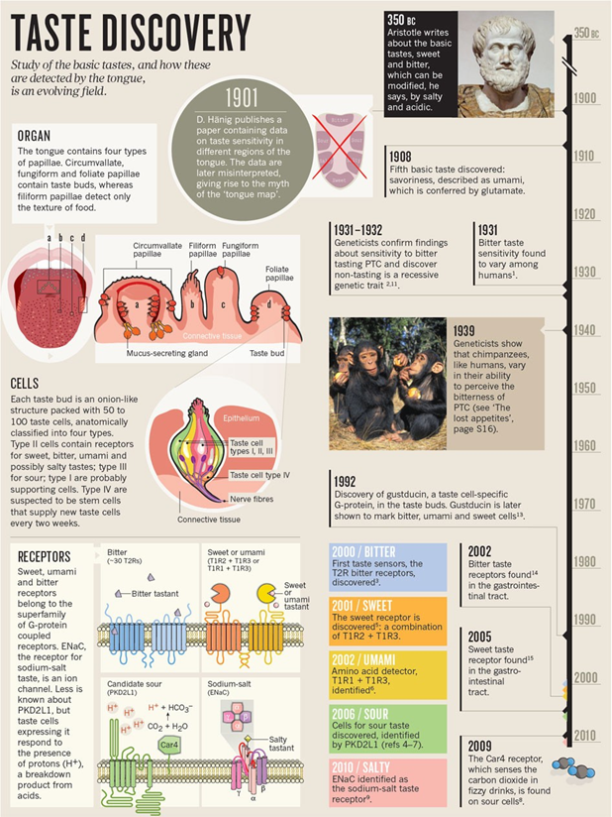
  2.3. Flavour and aroma profiles: sweet, savoury, sour, bitter, umami and characteristic aromas for dishes in the board kitchen
Eating healthy on board requires not only balancing nutritional values, but also skilful use of flavour and aroma profiles to create nutritious and appealing meals for the crew.
The different flavours - sweet, salty, sour, bitter and umami - along with the characteristic aromas are key to a varied and satisfying menu that not only meets physiological needs but also supports good mood and energy levels.
ONBOARD HEALTHY NUTRITION

Slide 69

  2.3.1. Sweet
Role in nutrition: sweetness is a natural part of many foods such as fruits, honey and vegetables (carrots, sweet potatoes) that provide energy through carbohydrates.
Use of the board: Preparing desserts and dishes with slightly sweet tastes, such as Asian sweet and sour sauces or fruit salads.
Healthy ingredients: natural sweeteners, such as honey or fruit concentrates, are preferred over refined sugar.
ONBOARD HEALTHY NUTRITION

Slide 70

  2.3.2. Salty
Nutritional Role: Salty flavours stimulate appetite and are important for electrolyte balance in the body, especially in a physically active crew.
Board use: skilfully seasoning dishes with salt or natural sources of salty flavour such as soy sauce, seafood and cheeses.
Health tip: Limit excess salt and replace it with spices and herbs to enhance flavour.
ONBOARD HEALTHY NUTRITION

Slide 71
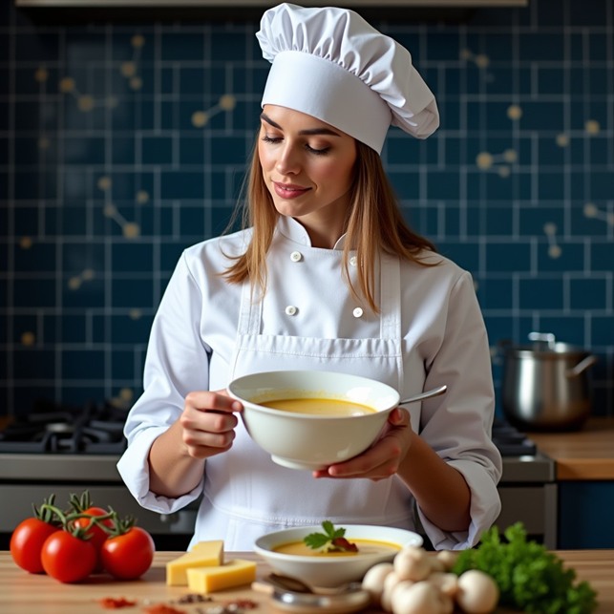
  2.3.3. Sour
Nutritional role: sour flavours induced by lemon, vinegar or fermented foods aid digestion and create balance in dishes.
Applications for the board: marinating meats, using citrus for freshness in salads and sauces, and incorporating pickled vegetables as part of garnishes.
Healthy ingredients: lemons, vinegar, yoghurt and fermented foods such as kimchi or pickles.
ONBOARD HEALTHY NUTRITION

Slide 72

  2.3.5. Bitter
Nutritional Role: Bitter flavours are often associated with antioxidant compounds and support liver and digestive system function.
Application on the board: Use bitter greens such as arugula, chicory or broccoli, as well as herbs such as parsley and cilantro.
Health benefits: bitter foods often reduce cravings for sweet and fatty foods, which is helpful for maintaining a balanced diet.
ONBOARD HEALTHY NUTRITION

Slide 73

  2.3.5. Umami
Role in nutrition: umami, often described as the "fifth taste," is a rich and deep flavour that enhances the overall appetite for foods.
Use the board: add mushrooms, soy sauce, tomatoes, cheese or meat broths to create complex flavours in main dishes.
Healthy Ingredients: Using natural sources of umami instead of supplements.
ONBOARD HEALTHY NUTRITION

Slide 74

  2.3.6. The sixth in the board kitchen: the starch
In addition to the five basic tastes - sweet, salty, bitter, sour and umami - scientists identified a sixth taste: starchy. This taste, which is associated with polysaccharides such as maltodextrin, offers a new dimension to understanding food and its impact on the senses. In onboard cuisine, starch plays a key role in meal planning, often being incorporated into foods such as bread, pasta, rice and potatoes.
Application in the kitchen on board. Energy value: starch is an essential source of energy for the crew during long voyages. Foods such as pasta, rice and potatoes not only fill you up but also provide long-lasting energy.
ONBOARD HEALTHY NUTRITION

Slide 75

Flavour appeal: starchy foods have a mild and delicate flavour that complements other flavour profiles such as umami and sweetness. They often serve as a base for complex dishes.
Cultural relevance: starch is a staple ingredient in many traditional cuisines, making it universally acceptable to a multicultural crew.
ONBOARD HEALTHY NUTRITION

Slide 76
Importance of a healthy diet: although starch is an important source of energy, it should be used in moderation, especially in processed forms such as chips and sweets. Whole grain and natural sources of starch, such as brown rice, whole grain pasta and root vegetables, are recommended across the board.
Menu integration: create dishes such as risotto, roast potatoes with herbs or pasta with tomato sauce that combine starch with other flavour profiles to provide variety and balance.
ONBOARD HEALTHY NUTRITION

Slide 77

  2.3.7. The sixth taste in the kitchen on board: ammonium chloride
According to other scientists, the sixth taste is ammonium chloride - a challenge for the board's kitchen. In addition to the five traditional tastes - sweet, salty, sour, bitter, and umami - research has revealed the existence of a sixth major taste: ammonium chloride. This taste is often described as "salty-bitter", which alerts the consumer of the product to possible toxicity. Despite its unusual taste, ammonium chloride is a common component in some regional cuisines, especially in Scandinavian countries
ONBOARD HEALTHY NUTRITION

Slide 78
  2.3.7. The sixth taste in the kitchen on board: ammonium chloride
On ships with crews of different nationalities, this flavour can be included as part of the daily menu to meet cultural expectations and preferences. For this reason, the new taste discovered makes it important not only for culinary purposes but also to maintain the instinct of caution when consuming potentially dangerous foods.
ONBOARD HEALTHY NUTRITION

Slide 79
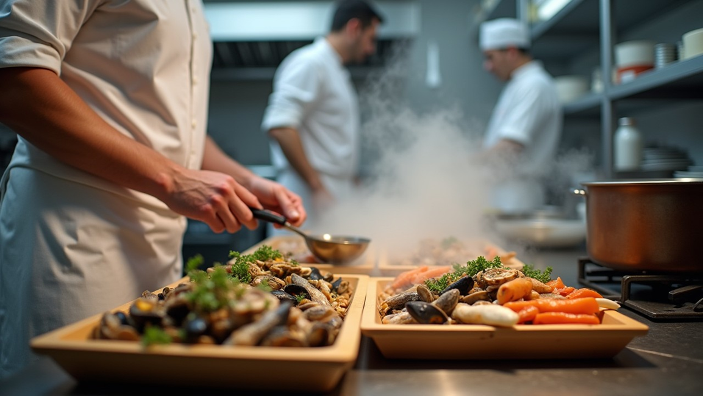
3. Incorporating different culinary traditions into the food on board
ONBOARD HEALTHY NUTRITION

Slide 80
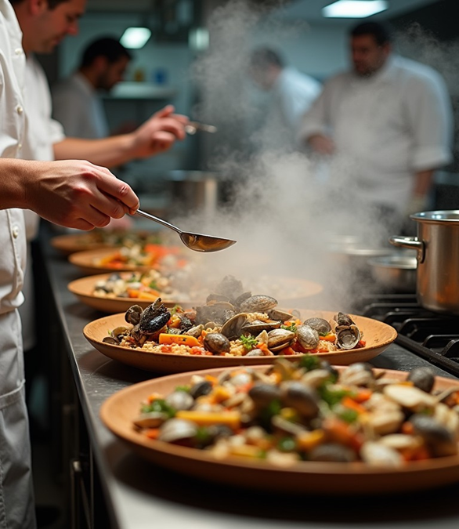
  3.1.1. Adapting regional dishes for the ship's kitchen environment
Optimising preparation techniques for limited kitchen spaces
Multifunctional equipment. Use appliances such as steam cookers that combine steaming, baking and grilling to reduce the need for multiple appliances
Methods for rapid preparation. Application of techniques such as sautéing, stir-frying or vacuum cooking (sous-vide) that save time and space
Rational workflow planning: organisation of pre-preparation (mise-en-place) to facilitate the preparation of complex dishes in a limited time.
ONBOARD HEALTHY NUTRITION

Slide 81
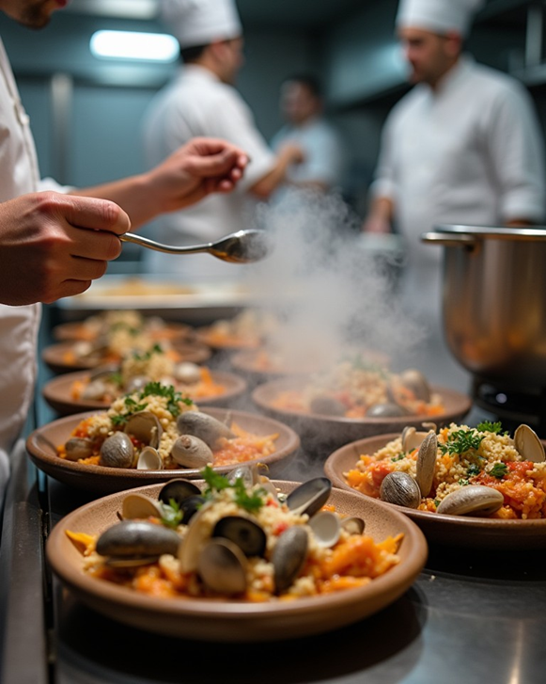
Choosing ingredients with a longer shelf life
Frozen and dried products: frozen vegetables, dried spices, and legumes that retain their quality for a long period.
Canned foods: canned tomatoes, fish (e.g. tuna) and legumes, which can serve as the basis for many dishes.
Long-life cereals and legumes: rice, quinoa, millet and lentils are suitable for long-term storage and easy adaptation to different recipes.
Substitutes for fresh produce: use pastes (e.g. ginger or garlic paste) and concentrates that have a longer shelf life and retain flavour profiles.
ONBOARD HEALTHY NUTRITION

Slide 82
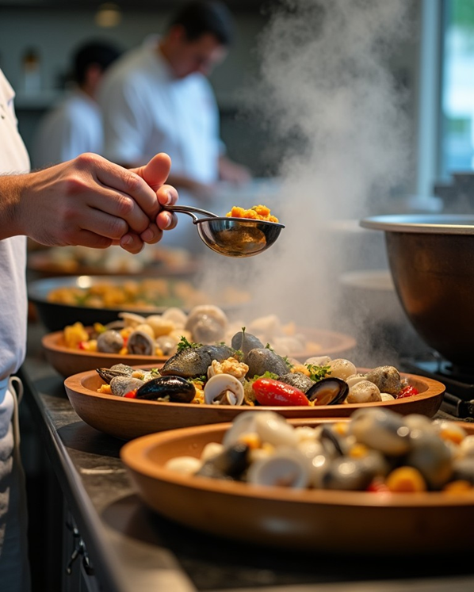
Adapting regional dishes to board needs
Mediterranean recipes: preparing dishes such as pasta with pesto or salads with chickpeas and olive oil that are easy to store and prepare.
Asian recipes: application of techniques such as stir-fry with rice, vegetables and soy sauce that do not require much space or complicated preparation.
Latin American recipes: use corn and beans for dishes such as tacos or chilli, which can be prepared in advance and reheated.
Taste Profile Adaptation: Reduce spiciness or specific seasonings to meet the diverse preferences of the crew.
ONBOARD HEALTHY NUTRITION

Slide 83
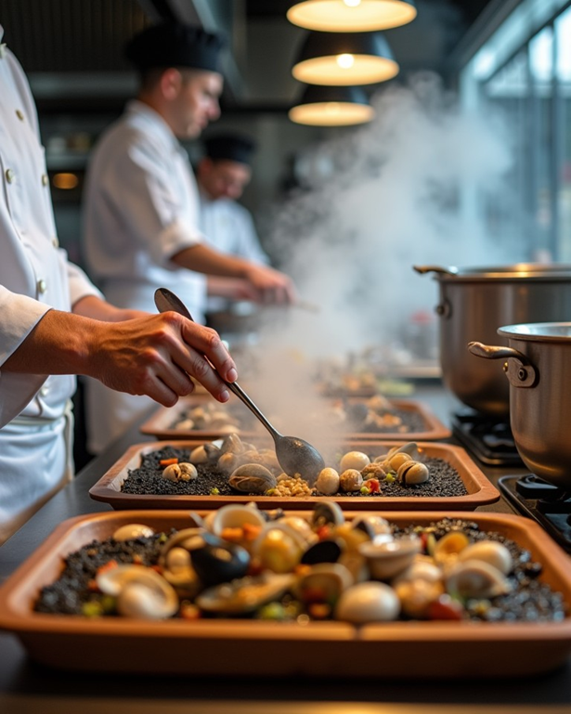
  Healthy menu planning tailored to the needs of the crew
Balancing nutrients for different crews. Planning a menu for the crew requires a combination of macronutrients (protein, carbohydrates and fat) and micronutrients (vitamins and minerals) to ensure energy, stress resistance and good health during sailing.
Protein: Provide a variety of sources such as fish, poultry, eggs, legumes.
Carbs: Include whole grains like brown rice, quinoa, millet and potatoes for long-lasting energy.
Healthy Fats: Use olive oil, avocados and nuts, which are easy to store and support cardiovascular health.
Micronutrients: Add fresh or frozen vegetables and fruits for vitamin and fibre needs.
ONBOARD HEALTHY NUTRITION

Slide 84
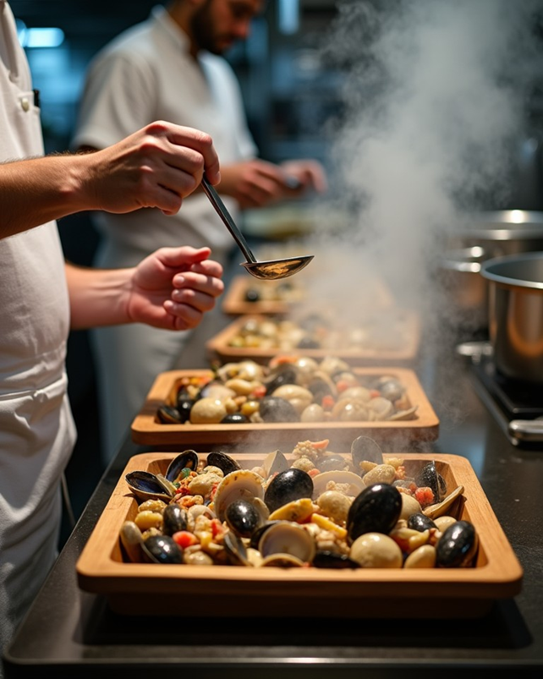
Create menus that take into account dietary restrictions. In order to meet the diverse demands of the crew, the menu needs to offer flexibility:
Vegetarian and vegan meals: Incorporate high-protein vegetable dishes (lentils, chickpeas, quinoa) and a variety of spices to enhance flavour.
Gluten-free options: replace traditional grains with quinoa, rice, or millet and use gluten-free flour for bread or desserts.
Low-carb and diabetic options: Offer meals high in protein and vegetables, with limited use of sugars and refined carbohydrates.
Alternatives for food allergies: Avoid common allergens such as nuts, dairy or seafood, and offer safe alternatives.
ONBOARD HEALTHY NUTRITION

Slide 85
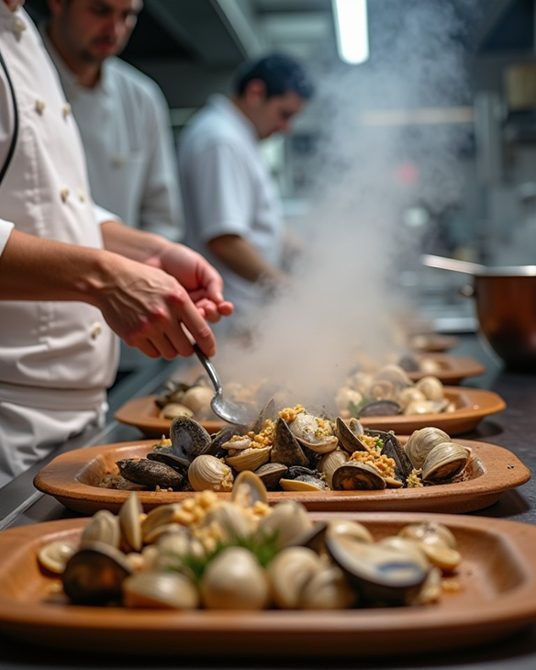
3.3. Practical tips for healthy menu planning
3.3.1. Implement food storage and preparation practices in the onboard kitchen
Menu rotation: create a 7-day or 14-day menu to avoid monotony and maintain interest in the dishes on offer.
Incorporating international flavours: add dishes from different cuisines (Mediterranean, Asian, Latin American) that offer variety and suit the cultural preferences of the crew.
Pre-prep: Use mise-en-plays to speed up the preparation process and avoid stress in the kitchen.
Planning a healthy and varied menu improves crew satisfaction, supports their health and increases their onboard performance.
ONBOARD HEALTHY NUTRITION

Slide 86
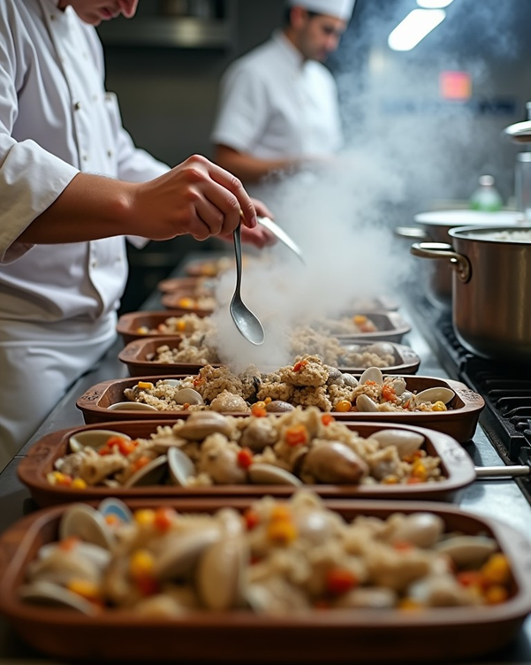
    3.3.2. Crew training and encouragement
Engage chefs in learning new cuisines: conduct training, workshops and demonstrations of dishes from different cultures. Encourage knowledge exchange between chefs, especially if they are from different nationalities.
Stimulating creativity: giving chefs the freedom to adapt recipes using the ingredients available on board.
Organise contests for the best new dish or implementation of healthy practices.
Encourage crew to try new foods: Include tasting menus explaining the nutritional benefits. Present dishes from different cultures in an intriguing way to pique crew interest.
ONBOARD HEALTHY NUTRITION

Slide 87

4. Practical workshops
    Workshop assignment for the course Healthy Cooking Dishes from Different Cultures
    Workshop Goal: Develop skills in preparing healthy dishes from different cultures, focusing on the use of international ingredients and their adaptation to specific conditions.
    Tasks for participants:
    Practical ingredient exploration: conduct a tasting of regional ingredients such as olive oil, quinoa, soy sauce, lemongrass, coriander, turmeric, etc.
    .
ONBOARD HEALTHY NUTRITION

Slide 88
4. Practical workshops
    Workshop assignment for the course Healthy Cooking Dishes from Different Cultures
    2. Evaluate flavors, aromas and textures of ingredients. Discuss their use in healthy cuisine and how they can adapt to an onboard environment.
    3. Create a healthy menu: divide into teams and develop a weekly menu with dishes from at least three different national cuisines (e.g., Mediterranean, Asian, and Latin American). Include a balance of nutrients and use ingredients with a long shelf life.
ONBOARD HEALTHY NUTRITION

Slide 89
4. Practical workshops
    4. Process of preparing a dish. Describe the preparation process in the following steps:
    - Preparation of ingredients: describe what ingredients you will use, how you will clean, chop or process them (e.g. chopping vegetables, marinating meat).
    - Cooking technology: Describe how the dish will be prepared - e.g. sautéing, baking, boiling. Specify the time and temperature required for each step.
ONBOARD HEALTHY NUTRITION

Slide 90
4. Practical workshops
    Final presentation: Describe how the dish will be served (e.g., decoration, garnish) and how it will be optimized for board conditions.-Menu and Process Presentation: Each team presents their menu and describes the process of preparing the selected dish.
    Evaluation criteria of the practical assignment:
    Originality and cultural awareness in the choice of dishes.
    Balance and healthiness of the proposed menu
ONBOARD HEALTHY NUTRITION

Slide 91
4. Practical workshops
    Evaluation criteria of the practical assignment:
    Detail and practicality in the description of the preparation process.
    Creativity in the presentation of the menu and the dish.
    The workshop encourages participants to explore international culinary traditions, develop practical skills for preparing healthy dishes and adapt their approaches to the specific conditions of a ship's kitchen.
ONBOARD HEALTHY NUTRITION

Slide 92
ASSESSMENT
Please check moodle page
ONBOARD HEALTHY NUTRITION

Slide 93
Course References
BAKER, Nick V. The Blue Book.
CIVITELLO, Linda. Cuisine and culture: A history of food and people. John Wiley & Sons, 2011.
COUNIHAN, Carole, et al. Food and culture. New York, NY: Routledge, 2013.
DONNELLY, Andrew; LEIDWANGER, Justin. Food at sea on the Late Antique Mediterranean. Journal of Roman Archaeology, 2025, 1-14.
GATLEY, Andy. The significance of culinary cultures to diet. British Food Journal, 2016, 118.1: 40-59.
EDELSTEIN, Sari. Food, cuisine, and cultural competency for culinary, hospitality, and nutrition professionals. Jones & Bartlett Publishers, 2010.
FIELDHOUSE, Paul. Food and nutrition: customs and culture. Springer, 2013.
KARKORI, Fidaa. Importance of Good Health and Hygiene on Ships. In: Ship Sanitation, Health and Hygiene: An Approach to Better Welfare for Modern Seafarers. Cham: Springer Nature Switzerland, 2024. p. 73-82.
MARCUS, Jacqueline B. Culinary nutrition: the science and practice of healthy cooking. Academic Press, 2013.
MONTANARI, Massimo. Food is culture. Columbia University Press, 2006.
PARASECOLI, Fabio. Al dente: a history of food in Italy. Reaktion Books, 2025.
RABER, Margaret, et al. An evidence-based conceptual framework of healthy cooking. Preventive Medicine Reports, 2016, 4: 23-28.
ONBOARD HEALTHY NUTRITION

