Slide 1








MARitime Soft Skills for Onboard Healthy Nutrition and CULinary Arts in Seagoing Services – CUL-MAR-Skills
KA220-VET - Cooperation partnerships in vocational education and training
2023-1-RO01-KA220-VET-000156711
ONBOARD HEALTHY NUTRITION
COURSE 5
.....................
Disclaimer: “Funded by the European Union. Views and opinions expressed are however those of the author(s) only and do not necessarily reflect those of the European Union or the ANPCDEFP. Neither the European Union nor the ANPCDEFP can be held responsible for them”

Slide 2
Learning outcomes of the course
Master basic knife skills
Apply proper cutting techniques
Implement efficient food preparation practices
Ensure safe handling of kitchen equipment
Promote healthy and creative cuisine
Maintain clean and sanitized cutting boards, knives, and preparation surfaces
Prevent cross-contamination between raw and cooked foods
NAVAL COMMUNICATIONS
ONBOARD HEALTHY NUTRITION

Slide 3
Content of the course
Introduction to knife skills and food preparation techniques
Types of knives and their uses
Knife handling and maintenance
Basic cutting techniques
Safe handling of kitchen equipment
Efficient food preparation methods
Assessment
ONBOARD HEALTHY NUTRITION

Slide 4
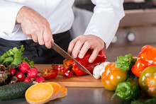
1. Introduction to knife skills and food preparation techniques
ONBOARD HEALTHY NUTRITION

Slide 5
1.1 Why Are Knife Skills Important
Efficient cutting saves time and enhances productivity.
Proper techniques reduce food waste and ensure consistency in preparation.
Improves safety and reduces the risk of injuries.
Enhances the visual appeal and quality of meals.
ONBOARD HEALTHY NUTRITION

Slide 6
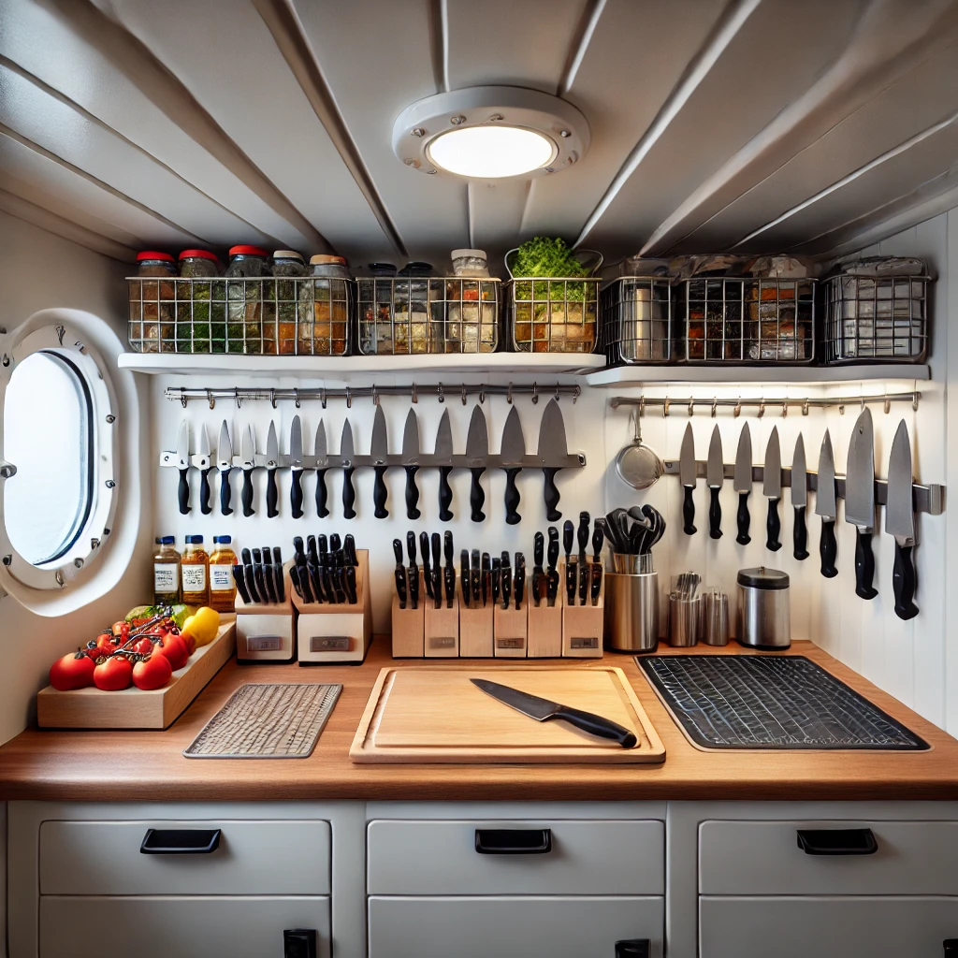
1.2 Why is Knife Skills relevant to Galley operations
Space constraints demand precision and organization.
High crew expectations require consistent, high-quality meal preparation.
Adherence to safety standards ensures a hazard-free environment.
ONBOARD HEALTHY NUTRITION

Slide 7
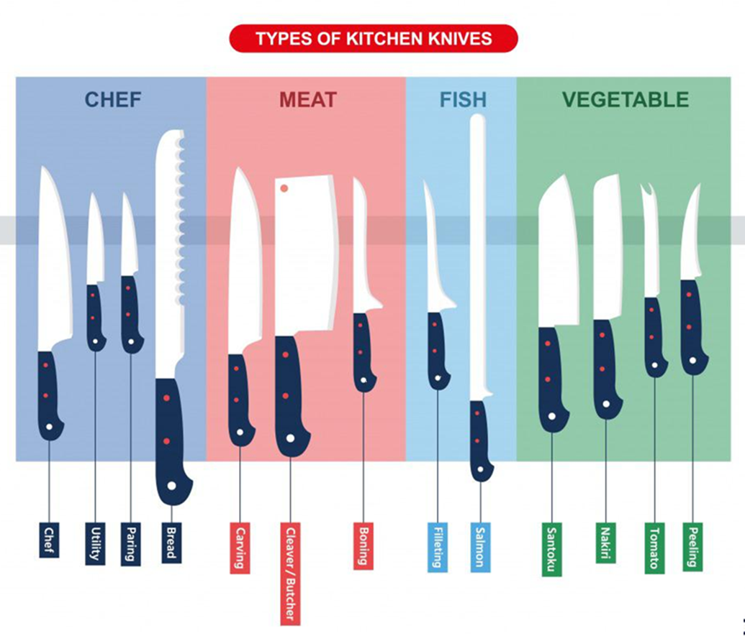
1.3 Types of knives and their specific applications
ONBOARD HEALTHY NUTRITION

Slide 8
1.3.1 Common Knife Types
Chef’s Knife: Versatile and multipurpose. Suitable for chopping, slicing, dicing, and mincing a variety of ingredients.
Paring Knife: Ideal for small, intricate tasks like peeling fruits and vegetables or deveining shrimp.
Serrated Knife: Designed for cutting through foods with a hard exterior and soft interior, such as bread or tomatoes.
Boning Knife: Used for deboning meat and fish. Flexible blades help maneuver around bones and joints.
Cleaver: Heavy and wide, perfect for cutting through bones or dense vegetables like squash.
Santoku knife: A Japanese knife that excels in slicing, dicing, and chopping with a straighter edge for a clean cut.
ONBOARD HEALTHY NUTRITION

Slide 9
1.3.2 Benefit of using appropriate knives
Precision Cuts: Ensure consistent cooking times and presentation.
Time Efficiency: The right knife for the task minimizes effort and enhances workflow.
Safety: Using a specialized knife reduces the risk of accidents caused by improper tools.
ONBOARD HEALTHY NUTRITION

Slide 10
1.4 Safe Knife Handling and Maintenance Techniques
A. Safe Knife Handling
Grip: Use a firm grip with your thumb and index finger pinching the blade at the base. Keep the rest of your fingers curled around the handle for control.
Cutting Surface: Always use a stable, non-slip cutting board to prevent accidents. Avoid cutting directly on metal or glass surfaces.
Knife Placement: Never leave knives in sinks or hidden under other utensils. Place knives in a safe, visible location when not in use.
Cutting Technique: Use a rocking motion with the chef’s knife for efficient chopping. Keep your guiding hand in a "claw" position to protect your fingers.
ONBOARD HEALTHY NUTRITION

Slide 11
1.4 Safe Knife Handling and Maintenance Techniques
B. Knife Maintenance
Cleaning: Wash knives immediately after use with warm, soapy water. Avoid putting knives in dishwashers to prevent dulling or warping.
Sharpening: Hone knives regularly using a honing steel to maintain a sharp edge. Sharpen blades periodically using a whetstone or professional service.
Storage: Use knife blocks, magnetic strips, or blade guards to store knives safely.
ONBOARD HEALTHY NUTRITION

Slide 12
1.5 Mastery of Essential Cutting Techniques
A. Core Cutting Methods
Slicing: Long, even cuts suitable for meats, fruits, and vegetables. Ensure consistent thickness for uniform cooking.
Dicing: Cutting into small, uniform cubes, commonly used for soups, stews, and salads. Fine dice (brunoise) for garnishes; medium dice for general use.
Chopping: Rough, irregular cuts suitable for rustic recipes or when precision isn’t critical.
Mincing: Fine cutting of herbs, garlic, or onions to release maximum flavor.
Julienning: Cutting into thin, matchstick-like strips, often used for stir-fries or garnishes.
Chiffonade: Rolling leafy greens or herbs tightly and slicing into thin ribbons, ideal for salads or garnishes.
ONBOARD HEALTHY NUTRITION

Slide 13
1.5 Mastery of Essential Cutting Techniques
B. Best Practices
Preparation: Organize your workstation with clean tools, ingredients, and adequate lighting.
Practice: Begin slowly to focus on technique before increasing speed.
Visual Consistency: Aim for uniform cuts to enhance presentation and ensure even cooking.
Waste Minimization: Utilize scraps for stocks or compost to reduce food waste.
ONBOARD HEALTHY NUTRITION

Slide 14
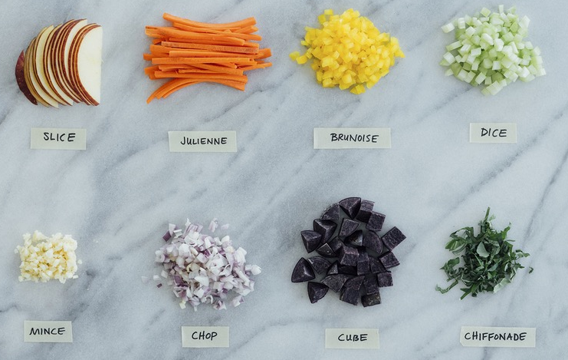
1.5 Mastery of Essential Cutting Techniques
ONBOARD HEALTHY NUTRITION

Slide 15
1.6 Takeaway message
Faster preparation speeds in tight schedules.
A professional touch to meals with clean, consistent cuts.
Enhanced safety, reducing accidents caused by improper cutting techniques.
ONBOARD HEALTHY NUTRITION

Slide 16
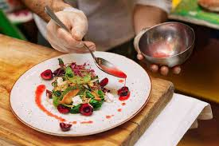
2. Efficiency and creativity in food preparation
ONBOARD HEALTHY NUTRITION

Slide 17
2.1 Time Management
Meal Planning: Prepare a clear plan for the menu and recipes to streamline preparation.
Batch Cooking: Cook in larger quantities when possible, storing portions for later use.
“Mise en Place”: A French culinary term meaning “everything in its place”. Prepare and organize ingredients (e.g., chopped vegetables, measured spices) before cooking.
ONBOARD HEALTHY NUTRITION

Slide 18
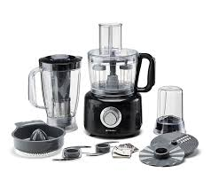
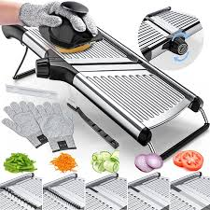
2.2 Use of Multi-Functional Equipment
Invest in versatile appliances to save time and space in the galley.
Utilize tools such as food processors, blenders, or mandolins to speed up repetitive tasks.
ONBOARD HEALTHY NUTRITION

Slide 19
2.3 Minimize food waste
Peels and Scraps: Repurpose vegetable scraps for stocks or soups.
Portion Control: Measure ingredients accurately to avoid over-preparation.
FIFO Principle: Rotate stock to use older items first, reducing spoilage.
ONBOARD HEALTHY NUTRITION

Slide 20
2.4 Effective Workflow
Design an ergonomic kitchen layout to minimize unnecessary movement.
Assign tasks efficiently among the crew to save time during high-demand periods.
ONBOARD HEALTHY NUTRITION

Slide 21
2.5 Creativity in Food Preparation
Innovative Ingredient Use: Substitute ingredients to create diverse meals (e.g., use yogurt instead of cream for healthier dishes). Explore different cuisines and techniques to enhance the menu variety.
Presentation Techniques: Plate food attractively using vibrant garnishes, contrasting colors, and balanced portions. Use tools like ring molds or squeeze bottles for professional plating.
Incorporating Seasonal and Local Ingredients: Adjust recipes to feature seasonal produce, enhancing freshness and sustainability. Use locally sourced ingredients to support sustainability and reduce costs.
Adapting to Dietary Preferences: Offer customizable options, such as gluten-free or vegetarian dishes, to cater to diverse crew needs. Experiment with flavor profiles to create memorable meals.
ONBOARD HEALTHY NUTRITION

Slide 22
2.6 Practical Tips for Galleys
Prioritize Organization: Label storage areas for quick ingredient access. Maintain a clean workstation to reduce time spent searching for tools or supplies.
Incorporate Pre-Prep Techniques: Pre-cut and pre-wash vegetables to reduce preparation time during meal service. Use marinades or pre-mixed seasonings to enhance flavors without added effort.
Balance Nutrition and Creativity: Pair creativity with nutritional balance, ensuring meals are both enjoyable and healthy. Incorporate colorful vegetables and herbs for visual and nutritional appeal.
Experiment with Plating Styles: Test different plating styles to find the most appealing presentations. Use elements like height, symmetry, or asymmetry to make dishes visually interesting.
ONBOARD HEALTHY NUTRITION

Slide 23
2.7 Takeaway messages
Faster Meal Production: Allows the crew to maintain schedules and serve meals on time.
Minimized Stress: Streamlined workflows reduce pressure during peak hours.
Enhanced Dining Experience: Creative presentation makes meals more enjoyable and memorable.
Cost Savings: Efficient preparation reduces waste and optimizes ingredient use.
ONBOARD HEALTHY NUTRITION

Slide 24
3. Creative and Healthy Meal Preparation
ONBOARD HEALTHY NUTRITION

Slide 25
3.1 Balancing Nutrition and Flavor
Use of Healthy Ingredients: Incorporate whole grains, lean proteins, and healthy fats. Add colorful fruits and vegetables for variety and vitamins.
Reduce Unhealthy Components: Limit added sugars, salts, and saturated fats. Opt for natural sweeteners and herbs for seasoning.
Enhance Flavors Creatively: Experiment with spices, herbs, and marinades. Use citrus, garlic, or vinegars for zest without extra calories.
ONBOARD HEALTHY NUTRITION

Slide 26
3.2 Techniques for Creative Meal Preparation
Layering Textures and Colors: Combine crisp, smooth, and crunchy textures for an engaging meal. Add vibrant colors to make dishes more visually appealing.
Innovative Presentation Styles: Plate meals artistically using height, symmetry, or patterns. Serve meals in unique ways, like bowls, wraps, or layered dishes.
Healthy Substitutions: Replace heavy creams with yogurt or coconut milk. Use whole-wheat pasta, zoodles, or cauliflower rice instead of refined grains.
ONBOARD HEALTHY NUTRITION

Slide 27
3.3 Meal Preparation in Small Spaces
Optimize Galley Space: Use compact and multi-functional appliances. Keep utensils and tools organized and within reach.
Batch Preparation and Storage: Prepare components in bulk for multiple dishes. Use airtight containers for long-lasting freshness.
Adapt Recipes to Limitations: Choose recipes that require minimal ingredients and equipment. Prioritize one-pot or sheet-pan meals for simplicity.
ONBOARD HEALTHY NUTRITION

Slide 28
3.4 Takeaway message
Focus on seasonal ingredients for freshness and flavor.
Adjust dishes to meet dietary preferences like vegetarian or low-carb.
Experiment with international cuisines for new ideas.
Ensure meals are balanced in macronutrients (proteins, carbs, and fats).
Use leftovers creatively to reduce waste and inspire new dishes.
ONBOARD HEALTHY NUTRITION

Slide 29
4. Best Practices for Healthy and Efficient Cooking
ONBOARD HEALTHY NUTRITION

Slide 30
4.1 Healthy Cooking Techniques
Steaming: Cooking food using steam. Ideal for vegetables, fish, and dumplings. Preserves vitamins and minerals.
Grilling: Cooking food over direct heat, often on a grill or griddle. Adds natural smokiness and flavor. Reduces fat content by letting excess fat drip off.
Roasting: Baking food in the oven with dry heat, often at high temperatures. Ideal for root vegetables, poultry, and meats. Enhances natural sweetness and caramelization.
Sautéing: Cooking food quickly in a small amount of oil or butter over medium-high heat. Great for vegetables, seafood, or lean meats. Preserves texture and color of ingredients.
ONBOARD HEALTHY NUTRITION

Slide 31
4.2 Flavour Enhancement
Use of herbs and spices: Basil, rosemary, cumin, turmeric for added depth. Experiment with spice blends from different cuisines.
Acidity for balance: Add lemon juice, vinegars, or citrus zest. Enhances brightness and cuts through richness.
Layering textures: Combine crispy, creamy, and tender elements. Provides a more engaging eating experience.
Marinades and rubs: Combine garlic, ginger, and soy for umami flavors. Use yogurt or citrus-based marinades for tenderizing proteins.
Natural sweetness: Add fruits like apples, berries, or dates. Helps balance flavors without refined sugars.
ONBOARD HEALTHY NUTRITION

Slide 32
4.3 Time management in food preparation
Meal planning: Create a weekly menu to avoid last-minute stress. Focus on balanced meals with versatile ingredients.
Batch cooking: Prepare large quantities of staples (e.g., grains, soups). Freeze portions for quick reheating.
Prep in advance: Chop vegetables, marinate proteins, and measure spices ahead of time. Use pre-portioned ingredients to speed up cooking.
Use multi-functional equipment: Opt for pressure cookers, slow cookers, or air fryers. Save time with one-pot or sheet-pan meals.
Organize workspace: Keep tools and ingredients easily accessible. Clean as you go to minimize downtime.
ONBOARD HEALTHY NUTRITION

Slide 33
4.4 Takeaway message
Prioritize nutrient-rich cooking methods like steaming and roasting.
Use natural ingredients to enhance flavor creatively.
Save time by adopting batch cooking and meal planning habits.
Maintain an organized kitchen to work efficiently.
Continuously explore new techniques to make meals healthier and more flavorful.
ONBOARD HEALTHY NUTRITION

Slide 34
5. Safe handling of kitchen equipment
ONBOARD HEALTHY NUTRITION

Slide 35
5.1 Why safe handling of kitchen equipment matters
Safe handling
Prevents accidents and injuries.
Ensures smooth and efficient food preparation.
Prolongs the life of kitchen tools and appliances.
ONBOARD HEALTHY NUTRITION

Slide 36
5.2 Proper use and maintenance of kitchen equipment
Stove and Oven: Ensure knobs are off when not in use. Clean spills immediately to prevent grease fires. Regularly check for gas leaks or faulty wiring.
Blender and Food Processor: Assemble and secure parts properly before use.Never reach into the bowl while the blades are in motion. Wash blades and containers carefully to avoid cuts.
Safety Precautions: Always read the equipment manual. Inspect appliances regularly for wear or damage. Keep cords and plugs away from water.
ONBOARD HEALTHY NUTRITION

Slide 37
5.3 Safe electrical practices in the kitchen
Avoid overloading circuits: Use appliances one at a time on shared outlets. Plug directly into a grounded outlet, avoiding extensions.
Prevent water contact: Keep cords and plugs dry. Never use wet hands to handle electrical appliances.
Perform regular inspections: Check cords for frays, cracks, or damage. Replace damaged equipment immediately.
Turn off when not in use: Unplug appliances after use to conserve energy and reduce risk.
ONBOARD HEALTHY NUTRITION

Slide 38
5.3 Fire safety and injury prevention
Fire safety: Keep a fire extinguisher within reach. Use pots and pans with handles turned inward to avoid spills. Never leave cooking unattended.
Responding to fires: Smother small grease fires with a lid or baking soda. Never use water on a grease fire. Evacuate and call for help if the fire spreads.
Handling sharp tools: Always cut on a stable surface. Keep knives sharp; dull blades are more dangerous. Store sharp tools in a secure location, such as a knife block.
ONBOARD HEALTHY NUTRITION

Slide 39
5.4 Takeaway message
Know your tools: Understand proper use and limits of all equipment.
Routine maintenance: Clean and check appliances regularly to avoid hazards.
Electrical and fire safety: Follow all safety protocols to prevent accidents.
Injury prevention: Use protective gear like oven mitts and avoid distractions while handling hot or sharp tools.
ONBOARD HEALTHY NUTRITION

Slide 40
6. Cross-Contamination Prevention
ONBOARD HEALTHY NUTRITION

Slide 41
6.1 Critical role of hygiene
Cross-contamination is the transfer of harmful microorganisms between foods, surfaces, or hands. It acts as a primary cause of foodborne outbreaks.
Good hygiene practices can prevent cross-contamination.
Prevents the spread of harmful bacteria and foodborne illnesses.
Is essential for maintaining food safety and crew health.
ONBOARD HEALTHY NUTRITION

Slide 42
6.2 Cross-contamination prevention
Separate Workspaces: Dedicate areas for raw and ready-to-eat foods. Clean and sanitize surfaces frequently.
Proper Use of Utensils and Equipment: Use separate knives and cutting boards for raw meats, produce, and cooked foods. Color-code tools to avoid mix-ups.
Storage Practices: Store raw foods below cooked or ready-to-eat items in the refrigerator. Seal and label all food containers.
ONBOARD HEALTHY NUTRITION

Slide 43
6.3 Cleaning and sanitizing protocols
Routine Cleaning: Clean as you go to maintain a safe and organized workspace. Use hot, soapy water for washing utensils and surfaces.
Sanitizing: Apply food-safe sanitizers to kill bacteria after cleaning. Ensure tools and equipment are completely dry before reuse.
Waste Management: Dispose of food waste promptly to avoid contamination. Use covered bins and empty them regularly.
ONBOARD HEALTHY NUTRITION

Slide 44
6.4 Takeaway message
Train all staff on food safety protocols and updates.
Perform regular hygiene inspections in the galley.
Use appropriate equipment and calibrated thermometers to ensure proper cooking and storage temperatures.
Encourage a culture of accountability for hygiene among the crew.
ONBOARD HEALTHY NUTRITION

Slide 45
ASSESSMENT
Please check moodle page
ONBOARD HEALTHY NUTRITION

Slide 46
Course References
The Culinary Institute of America. The Professional Chef. 10th edition. Willey (2024).
Lumb M. Kitchen Knife Skills. Apple Press; UK ed. edition (2009).
Dornenburg A, Page K. Culinary Artistry. 1st ed. Willey (1996).
ONBOARD HEALTHY NUTRITION

