Slide 1






MARitime Soft Skills for Onboard Healthy Nutrition and CULinary Arts in Seagoing Services – CUL-MAR-Skills
KA220-VET - Cooperation partnerships in vocational education and training
2023-1-RO01-KA220-HED-000155888
Disclaimer: “Funded by the European Union. Views and opinions expressed are however those of the author(s) only and do not necessarily reflect those of the European Union or the ANPCDEFP. Neither the European Union nor the ANPCDEFP can be held responsible for them”

Slide 2
“ONBOARD HEALTHY NUTRITION”
Menu Planning And Recipe Development
By the end of this chapter, the participants will be able to:
Understand how to design inclusive menus that respect diverse cultural, religious, and dietary needs
Be proficient in creating or adapting recipes for the constraints of a marine kitchen
Have the ability to balance cost-efficiency with high-quality ingredients in provisioning.
Understand how providing high-quality meals, tailored to the crew's tastes and needs, can boost morale, reduce stress, and improve productivity.

Slide 3

“ONBOARD HEALTHY NUTRITION”
Menu Planning And Recipe Development
Explore alternative cooking methods, seasonal menus, and the use of herbs and spices to create diverse flavors.
Develop systems for tracking ingredient use, minimizing food waste, and maintaining cost-effective supply chains.

Slide 4
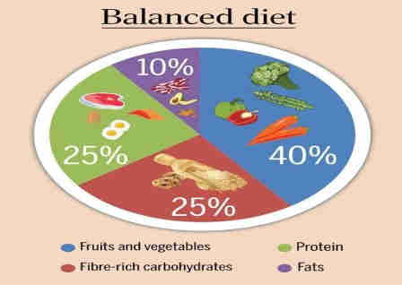
“ONBOARD HEALTHY NUTRITION”
Menu Planning And Recipe Development
Techniques for planning menus that cater to diverse tastes and dietary needs
Dietary needs seafarers may be due to the unique demands of life at sea, physical workload, cultural diversity, and health considerations. These include:
Nutritional Needs for Physical Demands
Nutrient Deficiencies
Catering to Cultural and Religious Diversity
Notes:
Seafarers may have a wide range of dietary needs due to the unique demands of life at sea, physical workload, cultural diversity, and health considerations. These include:
1. Nutritional Needs for Physical Demands
• Energy Requirements: Seafarers often perform physically demanding tasks, requiring meals rich in energy-dense foods like complex carbohydrates (whole grains, legumes) and healthy fats (nuts, fish, avocados).
• Protein Needs: High-quality protein from lean meats, fish, eggs, or plant-based sources (tofu, lentils) is essential for muscle repair and maintenance, particularly for labor-intensive roles.
2. Nutrient Deficiencies
• Vitamin D: Limited sun exposure during extended periods indoors may lead to deficiencies, necessitating fortified foods or supplements.
• Omega-3 Fatty Acids: Essential for cardiovascular health, these can be sourced from fatty fish or flaxseeds.
• Iron and Calcium: For physical strength and endurance, iron-rich foods (red meat, spinach) and calcium (dairy, fortified plant milk) are important.
3. Catering to Cultural and Religious Diversity
• Halal, Kosher, and Vegetarian Diets: Multicultural crews may require meals adhering to religious dietary laws or preferences.
• Staple Foods from Home Cultures: Including rice, noodles, or bread types specific to crew demographics can boost morale and satisfaction.

Slide 5

“ONBOARD HEALTHY NUTRITION”
Menu Planning And Recipe Development
Techniques for planning menus that cater to diverse tastes and dietary needs
Special Diets for Health Conditions
Diabetes-Friendly Diets
Low-Sodium or Heart-Healthy Diets
Food Allergies and Intolerances
Mental Health and Wellbeing
Notes:
4. Special Diets for Health Conditions
• Diabetes-Friendly Diets: Low-glycemic-index foods, such as whole grains and non-starchy vegetables, are essential for crew members with diabetes.
• Low-Sodium or Heart-Healthy Diets: Needed for seafarers with hypertension or cardiovascular risks, featuring reduced salt and saturated fat intake.
• Food Allergies and Intolerances: Meals must accommodate common allergies (e.g., nuts, shellfish, gluten, dairy) to avoid adverse reactions.
5. Mental Health and Wellbeing
• Balanced diets rich in omega-3s, magnesium, and antioxidants can help combat stress, fatigue, and depression, conditions common in isolated environments like ships.
6. Hydration Needs
• Ensuring access to clean water and hydrating foods (soups, fruits) is critical, as dehydration is a frequent risk in maritime environments.
7. Adaptations for Prolonged Voyages
Preserved and Shelf-Stable Foods: Long storage times require nutrient-rich, non-perishable items like canned fish, dried fruits, and frozen vegetables to supplement fresh produce.
Rotational Menus: Preventing monotony while ensuring balanced nutrition is key during extended sea journeys.

Slide 6
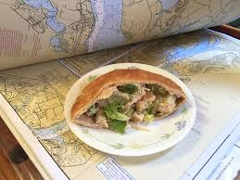
“ONBOARD HEALTHY NUTRITION”
Menu Planning And Recipe Development
Techniques for planning menus that cater to diverse tastes and dietary needs
Hydration Needs
Adaptations for Prolonged Voyages
  Preserved and Shelf-Stable Foods
  Rotational Menus
Notes:
6. Hydration Needs
• Ensuring access to clean water and hydrating foods (soups, fruits) is critical, as dehydration is a frequent risk in maritime environments.
7. Adaptations for Prolonged Voyages
Preserved and Shelf-Stable Foods: Long storage times require nutrient-rich, non-perishable items like canned fish, dried fruits, and frozen vegetables to supplement fresh produce.
Rotational Menus: Preventing monotony while ensuring balanced nutrition is key during extended sea journeys.

Slide 7

“ONBOARD HEALTHY NUTRITION”
Menu Planning And Recipe Development
Techniques for planning menus that cater to diverse tastes and dietary needs
People’s food preferences are influenced by cultural, geographical, historical, and socio-economic factors. Following are the most significant of these factors:
1. Cultural Influences
Traditional Cuisines
Flavor Preferences
Religious Practices
Notes:
People’s food preferences and tastes often vary significantly across different parts of the world, influenced by cultural, geographical, historical, and socio-economic factors. These differences are reflected in ingredients, flavors, preparation methods, and dietary practices. Here's an overview:
1. Cultural Influences
Traditional Cuisines: Cultural heritage shapes food preferences. For example, Mediterranean cuisines often emphasize olive oil, garlic, and seafood, while East Asian cuisines feature rice, soy sauce, and fermented foods like kimchi or miso.
Flavor Preferences: Some cultures favor spicy foods (e.g., India, Thailand), while others prefer milder flavors (e.g., Nordic countries). Sweet, sour, bitter, and umami are appreciated differently across regions.
Religious Practices: Dietary laws and restrictions, such as halal (Islam), kosher (Judaism), and vegetarianism (Hinduism, Jainism), significantly influence food choices in various regions.

Slide 8

“ONBOARD HEALTHY NUTRITION”
Menu Planning And Recipe Development
Techniques for planning menus that cater to diverse tastes and dietary needs
2. Geography and Climate
Local Ingredients
Seasonal Preferences
3. Socio-Economic Factors
Urbanization and Globalization
Economic Status
Notes:
2. Geography and Climate
Local Ingredients: Geographical location determines the availability of specific ingredients. Coastal areas often feature seafood-based diets, while tropical regions may emphasize fruits, cassava, and root vegetables.
Seasonal Preferences: Cold climates often lead to a preference for hearty, calorie-dense meals (e.g., stews, breads), while warmer regions might favor lighter dishes and cooling beverages.
3. Socio-Economic Factors
Urbanization and Globalization: Urban areas may see more diverse food options due to international influence, while rural areas often stick to traditional diets. Western fast food has become popular globally but is often adapted to local tastes (e.g., McSpicy Paneer in India).
Economic Status: Affordability affects preferences. Staple foods like rice, beans, or potatoes are essential in many low-income regions, while higher-income areas might emphasize organic or specialty products.

Slide 9

“ONBOARD HEALTHY NUTRITION”
Menu Planning And Recipe Development
Techniques for planning menus that cater to diverse tastes and dietary needs
4. Psychological and Emotional Factors
Comfort Foods
Novelty vs. Tradition
5. Examples of Regional Differences
Asia-Europe-Africa - Americas
Notes:
4. Psychological and Emotional Factors
Comfort Foods: Foods linked to childhood or local traditions evoke strong emotional connections, making them preferred. For instance, rice is a staple comfort food in many Asian cultures, while bread or pasta might hold similar value in Europe.
Novelty vs. Tradition: Some regions embrace new culinary trends (fusion cuisine), while others may prioritize preserving traditional food customs.
5. Examples of Regional Differences
Asia: Rice dominates as a staple, paired with spices, fermented products, and soy. Sweet desserts are often lighter, such as mochi or mango sticky rice.
Europe: Dairy products, meats, and bread feature prominently, with a wide array of cheeses and cured meats varying by country.
Africa: Spices and starches (e.g., millet, yam, sorghum) dominate, with unique dishes like injera in Ethiopia or jollof rice in West Africa.
Americas: Latin American cuisine emphasizes beans, corn, and bold spices, while North American diets often integrate a mix of indigenous and immigrant influences, such as barbecue and casseroles.
As a result, it can be concluded that globalization has bridged many culinary gaps, introducing regional tastes to international audiences. However, these foundational cultural, geographical, and socio-economic factors continue to preserve distinct food preferences worldwide, showcasing the diversity of human taste and tradition (5).

Slide 10
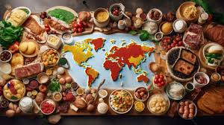
“ONBOARD HEALTHY NUTRITION”
Menu Planning And Recipe Development
Techniques for planning menus that cater to diverse tastes and dietary needs
Key approaches tailored for maritime settings:
Cultural Sensitivity and Diversity
Nutritional Balance
Notes:
ONBOARD SHIPS
Planning menus on board ships to cater to diverse tastes and dietary needs involves specialized techniques, considering the unique challenges of a maritime environment. These include limited storage, varied crew cultural backgrounds, and long durations at sea. Below are key approaches tailored for maritime settings:
Cultural Sensitivity and Diversity
Understanding the cultural and religious backgrounds of the crew is essential. Seafarers often come from diverse nationalities, and their diets may include requirements for halal, kosher, vegetarian, or vegan meals. Menu planning should include a variety of culturally appropriate dishes that respect these dietary restrictions. For instance, providing halal-certified proteins, vegetarian options, and seasoning choices that reflect the preferences of Asian, European, or African crew members fosters inclusivity and morale (6, 7).
Nutritional Balance
Menus must provide sufficient caloric intake and essential nutrients to sustain the demanding physical activities onboard. Balanced meals should include appropriate proportions of carbohydrates, proteins, and fats, alongside adequate vitamins and minerals. Utilizing nutrient-dense foods, such as whole grains, lean proteins, and a variety of vegetables, ensures that the crew's energy needs are met.

Slide 11
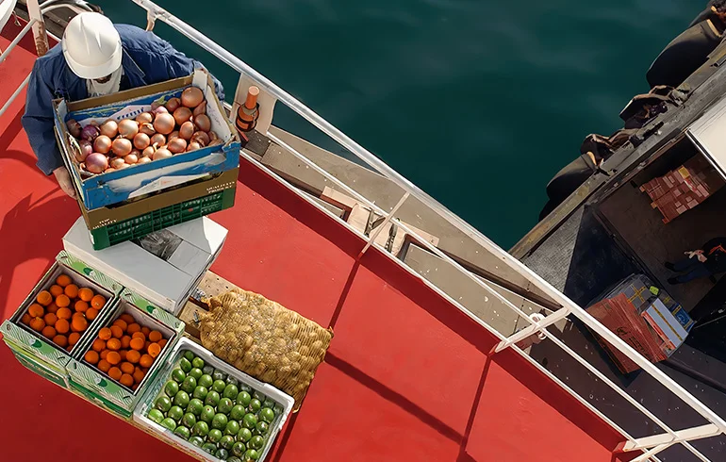
“ONBOARD HEALTHY NUTRITION”
Menu Planning And Recipe Development
Techniques for planning menus that cater to diverse tastes and dietary needs
Key approaches tailored for maritime settings:
Use of Long-Lasting and Preserved Foods
Modular Meal Design
Rotational Menus
Notes:
Use of Long-Lasting and Preserved Foods
Given limited access to fresh supplies during voyages, menus should leverage frozen, canned, or dried ingredients to maintain variety and quality. For example, frozen vegetables, canned legumes, and vacuum-sealed fish can substitute fresh ingredients without compromising nutrition.
Modular Meal Design
Providing a base with optional add-ons can accommodate various dietary needs. For instance, offering a neutral carbohydrate base like rice or pasta, paired with different proteins (meat, fish, or plant-based), sauces, and sides, allows crew members to customize their meals.
Rotational Menus
Rotating meal plans weekly or bi-weekly helps to avoid monotony and ensures a variety of flavors, textures, and cuisines. This also allows efficient stock planning and ensures balanced nutrition over time (6).

Slide 12
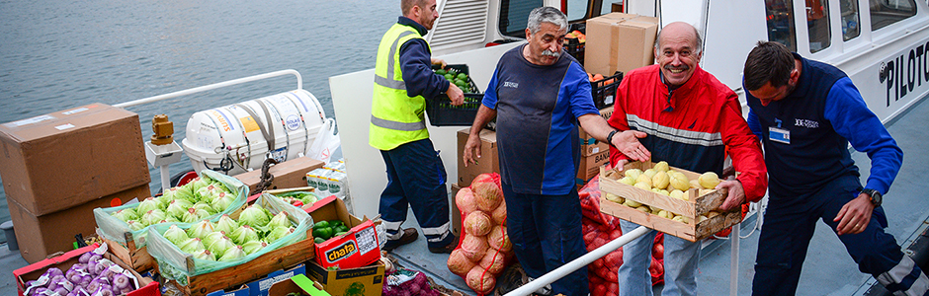
“ONBOARD HEALTHY NUTRITION”
Menu Planning And Recipe Development
Techniques for planning menus that cater to diverse tastes and dietary needs
Allergies and Intolerances
Practicality and Preparation
Hydration and Supplementary Options
Crew Feedback and Adaptation
Notes:
Allergies and Intolerances
Clear labeling of allergens and providing alternative options for common allergens like gluten, dairy, and nuts is critical. Using substitutes like plant-based milk for lactose-intolerant crew members or gluten-free grains ensures inclusivity.
Practicality and Preparation
Menus should account for the ship’s galley resources, such as available cooking equipment and space. Simpler recipes with fewer steps are often more feasible in these environments. Meals that can be batch-cooked and stored, like stews or casseroles, are particularly efficient.
Hydration and Supplementary Options
Including hydrating foods like soups and providing alternatives to water, such as herbal teas or diluted juices, supports crew well-being. Supplementary snacks, like energy bars and nuts, can cater to those with higher caloric needs due to physically demanding roles.
Crew Feedback and Adaptation
Regularly collecting feedback helps refine menus and address any dissatisfaction or unmet dietary needs. This iterative process ensures that meals remain relevant and appealing to the crew.
By leveraging these strategies, galley staff can effectively plan menus that meet the diverse tastes and dietary needs of their crew while managing logistical constraints.

Slide 13

“ONBOARD HEALTHY NUTRITION”
Menu Planning And Recipe Development
Recipe Development and Adaptation For Maritime Environment
The maritime environment presents unique challenges for meal planning, and adapting recipes for this context involves practical approaches to ensure the crew's well-being while maintaining variety and quality.
Long Shelf Life and Storage Constraints
Nutritional Requirements and Balance
Cultural Sensitivity and Dietary Restrictions
Notes:
1. Long Shelf Life and Storage Constraints:
In a maritime environment, fresh produce and ingredients may not always be available due to long periods at sea. Therefore, recipes need to be adapted using ingredients that have a long shelf life, such as canned, frozen, dried, or preserved foods. For instance, using dried beans or legumes instead of fresh produce, or relying on vacuum-sealed meats, helps maintain nutritional content while ensuring ease of storage. Ingredients that require minimal refrigeration or are easy to preserve, such as root vegetables (e.g., potatoes, carrots), are often used in maritime recipes (8).
2. Nutritional Requirements and Balance:
Seafarers have higher energy requirements due to their physically demanding work. Meals must be carefully planned to provide the necessary macronutrients (carbohydrates, proteins, and fats) and micronutrients (vitamins and minerals) while adapting to limited resources. Recipes should incorporate easily accessible and nutrient-dense ingredients like whole grains, protein-rich fish, lean meats, and fortified foods to maintain the health and performance of the crew. Additionally, certain micronutrients like vitamin D (from fortified foods or fish) and omega-3 fatty acids (from fatty fish) become especially crucial given the limited sun exposure onboard (9, 10).
3. Cultural Sensitivity and Dietary Restrictions:
Given the multicultural nature of the maritime workforce, recipes need to cater to diverse dietary preferences and restrictions. Halal, kosher, vegetarian, and gluten-free options must be taken into account. For example, crew members from Muslim backgrounds require halal meat, while those from Hindu backgrounds may avoid beef. Incorporating alternative protein sources like legumes, tofu, or certified halal or kosher meats can ensure inclusivity. Balancing these dietary needs with the constraints of onboard kitchen facilities and available ingredients is key (10, 11).

Slide 14

“ONBOARD HEALTHY NUTRITION”
Menu Planning And Recipe Development
Recipe Development and Adaptation For Maritime Environment
4. Practical Cooking Techniques and Equipment Constraints
5. Maintaining Variety and Preventing Menu Monotony
6. Cost-Effectiveness and Waste Reduction
Notes:
4. Practical Cooking Techniques and Equipment Constraints:
Onboard kitchens are often limited in terms of space, equipment, and utilities. Therefore, recipes should be designed for simplicity and ease of preparation. Multi-purpose ingredients and cooking methods, such as steaming, baking, or grilling, are preferred as they require less equipment and allow for greater versatility. Meal preparation must consider time constraints as well—quick-cooking meals or those that can be easily reheated from stored or pre-prepared ingredients are ideal (11).
5. Maintaining Variety and Preventing Menu Monotony:
To prevent menu monotony, which can lead to dissatisfaction among crew members, recipes should be adaptable to ensure variety over long voyages. This can be achieved by rotating meal options and experimenting with different flavor profiles. Spice usage, for example, can add diversity to otherwise similar meals and cater to different regional tastes. Furthermore, introducing seasonal ingredients (frozen or canned) and changing cooking styles (e.g., stews, curries, or stir-fries) can keep meals interesting (9).
6. Cost-Effectiveness and Waste Reduction:
In a maritime environment, managing food costs is essential, as onboard budgets for provisioning can be limited. Recipe development must, therefore, prioritize cost-effective ingredients while ensuring meals remain nutritious and flavorful. Bulk purchasing of ingredients with a long shelf life and minimizing waste by using leftovers creatively are key strategies. For example, using leftovers from one meal as ingredients for the next (e.g., leftover meat in stews or soups) helps optimize resources without sacrificing nutrition (8, 11).

Slide 15
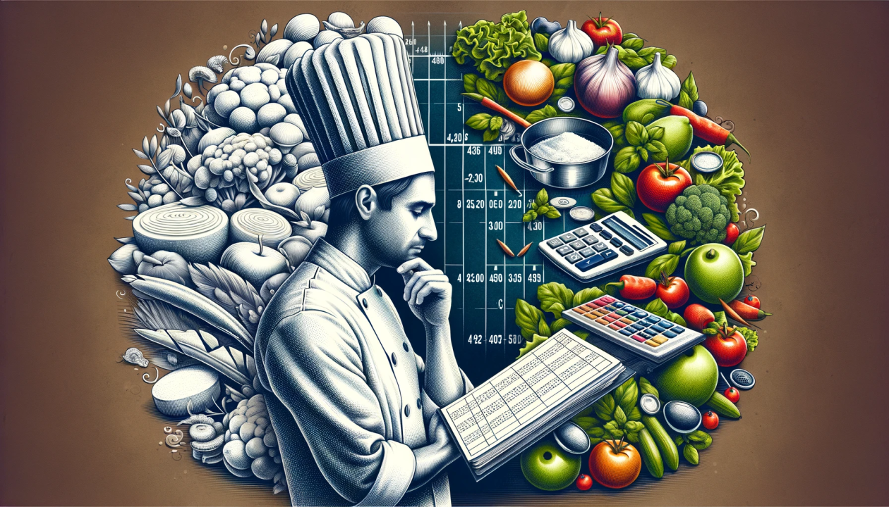
“ONBOARD HEALTHY NUTRITION”
Menu Planning And Recipe Development
Balancing Cost-Effectiveness with Quality Ingredients
Balancing cost-effectiveness with quality ingredients in the galley (kitchen) onboard ships requires strategic planning, understanding of food logistics, and adaptability to ensure seafarers receive nutritious, satisfying meals without exceeding the budget.

Slide 16

“ONBOARD HEALTHY NUTRITION”
Menu Planning And Recipe Development
Balancing Cost-Effectiveness with Quality Ingredients
Bulk Purchasing and Long Shelf Life Ingredients
2. Menu Planning and Recipe Standardization
3. Maximizing Use of Available Resources and Minimizing Waste
Notes:
There are several key strategies to achieve this balance, ensuring that quality is not compromised while still keeping costs manageable.
1. Bulk Purchasing and Long Shelf Life Ingredients
One of the most effective ways to balance cost and quality is by purchasing ingredients in bulk. Items with long shelf lives such as canned goods, dried fruits, grains, legumes, and frozen vegetables can be bought in large quantities and stored for extended periods without spoiling. This not only reduces the cost per unit but also minimizes the frequency of replenishment. For instance, frozen fish, which is often as nutritious as fresh fish, can be bought in bulk, reducing waste and cost. Similarly, dried herbs and spices are economical and can enhance flavor without the need for fresh ingredients (8, 9).
2. Menu Planning and Recipe Standardization
Planning menus that allow for ingredient overlap across different meals can reduce waste and ensure that all ingredients are utilized efficiently. For example, vegetables or meats used in one dish can be repurposed in another. This reduces the need for purchasing a wide variety of ingredients and ensures that every item bought has a purpose. Additionally, recipe standardization helps streamline ingredient procurement, allowing for purchasing in bulk, reducing costs, and ensuring consistent quality. Standardized recipes ensure that meals remain nutritious and satisfying while sticking to budgetary constraints (10, 11).
3. Maximizing Use of Available Resources and Minimizing Waste
Minimizing food waste is crucial in balancing costs and maintaining quality. Using leftover ingredients creatively in new meals is an effective way to reduce waste. For instance, leftover meats can be used in stews, soups, or casseroles, and excess vegetables can be made into sauces or side dishes. Additionally, ensuring proper food storage techniques onboard is important to prevent spoilage and waste. The careful rotation of stock (using older products first) also helps in reducing food waste (8).

Slide 17
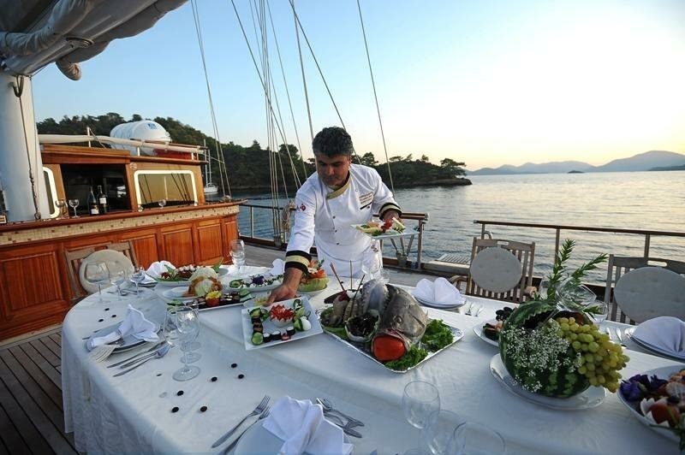
“ONBOARD HEALTHY NUTRITION”
Menu Planning And Recipe Development
Balancing Cost-Effectiveness with Quality Ingredients
4. Sourcing Local Ingredients When Possible
5. Incorporating Affordable but Nutritious Ingredients
6. Health and Dietary Considerations
Notes:
4. Sourcing Local Ingredients When Possible
Whenever a vessel is docked at a port, it is advisable to source fresh ingredients locally. This can help reduce the costs associated with importing food and may offer higher-quality ingredients than those available through standard shipping methods. By purchasing in-season local produce, ships can offer fresh options without breaking the budget. However, this requires flexibility in menu planning to adapt to the local food availability (10, 11).
5. Incorporating Affordable but Nutritious Ingredients
Affordable ingredients that are rich in nutrients should be prioritized. For instance, pulses (such as lentils, beans, and peas), which are cost-effective, are excellent sources of protein and fiber. Canned fish, such as tuna or sardines, is another affordable option that can be high in essential fatty acids and protein. Whole grains like rice, oats, and barley are cost-effective and provide long-lasting energy for seafarers during their physically demanding work. Additionally, using less expensive cuts of meat, like chicken thighs instead of breasts, can offer the same nutritional value at a lower cost (9).
6. Health and Dietary Considerations
Seafarers' diets must be balanced, providing essential nutrients that support their demanding physical labor and the conditions onboard. Ingredients that provide key nutrients like vitamin D, omega-3 fatty acids, and protein should be prioritized. At the same time, special dietary requirements (e.g., vegetarian, gluten-free, or halal diets) must be taken into account. In these cases, plant-based proteins, fortified foods, and plant-based oils can provide healthy alternatives that are cost-effective and accommodate dietary restrictions without sacrificing nutritional value (8, 10).

Slide 18
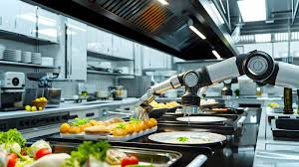
“ONBOARD HEALTHY NUTRITION”
Menu Planning And Recipe Development
Balancing Cost-Effectiveness with Quality Ingredients
6. Health and Dietary Considerations
7. Efficient Cooking and Preparation Techniques
Notes:
6. Health and Dietary Considerations
Seafarers' diets must be balanced, providing essential nutrients that support their demanding physical labor and the conditions onboard. Ingredients that provide key nutrients like vitamin D, omega-3 fatty acids, and protein should be prioritized. At the same time, special dietary requirements (e.g., vegetarian, gluten-free, or halal diets) must be taken into account. In these cases, plant-based proteins, fortified foods, and plant-based oils can provide healthy alternatives that are cost-effective and accommodate dietary restrictions without sacrificing nutritional value (8, 10).
7. Efficient Cooking and Preparation Techniques
In a maritime environment with limited kitchen space, efficient cooking techniques that minimize ingredient use and reduce preparation time are essential. One-pot meals, stews, and casseroles are ideal for maximizing the flavor and nutrition of available ingredients while minimizing food waste. Additionally, batch cooking can help reduce the overall costs by preparing meals in larger quantities and storing portions for later consumption (11).
In conclusion, balancing cost-effectiveness with high-quality ingredients onboard ships requires a comprehensive approach that includes smart purchasing, careful menu planning, efficient food use, and consideration of crew needs and preferences. By adopting these strategies, ship kitchens can provide nutritious, enjoyable meals that support the health and morale of the crew without overspending.

