Slide 1




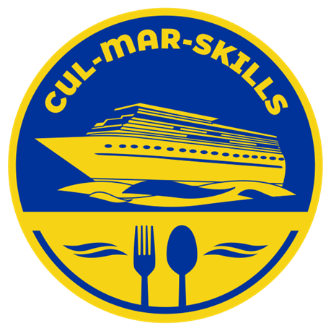

MARitime Soft Skills for Onboard Healthy Nutrition and CULinary Arts in Seagoing Services – CUL-MAR-Skills
KA220-VET - Cooperation partnerships in vocational education and training
2023-1-RO01-KA220-HED-000155888
Disclaimer: “Funded by the European Union. Views and opinions expressed are however those of the author(s) only and do not necessarily reflect those of the European Union or the ANPCDEFP. Neither the European Union nor the ANPCDEFP can be held responsible for them”

Slide 2
“ONBOARD HEALTHY NUTRITION”
Basic Nutrition and Dietary Requirements
By the end of this chapter, the participants will be able to:
Explain the fundamentals of nutrition and describe the roles of macronutrients (carbohydrates, proteins, and fats) and micronutrients (vitamins and minerals) in maintaining physical and mental health.
Evaluate how factors like age, gender, activity level, and medical conditions influence individual nutritional needs.
Create meal plans that ensure nutritional adequacy, cater to diverse dietary preferences, and address restrictions such as allergies or religious practices.

Slide 3
“ONBOARD HEALTHY NUTRITION”
Basic Nutrition and Dietary Requirements
By the end of this course, the participants will be able to:
Adapt meal planning strategies for challenging environments, such as onboard ships, using limited resources while maintaining nutritional balance.
Advocate for sustainable and inclusive dietary habits that respect cultural diversity and contribute to long-term health and well-being.

Slide 4

“ONBOARD HEALTHY NUTRITION”
Basic Nutrition and Dietary Requirements
Understanding Basic Nutrition and Dietary Requirements for Seafarers
Seafarers have unique dietary and nutritional needs due to the demanding nature of their work, long hours, exposure to varying climatic conditions, and the isolated environment of a ship. Proper nutrition is vital for maintaining physical and mental well-being, enhancing work performance, and preventing fatigue or illness. Basic nutrition and dietary requirements for seafarers can be given under the following titles:

Slide 5

“ONBOARD HEALTHY NUTRITION”
Basic Nutrition and Dietary Requirements
Understanding Basic Nutrition and Dietary Requirements for Seafarers
Caloric Needs
Macronutrients
• Carbohydrates -50–60% of daily calories
• Proteins - 15–20% of daily calories
• Fats 20–30% of daily calories
3. Micronutrients
• Vitamins
• Minerals
Notes:
1. Caloric Needs: Their energy requirements are high. Moderate physical activity requires ~2,500–3,000 kcal/day for men, ~2,000–2,500 kcal/day for women.
High physical activity (engine room workers or deckhands) requires higher caloric intake to meet energy expenditure.
2. Macronutrients. Macronutrients that seafarers will need are given below:
Carbohydrates (50–60% of daily calories):
The sources of carbonhydrates are whole grains, rice, pasta, bread, oats, and starchy vegetables like potatoes. They provide energy.
Proteins (15–20% of daily calories):
They are found in fish (often readily available at sea), lean meat, poultry, eggs, legumes, and dairy products. They support muscle repair and immune function.
Fats (20–30% of daily calories):
Fatsa are provided nuts, seeds, olive oil, avocados, and fatty fish (rich in omega-3 fatty acids). Healthy fats are essential for long-term energy and brain function.
3. Micronutrients
Vitamins: Essentials vitamins for seafarers are Vitamin C, Vitamin D and B Vitamins.
Sources of Vitamin C, which boosts immunity and helps prevent scurvy, are citrus fruits, tomatoes, and bell peppers. Vitamin D is found in fortified foods, fish, or supplements. Vitamin D is essential for bone health, especially given limited sun exposure. Finally, B Vitamins, which are provided by whole grains, eggs, dairy, and leafy greens are critical for energy metabolism.
Minerals:
Minerals that are the most vital for seafarers are iron, calcium, and zinc. Of these, Iron, which is provided by Red meat, spinach, and legumes, prevents anemia and supports oxygen transport in the blood. Calcium, which supports bone health, can be found in milk, cheese, yogurt, and fortified plant-based alternatives. Another mineral source, zinc, is provided by shellfish, meat, and seeds. They support immunity and wound healing.

Slide 6

“ONBOARD HEALTHY NUTRITION”
Basic Nutrition and Dietary Requirements
Understanding Basic Nutrition and Dietary Requirements for Seafarers
4. Hydration
5. Dietary Diversity
6. Special Considerations
Having a good account of Dietary Restrictions and Allergies.
Hygiene
Cultural preferences
Notes:
4. Hydration
Adequate water intake is crucial for combating dehydration, especially in hot environments or physically demanding roles. Seafarers are recommended to drink ~2.5–3 liters/day, with adjustments for climate and activity levels.
5. Dietary Diversity
Varied meals are vital to prevent nutrient deficiencies and monotony. Meals should include a variety of fruits, vegetables, proteins, and grains. Seasonal/Preserved Foods can be used since fresh produce may be limited, use frozen, canned, or dried alternatives.
6. Special Considerations
In addition to considering the nutritional needs of the seafarers, other important points should be given special importance. One of these points is having a good account of Dietary Restrictions and Allergies. So, individual needs, such as vegetarianism or gluten intolerance can be catered. Hygiene is another important point. It must be ensured that food is stored, prepared, and served safely to prevent foodborne illnesses. Last but not least, cultural preferences should be given special attention: Diverse crew backgrounds should be considered when planning menus.

Slide 7

“ONBOARD HEALTHY NUTRITION”
Basic Nutrition and Dietary Requirements
Understanding Basic Nutrition and Dietary Requirements for Seafarers
Food that promotes mental well-being should be provided to the seafarers. That is they should eat Omega-3-rich fish for brain health, complex carbohydrates for steady energy and mood stabilization., and foods rich in magnesium (nuts, seeds, leafy greens) to combat stress.
Notes:
On the other hand, food that promotes mental well-being should be provided to the seafarers. That is they should eat Omega-3-rich fish for brain health, complex carbohydrates for steady energy and mood stabilization., and foods rich in magnesium (nuts, seeds, leafy greens) to combat stress.
It is important for the galley staff to follow the ILO Maritime Labour Convention (MLC 2006), which mandates that meals on board be nutritious, of adequate quantity, and suitable for the crew.
By adhering to these dietary principles, seafarers can maintain their health and productivity while navigating the physical and emotional challenges of life at sea.

Slide 8

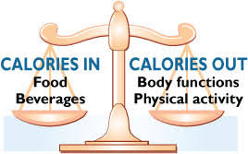
“ONBOARD HEALTHY NUTRITION”
Basic Nutrition and Dietary Requirements
How to plan balanced meals that meet the crew's nutritional needs.
1. Assessing Nutritional Needs: Two important issues need to be addressed under this heading.
Caloric Requirements and Nutritional Balance
Notes:
1. Assessing Nutritional Needs: Two important issues need to be addressed under this heading. Caloric Requirements and Nutritional Balance
Caloric Requirements: To determine calorie needs correctly, energy needs based on crew roles (e.g., deckhands need more calories than administrative personnel) should be calculated. In terms of caloric needs, it is found that male crew members typically need 2,400–2,600 kcal/day, while females require 1,600–2,000 kcal/day (1, 2)
Nutrient Balance is the second important factor to consider in this regard. Carbohydrates, proteins, and fats are evaluated under nutrient balance. Seafarers should eat carbohydrates such as whole grains or potatoes for sustained energy, while they should have proteins like fish, meat, or, beans for muscle repair and immune support and fat like olive oil, nuts, or fatty fish for long-term energy, focusing on healthy fats

Slide 9
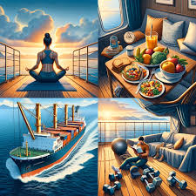
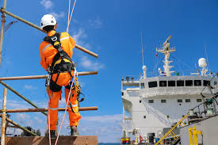
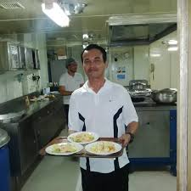
“ONBOARD HEALTHY NUTRITION”
Basic Nutrition and Dietary Requirements
How to plan balanced meals that meet the crew's nutritional needs.
2. Including All Food Groups. All kinds of food groups offer different vitamins or minerals.
Fruits and vegetables Protein-rich foods
Whole grains and complex
Healthy fats
Notes:
2. Including All Food Groups. All kinds of food groups offer different vitamins or minerals. For example, fruits and vegetables like fresh, frozen, or canned options offer vitamins and fiber. They can eat citrus fruits (vitamin C) and leafy greens (iron, vitamin A). Protein-rich foods like fish, eggs, poultry, legumes, and dairy encourage fatty fish like mackerel and salmon for omega-3 fatty acids. Whole Grains and Complex Carbohydrates should be opted for whole wheat bread, brown rice, and oats over refined grains. Finally, seafarers should take healthy fats provided by nuts, seeds, avocados, and oils like olive or canola oil.

Slide 10

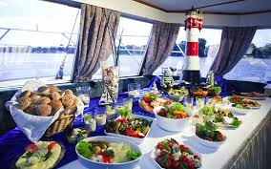
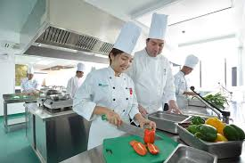
“ONBOARD HEALTHY NUTRITION”
Basic Nutrition and Dietary Requirements
How to plan balanced meals that meet the crew's nutritional needs.
3. Catering to Cultural and Dietary Preferences
4. Planing for Variety and Avoiding Monotony
5. Focusing on Practicality
Notes:
3. Catering to Cultural and Dietary Preferences
Recognizing diverse crew backgrounds and providing alternatives for vegetarians, those with food allergies, or religious dietary restrictions is vital. For example, offer halal or vegetarian protein options alongside regular meals【19†source】.
4. Planing for Variety and Avoiding Monotony. This is a key to well-being. This can be done with the help of food. For example, meal options can be rotated weekly to prevent boredom, different cooking methods can be used (e.g., grilling, steaming, baking), and spices for flavor diversity.
5. Focusing on Practicality This can be done from storage and preparation perspectives. For storage, prioritizing long-lasting fresh produce and non-perishables that can be stored without spoilage during long voyages and using frozen or canned fruits and vegetables as backups are two important options. For preparation ensuring meals are simple to prepare but nutritionally balanced is vital. For instance, a meal could consist of grilled chicken, steamed vegetables, and whole-grain rice.

Slide 11
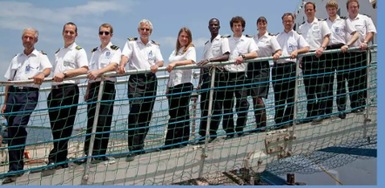
“ONBOARD HEALTHY NUTRITION”
Basic Nutrition and Dietary Requirements
An overview of dietary restrictions and cultural preferences for seafarers on board
Cultural and Religious Diversity
Psychological and Emotional Importance
Challenges in Provisioning
Notes:
Dietary restrictions and cultural preferences are crucial considerations for the well-being of seafarers due to the diverse nationalities and religious backgrounds represented on ships. Here is an overview based on recent information:
1. Cultural and Religious Diversity: Seafarers often come from various regions, each with distinct food preferences and religious dietary requirements. For instance, Muslims may require halal food, Hindus might avoid beef, and some seafarers might be vegetarian. Providing meals that accommodate these needs is vital for their morale and physical health. Catering companies onboard vessels are increasingly using menu planning software to provide diverse and culturally appropriate meals .
Psychological and Emotional Importance: Food serves as a connection to home and can significantly impact the mental health of seafarers. Familiar meals evoke memories of home and help improve social interactions among crew members, fostering a sense of unity and cultural appreciation.
Challenges in Provisioning: Ensuring a variety of meals that cater to all cultural needs can be logistically challenging due to availability in certain ports and the storage limitations of ships. However, catering companies emphasize training cooks to prepare a range of dishes while seeking regular feedback from crew members to refine menus.

Slide 12


“ONBOARD HEALTHY NUTRITION”
Basic Nutrition and Dietary Requirements
An overview of dietary restrictions and cultural preferences for seafarers on board
4. Role of Food in Crew Welfare: Meals onboard are not only about nutrition but also about creating enjoyable social experiences. Good food contributes to physical and mental strength, which is essential for the demanding nature of seafaring job.
Notes:
4. Role of Food in Crew Welfare: Meals onboard are not only about nutrition but also about creating enjoyable social experiences. Good food contributes to physical and mental strength, which is essential for the demanding nature of seafaring job
Seafarers come from diverse cultural, religious, and personal backgrounds, which can significantly influence their dietary preferences and restrictions. Catering to these needs onboard is essential for maintaining morale, inclusivity, and health.

Slide 13
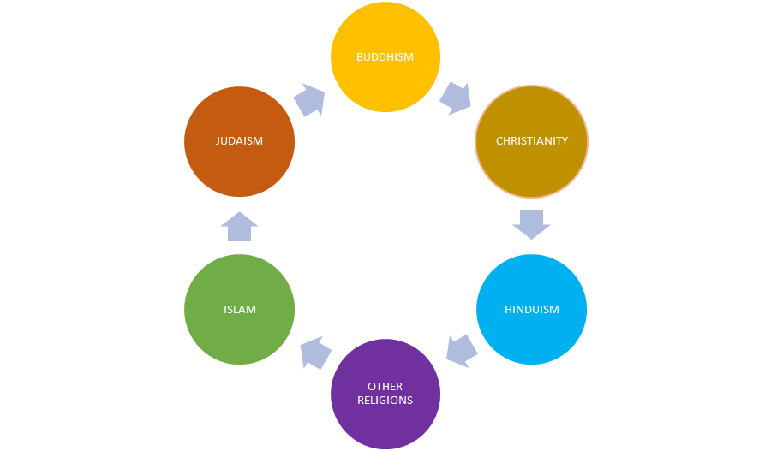
“ONBOARD HEALTHY NUTRITION”
Basic Nutrition and Dietary Requirements
An overview of dietary restrictions and cultural preferences for seafarers on board
When approached the issue from dietary restrictions and cultural preferences point of view some detailed information on seafarers on board can be given
1. Religious Dietary Practices
Notes:
When approached the issue from dietary restrictions and cultural preferences point of view some detailed information on seafarers on board can be given
1. Religious Dietary Practices
Islam:
Requires halal food, which excludes pork and alcohol and adheres to specific slaughtering practices.
Common substitutions: Chicken, beef, and lamb prepared in halal-certified ways.
Hinduism:
Many Hindus are vegetarian, avoiding meat, fish, and eggs. Those who consume meat often avoid beef due to the sacred status of cows.
Meals should include vegetarian protein sources like lentils, chickpeas, and paneer.
Buddhism:
Often vegetarian or vegan, depending on regional practices. Some sects also avoid alliums like garlic and onions.
Use tofu, tempeh, and diverse vegetables to create balanced meals.
Judaism:
Kosher food requirements exclude pork and shellfish and require specific slaughtering practices. Dairy and meat cannot be consumed together.
Kosher-certified products and separate preparation methods are necessary.
Christianity:
Some Christian sects observe fasting periods or dietary restrictions during Lent, avoiding meat on certain days.
Other Religions:
Practices vary widely, such as Rastafarians who may follow an ital diet, focusing on natural, unprocessed, plant-based foods.

Slide 14

“ONBOARD HEALTHY NUTRITION”
Basic Nutrition and Dietary Requirements
An overview of dietary restrictions and cultural preferences for seafarers on board
2. Allergies and Intolerances
Common Allergies:
Intolerances:
Notes:
2. Allergies and Intolerances
Common Allergies:
Include nuts, shellfish, gluten, and dairy.
Clearly label dishes and ensure alternative options like lactose-free or gluten-free substitutes.
Intolerances:
Seafarers with lactose intolerance may require plant-based milk or dairy alternatives.
Gluten intolerance or celiac disease necessitates the use of gluten-free grains like rice, quinoa, or certified gluten-free bread.

Slide 15
“ONBOARD HEALTHY NUTRITION”
Basic Nutrition and Dietary Requirements
An overview of dietary restrictions and cultural preferences for seafarers on board
3. Vegetarian and Vegan Preferences
Increasingly common among younger seafarers or for health and ethical reasons.
Vegetarian meals should include plant-based proteins like legumes, tofu, and eggs.
Vegan options require additional care to provide sufficient protein, calcium, and vitamin B12.
Notes:
3. Vegetarian and Vegan Preferences
Increasingly common among younger seafarers or for health and ethical reasons.
Vegetarian meals should include plant-based proteins like legumes, tofu, and eggs.
Vegan options require additional care to provide sufficient protein, calcium, and vitamin B12.

Slide 16

“ONBOARD HEALTHY NUTRITION”
Basic Nutrition and Dietary Requirements
An overview of dietary restrictions and cultural preferences for seafarers on board
4. Cultural Food Preferences
Asian Crews
European Crews
Middle Eastern Crews
African Crews
Latin American Crews
Notes:
4. Cultural Food Preferences
Asian Crews:
May prefer rice as a staple, along with dishes flavored with soy sauce, ginger, and spices.
Dishes like stir-fried vegetables and fish are common.
European Crews:
May expect bread, pasta, potatoes, and dairy products as staples.
Meat-heavy dishes are often preferred.
Middle Eastern Crews:
May enjoy dishes with flatbreads, lentils, and spices like cumin and coriander.
Pork-free options are crucial for this demographic.
African Crews:
Typically prefer hearty meals with staples like yams, cassava, or maize alongside meat or fish.
Latin American Crews:
Often favor dishes with beans, rice, and meats, complemented by spicy or tangy flavors.

Slide 17
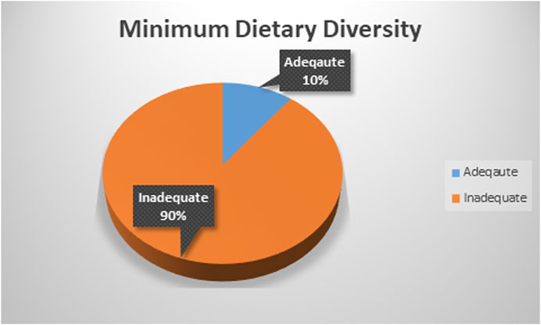
“ONBOARD HEALTHY NUTRITION”
Basic Nutrition and Dietary Requirements
An overview of dietary restrictions and cultural preferences for seafarers on board
5. Practical Strategies for Managing Dietary Diversity
Menu Planning
Clear Labeling
Separate Preparation
Crew Feedback
Notes:
5. Practical Strategies for Managing Dietary Diversity
Menu Planning:
Offer a variety of dishes to cater to diverse needs (e.g., including vegetarian, halal, and gluten-free options).
Rotate menus to ensure variety and accommodate different tastes.
Clear Labeling:
Clearly mark dishes with allergens or dietary suitability (e.g., halal-certified, gluten-free).
Separate Preparation:
Use separate utensils and cooking stations to avoid cross-contamination for allergens or religious restrictions.
Crew Feedback:
Regularly gather input from the crew to refine meal offerings and address unmet needs.

Slide 18
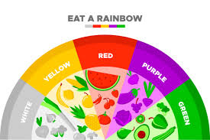
“ONBOARD HEALTHY NUTRITION”
Basic Nutrition and Dietary Requirements
An overview of dietary restrictions and cultural preferences for seafarers on board
Thank you for your attention!
Notes:
5. Practical Strategies for Managing Dietary Diversity
Menu Planning:
Offer a variety of dishes to cater to diverse needs (e.g., including vegetarian, halal, and gluten-free options).
Rotate menus to ensure variety and accommodate different tastes.
Clear Labeling:
Clearly mark dishes with allergens or dietary suitability (e.g., halal-certified, gluten-free).
Separate Preparation:
Use separate utensils and cooking stations to avoid cross-contamination for allergens or religious restrictions.
Crew Feedback:
Regularly gather input from the crew to refine meal offerings and address unmet needs.

