Slide 1






MARitime Soft Skills for Onboard Healthy Nutrition and CULinary Arts in Seagoing Services – CUL-MAR-Skills
KA220-VET - Cooperation partnerships in vocational education and training
2023-1-RO01-KA220-HED-000155888
Disclaimer: “Funded by the European Union. Views and opinions expressed are however those of the author(s) only and do not necessarily reflect those of the European Union or the ANPCDEFP. Neither the European Union nor the ANPCDEFP can be held responsible for them”

Slide 2
“ONBOARD HEALTHY NUTRITION”
Proper Nutrition and Wellbeing Onboard
By the end of this chapter, the participants will be able to:
Understand the nutritional requirements specific to seafarers, including macro- and micronutrients essential for health and endurance at sea.
Identify and address common nutritional deficiencies and health issues that may arise in the seafaring population.
Develop balanced meal plans that can be implemented on board, considering limitations in food storage, preparation facilities, and available ingredients.

Slide 3
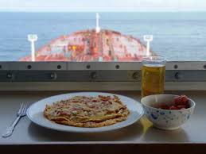
“ONBOARD HEALTHY NUTRITION”
Proper Nutrition and Wellbeing Onboard Introduction to Maritime Nutrition
Promote best practices for food safety, storage, and handling in maritime settings to prevent spoilage and foodborne illnesses.
Advocate for the importance of nutrition in fostering a healthy and safe environment on board.

Slide 4
“ONBOARD HEALTHY NUTRITION”
Proper Nutrition and Wellbeing Onboard
The captain and officers should:
Encourage and stimulate the crew members to eat healthily
Offer variation in food
Show their commitment as captain or officers
Ensure the menu of the coming week is on display and remember to stress the healthy alternatives.

Slide 5
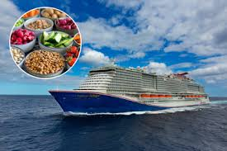
“ONBOARD HEALTHY NUTRITION”
Proper Nutrition and Wellbeing Onboard
Provide healthy drinks and snacks. Also, provide information (posters or leaflets) on healthy food in every place where food is available onboard.
Give crew members the possibility to suggest and try new recipes.
Do not forget behavioural changes take several months and benefits may take even longer to become measurable.

Slide 6
“ONBOARD HEALTHY NUTRITION”
Proper Nutrition and Wellbeing Onboard
Rice, whole grain products, and potatoes
These foods are excellent sources of complex carbohydrates, vitamins, minerals, and dietary fibre.
5 servings a day is recommended, preferably including 1 serving of whole grain products.
In shifts, they are better taken towards the end of the shift, instead of at the beginning.
Notes:
These foods are excellent sources of complex carbohydrates, vitamins, minerals, and dietary fibre. It is recommended that 5 servings a day be consumed, preferably including 1 serving of whole grain products. An average person eats 175-420 g of bread (5-12 slices), 210-350 g of potatoes (3-5 pieces) or 180-300 g of rice per day. When working in shifts this group is better taken towards the end of the shift, instead of at the beginning.

Slide 7

“ONBOARD HEALTHY NUTRITION”
Proper Nutrition and Wellbeing Onboard
Rice, whole grain products, and potatoes
1 serving =
* 1 slice of bread * ½ Cup (C.) cooked grains, pasta, rice, etc.
* 1 C. of most cold cereals * ¼ C. low-fat granola, Grape Nuts, Muesli
* ½ C. hot cereals * 3-4 C. low-fat microwave popcorn
* ½ large fl our tortilla * 6 saltine crackers
* ½ hamburger roll or small bagel * ¼ of a large muffin or bagel
* ½ pita

Slide 8
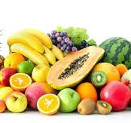
“ONBOARD HEALTHY NUTRITION”
Proper Nutrition and Wellbeing Onboard
Fruit
Both fresh fruit and dried, frozen, canned fruit and fruit juices.
Rich sources of vitamins A, and C, potassium, fiber (excluding fruit juices), and flavonoids.
Notes:
This group consists preferably of fresh fruit but also of dried, frozen, canned fruit and fruit juices. They are rich sources of vitamins A, and C, potassium, fiber (excluding fruit juices), and flavonoids. Eat 2 to 3 servings a day, especially the deep or bright. (yellow, orange) colored ones.

Slide 9
“ONBOARD HEALTHY NUTRITION”
Proper Nutrition and Wellbeing Onboard
2 to 3 servings a day, especially the deep or bright. (yellow, orange) colored ones.
1 serving =
* 1 piece of medium fruit (e.g., apple, orange, peach)
* ½ piece of large fruit (e.g., banana, grapefruit)
* ½ C. of cooked or dried pieces of fruit
* ½ C. of fruit juice (unsweetened)

Slide 10
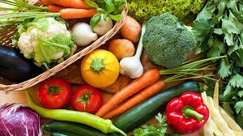
“ONBOARD HEALTHY NUTRITION”
Proper Nutrition and Wellbeing Onboard
Vegetables
Leafy, non-leafy, cruciferous, and root vegetables.
Rich sources of vitamins A, C, folic acid, minerals such as calcium, iron, potassium, fibre and phyto-chemicals.
Notes:
This group consists of leafy, non-leafy, cruciferous, and root vegetables. They are rich sources of vitamins A, C, folic acid, minerals such as calcium, iron, potassium, fibre and phyto-chemicals. Eat 2 servings a day and include 1 serving daily of dark green or yellow-orange vegetables.

Slide 11
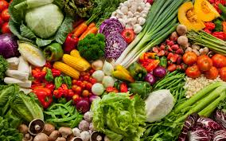
“ONBOARD HEALTHY NUTRITION”
Proper Nutrition and Wellbeing Onboard
2 servings a day should be eaten and include 1 serving daily of dark green or yellow-orange vegetables should be included. 1 serving =
* ½ C. cooked vegetables
* 1 C. vegetable juice
* 1 C. raw vegetables
Notes:
2 servings a day should be eaten and include 1 serving daily of dark green or yellow-orange vegetables should be included. 1 serving =
* ½ C. cooked vegetables
* 1 C. vegetable juice
* 1 C. raw vegetables

Slide 12
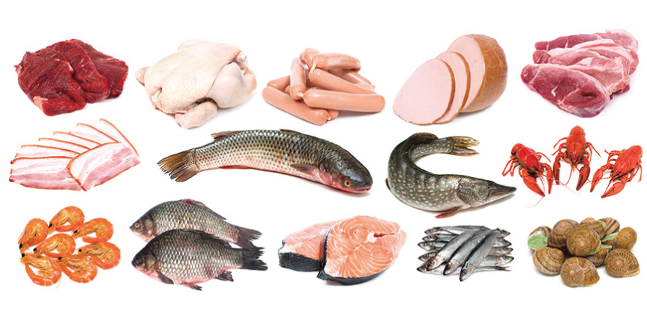
“ONBOARD HEALTHY NUTRITION”
Proper Nutrition and Wellbeing Onboard
Meat, fish, and alternatives
Meat, poultry, fish, and seafood. Alternatives are soya, pulses, nuts, and seeds.
Sources of protein, iron, and zinc. 100 g per day is sufficient.
1 serving =
* 100 g meat, poultry, or fish. 100 g is about the
size of a deck of cards or the palm of your hand.
* ½ C. cooked beans, legumes or nuts
* 2 eggs or 4 egg whites
Notes:
This group includes meat, poultry, fish, and seafood. Alternatives are soya, pulses, nuts, and seeds. These foods are excellent sources of protein, iron, and zinc. 100 g per day is sufficient.
1 serving =
* 100 g meat, poultry, or fish. 100 g is about the
size of a deck of cards or the palm of your hand.
* ½ C. cooked beans, legumes or nuts
* 2 eggs or 4 egg whites

Slide 13
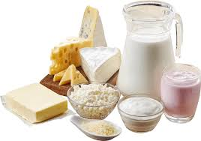
“ONBOARD HEALTHY NUTRITION”
Proper Nutrition and Wellbeing Onboard
Milk, dairy products, and alternatives
Excellent sources of protein, calcium, and B vitamins.
2 to 3 glasses of skimmed or half-fat milk or yogurt per day.
2 servings of cheese.
1 serving =
* 250 g or 1 C. of skimmed or half-fat milk or yogurt.
* 50 g hard cheese; lower-fat versions are
Notes:
These foods are excellent sources of protein, calcium, and B vitamins. Drink 2 to 3 glasses of skimmed or half-fat milk or yogurt per day. And try to eat 2 servings of cheese. Remember to bear in mind the fat quantity in these foods and to try and use low-fat products where possible.

Slide 14
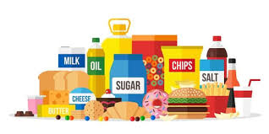
“ONBOARD HEALTHY NUTRITION”
Proper Nutrition and Wellbeing Onboard
Fats, oil, salt & sugar
Fat:
energy
essential vitamins A, D, E, and K.
High salt consumption:
raise blood pressure
risk of developing heart disease
Notes:
Although fat gives energy and contains essential vitamins A, D, E, and K, too much of it can lead to increased weight and increased cholesterol levels. Therefore it is important to keep an eye on the amount of fat you eat so that you don’t eat too much. This group contains chips, mayonnaise, fat sauces, cream, etc., and should be taken in limited quantities. High salt consumption can raise blood pressure which creates a greater risk of developing heart disease.

Slide 15

“ONBOARD HEALTHY NUTRITION”
Proper Nutrition and Wellbeing Onboard
Fats, oil, salt & sugar
Sugary food and drinks are loaded with calories and provide little by way of nutrition. Such foods are also a major source of tooth decay.
1 serving =
* 1 teaspoon oil, butter or margarine
* 2 teaspoons Tahini paste
* 1 tablespoon of regular salad dressing

Slide 16
“ONBOARD HEALTHY NUTRITION”
Proper Nutrition and Wellbeing Onboard
Water
Indispensable
1.5 liters should be consumed per day.
Unopened bottles if the quality of drinking water is uncertain.
Some contain a high level of minerals
Notes:
Although water does not give us energy and is not part of this food pyramid, it is indispensable for our bodies. In normal circumstances, 1.5 liters should be consumed per day. In warm climates, when undertaking strong physical activity and playing sport it is necessary to drink more fluids. It is best to drink water from unopened bottles if the quality of drinking water is uncertain. Not everybody can drink all types of mineral water as some contain a high level of minerals. Variation is the key!

Slide 17
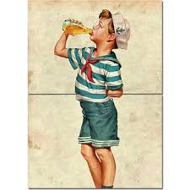
“ONBOARD HEALTHY NUTRITION”
Proper Nutrition and Wellbeing Onboard
Products containing caffeine, such as tea, coffee, and soft drinks should not be drunk more than 3 times per shift and should be avoided five hours before sleeping.

Slide 18
“ONBOARD HEALTHY NUTRITION”
Proper Nutrition and Wellbeing Onboard
Healthy Food and Safety
Difficult to estimate the impact of poor nutrition on occupational accidents,
The connection between fatigue and nutritional deficiency is well known.
Iron deficiency leads loss in productivity.
Results in fatigue and loss of dexterity.
Lack of food can induce drowsiness.
Notes:
Although it remains difficult to estimate the impact of poor nutrition on occupational accidents, the connection between fatigue and nutritional deficiency (iron and vitamin B) is well known.
Iron deficiency accounts for a loss in productivity and results in fatigue and loss of dexterity.
Lack of food can induce drowsiness and is a risk onboard ship.

Slide 19
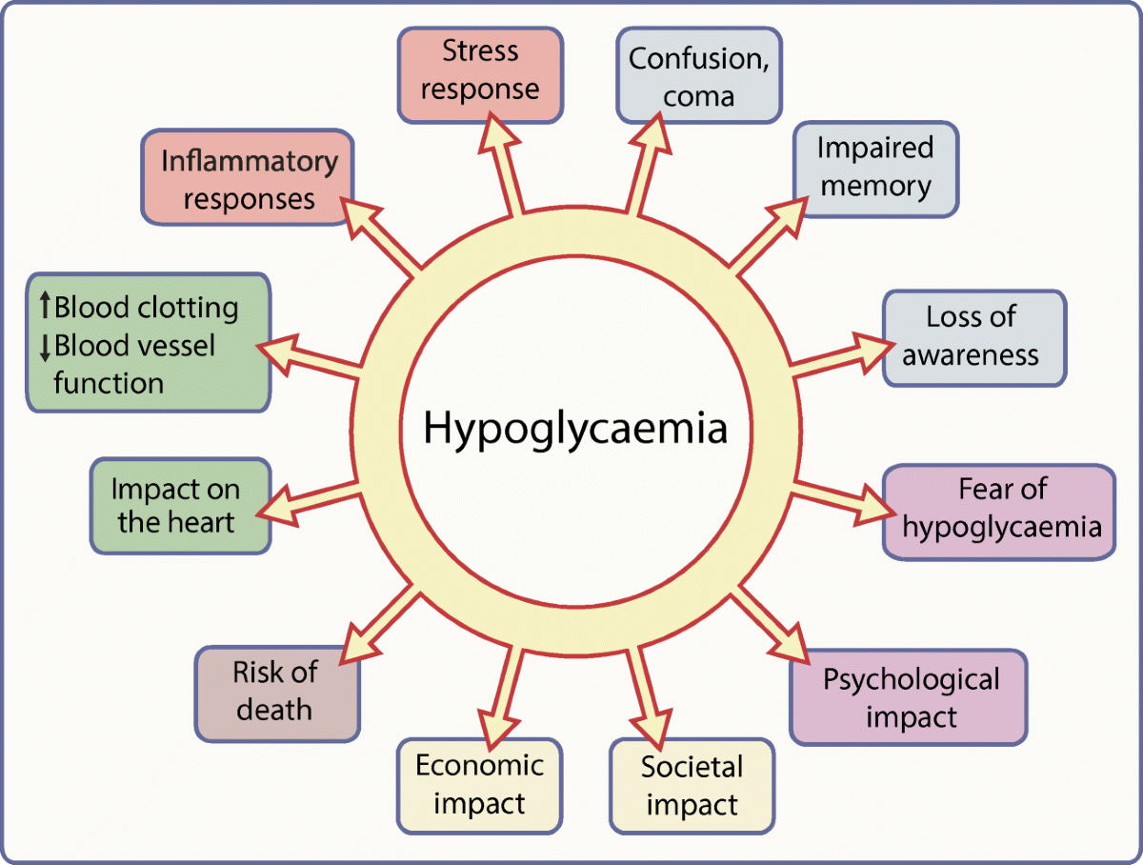
“ONBOARD HEALTHY NUTRITION”
Proper Nutrition and Wellbeing Onboard
Hypoglycaemia
Notes:
Hypoglycaemia (low blood sugar) can shorten attention spans and slow down the processing of information. Snacking on sugary foods and drinks gives a short surge in energy but can leave the body more tired afterward. https://link.springer.com/article/10.1007/s00125-020-05366-3

Slide 20
“ONBOARD HEALTHY NUTRITION”
Proper Nutrition and Wellbeing Onboard
Healthy Food and Shift Work
Shift work can interfere with the standard eating routine, cause broken sleep, tiredness, and digestive problems.
Light meals are the best solution: soups, salads, and lean meat.
Beginning of the shift, eat protein-rich food like yogurt, milk, and lean meat.
Later on in the shift eat carbohydrates like bread, potato salad, pasta salad, fruit, and whole grains
Notes:
Shift work means that meals cannot be taken at “normal” regular times. Shift work can interfere with the standard eating routine. Poor habits can lead to broken sleep, tiredness, and digestive problems. Light meals are the best solution: soups, salads, and lean meat. At the beginning of the shift, eat protein-rich food like yogurt, milk, and lean meat. Later on in the shift eat carbohydrates like bread, potato salad, pasta salad, fruit, and whole grains

Slide 21
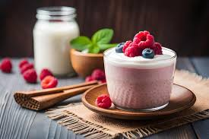
“ONBOARD HEALTHY NUTRITION”
Proper Nutrition and Wellbeing Onboard
Try and eat less spicy food, fried and fatty food, and sweets. Try and cut back on caffeine intake, try fruit juice for a change.
Eat light snacks like fruit, yogurt, or a glass of milk.
Eat a meal that provides enough energy before the shift starts.

Slide 22
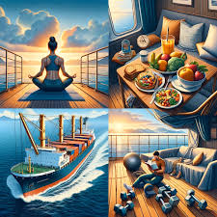
“ONBOARD HEALTHY NUTRITION”
Proper Nutrition and Wellbeing Onboard
We all know smoking is bad for your health. Try and cut down and consider others when you light up. Never smoke when others are eating.
Take regular exercise, if possible at least 30 minutes per day.

Slide 23
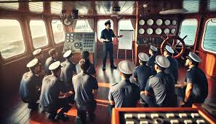
“ONBOARD HEALTHY NUTRITION”
Proper Nutrition and Wellbeing Onboard
Afternoon or evening shifts: eat a warm meal at noon instead of in the middle of the shift.
Night shifts: try and eat “breakfast” in the late afternoon or early evening. After work eat a light snack to avoid going to bed feeling hungry.
Notes:
If you are working in the afternoon or evening shifts: eat a warm meal at noon instead of in the middle of the shift.
If you are working at night try and eat “breakfast” in the late afternoon or early evening. After work eat a light snack to avoid going to bed feeling hungry.

Slide 24
“ONBOARD HEALTHY NUTRITION”
Proper Nutrition and Wellbeing Onboard
Caffeine
Coffee (75 mg per cup)
Tea (30 mg per cup)
Energy drinks, some sports drinks up to 80 mg per unit
Coca- Cola 23 mg per unit
Some herbal stimulants, especially guarana, and mate.
It keeps one awake, but this does not lead to better physical performance.
Notes:
Caffeine is a natural component of coffee (75 mg per cup) and tea (30 mg per cup), today also energy drinks and even some sports drinks contain varied levels of caffeine up to 80 mg per unit, compared to the 23 mg in a Coca- Cola which is a lot. Some herbal stimulants can contain naturally occurring caffeine, especially guarana and mate. Caffeine stimulates short-term memory, e.g. to memorize a telephone number before writing it down. It also keeps one awake, but this does not lead to better physical performance.

Slide 25
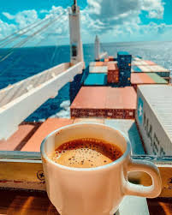
“ONBOARD HEALTHY NUTRITION”
Proper Nutrition and Wellbeing Onboard
Caffeine
Duty and watchkeeping can raise the consumption of coffee or tea drastically.
Too much caffeine can cause side effects such as tension (stress), restlessness, trembling, insomnia, headaches, and heart palpitations.
The maximum dose of caffeine is 400 mg per day.
Try to drink a maximum of 3 cups of coffee or tea per shift.
Notes:
Duty and watchkeeping can raise the consumption of coffee or tea drastically and besides the presumed stimulating effect of caffeine, this also has negative effects. Too much caffeine can cause side effects such as tension (stress), restlessness, trembling, insomnia, headaches, and heart palpitations. The maximum dose of caffeine is 400 mg per day. Try to drink a maximum of 3 cups of coffee or tea per shift.

Slide 26
“ONBOARD HEALTHY NUTRITION”
Proper Nutrition and Wellbeing Onboard
Breakfast
Breakfast is the most important meal of the day :
- It provides a good start to the day and a healthy breakfast delivers 20 - 25 % of the total energy for a day.
- Breakfast helps to improve concentration and dexterity throughout the morning.
- People, who skip breakfast tend to eat more snacks and often overcompensate for the loss of energy by eating a large lunch, rich in fats and sugar.

Slide 27
“ONBOARD HEALTHY NUTRITION”
Proper Nutrition and Wellbeing Onboard
Carbohydrates are found a lot in bread, grain products, rice, and pasta are excellent sources of energy.
- Milk and milk products are good sources of protein at breakfast.
- It is recommended that you eat several pieces of fruit per day. It is a good idea to start the day with fruit or fruit juice
and also stewed fruit or compote, as it is not always possible to get the full quota of nutrients from fresh fruit.

Slide 28
“ONBOARD HEALTHY NUTRITION”
Proper Nutrition and Wellbeing Onboard
Fats
Some fats are essential for health. - Fats in foods are made up of 4 different types of fatty acids
- Omega 3 is an essential fat and plays a crucial part in the development of the brain and the nervous system it prevents cardiovascular disease and supports the immune system.

Slide 29
“ONBOARD HEALTHY NUTRITION”
Proper Nutrition and Wellbeing Onboard
Fats
The type of food eaten in the West does not contain enough Omega-3 fatty acids.
The balance between Omega 3 and Omega 6 is particularly important as both use the same enzymes in metabolism.
Omega 3 is found in algea, plankton, rapeseed, linseed, walnut, or soya oil.
Fat fish and fish oil contain a lot of Omega-3 fatty acids.
Notes:
In general, the type of food eaten in the West does not contain enough Omega-3 fatty acids. The balance between omega 3 and omega 6 is particularly important as both use the same enzymes in metabolism. Omega 3 is found in algea, plankton, rapeseed, linseed, walnut, or soya oil. Fat fish and fish oil contain a lot of Omega-3 fatty acids.

Slide 30
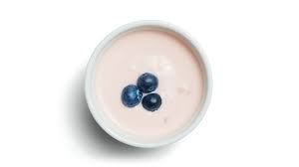
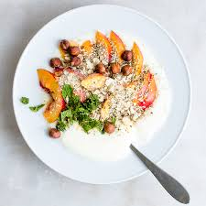
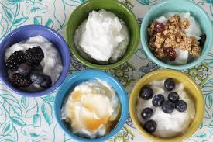
“ONBOARD HEALTHY NUTRITION”
Proper Nutrition and Wellbeing Onboard
Snacks
A healthy alternative such as fruit or yogurt should be available
Snacks rich in fat and sugar should not be consumed.
Notes:
If snacks are available during the day always ensure that a healthy alternative such as fruit or yoğurt is available and try to encourage the crew to go for one of these options to go for one of these options as opposed to a less healthy snack.
Do not offer snacks rich in fat and sugar.

Slide 31
“ONBOARD HEALTHY NUTRITION”
Proper Nutrition and Wellbeing Onboard
Working in extreme heat: Salt and Fluid Supplements
Intensive pace or in a very hot environment causes loss of water and salt through sweat.
Fluid intake should equal fluid loss: what goes out must come in. On average, about one liter of water each hour may be required to replace the fluid loss.
Plenty of cool drinking water (1-15 C) should be readily available
Seafarers should be encouraged to drink water every 15*20 minutes, even if they do not feel thirsty.
Notes:
A person working at an intensive pace or in a very hot environment such as the engine room loses water and salt through sweat. This salt should be made up by consuming more water and salt.
Fluid intake should equal fluid loss: what goes out must come in. On average, about one liter of water each hour may be required to replace the fluid loss.
Plenty of cool drinking water (1-15 C) should be readily available and workers should be encouraged to drink water every 15*20 minutes, even if they do not feel thirsty. Sports drinks specially designed to replace body fluids and electrolytes can also help workers remain properly hydrated.

Slide 32
“ONBOARD HEALTHY NUTRITION”
Proper Nutrition and Wellbeing Onboard
Lifting heavy loads, or working in high temperatures cause seafarers to sweat more ‘efficiently’ sooner and to a greater degree.
The salt in a normal diet is usually enough to maintain the electrolyte balance and keep the body working well.
For workers who are not used to manual labor or working in high temperatures and who will therefore lose more salt in their sweat, it may be a good idea to use salt in your food.
Salt tablets are not a suitable alternative.
Too much salt can cause body temperature to rise and can also make someone feel thirsty or sick.
Notes:
A worker used to or acclimatized to lifting heavy loads, or working in high temperatures, sweats more ‘efficiently’
They sweat sooner and sweat to a greater degree but they use less salt in their sweat than labourers who are not used to such work. For this reason, the salt in a normal diet is usually enough to maintain the electrolyte balance and keep the body working well.
For workers who are not used to manual labor or working in high temperatures and who will therefore lose more salt in their sweat, it may be a good idea to use salt in your food. Salt tablets are not a suitable alternative; however, as the salt does not enter the body system as fast as water or other fluids. Too much salt can cause body temperature to rise and can also make someone feel thirsty or sick. Workers on salt-restricted diets should talk to their doctor about how much salt they need for their job.

Slide 33
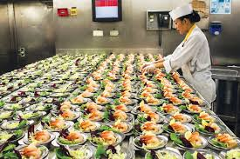
“ONBOARD HEALTHY NUTRITION”
Proper Nutrition and Wellbeing Onboard
2. 2. The Role of Meal Planning Onboard Ships
Seafarers face unique nutritional challenges in the course of their duties. As such, it becomes imperative to factor in meal planning and careful meal selection. A proper meal can replenish dipping energy levels and promote work efficiency.

Slide 34
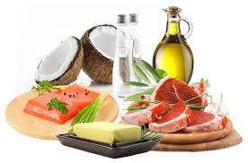
“ONBOARD HEALTHY NUTRITION”
Proper Nutrition and Wellbeing Onboard
Variety Carbohydrates - ideally whole grain meals because of their high fiber content.
Proteins - poultry, beef, legumes, and dairy products.
Vitamins and minerals fresh fruits and vegetables; all sorts of foods.
Fats and oils olive oil, nuts, seeds, and avocado. Bad fats contained in fatty meat, butter, ghee, and processed foods should be avoided.
Notes:
Variety Chief Cooks plan nutritionally balanced meals ahead of time. This should include adequate amounts of;
Carbohydrates - ideally whole grain meals because of their high fiber content.
Proteins - These take the longest to digest, therefore sustaining seafarers for a longer period. Sources of protein include poultry, beef, legumes, and dairy products.
Vitamins and minerals are not only present in fresh fruits and vegetables but in all sorts of foods.
Fats and oils are super-important for immune health. In addition, all hormones depend on fatty-rich foods. Good fats are unsaturated and have a lower risk of disease. These include olive oil, nuts, seeds, and avocado. On the other hand, bad fats contained in fatty meat, butter, ghee, and processed foods should be avoided.

Slide 35
“ONBOARD HEALTHY NUTRITION”
Proper Nutrition and Wellbeing Onboard
Sustainability
Reducing food waste
Mitigating the potential man-made greenhouse gas emissions crisis.
Ensuring that provisions are ordered and utilized correctly according to the desired quantity and the expiration date. Utilizing provisions of the First-In-First-Out approach.
Using fresh and perishable provisions first before frozen and canned provisions.
Notes:
Onboard a sea vessel, Chief Cooks must monitor consumption levels and adhere to the recommended calories across the key food groups Meal planning reduces food waste and, as a result, mitigates the potential man-made greenhouse gas emissions crisis. Proper meal planning also ensures that provisions are ordered and utilized correctly according to the desired quantity and the expiration date. Provisions are normally utilized using the First-In-First-Out approach. In addition, fresh and perishable provisions are used first before frozen and canned provisions.

Slide 36
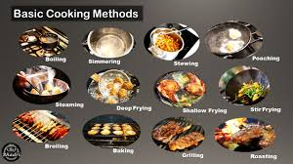
“ONBOARD HEALTHY NUTRITION”
Proper Nutrition and Wellbeing Onboard
Economical and efficient food production.
Determining the cost, quality, and quantity of ingredients required to maximize utility and minimize waste.
Using different cooking methods such as braising, boiling, stewing, and roasting depending on the meal.
Managing weight better, ensuring a balanced diet, presenting healthier food options, and limiting food waste
*IFS example for food monitoring software.
Notes:
In their meal planning, chief cooks need to consider the cost, quality, and quantity of ingredients required to maximize utility and minimize waste.Different cooking methods are used for different types of meals. Cooking methods may include braising, boiling, stewing, and roasting. Menu planning comes in handy for chief cooks to determine the cooking method that is most suitable for a particular meal. The cooking methods also influence the flavor, texture, and appearance of food. “In the long run, meal planning helps manage weight better, ensures a balanced diet, presents healthier food options, and limits food waste." IFS Dietician, Pettie Peeters. Our Chief Cooks are guided by the data provided in our IFS food monitoring software. The interface provides shipowners and ship managers with precise cost, nutritional value, and quantity information. At IFS, looking out for the well-being of our crew and seafarers is paramount. Being a data-driven company, we are keen to source wholesome, healthy, and quality food even within a controlled budget .

Slide 37

“ONBOARD HEALTHY NUTRITION”
Proper Nutrition and Wellbeing Onboard
Balanced meals that meet the crew's nutritional needs.
To maintain proper nutrition and well-being onboard—whether on a ship, an aircraft, or any situation where people are away from typical food sources and routines—requires a thoughtful approach to diet, exercise, mental health, and hydration. Here are the key principles:

Slide 38

“ONBOARD HEALTHY NUTRITION”
Proper Nutrition and Wellbeing Onboard
Balanced meals that meet the crew's nutritional needs.
1. Balanced Nutrition
Macronutrients: adequate protein, healthy fats, and complex carbohydrates.
Micronutrients: a variety of fruits and vegetables for essential vitamins and minerals
Notes:
A balanced diet is essential for energy, mental clarity, and overall health, especially in environments where physical demands might be high.
- Macronutrients: Ensure meals include adequate protein (for muscle maintenance and repair), healthy fats (for sustained energy), and complex carbohydrates (for quick energy and fiber).
- Micronutrients: Include a variety of fruits and vegetables for essential vitamins and minerals that support immunity, cognitive function, and general health.

Slide 39
“ONBOARD HEALTHY NUTRITION”
Proper Nutrition and Wellbeing Onboard
Balanced meals that meet the crew's nutritional needs.
- Portion Control: Since physical activity might be limited on board, overeating can lead to unwanted weight gain. Adjust portion sizes based on activity level.
- Limited Processed Foods: Where possible, prioritize whole, minimally processed foods to avoid excess salt, sugar, and unhealthy fats, which are common in processed snacks and ready-made meals.

Slide 40
“ONBOARD HEALTHY NUTRITION”
Proper Nutrition and Wellbeing Onboard
Balanced meals that meet the crew's nutritional needs.
2. Hydration
Dehydration can be a common issue onboard due to limited access to water and dry environments (like the recycled air on planes
Adequate Water Intake: Aim for at least 2-3 liters of water daily, adjusting based on the individual's weight, climate, and activity levels.
Minimize Caffeinated and Sugary Beverages: While coffee and tea are stimulating, caffeine can be dehydrating in excess. Additionally, sugary drinks can cause energy crashes and deplete minerals.

Slide 41
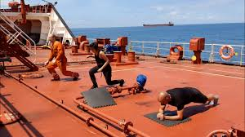
“ONBOARD HEALTHY NUTRITION”
Proper Nutrition and Wellbeing Onboard
3. Exercise and Physical Activity
Being sedentary for long periods, especially on long voyages or flights, can negatively impact physical health and mental well-being.
Daily Physical Activity
Stretching
Strength and Cardio Options
Notes:
. Exercise and Physical Activity
Being sedentary for long periods, especially on long voyages or flights, can negatively impact physical health and mental well-being.
Daily Physical Activity: Aim for at least 30 minutes of movement daily, whether through body-weight exercises, resistance bands, or just walking around if space allows.
Stretching: Incorporate regular stretching to prevent stiffness and improve circulation. Simple stretches and mobility exercises can prevent injury and relieve muscle tension.
Strength and Cardio Options: If possible, include strength exercises (like squats, lunges, and push-ups) and cardiovascular activities to maintain fitness levels.

Slide 42
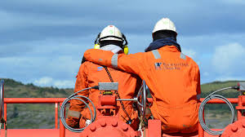
“ONBOARD HEALTHY NUTRITION”
Proper Nutrition and Wellbeing Onboard
4. Mental Well-being
Isolation, confined spaces, and long hours can lead to mental stress and fatigue. Nutrition plays a critical role in managing stress, but mental health practices are equally essential.
Mental Health Support
Mindfulness and Relaxation
Adequate Sleep
Notes:
Isolation, confined spaces, and long hours can lead to mental stress and fatigue. Nutrition plays a critical role in managing stress, but mental health practices are equally essential.
Mental Health Support: Access to counseling or check-ins with a mental health professional (via telemedicine if needed) can be beneficial.
Mindfulness and Relaxation: Techniques like meditation, deep breathing exercises, or journaling can help manage stress, reduce anxiety, and improve focus.
Adequate Sleep: Establishing a regular sleep schedule is important for mental clarity and mood stability. Aim for 7-9 hours of sleep, as uninterrupted as possible, to prevent fatigue.

Slide 43
“ONBOARD HEALTHY NUTRITION”
Proper Nutrition and Wellbeing Onboard
5. Regular Health Checks
Routine health checks help to identify potential health issues early and promote a proactive approach to health.
Health Screenings: Regular blood pressure, glucose, and cholesterol checks can identify health risks.
Metrics: Monitoring body weight, hydration levels, and muscle mass can provide insights into whether current practices are effective or need adjustment.

Slide 44
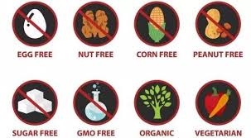
“ONBOARD HEALTHY NUTRITION”
Proper Nutrition and Wellbeing Onboard
6. Personalized Nutritional Needs
Each crew member or passenger may have unique dietary needs based on their health, fitness level, and personal preferences.
Dietary Restrictions and Preferences
Supplementation
Notes:
Each crew member or passenger may have unique dietary needs based on their health, fitness level, and personal preferences.
Dietary Restrictions and Preferences: Catering to dietary restrictions (like allergies, intolerances, or personal choices) is crucial for individual well-being.
Supplementation: Where access to fresh produce is limited, supplements like multivitamins, omega-3s, and probiotics may support nutrient intake.

Slide 45
“ONBOARD HEALTHY NUTRITION”
Proper Nutrition and Wellbeing Onboard
7. Emergency Preparedness
Ensure there is adequate stock of healthy emergency food and water supplies in case of unexpected delays or detours.
Non-Perishable Food Options: Nut butters, whole-grain crackers, canned fruits (in water, not syrup), and freeze-dried vegetables are options for nutrient-dense, long-lasting foods.
Electrolytes: Emergency hydration packs or electrolyte tablets can help maintain hydration in cases of high activity or extreme heat.

Slide 46
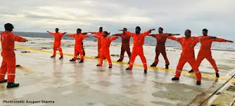

“ONBOARD HEALTHY NUTRITION”
Proper Nutrition and Wellbeing Onboard
Conclusion
By addressing these principles, those onboard can maintain their physical and mental health, stay energized, and enjoy greater comfort. Tailoring these guidelines to specific needs and conditions will further enhance well-being, promoting resilience and morale for everyone involved.

Slide 47
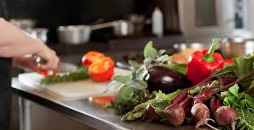
“ONBOARD HEALTHY NUTRITION”
Proper Nutrition and Wellbeing Onboard
Relation Between Healthy Nutrition and Wellbeing Onboard
Healthy nutrition plays a foundational role in supporting well-being onboard, impacting not only physical health but also cognitive performance, mood, and overall resilience. Here’s how proper nutrition relates to different aspects of well-being in onboard environments:

Slide 48

“ONBOARD HEALTHY NUTRITION”
Proper Nutrition and Wellbeing Onboard
1. Energy and Stamina
Onboard tasks can be physically and mentally demanding, especially for crew members, and a balanced diet provides the energy needed to meet these demands.
Stable Energy Levels
Endurance and Physical Strength
Notes:
Onboard tasks can be physically and mentally demanding, especially for crew members, and a balanced diet provides the energy needed to meet these demands.
Stable Energy Levels: Nutrient-dense meals rich in complex carbohydrates, proteins, and healthy fats help stabilize blood sugar, avoiding energy spikes and crashes. This is essential for maintaining consistent energy and preventing fatigue.
Endurance and Physical Strength: Proteins, vitamins, and minerals are necessary for muscle maintenance and recovery. A diet rich in these nutrients supports stamina, which is particularly important for physically demanding tasks on ships, planes, or long-haul transport vehicles.

Slide 49
“ONBOARD HEALTHY NUTRITION”
Proper Nutrition and Wellbeing Onboard
2. Cognitive Performance and Focus
Nutrition directly impacts brain health and cognitive abilities, both of which are crucial for alertness and decision-making onboard.
Mental Clarity and Focus
Stress Management
Notes:
2. Cognitive Performance and Focus
Nutrition directly impacts brain health and cognitive abilities, both of which are crucial for alertness and decision-making onboard.
Mental Clarity and Focus: Foods high in omega-3 fatty acids (found in fish, walnuts, and flaxseed) are known to support brain function and may improve focus and memory, while foods rich in antioxidants (like berries and leafy greens) reduce oxidative stress that can impair cognition.
Stress Management: Nutrients such as B vitamins, magnesium, and amino acids from protein sources are known to regulate stress hormones. Consistent intake of these nutrients supports calmness, reduces anxiety, and helps in managing onboard stress.

Slide 50

“ONBOARD HEALTHY NUTRITION”
Proper Nutrition and Wellbeing Onboard
3. Mood and Emotional Health
Living and working in confined spaces, often far from home, can affect mental health. Nutrition can help balance mood and improve emotional resilience.
Mood Regulation
Reduction of Stress-Related Cravings
Notes:
Living and working in confined spaces, often far from home, can affect mental health. Nutrition can help balance mood and improve emotional resilience.
Mood Regulation: Certain nutrients like tryptophan (found in turkey, bananas, and oats) are precursors to serotonin, a neurotransmitter linked to mood regulation. A steady intake of these foods can help uplift mood and decrease irritability or feelings of isolation.
Reduction of Stress-Related Cravings: Balanced nutrition helps prevent stress-induced cravings for unhealthy, sugary, or processed foods, which can negatively impact emotional health and lead to energy crashes.

Slide 51
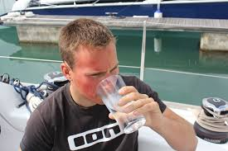
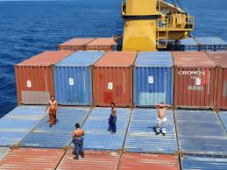
“ONBOARD HEALTHY NUTRITION”
Proper Nutrition and Wellbeing Onboard
4. Physical Health and Immunity
Healthy nutrition strengthens the immune system, which is essential for anyone onboard who may be more vulnerable to contagious illnesses due to close quarters and shared spaces.
Enhanced Immunity
Prevention of Chronic Illnesses
Notes:
Healthy nutrition strengthens the immune system, which is essential for anyone onboard who may be more vulnerable to contagious illnesses due to close quarters and shared spaces.
Enhanced Immunity: Foods rich in vitamin C (citrus fruits, peppers), zinc (nuts, seeds), and other antioxidants help the body fight infections. This is especially important onboard, where medical facilities may be limited and disease prevention is key.
Prevention of Chronic Illnesses: A nutritious diet that limits processed foods, unhealthy fats, and added sugars reduces the risk of chronic diseases such as hypertension, diabetes, and obesity, which are more challenging to manage in isolated or confined environments.

Slide 52

“ONBOARD HEALTHY NUTRITION”
Proper Nutrition and Wellbeing Onboard
5. Hydration and Environmental Adaptation
Different onboard environments (like aircraft cabins or maritime vessels) often have dry air and limited water access, which can lead to dehydration and related health issues.
Hydration for Vital Functions
Nutrient Absorption
Notes:
Different onboard environments (like aircraft cabins or maritime vessels) often have dry air and limited water access, which can lead to dehydration and related health issues.
Hydration for Vital Functions: Water is essential for digestion, circulation, and temperature regulation, all of which are necessary to function well. Staying hydrated is crucial for maintaining mental focus, energy, and physical endurance.
Nutrient Absorption: Adequate hydration improves the body’s ability to absorb and transport essential nutrients, ensuring maximum benefit from the foods consumed.

Slide 53
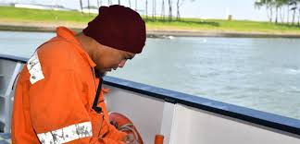
“ONBOARD HEALTHY NUTRITION”
Proper Nutrition and Wellbeing Onboard
6. Resilience Against Fatigue and Jet Lag
Poor diet and dehydration can amplify the effects of fatigue and jet lag, which are common in long-haul travel or extended shifts.
Balanced Blood Sugar Levels
Adaptation to Time Zone Changes
Notes:
Poor diet and dehydration can amplify the effects of fatigue and jet lag, which are common in long-haul travel or extended shifts.
Balanced Blood Sugar Levels: Regular, nutrient-rich meals with whole grains, lean proteins, and healthy fats prevent blood sugar crashes, helping reduce the sensation of fatigue and supporting stable energy throughout the day.
Adaptation to Time Zone Changes: Proper timing of meals and consuming foods that support melatonin production (like cherries and tomatoes) can help regulate sleep-wake cycles, aiding in quicker recovery from jet lag.

Slide 54
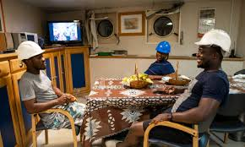
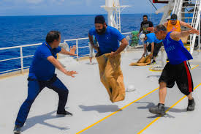
“ONBOARD HEALTHY NUTRITION”
Proper Nutrition and Wellbeing Onboard
7. Enhanced Social and Community Well-being
Good nutrition supports a positive onboard community, contributing to morale and teamwork.
Shared Meals and Social Connection
Positive Work Environment
Notes:
Good nutrition supports a positive onboard community, contributing to morale and teamwork.
Shared Meals and Social Connection: Sharing healthy, enjoyable meals can foster a sense of camaraderie, reducing isolation and promoting a positive atmosphere.
Positive Work Environment: Proper nutrition reduces irritability and stress, helping crew members or passengers maintain a cooperative and harmonious environment onboard.

Slide 55
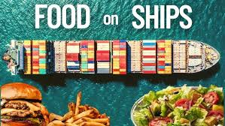
“ONBOARD HEALTHY NUTRITION”
Proper Nutrition and Wellbeing Onboard
As a result, healthy nutrition is more than just fuel for the body; it is a critical component of well-being that affects energy, focus, mood, immunity, and even social dynamics onboard. By prioritizing balanced and nutrient-dense meals, individuals and teams can enjoy greater resilience, mental clarity, and emotional stability, leading to a safer, more enjoyable experience for all onboard.

Slide 56

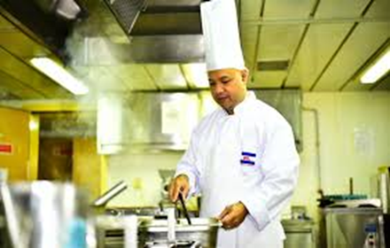
“ONBOARD HEALTHY NUTRITION”
Proper Nutrition and Wellbeing Onboard
3. Understanding the importance of providing nutritious and balanced meals at sea.
Ideal Nutrition Onboard
Healthy nutrition plays a foundational role in supporting well-being onboard, impacting not only physical health but also cognitive performance, mood, and overall resilience. Here’s how proper nutrition relates to different aspects of well-being in onboard environments.

Slide 57
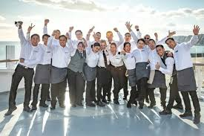
“ONBOARD HEALTHY NUTRITION”
Proper Nutrition and Wellbeing Onboard
1. Physical Health and Stamina
• Energy Needs
• Preventing Deficiencies
Notes:
1. Physical Health and Stamina
• Energy Needs: Life at sea demands high energy due to physically intensive tasks like operating machinery, handling cargo, and standing long hours on watch. Nutrient-rich meals supply the energy necessary for sailors to perform these tasks effectively.
• Preventing Deficiencies: Limited access to fresh food can lead to nutrient deficiencies, such as vitamin C deficiency, which historically led to scurvy among sailors. Balanced meals help prevent these health issues by ensuring an adequate intake of essential vitamins and minerals.

Slide 58
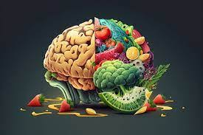
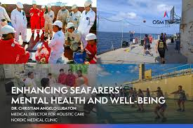
“ONBOARD HEALTHY NUTRITION”
Proper Nutrition and Wellbeing Onboard
2. Mental Health and Cognitive Function
• Concentration and Alertness
• Mood and Morale
Notes:
2. Mental Health and Cognitive Function
• Concentration and Alertness: Long shifts and unpredictable hours require high levels of concentration. Nutritious meals support cognitive function, which is crucial for making sound decisions, staying alert, and ensuring safety in potentially hazardous conditions.
• Mood and Morale: Nutrient-rich meals can improve mood and reduce stress, which helps maintain a positive work environment. Poor diet, on the other hand, can lead to irritability, fatigue, and decreased morale, which can affect teamwork and productivity.

Slide 59


“ONBOARD HEALTHY NUTRITION”
Proper Nutrition and Wellbeing Onboard
3. Immune System Support
• Resistance to Illness
Notes:
3. Immune System Support
• Resistance to Illness: At sea, sailors are often isolated for extended periods, and illness can spread quickly in close quarters. Balanced nutrition supports immune health, making crew members less susceptible to infections, which is critical as medical resources are limited on board.

Slide 60

“ONBOARD HEALTHY NUTRITION”
Proper Nutrition and Wellbeing Onboard
4. Adaptability to Harsh Conditions
• Weather Resilience
• Recovery and Endurance
Notes:
4. Adaptability to Harsh Conditions
• Weather Resilience: Working in extreme weather conditions, like cold or intense sun, places additional strain on the body. A diet rich in antioxidants, healthy fats, and proteins helps the body adapt and withstand these stresses.
• Recovery and Endurance: Sea duties are taxing, and proper nutrition aids in faster recovery from physical exertion, minimizing injury risk and maintaining endurance over long voyages.

Slide 61
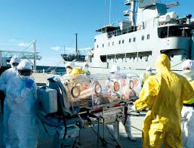
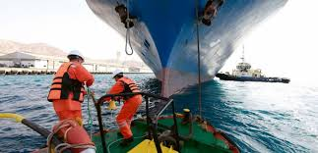
“ONBOARD HEALTHY NUTRITION”
Proper Nutrition and Wellbeing Onboard
5. Long-Term Health and Safety
• Chronic Disease Prevention
• Operational Safety
Notes:
5. Long-Term Health and Safety
• Chronic Disease Prevention: Balanced diets help reduce the risk of long-term health issues such as obesity, cardiovascular disease, and diabetes. Keeping crew members healthy reduces downtime and ensures they remain fit to work.
• Operational Safety: When sailors are healthy, alert, and energized, they’re better able to perform tasks safely and efficiently, which is essential for preventing accidents and maintaining a secure work environment.

Slide 62

“ONBOARD HEALTHY NUTRITION”
Proper Nutrition and Wellbeing Onboard
Thank You for Your Attention

