Slide 1






MARSNET
MIRCEA CEL BĂTRÂN
NAVAL ACADEMY
SIMULATION CAPABILITY
KA220 - Cooperation Partnerships in Vocational Education and Training
2021-1-RO01-KA220-VET-000029412

Slide 2
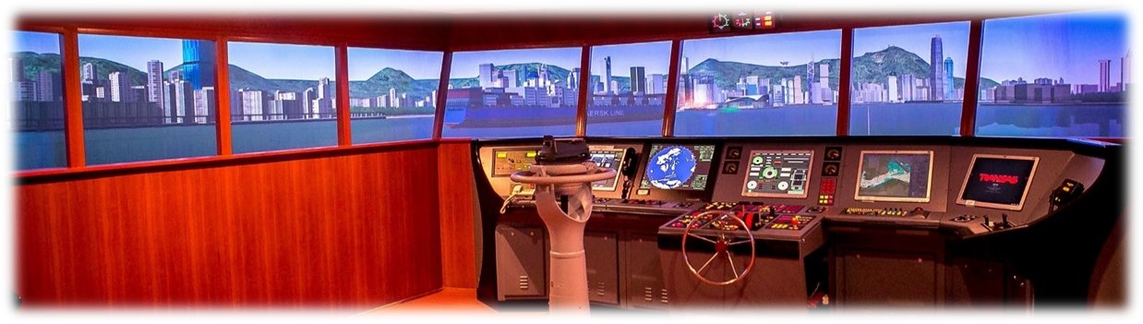
“SHIP HANDLING SIMULATOR"
Notes:
"Mircea cel Batran" Naval Academy purchased in 2009 a complex of operational maritime simulators named "Integrated simulator for driving of watercraft" type Navi-Trainer Professional 5000 manufactured by TRANSAS Limited Co and certified by DetNorskeVeritas (DNV) as A class (full mission) for bridge and machinery.

Slide 3
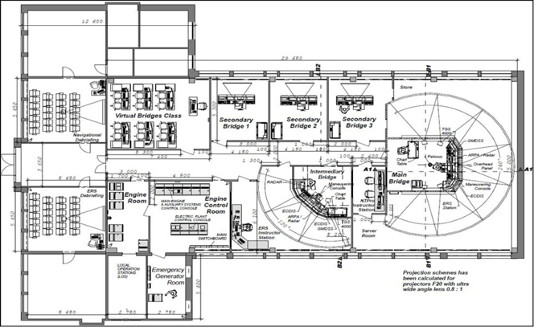
Notes:
The Standard of Training Certification and Watchkeeping (STCW) Convention with Standard Certification No. 2.14 for Maritime Simulator Systems, adopted in January 2011, impose the requirements for the performance of this systems whence must include an appropiate level of physical and behavioural realism in accordance with recognised training and assesment objectives. A Class A (NAV) full mission simulator must by capable of simulating a total shipboard bridge operation situation, including the capability for advanced maneuvering in restricted waterways.
Full Mission Bridge Simulator arrangement
- 1 x main bridge with horizontal field of view (HFOV 240º) as per IACS class A requirements;
- 1 x intermediary bridge (HFOV 120º);
- 3 x secondary bridges (HFOV 90º);
- 6 x virtual bridges class;
- training, analysis and debriefing room;
- Global Maritime Distress & Safety System (GMDSS)
- Communication workplaces (on all bridges).

Slide 4
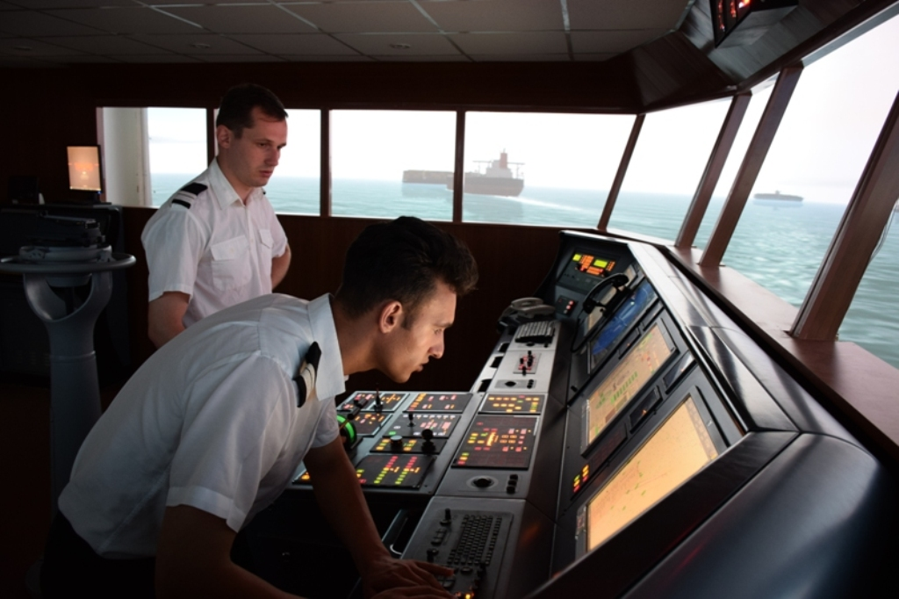
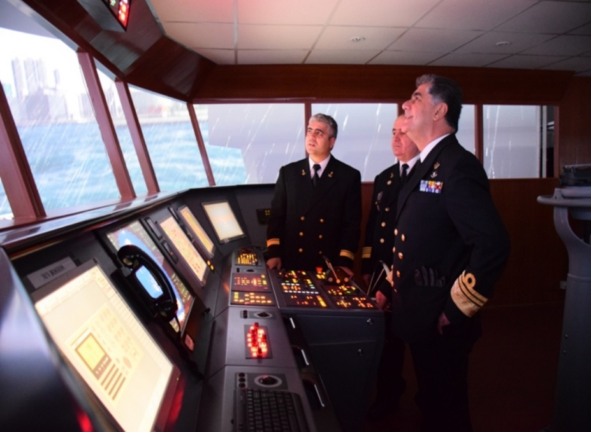
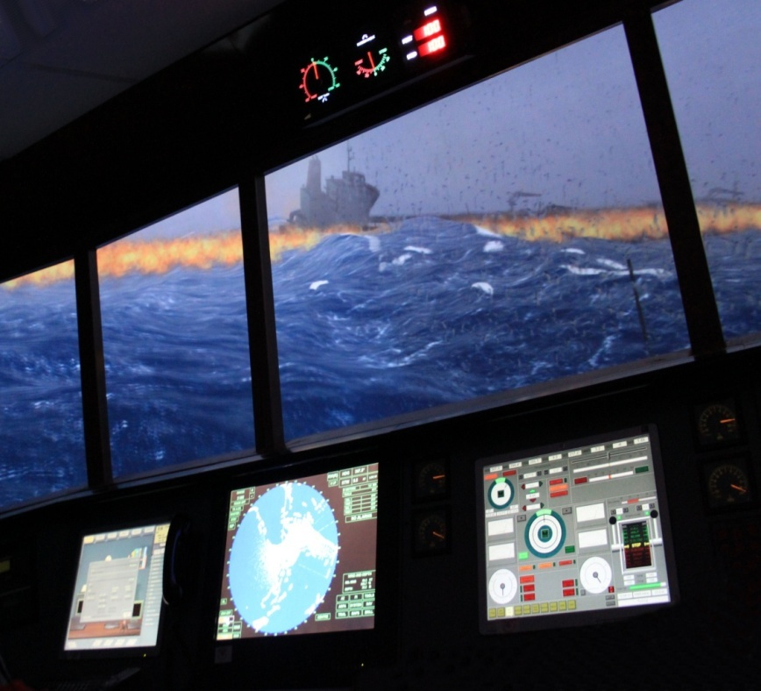
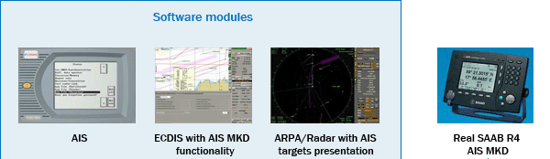
Notes:
The main capabilities of the bridge simulator are:
- plan and conduct a passage and conduct navigation;
maneuver and handle a ship in all conditions;
maintain a safe navigational watch with Electronic Chart Display and Information System (ECDIS), Automatic Identification System (AIS) and Ship Security Alert System (SSAS);
use of radar and Automatic Radar Plotting Aid (ARPA) to maintain safety of navigation;
respond to emergencies and distress signal at sea;
conducting telephone conversations via Intercom and Very High Frequency (VHF) station;
plan a voyage;
co-ordinate search and rescue operations;
establish watch keeping arrangements and procedures;
operate remote controls of propulsion plant and engineering systems and services.

Slide 5
Notes:
The “Integrated simulator for driving of watercraft” achieved:
- initial operational level of undergraduate students;
- managerial level of master students;
- professional improvement of navy personnel;
- professional improvement of seagoing personnel on the basis of agreements with crewing and shipping companies.
The ”Transas Evaluation and Assessment System” (TEAS) module of simulator allows assessing objectively the correctness of an exercise fulfilment.
For the evaluation of the students, the simulator has the Transas Evaluation and Assesment System (TEAS) module. The Transas Evaluation and Assessment System (TEAS) allows assessing objectively the correctness of an exercise fulfillment by a trainee. The assessment is based on the check of the exercise fulfillment correctness with regard to the selected set of criteria.
The by-criterion check consists in comparing the exercise assessment parameters to the set limit values according to the set rule. In the by-criterion check, at each moment of time a relative error is recorded (relative deviation of the assessment parameter from the limit values), and penalty points are calculated as a function of the relative error and the “error weight”.
The trainee competency is assessed in points (Score %) starting from 100% minus penalty score.
The instructor procedure for handling the TEAS is shown in the diagram

Slide 6
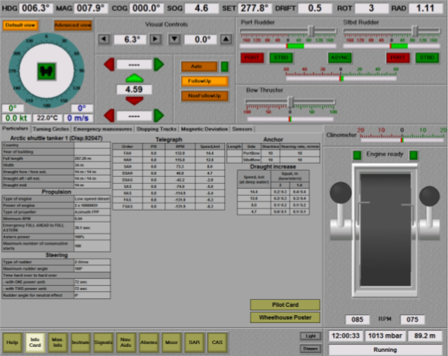
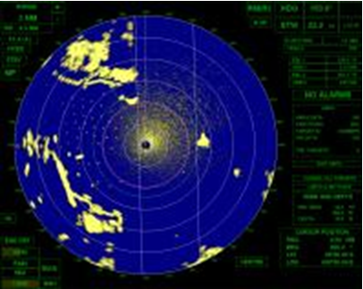

Slide 7
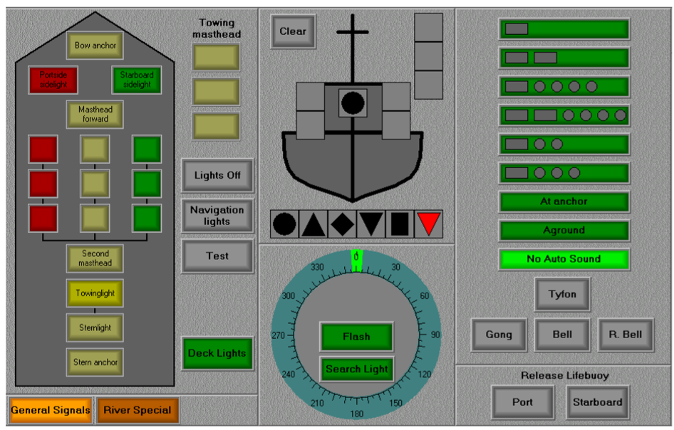
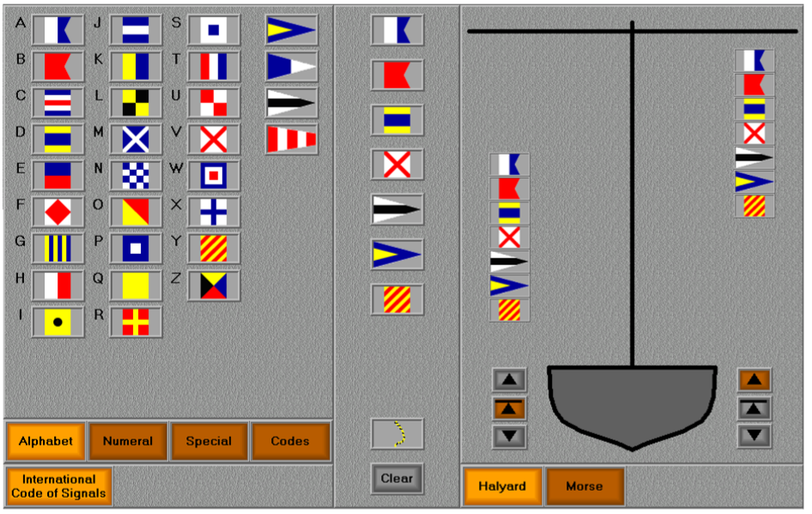

Slide 8
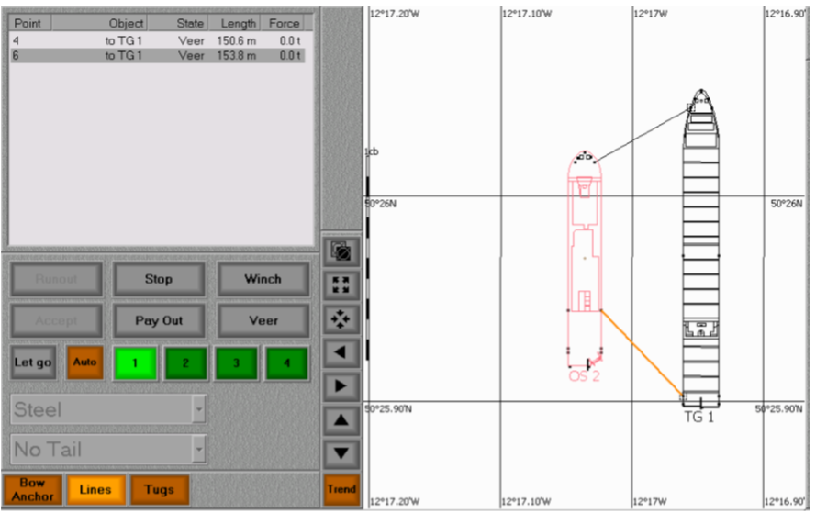

Slide 9
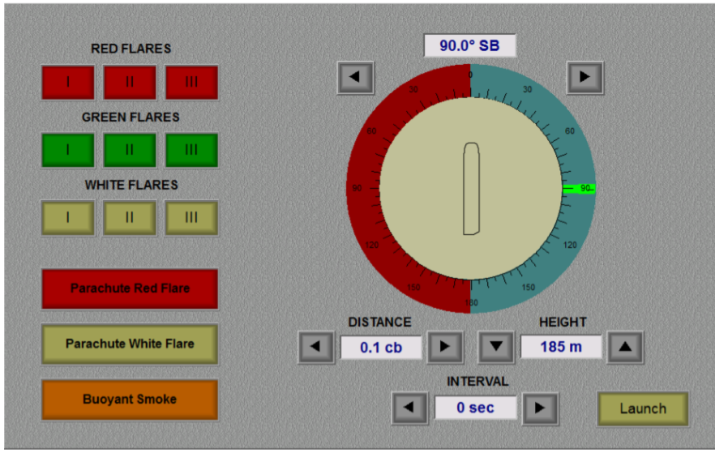
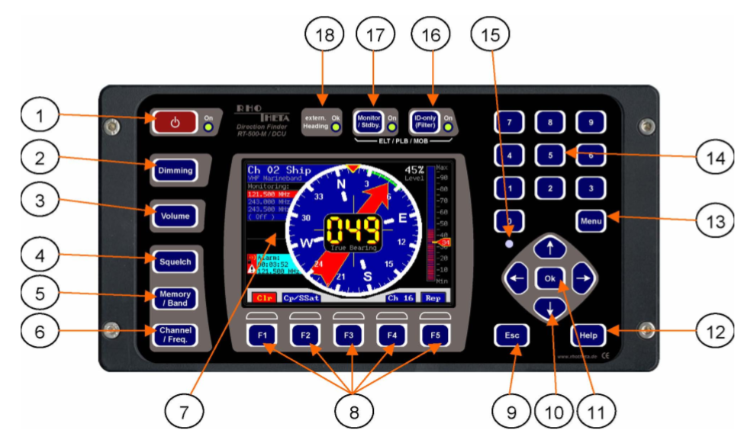

Slide 10
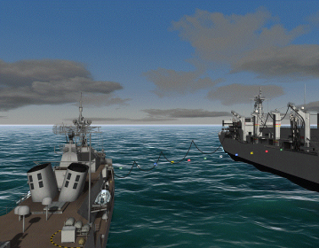
Notes:
For the helmsmanship skills training, the instructor can perform exercises in which to demand the use of the ship autopilot in manual mode in different hydrometeorological conditions (wind, current, swell) and different courses.
In order to train the officers of the watch skills to bring the ship into position and to match speed, the instructor can create exercises for learning and understanding the maneuver and evolutionary characteristics of vessels engaged in replenishment at sea operations.

Slide 11
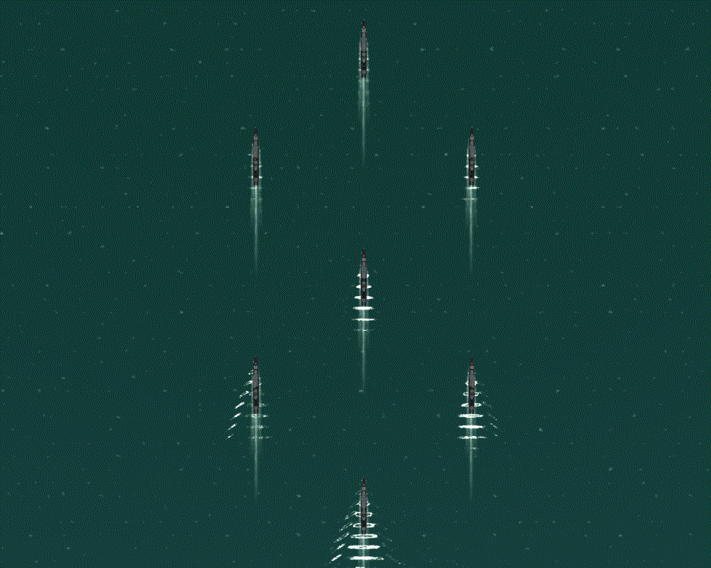
Notes:
The instructor plays a crucial role in the training and coaching process of this personnel by creating gradual difficulty exercises. In order to achieve his role the instructor uses facilities like: „Fleet formation”, „GMDSS communication console”, „Flags panel” and naval equipments from the "Integrated simulator for driving of watercraft".

Slide 12
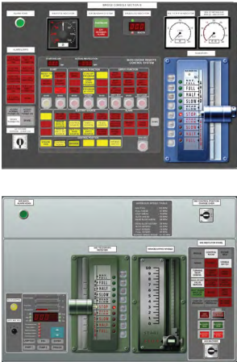
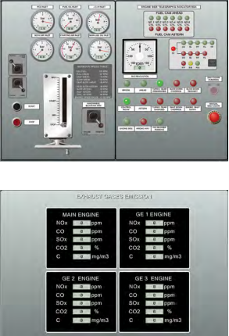
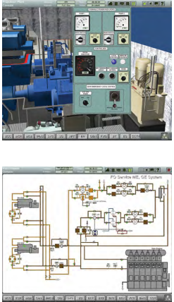
Notes:
The instructor plays a crucial role in the training and coaching process of this personnel by creating gradual difficulty exercises. In order to achieve his role the instructor uses facilities like: „Fleet formation”, „GMDSS communication console”, „Flags panel” and naval equipments from the "Integrated simulator for driving of watercraft".

Slide 13
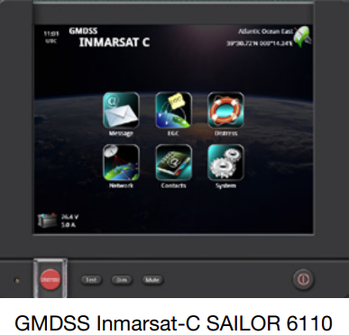
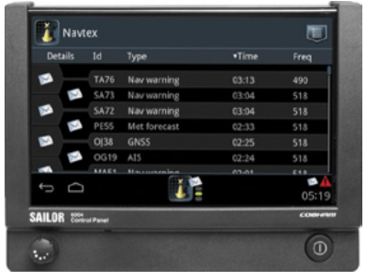
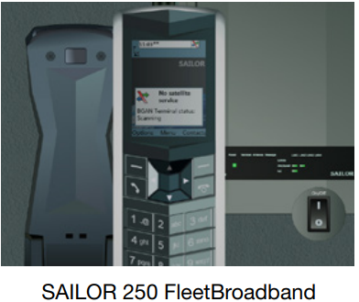
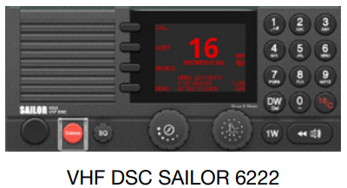
Notes:
The instructor plays a crucial role in the training and coaching process of this personnel by creating gradual difficulty exercises. In order to achieve his role the instructor uses facilities like: „Fleet formation”, „GMDSS communication console”, „Flags panel” and naval equipments from the "Integrated simulator for driving of watercraft".

Slide 14
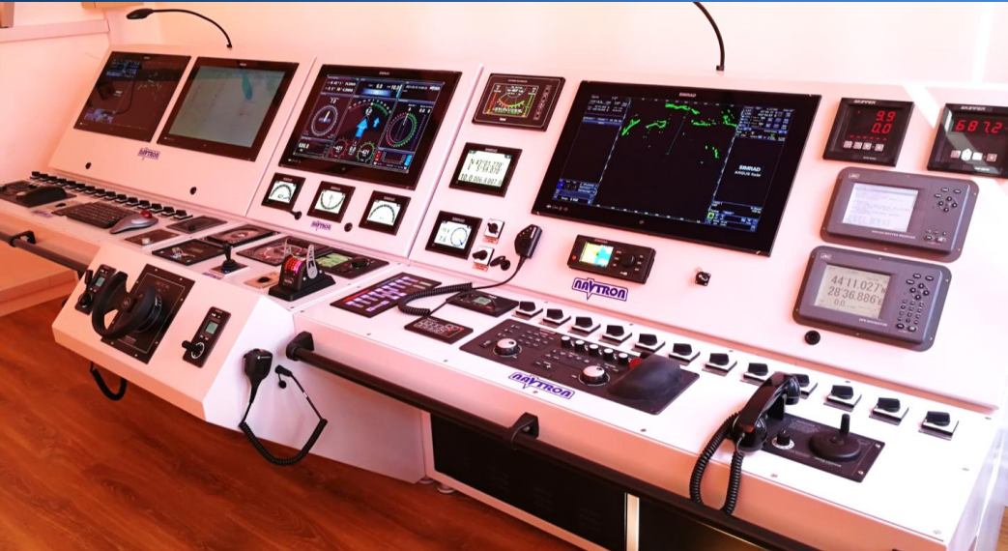
Navigation equipment simulator
Notes:
Scenariu Tactic

Slide 15
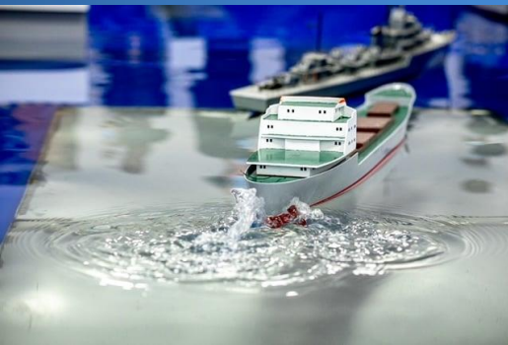
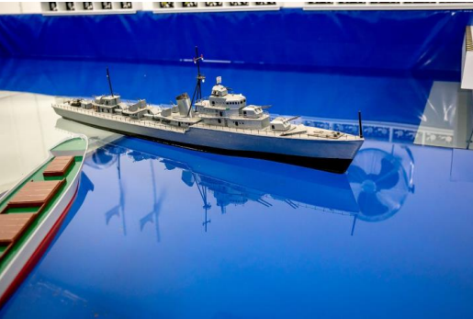
Shiphandling Laboratory
Notes:
Scenariu Tactic

Slide 16
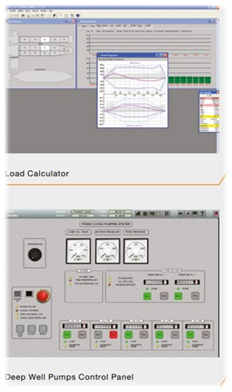
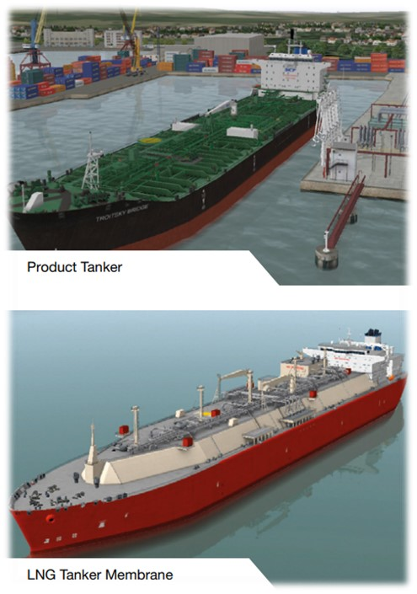
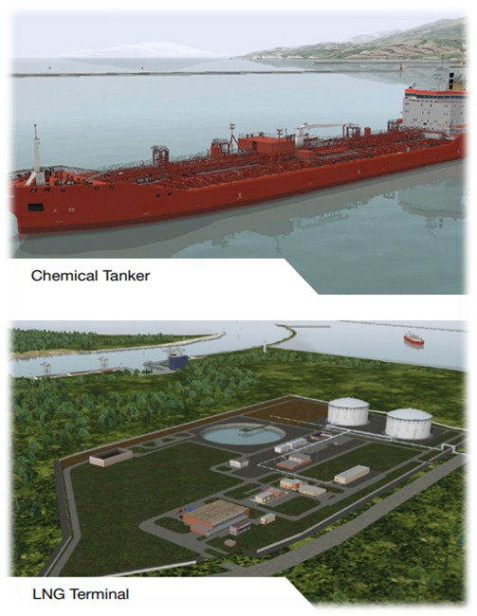
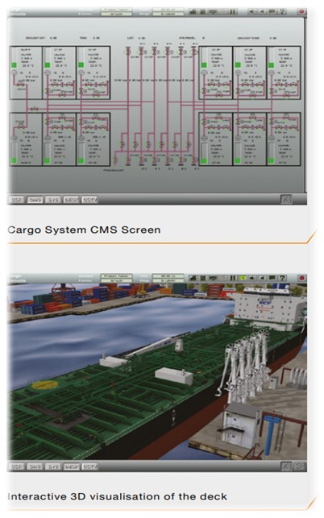
LCHS

Slide 17
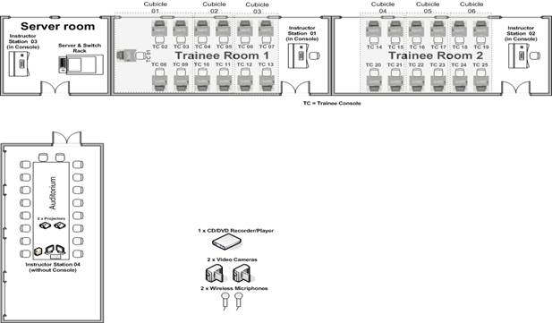
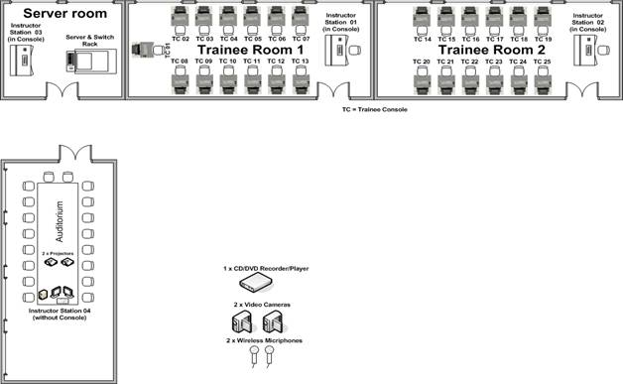
PROTEUS ASTT
Action Speed Tactical Trainer
Notes:
Simulatorul PROTEUS ASTT este destinat pentru familiarizarea studentilor militari cu procedurile tactice navale, pentru formarea priceperilor si deprinderilor necesare studentilor pentru operarea diverselor sisteme de senzori si armamente de la bordul navelor Fortelor Navale Romane, precum si pentru instruirea si evaluarea individuala a operatorilor sau pentru instruirea si evaluarea colectiva a echipelor de lupta din CIC-ul unei nave de lupta sau, simultan, din CIC-urile a pana la 6 nave de lupta, la standarde NATO, in limbile engleza si romana.

Slide 18
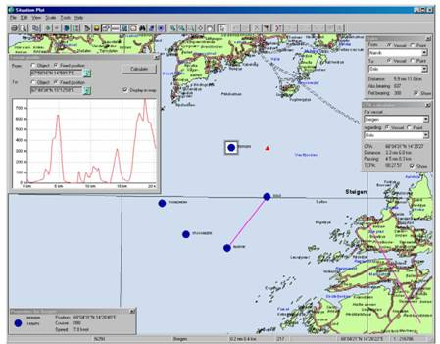
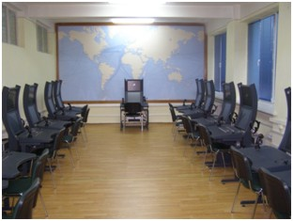
PROTEUS ASTT
Action Speed Tactical Trainer
Notes:
Scenariu Tactic

Slide 19
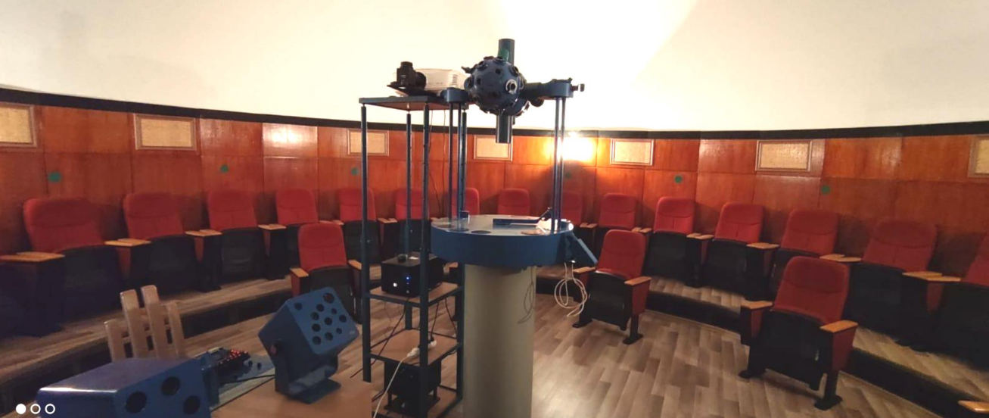
Planetarium
Notes:
Scenariu Tactic

Slide 20
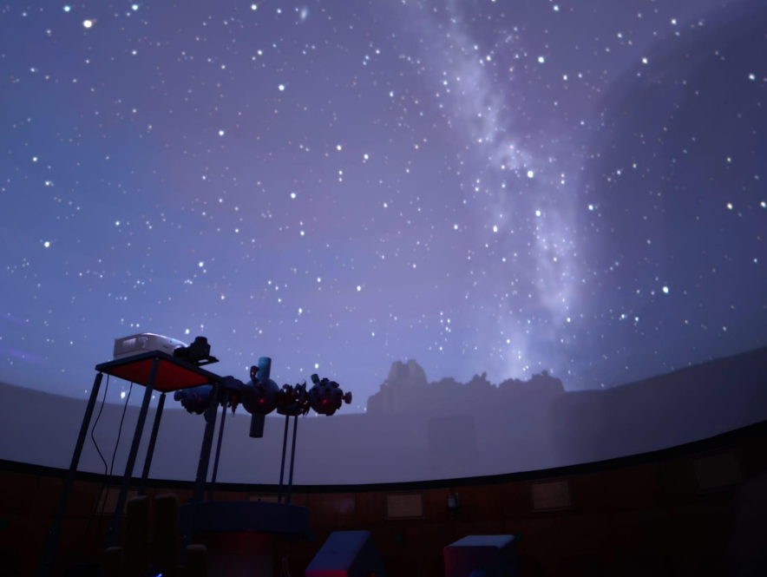
Planetarium
Notes:
Scenariu Tactic

Slide 21
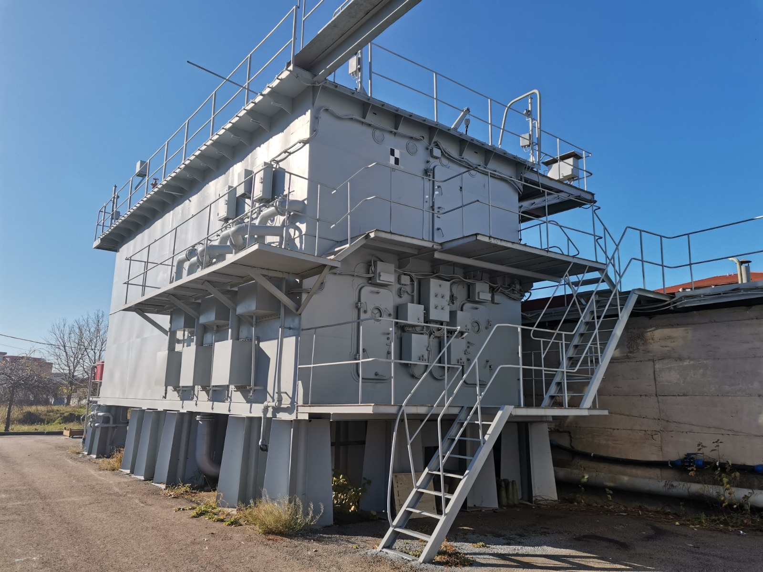
Damage control
Notes:
Scenariu Tactic

Slide 22
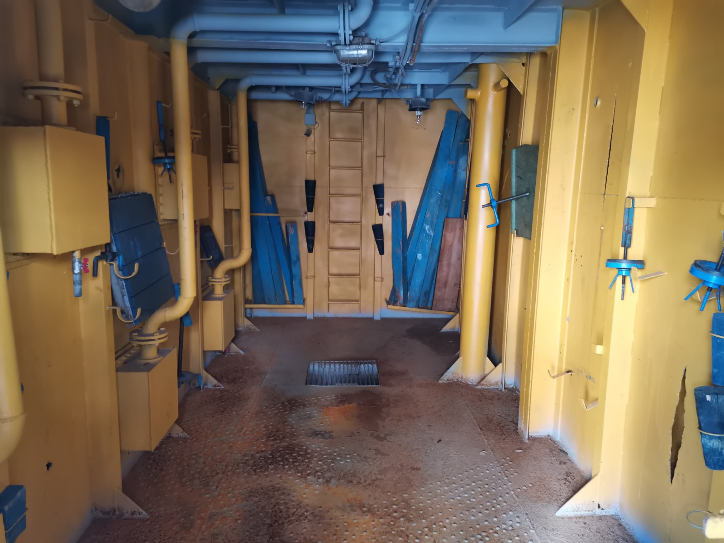
Damage control – flood fighting
Notes:
Scenariu Tactic

Slide 23
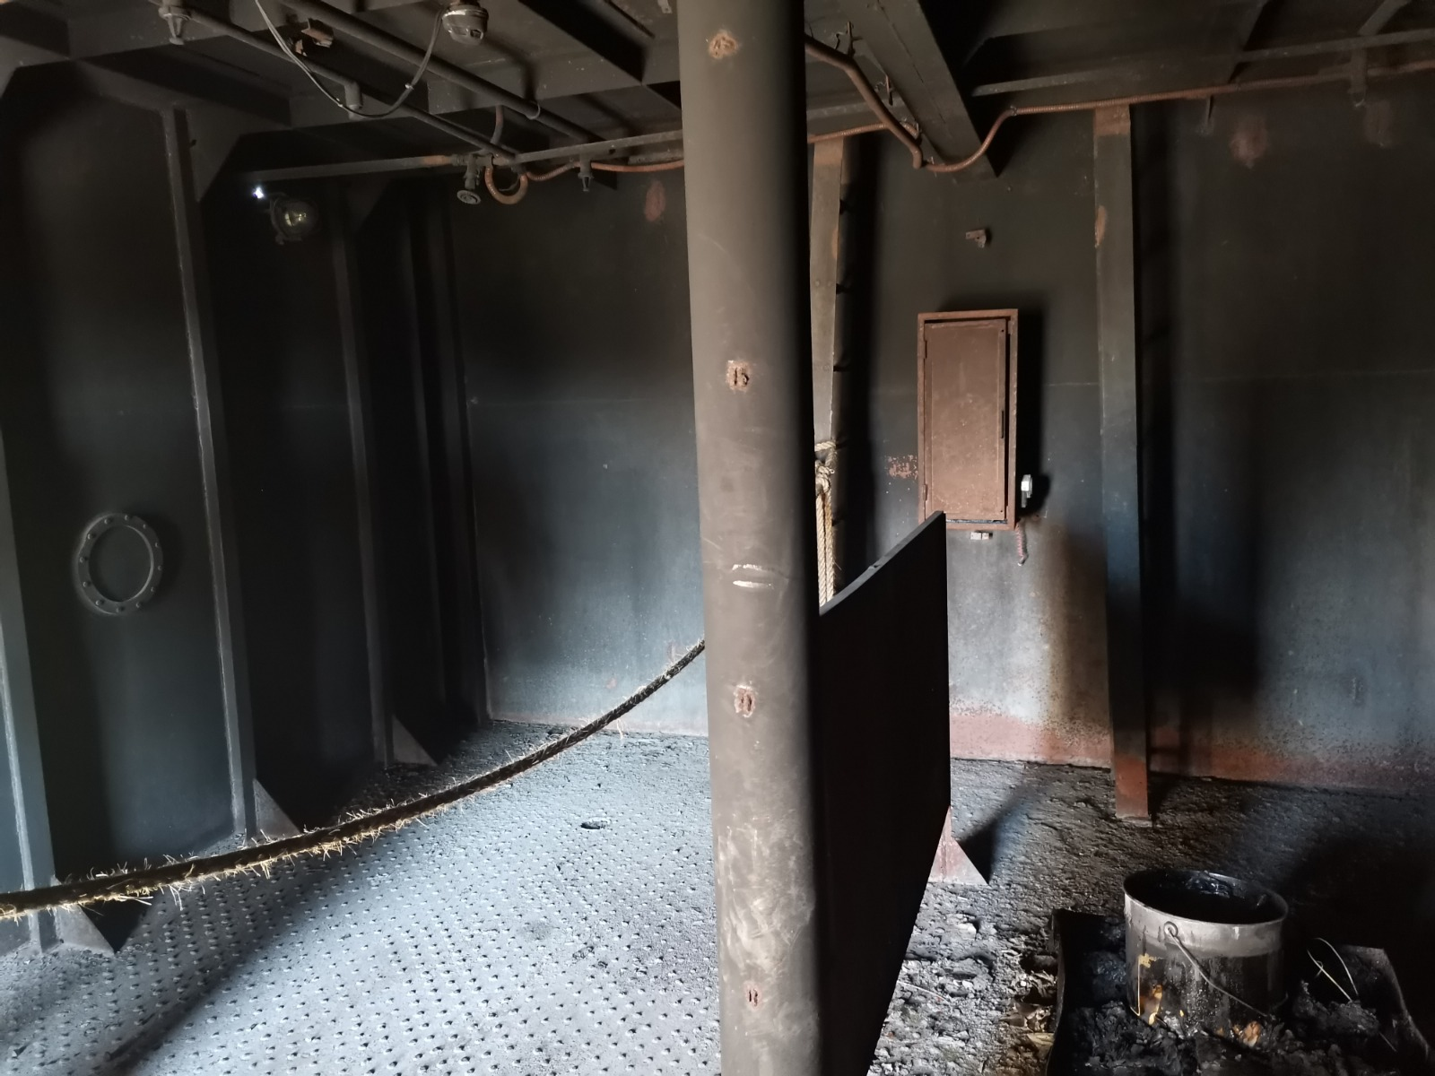
Damage control – flood fighting
Notes:
Scenariu Tactic

Slide 24
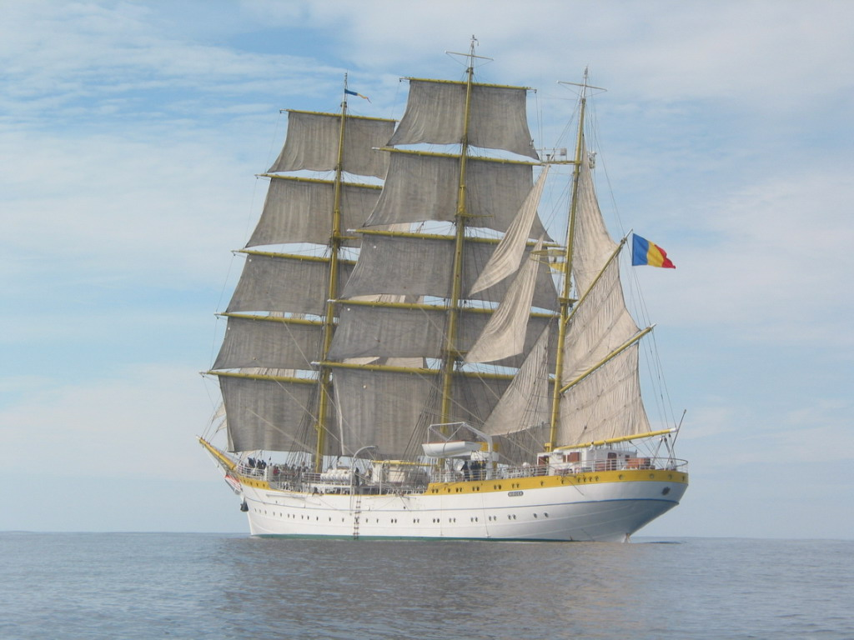
Notes:
Scenariu Tactic

Slide 25
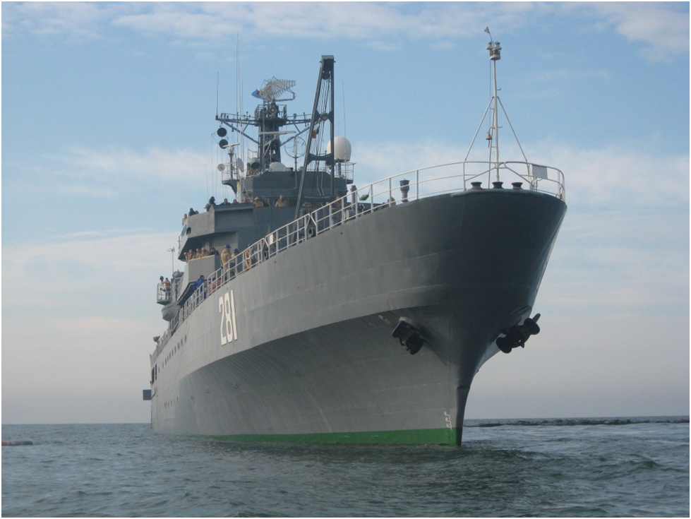
Notes:
Scenariu Tactic

Slide 26
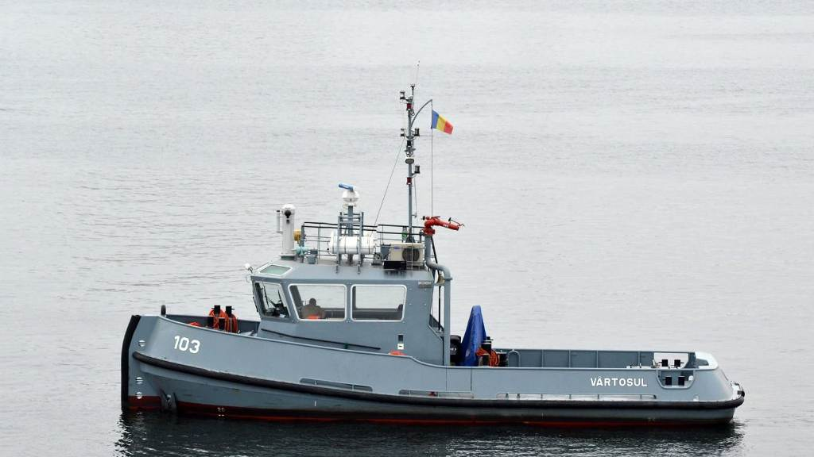
TUGS
Notes:
Scenariu Tactic

Slide 27
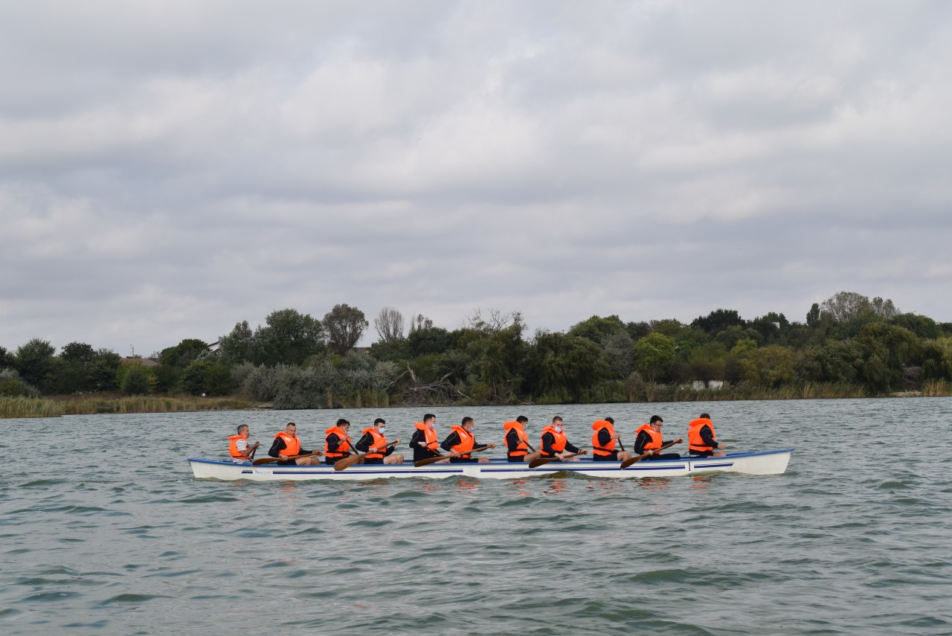
TUGS
Notes:
Scenariu Tactic

