Slide 1
Experiential Knowledge Based MENTORING
Ugurcan Acar
EU Project Manager/ General Coordinator/Merchant Navy Deck Officer
acarugurcan@gmail.com

Slide 2
Curriculum Vitae
2003-2008 Graduated from TUDEV (Turkish Maritime Education Centre)
2008-2009 Studied at University of Plymouth (UK) – Marine Studies
208/2010 Gained both UK and Turkish Certificate of Competency (Unlimited)
2010 Mentor for TUDEV graduates at Glasgow College
2010-2014 Worked as Project Officer at Centre for Factories of the Future in EU funded projects
2013 – Managed to secure over 300.000 Euros with his own project idea from European Commission – Project called “ACTs – Avoiding Collisions at sea”
2016 – Managed to secured over 240.000 Euros with his own project idea from European Commission – Project called “NEO-COL – Navigational Equipment Oriented Colregs Training” and works as a Project Manager at Turk Loydu

Slide 3
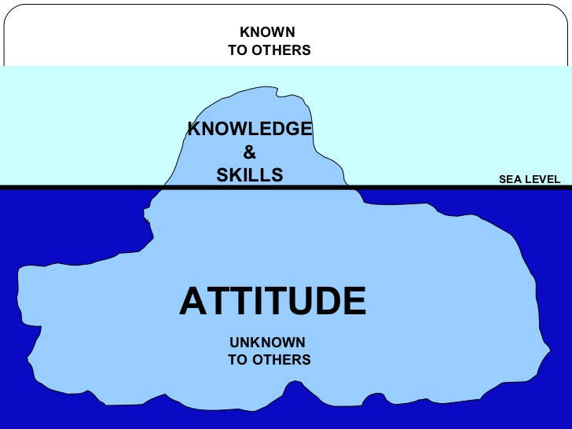
Competence

Slide 4
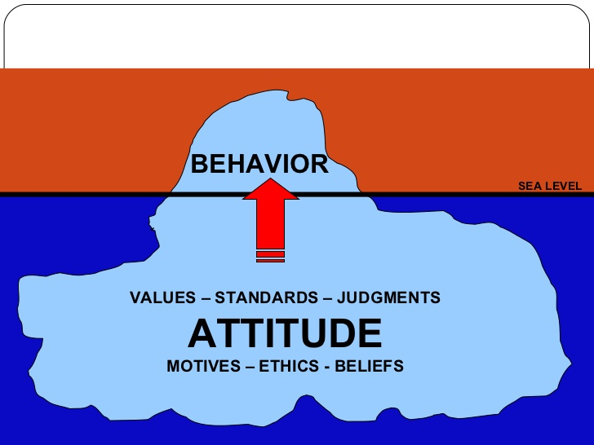
Competence

Slide 5
Components of Competence

Slide 6
Experiential Knowledge
Experiential knowledge is knowledge gained through experience, as opposed to a priori (before experience) knowledge: it can also be contrasted both with propositional (textbook) knowledge, and with practical knowledge.
KNOWLEDGE
APPLICATION OF KNOWLEDGE IN REAL LIFE
EXPERIENTIAL KNOWLEDGE

Slide 7
Background of the Problem – Experiential Knowledge
Experiential knowledge is not being passed from senior to juniors
Experiential Knowledge is not tangible and can not be taught at college
Industry needs career mentors and role models
Reduction in the opportunities for on-the-job experience
Barriers to easy transfer of experiential knowledge
Language and culture
Pressure of work
Lack of time due to long working hours
Real disconnect in the maritime world
Average working time of seafarers at sea is 4.8 years (Sail Ahead Project)
Shore based occupation has a lot of Mentors available which meet regularly but Seafarers do not
Need for new graduates to be guided on the skills and competences that Colleges/Universities can not deliver

Slide 8
Why Mentoring?
Learning is a lifelong occupation and each seafarers have a duty to pass their learning on
Informal Learning counts as 70% of the learning
It contributes worker retention in the industry and skill development
It extends your network and provide opportunities to recruit the best and brightest
Rules and regulations are dictated to us and policies may well be community-dictated if we create this synergy hence knowledge base and expertise
It makes a huge difference if one spares 5 minutes of their time to pass few “experiential knowledge” to other
Professional Network

Slide 9
What is MENTORING?
It is NOT a Training Role
Experiential Knowledge Supplementary to Foundation Knowledge obtained at college and ashore
Confidential, trust-based and voluntary arrangements
Provides guidance based on experimental knowledge for career progression

Slide 10
Who can be a MENTOR?
Someone who:
worked in the industry for some years and has experience to share whether they know it all or not
does not need to be a Trainer
can give guidance, answer questions, provide advice with experiential knowledge
worked in maritime industry more than 5 years
Anyone can be MENTOR and anyone needs MENTORING!

Slide 11
Benefits of MENTORING
Facilitates flow of Experiential Knowledge between graduates and students
Enables consolidation on-the-job experience for graduates progressing through ranks
Improved communication and enhancing team building
That it is long-lived as it is NOT formal and time consuming
Reduction in accidents and incidents at sea

Slide 12
Traditional On-board Mentoring and Drawbacks
Uses “Learning from others” model on board
It is on board and short-lived due to contract timing
It does not start until you are on board
It is Face-to-Face
Lack of motivation due to isolation of being at Sea and reduced manning

Slide 13
MENTORING VERSUS TRAINING
Mentoring is NOT a training but supplementary to it and never a replacement
Training should be formal, structured, standardized, and well analysed. Mentoring is NOT.
Training is technical where Mentoring is solely experience

Slide 14
Who are MENTORS?
Role Models
Motivators
Source of wisdom
Leaders
Network Enablers
Inspirations
supporters
Advisors

Slide 15
Good Mentoring
Sustainable
Personal
Objective
Win-Win

Slide 16
Question?
Are you a MENTOR?

Slide 17
Answer?
Your answer was probably NO but reality is You are! without being aware of it!
UK Practices:
Master Mariners link young seafarers with a Master Mariner until they become Master Mariner. This is for:
Knowledge acquisitions
Experience process
This builds friendship bonds between mariners.

Slide 18
Our Proposal
A Platform where MENTORS and MENTEES can connect

Slide 19
Structure Proposed
Master
Chief Officer
Second/Third Officer
Chief Officer
Second/Third Officer
Student
Second/Third officer
Student
New Joiner
Student
New Joiner
New Joiner
Student
New Joiner

Slide 20
Online Mentoring
Graduates at sea and ashore (Aimed at)
Mentorship before, during and after on board duties
Competent and experienced seafarers available
Available anywhere and everywhere with Internet connection and far more flexible in nature
It does not restrict it to online. If they are nearby, they can
Database is limited to partners in short term and may be exploited in various platforms such as seminars, workshops etc
Larger and more stable community of peers and mentors

Slide 21
Initial Work
Creation of directory of graduates – mentors and mentees
Facilitate “Find a Mentor or Mentee” function that mentors and mentees can connect
Provide a venue where mentoring can take place

Slide 22
FUTURE ROADMAP
MENTORING INTIATIVE
RESTORING CONNECTIONS
EU/NATIONAL/
INTERNATIONAL PROJECTS
POLICY MAKING
PROFESIONAL NETWORK
EXPERIENCE AND EXPERTICE
2017

Slide 23
QUESTIONS?

