Slide 1








Maritime Simulators and Training Facilities Network for Enhancing the Exchange of Good Practices and Digital Learning
Update – 06.09.2023
KA220 - Cooperation Partnerships in Vocational Education and Training
2021-1-RO01-KA220-VET-000029412

Slide 2






PROJECT OUTLINES
Project Acronym: MARS-NET
Project Start Date: 2022-02-01
Project Total Duration: 24 months
Project End Date: 2024-01-31
Grant approved: 207.970 Euro

Slide 3

Project Partners
RNA - Romanian Naval Academy - Academia Navala "Mircea cel Batran" (E10093117 - Romania)
PRU - Piri Reis University - T. C. Piri Reis Universitesi (E10105404 - Turkey)
NVNA - Bulgarian Naval Academy - “Nikola Yonkov Vaptsarov” Naval Academy (E10108590 - Bulgaria)
PNA - Polish Naval Academy - AKADEMIA MARYNARKI WOJENNEJ (E10090628 - Poland)
LMA - Lithuanian Maritime Academy - Lietuvos aukstoji jureivystes mokykla (E10108901 - Lithuania)

Slide 4
Project director: Alecu Toma
MarsNet Steering Committee:
Project responsible RNA: Sergiu Lupu
Project responsible PRU: Taner Albayrak
Project responsible LMA: Rima Mickiene
Project responsible PRU: Marcin Kluczyk
Project responsible NVNA: George Dimitrov

Slide 5
Working teams
Romanian Naval Academy (RNA)
Name | email address | Responsabilities
Alecu Toma | catalin.popa@anmb.ro | Project director
Sergiu Lupu | Sergiu.lupu@anmb.ro | Project responsible MBNA
Catalin Popa | catalin.popa@anmb.ro | Project implementation expert
Alexandru Cotorcea | alexandru.cotorcea@anmb.ro | Instructor
Dragos Simion | dragos.simion@anmb.ro | Instructor
Pocora Andrei | andrei.pocora@anmb.ro | Instructor
Andrei Bautu | andrei.bautu@anmb.ro | Instructor
Marius Cucu | marius.cucu@anmb.ro | Erasmus+ admin officer
Polish Naval Academy (PNA)
Name | email address | Responsabilities
Marcin Kluczyk | m.kluczyk@amw.gdynia.pl | Project responsible PNA
Andrzej Grządziela | a.grzadziela@amw.gdynia.pl | Instructor
Artur Bogdanowicz | a.bogdanowicz@amw.gdynia.pl | Instructor
Paweł Wirkowski | p.wirkowski@amw.gdynia.pl | Instructor
Marcin Zacharewicz | m.zacharewicz@amw.gdynia.pl | Instructor
Iwona Królikowska | i.królikowska@amw.gdynia.pl | Instructor
Adam Polak | a.polak@amw.gdynia.pl | Instructor
Radosław Kiciński | r.kicinski@amw.gdynia.pl | Instructor
Piotr Zwolan | p.zwolan@amw.gdynia.pl | Instructor
PhD Sławomir Świerczyński | s.swierczynski@amw.gdynia.pl | Instructor
Łukasz Marchel | l.marchel@amw.gdynia.pl | Instructor
Arkadiusz Adamczyk | a.adamczyk@amw.gdynia.pl | Instructor
Joanna Szczepankowska | j.szczepankowska@amw.gdynia.pl | Administrative Expert
Priri Reis University (PRU)
Name | email address | Responsabilities
Taner Albayrak | talbayrak@pirireis.edu.tr | Project responsible PRU
Pinar Ozdemir | pozdemir@pirireis.edu.tr | Instructor
Tolunay Kayaarasi | tkayaarasi@pirireis.edu.tr | Instructor
Ergun Demirel | edemirel@pirireis.edu.tr | Instructor
Bulgarian Naval Academy (NVNA)
Name | email address | Responsabilities
George Dimitrov | g.dimitrov@nvna.eu | Project responsible NVNA
Augustin Christov | a.hristov@nvna.eu | Instructor
Maria Boycheva | m.boycheva@nvna.eu | Instructor
Veselin Atanasov | atanasov@nvna.eu | Instructor
Ivaylo Bakalov | bakalov@nvna.eu | Instructor
Milen Dolapchiev | m.dolapchiev@nvna.eu | Instructor
Eugeniy Andreev | e.andreev@nvna.eu | Instructor
Yulian Kolarov | y.kolarov@nvna.eu | Instructor
Chavdar Alexandrov | ch.alexandrov@nvna.eu | Instructor
Desislava Zografova | d.zografova@nvna.eu | Expert
Lithuanian Maritime Academy (LMA)
Name | email address | Responsabilities
Rima Mickiene | r.mickiene@lajm.lt | Project responsible LMA
Vilma Locaitiene | v.locaitiene@lajm.lt | Instructor
Arvydas Jankauskas | a.jankauskas@lajm.lt | Instructor
Vytautas Dubra |  | Instructor
Steponas Litvinas |  | Instructor
Kęstutis Žalys |  | Instructor
Marijus Jacevičius |  | Instructor
Notes:
according to the discussions between the partners, each of the partners formed his own team that you sent us

Slide 6
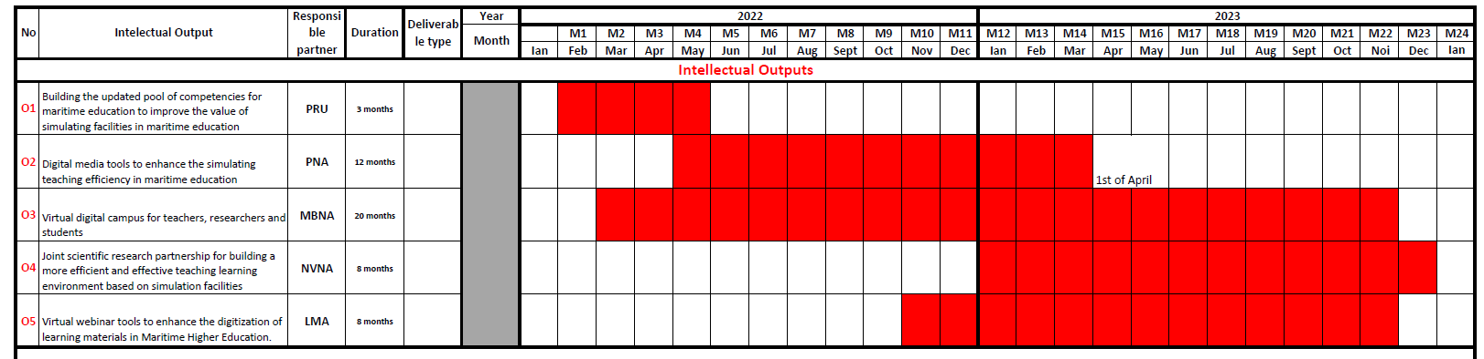
Intellectual outputs
Notes:
here we have the Gantt diagram with the 5 intellectual outputs.

Slide 7
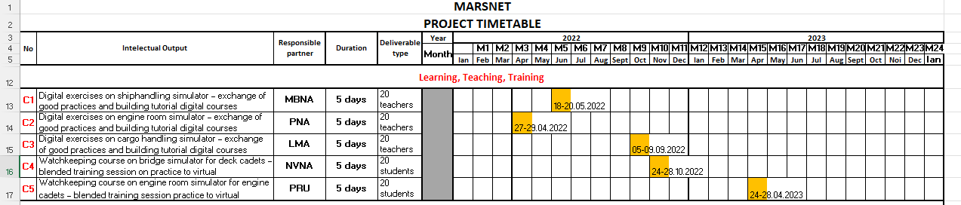
Learning, teaching, training activities
Notes:
The training activities have been completed and we also have the periods when they were carried out. the last activity took place last week here at Piri Reis University. I believe that this, as well as the others, were a real success. hus, the involvement of the partners for these activities was very good and professional

Slide 8
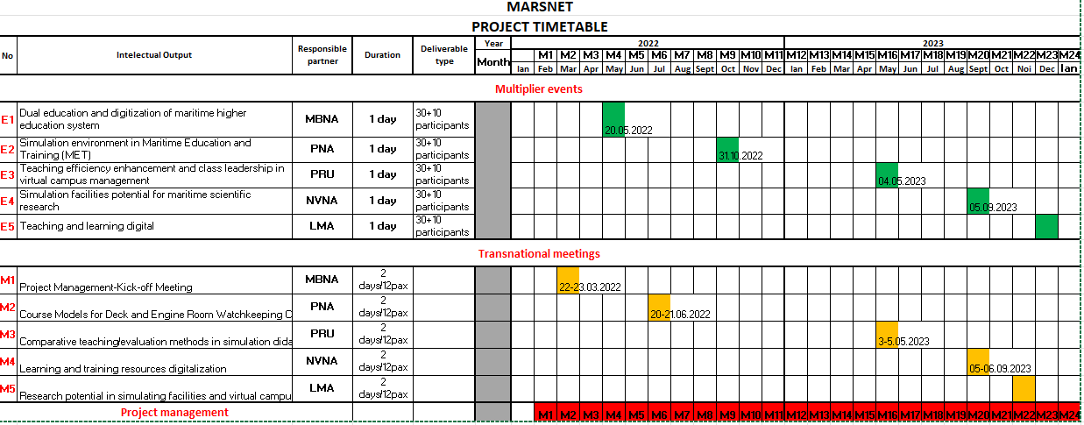
Events and transnational meetings
Notes:
for events and transnational meetings, 3 out of 5 were made. The next one will be in Bulgaria and the last one in Lithuania

Slide 9
Events and transnational meetings
ADMINISTRATIVE ISSUES: Update the financial matters, check the available budget and provide the time sheets on time!!!

Slide 10
O1 “Building the updated pool of competencies for maritime education to improve the value of simulating facilities in maritime education”
Leader: PRU
February 2022 – April 2022
WORKING GROUP
WHAT TO DO?
HOW?
  Taner Albayrak
10 course syllabuses have been harmonized for selected STCW courses, to value the simulation learning methods on hard and soft skills requirements:
  Ship Handling and Manoeuvring,
  Cargo handling,
  Navigational Watchkeeping,
  Engine Room Watchkeeping,
  Radar Navigation,
  Maritime Search and Rescue,
  Coastal Navigation,
  Naval Machines and Equipment,
  Naval Communications,
  Celestial Navigation.
The partners will identify, the most relevant courses, that use the simulation facilities, seeking to develop hard skills for graduates.
Once agreed, these courses will be developed in their content based on simulation facilities utilization, to improve the learning process and digitization of maritime education, but more focused on practical side of maritime profession.
The final versions are already posted on marplat.eu.

Slide 11
O2 “Digital media tools to enhance the simulating teaching efficiency in maritime education”
Leader: PNA
May 2022 – April 2023
WORKING GROUP
WHAT TO DO?
HOW?
1 guide for best practices in modelling the digital course content to exchange good practices in building the digital materials, as to be forth commonly used in exchange programmes implemented among the partners. (by 30 September 2022)
1 evaluation/assessment guide for simulation courses in maritime education will be conceived to facilitate the common practices implementation on hard skills courses, solving a great issue faced among the partners in reference to the simulation facility usage. (by 30 September 2022)
5 common harmonized course/seminar digital materials.
(by 1st of April 2023)
25 video tutorial materials for simulating classes instructions will be prepared. (by 1st of April 2023)
The guidance framework for the project will be issued, together with the summary design of most 5 relevant courses in which simulation facilities are used.
the partners will produce in support of this objective, as models, several samples of digital materials, using the simulators
the partners will create harmonized teaching materials for 5 selected courses, as the most relevant in using intensively the simulation facilities.
  Marcin Kluczyk
Notes:
for this activity I had to do:

Slide 12
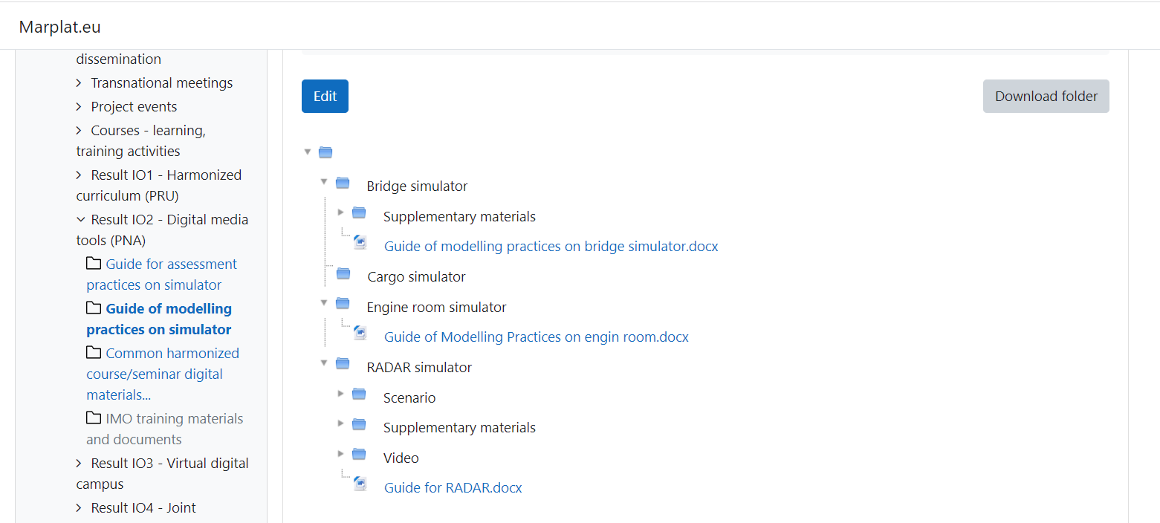
REPORTED SITUATION
REAL SITUATION
1 guide for best practices in modelling the digital course content to exchange good practices in building the digital materials has been developed;
The Guide of modelling practices on simulator contain a short description of each simulator used for the nominated courses (Ship handling, Bridge/engine watchkeeping, Radar Navigation, Cargo Handling). The contribution of each partner was as follows:
RNA – Bridge simulator;
PNA – Bridge simulator;
NVNA – Radar simulator;
PRU – Engine room simulator;
LMA – Cargo handling simulator.
Task completed – 100%.
Bridge simulator
- Guide of modelling practice on bridge simulator
Engine room simulator
- Guide of modelling practice on engine room simulator
Cargo handling simulator
- Guide of modelling practice on cargo handling simulator
Radar simulator
- Guide of modelling practice on RADAR navigation simulator

Slide 13
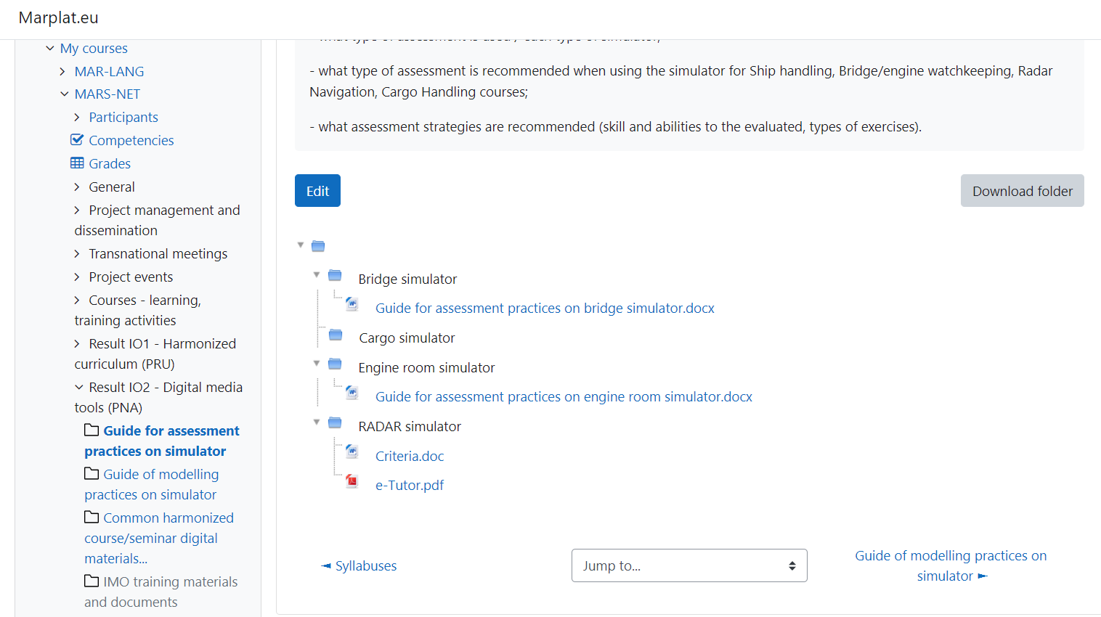
REPORTED SITUATION
REAL SITUATION
1 evaluation/assessment guide for simulation courses in maritime education has been elaborated;
The Guide for assessment practices on simulator contains data about what type of assessment and strategies are recommended when using the simulator for Ship handling, Bridge/engine watchkeeping, Radar Navigation and Cargo Handling.
The contribution of each partner was as follows:
RNA – Bridge simulator;
PNA – Bridge simulator:
NVNA – Radar simulator:
PRU – Engine room simulator:
LMA – Cargo handling simulator
Task completed – 100%
Bridge simulator
- Guide for assessment practices on bridge simulator
Engine room simulator
- Guide for assessment practices on engine room simulator
Cargo handling simulator
-
Radar simulator
- Criteria
- e-Tutor
Notes:
the activity was reported to the agency as being 100% completed

Slide 14
REPORTED SITUATION
REAL SITUATION
- 5 common harmonized course/seminar digital materials and 25 video tutorial materials for simulating classes instructions are in course to be developed, partially done, as following:
- RNA – Bridge simulator:
“Anchoring of the ship”
“Ship handling and maneuvering with pilot on board”
“Ship handling and maneuvering in case of loss engine”
“Ship handling and maneuvering in case of loss steering”
“Ship handling in heavy weather/restricted visibility”
- PNA – Bridge simulator:
- NVNA – Radar simulator:
”Radar observation”
“Radar plotting”
“Radar calculation”
“ARPA”
“AIS navigation”
- PRU – Engine room simulator:
- LMA – Cargo handling simulator
“Loading operations of bulk carrier”
“Loading operations of container vessel”
“Daft survey”
“Preparation for single cargo loading”
“LNG bunkering by mode terminal - ship”
Task in progress 50% fulfilled. Presently RNA is collecting the developed drafts of ppt and video resources.
- RNA – Bridge simulator:
“Anchoring of the ship” – 50%
“Ship handling and maneuvering with pilot on board” – 50%
“Ship handling and maneuvering in case of loss engine” – 50%
“Ship handling and maneuvering in case of loss steering” – 50%
“Ship handling in heavy weather/restricted visibility” – 50%
- PNA – Bridge simulator:
“Anchoring”
“Berthing”
“MOB”
”Overtaking”
“Passing”
“SAR”
- NVNA – Radar simulator:
“ARPA” – 100%
- PRU – Engine room simulator:
- LMA – Cargo handling simulator
“Loading operations of bulk carrier” - 100%
“Loading operations of container vessel” – 100%
“Daft survey” – 100%
“Preparation for single cargo loading” – 100%
“LNG bunkering by mode terminal - ship” – 100%
Notes:
for this activity I will use LMA as an example of good practice.

Slide 15
O3 “Virtual digital campus for teachers, researchers and students”
Leader: RNA
March 2022 – October 2023
WORKING GROUP
WHAT TO DO?
HOW?
1 virtual network for teachers/experts/ and 1 virtual collaborative e-campus for teachers and researchers (by 01 of February 2023).
1 video conference system (by 01 of October 2022).
5 subject shall to be uploaded on the platform available to facilitate the dual education system for cadets onboard the ships -each partner will be responsible for one course, as assigned in O2 (by 01 of September 2023):
PLEASE REPORT YOUR PROGRESS UP-TO-DATE!
  Ship Handling and Manoeuvring (Navigation simulator) – RNA;
  Navigational Watchkeeping (Navigation simulator) – PNA;
  Radar Navigation (Navigation simulator) – NVNA;
  Engine Room Watchkeeping (Engine Room Simulator) – PRU;
  Cargo handling (Cargo handling Simulator) – LMA.
  Sergiu Lupu
- create and to access the virtual network developed as a “virtual campus” for sharing the didactic materials and the digital resources.

Slide 16
Working groups for IO3 – 5 MODULES DEVELOPEMENT
Leader: RNA
  Sergiu Lupu
- by 6th of September (C3) each partner will assign the responsible persons for modules development.
COURSE | RESPONSIBLE PARTNER / TEAM LEADER | PNA responsible | RNA responsible | NVNA responsible | PRU responsible | LMA responsible
Navigational Watchkeeping | PNA | Piotr Zwolan p.zwolan@amw.gdynia.pl | Lupu Sergiu sergiu.lupu@anmb.ro | Milen Dolapchiev m.dolapchiev@nvna.eu | Taner Albayrak Selcuk Solmaz talbayrak@pirireis.edu.tr | Arvydas Jankauskas a.jankauskas@lajm.lt
Engine Room Watchkeeping | PRU | Marcin Kluczyk m.kluczyk@amw.gdynia.pl | Simion Dragoș dragoș.simion@anmb.ro | Ivaylo Bakalov bakalov@nvna.eu | Taner Albayrak Tolunay Kayaarasi talbayrak@pirireis.edu.tr | Marijus Jacevicius m.jacevicius@lajm.lt
Cargo handling | LMA | Marcin Kluczyk m.kluczyk@amw.gdynia.pl | Andrei Pocora andrei.pocora@anmb.ro | Veselin Atanassov atanasov@nvna.eu | Taner Albayrak Ergun Demirel talbayrak@pirireis.edu.tr | Vilma Locaitiene v.locaitiene@lajm.lt Steponas Litvinas s.litvinas@lajm.lt
Ship Handling and Manoeuvring | RNA | Piotr Zwolan p.zwolan@amw.gdynia.pl | Lupu Sergiu sergiu.lupu@anmb.ro | Georgi Dimitrov Milen Dolapchiev g.dimitrov@nvna.eu | Taner Albayrak Ergun Demirel talbayrak@pirireis.edu.tr | Arvydas Jankauskas a.jankauskas@lajm.lt
Radar Navigation | NVNA | Piotr Zwolan p.zwolan@amw.gdynia.pl | Lupu Sergiu sergiu.lupu@anmb.ro | Milen Dolapchiev Chavdar Alexandrov Ch.alexandrov@nvna.eu | Taner Albayrak Selcuk Solmaz talbayrak@pirireis.edu.tr | Arvydas Jankauskas a.jankauskas@lajm.lt Kestutis Zalys k.zalys@lajm.lt

Slide 17
O4 “Joint scientific research partnership for building a more efficient and effective teaching learning environment based on simulation facilities”
Leader: NVNA
May 2023 – October 2023
WORKING GROUP
WHAT TO DO?
HOW?
  George Dimitrov
- 5 research studies on simulating environment efficiency and effectiveness for maritime education and training (by 06 of September 2023).
Class leadership and methods to overcome the limits of virtual education - PRU;
Evaluation methods for students on learning by simulating environment - PNA;
Virtual scenarios development - NVNA;
Leadership studies on bridge team management using the simulators - LMA;
Research study about connecting solution of simulating facilities of partners (academic network of simulators) - RNA.
- the studies will be
presented on project conferences and will be further published in
open access international journals for dissemination.

Slide 18
REPORTED SITUATION
WHAT TO DO?
Class leadership and methods to overcome the limits of virtual education - PRU;
Evaluation methods for students on learning by simulating environment - PNA;
Virtual scenarios development - NVNA;
Leadership studies on bridge team management using the simulators - LMA;
Research study about connecting solution of simulating facilities of partners (academic network of simulators) - RNA.
Task in progress 20% fulfilled.
The studies must be disseminated within conferences
All research studies will be disseminated in a special issue in the Scientific Bulletin of Naval Academy
The deadline – 6th of September 2023, Varna
The concluding remarks and the book of total papers published within the project framework will be published by the E5 deadline to be presented in Lithuania as the project charter (booklet)

Slide 19
O5 “Virtual webinar tools to enhance the digitization of learning materials in Maritime Higher Education”
Leader: LMA
October 2023 – December 2023
WORKING GROUP
WHAT TO DO?
HOW?
  Rima Mickiene
250 students and 20 teachers will be virtually enrolled in digital classes, to support the developing of the digital content materials (from 1st of September 2023).
5 digital courses, fully covered with harmonized curriculum (O1), teaching materials (O2) and online available resources (O3), digitally developed in virtual manner to stimulate the cadetship dual system programs, the virtual mobility of international students and the digitization of simulating classes.
For each online course 10 students x 5 partners = 50 students will be enrolled.
For each module digital resource learning: 7 topics /15 min + 7 seminars/15 min – recorded online (capture) + 5 video tutorials (laboratory) to be filmed in the simulator - to be uploaded via marplat.eu.
- LMA as responsible partner will coordinate the students
enrolment and teachers assignments for virtual activities managed within the virtual campus environment.
- The responsible teachers will be assigned by each partner, in compliance with the attributed tasks.
Notes:
The virtual platform is in use – the partners are working out the digital learning materials – to be concluded by the end of May 2023. Task in progress 40% fulfilled.

Slide 20
Learning, Teaching and Training” activities
Leader: RNA
INTENSIVE PROGRAMMES FOR HIGHER EDUCATION TEACHING STAFF (3-5 days training program)
C1 -“Digital exercises on shiphandling simulator – exchange of good practices and building tutorial digital courses”, 5 pax x 4 partners x 3 days= 20 learners/instructors – RNA, Romania, M5 (18-20 of May 2022)
C2 -“Digital exercises on engine room simulator – exchange of good practices and building tutorial digital courses”, 5 pax x 4 partners x 3 days = 20 learnears/ instructors – PNA, Poland, M3 (27-29 of April 2022)
C3 -“Digital exercises on cargo handling simulator – exchange of good practices and building tutorial digital courses”, 5 pax x 4 partners x 5 days = 20 instructors – LMA, Lithuania, M9 (05-09 of September 2022)
INTENSIVE PROGRAMMES FOR LEARNERS (5 days training program)
C4 -“Watchkeeping course on bridge simulator for deck cadets – blended training session on practice to virtual”, 5 pax x 4 partners x 5 days = 20 trainees – NVNA, Bulgaria, M10 (24-28 of October 2022)
C5 - “Watchkeeping course on engine room simulator for engine cadets – blended training session practice to virtual”, 5 pax x 4 partners x 5 days = 20 trainees – PRU, Turkey, M14 ( 24-28 April 2023)

Slide 21
TRANSNATIONAL MEETINGS
“Project Management-Kick-off Meeting”, two days organizational meeting, to be organized by the ”Mircea cel Batran” Naval Academy in Romania in M2 (22nd-23rd of March 2022)
“Course Models for Deck and Engine Room Watchkeeping Courses”, two days organizational meeting, to be organized by the Polish Naval Academy in Poland in M6 (20th–21st of June 2022) – online
“Comparative teaching/evaluation methods in simulation didactic activities”, two days organizational meeting, to be organized by the PiriReis University in Turkey in M12 (03-05 May 2023)
“Learning and training resources digitalization”, two days organizational meeting, to be organized by the Bulgarian Naval Academy in Bulgaria in M20 (5-6 September 2023)
“Research potential in simulating facilities and virtual campus management”, two days organizational meeting, to be organized by the Lithuanian Maritime Academy in Lithuania in M22 (November 2023)???

Slide 22
EVENTS
“Dual education and digitization of maritime higher education system”, 1 day event, 30 national and 10 international participants, to be organized by the ”Mircea cel Batran” Naval Academy in Romania in M4 (20th of May 2022)
“Simulation environment in Maritime Education and Training”, 1 day event, 30 national and 10 international participants, to be organized by the Polish Naval Academy in Poland in M9 (31st of October 2022)
“Teaching efficiency enhancement and class leadership in virtual campus management”, 1 day event, 30 national and 10 international participants, to be organized by the PiriReis University in Turkey in M12 (24-28 April 2023)
“Research and innovation in Maritime Education and Training”, 1 day event, 30 national and 10 international participants, to be organized by the Bulgarian Naval Academy in Bulgaria in M20 (7th of September 2023) IMLA Conference
“Teaching and learning digitally”, 1 day event, 30 national and 10 international participants, to be organized by the the Lithuanian Maritime Academy in Lithuania in M23 (December 2023)

Slide 23
E1
A workshop was organized during the SEACONF 2022 international scientific event, at which a number of 6 articles were presented as follows:
Evaluation methods for students on learning by simulating environment based on marine pOwer plant simulator
Authors: Iwona Królikowska, Marcin Kluczyk, Paweł Wirkowski, Catalin Popa
EVALUATION OF SIMULATOR USE IN MARITIME EDUCATION AND TRAINING (MET) INSTITUTES
Authors: Ergun Demirel, Taner Albayrak
CADETS’ PERSPECTIVE ON MARITIME EDUCATION AND TRAINING
Author: Ergun Demirel
EVALUATION METHODS FOR TRAINEES ON LEARNING BASED ON VIRTUAL ENVIRONMENT USING THE NAVIGATIONAL SIMULATOR
Authors: Alecu Toma, Sergiu Lupu , Andrei Pocora, Catalin Popa, Rima Mickiene
THE ROLE OF THE MARITIME SIMULATOR INSTRUCTOR FOR TRAINING AND COACHING PROGRAMS
Authors: Alecu Toma, Sergiu Lupu, Andrei Pocora, Catalin Popa, Marcin Kluczyk
Justification of the sustainable development of inland waterway transport through the Environmental Performance Index
Authors: Vilma Locaitiene, Rima Mickiene, Catalin Popa

Slide 24
E2
“HIGH VOLTAGE DIESEL ELECTRIC ENGINE ROOM SIMULATOR HV-DE3D”,
Author: PhD Adam SZELEZIŃSKI, Maritime University Gdynia;
“NEW POSSIBILITIES OF LNG BUNKERING SYSTEM IN UNITEST LOW SPEED ENGINE ROOM SYMULATOR W-XPERT RT-FLEX50DF ELECTRONICALLY CONTROLLED”,
Author: Eng Tomasz MUCHOWSKI, Maritime University Gdynia;
“SELECTED PSYCHOSOCIAL BARRIERS IN THE PROCESS OF TRAINING THE SEA STAFF WITH THE USE OF SIMULATORS”,
Author: MSc Ewelina BUCZKO, Polish Naval Academy,
“EFFECTIVENESS OF ACTIVATING TEACHING METHODS USING MARINE SIMULATORS IN THE OPINION OF LECTURERS”,
Author: PhD Iwona Królikowska, Polish Naval Academy;
“SIMULATION PEDAGOGY IN THE TEACHING OF MARITIME UNIVERSITIES”,
Author: PhD Agnieszka Suchocka, Polish Naval Academy.

Slide 25
RNA Responsabilities
RNA had organized in Constanta, the TM1 Kick off Meeeting gathering the 2 members of each partner in M2 (22-23.03.2022).
RNA have organized in Constanta, the E1 for 30 local and 10 international participants in M5 (20.05.2022)/SeaConf Event – MARS-NET workshop.
RNA will elaborate the Project Management Plan (PMP), Schedule management plan (SMP), Cost management plan (CMP)
RNA will be Task leader for O3.

Slide 26
RNA Responsibilities (cont)
RNA is in charge with the coordination of curriculum development of course module on “Ship Handling and Maneuvring“- total: 28 hours (seminar - 14 hours + simulator/laboratory – 14 hours) + 5 video tutorials from selected simulators.
RNA will deliver the course of “Ship Handling and Maneuvring" for 50 students – capture recording of 7 topics (theory) and 7 practical exercises (simulator/laboratory training), out of which min. 5 video tutorials in the simulator/laboratory training.
RNA will elaborate 1 study in O4: Research study about connecting solution of simulating facilities of partners .
RNA is in charge with the coordination of the team involved in all technical aspect related on the ITC project managing the online platform (marplat.eu).
During M5 (18.05-20.05)- organized in Constanta C1: ”Digital exercises on shiphandling simulator – exchange of good practices and building tutorial digital courses”, with a duration of 3 days, for 5 instructors/each partner = 20 instructors.

Slide 27
PNA Responsabilities
PNA will organize in Gdynia, the TM2 Course Models for Deck and Engine Room Watchkeeping Courses gathering the 2 members of each partner in M6 (20th-22nd of June).
PNA will organize in Gdynia, the E2 Simulation environment in Maritime Education and Training for 30 local and 10 international participants in M9 (31st of October).
PNA will be Task leader for O2.

Slide 28
PNA Responsibilities (cont)
PNA is in charge with the coordination of curriculum development of course module on “Navigational Watchkeeping“ 28 hours (seminar - 14 hours + simulator/laboratory – 14 hours) + 5 video tutorials from selected simulators.
PNA will deliver the course of “Navigational Watchkeeping " for 50 students – capture recording of 7 topics (theory) and 7 practical exercises (simulator/laboratory training), out of which min. 5 video tutorials in the simulator/laboratory training.
PNA will elaborate 1 study in O4: Evaluation methods for students on learning by simulating environment.
During C2 (27th-29th of April 2022) - had been organized in Gdynia 1 training sessions with a duration of 5 days each, for instructors, Digital exercises on engine room simulator – exchange of good practices and building tutorial digital courses.

Slide 29
PRU Responsabilities
PRU will organize in Istanbul-Tuzla, the TM3 Comparative teaching/evaluation methods in simulation didactic activities gathering the 3 members of each partner in M12 (24-28 April 2023).
PRU will organize in Istanbul-Tuzla, the E3 Teaching efficiency enhancement and class leadership in virtual campus management for 30 local and 10 international participants in M12 (03-05 May 2023)
PRU will be Task leader for O1.

Slide 30
PRU Responsibilities (cont)
PRU is in charge with the coordination of curriculum development of course module on “Engine Room Watchkeeping" 28 hours (seminar - 14 hours + simulator/laboratory – 14 hours) + 5 video tutorials from selected simulators.
PRU will deliver the course of “Engine Room Watchkeeping " for 50 students – capture recording of 7 topics (theory) and 7 practical exercises (simulator/laboratory training), out of which min. 5 video tutorials in the simulator/laboratory training.
PRU will elaborate 1 study in O4: Evaluation methods for students on learning by simulating environment .
During M14 (April 2023)- will organized in Istanbul-Tuzla 1 training sessions with a duration of 5 days each, for students, Watchkeeping course on engine room simulator for engine cadets – blended training session practice to virtual.

Slide 31
NVNA Responsabilities
NVNA will organize in Varna, the TM4 Learning and training resources digitalization gathering the 3 members of each partner in M17 (May-June 2023).
NVNA will organize in Varna, the E4 Simulation facilities potential for maritime scientific research for 30 local and 10 international participants in M17 (May-June 2023).
NVNA is the Task leader for O4.

Slide 32
NVNA Responsibilities (cont)
NVNA is in charge with the coordination of curriculum development of course module on “Radar Navigation“ 28 hours (seminar - 14 hours + simulator/laboratory – 14 hours) + 5 video tutorials from selected simulators.
NVNA will deliver the course of “Radar Navigation" for 50 students – capture recording of 7 topics (theory) and 7 practical exercises (simulator/laboratory training), out of which min. 5 video tutorials in the simulator/laboratory training.
NVNA will elaborate 1 study in O4: Virtual scenarios development.
During M10 (24th-28th of October 2022)- will organized in Varna 1 training sessions with a duration of 5 days each, for students, Watchkeeping course on bridge simulator for deck cadets – blended training session on practice to virtual.

Slide 33
LMA Responsabilities
LMA will organize in Klaipeda, the TM5 Research potential in simulating facilities and virtual campus management gathering the 3 members of each partner in M21.
LMA will organize in Klaipeda, the E5 Teaching and learning digitally for 30 local and 10 international participants in M23.
LMA will be Task leader for O5.

Slide 34
LMA Responsibilities (cont)
LMA is in charge with the coordination of curriculum development of course module on “Cargo Handling" - total: 28 hours (seminar - 14 hours + simulator/laboratory – 14 hours) + 5 video tutorials from selected simulators.
LMA will deliver the course of “Cargo Handling " for 50 students – capture recording of 7 topics (theory) and 7 practical exercises (simulator/laboratory training), out of which min. 5 video tutorials in the simulator/laboratory training.
LMA will elaborate 1 study in O4: Leadership studies on bridge team management using the simulators.
During M8 (05-09 of September 2022)- has been organized in Klaipeda 1 training sessions with a duration of 5 days each, for instructors, Digital exercises on cargo handling simulator – exchange of good practices and building tutorial digital courses.

Slide 35
Tasks to follow up!
In order to conclude IO2/IO3 deliverables (prepare the Agency visit!):
- Guide for cargo handling – to be delivered by 01.06.2023
- Guide for assessment on cargo handling – to be delivered by 01.06.2023
- Guide for assessment on RADAR simulator – to be delivered by 01.06.2023
- 5 common harmonized course/seminar digital materials and 25 video tutorial materials for simulator classes – establish the video format! – deadline 01.09.2023 (to be ready to be delivered to the students in fall semester 01.09-01.12.2023)
- The partners will plan the students recruitment for each course – enrolment roaster to be concluded by 1st of September 2023 (i.e. 10 students/course/partner, total of 50 students/partner;
- 5 scientific studies to be delivered by each partner, latest by 1st of September, to be presented to E3 - IMLA Conference in Varna, and to be published latest by 01st of October.
- Next activities will be set up (TM5/E5 in Lithuania).
ADMINISTRATIVE ISSUES: Update the financial matters, provide the time sheets on time!!!

Slide 36

Discussions? Questions?
THANK YOU!

