Slide 1
ENHANCING QUALITY IN HIGHER EDUCATION THROUGH INTERNATIONAL COLLABORATION: PROJECT MENTORESS*
*MENTORESS Maritime Education Network to Orient and Retain Women for Efficient Seagoing Services
“Funded by the Erasmus+ Program of the European Union. However, European Commission and Turkish National Agency cannot be held responsi­ble for any use which may be made of the information contained therein”

Slide 2
GENDER IDENTITY MANAGEMENT and
LEADERSHIP
*

Slide 3
GENDER IDENTITY MANAGEMENT and LEADERSHIP
COURSE OBJECTIVES
Understanding contemporary approaches on discrimination, in particular gender discrimination.
Learning different tools and methods to overcome discrimination and best practices throughout the world.

Slide 4
GENDER IDENTITY MANAGEMENT and LEADERSHIP
COURSE OBJECTIVES
The importance of the gender diversity in different work environments to increase effectiveness in workplaces with an emphasis on maritime life.
Creation of synergy to overcome gender discrimination related problems and using leadership skills to integrate the female in maritime environment.

Slide 5
GENDER IDENTITY MANAGEMENT and LEADERSHIP
COURSE LEARNING OUTCOMES
Students passing the course successfully will acquire knowledge and skills as listed below and will able to be;
Understand gender discrimination and gender diversity with negative effects in social life and work environment
Practice different tools and methods to overcome gender discrimination

Slide 6
GENDER IDENTITY MANAGEMENT and LEADERSHIP
COURSE LEARNING OUTCOMES
Understand and provide a general understanding of gender diversity for work effectiveness.
Use leadership abilities to ensure abolish gender discrimination and enhance gender diversity in maritime professions

Slide 7
GENDER IDENTITY MANAGEMENT AND LEADERSHIP CHAPTER I DIVERSITY and DIVERSITY MANAGEMENT

Slide 8
DIVERSITY and DIVERSITY MANAGEMENT 1.1 Diversity 1.1.1 Effects of Diversity 1.1.1.1 Advantages of Diversity in Workplace 1.1.1.2 Disadvantages of Diversity in Workplace 1.2 Diversity Management 1.2.1 Strategies to Promote Diversity

Slide 9
DIVERSITY and DIVERSITY MANAGEMENT 1.3 Gender Discrimination Problem 1.3.1 Gender Discrimination and Woman Seafarers

Slide 10
DIVERSITY and DIVERSITY MANAGEMENT
CHAPTER OBJECTIVES
Understand what diversity is.
Learn how diversity can be used for the benefit of a workplace.
Learn how to avoid disadvantages of diversity.

Slide 11
DIVERSITY and DIVERSITY MANAGEMENT
CHAPTER LEARNING OUTCOMES
Students passing the course successfully will acquire knowledge and skills to be able to;
Understand diversity and its advantages and disadvantages,
Learn about diversity management,
Aware of gender discrimination problems in maritime.

Slide 12
1.1 Diversity What is Diversity?
“variety” in role, function and personality
differences in the population
globalization process
international business
cross borders business
Notes:
In the Human Resource (HR) literature, it is usually conceptualised in terms of differences of particular relevance to issues of identity, that is; gender, age, ethnicity, disability and sexual orientation. Diversity is increasingly perceived as an important issue in the context of business management.

Slide 13
1.1.1 Effects of Diversity
competitive advantages
a key component of effective people management
improve workplace productivity
contribute to the strategic objectives of human resource management
Notes:
Apparently, managing and valuing diversity is a key component of effective people management, which can not only improve workplace productivity, but also contribute significantly to the strategic objectives of human resource management.

Slide 14
Areas of Human Differences
Primary Differences | Secondary Differences
Race | Religion
Gender | Class
Sexual Orientation | Income
Physical and Mental Ability, | Education
Ethnicity, Age | Other Human Differences
Notes:
Human differences are categorized in different ways by various authors. In a framework called “dimensions of diversity,” differences are identified as primary and secondary human differences. Primary differences are in-born and have a life-long impact on people’s lives. They include race, gender, sexual orientation, physical and mental ability, ethnicity, and age. Secondary differences are more changeable, less visible, and have a less-sustained impact on people’s lives. They include religion, class, income, education, and other human differences.

Slide 15
Aspects of Human Experience
Ideas
Behaviors
Attitudes
Physical Sensations
Feelings
Core Values
Notes:
People are different from each other, as well, in their range of responses about diversity and oppressions issues in terms of: ideas, behaviors, attitudes, physical sensations, feelings, and core values. These areas of response are the aspects of human experience which define reality. The aspects of human experience, when they are combined with levels of human system, are referred as “dimensions of diversity”. These aspects of human experience apply to groups, organizations, communities, and society, as well, as individuals.

Slide 16
Levels of Human System
Individual - Personal, Intrapersonal – Interpersonal
Group or Inter – group
Organization
Community
Society
Notes:
Levels of Human System
Personal, intrapersonal, interpersonal work in the groups can play an important role in diversity and oppression issues. There are also some consequences for group and inter-group, organization, community, and society experience concerning diversity and oppression issues. The experiences of individuals affect their involvement and membership in groups, organizations, and society. That’s why all levels of human system should be taken into consideration while studying diversity and oppression issues.

Slide 17
Elements of Culture
Power Status | Authority
Leadership | Language
Time | Space
Intimacy | Laws
Regulations | Rules
Norms | Standarts
Structures | Values
Beliefs | Assumptions
Ideology | Spirituality
Rewards and Punishments | Ways of Making Meaning,
Dress
Notes:
Elements of Culture
Different individuals have different cultures. These cultural differences also apply to group cultures, organization cultures, and societal/national cultures. The building blocks for defining and understanding culture and cultural differences are the elements of culture – cultural differences in, for example, power status, authority, leadership, language, time, space, intimacy, laws, regulations, rules, norms, standards, structure, values, beliefs, assumptions, ideology and ways of making meaning, rewards and punishments, and spirituality.

Slide 18
Effective diversity management enhances:
organizational performance
organizational culture and managerial attitudes
growth, learning, and intuition
Notes:
Some studies concluded that more heterogeneous work groups consider more perspectives and produce higher-quality solutions than homogeneous groups. Others contended that heterogeneous groups show lower levels of integration and have higher levels of dissatisfaction and turnover than homogeneous groups. Two perspectives have shaped research on the impacts of diversity.
One perspective, based on information and decision-making theories, argues that diversity can benefit organizations by providing a broad range of ideas, skills, and insights that can improve organizational capabilities to solve problems and make better decisions.
The other perspective, based on social categorization and social identity theories and the similarity-attraction paradigm contends that diversity may burden organizations with high costs of coordination and conflict resolution, thus compromising organizational effectiveness, given that people tend to distinguish between in-group and out-group members, which may cause conflicts and miscommunication.

Slide 19
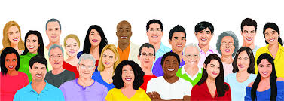
The workforce of today is more diverse than ever.
-with different gender, race, personality, ethnicity, cognitive style, tenure, organizational function, group, age, education, background.
Notes:
Diversity also involves how people perceive others and themselves, which can affect how they interact with their colleagues and peers. This can either cause a bond to form or introduce a gap.

Slide 20
1.1.1.1 Advantages of Diversity in Workplace
Increased creativity
Increased adaptability
Melting Pot of ideas
Increased productivity
Increased range of services
Notes:
Advantages of Diversity in the Workplace
1. Increased creativity: When people from different cultures, backgrounds and with different beliefs come together to work for a common goal, increased creativity can be achieved. What is already artistic can become even better. What already works can evolve into something else.
2. Increased adaptability: In order to address problems of workplace diversity, an organization has to develop a variety of solutions, forcing them to adapt to a diverse workforce. It will be a long process, but totally worth it. Moreover, people from diverse backgrounds can provide ideas for adapting to ever-changing customer demands and fluctuating markets.
3. Melting Pot of ideas: No two people think exactly alike, and a company that knows how to exploit varying viewpoints of each individual can create a large pool of ideas and experiences. They can then draw from the pool strategies to effectively deal with business concerns and customer needs.
4. Increased productivity: Globalization and internalization are two of the gifts that workforce diversity brings to the table, which is why foreign executives are very successful in the corporate world in America, while citizens from Europe find their place in high-level jobs. Put them together in one place and what you get is increased productivity.
5. Increased range of services: A diverse collection of people with different experiences, skills, cultural understanding, languages and other differences enables a company to provide customers services on a global basis.

Slide 21
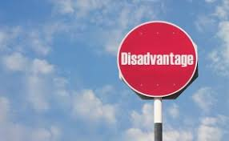
1.1.1.2 Disadvantages of Diversity in the Workplace
Communication Issues
Lack of freedom of speech
Increased cost of training
Integration issues
Increased competition
Breeds disrespect
Notes:
Disadvantages of Diversity in the Workplace
1. Communication Issues
Effective communication is a driving factor for success. Unfortunately, diversity can be in the way, and can directly impact productivity because of a lack of cohesiveness. This explains why some companies catering to international customers hire multilingual or bilingual customer service reps. It is easier for Spanish-speaking customers, for example, to communicate with someone who understands their culture and knows their native language. So unless effective communication is achieved, workplace diversity can be a problem.
2. Lack of freedom of speech
In a diverse workplace, an employee must be sensitive to others’ race, cultural background, beliefs, etc. So you don’t just crack jokes about the Chinese or Indians, because it won’t be as acceptable as when a stand-up comedian would do it. People can’t freely state their opinions or tell stories whenever they want for fear of being judged as discriminating. So it’s not only effective communication that is a disadvantage in a diverse workplace, but also freedom of speech. Imagine working in an environment where you need to always tread carefully. Not exactly a fun and attractive workplace.
3. Increased cost of training
Apart from the usual training, an organization must invest in seminars, programs and lectures designed to promote diversity in the workplace. If unity is to be achieved, such training is essential as they will teach employees how to accept thoughts, ideas and personalities of others in the workplace. It will also provide information on how to deal with prejudice and conflict in a civilized and professional manner. As it is possible that you are likely to continue hiring employees, you will continue to spend on training.
4. Integration issues
Even in a non-diverse workplace exclusive social groups or cliques naturally happens, more so in a diverse workforce. When such groups form, informal divisions can occur, which will impede social integration. It will also lead to a situation where culturally diverse employees will avoid each other. This can hinder the effective sharing of knowledge, experience, skills, resulting in decreased productivity, team efficacy, and business growth.
5. Increased competition
Competition in the workplace is good as it can drive success and higher productivity. But when employees do not accept other culture, they are likely to compete against each other, rather than become collaborative members of a team. This results in divisions where people prefer to work separately, prolonging the process of task or project completion. This can have a negative impact on business because progress will be slow moving. There is strength in numbers, after all.
6. Breeds disrespect
The same people who don’t accept other cultures are likely to openly show disrespect and indifference. This can lead to unnecessary tension and can inhibit communication in the workplace. The problem with a highly tense or hostile workplace is that everyone is affected, including those that accept and respect diversity in the workplace.

Slide 22
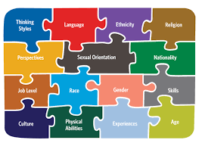
1.2 Diversity Management
Diversity is an important issue in business management because of
increasing differences in the population
globalization proces
international business
cross borders business
Notes:
In the business community, companies have also tend to pay more focus on diversity and look for ways to reap the opportunities offered by diversity as they acknowledge that diversity has the potential of yielding greater productivity and competitive advantages. Apparently, managing and valuing diversity is a key component of effective people management, which not only can improve workplace productivity, but also contribute significantly to the strategic objectives of human resource management.(6)
Diversity Management is a relatively new concept that was originally developed in the USA in the mid-1980s, although the term “Diversity Management” was not actually used until 1990.
The “Title VII of the Civil Rights Act” of 1964 was the first legal step to outlaw discrimination due to colour, race, religion, gender/sex, age, national background, physical ability, sexual orientation, and marital status and applied to the business context as well.
Then, Executive Order 11246 came into effect in 1965.

Slide 23
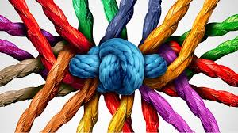
Workforce Diversity Management
includes the fight against stereotypes, prejudice and all kind of discrimination
maximizes the benefit
minimizes barriers of different opinions, behavior and attitudes
Notes:
The idea of this management style is to encourage employees to be comfortable with diversity in the workplace and develop an appreciation for differences in race, gender, background, sexual orientation or any other factors that may not be shared by everyone working in the same area of the company.
Workforce diversity management can be adapted to many different types of working environments and be integrated into many different types of management styles.

Slide 24
1.2.1 Strategies to Promote Diversity
Individual level strategies
Diversity awareness training
Assisting in building social cohesion
Mentoring
Notes:
According to the findings of them, after a diversity training program, while 75% of respondents state trainees leave diversity training with positive diversity attitudes, only 9% believed trainees enter with favorable attitudes. Similarly, 68% believed that employees are skeptical prior to training, whereas only 7% reported skepticism after training. Importantly, these were Human Resources managers’ estimates rather than actual measures of attitude change. Training success was also correlated with managerial mandatory attendance and rewards for increasing diversity, long-term evaluation of training results and defining diversity broadly. Despite these positive perceptions, this same study found that only one-third of organizations viewed diversity management training efforts as having lasting change. Others have been unable to document the advantages of diversity training (16).
Despite their benefits, training programs have some drawbacks. One reason training may have limited impact is that most training programs reinforce norms, values and perspectives of the dominant organizational culture; the focus is on helping members of the non-dominant group to adapt to the majority (17).
A successful senior mentor is matched with a more junior woman or minority.

Slide 25
Group level strategies
Forming identity-based networking groups
Cross-training
Self managed teams
Notes:
Working side-by-side breks down streotypes which leads to a more equitable hiring and promotion. There is evidence that the percentage of women in management rose byy 3 % in five years in the firms that created their self-managed work teams. (12)
Cross-training, rotating trainess through departments, is another way to increase contact. It not only helps people to try various jobs and deepen their understanding of the whole organization but also has a positive impact on diversity because it exposes both the department heads and trainees to a wider variety of people.

Slide 26
Organizational level strategies
Involvement of top management
Social accountability
Task forces
Notes:
It’s more effective to engage managers in solving the problem, to expose them to people from different groups by increasing their on-the-job contact with female and minority workers, and to encourage social accountability for change (12)
People are responsible for the decisions they give and the possibility/obligation of discussing their decisions with peers forces them to give fair decisions. In this sense, transparency is a way to provide diversity. When people know they might have to explain their decisions, they are less likely to act on bias.
Task forces, which are cheap to form, both promote accountability and engage members who might have previously been cool to diversity projects and increase contact among women, minorities and men who participate.

Slide 27
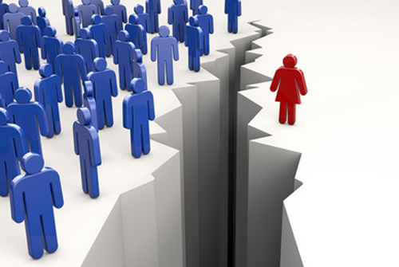
1.3 Gender Discrimination Problem
Women Discrimination
the societies both with paternal and maternal type families.
the effects of the religions
male suppression
Notes:
The discrimination is defined as “unjust or prejudicial treatment of different categories of people, especially on the grounds of race, age, or sex” (Oxford Dictionary).
The preamble to the Universal Declaration of Human Rights states that “recognition of the inherent dignity and of the equal and inalienable rights of all members of the human family is the foundation of freedom, justice and peace in the world.”
The United Nations Women's Treaty, which was implemented a few decades ago, was supposed to give women right to take part in their nations political and public life, but that hasn't changed much (9). Beyond the equality of woman, in many countries, women are still unable to vote or even wear what they want. In most parts of Asia, ex- Soviet Union territories, Latin America, Africa and Central and Eastern Europe woman trafficking is still a heart-breaking problem.
Women Discrimination is more serious in the societies which have paternal type families. However there is not a big difference in the societies which have a maternal type family background. We should consider the effects of the religions which have strong tenets based on male suppression.
Throughout history, women haven't received the same rights that men have; they couldn't vote or work outside of the home, were scorned and treated with little or no respect. Women were supposed to remain behind the men and were expected to be supportive without voicing an opinion of their own. Starting from the beginning of the 20th century, the women's rights movements have started and gradually improved.
One of the most famous women's organizations that has been leading the fight for women's rights since it was established in 1966 is the National Organization For Women, or NOW. NOW has been a major source of protection for woman on every subject important to women from workplace equality, to reproductive rights. NOW is a strong organization that will never give up the fight for the rights of all women.
There are groups that help women in many countries, and these groups aimed at helping women in the workplace. The group Equality Now is an organization that helps women who suffer in foreign countries. They help to protect woman from the horrors that are often endured by women in other less civilized countries.

Slide 28
For SIGI (Social Institute Gender Index
Social institutions can be a source of positive social transformation and empowerment.
Discriminatory social institutions have a domino effect on a woman’s whole life cycle.
Gender-neutral laws and policies are not enough to guarantee equality.
Notes:
The social institutions covered by the SIGI fall under five dimensions, spanning major socio-economic areas that affect the life course of a girl and woman: discriminatory family code, restricted physical integrity,some bias, restricted resources and assets, and restricted civil liberties. These dimensions look at the gaps between women and men in terms of rights and opportunities as reflected in legislation, practices and attitudes.
Discriminatory social institutions are formal and informal laws, social norms and practices that restrict or exclude women and consequently curtail their access to rights, justice, resources and empowerment opportunities.

Slide 29
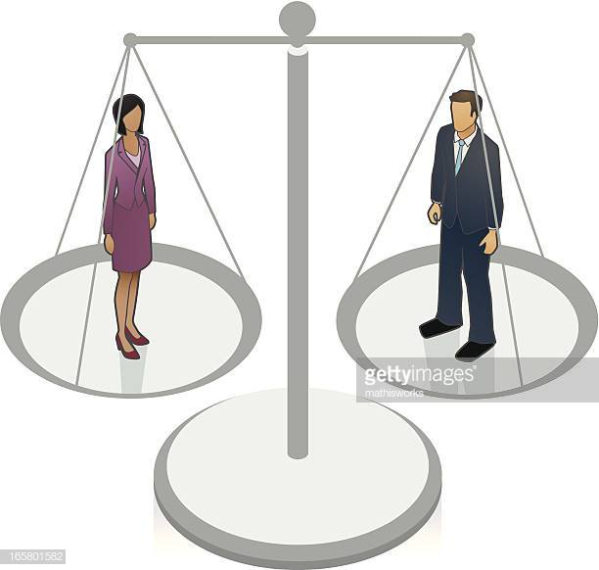
Gender equality has improved, but greater investments are needed to bridge the gaps.
Gender equality needs the united voices and actions of a cross-section of actors.
Notes:
The social institutions covered by the SIGI fall under five dimensions, spanning major socio-economic areas that affect the life course of a girl and woman: discriminatory family code, restricted physical integrity,some bias, restricted resources and assets, and restricted civil liberties. These dimensions look at the gaps between women and men in terms of rights and opportunities as reflected in legislation, practices and attitudes.
Discriminatory social institutions are formal and informal laws, social norms and practices that restrict or exclude women and consequently curtail their access to rights, justice, resources and empowerment opportunities.

Slide 30
1.3.1. Gender Discrimination and Women Seafarers
too rare in the world (2 %)
work generally in the cruise and ferries sector
are confronting prejudice but becoming valuable members
lower pay
doing work equivalent to that of male colleagues
Notes:
ITF (2017) reports that women are deployed among the worst paid and least protected of jobs at sea. Women also tend to be younger, and fewer than their male crew mates. Their low number means that women can be subject to discrimination and harassment. The maritime unions are alert to these dangers and strive to protect the interests of women members – who now number about 23,000 worldwide.
The status of the women changes in different countries depending upon economic, social and cultural development level.
The highest employment rate for woman seafarers is in the United Kingdom; 7 percent of the officers and 21 per cent of the ratings are female.

Slide 31
DIVERSITY MANAGEMENT IN MARITIME
CIRCLE THE CORRECT ANSWER
1. Diversity is synonymous for …..
a. ethnicity b. variety
c. functionality d. identity
2. Primary diffferences among people are ….
a. changeable b. less visible c. less sustainable d. in-born
3. One of the advantages of diversity in the workplace is ……
a.cultural gap b. localization
c. increased creativity d. common backgrounds

Slide 32
DIVERSITY MANAGEMENT IN MARITIME
3. One of the advantages of diversity in the workplace is ……
a. cultural gap
b. localization
c. increased creativity
d. common backgrounds

Slide 33
DIVERSITY MANAGEMENT IN MARITIME
4.Unless ………… is achieved, workplace diversity can be a problem.
a. increased cost of training
b. lack of speech freedom
c. disrespect
d. effective communication

Slide 34
DIVERSITY MANAGEMENT IN MARITIME
5. Workforce diversity management ..…
a. can lead to unnecessary tension.
b. intends to maintain a positive workplace environment.
c. helps only majority groups are represented in meetings.
d. prevents communication in the workplace.

Slide 35
DIVERSITY MANAGEMENT IN MARITIME
6.If handled insensitively,
a. a diversity management program can
harm employee privacy
b. increase competition
c. decrease productivity
d. support collaboration

Slide 36
DIVERSITY MANAGEMENT IN MARITIME
7.United Nations Women’s Treaty was supposed to give women the right to ...
a. take part in their nation’s political and public life
b. wear what they want
c. get rid of male suppression
d. vote and to be elected for the parliment of their country

Slide 37
DIVERSITY MANAGEMENT IN MARITIME
8.Women discrimination is more serious in societies with ...
a.diverse workforce
b.over population
c.paternal type families
d.less schools

Slide 38
DIVERSITY MANAGEMENT IN MARITIME
9.Diversity Management is a…
a.relatively new concept which was developed in mid-1980s.
b.is not a must for most companies.
c.prevents free communication in the workplace.
d.causes unnecessary discussions.

Slide 39
DIVERSITY MANAGEMENT IN MARITIME
10. The status of women changes in different countries depending on ..
a. the wealth of the country
b. economic, social and cultural development level
c. the training men are given at work
d. the religion of the country

